Slide 1
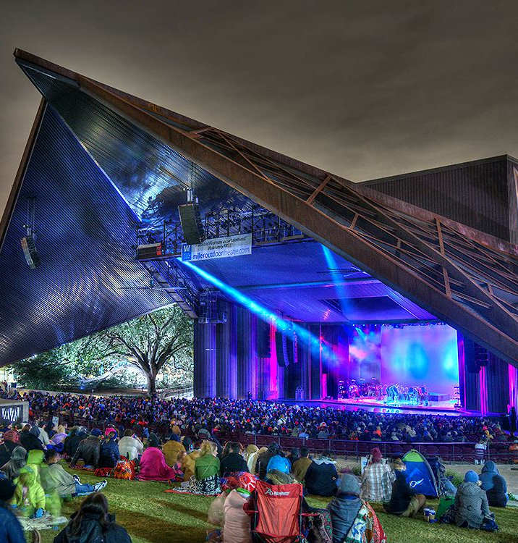

Claudia de Vasco
Managing Director
Miller Theatre
Advisory Board

Slide 2
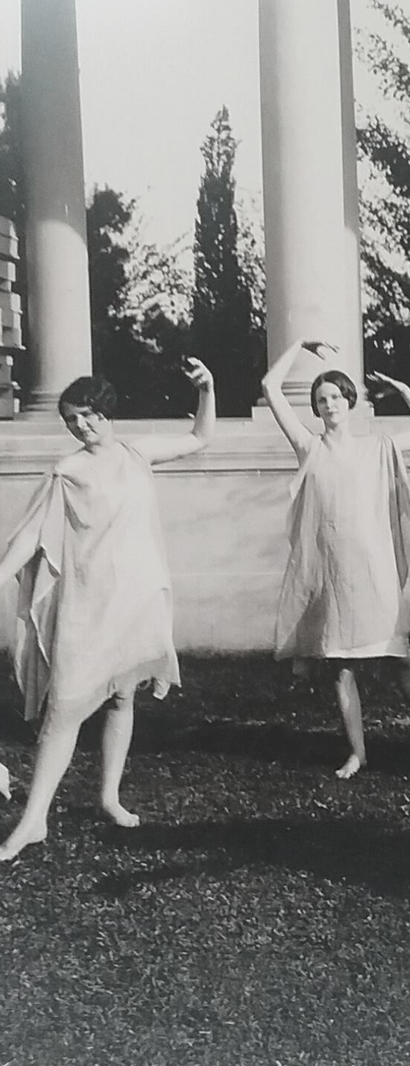
AGENDA
Miller Theatre
Advisory Board
MTAB acts as a steward of public and private funds to provide professional-caliber performances, free to the public, at the Miller Outdoor Theatre for the cultural enrichment of Houston’s diverse communities and the visitors to this great city.

Slide 3
AGENDA
Miller Theatre
Advisory Board
Miller Outdoor Theatre was founded just over 100 years ago!
Miller Theatre Advisory Board was created by ordinance in 1970 by the City of Houston.
Advisory Board – 21 voting members, appointed by Mayor, confirmed by City Council.

Slide 4







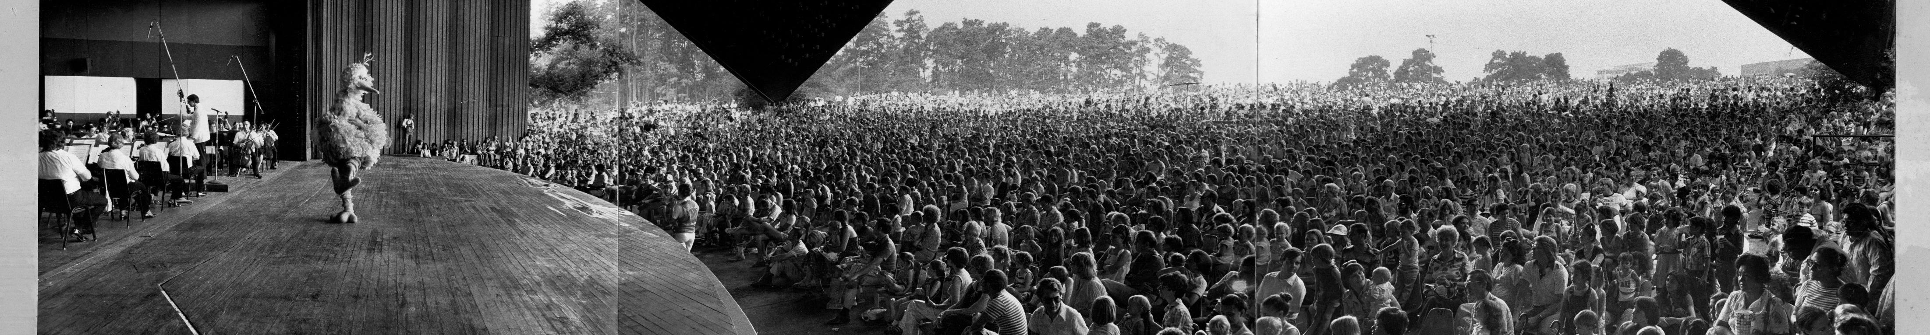
Miller City & Park Partners

Slide 5
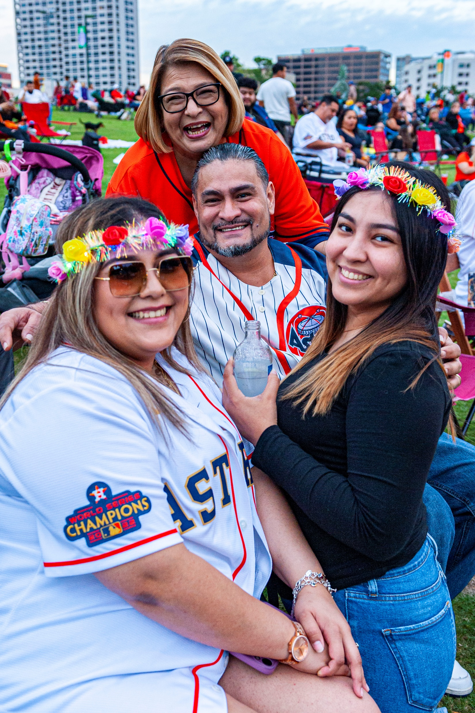
Houston’s Performing Arts Gateway
PROVIDING FREE ACCESS to high-caliber performing arts all season long.

Slide 6
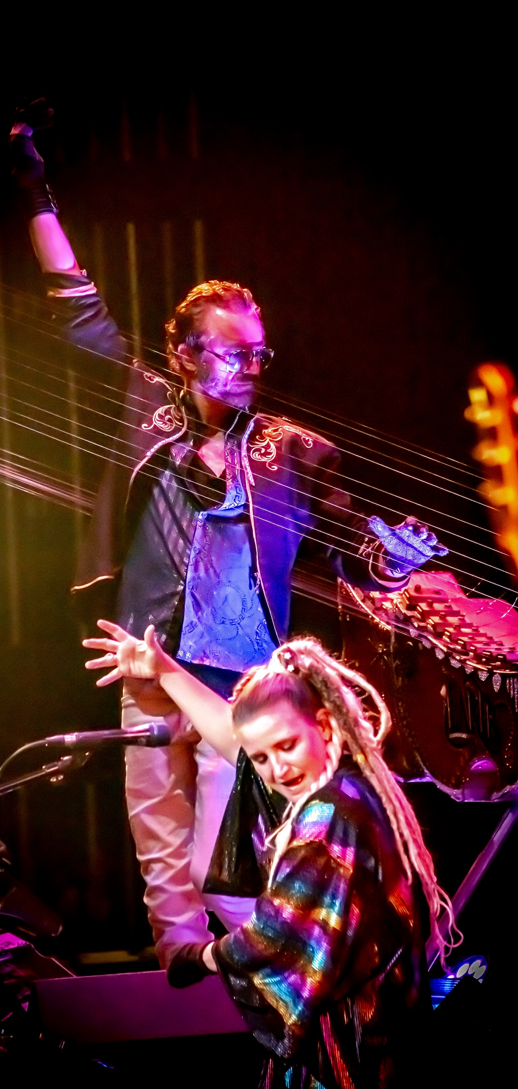
MILLER SEASON PROGRAMS
FREE Performing Arts from Spring to Fall.
Most performances – local arts and culture nonprofits
Weekday young audiences matinees.
Miller Presents - national and international touring acts, as well as local performers.
Typical season hosts around 80+ performances.
250,000+ expected to attend 2024 season.

Slide 7




MILLER OUTDOOR FUNDING
80-85% - from HOT Funds.
Additional funds raised through grants, foundations, individuals and corporate sponsorship.
Venue operations (Management and production staff, maintenance, equipment) funded by Houston First Corporation.

Slide 8
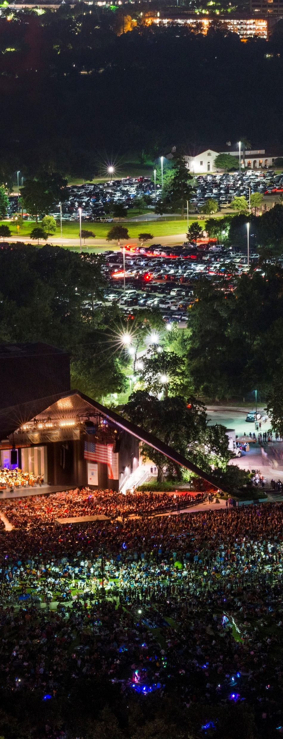
AGENDA
MTAB’s 2024 Operating Budget is about $5,500,000:
  $4,000,000 – operations & programming
  $1,500,00 estimated towards breaking ground on first of construction projects, funded by the 100th anniversary capital campaign.
  In 2024, 39 arts nonprofits were awarded roughly $750,000 in grants.
  MTAB covers the cost of occasional venue/production needs, such as the purchase of a piano.
Cost of Miller

Slide 9

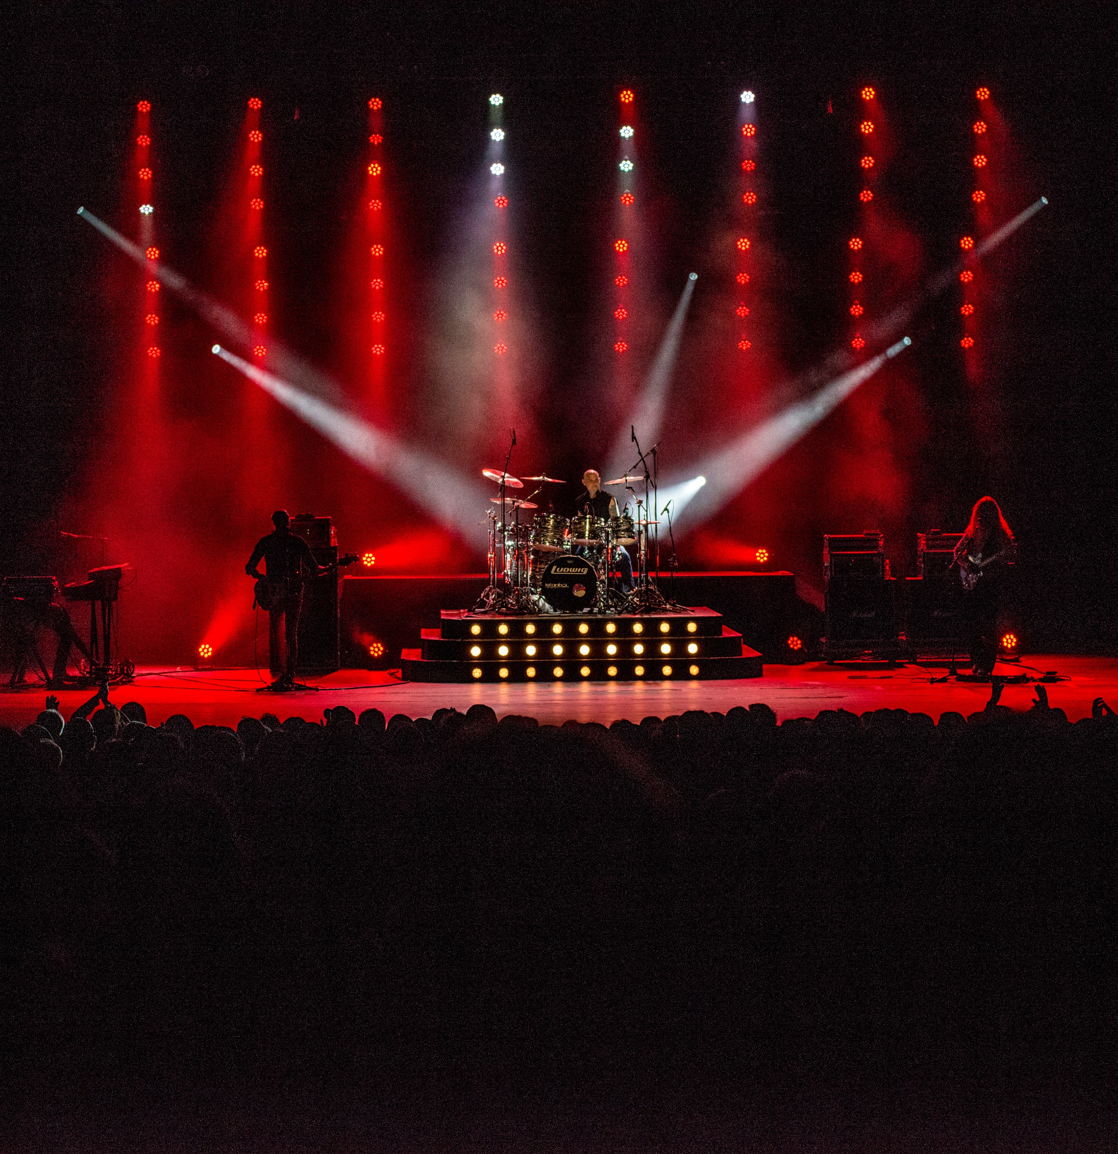
VISION FOR MILLER OUTDOOR
Continued focus on reflecting Houston’s communities on our stage.
Miller as an asset for our arts nonprofits, Houston First, and the City of Houston/MOCA in audience development, economic growth, and other strategies.
Improved outreach to expand our impact in our city, region, and for visitors to Houston.
Organizational sustainability – ensuring Miller is serving the City of Houston for the next 100 years!

Slide 10
FOR YOUR CONSIDERATION
Capital Campaign – 100th Anniversary
  Current fundraising goal $15million
  3 projects improving audience experience
Infrastructure
  Park capacity, traffic, parking, and resources
  Support for the work of HPARD and park partners
Support Performing Arts in Houston!
  Supporting Houston’s arts institutions makes it possible as a presenting venue to continue providing access to arts programming.
  We rely on the work of the MOCA and HAA, as well as our strong partnership with Houston First.

Slide 11
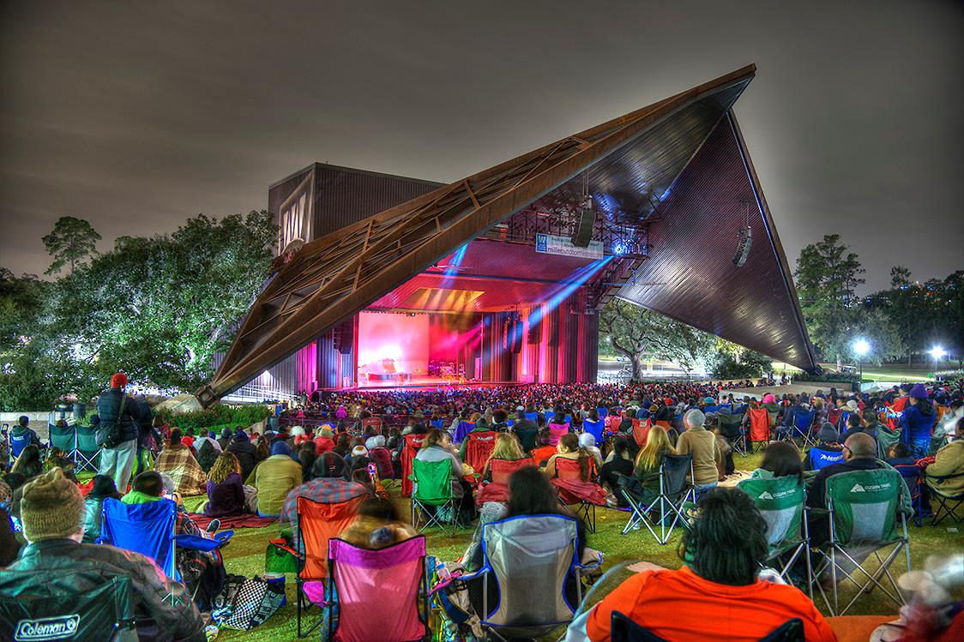


THANK YOU
www.milleroutdoortheatre.com
2024 season ends November 2!

