Slide 1


Music Program Overview – 2024
ARTS + CULTURE COMMITTEE
Mayor’s Office of Cultural Affairs
Gracie Chavez, Music + Cultural Tourism Officer

Slide 2
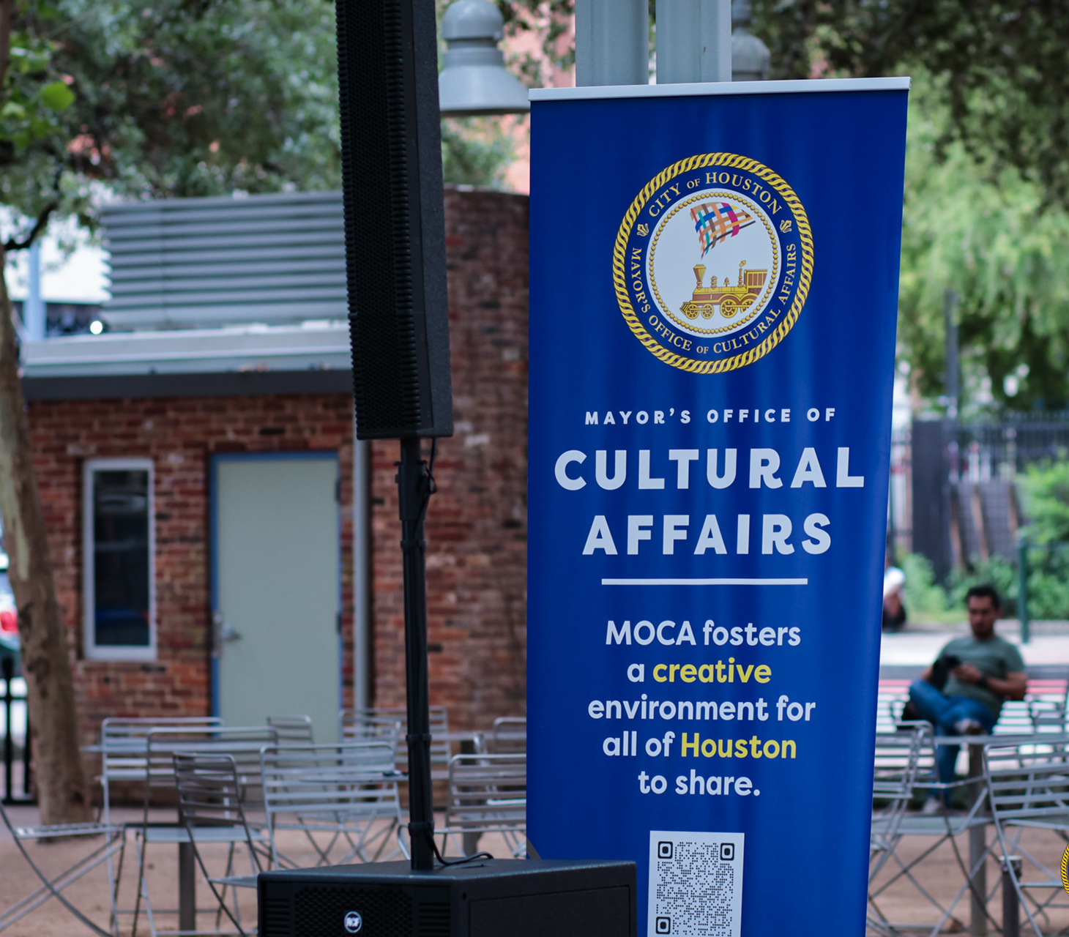
MAYOR’S OFFICE OF CULTURAL AFFAIRS
The Mayor’s Office of Cultural Affairs (MOCA) fosters an environment in which art and culture flourish for the sharing and benefit of all residents and visitors.
MOCA manages and supports Houston’s cultural investments by implementing policies and initiatives that enhance access to creative and cultural experiences across the city and across the diverse creative ecosystem including public art, grants, cultural facilities, and now music.
Photo Marco Torres, 2024
2

Slide 3
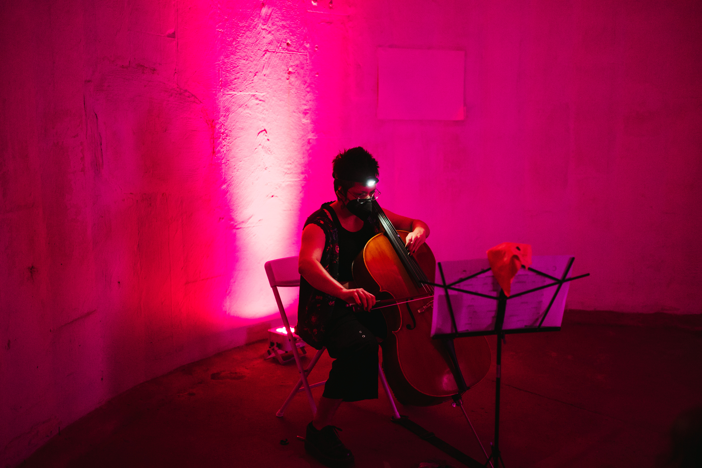
CONNECTING THE MUSIC COMMUNITY
Undoubtedly, Houston music is one of our City’s truly rich cultural assets.
Supporting Houston’s music industry is crucial for sustaining not only local musicians and a thriving music scene, but also its economic development.
The administration and our office were committed to enhancing support for music by appointing a dedicated individual to lead this initiative and by proactively seeking input from the music community.
Photo J.Andrade, 2022
3

Slide 4
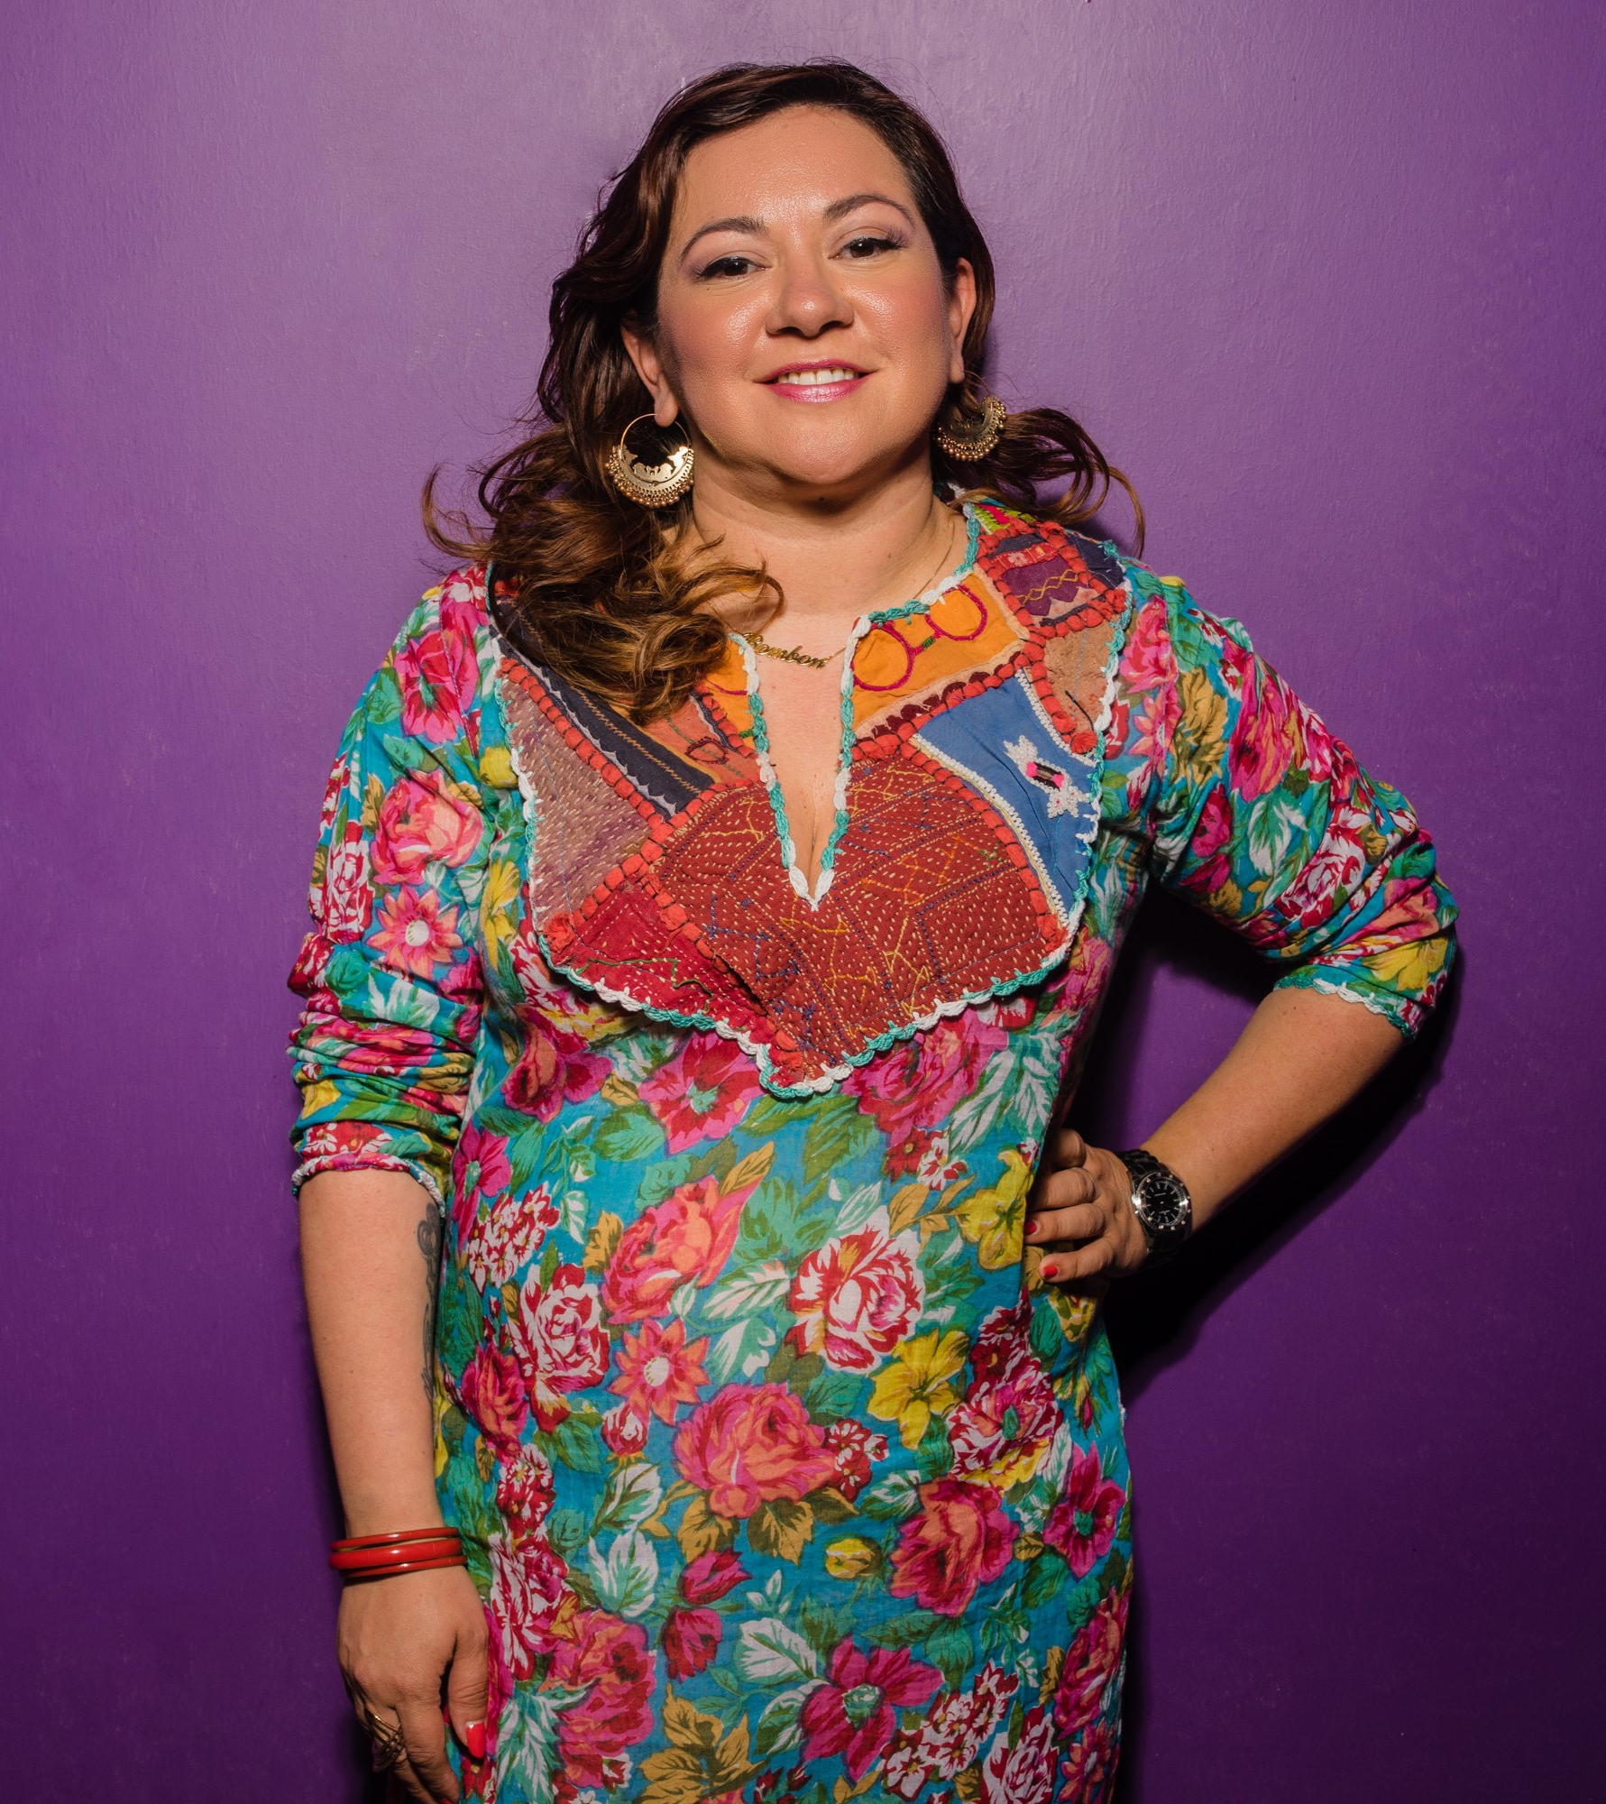
GRACIE CHAVEZ
Music + Cultural Tourism Officer
MOCA has an experienced and dedicated person in the role of Music + Cultural Tourism Officer.
To achieve the work of advancing Houston’s music industry and local tourism, advocate and musician Gracie Chavez joined in 2022.
The seasoned Houston-based artist parlayed her journalism background and musical talents into leading up Bombón, a national music collective and record label, and advocating for women in music.
In her role as Music Officer, she facilitates the annual celebration Make Music Day Houston and designs strategy for municipal support of Houston musicians and its music industry.
Photo J.Tovar
4

Slide 5
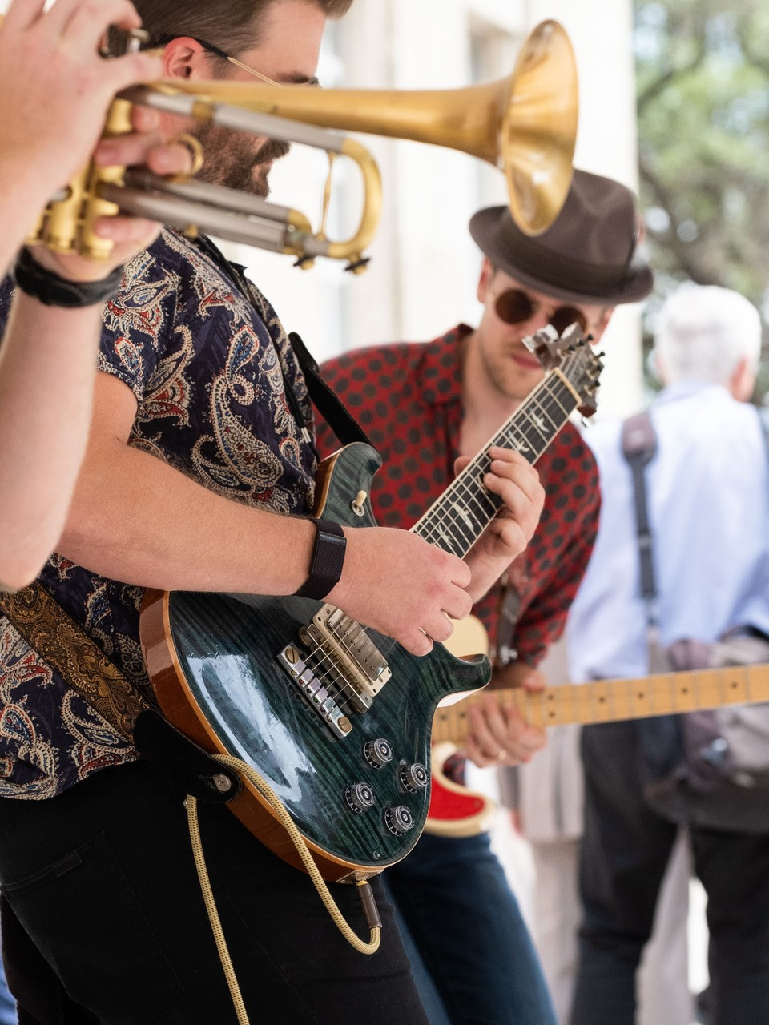

Since 2021, Houston has joined over 1,000 international cities for a global celebration of live music on the first day of summer, June 21st.
KEY STATS
  o 5,000+ attendees per year
  o 150+ venues, performers
    • 80+ venues
  o 10+ international consulates
    • 9 performances hosted at Eastern Glades (Memorial Park) by French Consulate
  o 7 Cultural Arts Districts + dozens of neighborhoods participated
  o 11+ City Departments + Municipal Organizations participated
  Photo F.Carter Smith, 2022
5

Slide 6
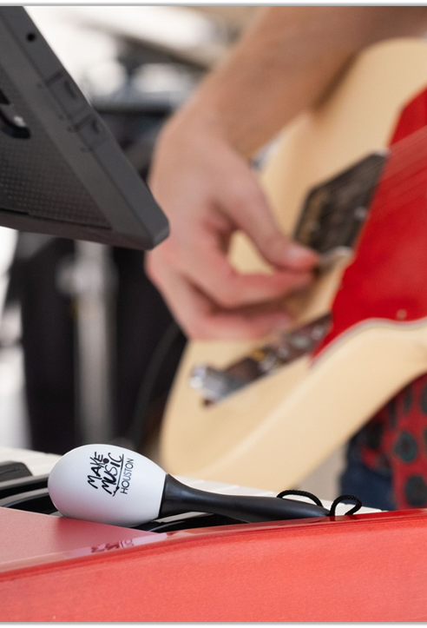



PARTNERSHIPS
Ongoing with Consulate General of France in Houston, Downtown Houston+ and Houston Professional Musicians' Association.
HIGHLIGHTS
City Hall + Market Square Kick-off Ceremonies
Japanese (taiko) drumming - Rothko Chapel
Improvisation at SITE Gallery in The Silos - Sawyer Yards
Sound bath - Discovery Green
METRO station performances
Flowerpot music - Mandell Park
Latin jazz performance – Emmit’s Place
www.makemusicday.com/houston
Photo F.Carter Smith, 2022
6

Slide 7

MUSIC FRIENDLY CITY CERTIFICATION
Houston was state certified as a Music Friendly City in 2022 by the Texas Music Office.
As part of becoming a Texas certified music community, Houston:
Confirmed a music officer/liaison responsible for the program
Launched a local music directory
Created a music advisory board
7

Slide 8
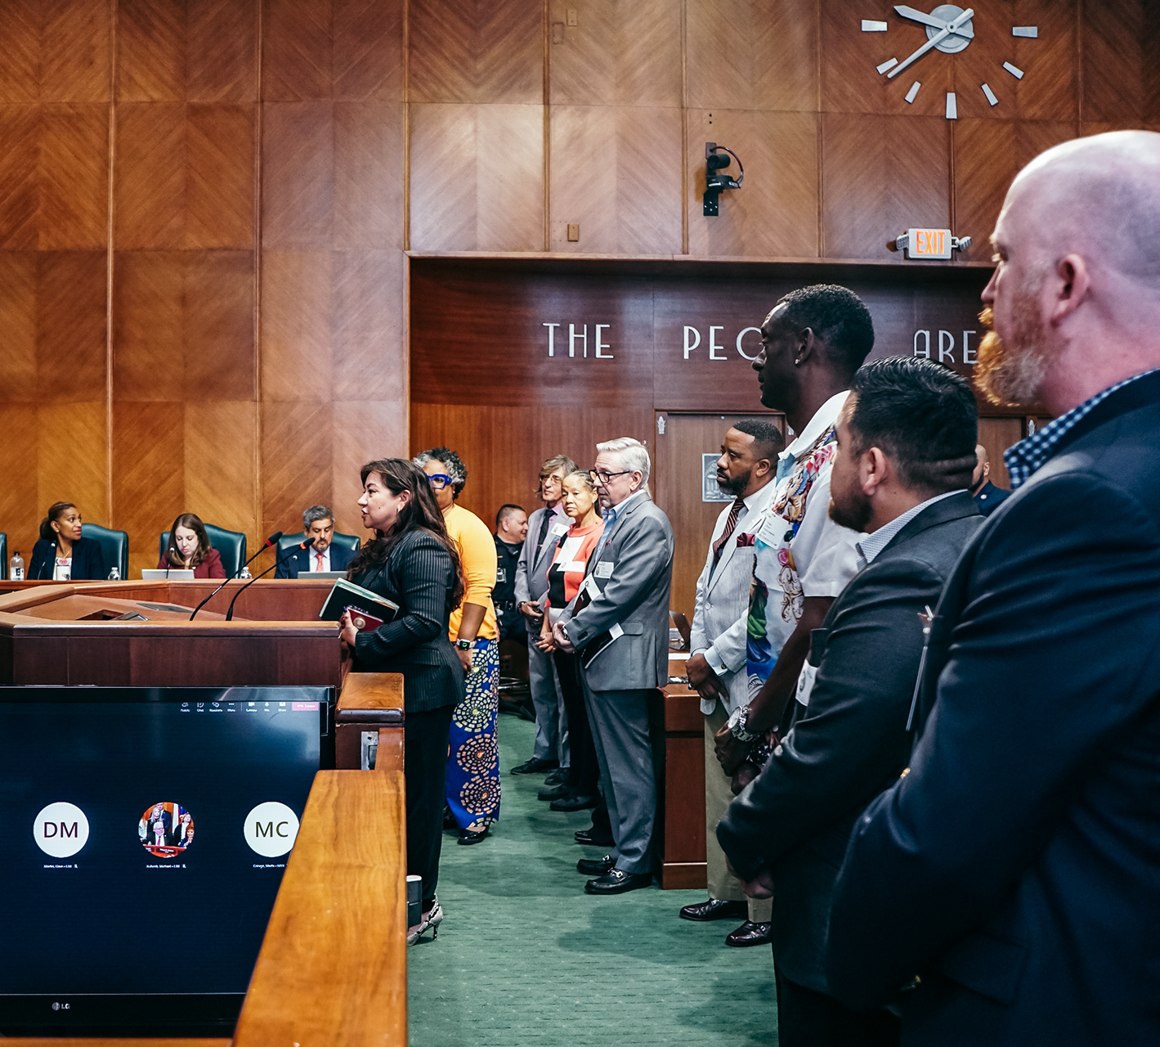
HOUSTON CITY ORDINANCE
With such significance to who Houston is, this office recognized the need to establish an advisory board to impact and influence the City’s work.
In 2022, City Council unanimously approved an ordinance drafted by Music Officer Gracie Chavez to establish the Houston Music Advisory Board.
Appointed by the Mayor, the board represents the diversity, interests and expertise of Houston’s Music Community.
Photo Marco Torres, 2022
8

Slide 9

MISSION
To serve as a liaison between the music community and its municipality, create opportunities, and foster the economic development of Houston musicians and music industry.
MOCA and Houston Music Advisory Board (HMAB) hold regular public meetings to discuss key issues in advancing the local music industry and provide recommendations for improvement.
The board reports to the Music Officer, who provides advice and guidance to MOCA and the administration.
www.houston-music.live
BOARD MEMBERS
Nine (9) board members and three (3) alternates are appointed by the Mayor and approved by City Council represent the diversity, interests and expertise of Houston. Members are active stakeholders in the music industry.
Alumni include Dr. Anne Lundy and former board secretary Eric Jimenez (2022-2023).
9

Slide 10
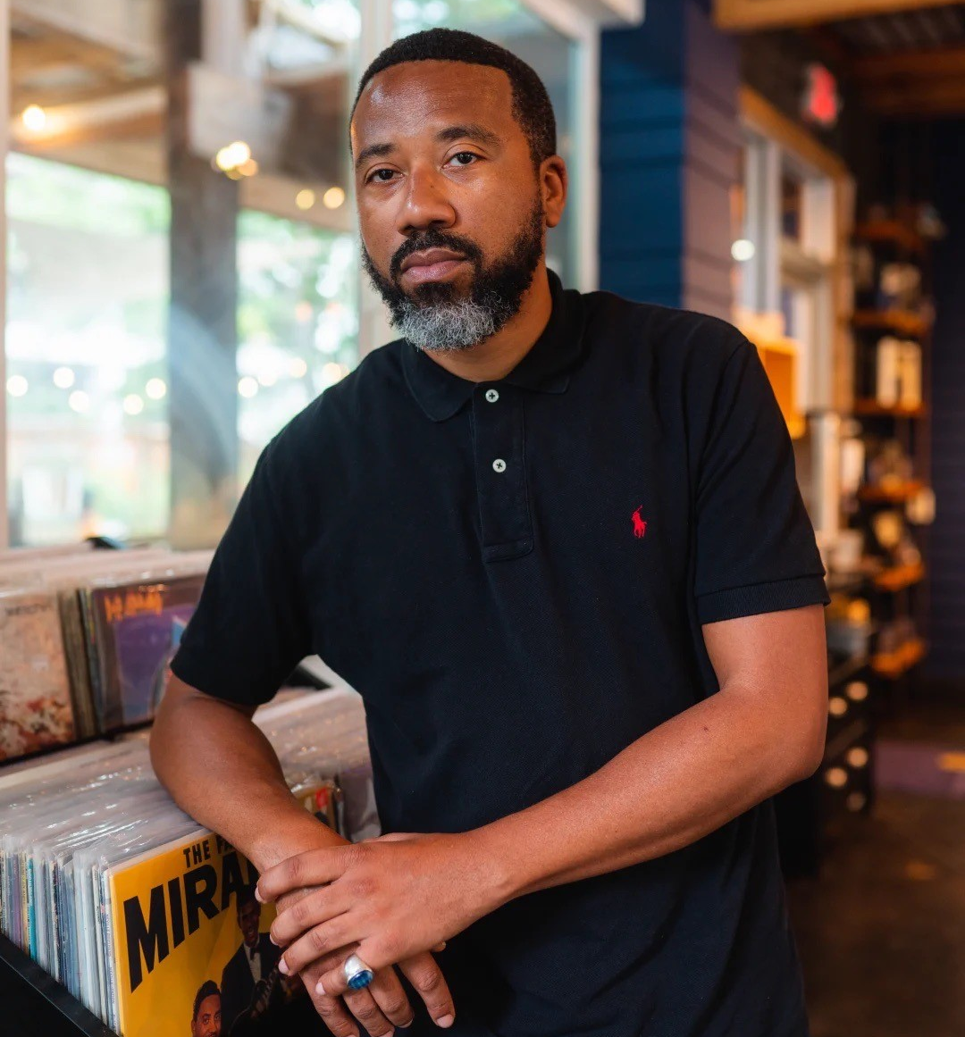
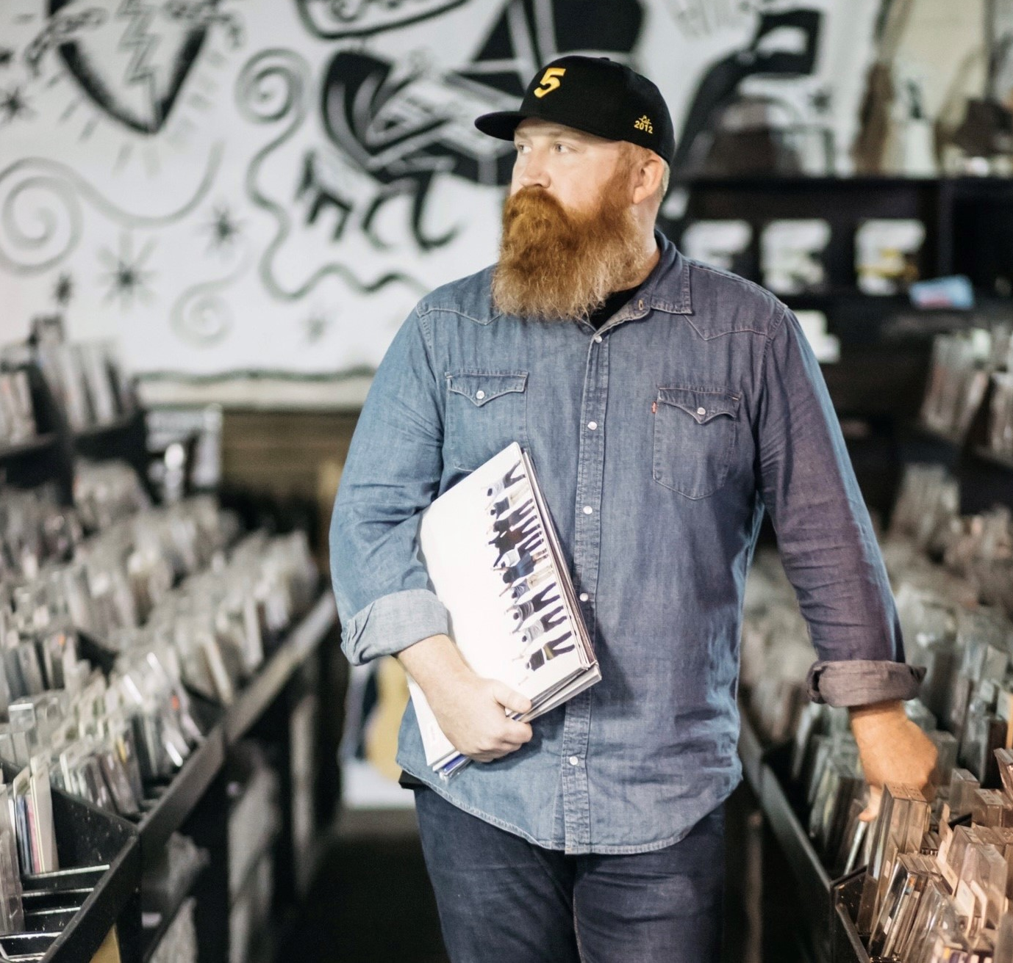
JASON WOODS
Chair
Vice-Chair
MARK AUSTIN
Flash Gordon Parks, Mo’Better Brews
Houston Music Foundation

Slide 11
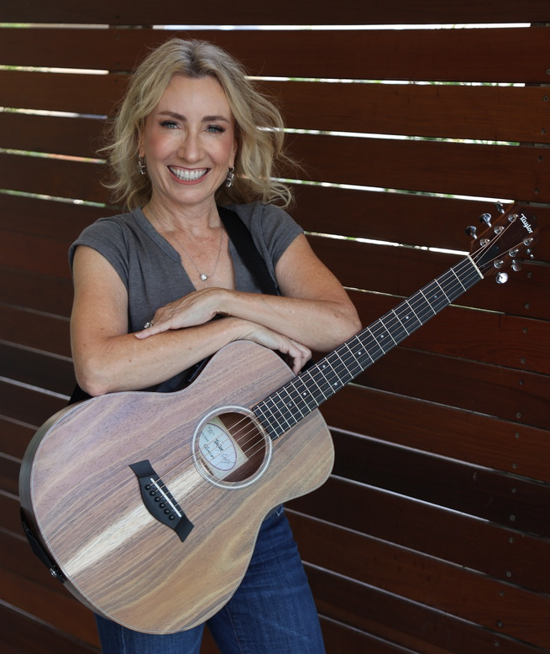
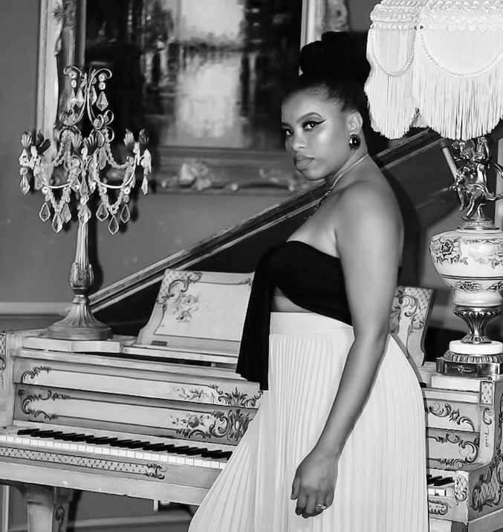
TRACY DEJARNETT
Secretary
Treasurer
DRIA THORNTON
HoustonLive, SongFest
Singer/Songwriter, Dria LLC

Slide 12
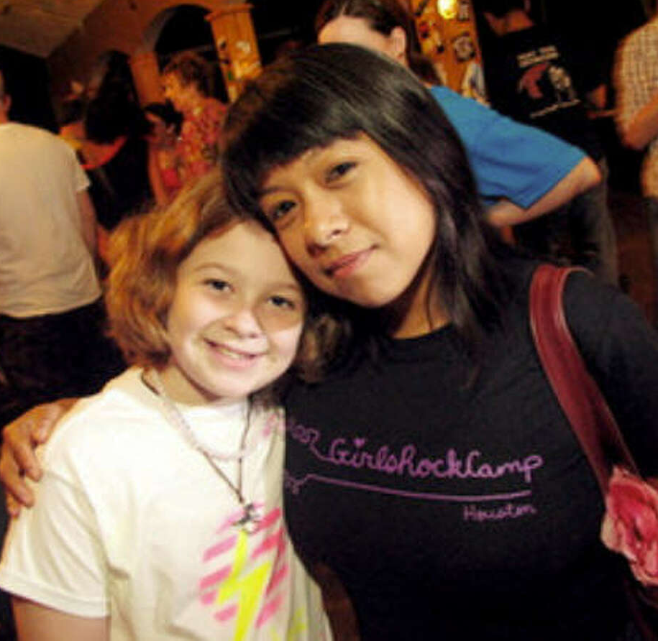
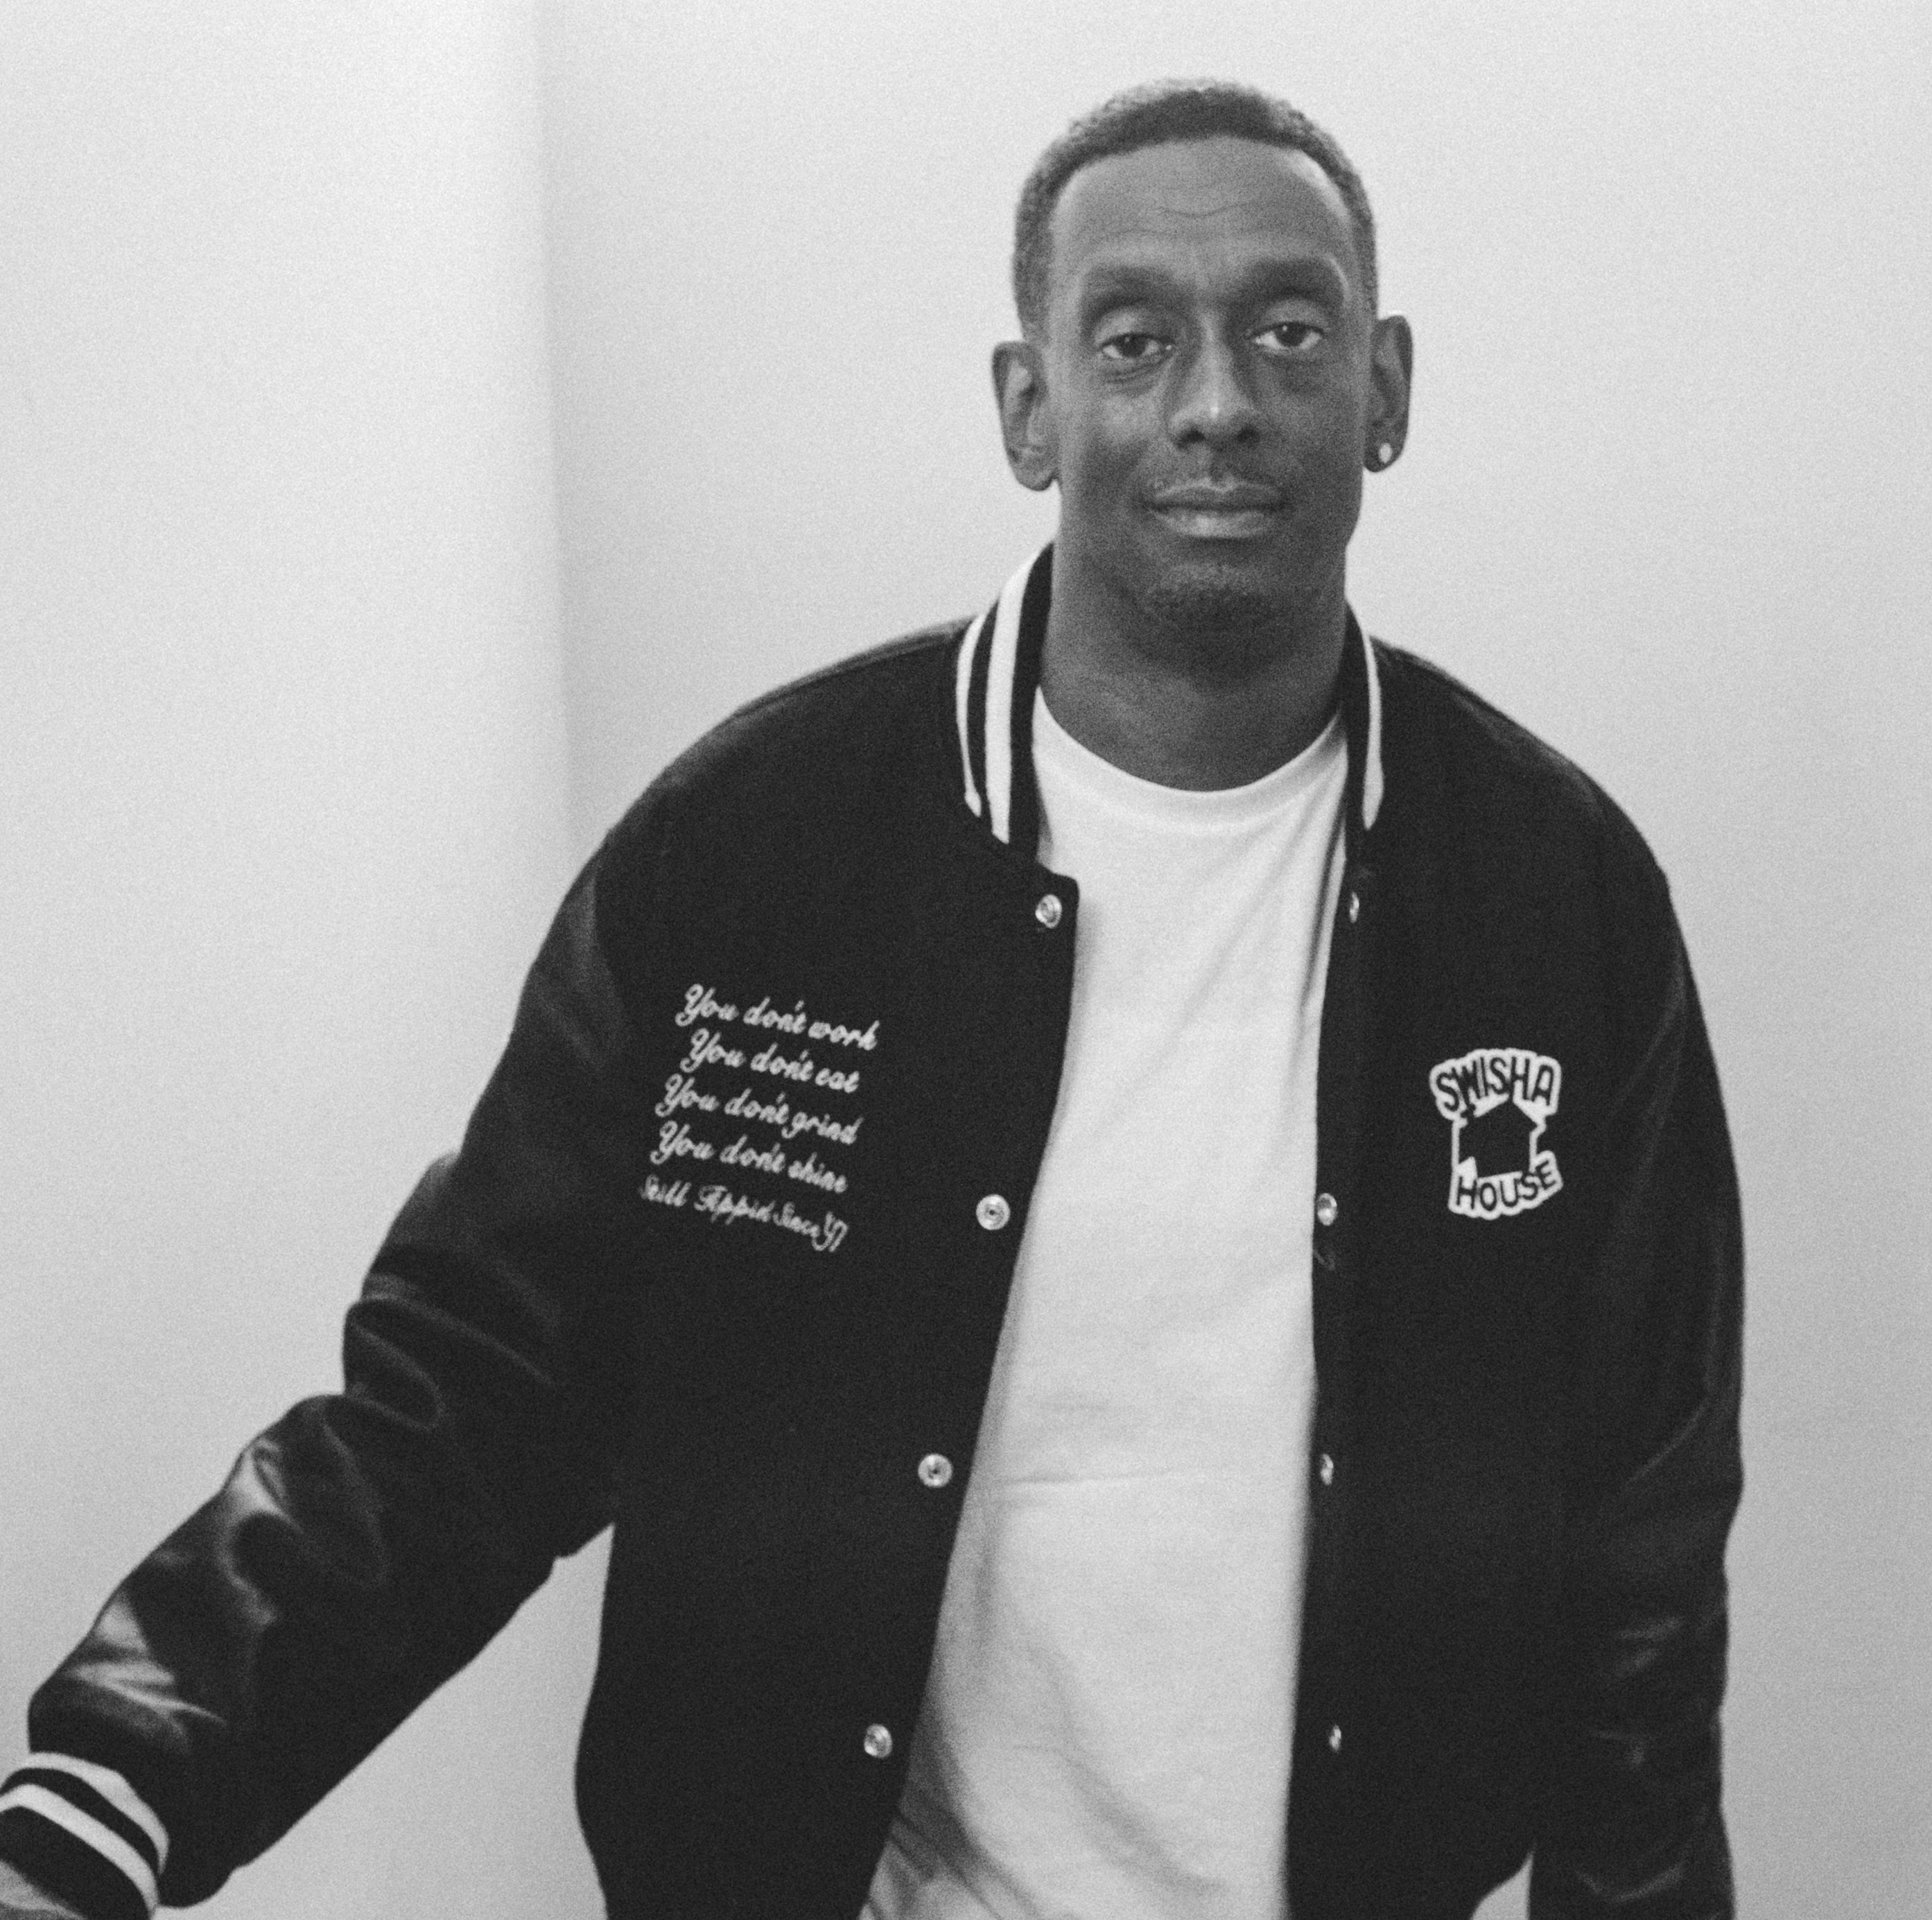
ANNA GARZA
HENRY GUIDRY
Girls Rock Camp Houston
G-Dash of Swisha House

Slide 13
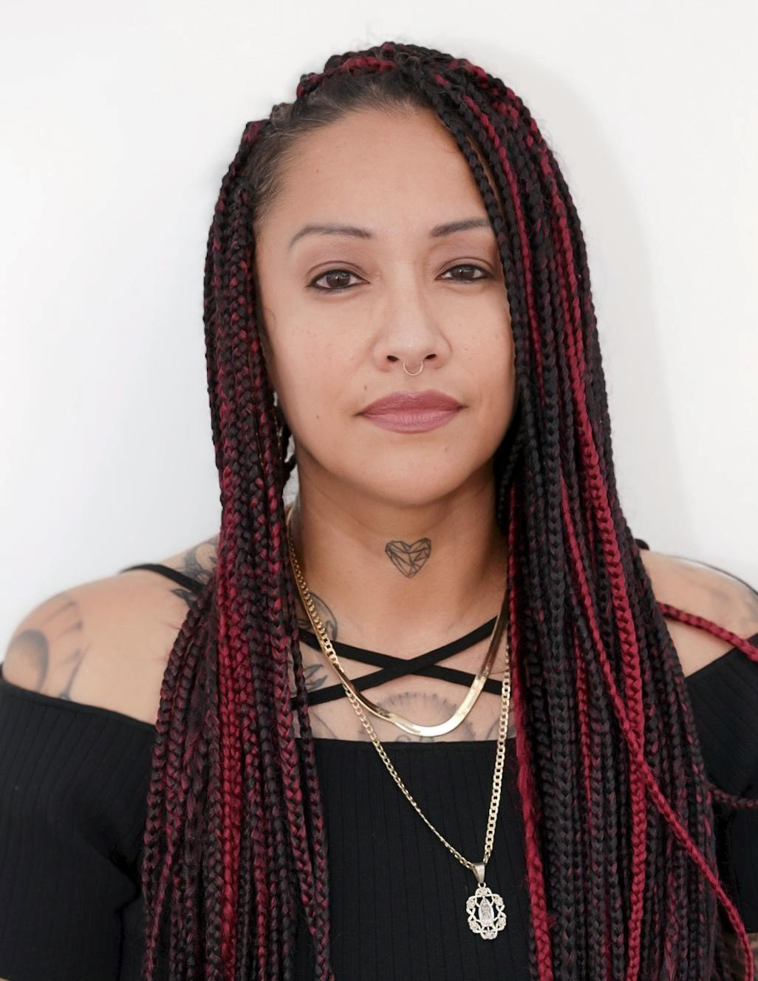
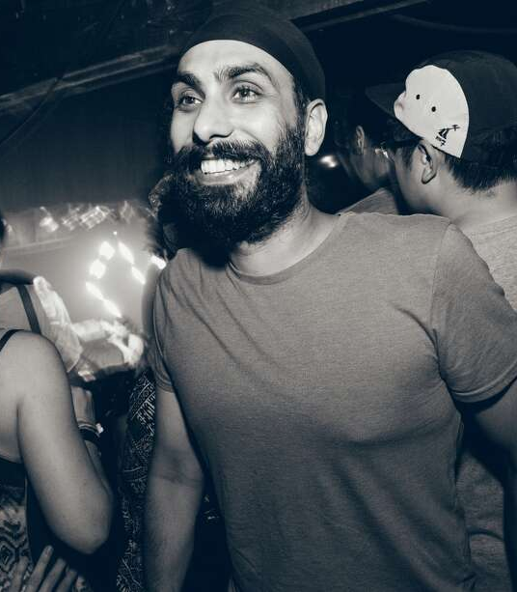
ERICKA DE LEON
JAGI KAITAL
Hip Hop Vintage Flea Market
White Oak Music Hall

Slide 14
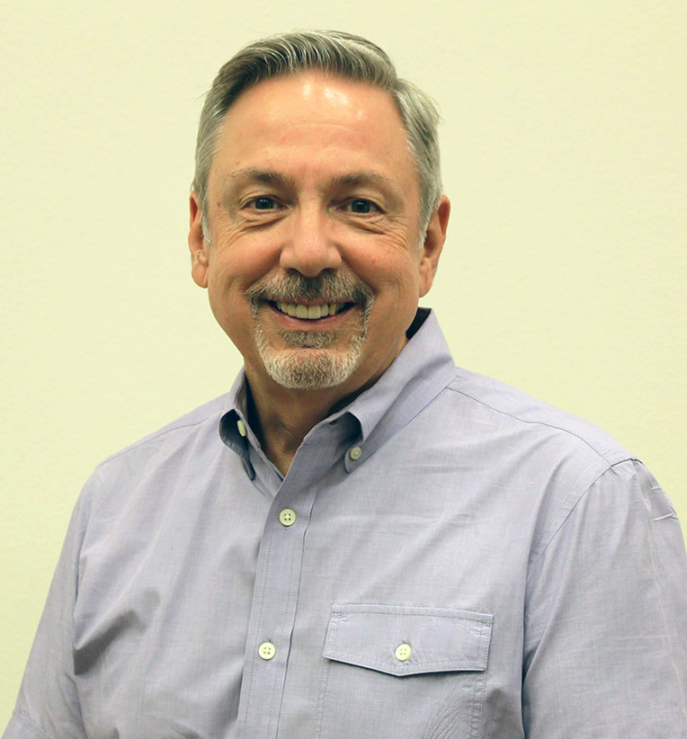
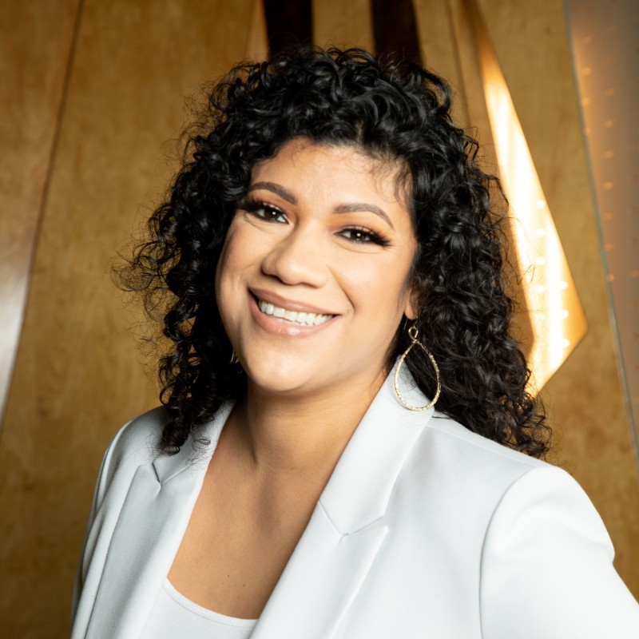
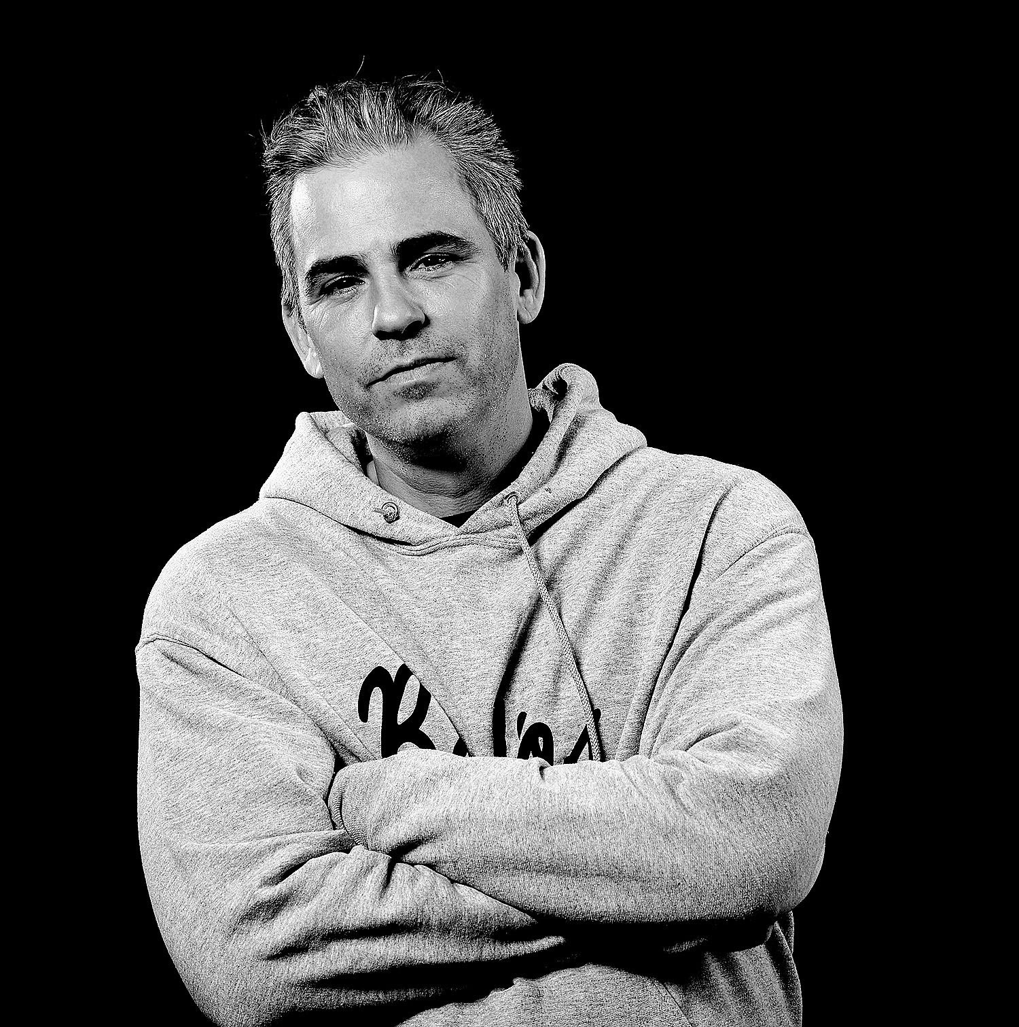
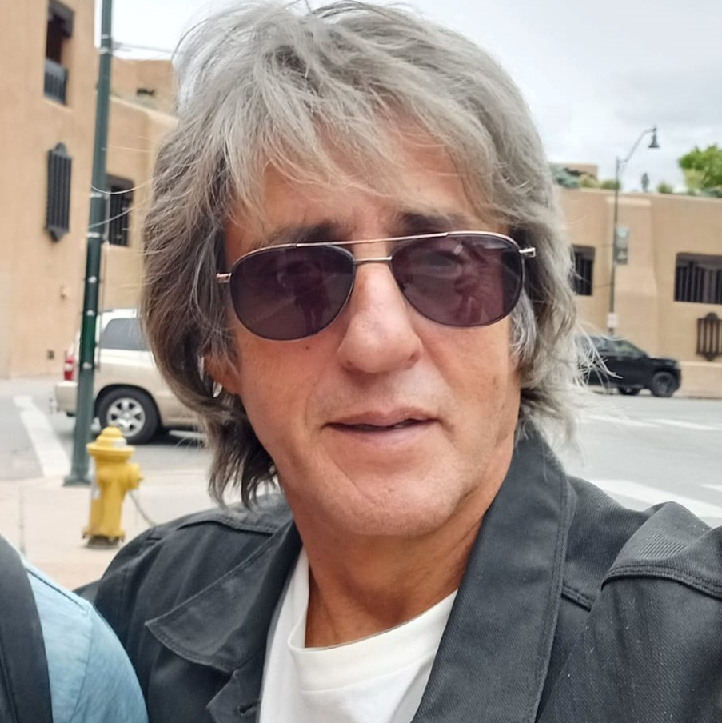
JASON KANE
ALTERNATE BOARD MEMBERS
Houston Livestock Show & Rodeo
MARISSA SAENZ
Rukaz Kultura
MIKE (FROST) MOORE
SLFMP
LUPE OLIVARES JR.
East End Street Fest, Houston
International Festival (iFest), Bohemeo’s

Slide 15
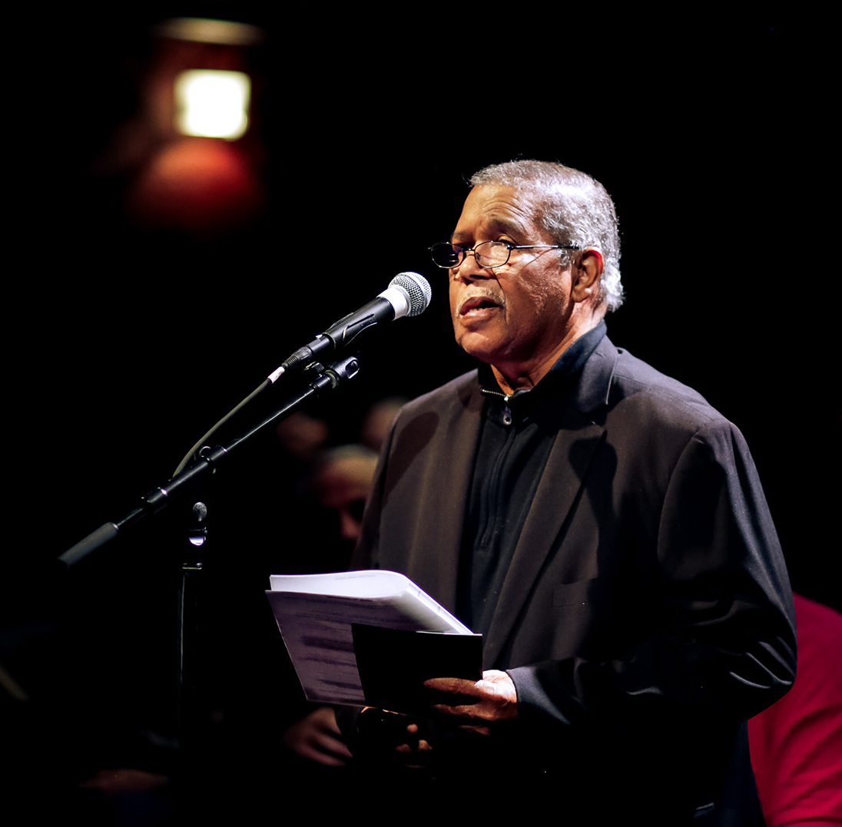
LISTENING SESSIONS
Work continued after the certification and ordinance passing.
The music community was invited to join the inaugural music board and MOCA for a Listening Session. Much like a town hall meeting, this is where music community members share feedback and discuss key issues.
Annual Listening Sessions are now scheduled each fall to better understand current concerns in our music ecosystem.
This community feedback also helps MOCA be more responsive and recalibrate resources offered each year.
Conrad Johnson, Jr. - Photo Marco Torres, 2022
15

Slide 16
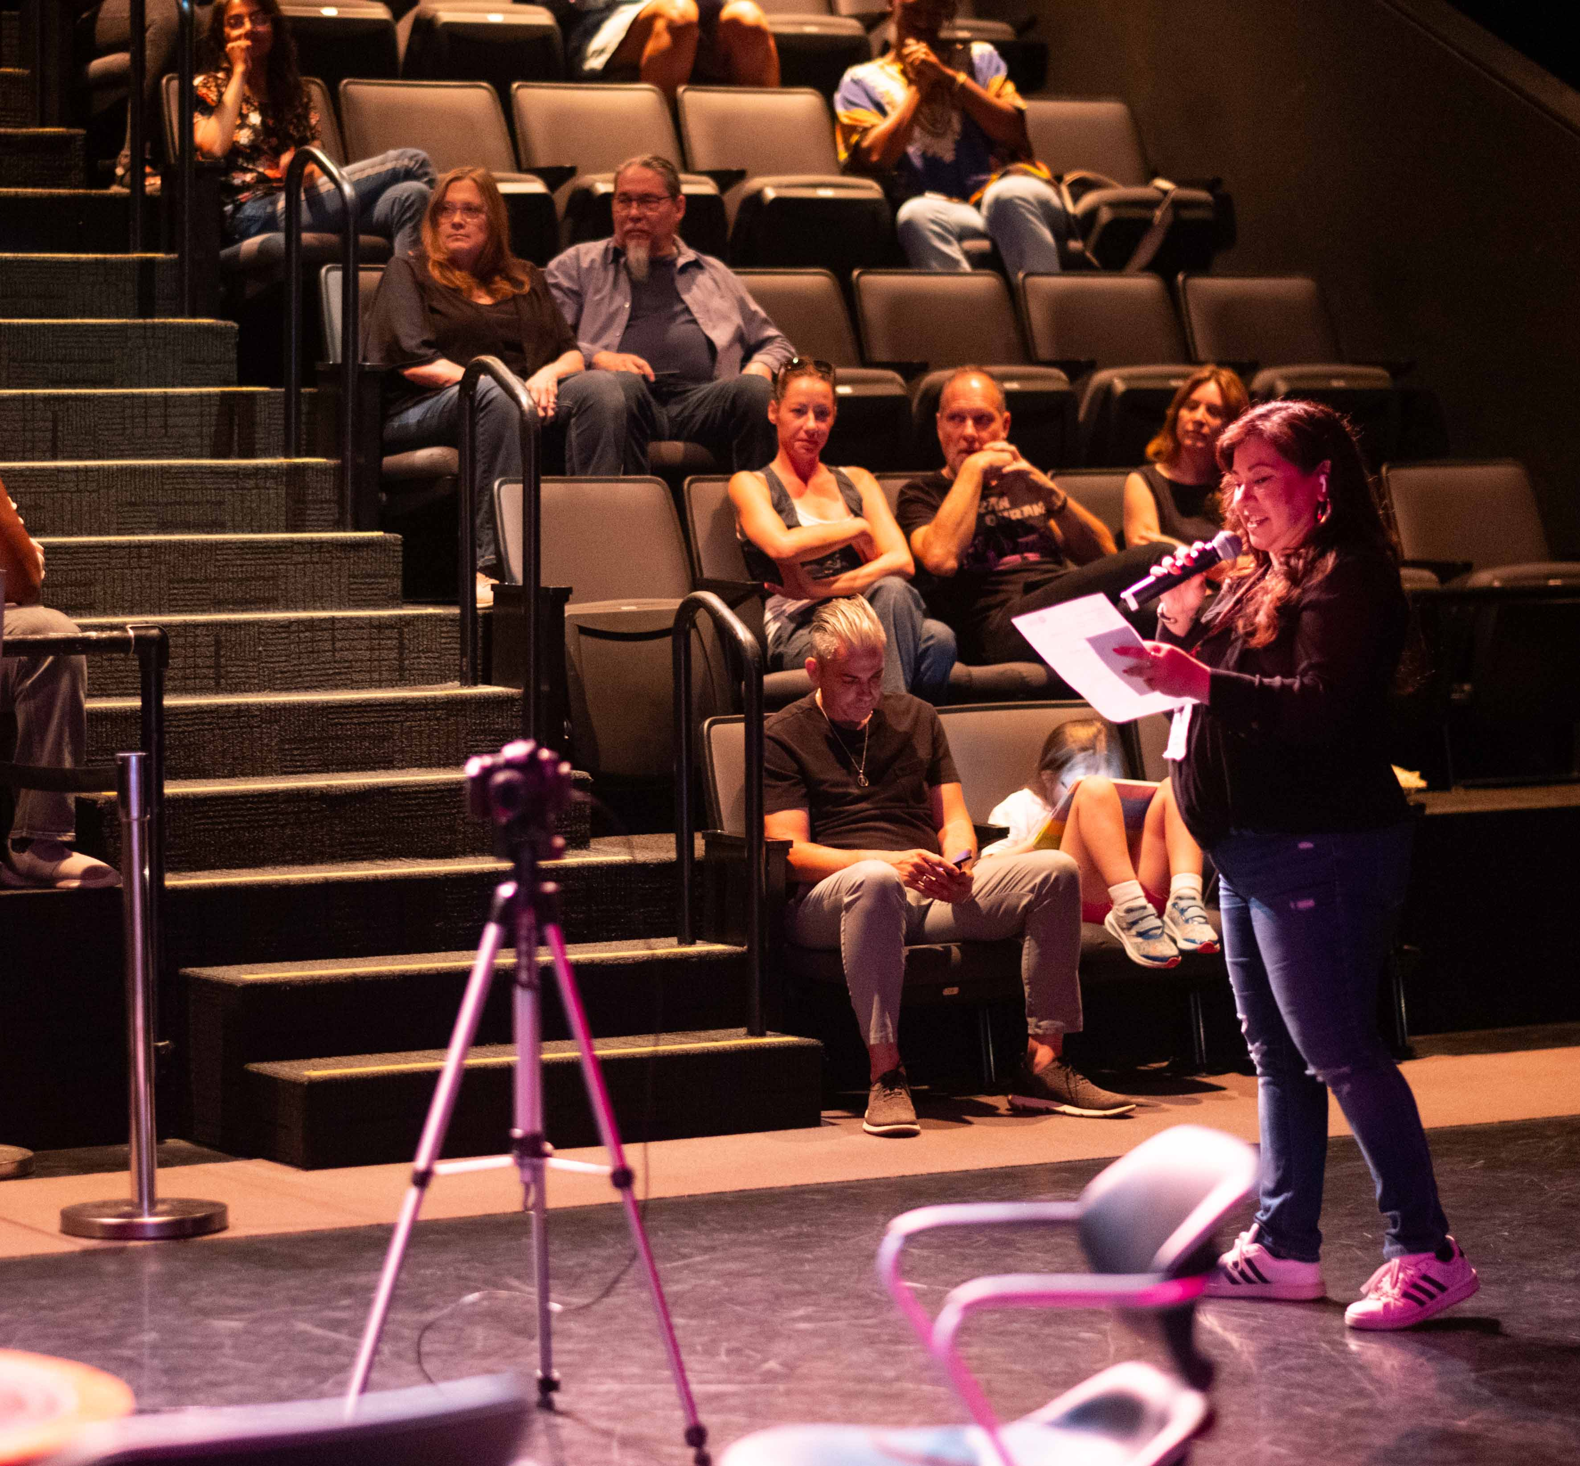
MUSIC FOCUS + ACTIVATIONS
Activities are developed by the Music Officer with music board support that shape event programming and workshops to continue the advancement of our Houston music community.
For example, based on community feedback from Fall 2022, three (3) focus topics were designated for 2023:
Music Education
Collaboration
Historical Preservation
Photo F.Carter Smith, 2023
16

Slide 17
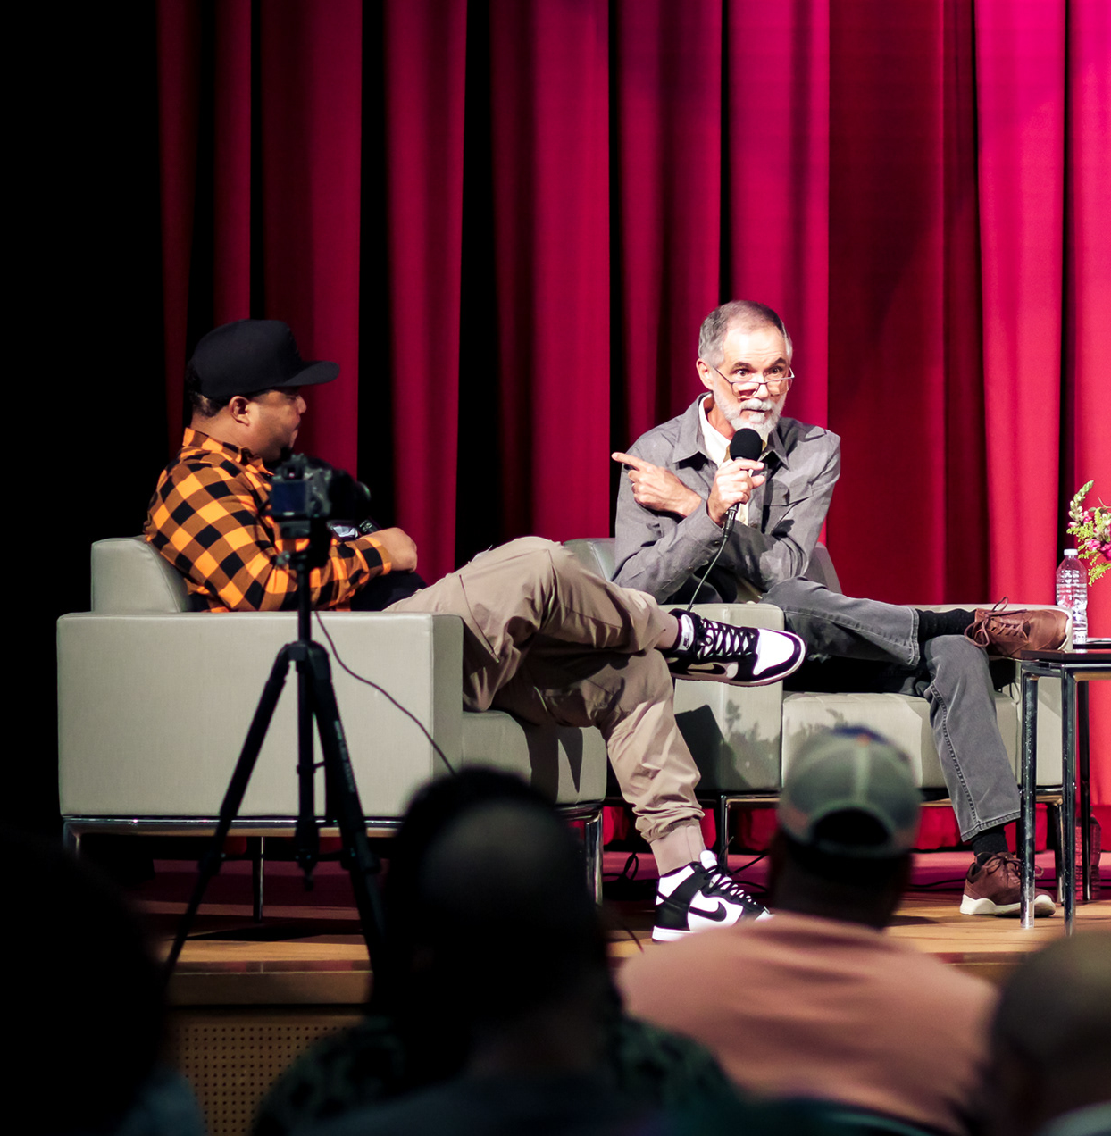
2023
MUSIC PRESERVATION
A series of panel discussions was developed by MOCA’s Music Officer Gracie Chavez and moderated by Donnie Houston, that would encompass the board’s designated topics to address the history and preservation of Houston music culture.
This three-part series incorporated education and collaboration into the preservation thematic with discussions on:
Preserving Music Landmarks
Encouraging More Recordings + Documentation
Inspiring Intergenerational Mentorships Between Musicians
Each live recording is available on www.houston-music.live and on Donnie Houston’s YouTube.
17
Photo Marco Torres, 2023

Slide 18
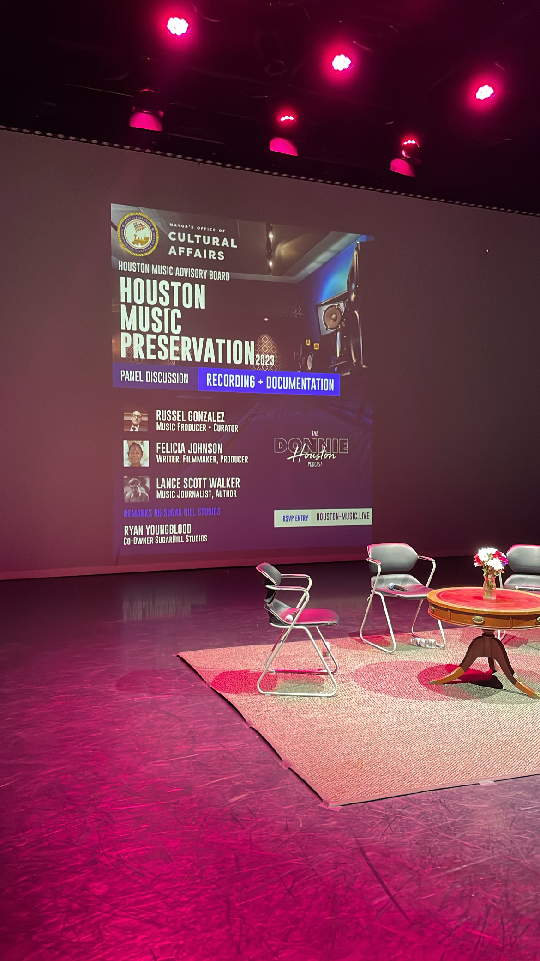
2023
IMPACT
The impact from the Houston music preservation focus included:
steps to preserve our local musical heritage
education (and pride) around the history of our rich music culture
meaningful collaboration between generations of musicians
Photo Boma West, 2023
18

Slide 19

2024
MUSIC FOCUS
This year’s focus included:
Music Business Development
Grants + Funding
Collaboration
In response, our community activations have been strengthening partnerships with organizations like Sound Diplomacy, UH Law Center, Texas Accountants & Lawyers Association (TALA), SoundSync Music and Houston Arts Alliance.
Live recordings also available at www.houston-music.live
19

Slide 20
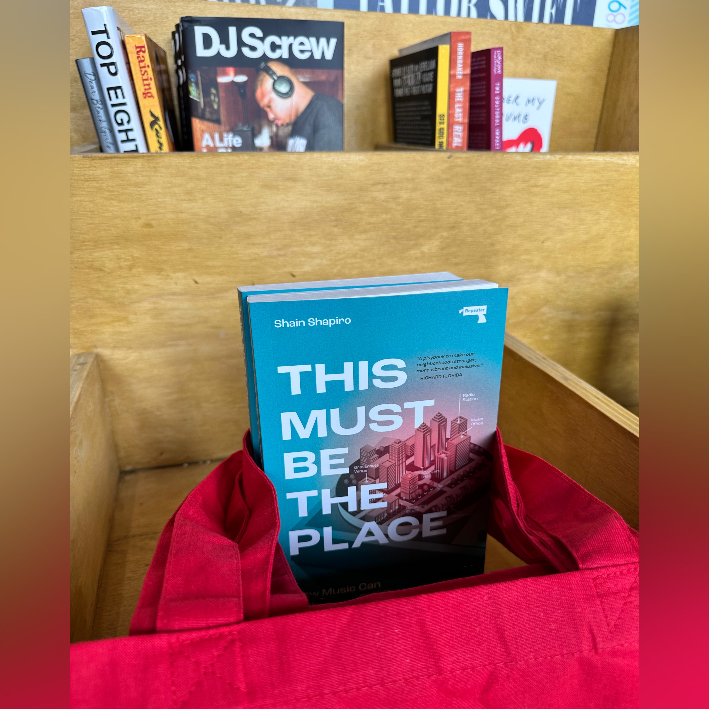
2024
IMPACT
The desired impact for 2024 include:
making more musicians aware of grant opportunities and the process
increasing collaboration between local filmmakers and musicians
harnessing the impact music can have on city economies.
The true measure will come each fall as MOCA and the Board host another Listening Session to hear feedback in real time.
Photo Joseph Arriaga, 2024
20

Slide 21
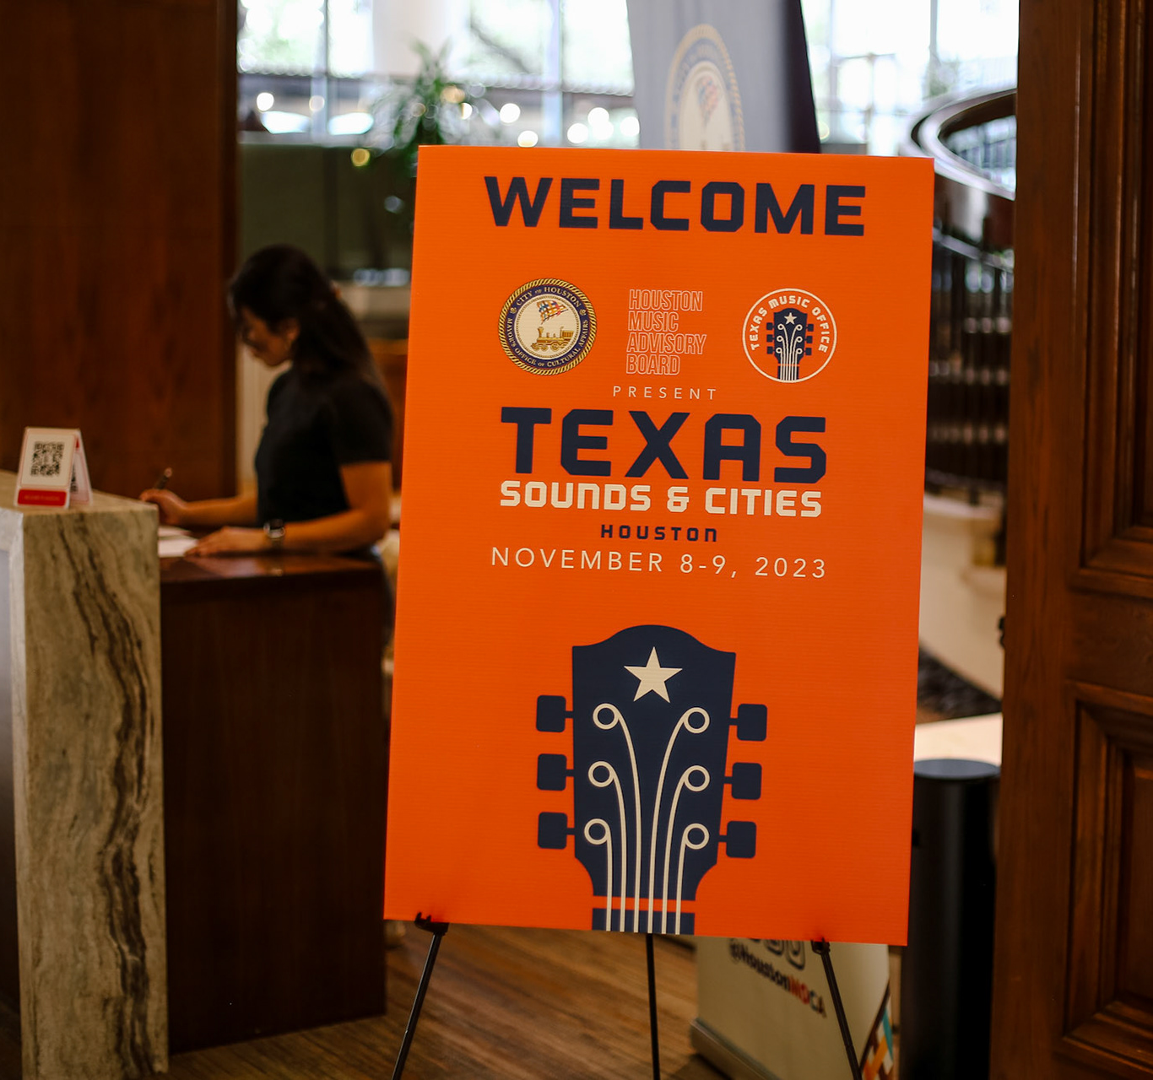
2024
INSPIRED BY HOUSTON
TEXAS SOUNDS & CITIES
“…the City of Houston hosted the 2023 Texas Music Office’s annual Texas Sounds & Cities Conference.
As the gold standard on how a strong advisory board can make real impact on their community, we brought the Houston Music Advisory Board members together to speak on a panel to showcase how their efforts could inform other cities and communities across the state on…ways to keep their boards active and engaged.”
— Chip Adams, Director of Texas Music Office
SUGAR LAND, TEXAS
Sugar Land leaders want to boost live music, support local talent.
“…building industry, providing resources, having forums that people can come to and have, like a town hall and speak about what the music industry needs…that didn't exist until Houston’s music advisory board was formed.”
— Houston Chronicle, Aug 2024
  Photo Doogie Roux, 2023
21

Slide 22
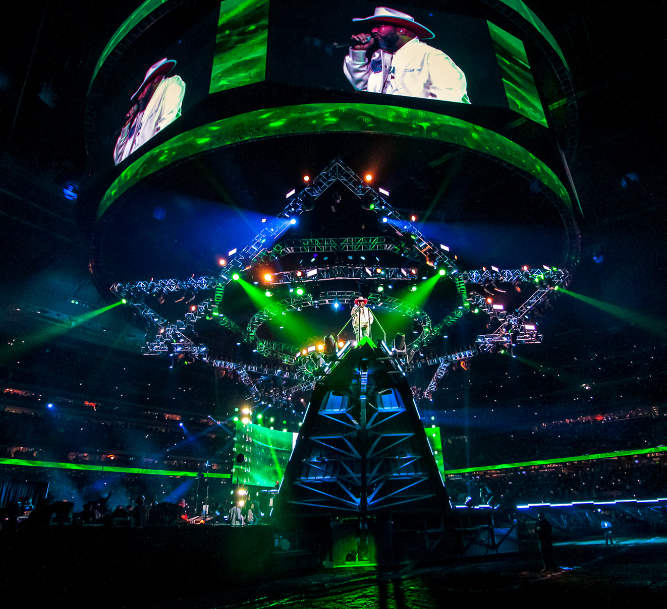
ECONOMIC IMPACT
Houston’s music industry is a vital component of our cultural identity and economic fabric.
This is something that the Houston Livestock Show & Rodeo knows all too well.
Over the last five years, the Rodeo has conducted a study to quantify the economic impact and economic activity generated.
Bun B at HLSR, Photo Marco Torres, 2022
22

Slide 23
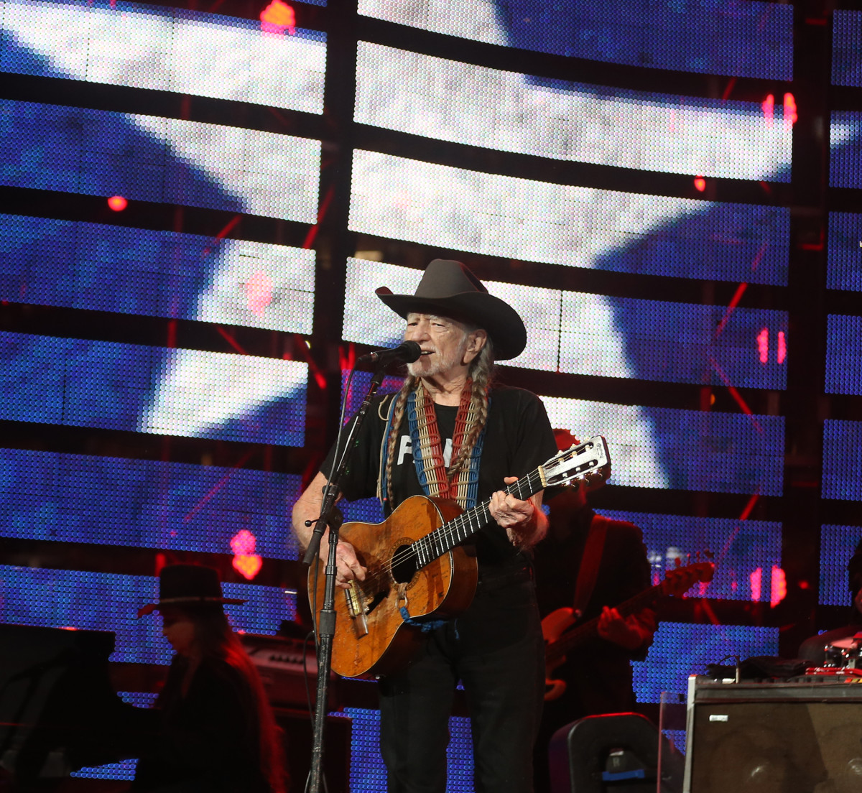
RODEO IMPACT
At the Houston Livestock Show & Rodeo all marketing activity is keyed to the music star announcement.
The big question in January is…”who’s coming to the Rodeo?”
2024 Economic Impact Study Results
$326 million total impact
$179 million in direct spending
3,536 direct jobs
5,694 total jobs supported in Greater Houston
Photo Courtesy of Houston Livestock Show & Rodeo
23

Slide 24
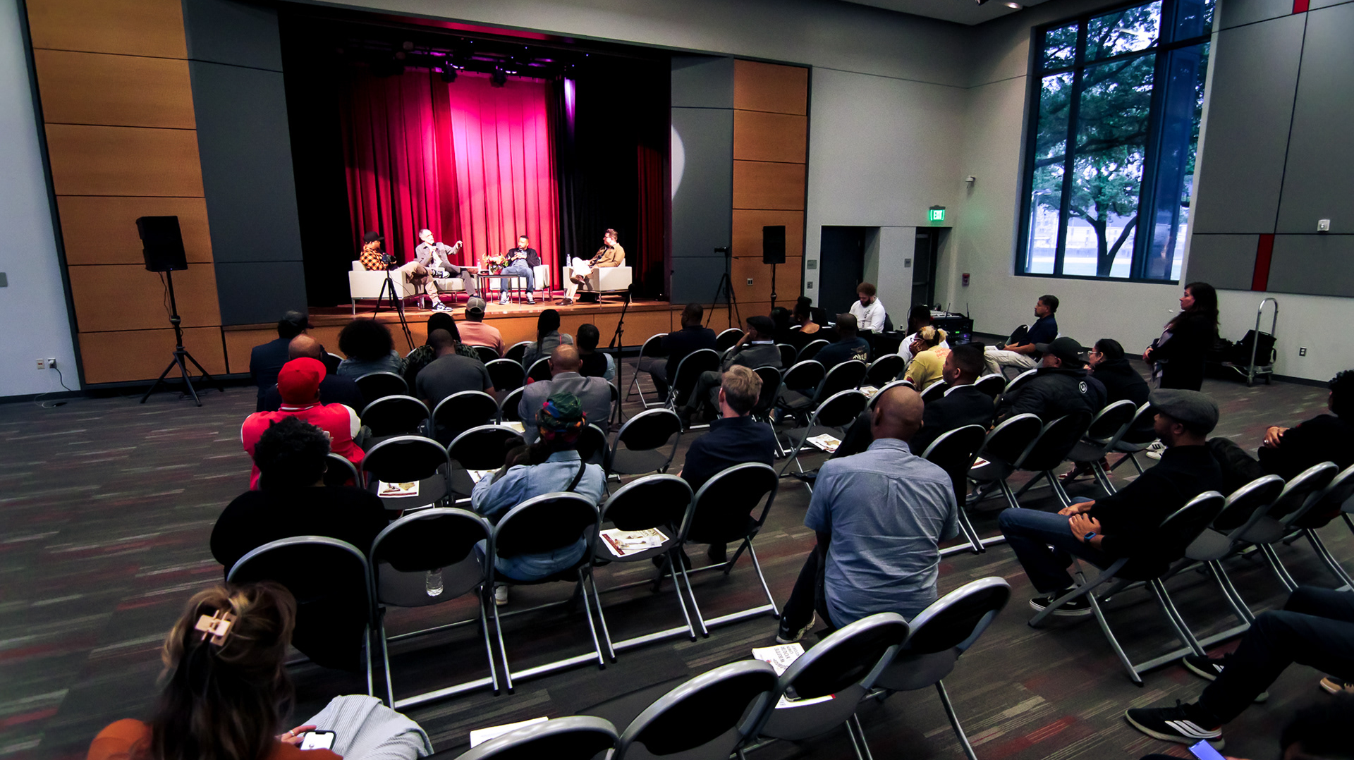
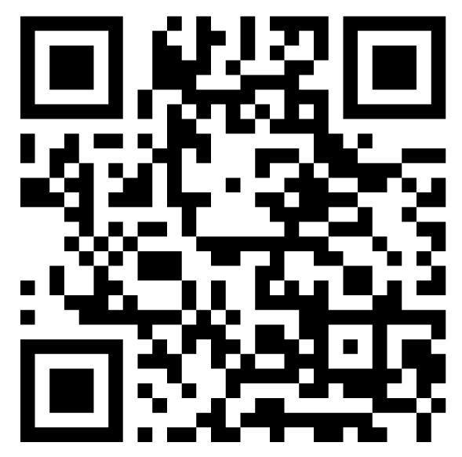
MUSIC DIRECTORY
You can now find local musicians, music industry professionals and support services much easier.
The Houston Music Directory is designed to market the creative music industries across the Greater Houston area.
Folks can set up a FREE Musician or Music Business profile. Scan or get started here:
www.houston-music.live/music-directory
Photo Marco Torres, 2023

Slide 25

MILLER SUMMER MIXTAPE
Landmark performing arts venues like Miller Outdoor Theatre continue to offer paid opportunities for many of our emerging local musicians.
The Music Board and MOCA have partnered with Miller to support Miller Summer Mixtape concerts each year that feature these talented artists.
A registration drive will be part of a call for artists and musical lineups will be curated from the Music Directory for showcases.
25

Slide 26
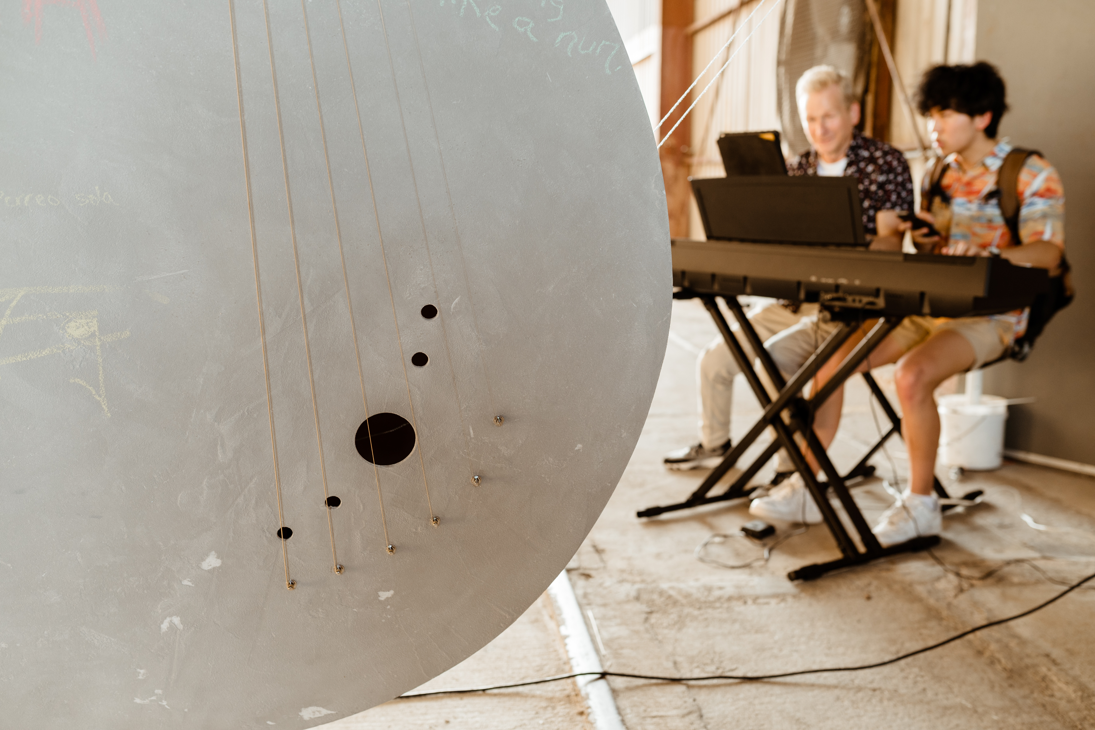
Music Program Overview
Mayor’s Office of Cultural Affairs
Gracie Chavez, Music Officer
gracie.chavez@houstontx.gov
www.houston-music.live
Photo J.Andrade, 2022
Courtesy of Arts District Houston

