Slide 1
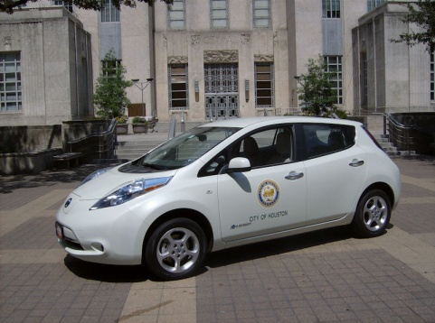
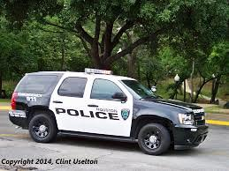

Fleet Management Department
Budget and Fiscal Affairs Committee
Home Storage Vehicles
Victor W. Ayres – Director
June 28, 2016

Slide 2
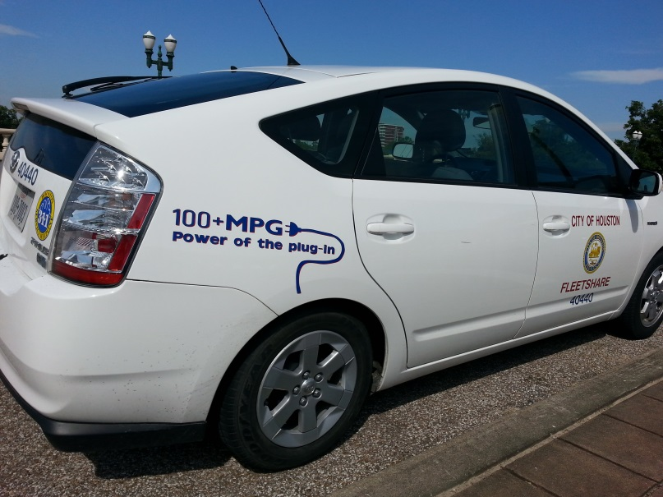
Brief Outline
What is our policy?
How do we assign?
  Job duty
  Labor Contract
How do we monitor & audit?
What are our findings?
Questions

Slide 3

Home Storage Vehicle
Administrative Procedure 2-2 Revised (12/4/2012)
7.3 Vehicle Home Storage
  7.3.1 - Employees who are required to report directly to various field work sites, or placed "on call" or providing special repair or emergency services after normal working hours may be assigned a City vehicle for home storage at the discretion of the department director or by the Mayor when it is beneficial to the City to do so.
  7.3.2 - Authorizations for home storage of City vehicles shall be approved only for employees who live within a 30-mile radius of City Hall.
  7.3.2.1 - With the approval of the Mayor or his/her designee, department directors are given discretion to authorize home storage outside the established radius for employees whose job functions are critical to department operations, such as maintenance mechanics who perform emergency repairs to City facilities and must transport their tools and equipment to the facility.
  7.3.2.2 - With the approval of the Mayor or his/her designee, Department Directors may establish a home storage mileage radius that differs from this A.P., provided that specific criteria and justifications are included and they are handled consistently.

Slide 4

Home Storage Vehicle
(Administrative Procedure 2-2 Revised (12/4/2012), section 7.3
Directors and Mayor may assign home storage privileges for City business use to include
  “on call” , special repair or emergency services after normal business hours
  requirement to report directly to various field work sites
Notes:
“on call” etc. would apply to service techs, emergency responders, arson investigators, building maintenance, etc.
Work site would apply to building inspectors, code enforcement, etc.

Slide 5
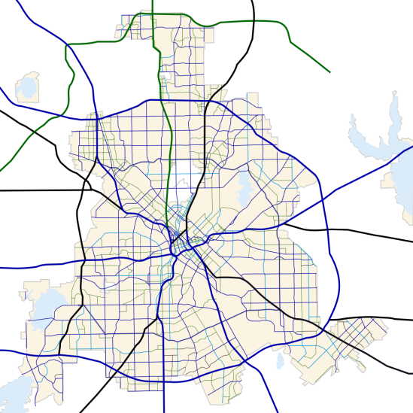
Home Storage Vehicle
(Administrative Procedure 2-2, section 7.3
Guideline limits the distance from home to a 30-mile radius of City Hall
  Exceptions may be granted by the Mayor for:
    Job functions critical to department operations
    Directors may establish a different mileage radius, provided specific criteria and justifications are included and consistently applied
Notes:
building maintenance mechanics for specialty tools/equipment stowed on the vehicle

Slide 6
COH Home Storage Vehicles
Department | # of Vehicles
Fleet Management Department | 8
General Services Department | 8
Houston Airport System | 6
Houston Fire Department | 274
Houston Police Department | 578
Human Resources Department | 1
Parks and Recreation Department | 8
Public Works and Engineering Department | 252
Solid Waste Management Department | 2
Total | 1,220

Slide 7
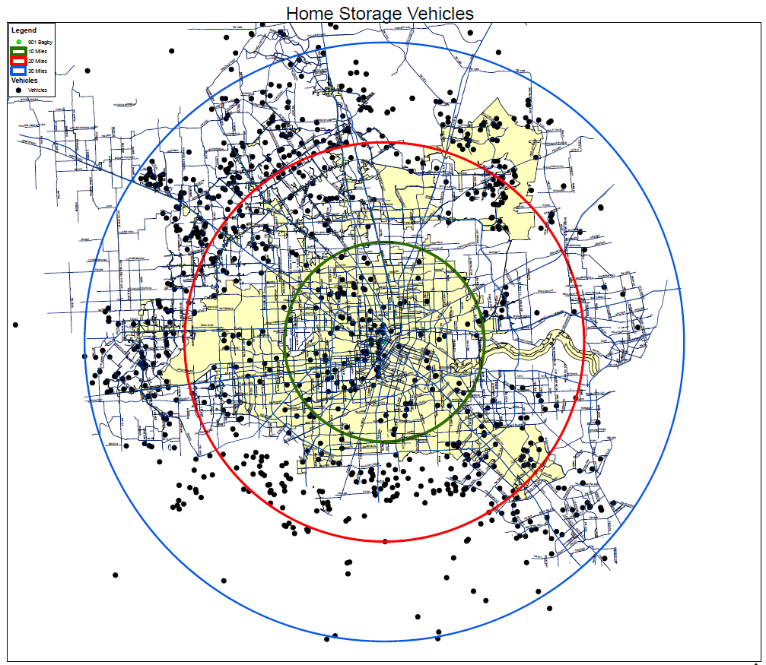
By Home Storage Location
Location | # of Vehicles
10 mile radius | 159
20 mile radius | 425
30 mile radius | 512
Outside 30 mile radius | 67
Pending Confirmation | 57

Slide 8
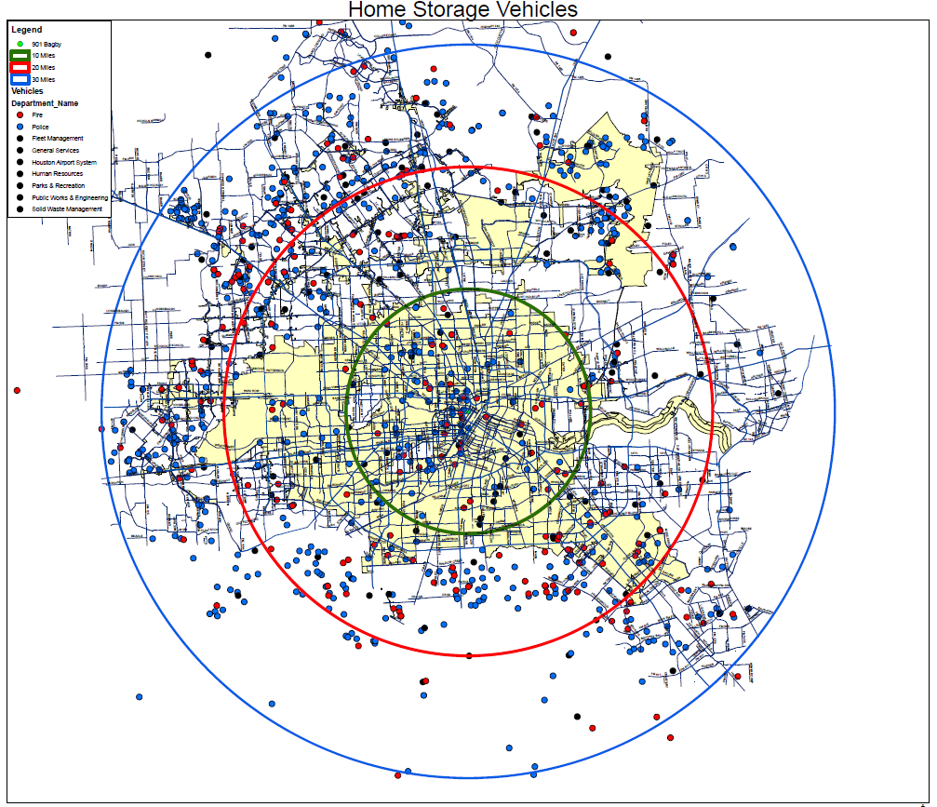
By Employee Classification
Classified
Non Classified
 | # of Vehicles
Classified | 852
Non Classified | 368

Slide 9
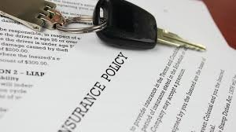
Home Storage Vehicle
Employee Requirements
May not utilize the vehicle for personal use (errands, trips, etc.)
With the exception of Police and Fire, must maintain an insurance addendum clause (non-owned rider coverage) on their personal insurance for property damage and personal injury
Employee is personally liable for injury, death and property damage connected with unauthorized use of the City vehicle

Slide 10

Home Storage Vehicle
Employee Requirements
Employee Reimbursement
  Employees reimburse the City for non-City business driving (commute miles)
Exceptions
  Exempted by the Mayor
  On temporary assignment (<=7 days in 30-day period)
  During emergency response operations
Notes:
Mayor Parker exempted Fire; what does MST wish to do?

Slide 11

Employee Reimbursement
Current rate is $98.00 per pay period which is reviewed at the beginning of each fiscal year by FMD
City collects approximately $1.6MM annually
Revenues collected are returned to employee departments

Slide 12

Monitor & audit process
7.3.6 Departments
  Maintain home storage requests, approvals and quarterly vehicle use reports.
  Directors or the Mayor review vehicle assignments annually, and can revoke home storage privileges.
  FMD audits department records in the 1st quarter of each fiscal year.

Slide 13
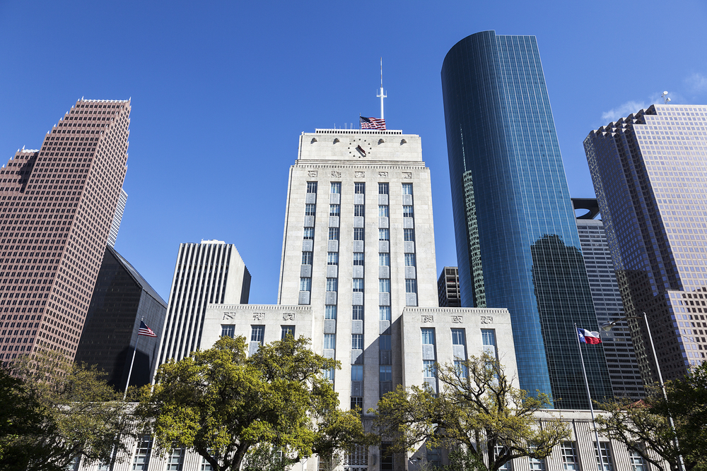
Questions?

