Slide 1
FFY 2017 - 2019
Proposed DBE Goals
Budget and Fiscal Affairs Committee
August 30, 2016

Slide 2
Background
The US Department of Transportation (USDOT) requires Federal Aviation Administration (FAA) recipients receiving funds in excess of $250,000 in a fiscal year for airport planning or development, to establish a Disadvantaged Business Enterprise Plan and set Triennial Goals for all federally-assisted projects. Historically, the City of Houston, through the Houston Airport System (HAS), has received Airport Improvement Program (AIP) funds from the FAA in excess of this amount.
The HAS anticipates receiving funds that will surpass the $250,000 threshold. As a result, the City of Houston must establish goals for the next three federal fiscal years. The established goals are specifically for DBE participation on HAS Construction and Professional Services contracts only. They are not applicable to the Airport Concessions contracts.

Slide 3
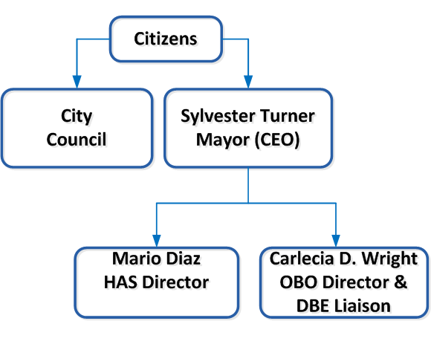
Organizational Structure
USDOT requires the recipient to appoint a DBE Liaison Officer with direct access to the entity’s Chief Executive Officer and that the governing body approve the Triennial Goals.

Slide 4
Proposed DBE Goals for Federal FY 2017-2019
Pursuant to Title 49, Code of Federal Regulations, Part 26, the City of Houston’s Office of Business Opportunity and the Houston Airport System have analyzed the criteria required by the federal authorities to determine the DBE Goals for the period of October 1, 2016 to September 30, 2019.
Airport | Proposed DBE Goal | Race Neutral Goal
IAH | 29% | 2.5%
Hobby | 29% | 2.5%
EFD | 26% | 2.5%
*Proposed Goals are for Construction and Professional Services contracts only

Slide 5
Current DBE Goals for Federal FY 2014 -2016
City Council last approved the DBE Goal for George Bush Intercontinental
Airport (IAH) in October, 2013. No goals were proposed at that time for William
P. Hobby (HOU) nor Ellington Field (EFD) Airports because HAS had not
anticipated receiving any federal funds.
Airport | Proposed DBE Goal | Race Neutral Goal
IAH | 29% | 3.7%
Hobby* | 19% | 3.7%
EFD* | 28% | 3.7%
*In September 2015, the City amended the Triennial Goals for Federal FY 2014-2016 to address AIP grants subsequently received for HOU and EFD.

Slide 6
DBE Goal Methodology (All Airports)
USDOT provides a methodology as guidelines to establishing the DBE Goals. Regulations also requires separate goals for each airport (based on HAS’ airport size).
Step 1: Determine a base figure for the relative availability of DBEs.
Step 2: Examine all of the evidence available in your jurisdiction to determine
what adjustment, if any, is needed to the base figure.
Base Figure
  HAS utilized the average DBE participation at IAH for the past three years as the base figure for all three airports.
Base Figure
Weighted Availability of Specific DBE Projects
Overall DBE
Goal
2
6

Slide 7
Race/Gender Neutral Goal
It is also necessary to determine how much DBE participation would result without the assistance of DBE contracting goals.
To calculate the Race/Gender Neutral Goal, we took the median DBE participation for the past three years and subtracted the overall DBE Goal. Information from IAH was once again utilized for all three airports.
Fiscal Year | Actual Participation | Overall DBE Goal
2013 | 25.1% | 29%
2014 | 34.2% | 29%
2015 | 31.5% | 29%
Median | 31.5% | 29% | 2.5%
Median DBE Participation (31.5%) – Overall DBE Goal (29%) = 2.5% (Race/Gender Neutral)

Slide 8
Stakeholders’ Opportunity
USDOT also requires that stakeholders and interested parties be
allowed an opportunity to ask questions about the City’s DBE Program
and provide feedback on the goal setting process.
A public informational stakeholders’ meeting was conducted on March 31, 2016 at the HAS Administrative Office.
A second meeting is scheduled for Monday, September 19, 2016.
The proposed goals are currently posted on the HAS Office of Business Opportunity’s website at http://houstonairports.biz/office-of-business-opportunity, and are available for inspection during regular business hours at the offices of HAS-OBO, the City Secretary, and the Office of Business Opportunity until September 6, 2016.

Slide 9
APPENDICES

Slide 10
Average DBE Participation at IAH for
Federal Fiscal Years 2013 – 2015
Fiscal Year | DBE Participation
2013 | 25.1%
2014 | 34.2%
2015 | 31.5%
Average | 30.3%

Slide 11
Weighted Availability - IAH

Slide 12
Weighted Availability - HOU

Slide 13
Weighted Availability - EFD

Slide 14
Stakeholders’ Comments and Recommendations
Stakeholders’ Comments | Stakeholders’ Recommendations
Opportunities are not easily accessible | Assist and educate the public in navigating the City and HAS’ websites. Create more comprehensive methods on how to market DBE projects. Host Industry Days for larger projects.
Information Technology is not well represented on DBE contracts | Have representatives from the IT group present at Industry Days, networking events, and any other outreach events to discuss various IT opportunities.

