Slide 1
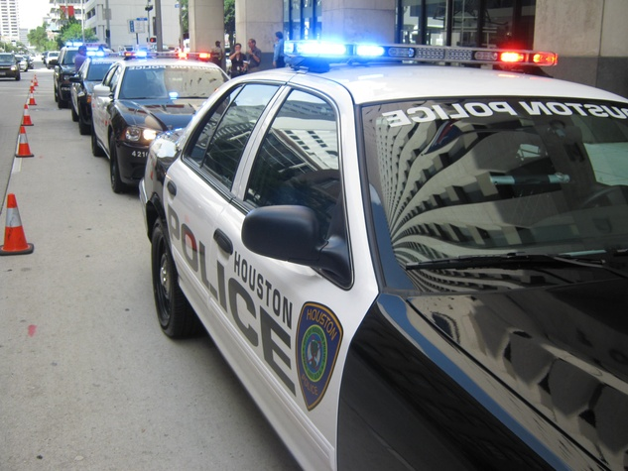

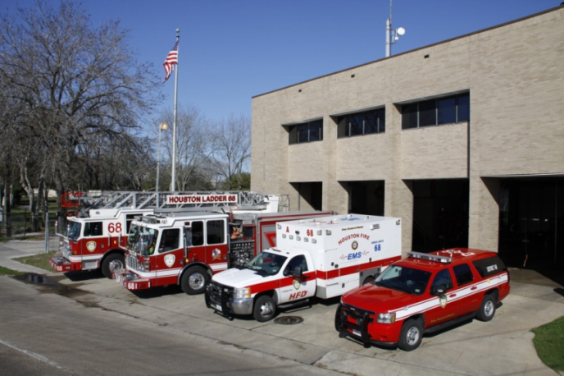
Budget and Fiscal Affairs Committee
Report on Fleet Condition and Alternative Fuel Vehicles
Victor Ayres, Director
Fleet Management Department
April 4, 2017

Slide 2
Topics of Discussion
2007 Mercury Associates Report and Historical Spend
Quality of Life and Homeland Security Departments
Emission Reductions and Alternative Fuel Vehicles
4/3/2017

Slide 3

Mercury Assessment
In 2007 Mercury Associates assessed fleet condition
Report highlights
  City keeps vehicles twice as long as recommended.
  Fleet replacement funding should be more than doubled to “catch up” with industry best standards.
  Cost of ownership includes excessive dollars maintaining equipment beyond its “best” useful life.
  A “smoothing” process should be implemented immediately to eliminate this cost inflator.
4/3/2017

Slide 4
Historical Spending
Despite recommendation to double spending levels on fleet acquisitions, financial challenges actually resulted in reduced spending levels.
4/3/2017

Slide 5
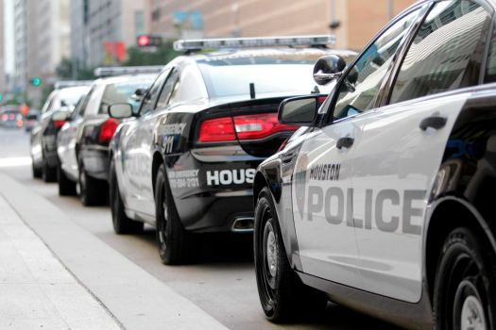
GENERAL FUND (GF)
Average Age
Mercury Report Projection
  If GF spend remains at $20 million/year for next 10-years, average age will increase from 6.9 to 8.0 years.
  WE HAVE SURPASSED THAT KEY MILESTONE
Recommended: 6.2 yrs.
2007 avg. age: 6.9 yrs.
Current avg. age: 8.6 yrs.
4/3/2017

Slide 6
GF Fleet Replacement Overview
A high level assessment identifies a $128 million backlog
Criteria based on unit being 1.5X estimated useful life or over 120,000 miles traveled.
4/3/2017

Slide 7

Primary Areas of Concern
Quality of Life and Homeland Security Departments
  Police Department
  Fire Department
  Solid Waste Management
4/3/2017

Slide 8
Houston Police Department
(Marked Patrol Units)
Vehicle purchases have been erratic.
2008 analysis shows dept. should acquire 275 – 300 units annually.
Past 10-year avg. has been <200/yr.
Proposed Annual Replacement Quantity
4/3/2017

Slide 9
Houston Police Department
(Marked Patrol Units)
Replacement Cost - $37,900 each
Recommended replacement age – 5 years
4/3/2017

Slide 10
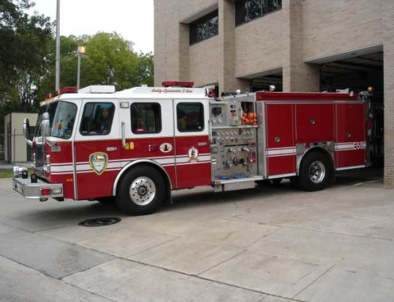
Houston Fire Department
Spike
Proposed Annual Replacement Quantity
The White, Parker and Turner Administrations inherited a purchasing “spike” which inflates ongoing fleet procurements and annual maintenance expenses.
A “smoothing” process should be implemented to eliminate this cost inflator.
4/3/2017

Slide 11
Houston Fire Department
Replacement Cost - $500,000 each
Recommended replacement age: 9 years
4/3/2017

Slide 12
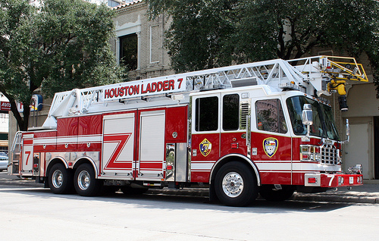
Houston Fire Department
Proposed Annual Replacement Quantity
4/3/2017

Slide 13
Houston Fire Department
Replacement Cost - $864,000 - $970,000 each
4/3/2017

Slide 14
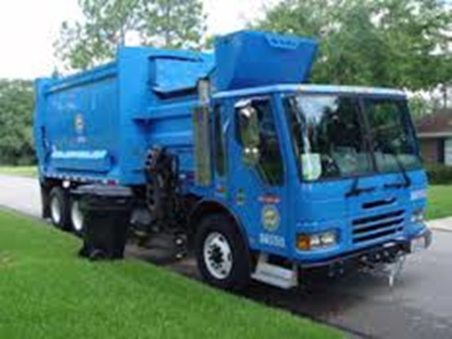
Solid Waste Management
Spike
Proposed Annual Replacement Quantity
4/3/2017

Slide 15
Solid Waste Management Status
Replacement Cost - $260,000 each
Recommended replacement age: 4 years
4/3/2017

Slide 16

Strategies
To address the City’s current financial situation and the $128MM backlog, options include:
Find additional funding sources
Continue repurposing vehicles.
4/3/2017

Slide 17
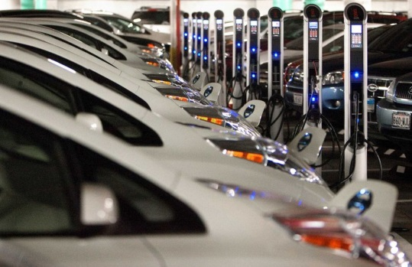
Strategies
3. Investigate lease options
    Costs may be similar to current maintenance cost for some older units
4. Continue to expand the FleetShare Program
4/3/2017

Slide 18

Strategies
5.Accelerate buying
through government co-ops
  Faster process
  Reduced maintenance and downtime costs
  Standardizes the fleet
    Reduces parts costs
    Reduces operator and mechanic training
4/3/2017

Slide 19

Vehicle Emissions Reductions and Alternative Fuels
4/3/2017

Slide 20
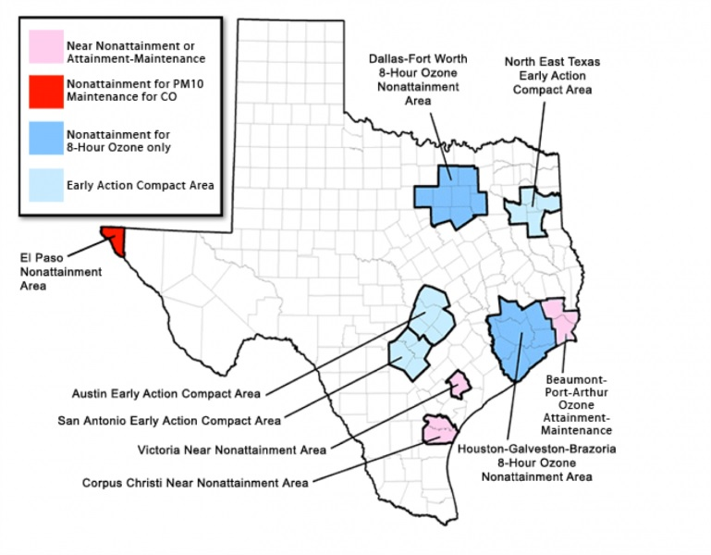
EPA Non-attainment areas in Texas
4/3/2017

Slide 21

Air Quality issues in Houston-Galveston-Brazoria Region
Non-attainment – Ozone (O₃)
Ozone is formed by chemical reaction of NOx and VOCs in sunlight.
NOx is emitted by diesel vehicles.
Near non-attainment - Particulate Matter (PM)
Fine airborne particles commonly viewed as the black smoke in diesel exhaust.
4/3/2017

Slide 22
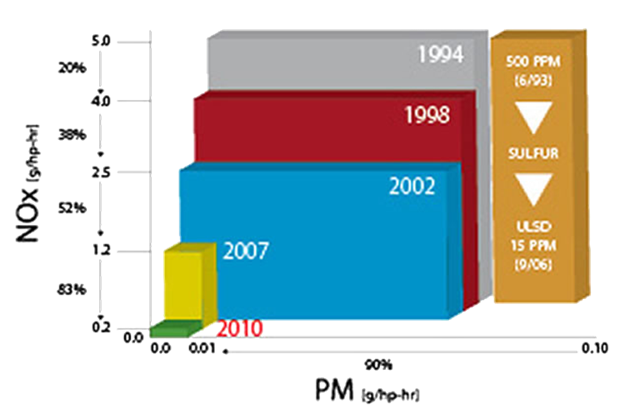
On-Road Diesel Engine Emissions (by Model Year)
4/3/2017

Slide 23
On-Road Diesel Engine Count by engine model year
Unit Count
1,925
Total
Emissions Std. by Model Year

Slide 24

Reduce Emissions
Replace pre-2007 diesel engines.
Additionally new vehicles
  Improve fuel economy
  Reduce maintenance costs
  Increase equipment uptime
    Reduce overtime
    Provide equipment reliability
    Reduce fleet size
4/3/2017

Slide 25

Alternative Fuel Vehicle Fleet
Total On-road Vehicles* - 5,274
Total AFVs - 707
Current – 13% AFV’s
Consist of hybrid, All Electric,
Plug-in Hybrid/Electric,
CNG and Propane
Typically cost 25% - 50% more than conventional vehicle.
*Excluding HPD and HFD
4/3/2017

Slide 26

Alternative Fuel Projects
Projects seeking funding opportunities:
CNG
  Analyzing opportunities
  Reviewing grants
Electric
  Lease pricing and terms for EVs
Propane
  Reviewing grants for conversion of pre-prepped vehicles and installation of propane fuel site
Awarded by Green Fleet Magazine - 2014
4/3/2017

Slide 27

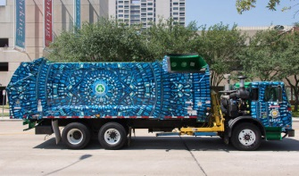
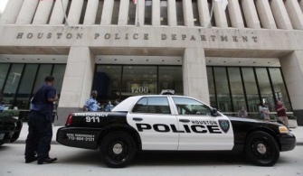
Summary
FLEET CONDITION
Funding for fleet is significantly below optimum level of $60+MM/yr. proposed by Mercury Associates.
Fleet age has increased, is stabilizing but needs to be reduced.
Units critical to HPD, HFD and SWM need to be addressed.
4/3/2017

Slide 28

Summary
EMISSIONS & ALT FUELS
Most cost effective way to reduce emissions is to replace older equipment.
City has historically done a good job in procuring alternative fuel vehicles.
City will continue to capitalize on technology that makes economic and operational sense.

Slide 29
QUESTIONS?

