Slide 1

Facility Solution for HFSC
Budget and Fiscal Affairs
September 10, 2018
®

Slide 2
Houston Forensic Science Center (HFSC) Background
Issues for “Crime Lab” date back over 20 years.
In 2011 backed by Administration, D.A., GHP and Community support reassessment initiated.
Model of an Independent Forensic Center chosen and passed by Council in February 2014.
At that time, focus was on governance, staffing and need to fully define mission.

Slide 3
Houston Forensic Science Center Background
Facility inadequacies were dealt with operationally, but funding to significantly change not available.
  Justice Center Study left HFSC separate.
  Detailed study done by consultants estimated newly constructed facility would cost $130M.
Instead, HFSC asked to seek alternatives within their existing budget.
  Multiple opportunities explored.
  Clear that major productivity improvements are limited by constraints with the 1200 Travis Building.
  Presentation today will focus solely on the facility plan. Tomorrow HFSC will give operational update.

Slide 4
Current Facility
11 different floors in 4 buildings
All retrofitted office space. No designed lab space
Inflexible, poorly laid out 80,000 sq. ft.
Half of 20,000 sq. ft. of lab is used as office
Inadequate electrical capacity for laboratory work
Insufficient cooling
Optics of HFSC in HPD headquarters

Slide 6
New HFSC facility: 500 Jefferson
New facility cost neutral with current facility
Occupy 4 floors and 3,000 sq. ft. of basement in 500 Jefferson
3 modular office floors, small modifications
1 floor designed as efficient, flexible laboratory space
  Air handling designed for a lab
  Adequate cooling
  Adequate electrical
3,000 sq. ft. in basement as laboratory/firing range
for firearms and CSU
83,000 sq. ft. designed for secure efficient evidence handling
Independent space

Slide 7
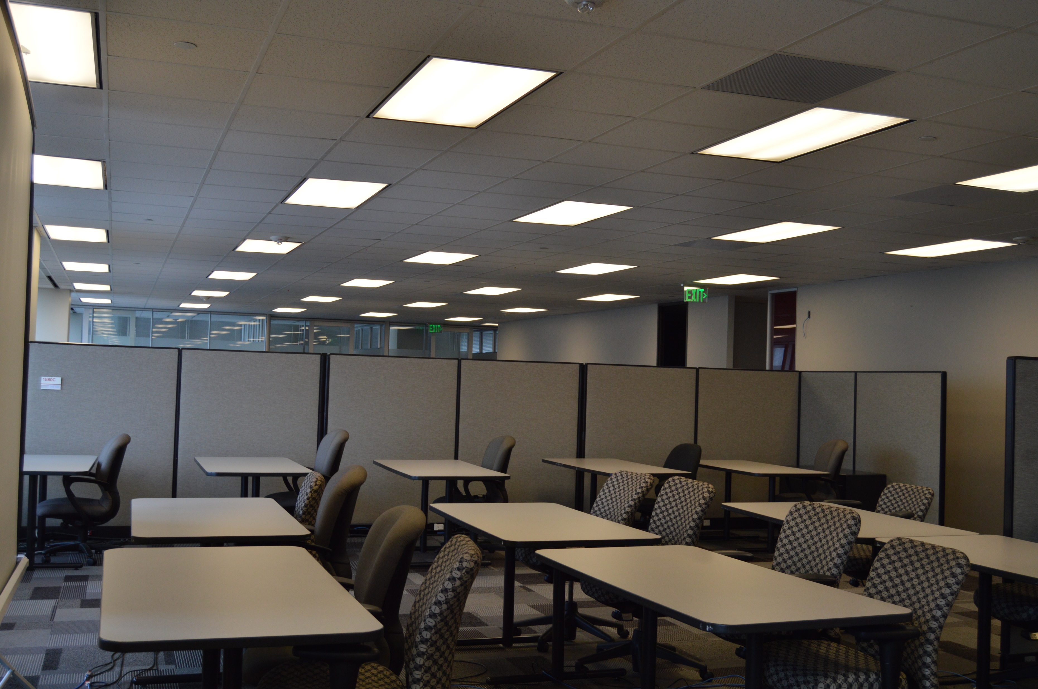
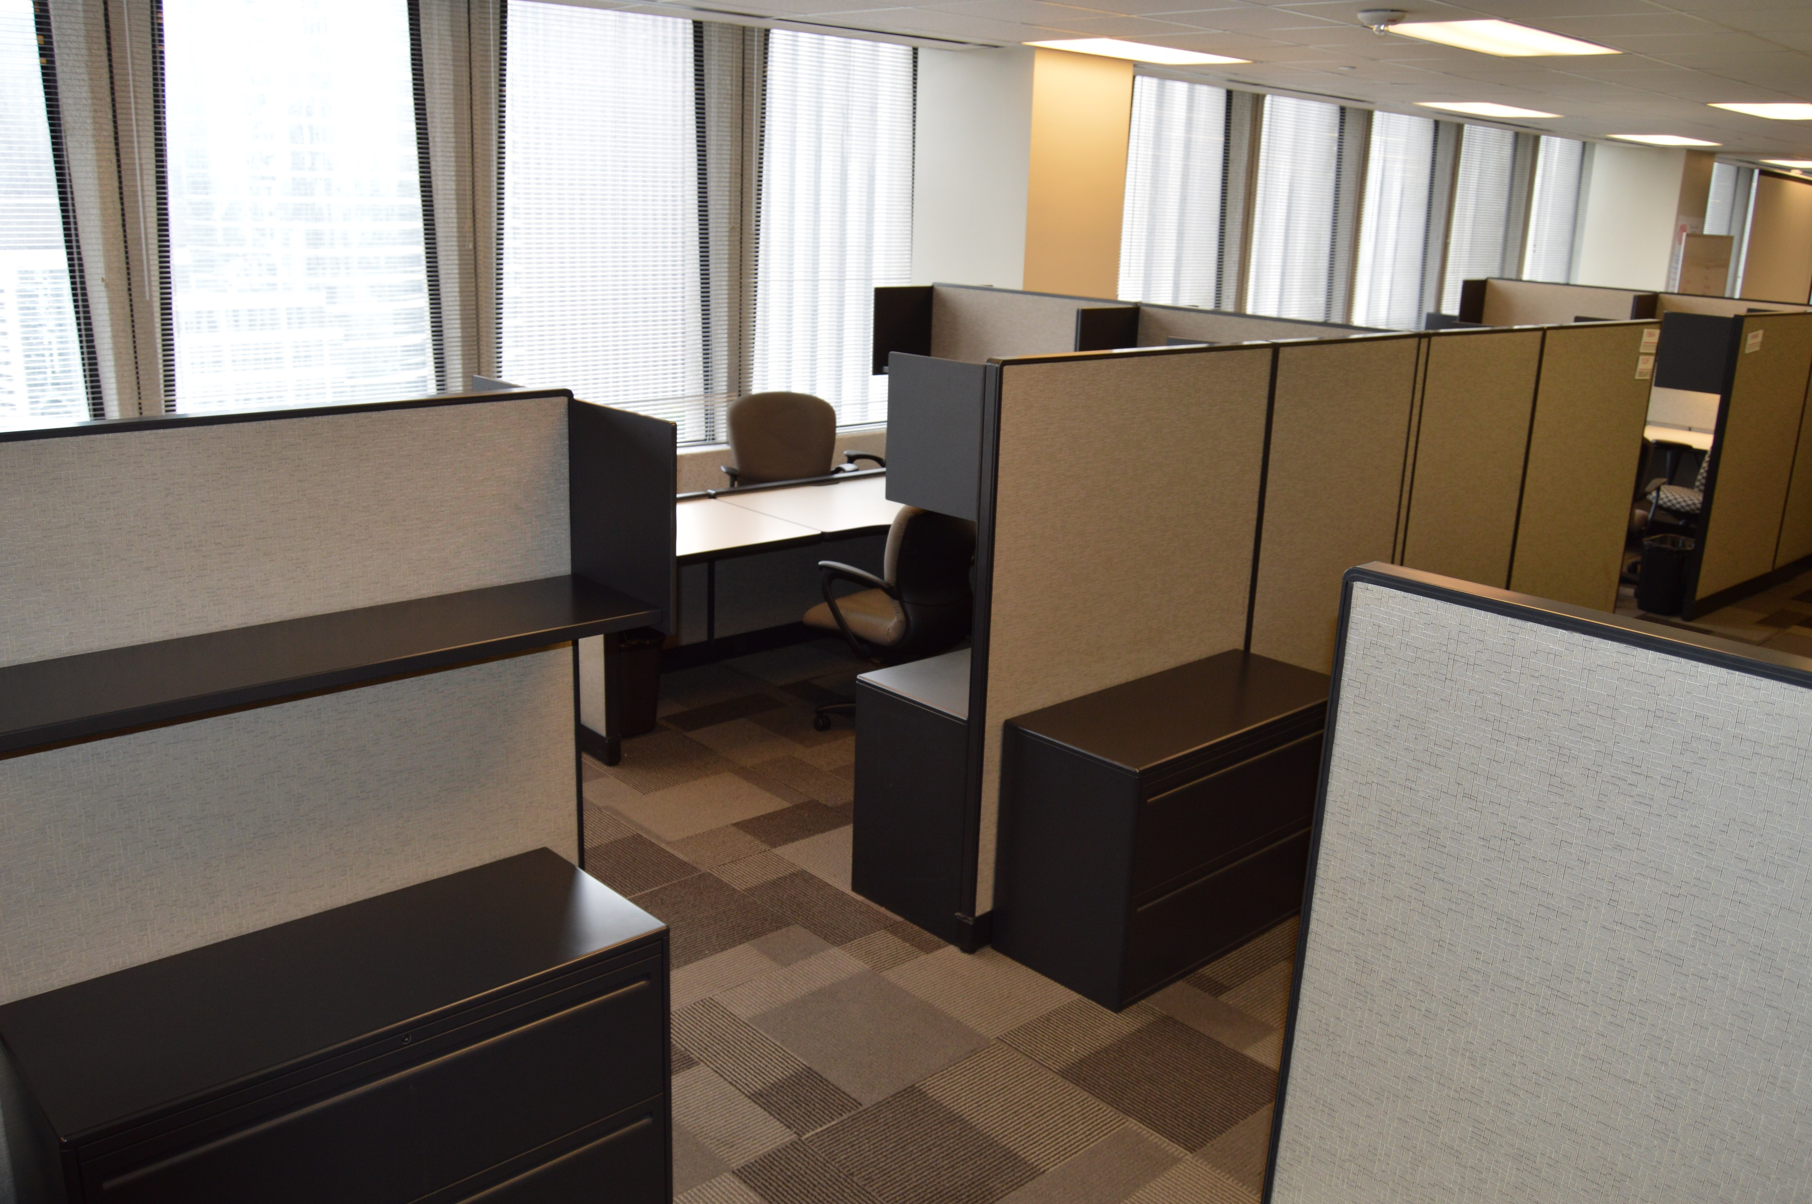
500 Jefferson office space (floors 13, 14, 15)
Existing office furniture and build out that HFSC will use

Slide 8
Laboratory floor (18th floor)
Latent Prints
Airflow
Biology/DNA
Quality/R&D
Seized Drugs
Toxicology

Slide 9
Basement (B1)– firearms and CSU
Crime Scene
Firearms

Slide 10
Lease summary
30-year lease for 83,000 sq. ft. Turnkey solution for facility with designed laboratory
  YEAR 1 annual cost: $2.7M (cost neutral)
  YEAR 11 annual cost: $3.4M
  YEAR 21 annual cost: $4.4M
Move starts: March 1, 2019
Move ends: December 2019

Slide 11
Lease financials summary

Slide 12
Forensic Workforce development with UHC/UHD
Projects planned with Central Campus and UH Downtown
  Internships
  Long term 1-2 year fellowship type programs
  Visiting faculty participation
Leverage science, engineering and information science programs with practical laboratory experience to develop future forensic practitioners
Specifically seek veterans for fellowship paths in firearms examination and latent prints

