Slide 1

2019 Budget Overview
Prepared for City of Houston Council Committee on Budget & Fiscal Affairs
Brenda Bazan
Chief Executive Officer
Frank Wilson
Chief Financial Officer

Slide 2



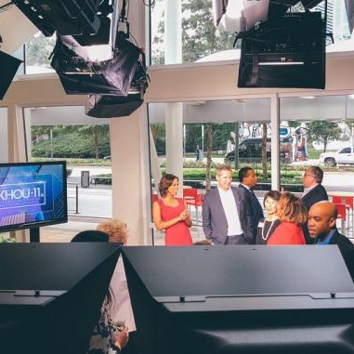
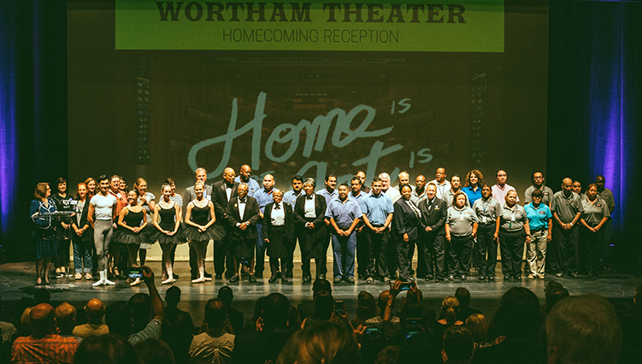
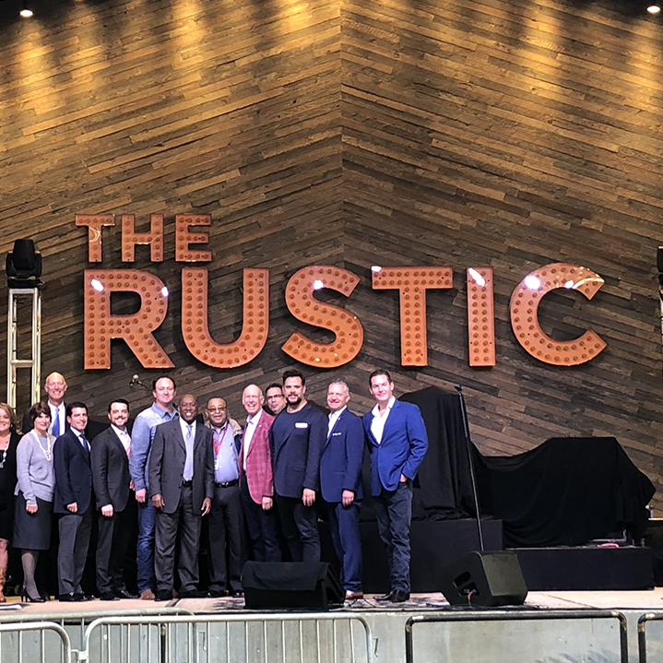





2018 Accomplishments
Projecting all-time high revenues in 2018
2nd Best
Revenue Year
$102 M
Venue
Revenue
$10.6 M
Food & Beverage
Revenue
$17.2 M
KHOU on Avenida Opens
Wortham Reopening
The Rustic Opening
FUTURE BOOKINGS
2019 2020
International Congress & World Petroleum Congress
Convention Association
2023 2024
NCAA Final Four Men’s College Football Playoffs
Basketball Championship
Exhibition partnership series bringing programs exploring Houston’s diverse culture

Slide 3

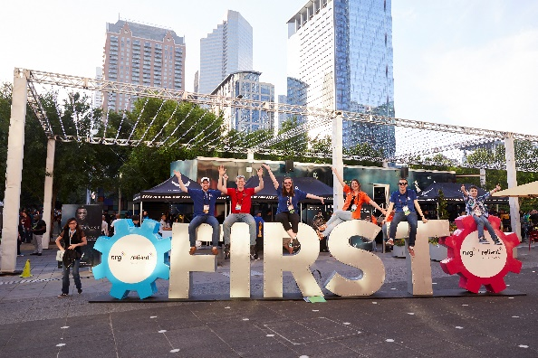
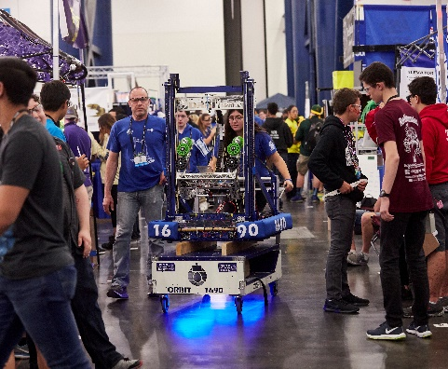

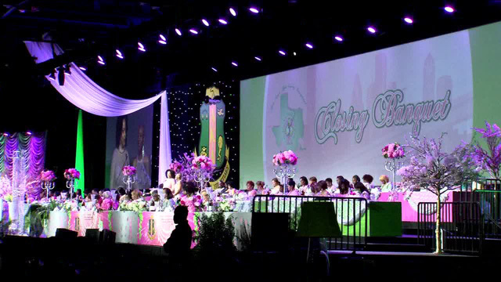
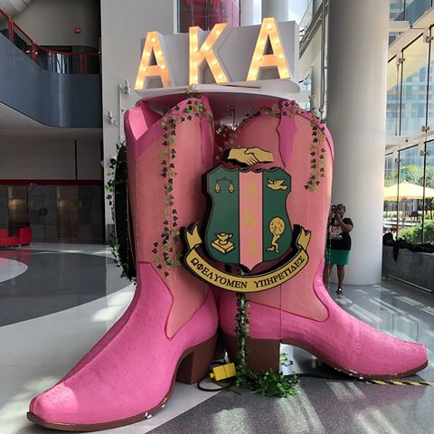

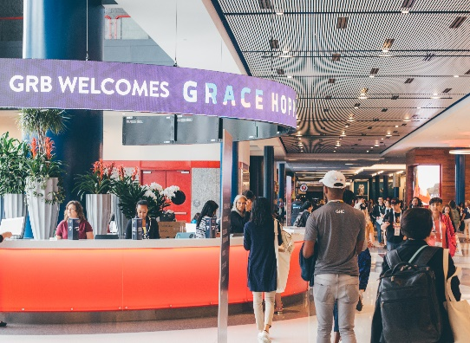

2018 Notable Conferences
FIRST Robotics
Attendees
2018: 30,655
2017: 29,468
Room Nights
2018: 17,031
2017: 14,577
Booked for
2019
2020
2021T
2022T
2023T
AKA Boulé
Attendees: 22,973
Room Nights: 24,372
Economic Impact¹:
$33.2 M
Grace Hopper Celebration
Attendees
2018: 21,780
2016: 14,537
2015: 12,052
Room Nights
2018: 36,078
2016: 29,894
2015: 19,141
Economic Impact¹:
$13.9 M
Exhibitors:
2018: 426
2016: 326
2015: 217
¹DMAI Event Impact Calculator
Notes:
FIRST Robotics included teams from all 50 states and 85 countries
AKA:

Slide 4

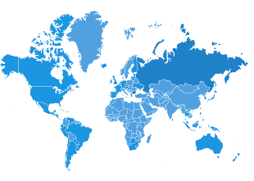








Memorial Weekend Effect
50,778 attendees
47 states
18 countries
300+ credentialed
media
25+ million
Media impressions
40,000+ subscribers
Opted in
73,000+ social media
followers/friends
$500,114
Food & beverage Sales (Gross)
$160,466
Parking revenue
600+ volunteers
63 members of loc
NET REVENUES¹ TO HFC/GHCVB
$1,172,711
¹ Includes GRB Rent & Services, Hilton-Americas, GRB Food & Beverage, Parking, Event Profitability, HOT Revenue

Slide 5
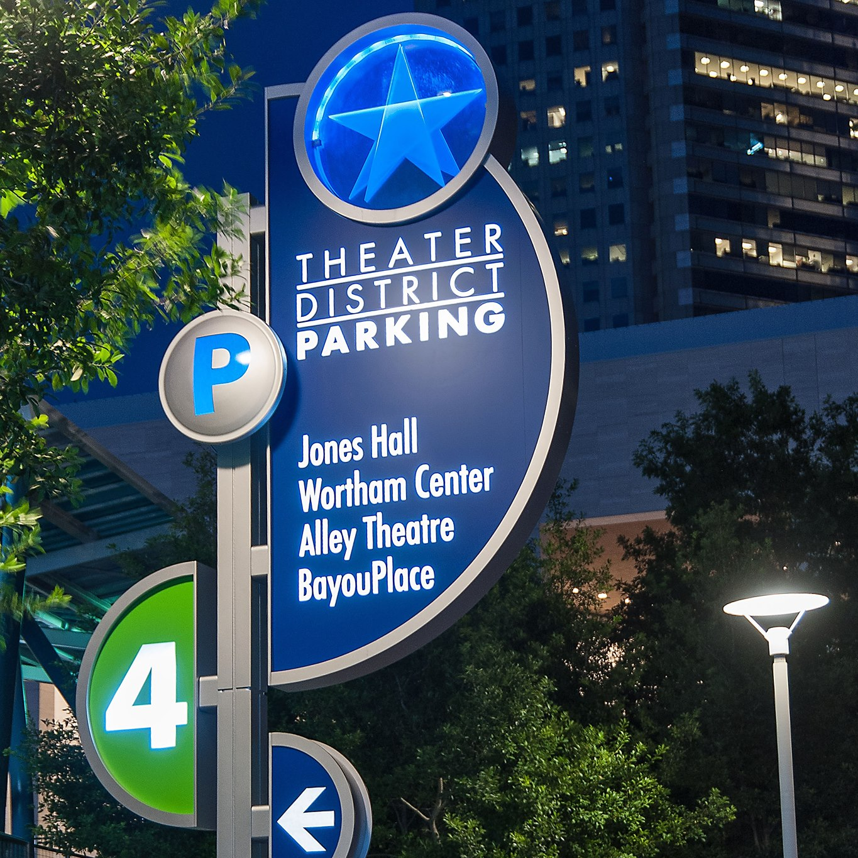
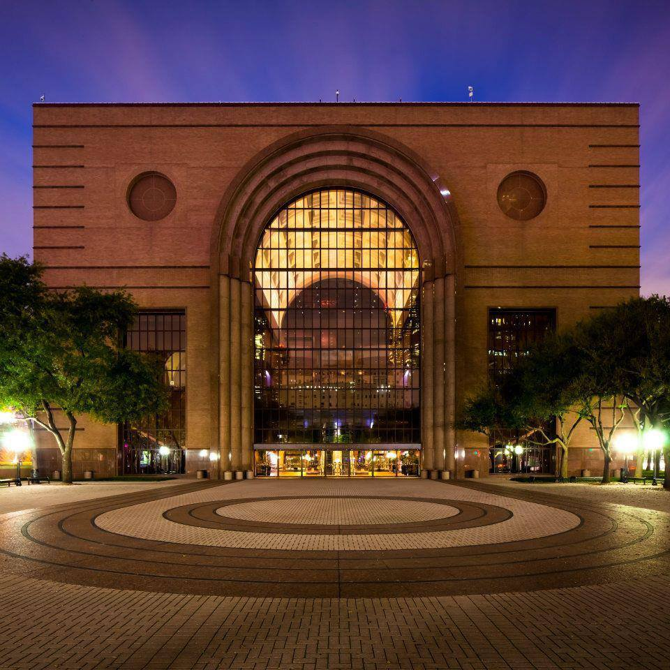
Harvey Project Progress Report
Theater District Garages
Wortham Theater
46.3%
Complete
75.3%
Complete
Notes:
TD Garage
2017: $33.9 M 2018: $11.8 M
Wortham
2017: $27.2 M 2018: $23.6 M

Slide 6
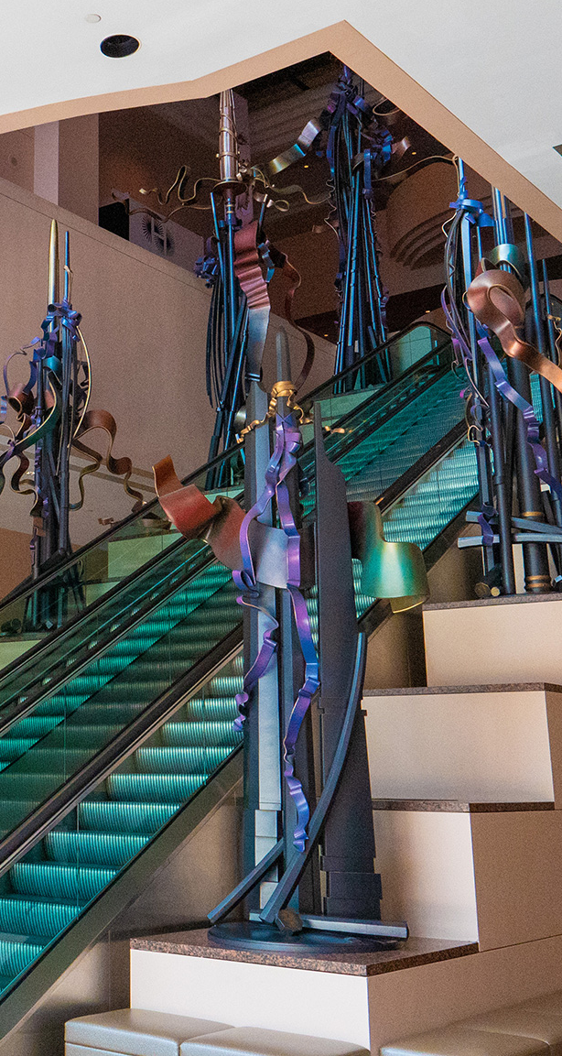
2019 Budget Process
Revenue and Expense Targets
Budget process involved projecting both 2018 year end & 2019 revenues.
HOT assumptions were based on outside consultants’ view of the Houston and US economies. In 2019 we assumed 4.5% growth over 2018 projected.
Hilton revenue assumed to go down 6.6%, based on the room displacement during the refresh.
Parking assumed to return to pre-Harvey levels, an increase of 20%.

Slide 7
2019 Budget Process
Revenue and Expense Targets
Expense targets were based on an average of 2015, 2016 & 2017 actual spend by department.
The impact of special events like Harvey, Super Bowl and Final Four were removed from the average.
Department heads did a great job of meeting targets by prioritizing and making tough choices.

Slide 8

2018 Projection
How We Expect to End the Year
We expect to finish the year $2.7 M in Revenues over Expenses for Operations, instead of the $8.1 M budgeted draw on reserves because:
  Department heads belt tightening
  Better than expected performance at the Hilton, Avenida garages and GRB

Slide 9
2019 Budget Highlights
TOTAL REVENUES AND EXPENSES
 | 2018 Projection | 2019 Budget | Variance
TOTAL REVENUES | $181,448,311 | $188,021,901 | $6,573,590
TOTAL EXPENSES | 178,703,388 | 187,684,488 | 8,981,100
TOTAL REVENUE LESS EXPENSES | $2,744,923 | $337,413 | -$2,407,510
Notes:
Budgeting Total Revenues to Exceed Expenses by $337 K
Included in the operating expenses are 231 positions (FTEs), down from 249 last year, a reduction of 18
Also included is $1.5 M of capital
Expenses increasing primarily due to debt service to respond to Harvey impact
Debt service increased by $9.7 M

Slide 10
Houston First Corporation
CY19 Budget
Operating Revenues
 | 2017 Actual | 2018 Budget | 2018 Projection | 2019 Budget | 2018 Proj. vs 2019 Budget Variance
Venue Revenue | $ 50,059,176 | $ 63,036,297 | $ 72,979,774 | $ 71,984,636 | $ (995,139)
Parking | $ 16,358,910 | $ 17,290,855 | $ 16,781,233 | $ 20,154,270 | $ 3,373,037
Miscellaneous | $ 945,315 | $ 1,193,152 | $ 825,403 | $ 993,000 | $ 167,597
Operating Revenues | $ 67,363,401 | $ 81,520,304 | $ 90,586,410 | $ 93,131,906 | $ 2,545,495
Notes:
The major variance in operating revenue is that Hilton revenue down $1.9 M due to refresh room displacement, facility event revenue is also $613 K lower (due to F & B offsets).
Parking revenue is anticipated to return to pre-Harvey levels. This is in part due to the return of contract parkers in the TD garages ($1.9) and Hilton’s North Garage, due in part to the Rustic.
Miscellaneous revenue increases include monetization of assets.
Operating Revenues
Hilton-Americas revenue down $1.9 M due to refresh room displacement
Parking revenue anticipated to return to pre-Harvey levels

Slide 11
Houston First Corporation
CY19 Budget
Operating Expenses
 | 2017 Actual | 2018 Budget | 2018 Projection | 2019 Budget | 2018 Proj. vs 2019 Budget Variance
Personnel | $ 27,347,221 | $ 28,780,564 | $ 26,858,489 | $ 27,619,283 | $ 760,794
Advertising & Promotion | $ 9,821,005 | $ 9,695,354 | $ 8,911,177 | $ 8,120,836 | $ (790,341)
Travel, Promotion, and Events | $ 5,208,432 | $ 5,479,205 | $ 4,239,161 | $ 4,590,188 | $ 351,027
Facility Maintenance | $ 8,387,868 | $ 8,746,847 | $ 7,773,293 | $ 9,059,015 | $ 1,285,721
Food and Beverage |  | $ 9,714,004 | $ 11,309,572 | $ 12,860,697 | $ 1,551,125
Security | $ 4,493,298 | $ 5,131,512 | $ 4,376,916 | $ 4,845,521 | $ 468,605
Utilities | $ 5,580,915 | $ 6,128,380 | $ 5,538,389 | $ 5,658,258 | $ 119,869
Parking | $ 3,265,503 | $ 4,113,628 | $ 3,495,405 | $ 3,592,880 | $ 97,475
Janitorial | $ 5,339,687 | $ 5,841,527 | $ 5,998,977 | $ 6,646,563 | $ 647,586
Insurance | $ 3,481,734 | $ 2,845,495 | $ 2,186,971 | $ 2,319,447 | $ 132,476
Lease Expense | $ 3,224,277 | $ 2,492,100 | $ 3,944,690 | $ 1,506,800 | $ (2,437,890)
Consulting | $ 3,397,391 | $ 4,259,452 | $ 2,941,542 | $ 3,156,960 | $ 215,418
Supplies | $ 1,513,072 | $ 1,790,138 | $ 1,459,384 | $ 1,818,228 | $ 358,844
Fees & Services | $ 1,187,383 | $ 1,116,375 | $ 988,283 | $ 1,047,025 | $ 58,742
Computer Services | $ 1,129,134 | $ 1,293,328 | $ 1,212,342 | $ 1,273,798 | $ 61,456
Legal Expense | $ 424,081 | $ 460,000 | $ 758,000 | $ 660,000 | $ (98,000)
Other | $ 829,267 | $ 1,119,640 | $ 712,145 | $ 866,919 | $ 154,774
Operating Expenses | $ 84,630,267 | $ 99,007,549 | $ 92,704,735 | $ 95,642,418 | $ 2,937,683
Approved Positions¹ | 223 | 249 | 231 | 231 | 18
¹ Variance in Approved Positions is 2018 Budget vs. 2019 Budget
Notes:
I will touch on a few of the major variances.
In our Personnel line there are 13 vacant positions that are included in the 2019 budget.
Recall that during the restructuring there was a RIF that eliminated 5 positions.
Additionally, 13 other positions were left unfilled so that we could finish the year in the black. We are funding 231 positions (FTEs) for 2019.
This is a reduction from the 2018 Budget of 249 positions, or 18 fewer positions.
Including these 13 vacant positions, the Personnel will be $1.2 M less than 2018 Budget.
Advertising & Promotion is going down $790 K, but will be offset by an increase in marketing dollars for websites ($185 K) and increased media FAMs ($115 k)
Travel, Promotion & Events has a increase of $351 K to fund previous commitments for events: Jehovah’s Witnesses and ICCA Conference.
Increase in Facility Maintenance reflects contract increases and return to pre-Harvey levels with the opening of the Wortham.
Food & Beverage expense is going up because the Wortham will be open for a full year, and revenues are up, so too are variable expenses.
Janitorial increase of $648 K is due to 2% contract increase and staffing for opening of the Wortham for a full year.
Lease Expense down $2.4 M because of 4 Houston Center lease buyout for 7th floor.
Consulting line going up slightly due to developer consultant for W Hotel project.
Operating Expenses
Venue Operations increase primarily due to expected food & beverage expenses, as well as an increase in personnel due to reorganization
Administration expenses are down due to buyout of 4 Houston Center lease, as well as a decrease in personnel due to reorganization

Slide 12
Houston First Corporation
CY19 Budget
Non-operating Revenues
 | 2017 Actual | 2018 Budget | 2018 Projection | 2019 Budget | 2018 Proj. vs 2019 Budget Variance
Hotel Occupancy Tax (Current & Delinquent) | $ 84,508,382 | $ 87,000,000 | $ 89,918,591 | $ 94,000,000 | $ 4,081,409
Contributions | $ 5,000 | $ - | $ - | $ - | $ -
Net Available Pledged Rev. Transfer | $ - | $ - | $ - | $ - | $ -
Interest Income | $ 739,979 | $ 675,744 | $ 943,310 | $ 889,995 | $ (53,315)
Non Operating Revenue | $ 85,253,361 | $ 87,675,744 | $ 90,861,901 | $ 94,889,995 | $ 4,028,094
Notes:
HOT is budgeted @ 4.5% higher than 2018 Projection.
Reduction in Interest Income is due to reduced reserves.
Non-Operating Revenues
HOT 4.5% expected increase from 2018 as determined by industry experts based on economic indicators

Slide 13
Houston First Corporation
CY19 Budget
Non-operating Expenses
 | 2017 Actual | 2018 Budget | 2018 Projection | 2019 Budget | 2018 Proj. vs 2019 Budget Variance
Sponsorship Expense | $ 11,132,834 | $ 7,157,650 | $ 6,373,693 | $ 6,049,720 | $ (323,973)
Contingency |  | $ 2,300,000 |  | $ 2,500,000 | $ 2,500,000
Capital Spending | $ 6,960,664 | $ 2,007,997 | $ 8,099,376 | $ 1,564,485 | $ (6,534,891)
Debt Service | $ 42,401,331 | $ 46,017,338 | $ 50,453,275 | $ 60,213,856 | $ 9,760,581
COH Contractual Obligations | $ 17,584,302 | $ 17,727,261 | $ 18,366,564 | $ 19,464,009 | $ 1,097,445
Hotel Tax Refunds | $ 2,049,846 | $ 3,096,213 | $ 2,705,745 | $ 2,250,000 | $ (455,745)
Non Operating Expense | $ 80,128,978 | $ 78,306,459 | $ 85,998,653 | $ 92,042,070 | $ 6,043,417
Notes:
Reduction in Sponsorships necessary to hit budget targets.
As they are used (in 2018), Contingency funds are moved into other lines of the GL, there is only a $200 K increase 2018 to 2019.
Capital spending in 2019 will be mostly debt funded, only $1.5 M from Operating Expenses.
Debt service is up substantially because of Harvey, the Hilton refresh, capital.
City of Houston Contractual Obligations go up as HOT goes up. We provide 19.3%.
Hotel Tax Refunds are going down because 1 hotel agreement ended in 2018
THANKS TO STAFF FOR THEIR HARD WORK
Lisa Smith
Karen Williams
Stephany Bland
Melanie Tep
Beth Thurber
Donald Brown
Daronda Gamble
Susan Tucker and Georgette Webber for the awesome strategic plan
All department heads
Non-Operating Expenses
Debt service increase from new debt for Hilton-Americas room refresh and capital projects, as well as no built-up earnings from previous years
COH payments increase as a percentage of the expected HOT collections
Additional capital for 2019 will be funded through financing
Sponsorships are down to follow reduced target allocation in keeping with creating a balanced budget
One hotel agreement ended in 2018; five remaining for 2019

Slide 14
Capital Projects
2019 CAPITAL PROJECTS
$37 M Hilton Refresh
$14.8 M for capital for other facilities – life / safety, operational risk
LONGER TERM PROJECTS
$125 M AIG Mortgage Loan Maturity 2020
$20 M GRB Loading Dock: estimated start 2021 - 2022
$20 M Harvey Mitigation: estimated start late 2019 - 2020

Slide 15
Total Debt Outstanding and Debt Service
TOTAL DEBT
OUTSTANDING²
$830.8 M
¹ Tax Exempt
² Includes the proposed $50 M in 2019

Slide 16
Cash Balances / Reserves
$66.4 M is bond ordinance restricted and included in sinking funds
$5.4 M Hilton Reserves

