Slide 1

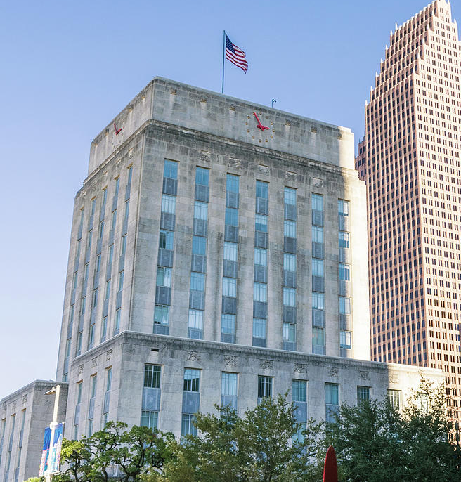
Disaster Recovery & Consulting Services Update
City of Houston
June 30, 2020

Slide 2
Contract Summary
Key Activities
RFP Issued | April 2016
Contract Awarded | February 2017 ($5M)
Contract Amendment | December 2017 ($32M)
Total Contract Award | $37M
Contract Term (3 years plus two 1 year renewals) | February 2017 – February 2022
Spend to Date | $30M
Harvey Monthly Spend | $866K*
MWBE Goal | 24%
Current MWBE Participation | 19%
Harvey
*Does not include COVID-19 ramp up
1

Slide 3

Hurricane Harvey Program Support
The City is moving sharply into Long Term Infrastructure Recovery entering Year 3 after the disaster.
2

Slide 4
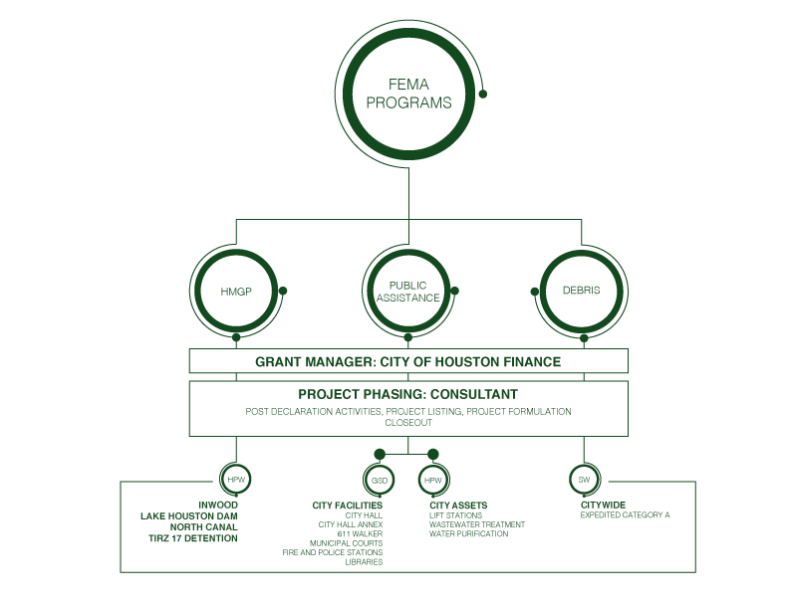
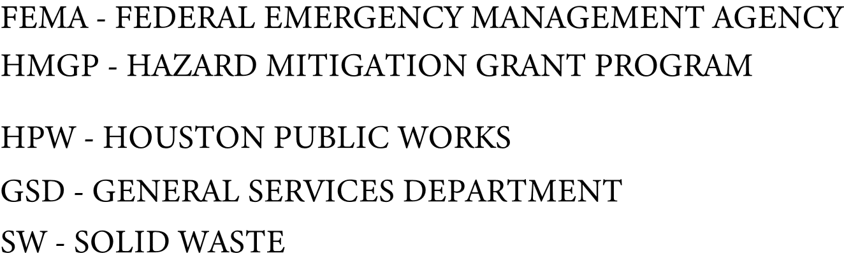
Hurricane Harvey FEMA Programs
Program through Project Management

Slide 5
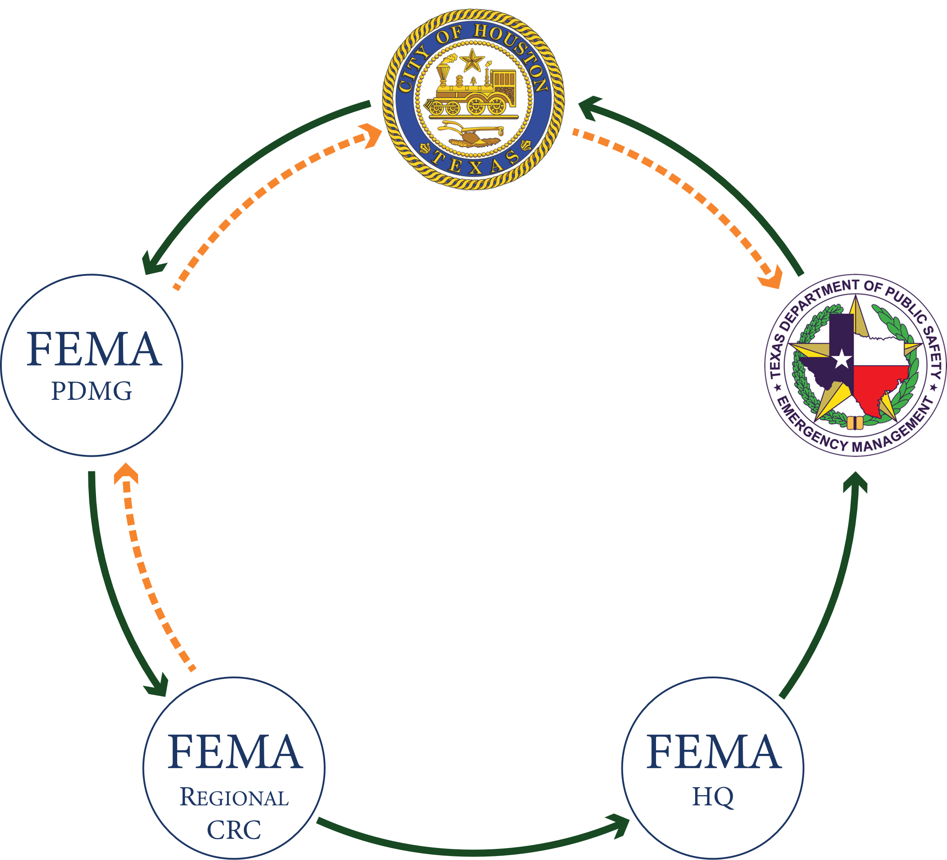
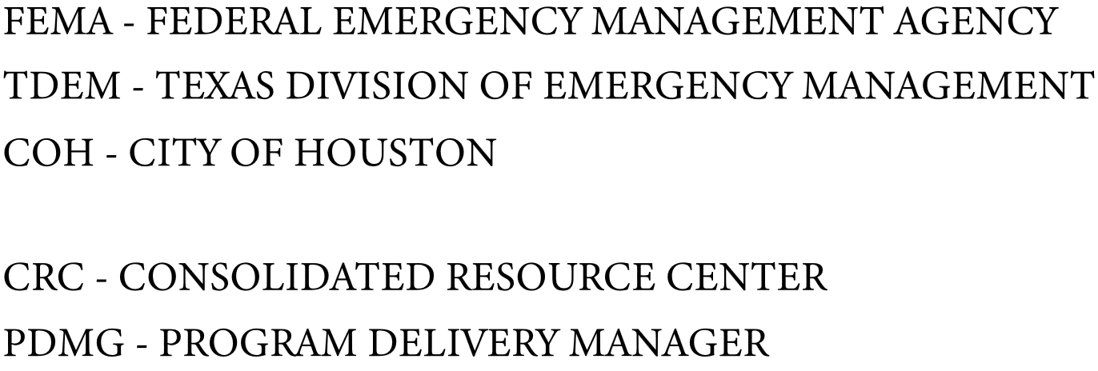
Funding Flow and Federal/State Engagements

Slide 6
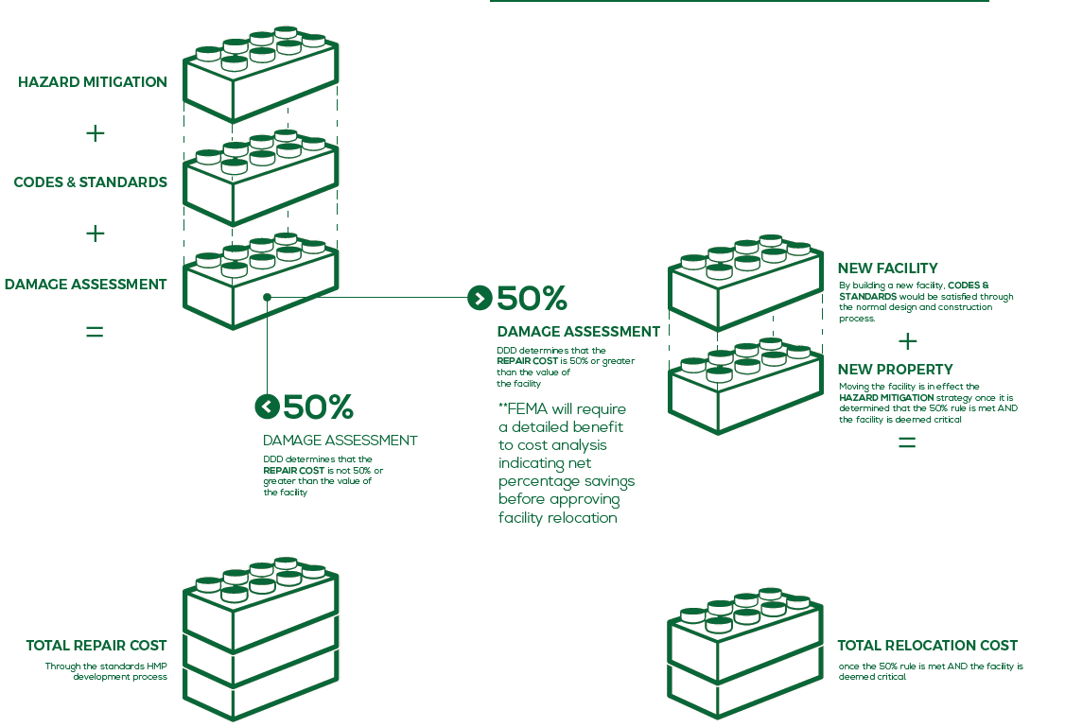
Hurricane Harvey FEMA Public Assistance
Reimbursement Model for Rebuilding and Mitigation

Slide 7
Hurricane Harvey Program Status
On Pace in Year 3 of 10 Year Recovery Program
97%

Slide 8

Delivering on our 5 Commitments to the City
Tetra Tech has partnered with the City to meet or exceed established by Mayor and Council in 2017.
2017
Today
Processing $350M in Harvey response costs to FEMA in Year 1
Processing total of $564.9M in Harvey costs over 3 years
Conducting more than 500 Damage Assessments in Year 1
Conducted 547 Assessments and Inspections over two years

Slide 9
Delivering on our 5 Commitments to the City
2017
Today
Billions of dollars in damages to City infrastructure available for federal assistance
Validating estimated $2.2B in rebuilding and mitigation from FEMA programs
Identifying both visible and hidden damage from Harvey
Documented 31% additional damages in facilities vs. FEMA
Commitment to build it back better wherever possible
Working with FEMA and State on $320.36M of Resilience funding

Slide 10






Program Accomplishments to Date
Key Metrics
Financial
Program/Policy
Mitigation
City Department Support

Slide 11
Program Accomplishments to Date
#1 in State of Texas for FEMA Recovery Dollars Obligated by FEMA for local governments
Leveraged new FEMA program to recover Tetra Tech costs at 100% federal funding
Financial
Category | $ Received (in Millions)
A (Debris) | 83.9
B (Emergency Work) | 123.3
E (Bldgs & Equip) | 32.7
G (Parks, Rec./Fac.) | 29.9
Z (MCIP) | 16.0
SB 7 (Local Share) | 6.9
Total | $292.7
Received funding for $292.7M of the $365.9M currently obligated by FEMA back to the City for Harvey Repairs.
Maximized insurance proceeds of $102.6M for flood loss, wind and business interruption

Slide 12

Program Accomplishments to Date
Partnered with SPD on proactive and preventative processes based on federal guidelines for 100+ Harvey-related procurements ensuring dollars remain in City
City Department Support
Inspector General Review on Procurements resulted in zero findings due to processes put in place
Worked collaboratively with Finance Department to maximize fiscal resources for ongoing disaster recovery through internal controls and audits
Assisted Houston First Corporation to expedite receiving funds from FEMA and State within 2 years and targeted for closeout in 2020
3
Under new FEMA policy, a 3-year timeline limiting “clawback” begins once a project is closed out by the City.

Slide 13
Program Accomplishments to Date
COH Finance led collaborative approach to disaster– “Strike Team”, Denton/Austin In-Person Meetings, Weekly “Ball-in-Court” working sessions
Program/Policy
Received approval from FEMA on apportionment and allocation methodology within 1 year for insurance proceeds
The City led process to improve FEMA’s online tool (GrantsPortal) resulting in 18 changes in the system
Supported Chief Recovery Officer during legislative session on SB7 to save the City an estimated $24.8M to date.
56
FEMA is 52% complete with adopting 56 distinct policy changes from the DRRA that impact Harvey recovery.

Slide 14
Program Accomplishments to Date
Awarded $14.8M in federal funds for Phase 1 Hazard Mitigation – Infrastructure (HMGP)
Obtained $14.2 in federal funds for Phase 1 Hazard Mitigation – Infrastructure
Awarded $38.9M in federal funds for Flood Mitigation – Residential (FMA) for ‘19 & ’20.
Obtained $17.4 in federal funds for Flood Mitigation - Residential
Mitigation
On pace to bring in an additional $0.69 in hazard mitigation funding for every $1 spent on repair for City projects.
Working with FEMA to develop 178 additional mitigation proposals for City facilities.
1:7
FEMA states that for every $1 spent on mitigation, you will save $7 in future repair costs from disasters.

Slide 15
Projected Milestones for 2020/2021
Milestones | Deadline | Status
Awarded $9.4M from State for Local Cost Share Assistance (SB7) | June 2020 | Completed
FEMA Approved new $21.5M in Flood Mitigation | June 2020 | In Process
Receive $4.5M for TIRZ 17 HMGP Application – Phase 1 | July 2020 | On Pace
Receive additional $24M for 406 Mitigation | Aug 2020 | On Pace
Receive $13M from State for closeout retainage currently held by State | Nov 2020 | On Pace
Updating FEMA GrantsPortal from supplemental damage assessments for HPW | Feb 2021 | On Pace
New Obligation of Projects at $1.3B | Feb 2021 | On Pace
Reimbursements of $800M (in General/Enterprise Funds) | Feb 2021 | On Pace
Receive approval for additional $266M for HMGP – Phase 2 | May 2021 | On Pace

Slide 16
Increase Contract Cap Request:
Breakdown:
  Harvey: $10M
  COVID-19 Request:
    FEMA Public Assistance $1M
    Coronavirus Relief Fund $5M
  Total COVID-19 $ 6M
  Other(s)/Future Disaster(s) $ 5M
Total Increase $21M

Slide 17
Program Operations:
Actual Allocation
Estimate for Future Years**
Current Estimates
Scope Area | Cost (M) June 2020* | Initial (%) | Cost (M) Thru Feb 2022 | Cumulative (%)
Damage Assessments | $14.5 | 39% | $1.95 | 28%
Project Development | $18.1 | 49% | $11.7 | 51%
Grant Administration | $4.2 | 11% | $4.43 | 15%
Closeout | $0.2 | 1% | $1.95 | 4%
Audit | $ - | 0% | $.97 | 2%
Total | $37 | 100% | $21 | 100%
*Expected for the period from August 2017 - October 2020
**Expected for the period of September 2020 through February 2022

Slide 18

COVID-19 Program Support
COVID-19 is an unprecedented disaster for the City of Houston and the Nation.
17

Slide 19
COVID-19 Activities – March Thru December 2020
Medical Expenses
Public Health Expenses
Payroll Expenses
Expenses to Facilitate Compliance
Economic Assistance
Administrative Expenses
Key Issues and Considerations:
Adherence 2 CFR 200 Compliance
Preparation for OIG and other Audits
Must Spend by December 30, 2020
Evolving federal regulations
Disaster unlike any in history
Tetra Tech’s Role:
Documentation and Procurement Compliance Analysis
Compliance Training
Daily Advisory Consulting Services
Data Management/Records Retention
Audit preparation and support
FEMA PA Project Formulation for Claims Submission
Duplication of Benefits Assessments

Slide 20

Questions and Discussion

