Slide 1
Budget and Fiscal Affairs Committee
Commercial Advertising on City Vehicles
Victor Ayres, Director
Fleet Management Department
December 8, 2020

Slide 2

Overview
FY21 Budget Amendment
  Permit the Houston Fleet Management Department (1005/6700) to generate revenues for the general fund by leasing commercial advertising space on appropriate city vehicles based upon guidelines adopted by the Administration and City Council.

Slide 3


Introduction
Advertising on vehicles can be
  A method for revenue generation
  A means to promote an entity’s product or service
  Provide public service information

Slide 4
Revenue Consideration
Market-Based Revenue Opportunities (MBROs) is the concept under review
A key consideration for the City is that Chapter 46, §4605(b)2 of the Sign Code will need to be amended to provide an exception to the City, to allow placement of signage on its vehicles.
Texas Tribune

Slide 5

Key Considerations
Companies are generally highly protective of their corporate branding. Ad placement on vehicles may have conditions attached such as
Overall vehicle condition
Washing frequency
Repair and maintenance of the ad and vehicle
Driver behavior
All of which may impact the City’s ability to enter into and comply with an agreement

Slide 6
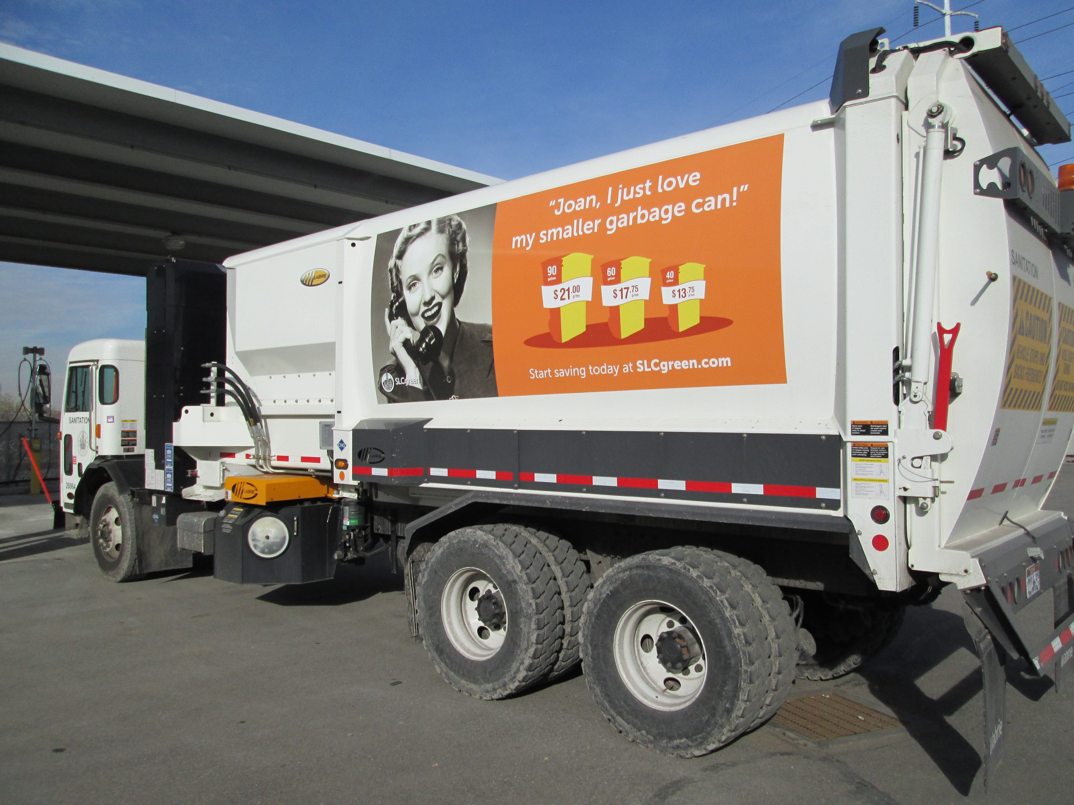

Other Considerations
Administrative control mechanisms will require management of
  Ad criteria and placement guidelines to include amount of market time or “road time”
  Rate schedules and collections
  Ad installation and removal processes

Slide 7
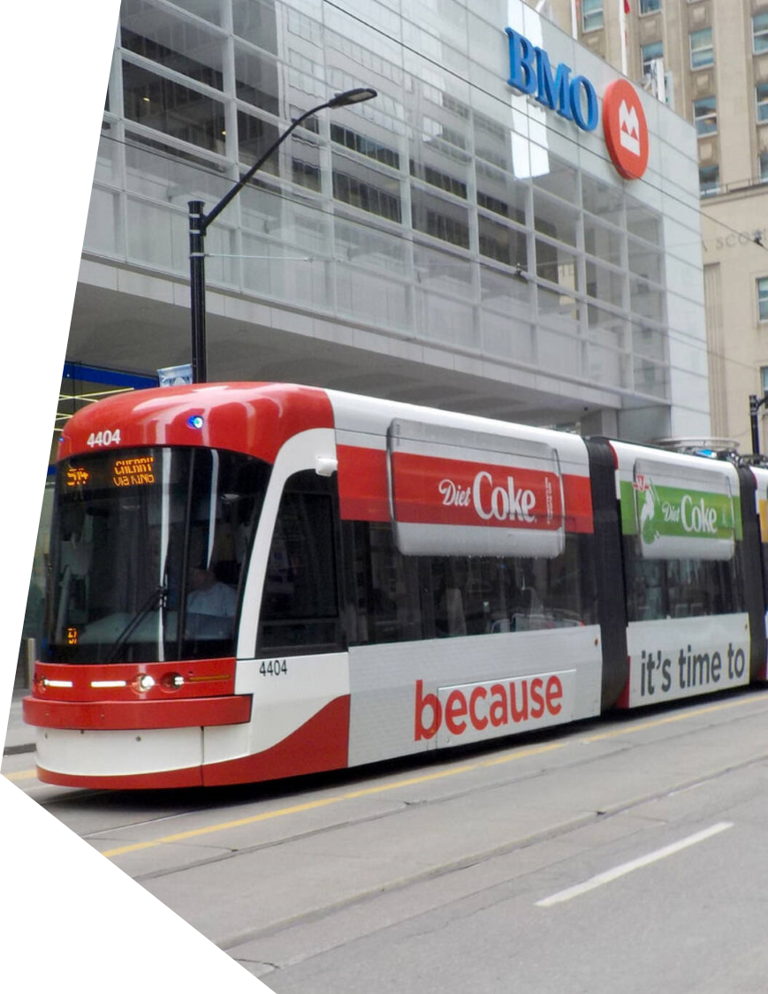
Current Status
Information from government agencies that are actively engaged in an MBROs using fleet vehicles is limited
Found are instances where large, highly controlled vehicle types such as buses and subway vehicles, are being used for revenue generation

Slide 8

Next Steps
  With approval of the Administration:
    Generate an RFI to ascertain feasibility and revenue potential for the program
    Modify Chapter 46 (Sign Ordinance) to grant the city an exemption
    Establish management processes either internally or via 3rd party,
      Establish guidance criteria
      Develop rate schedules
      Market to external entities

Slide 9
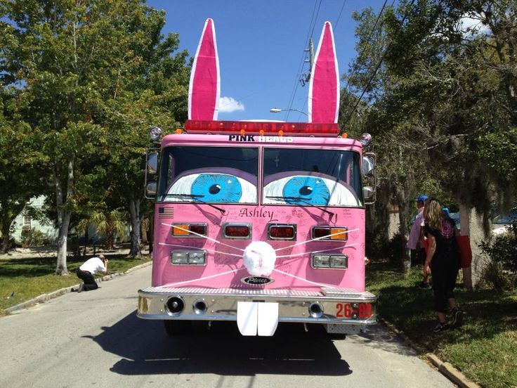
QUESTIONS?

