Slide 1

Economic Development Proposals
Economic Development Committee
July 26, 2018
Gwendolyn Tillotson – Deputy Director
Carnell Emanuel

Slide 2
Presentation Outline
Business Portal
  Background
  Development to Production Website Status
Tax Abatements Recommendations (Under Review)
  United Imaging Healthcare
Texas Enterprise Zone: Interlocal Agreement
  Huntsman International, LLC
Proposed FY19 TIRZ Budget Schedule
MWDBE Dashboard

Slide 3
Economic Development Proposals
Business Portal

Slide 4
Business Portal
History
As a result of our involvement in the Equitable Economic Development (EED) Fellowship, as well as collaboration with key stakeholders that influence or support small business development within the City of Houston, the Subcommittee on Small Business recommended the creation of a “business portal” to serve as a central location for various resources available across the City of Houston.
A proof-of-concept was developed internally by the Mayor’s Office of Economic Development, compiling resource information from various departments, including Office of Business Opportunity (OBO), Houston Public Library (HPL), and U.S. Small Business Administration (SBA). Concept was later integrated onto City’s website by the Houston Information & Technology Services (HITS) department with no external web development costs.
Estimated Rollout: August 2018

Slide 5
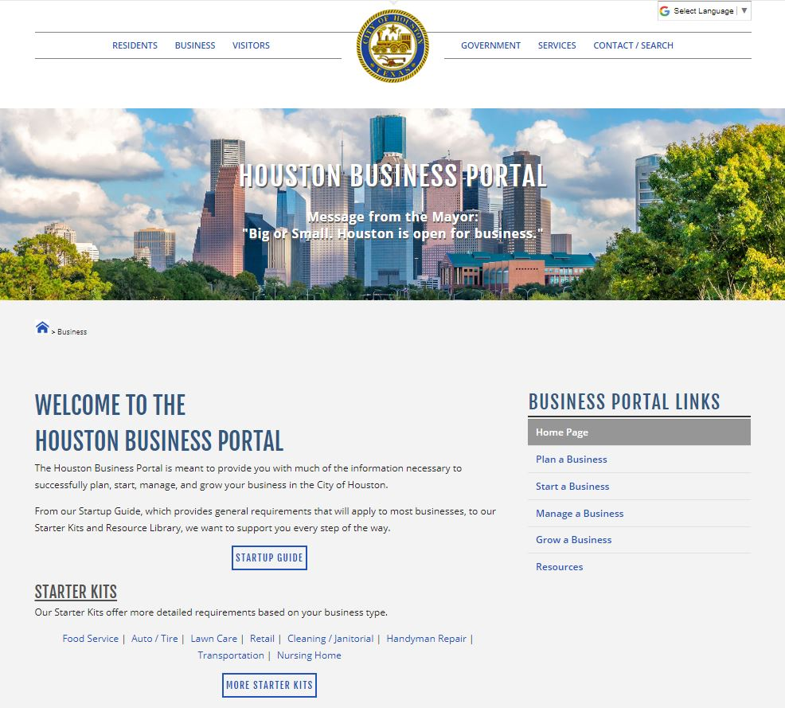
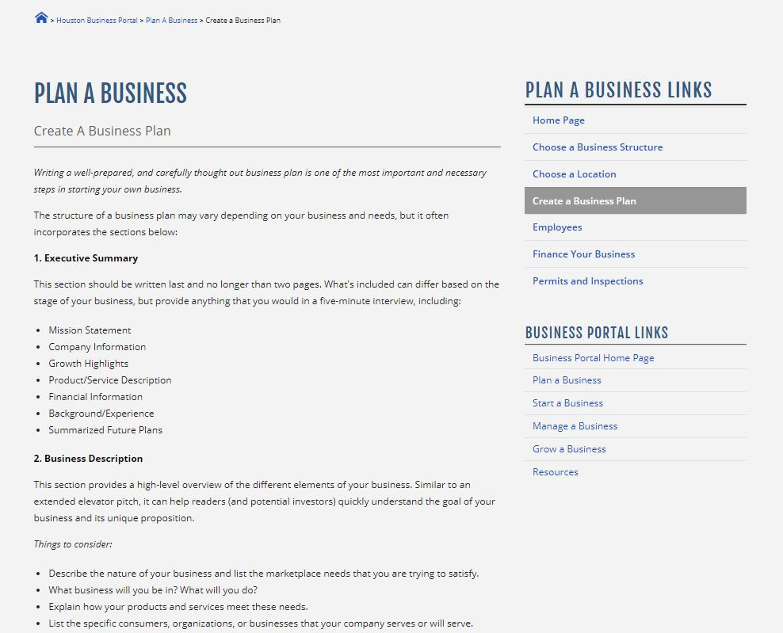
Business Portal
Sample Screenshots
“Create a Business Plan”
Home Screen

Slide 6
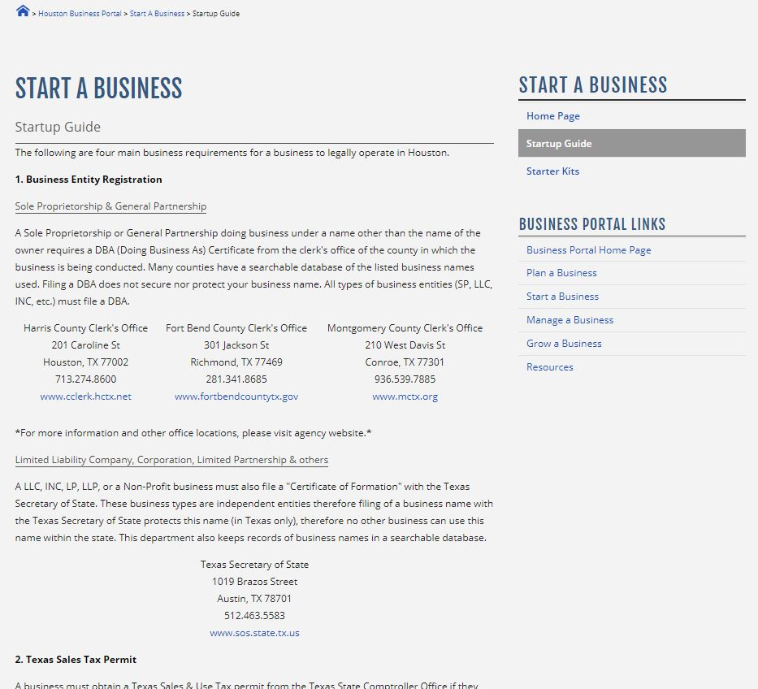
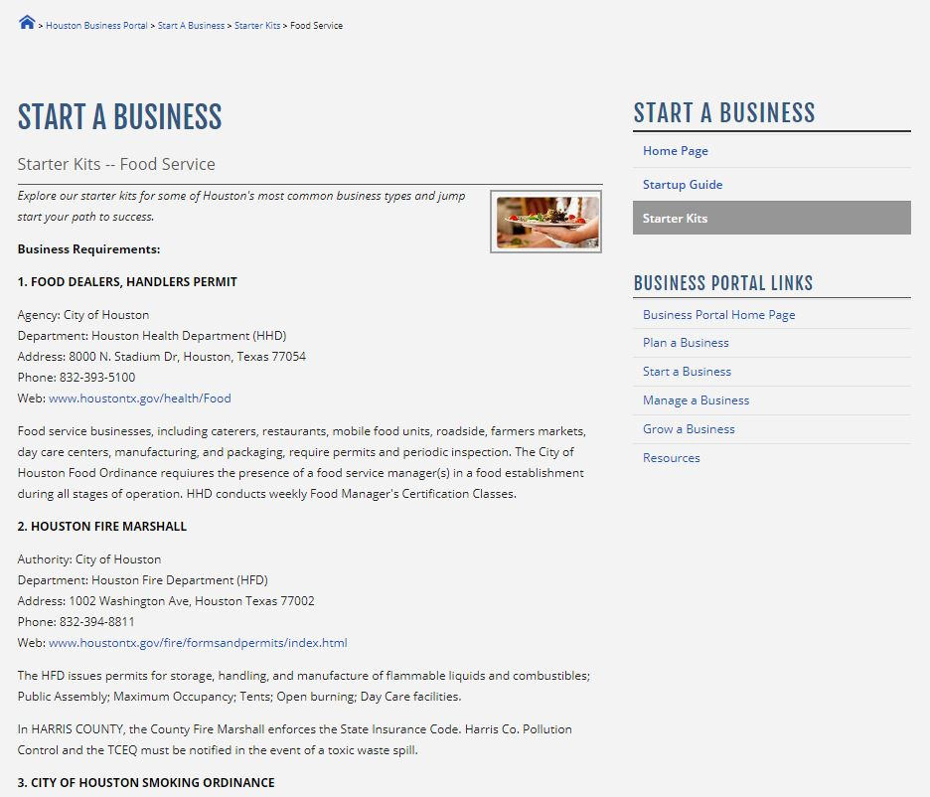
Business Portal
Sample Screenshots
Starter Kit: Food Service
Startup Guide
Other Starter Kits:
Auto | Lawn Care | Retail | Janitorial | Handyman Repair | Transportation | Nursing Home

Slide 7
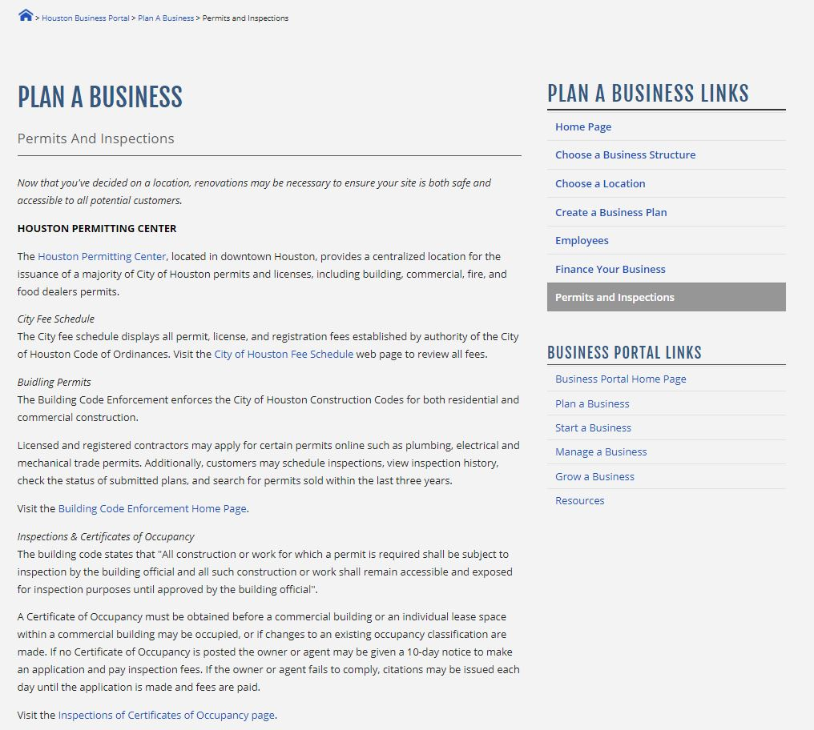
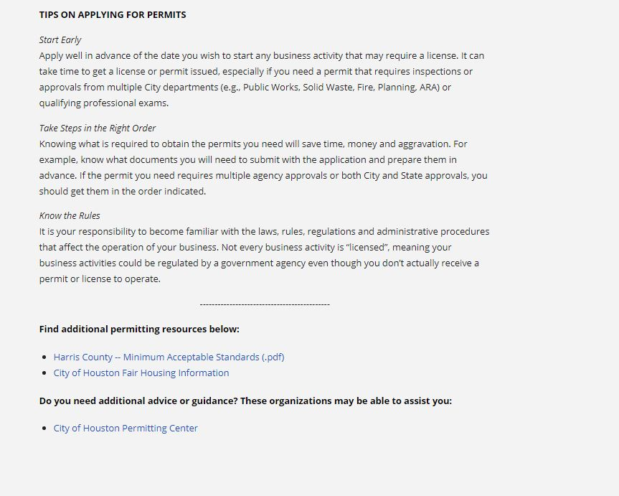
Business Portal
Sample Screenshots
“Permits and Inspections”
In-text links to other relevant resources (i.e. Houston Permitting Center)

Slide 8
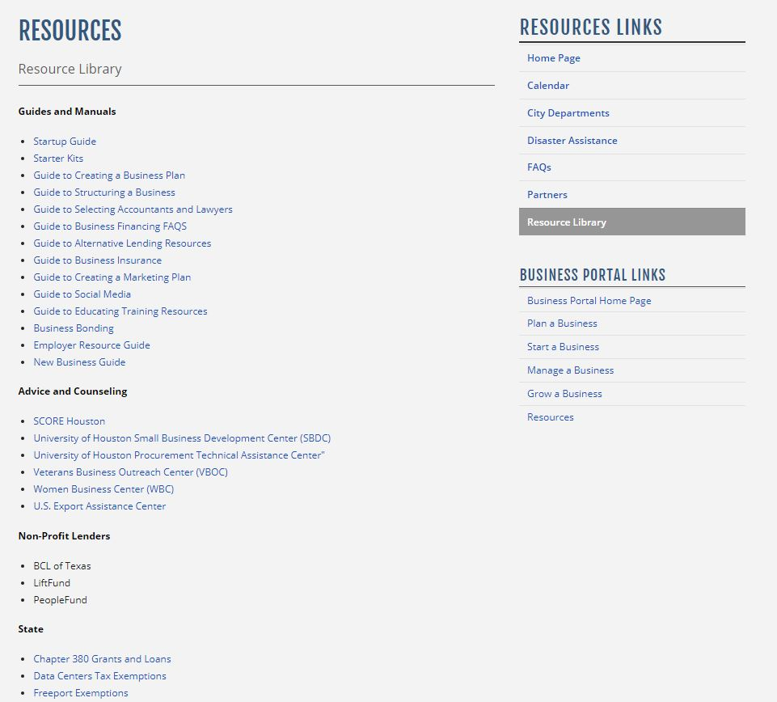
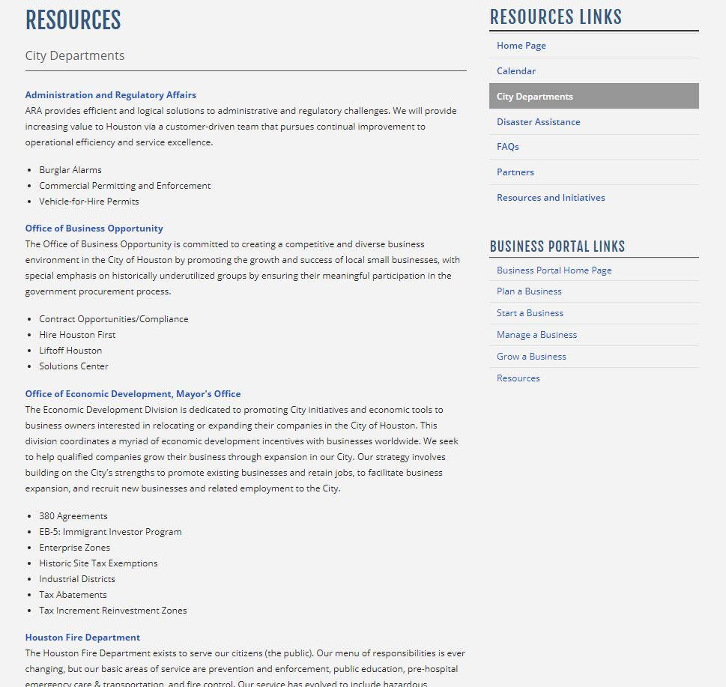
Business Portal
Sample Screenshots
Resource Library
City Departments

Slide 9
NEXT AGENDA ITEM
Questions?

Slide 10
Economic Development Proposals
Tax Abatements Recommendations
(Under Review)

Slide 11
Tax Abatements Recommendations:
United Imaging Healthcare (UIH)
United Imaging Healthcare
Will develop a manufacturing facility for advanced diagnostic imaging equipment, including magnetic resonance imaging (MRI), computer tomography (CT), digital radiography (XR) and related components. They will lease two (2) buildings in Corporate Center Kirby (9370 Kirby & 9380 Kirby Dr.). These buildings would be mainly purposed for manufacturing, office, training rooms and product show room.
Total Project Costs: $34M
$13M – Leasehold Improvements
$11M – Equipment
$10M – Operating Expenses
Job Creation:
At completion – 20
3 years after completion – 80
10 years after completion – 180

Slide 12
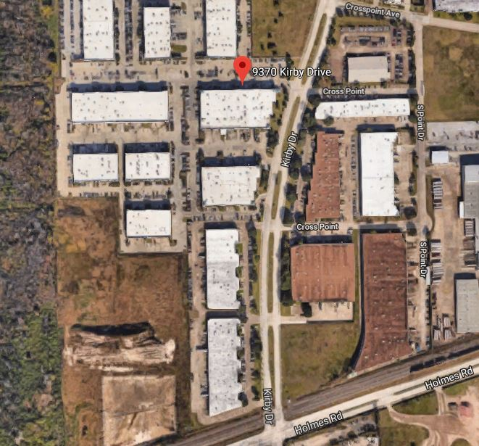
United Imaging Healthcare (UIH)
Site Map

Slide 13
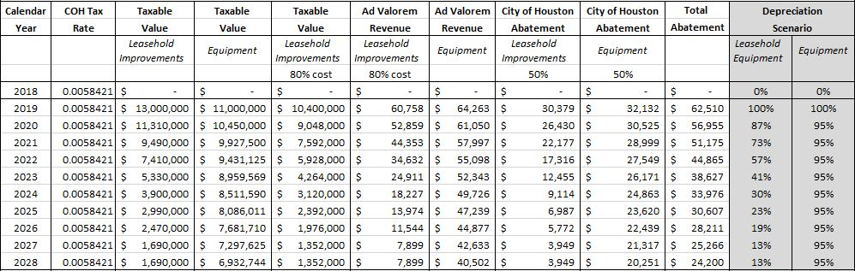
United Imaging Healthcare (UIH)
Projected Abatement Incentive
Proposed Tax Beneft
Fifty percent (50%) abatement on leasehold improvements and equipment
Average Annual Abatement: $39,639
Year One Abatement: $62,510
Ten-Year Projected Abatement: $396,392
Company Considerations (“But For” Argument)
Incentive requested to offset:
  Denied approval of $1,350,000 Texas Enterprise Fund (TEF) request
  Roughly $700K in increased cost of leasing rental property
  Help to meet a required 8% minimum rate of return
  Received $750K incentive offer from State of Ohio

Slide 14
United Imaging Healthcare (UIH)
Community Benefits
Community Benefits Commitment:
Minimum requirements under 2018 ordinance: 2018-391
Participate in city’s reentry job program
Provide OSHA 10 and OSHA 30 hour training
Exercise good faith effort for 25% local hire within low income census tract
Exercise good faith effort to hire 30% construction labor from DOL apprenticeship programs
Enhanced requirement under 2018 ordinance: 2018-391
Create a substantial number of middle-skill jobs over the next ten years
May Participate in reentry program other than the city’s
Provide internships to students from high poverty communities

Slide 15
NEXT AGENDA ITEM
Questions?

Slide 16
Economic Development Proposals
Texas Enterprise Zone: Interlocal Agreement

Slide 17
Texas Enterprise Zone
Interlocal Agreement
In accordance with Chapter 2303, Interlocal Cooperation Act, Texas Government Code (amended 2015):
“Before a county makes a nomination…the nominating county must enter into an interlocal agreement with the municipality that has jurisdiction of the territory in which the nominated project or activity will be located.”
Memorandum of Understanding (MOU) between The City of Houston and Montgomery County also requires companies seeking a nomination to:
  Participate in the Hire Houston Youth Program for internships and new job applicants where qualifications are met
  Exercise good faith effort to ensure 25% of new jobs reside within the City of Houston
Demonstrates that local municipality is in support of regional growth

Slide 18
Texas Enterprise Zone
Interlocal Agreement
  Montgomery County
  For Huntsman International, LLC:
  10003 Woodloch Forest Drive,
  The Woodlands, TX 77380
Huntsman Corporation is an American international manufacturer and marketer of chemical products for consumers and industrial customers
Huntsman anticipates investing over $20 million at The Woodlands headquarters facility. The project will consist of a renovation of the facility and office spaces.

Slide 19
Texas Enterprise Zone
Interlocal Agreement
The interlocal agreement for Montgomery County reflects:
  Nomination of Huntsman International, LLC by Montgomery County
  Project is located within the City’s ETJ
  Investment of approximately $35M
  TEZ reimbursement:
  Maximum $1,250,000 over 5 years (500 jobs retained/created)
  35% of new jobs must be filled by residents of an enterprise zone or who are economically disadvantaged

Slide 20
NEXT AGENDA ITEM
Questions?

Slide 21
Economic Development Proposals
Proposed FY19 TIRZ Budget Schedule

Slide 22
Proposed FY19 TIRZ Budget Schedule
GROUP 1 |  | GROUP 2 | GROUP 2 | GROUP 3 |  | GROUP 4
TIRZ NO. | TIRZ NAME | TIRZ NO. | TIRZ NAME | TIRZ NO. | TIRZ NAME | TIRZ NO. | TIRZ NAME
6 | Eastside | 8 | Gulfgate | 1 | St. George Place* | 2 | Midtown
9 | South Post Oak* | 13 | Old Sixth Ward | 5 | Memorial Heights# | 3 | Main St/Market Square
12 | City Park | 18 | Fifth Ward | 7 | OST/Almeda* | 15 | East Downtown
22 | Leland Woods^# | 21 | Hardy/Near Northside | 10 | Lake Houston*^# | 16 | Uptown
26 | Sunnyside | 24 | Greater Houston | 11 | Greenspoint | 17 | Memorial City^
 |  | 25 | Hiram Clark/Fort Bend Houston | 14 | Fourth Ward | 19 | Upper Kirby*
 |  |  |  | 23 | Harrisburg | 20 | Southwest
TARGET COUNCIL MEETING DATES
GROUP 1 |  | GROUP 2 | GROUP 2 | GROUP 3 |  | GROUP 4
August 22 |  | August 29 | August 22 | September 5 |  | September 12
* Debt Authorization Request
^ Annexation Request
# Life Extension Request

Slide 23
NEXT AGENDA ITEM
Questions?

Slide 24
Economic Development Proposals
MWDBE Dashboard

Slide 25
MWDBE Dashboard
History:
The MWDBE Dashboard was created in 2014 through careful collaboration with the Office of Business Opportunity (OBO) and Houston Information Technology Services (HITS). The primary goal of the application was to develop a system by which TIRZ Capital Improvement Projects (CIPs) could be monitored and reported on in order to ensure utilization of MWDBE-certified vendors.
Information Captured:
CIP Project
Contract Amount
MWDBE Goal vs Actual
Contract Start
Contractor Details (Prime & Sub)
Vendor Certification Category
Report to be provided to the Economic Development Committee: August 2018

Slide 26
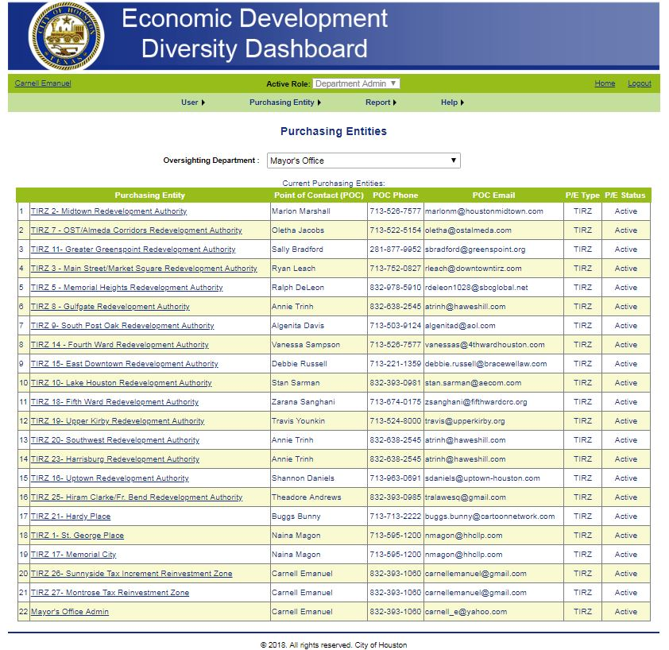
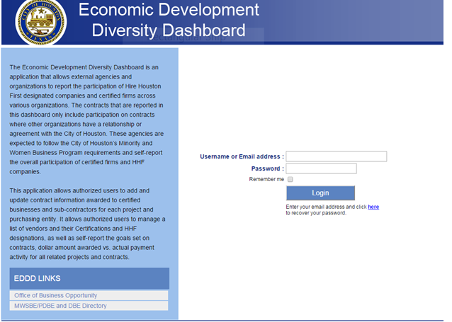
MWDBE Dashboard

Slide 27
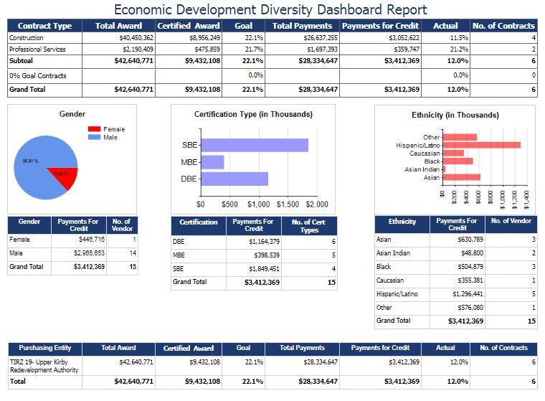
MWDBE Dashboard
Report

Slide 28
END OF PRESENTATION
Questions?

