Slide 1
STATION HOUSTON AND HX:
An Update to the Houston City Council Economic Development Committee
Thursday, October 11th, 2018

Slide 2
Introduction
Overview
Next Steps
Questions
Station Houston’s Mission
To transform Houston into a world-leading hub for technology innovation and entrepreneurship that drives business sector reimagination by connecting and cultivating the city’s startup community and its enterprise DNA.

Slide 3
Introduction
Overview
Next Steps
Questions
HX’s Mission
To accelerate the development and growth of Houston’s innovation economy.

Slide 4
Introduction
Overview
Next Steps
Questions
Station Houston represents an opportunity to address gender inequality, discrimination, technology skills training and other challenges in Houston and create pathways to opportunity that accelerate the development of an innovation ecosystem that is accessible to all.
Station Houston’s current 341 Members are:
54% Minority
27% Female
Average Age of our entrepreneurs is 41 years of age
We deliver 40+ Programming Events per month of which
75% are open to the public
Discounted Youth Memberships as well as collaborations with Pumps & Pipes, TXRX and others serve to drive youth entrepreneurship across Houston.

Slide 5
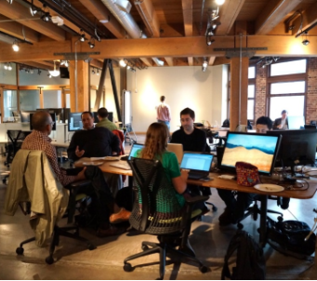
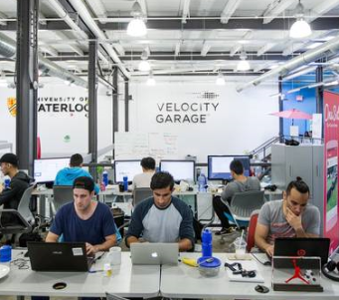
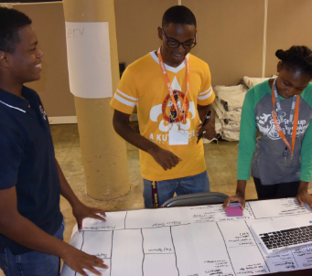
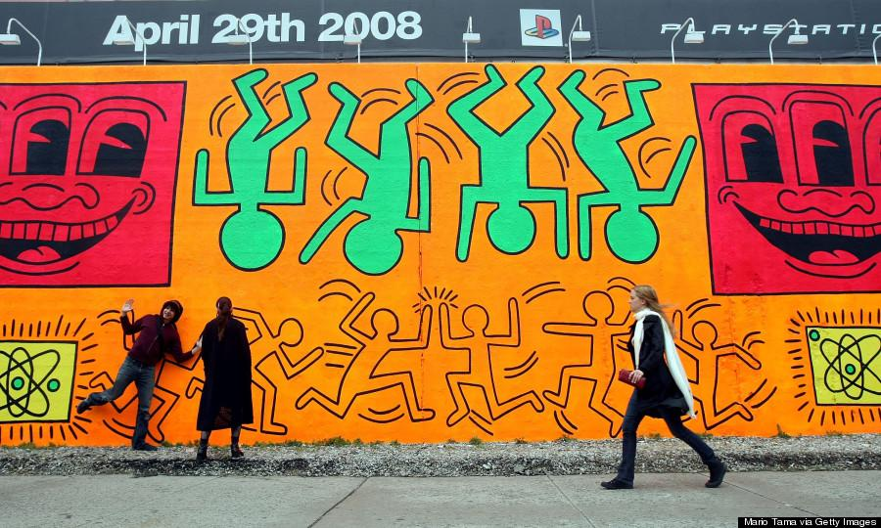
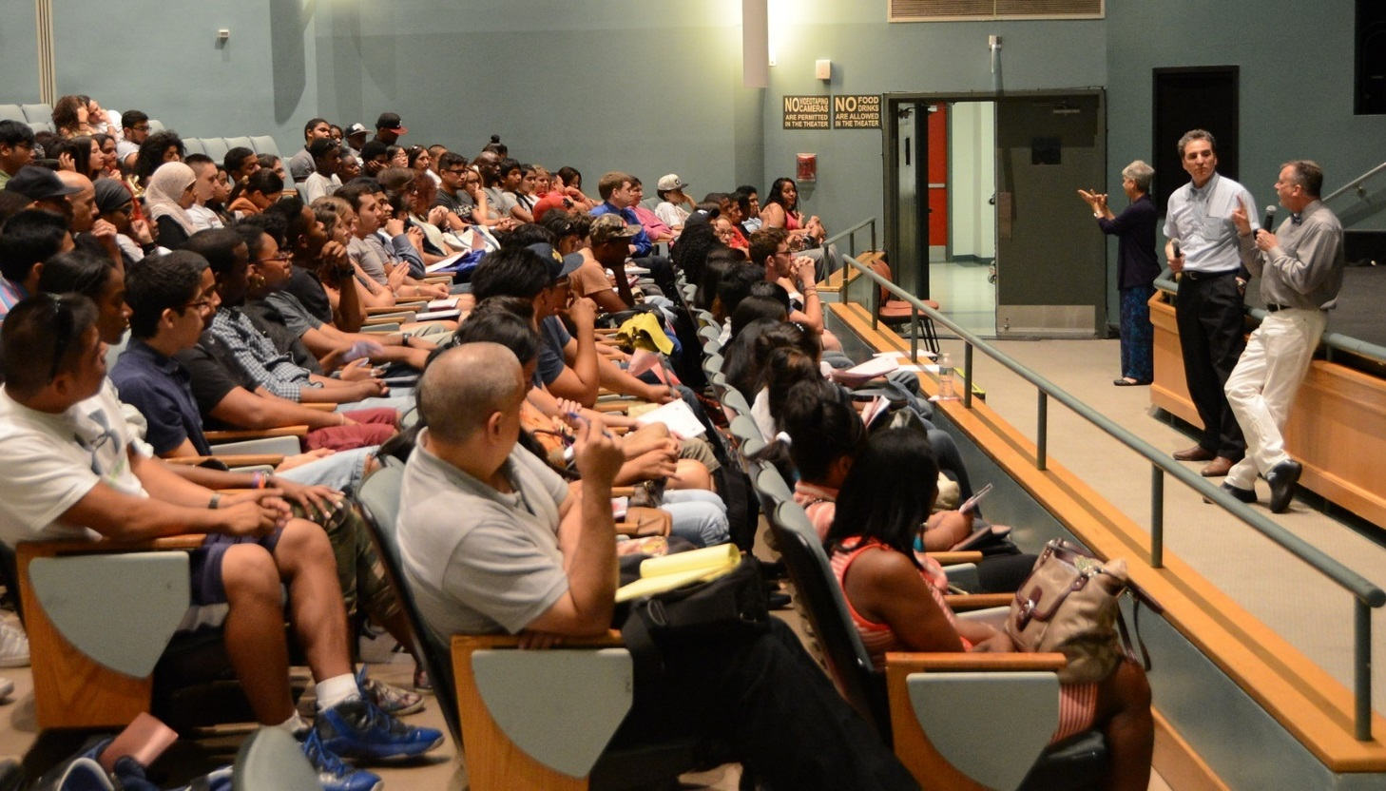
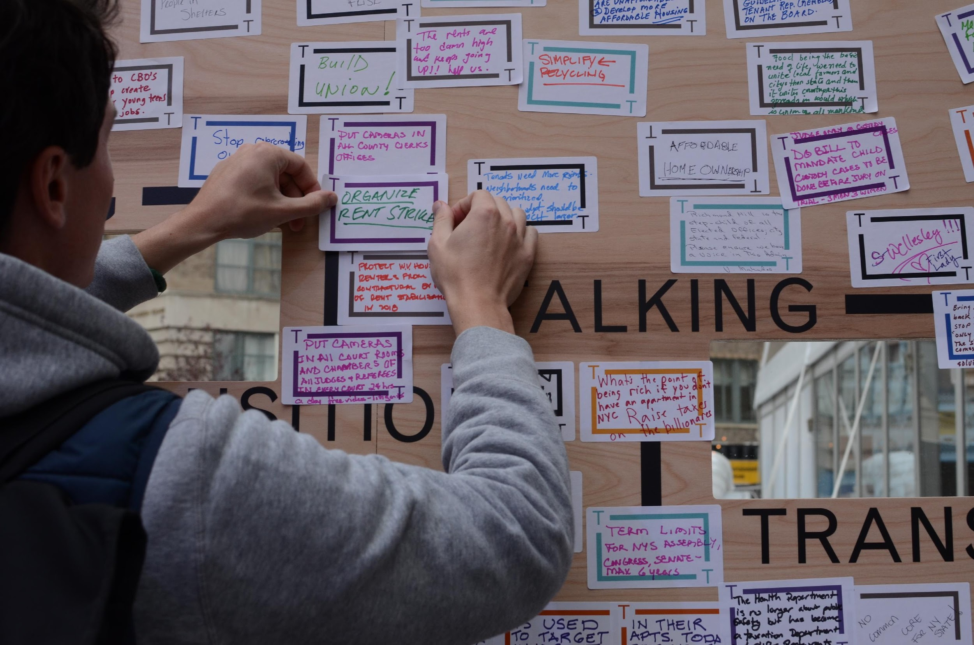

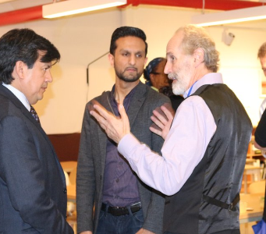
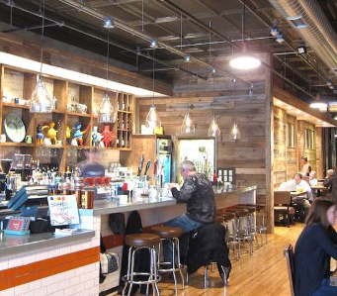
Introduction
Overview
Next Steps
sdfhadfhsdf
The role of Houston’s Innovation Ecosystem today and into the future is to
Grow, Engage & Attract
Incubators/Accelerators/
Investment
Coworking
Job Training
Arts & Creativity
Thought Leadership
Civic Activation
Commercial Tenants & VC’s
University Partnerships
F&B/Entertainment

Slide 6
Overview: Station Houston and
Houston Exponential’s Ecosystem Operations Today

Slide 7
Introduction
Overview
Next Steps
Questions
Station Houston currently delivers a range of entrepreneurship and programming services to the Houston Community
Innovation Impact
Lobbying
Incubation
Membership
Community Engagement &
Programming
Industrial
Acceleration
&
Investor’s Studio
Mentors’ Studio
Corporate Innovation
Station Houston is also the Programming and Content Partner for the Innovation Hub.

Slide 8




Introduction
Overview
Next Steps
Questions
Academia
City Government
Corporates
Top 10 US innovation ecosystem¹
Greater Houston Partnership
$2B venture funding²
Investors
Gov’t
Houston Technology Center
10,000 new tech jobs²
Entrepreneurs
Convening the “Power of 5” with over 200 volunteers serving on 14 committees to support 3 big goals

Slide 9
Introduction
Overview
Next Steps
Questions
Additionally, Station Houston and HX are collaborating with partners across the city in support of the New Innovation District to GROW Houston’s Ecosystem today and into the future…
Incubators / Accelerators
Co-Working
Job Training
For all stages of Startups
Partnerships with universities & investors, connection to government services
Access to financial, legal and operational support
Shared workspace distributed throughout Houston and the Innovation Hub
Open, flexible floor plan in the Hub which will Include workspace, breakout rooms, technical labs, makerspace etc.
Community-needs driven job training and talent transformation
Internship/apprenticeship programs and programming
Programming such as courses and events through university partnerships

Slide 10
Introduction
Overview
Next Steps
Questions
…we are working to ENGAGE…
Arts & Creativity
Thought Leadership
Civic Activation
Connect performances & workshops at the intersection of arts, science and tech
Create Public Gallery Exhibits and Arts Fairs for local art communities
Events that stimulate local engagement in innovation culture
Partnership with institutions to deliver community focused programming that supports innovation culture
Partner with civic leaders to deliver programming on inequality & access to opportunity to work towards an inclusive innovation culture

Slide 11
Introduction
Overview
Next Steps
Questions
…and we are working to ATTRACT…
Commercial Tenants & VC’s
University Partnerships
F&B/Entertainment
Startup development and investment attracts traditional, high-end office space for tech & innovation related enterprise
Complementary to innovation economy such as Venture Capital, Innovation Services, etc.
Academic presence including students, researchers, professors, and alumni
Supports R&A, workforce training, interdisciplinary collaboration, community programming
High-quality, varied food and beverage options with a focus on local talent
Areas for recreational activities that attract upscale restaurants, food trucks, outdoor bars, film screenings, etc.

Slide 12
Next Steps: Scoping and Driving Community Engagement

Slide 13
Introduction
Overview
Next Steps
Questions
The Next Steps for Station Houston and Houston Exponential must include…
Cooperation with and support for all post secondary partners to develop engagement models that enable their participation in the activation of the Innovation District
Collaboration with incubators, accelerators and innovation hubs both locally and globally to inform the development of programming and content for the Innovation Hub
Collaboration with public and private institutions to scope and foster participation in the activation of the Innovation District
Engage with angel investors and venture capitalists both locally and nationally to stimulate Houston’s startup economy

Slide 14
Questions?

