Slide 1


Disparity Study Engagement
Presented by Cylenthia Hoyrd, Director
John Whitmire, Mayor
Cylenthia Hoyrd, Director
611 Walker, 7th Floor
Houston, TX 77002
www.houstontx.gov/obo
T. 832-393-0600
F. 832-393-0646

Slide 2


Community Engagement

Slide 3
Community Engagement
Meetings were held via TEAMS and in-person with small business owners, chambers of commerce, management districts, and professional organizations.
OBO Advisory Board Policy Chair
Near North Management District
Energy Corridor Management District
Hispanic Chamber of Commerce
Tomball Chamber of Commerce
Regional Hispanic Contractors Association
American Council of Engineering Companies
Asian Chambers of Commerce
NAACP
American Institute of Architects
Greater Houston Black Chamber of Commerce

Slide 4
Community Engagement Cont.
HMSDC
Greater Houston Black Chamber
HiramStyle INC
City of Houston
National Coalition of 100 Black Women
Houston Hispanic Architects and Engineers
CELH
Mayor's AAPI Advisory Board
EDGE Engineering
JVS
United Electrical Supply
HDR Engineering, Inc.
ACEC
Parsons
Isani Consultants
Greater Houston Partnership
Goldman Sachs 10,000 Small Businesses
AAPI Mayor of Houston Advisory Board
Fort Bend Chamber of Commerce
NAMC
Hephill Group Inc.

Slide 5
Community Engagement Cont.
Tri-County Regional Black Chamber of Commerce, Inc.
Houston Contractors Association
Asian Chamber of Commerce
ERC
Sowells Consulting Engineers
RHCA
Pure Justice
GCALF
Camara de Empresarios Latinos
Rogers DeSimone Structural Engineers
WGI
The Power of Positive Action
Indo American Chamber, ASIE, TAG member
United Engineers, Inc.
ASIE
Bickham Services Unlimited
Korean American Chamber of Commerce of Houston
Houston Veteran Chamber of Commerce
Gratia Geomatics
Houston East End Chamber
J. Morales Inc.

Slide 6
Community Engagement Cont.
Mommy’s Sweet Treats and Company
Twins Construction & Home Repair Services
National Coalition of 100 Black Women - Houston Metropolitan Chapter
ElevationHR
Entech Civil Engineers, Inc.
Houston Hispanic Architects and Engineers
Digi-Clicks LLC
STOA Architects
EDGE Engineering
C&A Johnson Vending Service Inc.
UNITED ELECTRICAL SUPPLY CO
HDR Engineering, Inc.
Solid State Mechanical, LLC
LISC
Fivengineering, llc
Texan Concrete Enterprise Ready Mix Inc
National Center for Urban Solutions - TEC
ACME Equipment Distributors
Reytec

Slide 7
Community Engagement Cont.
Capital Construction
Prosperity House International LLC
Concept Engineers, Inc.
Gradient Group
Houston Chapter, American Institute of Architects
Minority Print Media, L.L.C.
Greater Houston Business Procurement
East End Business Advisors
Chamber of Latin Entrepreneur of Houston

Slide 8
Community Feedback

Slide 9

Community Feedback
The community provided insightful suggestions about the expansion and ways to improve Prime collaboration.
Data Collection
  Making better use of platforms
  Building external dashboards
  Focusing outreach to MWSBEs toward data trends
  Utilizing internal alerts for underutilization
Participation
  Increase MWBE engagement for goods
  Presentations on eBid Portal and Bidding
  Onboarding subs at Notice to Proceed
  Bidding in tiers
  Work specific outreach by scopes
Engaging Primes
  Meetup opportunities between Primes & Subs
  Hosted by partners
  Hosted in CNL Districts
  Highlighting payments during progress meetings
  Procurement Matchmaking
  Vendor roundtables
  Contractor Forum
Accountability
  Utilizing partners as advocates
  Utilizing partners for ongoing anecdotals
  Rejecting pay apps without sub payment
  Improved Prompt
Partnerships
  Train the trainer for certification clinics
  Chambers and Mgmt. Districts host speed partnering
  Notifications of low availability to increase certifications
  Utilizing more videos presentations
  OBO share quarterly MWSBE report
    Utilizing GHP
    HTV
    Partners

Slide 10
New Goals

Slide 11
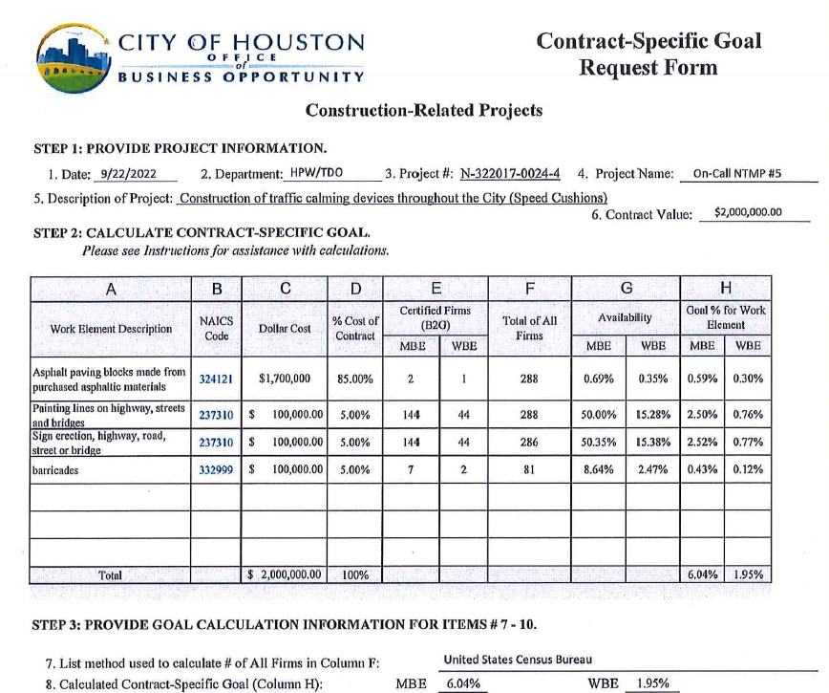
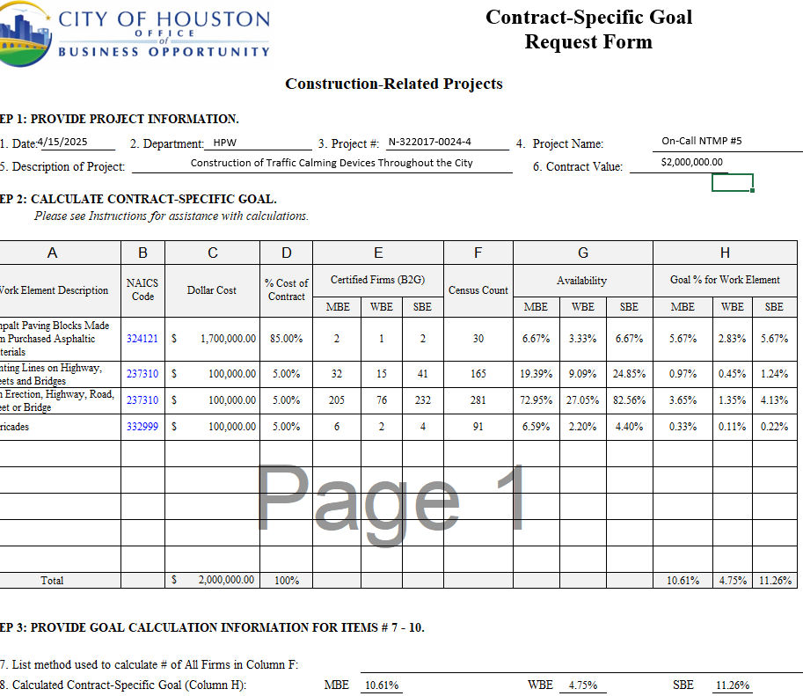
Construction Example
Construction of Speed Cushions

Slide 12
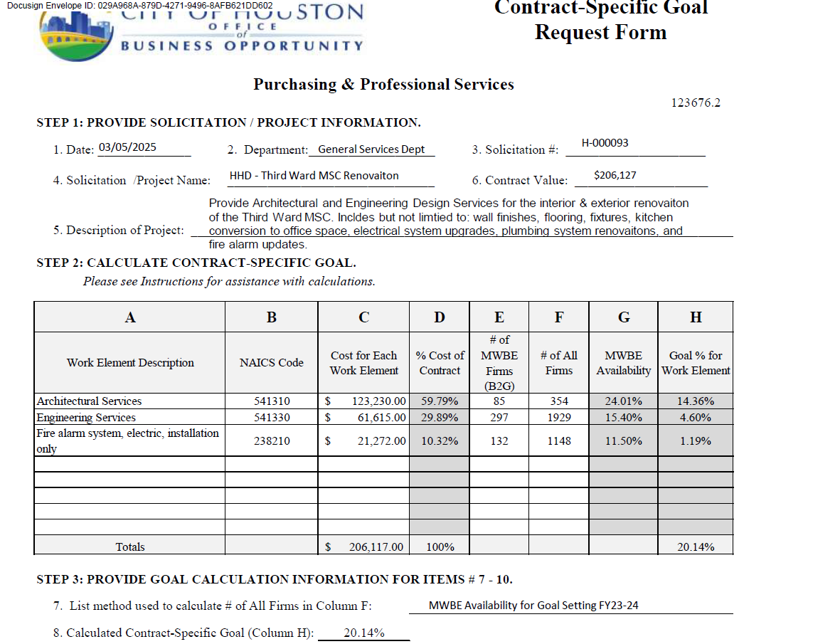
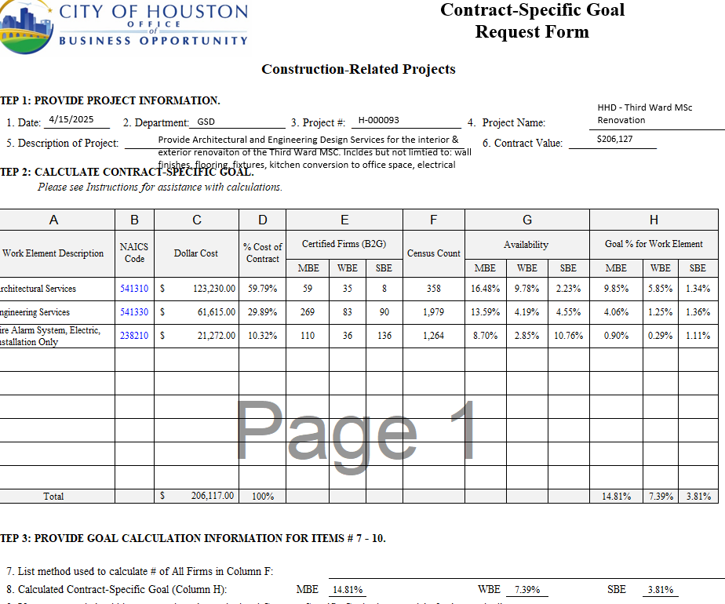
Professional Services / Engineering Example
Architecture & Design

Slide 13
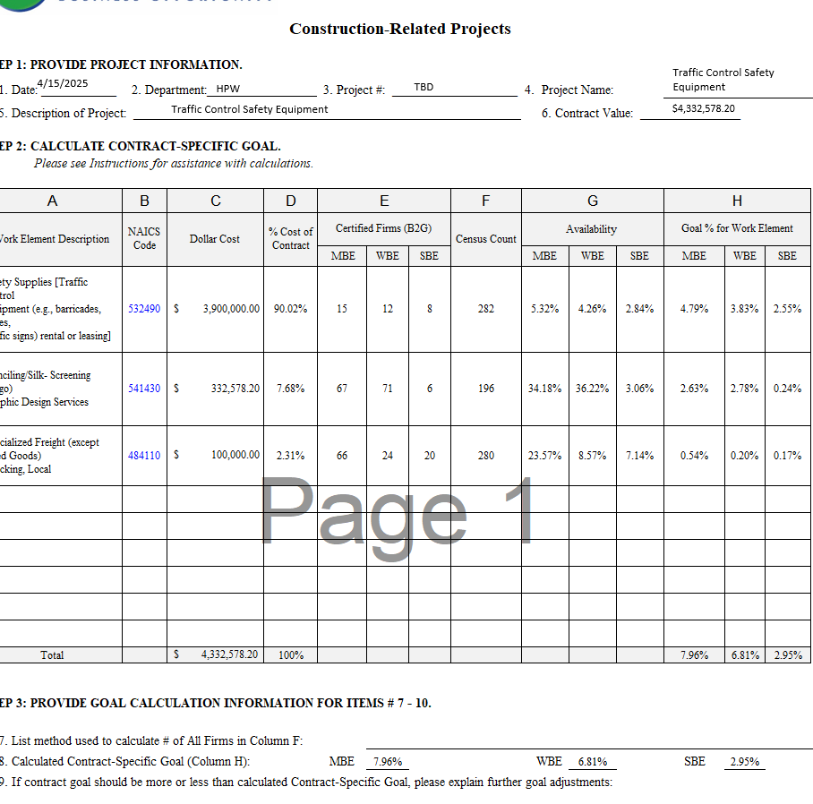
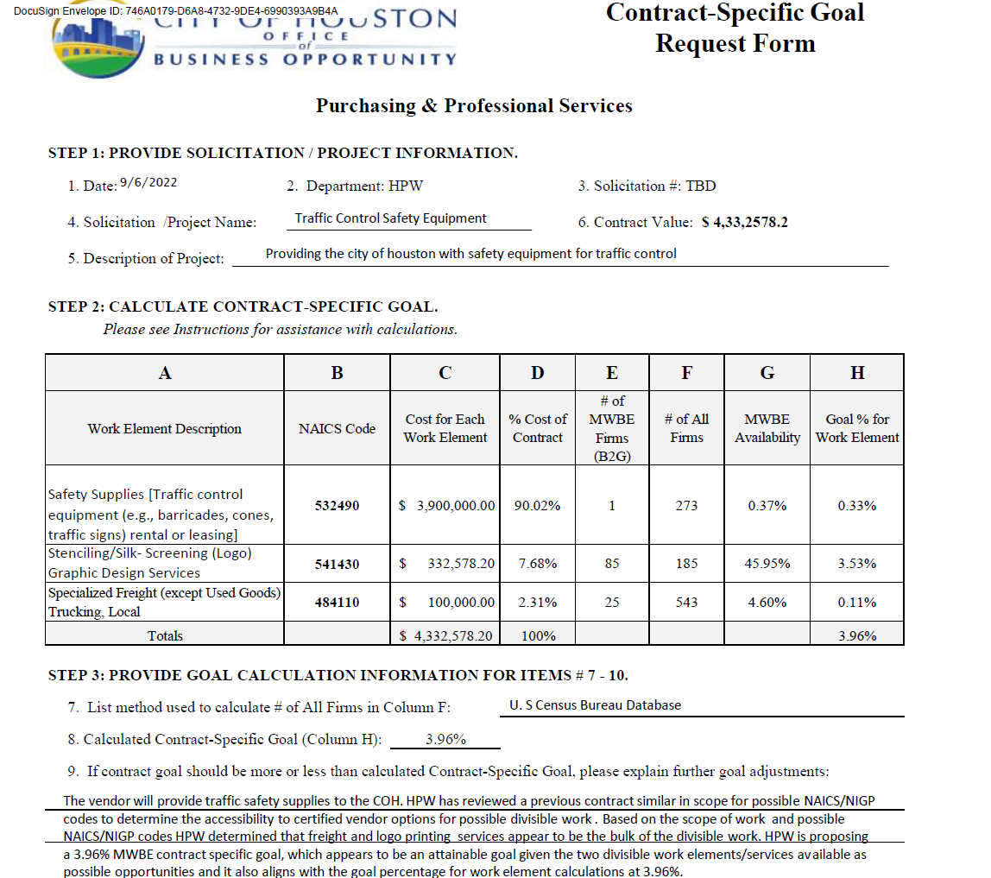
Goods Example
Traffic Control Safety Equipment

Slide 14
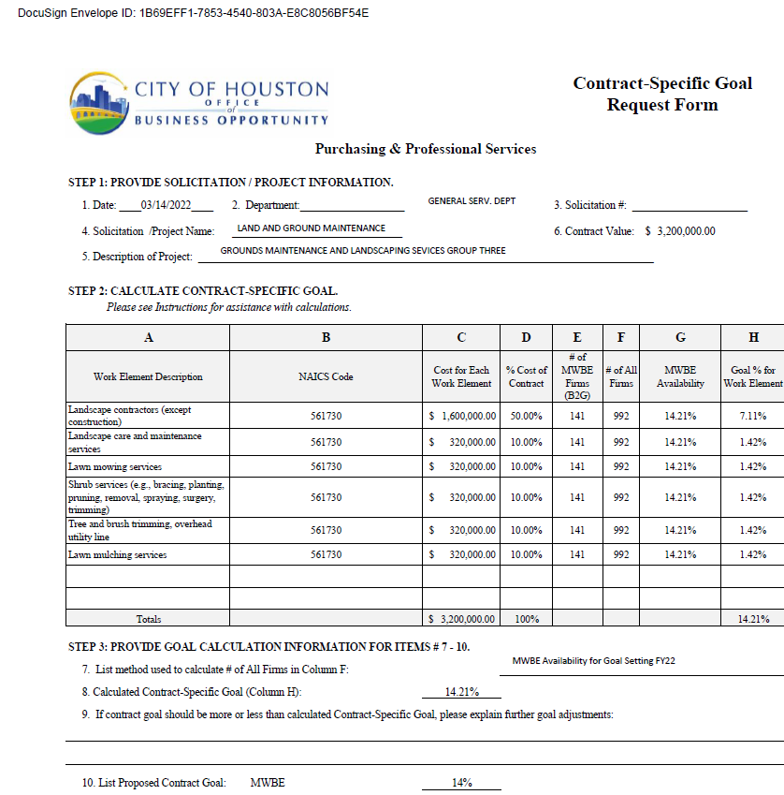
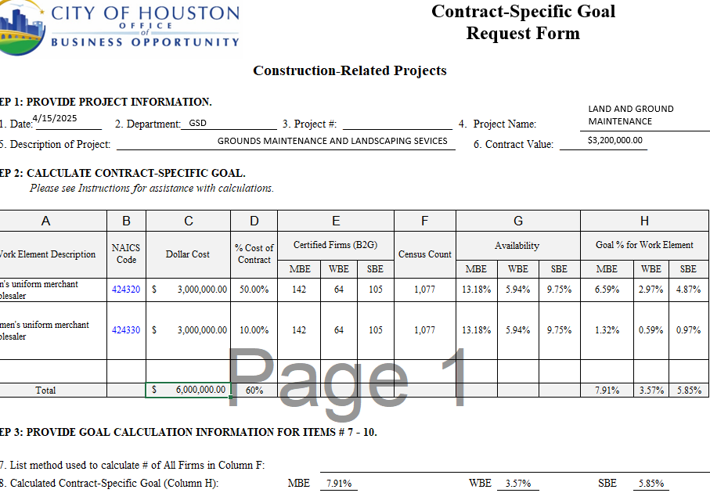
Services Example
Landscaping

