Slide 1

Texas Enterprise Zone Program
Economic Development Committee
April 16, 2025
Mayor’s Office of Economic Development
Andrew Busker
Senior Staff Analyst

Slide 2
Texas Enterprise Zone Nomination for June 2nd
Application Deadline

Slide 3
Texas Enterprise Zone
TX Tax Code Chapter 2303
Program is administered by the State of Texas and has a quarterly rolling application process. Local governments nominate eligible projects. Nominated companies apply directly to the Governor’s Office.
  A county can only nominate a project through an interlocal agreement with the municipality in which the project is located (includes city limits and ETJ).
The State provides a reimbursement of state sales/use taxes to awarded projects. Nominations do not require any funding from the municipality.
Both municipalities and counties are allotted 9 nominations each state biennium. Unused nominations are forfeited at the end of the biennium (August 31, 2025).
  June 2nd is the 8th and final nomination round in this biennium cycle
  Nominated 4 projects so far – 3 were awarded a TEZ designation
  Proposing to use 1 of our 5 remaining nominations

Slide 4
Texas Enterprise Zone
TX Tax Code Chapter 2303
PROJECT CATEGORIES | LEVEL OF CAPITAL INVESTMENT | MAXIMUM NUMBER OF JOBS ALLOCATED | MAXIMUM POTENTIAL REFUND | MAXIMUM REFUND PER JOB ALLOCATED
Half Enterprise | $40,000 - $5,000,000 or more | 250 (total new & retained) | $625,000 | $2,500
Enterprise | $5,000,000 - $149,999,999 | 500 (total new & retained) | $1,250,000 | $2,500
Double Jumbo | $150,000,000 - $249,999,999 | 500 (new jobs only) | $2,500,000 | $5,000
Triple Jumbo | $250,000,000 or more | 500 (new jobs only) | $3,750,000 | $7,500

Slide 5
TEZ Nomination for City Council Consideration
MOED Proposes
Powell Electrical Systems, Inc.
7232 Airport Blvd, Houston 77061
8550 Mosley Rd, Houston 77075
for Texas Enterprise Zone nomination

Slide 6
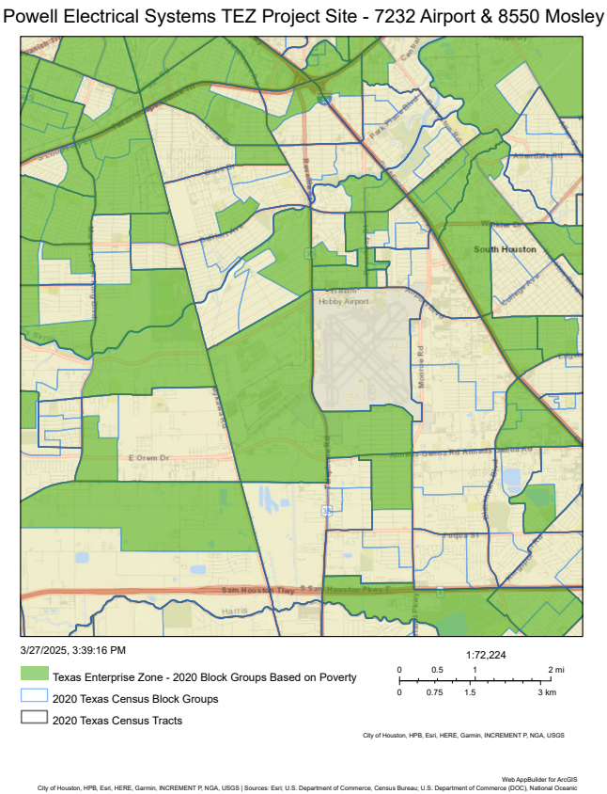
TEZ Nomination
Powell Electrical Systems, Inc.
7232 Airport Blvd, Houston 77061
8550 Mosley Rd, Houston 77075
Project Site
7232 Airport
Project Sites:
  Located in District I
  Located in and near Enterprise Zones
  (A census block group with greater than 20% poverty)
Project Investment:
  Creating 15 jobs and retaining 649 jobs
    $105,512 average salary
    TEZ program caps benefit at 500 jobs
  $8M investment
    Mosley ($6M): Wastewater system replacement and upgrades to machinery and equipment
    Airport ($2M): HVAC and IT infrastructure upgrades
Project Site
8550 Mosley

Slide 7
Proposed Council Action Timeline
Nomination Resolution on Agenda
June 2, 2025
Target Application Deadline for State of Texas
April 30, 2025

