Slide 1

Housing & Community Affairs Committee
November 15, 2016
Sylvester Turner, Mayor
Tom McCasland, Interim Director

Slide 2
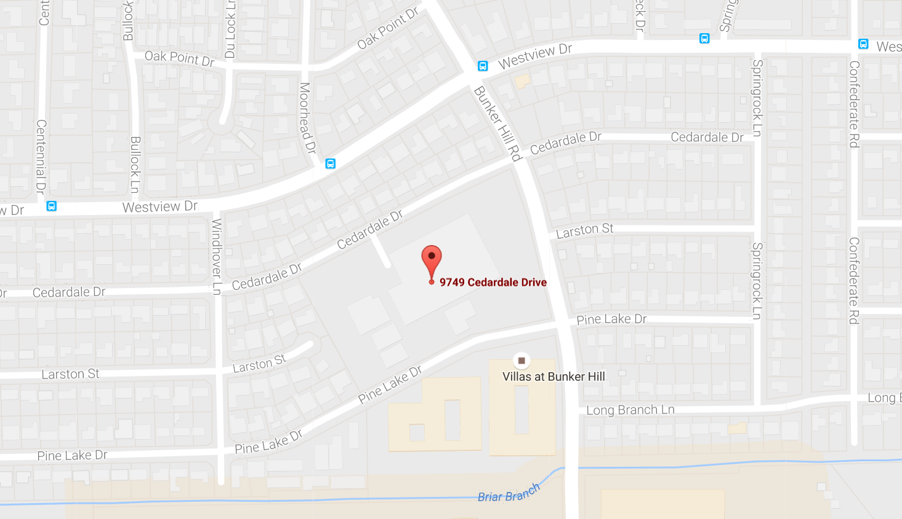
Spark Park Woodview – District A
9749 Cedardale Drive
City of Houston Investment: $150,000 – CDBG Funds
City of Houston Investment: $150,000 – CDBG Funds

Slide 3
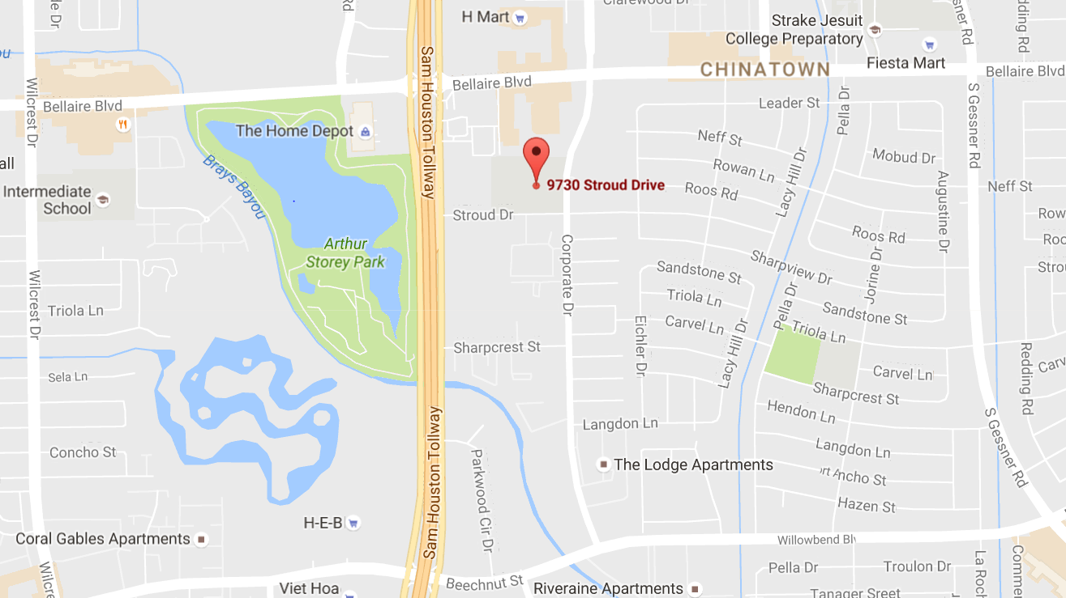
Spark Park Milne – District K
9730 Stroud
City of Houston Investment: $150,000 – CDBG Funds

Slide 4
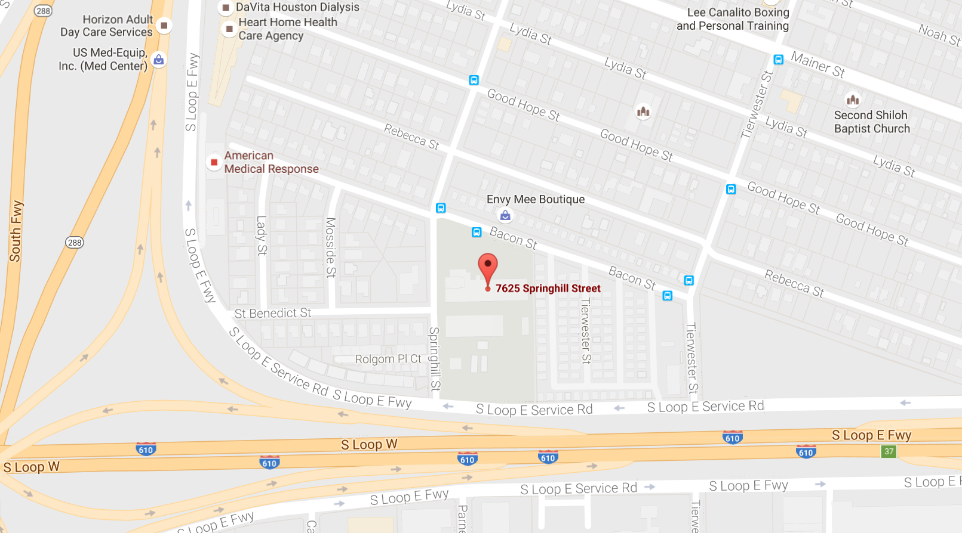
Spark Park Whidby – District D
7625 Springhill
City of Houston Investment: $150,000 – CDBG Funds

Slide 5
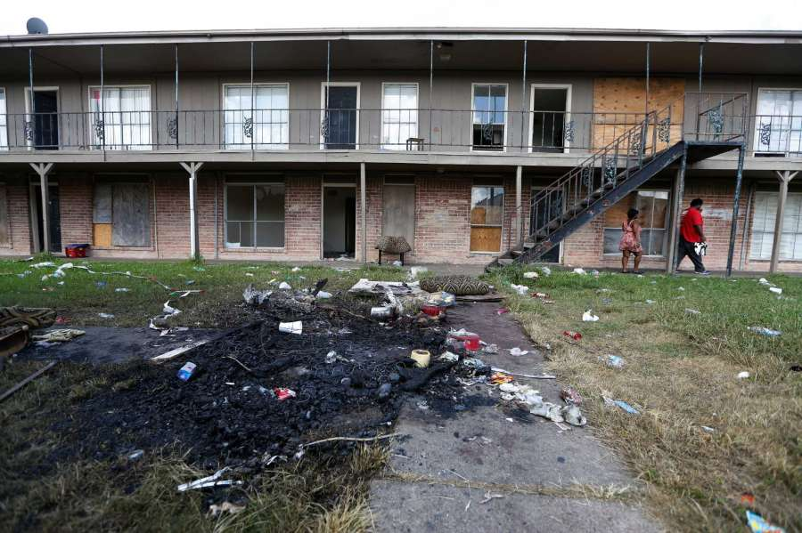
Demolition of Crestmont Apartments – District D
5638 Selinsky Road
City of Houston Investment: $348,000 – TIRZ Funds

Slide 6
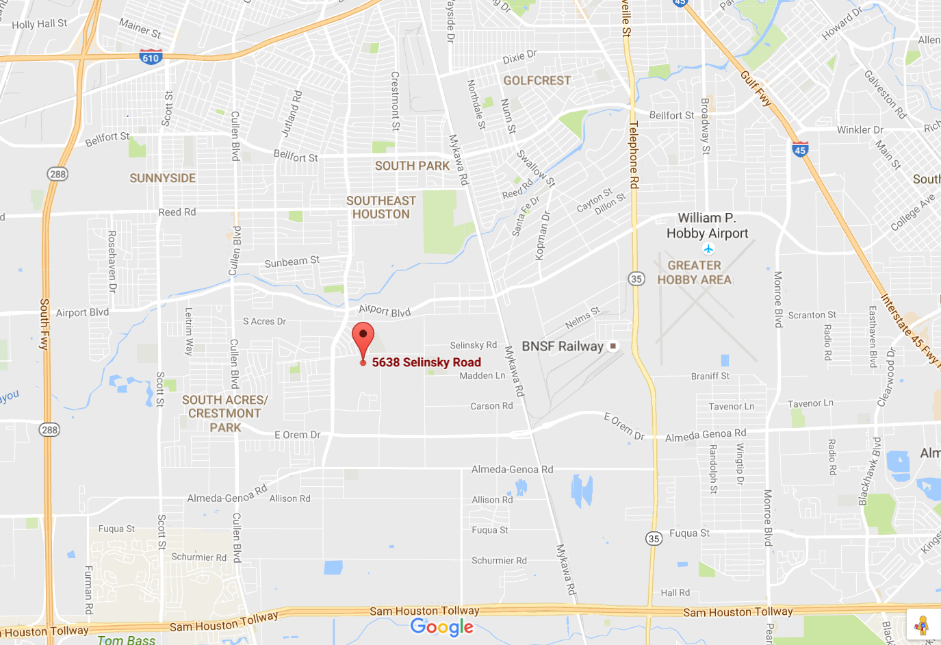
Demolition of Crestmont Apartments – District D
5638 Selinsky Road
City of Houston Investment: $348,000 – TIRZ Funds

Slide 7
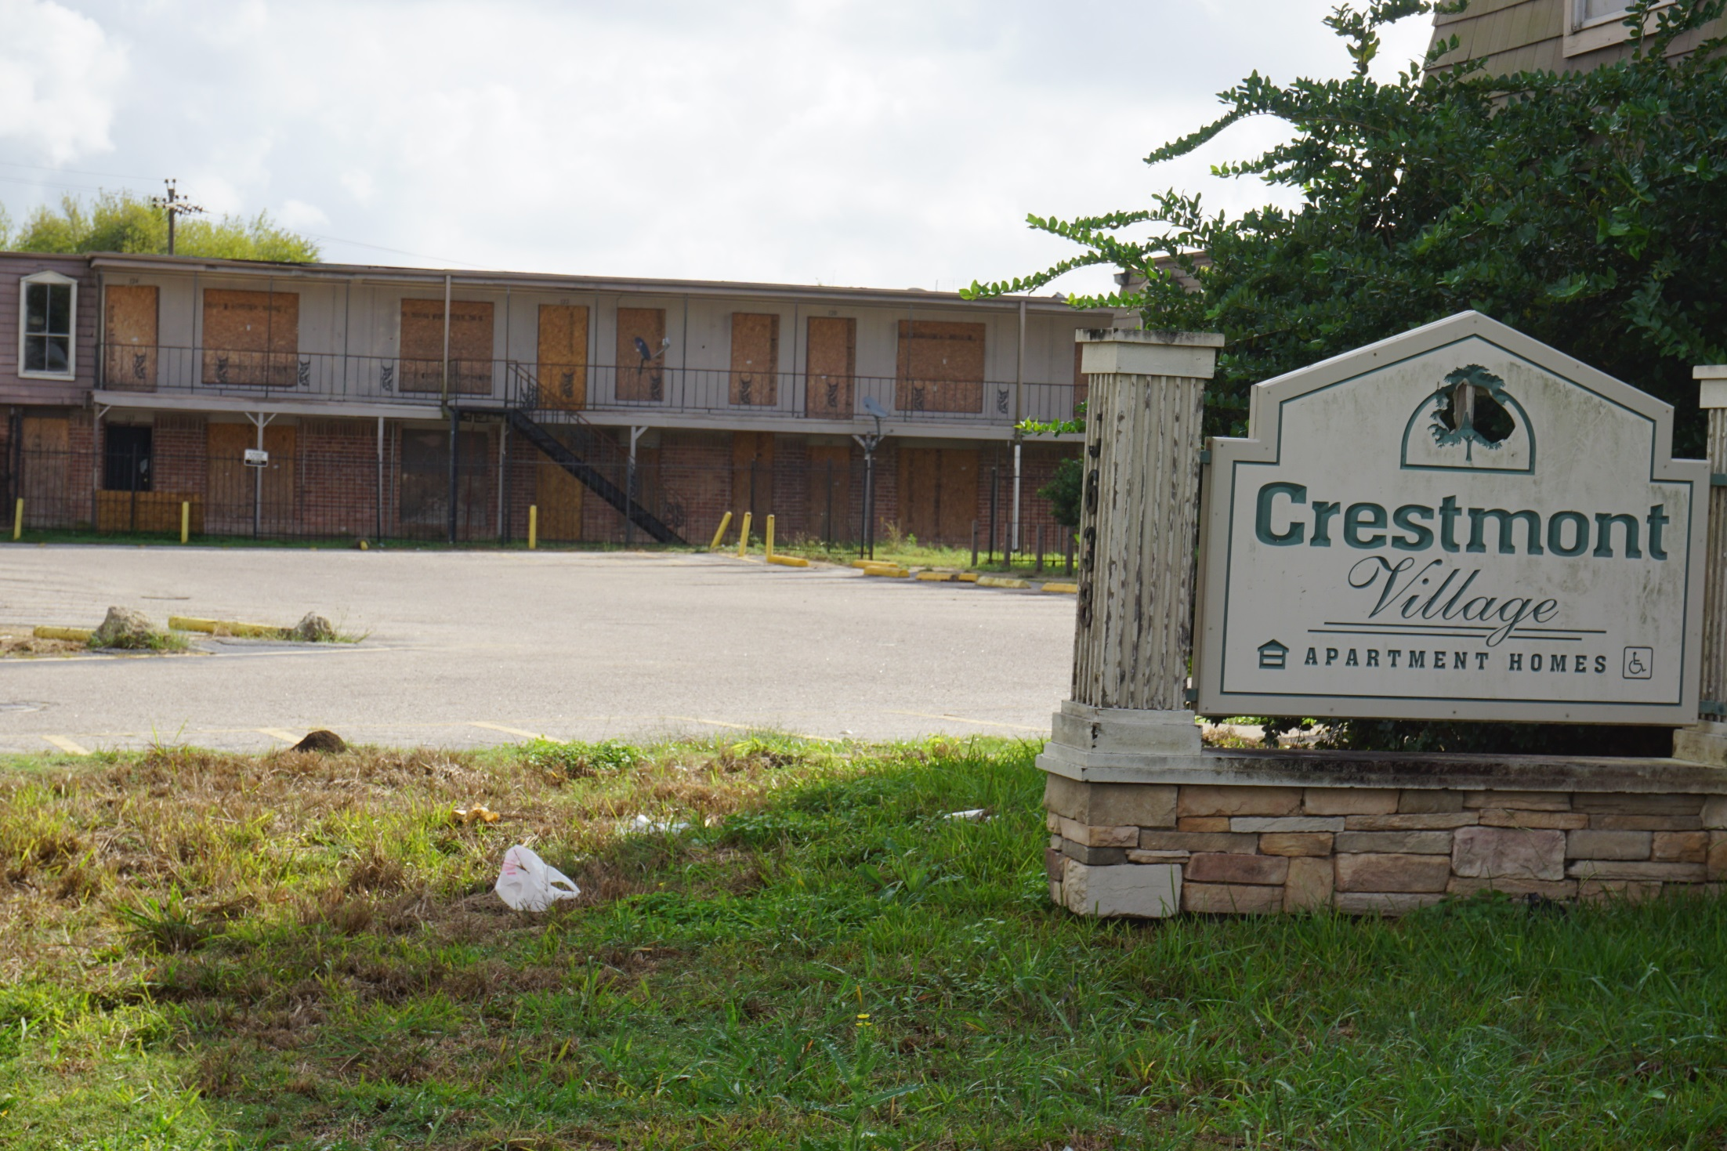

Slide 8
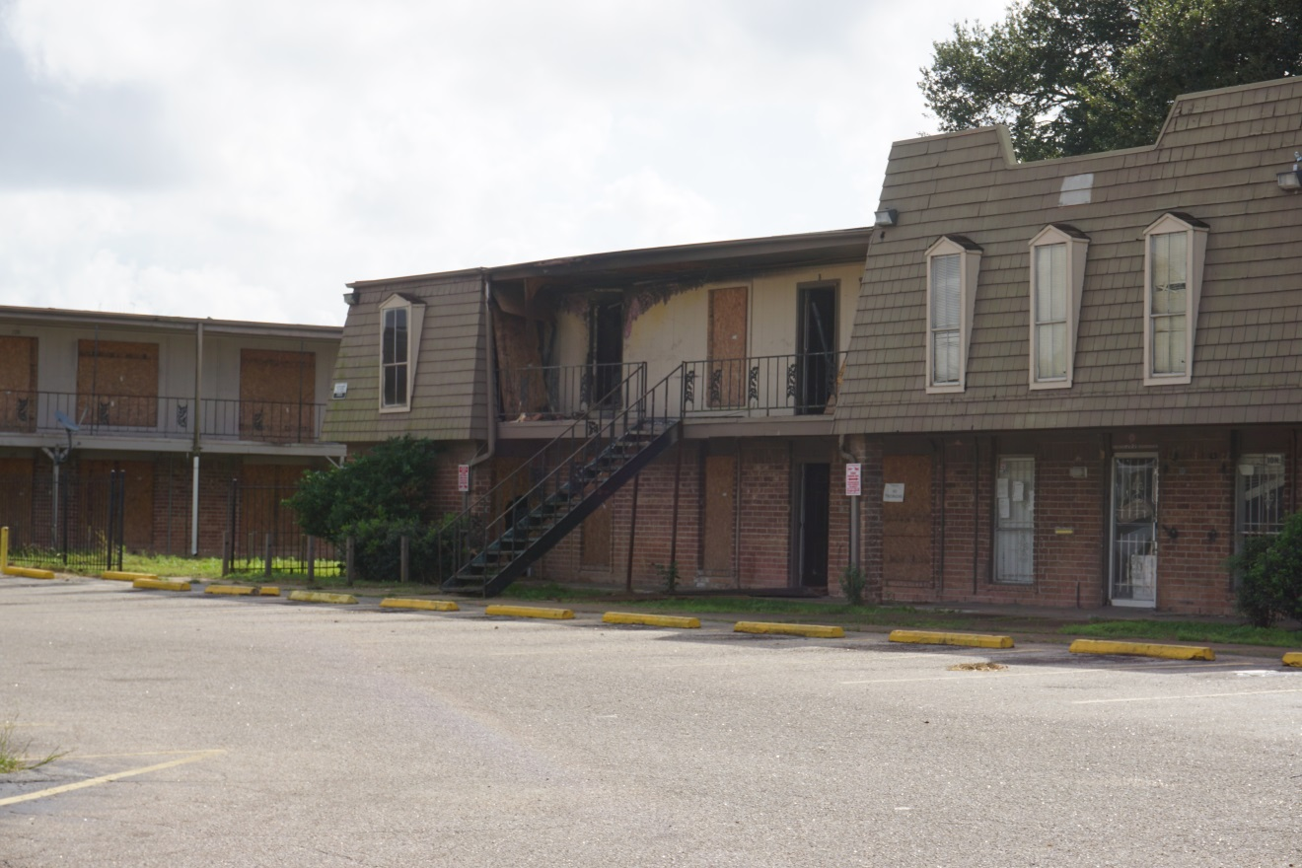
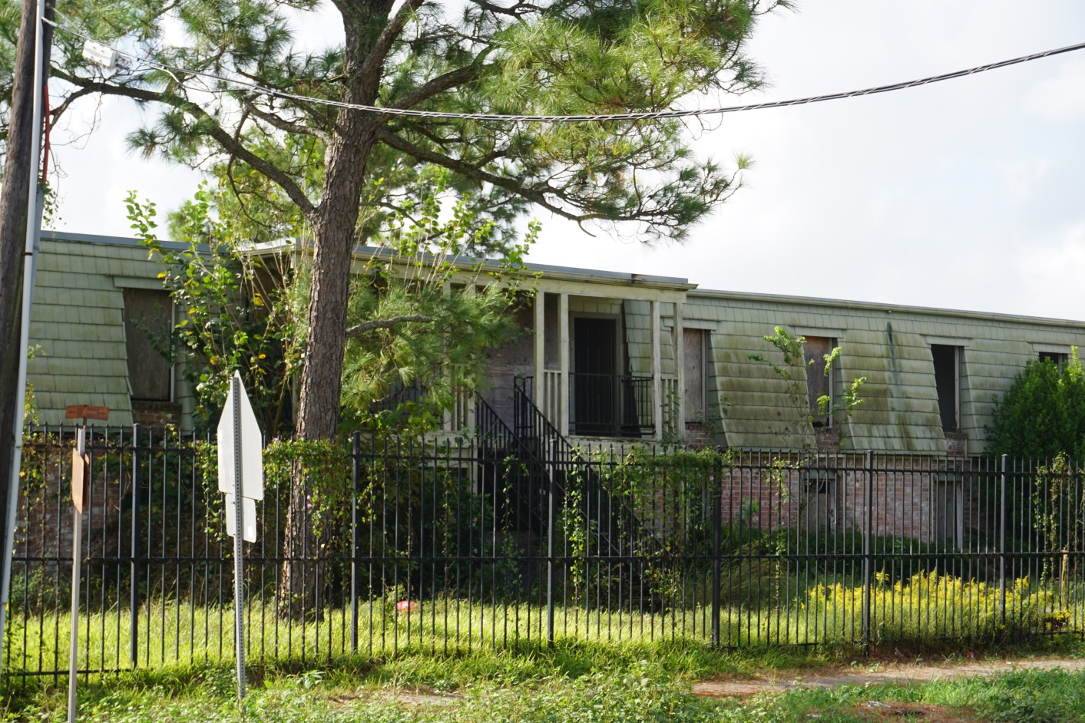
Crestmont Village

Slide 9
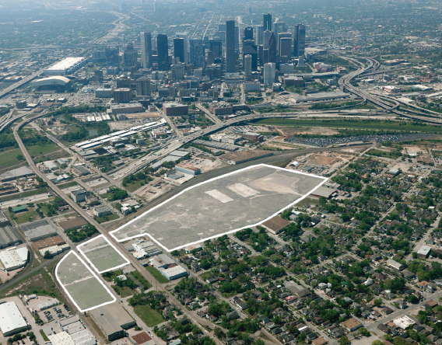
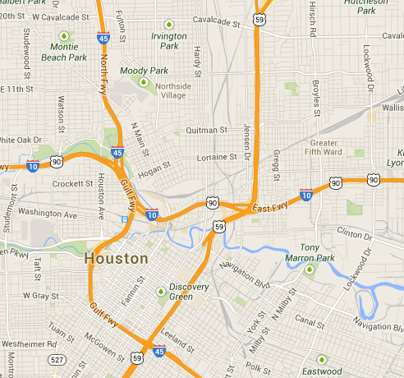
Hardy Yards – District H
North Main/Burnett

Slide 10
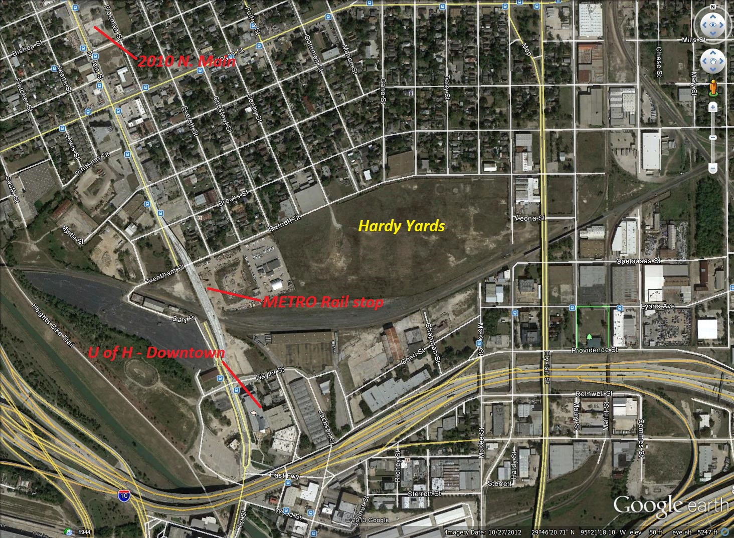
Hardy Yards – District H
North Main/Burnett
City of Houston Investment: $4.7 MM – CDBG DR Funds

Slide 11
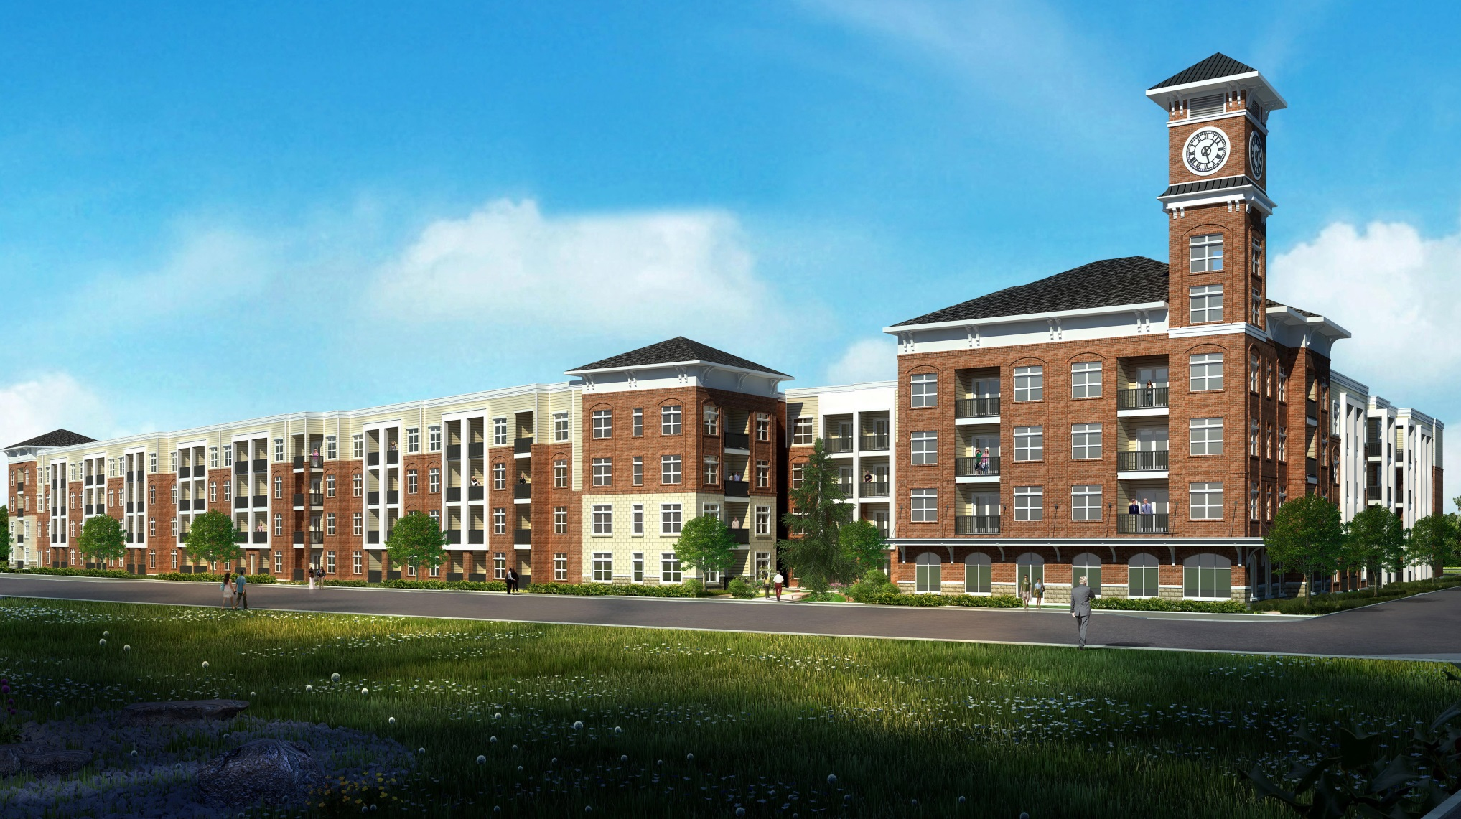
Residence at Hardy Yards – District H
North Main/Burnett
Artist Rendering

Slide 12
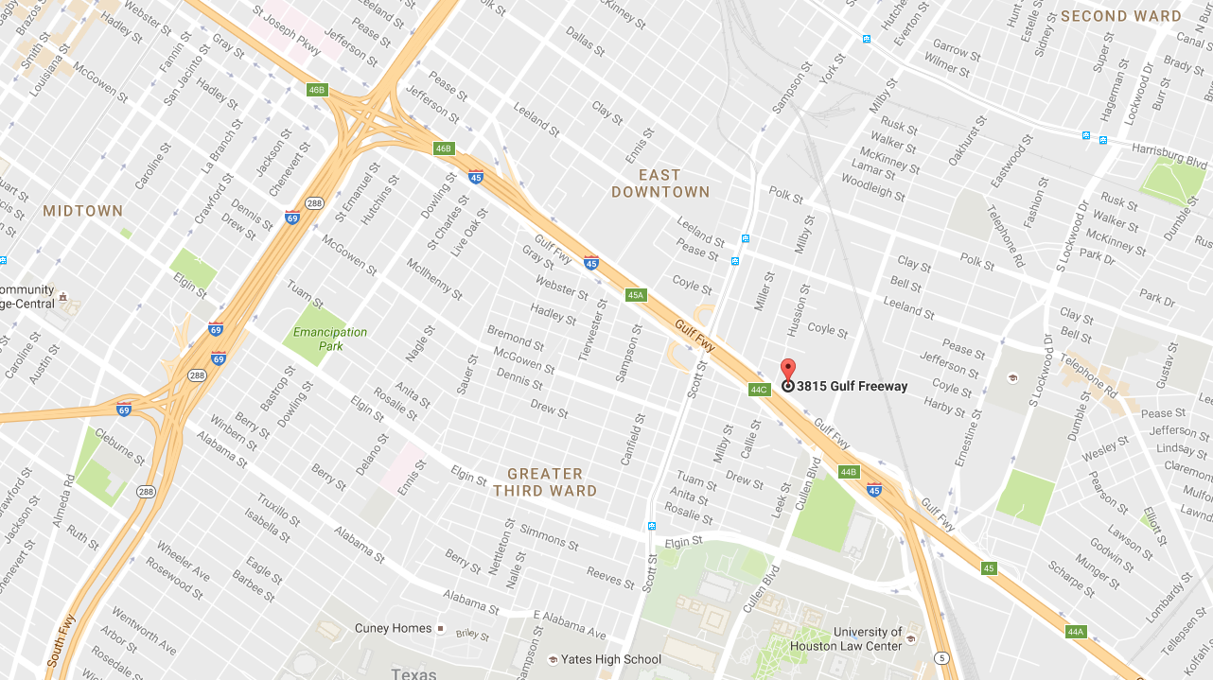
Fenix – District I
3815 Gulf Freeway
City of Houston Investment: $3.9 MM – HOME Funds

Slide 13
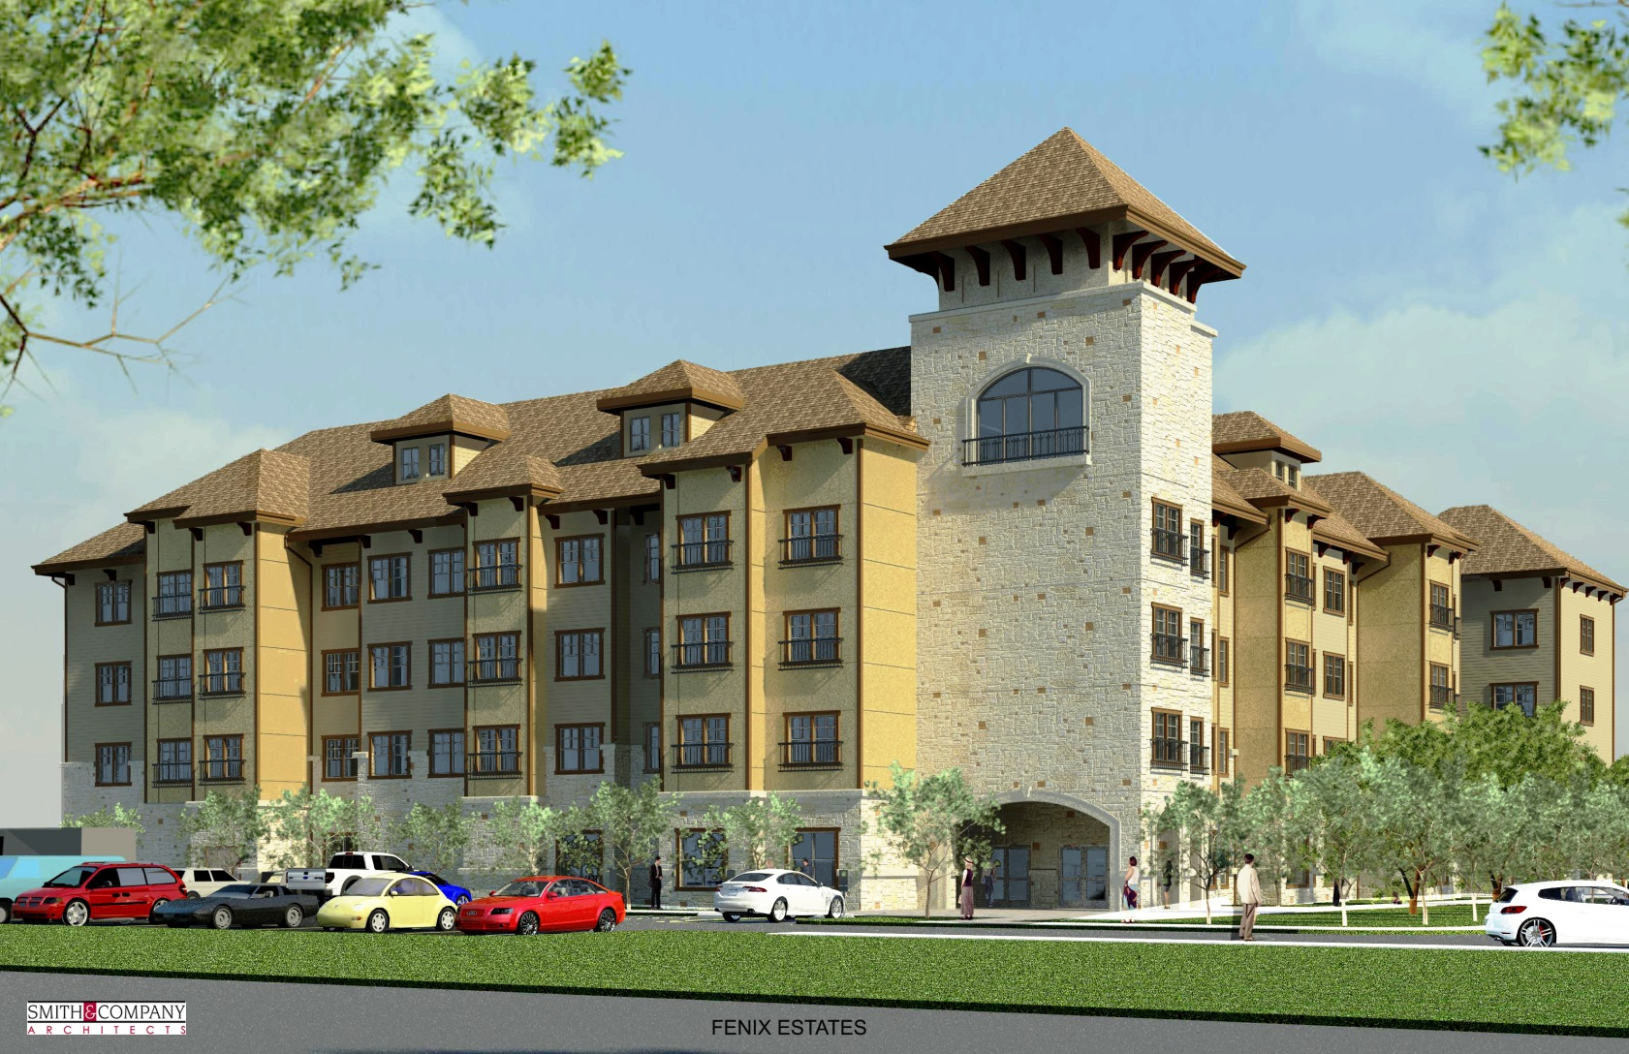
Fenix – District I
3815 Gulf Freeway
Artist Rendering

Slide 14
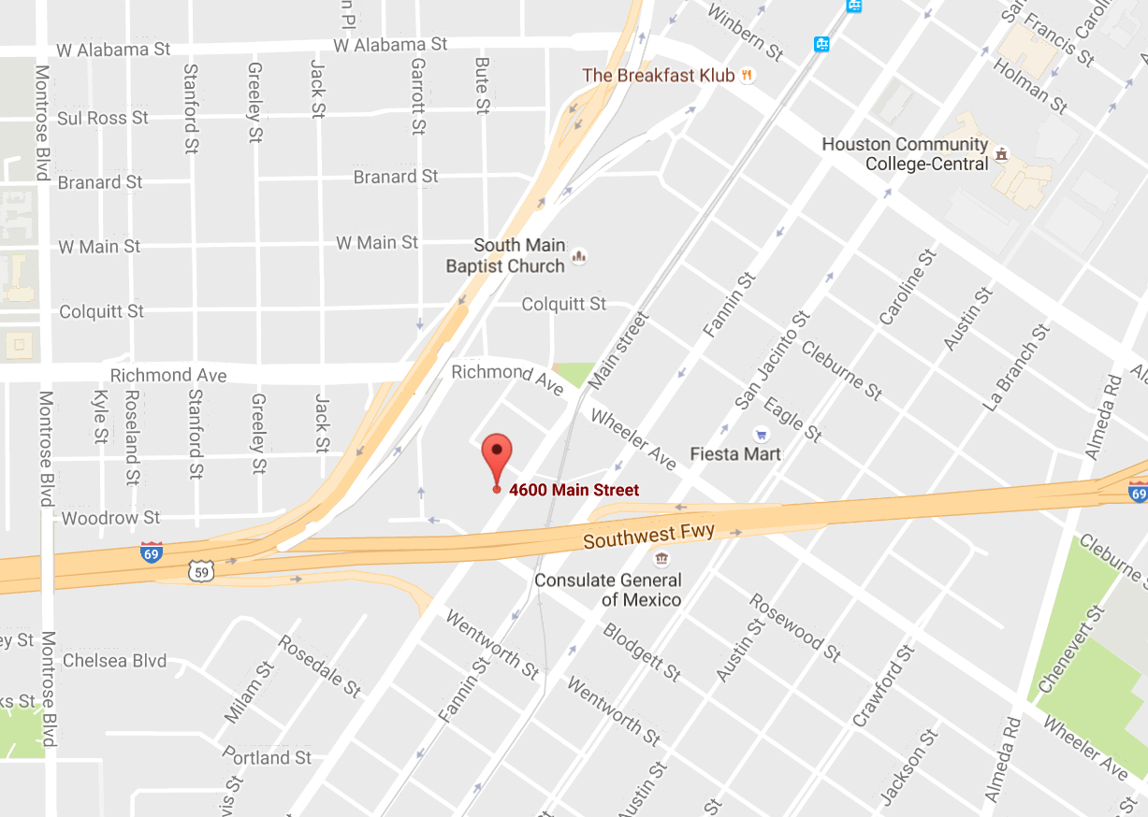
Light Rail Lofts – District C
4600 Main
City of Houston Investment: $1.5 MM – CDBG Funds

Slide 15
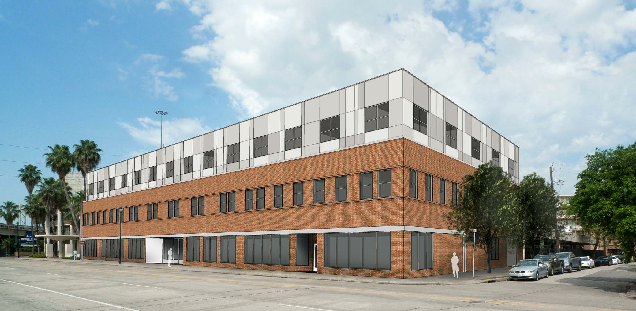
Light Rail Lofts – District C
4600 Main
Artist Rendering

Slide 16
Rapid Rehousing System
Re-Thinking Rapid Re-Housing in Houston

Slide 17
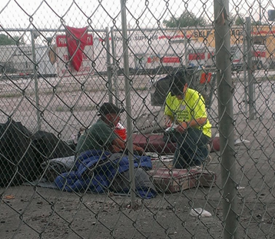
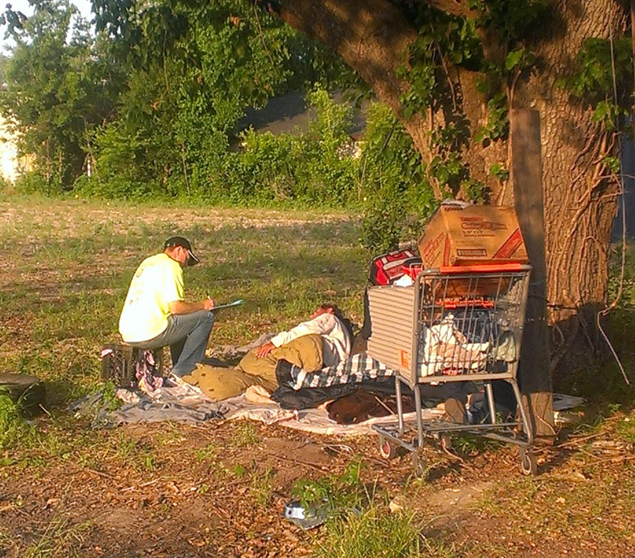
In 2010 …
One of largest homeless populations in U.S.
High rate of recidivism
Houston losing federal funds
Notes:
In 2010 Our Community was falling short.
What we discovered was that Houston had:
one of the largest homeless populations in the country.
There is a high incidence of recidivism.
We were losing federal funds as a community.
And it was very chaotic for homeless persons to access the services they needed most – housing.

Slide 18
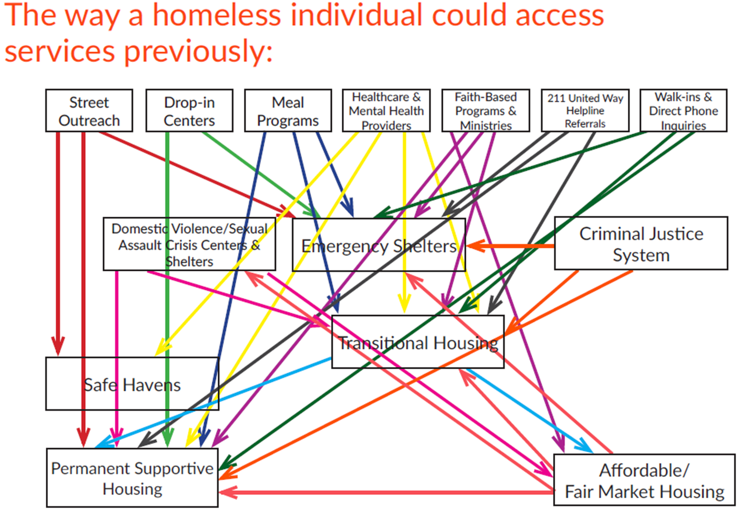
Notes:
This was the way that Homeless Persons could access services they so desperately needed. It really became a system where you had to hope you landed at the right services provider on that particular day.

Slide 19
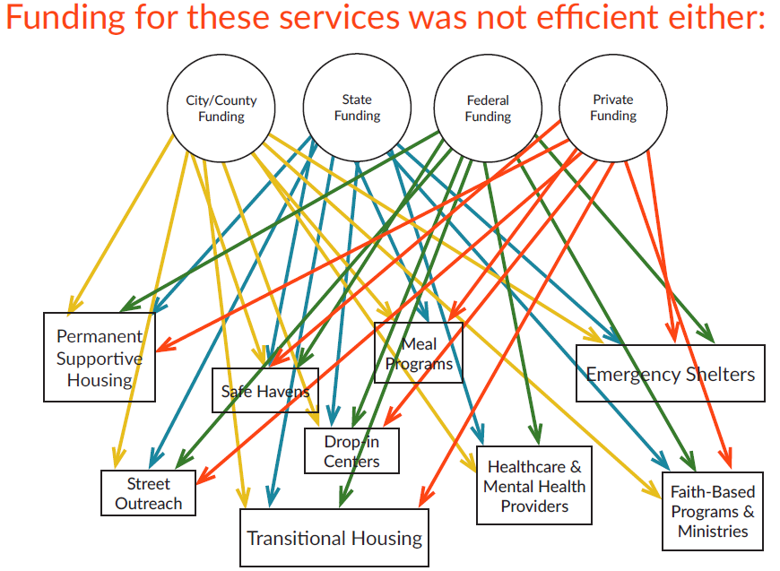
Notes:
Unfortunately the same was true for the way we were funding in Houston/Harris County. Local funders were at times funding the same programs unknowingly.

Slide 20
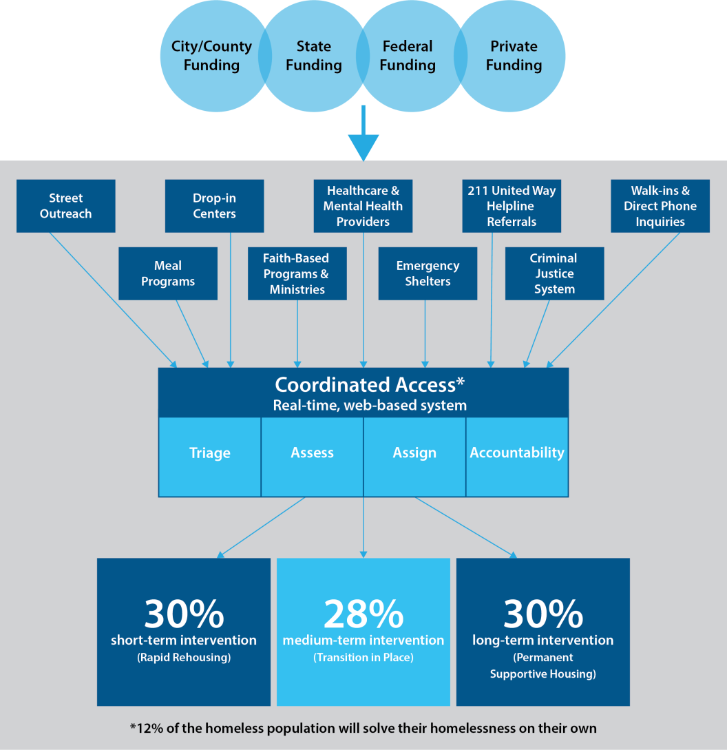

Slide 21
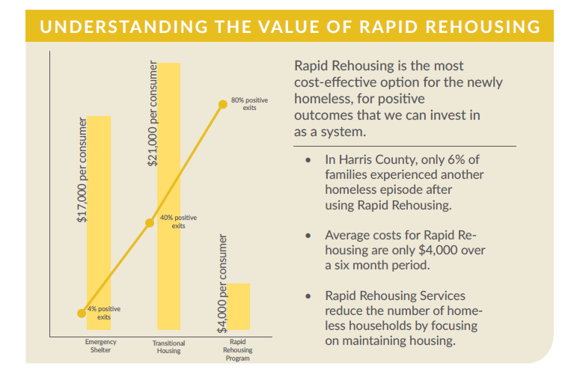
Notes:
Understanding the Cost of Rapid Rehousing.

Slide 22
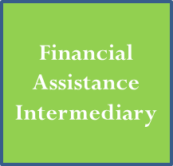
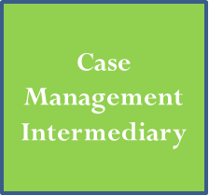
New Rapid Rehousing
Notes:
We have procured two intermediaries. The Financial Assistance Intermediary and the Case Management Intermediary.
The Financial Assistance Intermediary’s primary responsibilities are to manage, report, and oversee available funding dedicated to Rapid Rehousing.
The locals funders – City of Houston, Harris and Ft Bend County, the Continuum of Care have aligned their Rapid Rehousing dollars to create a Rapid Rehousing Collaborative financial assistance fund.
The Financial Assistance Intermediary will deliver the following program services: (1) manage Rapid Rehousing Collaborative financial assistance funds, and (2) administration of direct rental and utility assistance to Rapid Rehousing clients, additionally they will perform Rent Reasonableness and Housing Quality Standards inspection prior to releasing funds. In very simple terms they are the people that will be cutting the check to landlords and to utility companies.
The Case Management Intermediary’s primary responsibilities includes the management and financial oversight of multiple vendor agencies for case management and navigation services for homeless individuals and families.
The Case Management Intermediary responsibilities will include: (1) conducting a Request for Proposals (RFP) process to select providers of Case Management and Housing Navigation services to Rapid Rehousing clients, (2) negotiating contracts with providers, (3) processing reimbursement requests, (4) monitoring performance and compliance with HUD regulations, and (5) providing technical and management assistance and training.
Simply stated: The CMI is the Lead Agency for our Case Managers.

Slide 23
New Rapid Rehousing
Coordinated Access
Notes:
In this systems change, all clients come through Coordinated Access. Coordinated Access is a uniformed way in which clients can receive services.
There are multiple front doors in our community where services can be accessed. Once a client goes through the Coordinated system, they are assigned funding and the funding follows the client. A Case manager is assigned to work with the client from enrollment to lease up.

Slide 24

Coordinated Access
Financial Assistance
Intermediary
Case Management Intermediary
Case managers + Housing Locator Services
Payment to landlord – direct deposit, utilities
Permanent Housing
Notes:
Let’s Talk Funding
For the Case Management Intermediary --- we wanted the most flexible funding possible, the least restricted. We used Private funding and Public funding – United Way and Homeless Housing Services Program administered from the Texas Department of Housing and Community Affairs – which come from the Texas General Fund. Very flexible money (only restriction is that it must be used in Houston and used in a way to serve our local homeless initiatives).
For the Financial Assistance Intermediary – we aligned a variety of funding. First as a system we repurposed our Shelter + Care funds, with the help of our Housing Authorities, to Rapid Rehousing dollars. The Counties in our CoC area (Harris County and Ft. Bend County) and the City of Houston aligned their ESG dollars through a collaborative RFP. The City put in HHSP funds. The aligning of these funds allowed or system the flexibility to serve not only families with minor children (a restriction under the CoC RRH funds), but all households and singles.

Slide 25
Financial Assistance
$4.5M
Case Management
$2.4M
CoC
City ESG
County ESG
State HHSP
United Way
State HHSP
County CDBG-PS
State ESG
Notes:
Speak on other areas of support – Tax Credit developers or developers receiving funding from the jurisdictions, reach out to CDBG funders, build relationships.
What this picture does not show is that there is about $200K designated specifically to DV providers.

Slide 26
Aim is to achieve level funding availability and spending
Important lesson learned about factoring in ramp up ~6 months before a CM has a full spending caseload which results in underspending in first year
Very difficult to go back and spend without careful management

Slide 27
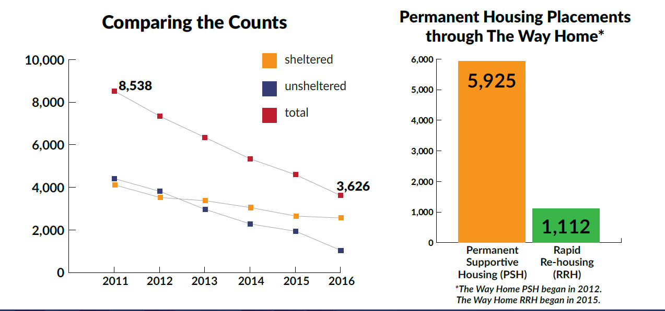
2016 Homeless Count
The annual Homeless Count was organized and led by the Coalition for the Homeless in consultation with the University of Texas School of Public Health and the Houston Department of Health and Human Services. For a full executive summary, visit: www.homelesshouston.org
Notes:
Key Findings:
71% of homeless individuals counted were sheltered, compared with 64% last year, and 48% in 2011.
73% decrease in unsheltered homelessness since 2011.
57% decrease in overall homelessness since 2011, and a 21% decrease in overall homelessness since 2015.
71% reduction in chronic homelessness since 2011.
There were no unsheltered families with minor children found on the night of the 2016 Homeless Count.

Slide 28
Homebuyer Assistance Program
Nov 2015
Dec
2015
Jan
2016
Feb 2016
Mar 2016
Apr 2016
May 2016
Jun 2016
Jul 2016
Aug 2016
Sep 2016
Oct 2016
Total Investment in Down Payment Assistance to Date: $398,727
Total Admin: $312,453

Slide 29
Homebuyer Assistance Program
Assistance Levels
70% - 80% AMI | $15,000
70% AMI or below | $25,000

Slide 30

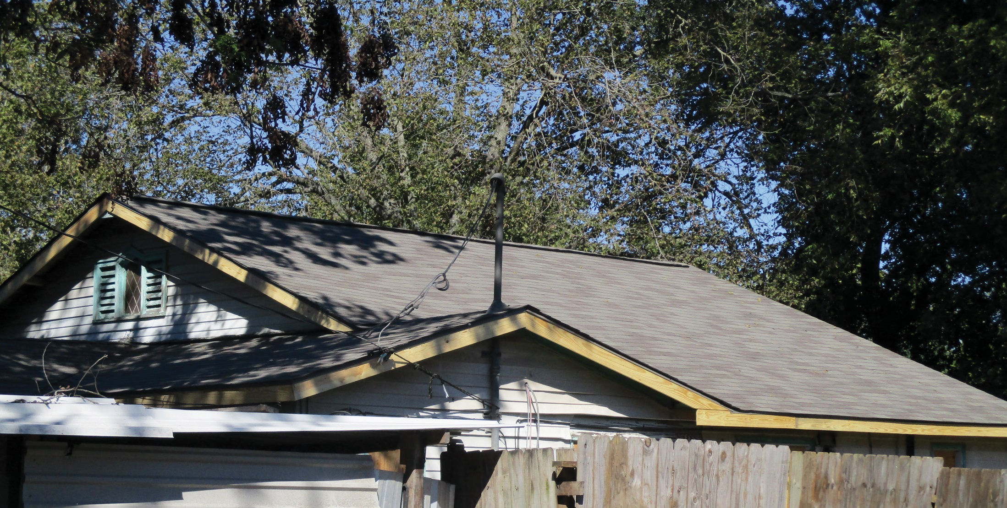
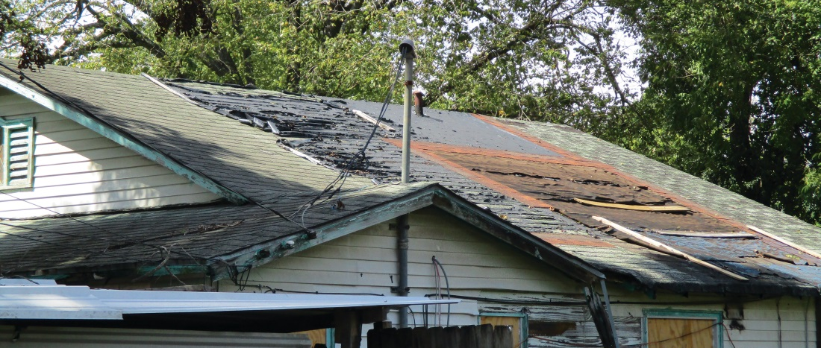
District B Home
BEFORE
AFTER

Slide 31
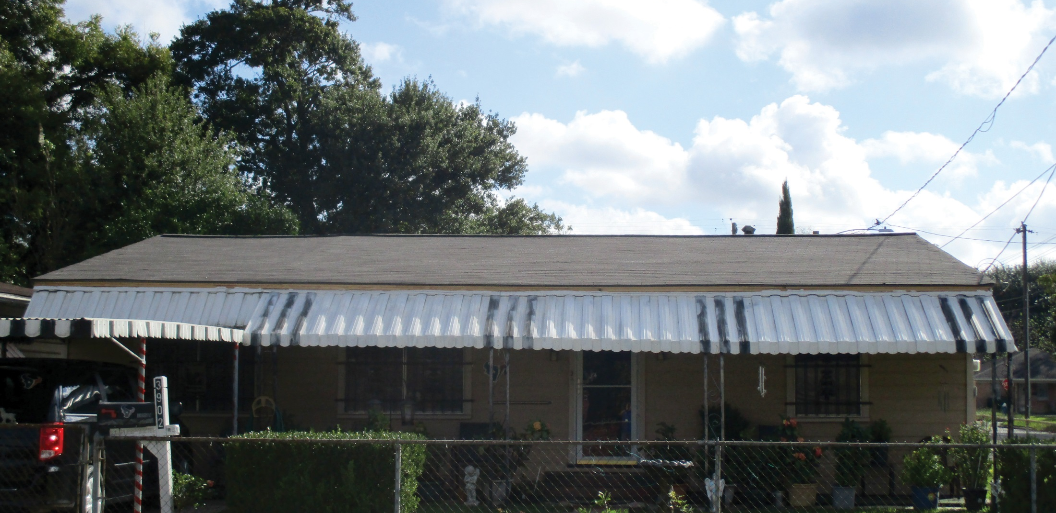
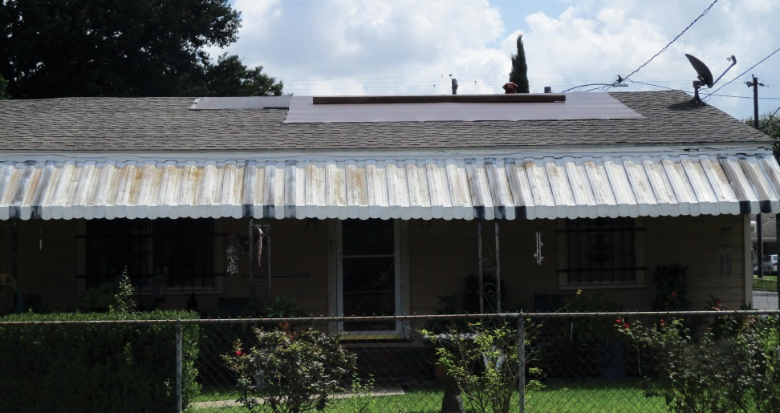
District H Home
BEFORE
AFTER

Slide 32
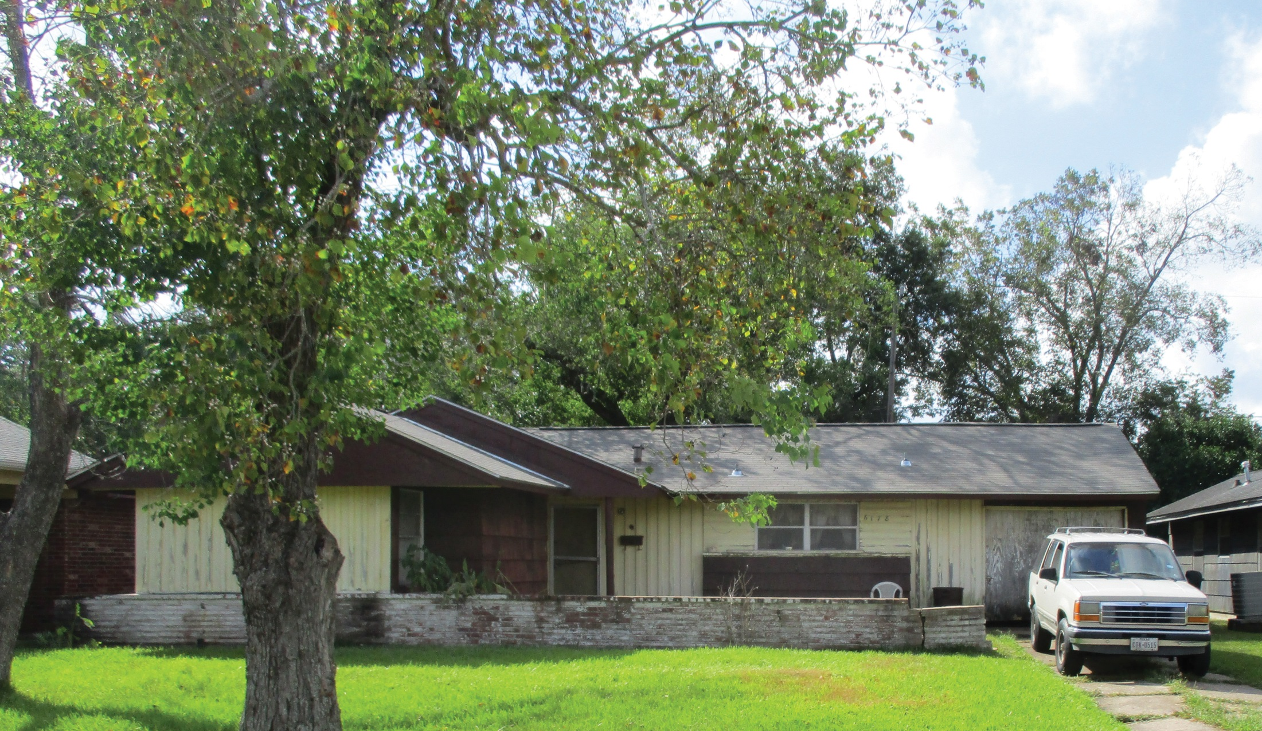
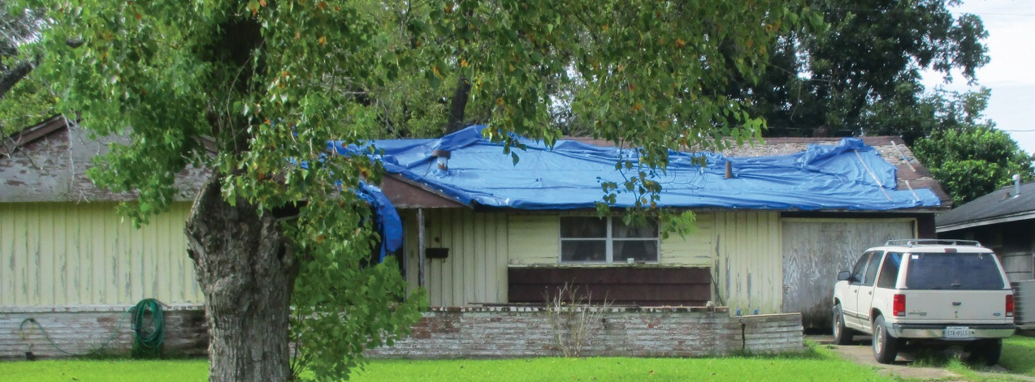
District D Home

Slide 33
Disaster Recovery 2 Single-Family Home Program
Nov 2015
Dec
2015
Jan
2016
Feb 2016
Mar 2016
Apr 2016
May 2016
Jun 2016
Jul 2016
Aug 2016
Sep 2016
Oct 2016
Total Expenditures: $19,367,919
Total Admin & Project Delivery: $2,164,337

Slide 34
Homebuyer Assistance Program
Nov 2015
Dec
2015
Jan
2016
Feb 2016
Mar 2016
Apr 2016
May 2016
Jun 2016
Jul 2016
Aug 2016
Sep 2016
Oct 2016
Total Investment in Down Payment Assistance to Date: $398,727
Total Admin: $312,453

Slide 35
Minor Critical Repair & Blue Tarp Programs
Nov 2015
Dec
2015
Jan
2016
Feb 2016
Mar 2016
Apr 2016
May 2016
Jun 2016
Jul 2016
Aug 2016
Sep 2016
Oct 2016
Total Investment in Repairs through October 2016: $568,701.71
Total Admin: $68,306.07

Slide 36
Blue Tarp Status Report
Blue Tarp Initiative Progress Report As of 11.14.16
Status Report | Count
Intake | 157
Intake Complete | 139
In Progress | 18
Blue Tarps by Council District | A | B | C | D | E | F | G | H | I | J | K | Intake Complete
 | 2 | 50 | 1 | 49 | 0 | 0 | 0 | 21 | 10 | 1 | 5 | 139

Slide 37


