Slide 1


City of Houston
Office of Veterans Affairs
Dr. Steven L. Hall, Director, Office of Veterans Affairs

Slide 2
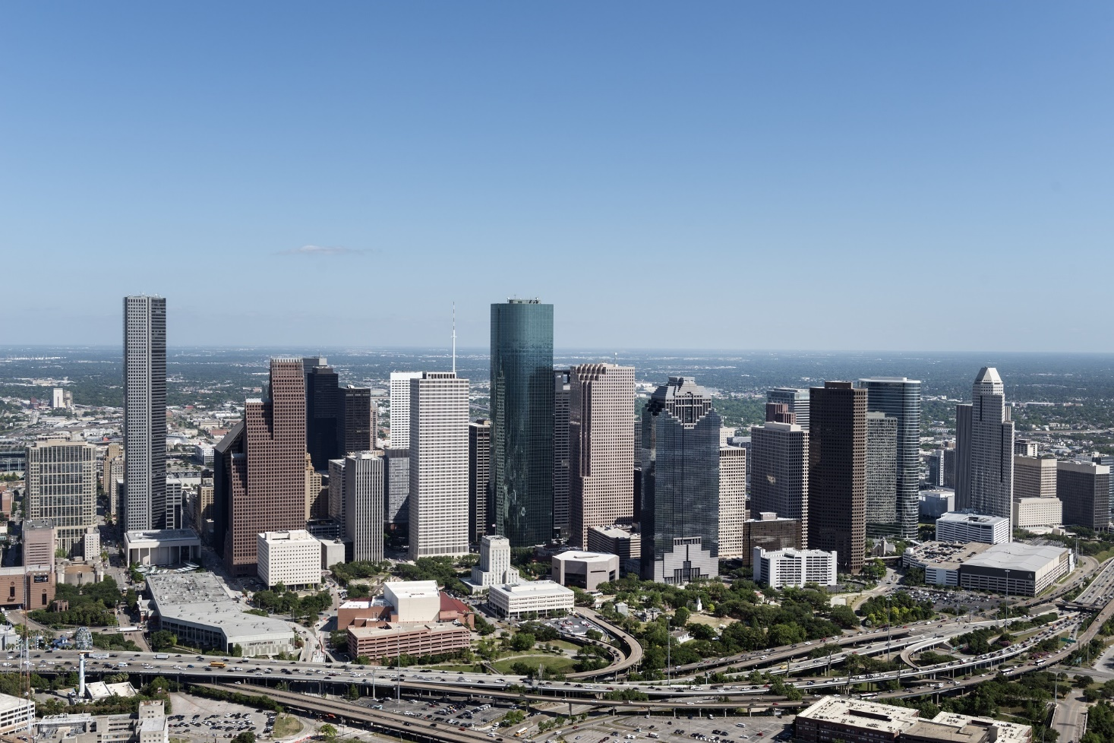
AGENDA
1 | STATISTICS: ACTIVE DUTY / VETERAN / MILITARY-AFFILIATED POPULATION(S)
2 | MAYOR’S OFFICE – STRATEGIC PLAN – CURRENT INITIATIVES
3 | STRATEGIC FORECAST
Notes:
SLIDE 2 - AGENDA

Slide 3

STATISTICS
VETERAN POPULATION – CURRENT/FUTURE PROJECTIONS
2017-2037
Texas – 2nd Largest Veteran Population in U.S.
City of Houston – Largest Veteran Population in Texas
City of Houston – 2nd Largest Veteran Population in U.S.
Harris County – Largest County Veteran Population in U.S.
Gulf War–Era Veterans – Largest Population
Minority Veteran Pop. – Predicted Increase – 23.2% to 32.8%
Hispanic Veteran Pop. – Predicted Increase – 7.4% to 11.2%
Female Post 9/11 Veterans – Ratio 1:11 Total Veteran Population
Notes:
SLIDE 3 – STATISTICS
City of Houston has the largest Veteran population in Texas – Peer-reviewed estimates conservatively gauge the population to be between 250,000 – 290,000. NOTE: The population estimate(s) do not account for the larger military-affiliated population(s) [Spouse & Dependents].
While the City of Houston is currently ranked 2nd behind Los Angeles, CA in total Veteran population, we must consider that LA has what is termed as ‘anchor military installations’ within the city’s footprint in addition to military installations in close proximity to the city. When we consider Houston, we must consider that the City of Houston, with exception to Ellington Field, has no such anchor installations within hundreds of miles (e.g. Ft Hood, Killeen, Joint Base San Antonio).
Gulf War-era veterans now account for the largest share of all U.S. veterans, surpassing Vietnam-era veterans in 2016, according to Veterans Affairs’ 2016 population model estimates. As of last year, there were 6.8 million American veterans who served during the Vietnam era and 7.1 million who served in the Gulf War era. Of the total population, Female Veterans comprise over 700,000 considered Post-9/11.
Today’s military is comprised of the most diverse population(s). Presented are conservative estimates regarding diverse population growth.
Of the overall Post 9/11 Veteran population, Females currently comprise 1 out of 11 Veterans.

Slide 4
STRATEGIC PLAN
MAYOR’S OFFICE – STRATEGIC PLAN – CURRENT INITIATIVES
Develop/Implement Strategic Plan – End-Goal Achievement
US Army Partnership for Youth Success (PaYS)
Governor’s/Mayor’s Challenge - Substance Abuse and Mental Health Services Administration (SAMHSA) & Department of Veterans Affairs (VA)
City of Houston – Michael E. DeBakey VA Medical Center
Harris Center Mental Health & IDD / DeBakey VA MOU – City of Houston First Responders – ‘No Wrong Door’
Notes:
SLIDE 4 – MAYOR’S OFFICE – STRATEGIC PLAN
Under the Mayor’s Office direction, the Office of Veterans Affairs has developed/implemented a strategic plan to engage and support initiatives/programs with intent to focus on ‘End-Goal’ achievement. As a result, the City of Houston is playing a much more intentional role in collaborating with Faith-Based, Non-Profits and further building upon public/private relationships to arrive at mutually-beneficial outcomes.
The US Army Partnership for Youth Success (PaYS) Program partners with a cross section of private industry, academia, businesses and state and local public institutes. Our PaYS partners sign an agreement to provide job interviews and potential employment to separating/transitioning Soldiers [Active Duty, Guard/Reserves].
The PaYS Program provides America's youth with an opportunity to serve their country, while they prepare for their future. Soldiers learn technical skills required by industry and selected government agencies; along with work ethics, teamwork, communication, and leadership during their enlistment in the United States Army.
The Substance Abuse and Mental Health Services Administration (SAMHSA) and the Department of Veterans Affairs (VA) are proud to announce the cities that will participate in the first group for the Mayor’s Challenge to Prevent Suicide Among Service Members, Veterans, and their Families. Albuquerque, N.M.; Billings, Mont.; Richmond, Va.; Helena, MT; Houston, TX; Las Vegas NV; Los Angeles, CA and Phoenix, AZ will form interagency teams to increase suicide prevention support for veterans in their communities [Austin, TX joined later].
SAMHSA and VA identified these cities based on veteran population data, suicide prevalence rates and capacity of the cities to lead the way in this first year of the Mayor’s Challenge.
DeBakey VA Medical Center serves as the primary health care provider for more than 151,000 Veterans in Southeast Texas. Veterans from around the country are referred to DeBakey for specialized diagnostic care, radiation therapy, surgery, and other medical treatments… Please see attachment for additional highlight information.
City of Houston oversaw/facilitated collaborative between the Harris Center for Mental Health and Intellectual and Developmental Disability Services & DeBakey VA – Suicide Prevention Initiative – Memorandum of Understanding – Collaboration to include City of Houston First Responders – ‘No Wrong Door’ Policy.

Slide 5
STRATEGIC FORECAST
MAYOR’S OFFICE – STRATEGIC FORECAST
City of Houston – Collaboration 15 Texas Military Installations – Sponsor Program Initiative
City of Houston – Collaboration Between Office of VA & HR
Re-Boot City of Houston VA Website – Concept = 3 Spheres
City of Houston – Council Member Engagement – Heat-Mapping
Recurring Briefing/Presentations
Notes:
SLIDE 5 – MAYOR’S OFFICE – STRATEGIC FORECAST
Under the Mayor’s Office direction, the Office of Veterans Affairs has initiated levels of collaboration between the City and the 15 military installations located in Texas to assist in the transition/reintegration of service-members into the City of Houston. Sponsor Program – Acting as facilitator of access to resources within the City of Houston.
City of Houston VA, in collaboration with City of Houston HR Department – Seeking stronger/intentional alignment in identifying: Active Duty, Veteran and Military-Affiliated employee population(s). Setting example in developing/leveraging ‘Best Practices’ to providing services and resources and/or facilitating access to services outside the current scope of City of Houston.
Re-Boot of City of Houston VA Website to include the Spheres: Educational Attainment / Vocational Proficiency / Financial Literacy, built upon foundation of Holistic Health, Well-Being and Resiliency.
City of Houston – Engagement of Council Members – Heat-Mapping = Population(s) & Proximity of Resources.
Office of Veterans Affairs – Recurring Briefings/Presentations to inform and/or highlight progress on current initiatives/programs as well as future initiatives/programs.

