Slide 1
Housing & Community Affairs Committee
Agenda Items
August 18, 2020

Slide 2
HCDD Agenda
I. Welcome/Call to Order
II. Planning & Grants Management
III. Public Facilities
IV. Director's Comments
V. Public Comments

Slide 3
II. Planning & Grants Management Substantial Amendment ESG-CV
An Ordinance authorizing a Substantial Amendment to the 2019 Annual Action Plan budget and authorizing the execution and submittal of forms and documents to HUD, as follows:
A Substantial Amendment to the current ESG-CV budget in the Amended 2019 Annual Action Plan, transferring $5,579,660.00 from various activities to the Rapid Re-housing Activity.
The submission of the second Amended 2019 Annual Action Plan to HUD, including a revised application for the Emergency Solutions Grants - Coronavirus (ESG-CV) entitlement grants to be received from HUD.

Slide 4
II. Planning & Grants Management Substantial Amendment ESG-CV
The execution of the agreement between the City of Houston and HUD for the grants by the Mayor, or the Mayor’s designee; and
The execution of related forms and documents for the grants by the Mayor, or the Mayor’s designee. The application estimates an additional of $21,649,868.00 in ESG-CV funds.
On March 27, 2020 the Coronavirus Aid, Relief, and Economic Security Act (CARES Act), Public Law-116-136, authorized a special allocation of Community Development Block Grant – Coronavirus (CDBG-CV), Housing Opportunities for Persons with HIV/AIDS (HOPWA-CV), and ESG-CV to states and local jurisdictions to prevent, prepare for, and respond to the coronavirus (COVID-19).

Slide 5
II. Planning & Grants Management Substantial Amendment ESG-CV
HCDD proposes to fund $21,649,868.00 in the following ESG-CV activities by September 30, 2022:
Activity | Current Amount | Change in Current Amount | Additional Grant Amount | New Total Amount | Percent
Street Outreach | $127,297.00 | $(127,297.00) | $0.00 | $0.00 | 0.0%
HMIS | $100,000.00 | $(100,000.00) | $0.00 | $0.00 | 0.0%
Emergency Shelter | $4,000,000.00 | $(3,352,363.00) | $11,777,882.00 | $12,425,519.00 | 43.0%
Homeless Prevention | $2,000,000.00 | $(2,000,000.00) | $1,707,000.00 | $1,707,000.00 | 5.9%
Rapid Re-Housing | $300,000.00 | $5,579,660.00 | $6,000,000.00 | $11,879,660.00 | 41.1%
Administration | $725,255.00 | $0.00 | $2,164,986.00 | $2,890,241.00 | 10.0%
Total | $7,252,552.00 | - | $21,649,868.00 | $28,902,420.00 | 100.0%

Slide 6
III.a. Public Facilities Voluntary Buyout Program (First Amendment)
An Ordinance authorizing a First Amendment to the Amended and Restated Interlocal Agreement between the City of Houston (City) and Harris County Flood Control District (the District) to replace the title of all exhibits stated as “Voluntary Housing Buyout” with “the Voluntary Buyout Program” to expand the pool of properties eligible under the Voluntary Buyout Program.
In addition, a budget modification will be made within three neighborhoods to allow for additional property buyouts:
Braeburn Glen
Glenburnie & Cashiola
Langwood

Slide 7
III.a. Public Facilities Voluntary Buyout Program (First Amendment)
The Amended and Restated Interlocal Agreement between the City and the District was effective on February 11, 2020 with a budget not to exceed $10,660,000.00.
To date, the District has spent a total of $5,165,445.39, for the purchase of 23 properties with 16 properties pending acquisition.

Slide 8
III.a. Public Facilities Voluntary Buyout Program (First Amendment)
Budget Estimate by Costs | Total Cost | Budget Modification | Total Cost
Purchase Price/Acquisition Cost | $8,573,360.40 | (264,726.00) | $8,308,634.40
Closing Costs | $128,600.41 | 53,000.00 | $181,600.41
Appraisal Fees | $42,750.00 | 11,800.00 | $54,550.00
Demolition Cost | $456,000.00 | 50,000.00 | $506,000.00
Relocation Costs/Supplement | $1,316,789.19 | 134,000.00 | $1,450,789.19
Moving Expenses | $142,500.00 | 15,926.00 | $158,426.00
Total Budget | $10,660,000.0 | $0.00 | $10,660,000.0

Slide 9
III.a. Public Facilities Voluntary Buyout Program (First Amendment)
Budget by Neighborhoods | Total Cost | Budget Modification | Total Cost
Braeburn Glen | $6,000,000.00 | (3,232,090.73) | $2,767,909.27
Glenburnie & Cashiola | $2,860,000.00 | $605,235.76 | $3,465,235.76
Langwood | $1,800,000.00 | $2,626,854.97 | $4,426,854.97
Total Budget | $10,660,000.00 | $0.00 | $10,660,000.00

Slide 10
III.b. Public Facilities 5312 Clarewood Option Agreement
An Ordinance authorizing an Option Agreement for Purchase and Sale of Real Property between the City of Houston (City) and Monticello Square, LLC (Seller) in the amount of $13,199,500.00.
In collaboration with Houston Public Works (HPW), HCDD will convert this site into greenspace or detention to help reduce the risk of future flooding in the area.
The MVB Program was approved by Ordinance No. 2019-109, adopted on February 19, 2019 and the HB Program was approved by Ordinance No. 2020-0181, adopted on March 10, 2020.

Slide 11
III.b. Public Facilities 5312 Clarewood Option Agreement
The property (known as Monticello Square) is located at 5312 Clarewood Drive, Houston TX 77081. The Property comprises approximately 4.4107 acres of land and 122,352 square feet of improvements.
The Purchase Price is $12,830,000.00 based on appraisal, plus additional due diligence, closing costs and operational costs during post-closing of approximately $369,500.00.
This activity is eligible under the Community Development Block Grant - Disaster Recovery 2016 (CDBG-DR16) - Multifamily Voluntary Buyout (MVB) and Community Development Block Grant – Harvey Disaster Recovery (CDBG-DR17) - Harvey Buyout (HB) Programs.

Slide 12
III.b. Public Facilities 5312 Clarewood Option Agreement

Slide 13
DIRECTOR’S COMMENTS

Slide 14
Virtual Community Office Hours

Slide 15
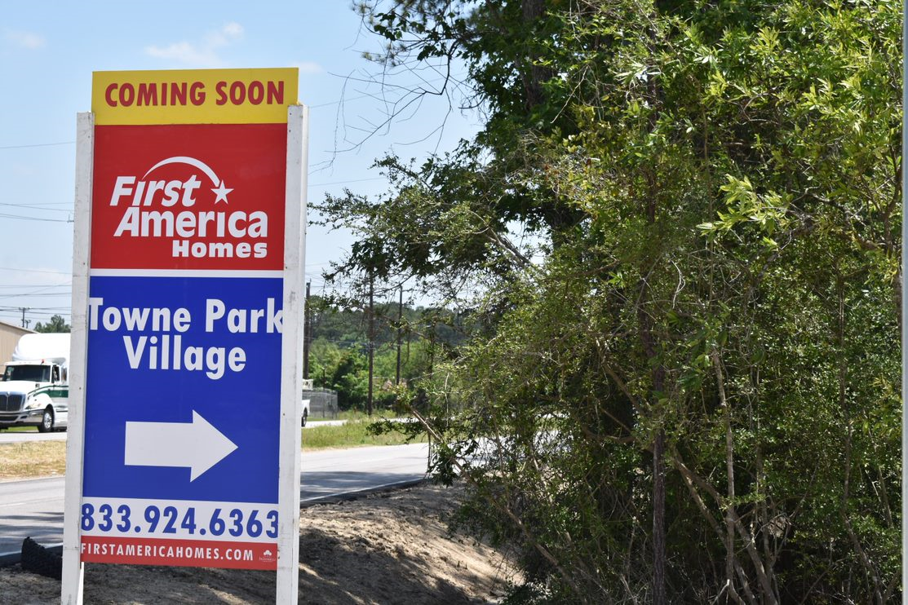
Towne Park Village
This newly mastered-planned affordable housing community at 7778 Little York Road is located in northeast Houston. Planned community amenities include a playground, dog park, bus stop & a proposed day care.

Slide 16
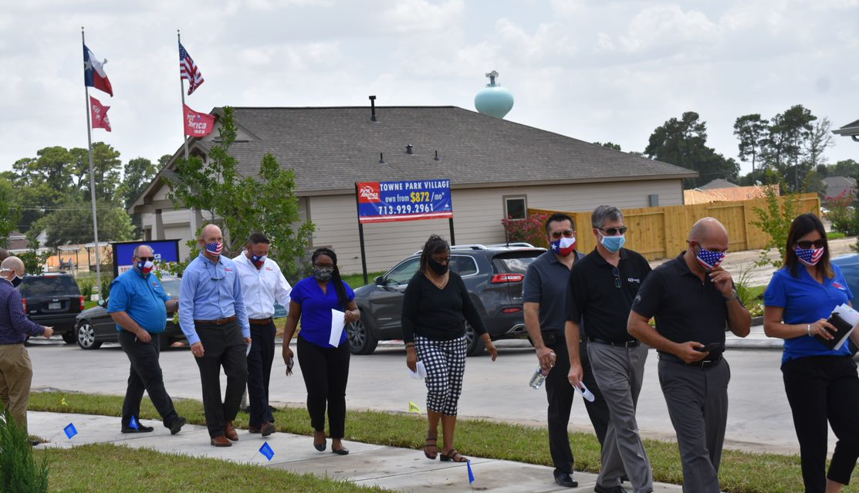
Towne Park Village
Director Tom McCasland and Zack Burghli tour the community with representatives from First American Homes, KHovnanian Homes, Houston Community Land Trust, Leland Woods TIRZ 22 and Houston Housing Finance Corp.

Slide 17
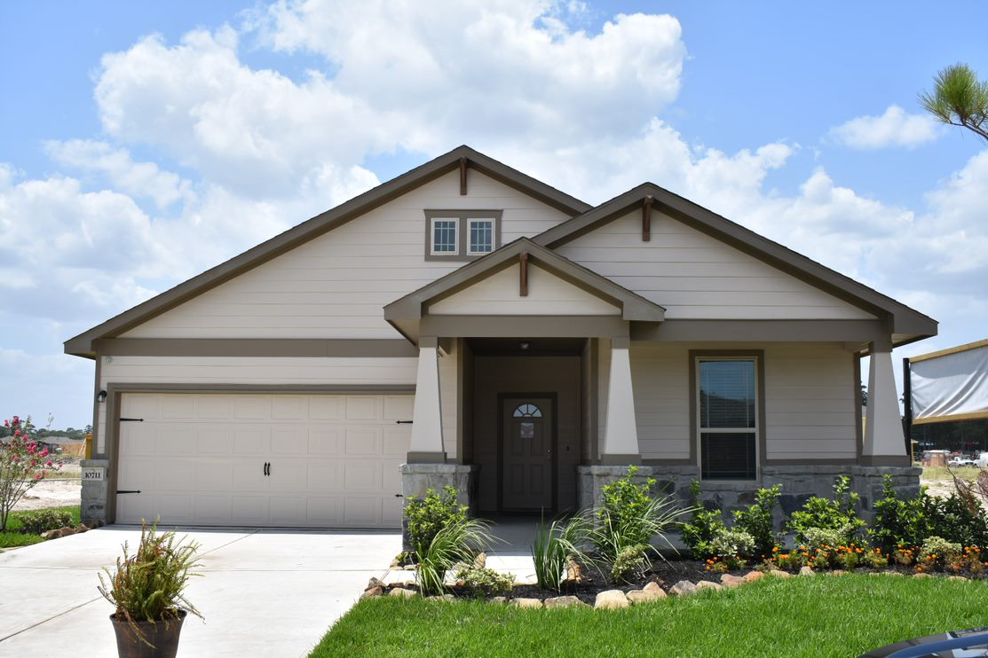
Towne Park Village

Slide 18
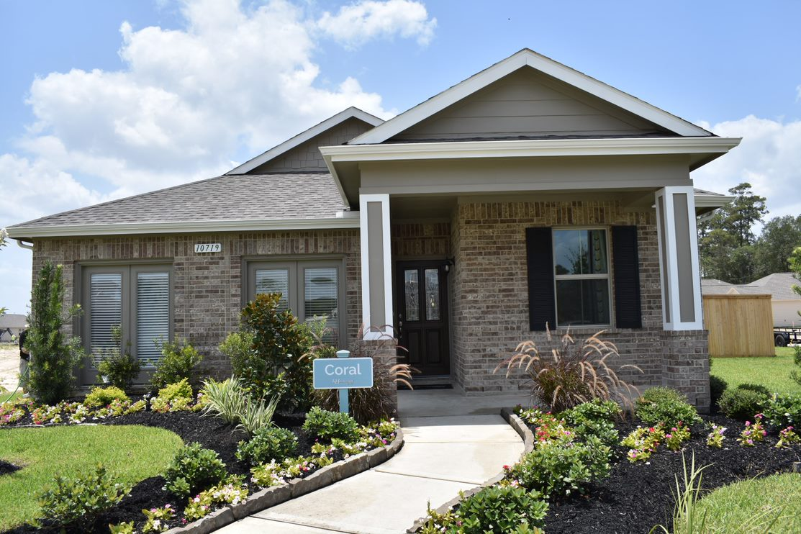
Towne Park Village

Slide 19
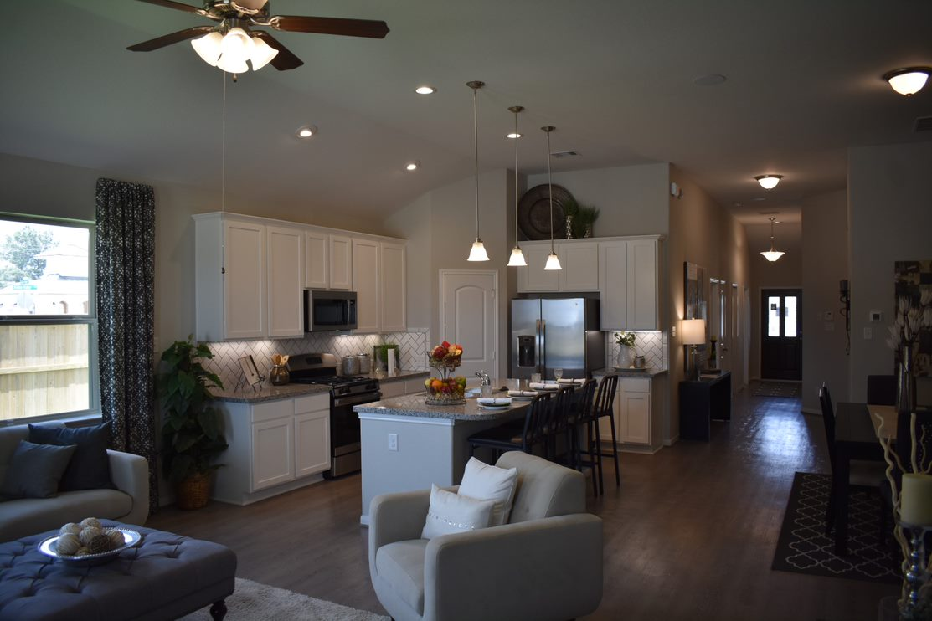
Towne Park Village

Slide 20
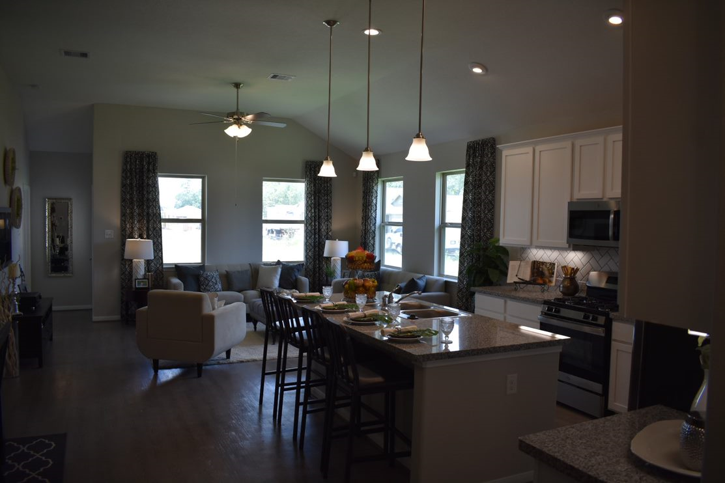
Towne Park Village

Slide 21
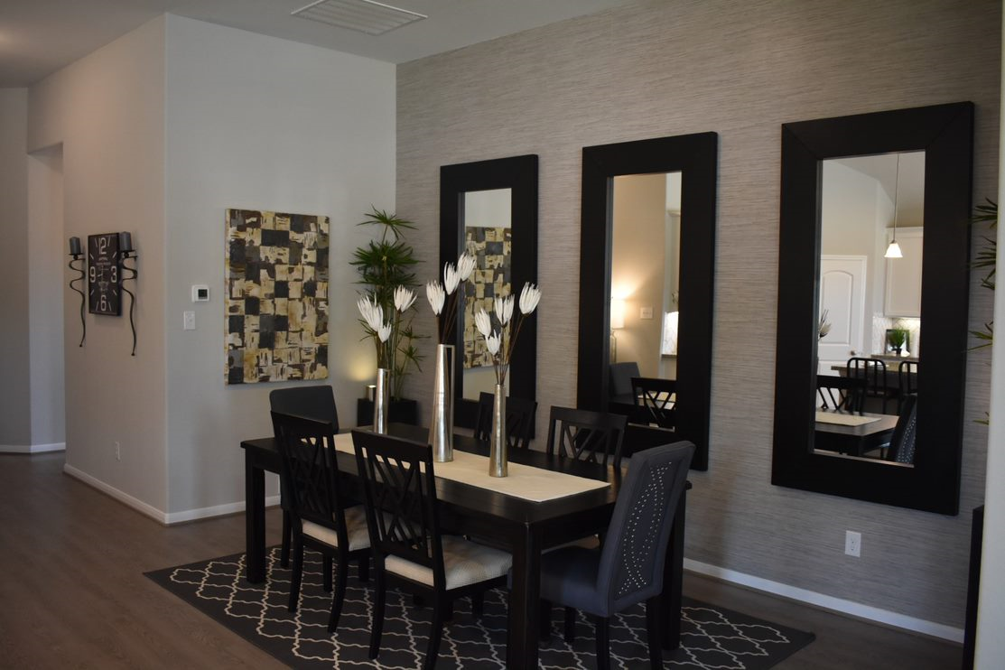
Towne Park Village

Slide 22
Fair Housing & Hurricane Resilience
HCDD's Planning & Grants Management Team hosted: Fair Housing & Hurricane Season Resilience Outreach, Grant Introduction Workshop at HCDD's Office via online event access with over 204 registered.

Slide 23
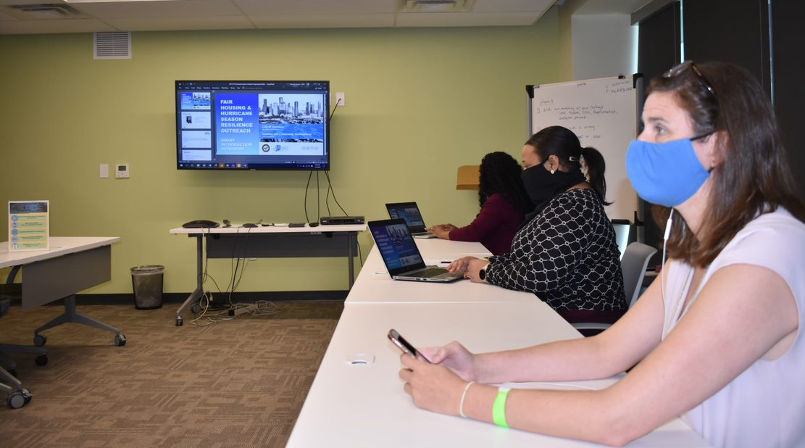
Fair Housing & Hurricane Resilience
Both Non-Profit Organizations & Housing Advocates engaged through social media access learning about grant resources offered by HCDD, while raising awareness of flood preparation and fair housing.

Slide 24
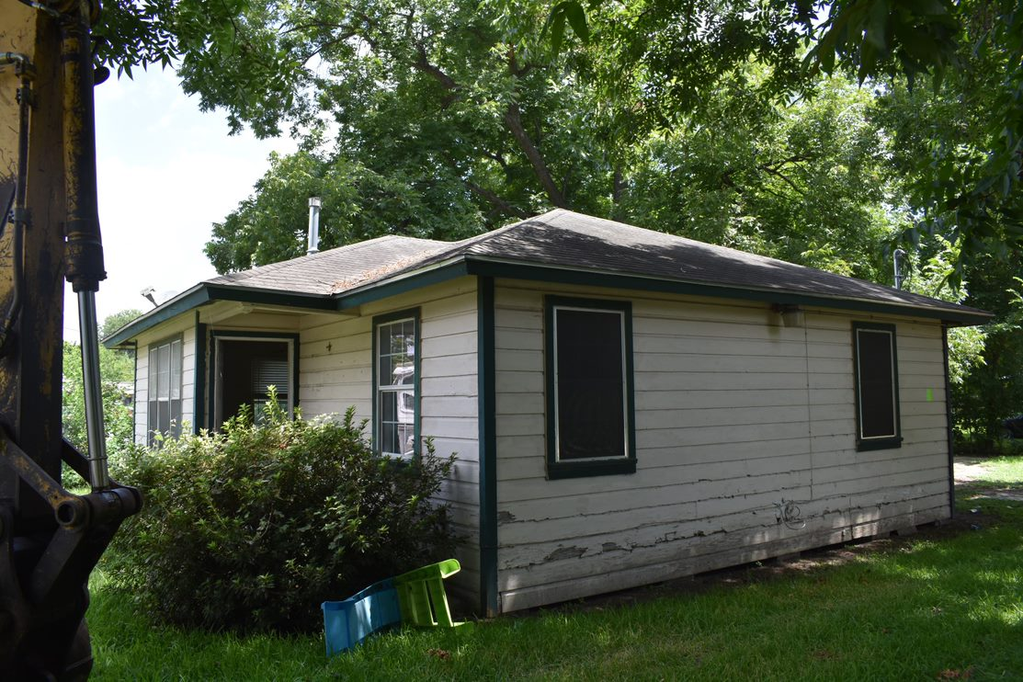
Disaster Recovery: Demolition
8010 De Priest in Acres Homes.

Slide 25
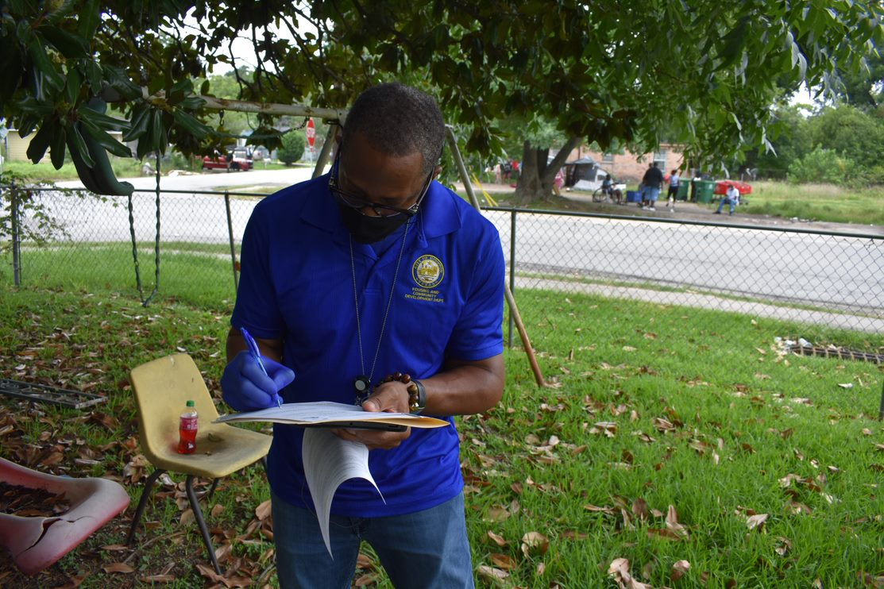
Disaster Recovery: Demolition
HCDD Inspector Marion Scott signs the paperwork to begin the demolition and reconstruction process.

Slide 26
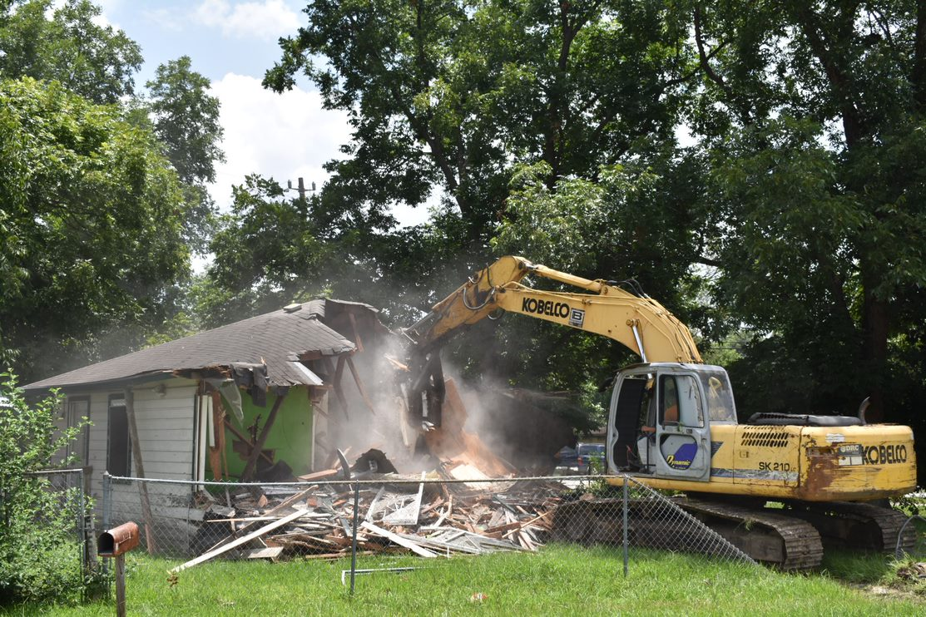
Disaster Recovery: Demolition

Slide 27
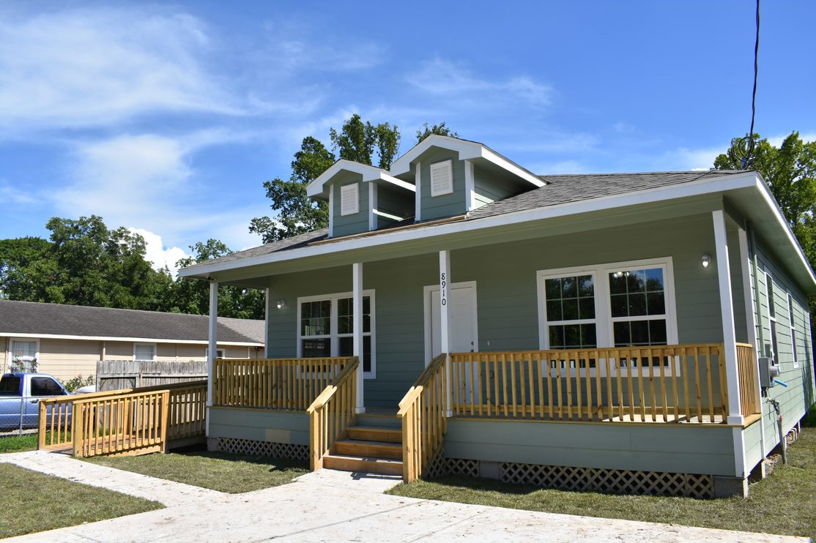
HoAP
Homeowner Glenda Harris' new home is located in East Houston.

Slide 28
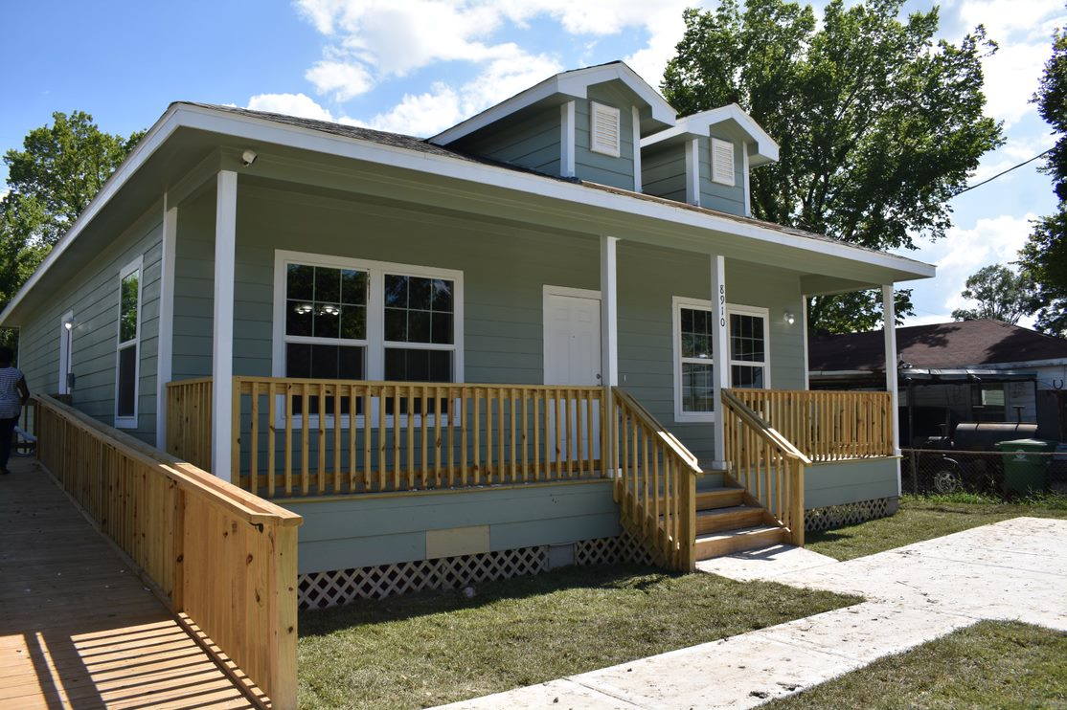
HoAP: Glenda Harris
This new home replaces Ms. Harris' original home, which was flooded during Hurricane Harvey.

Slide 29
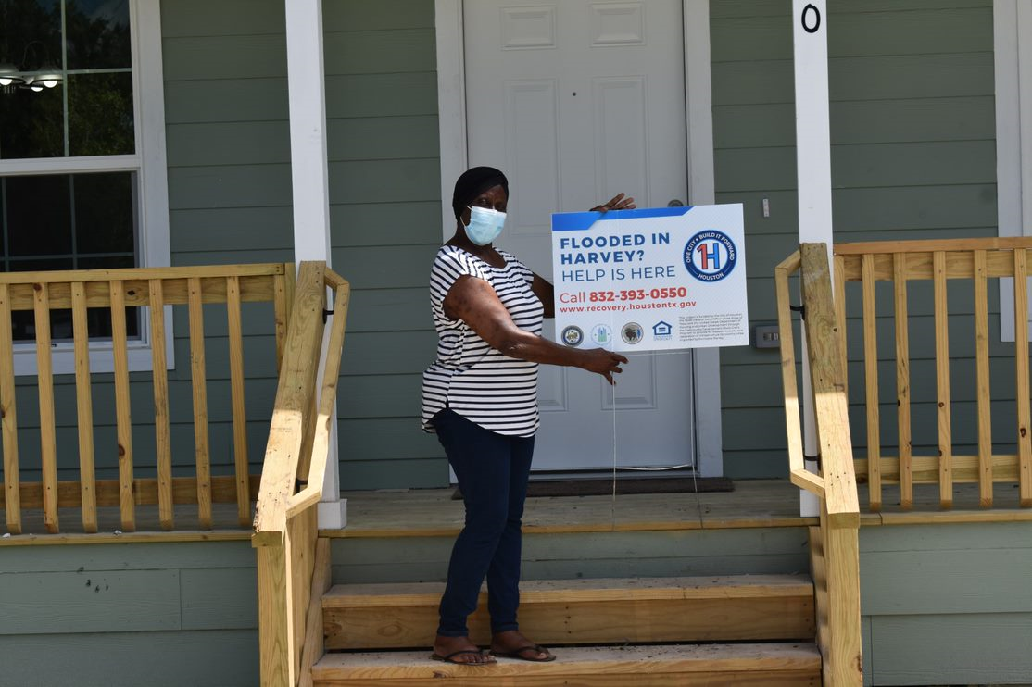
HOAP
Ms. Harris said, "Welcome to my home!" "This is my mansion! I love it... Beautiful, beautiful, beautiful!"

Slide 30
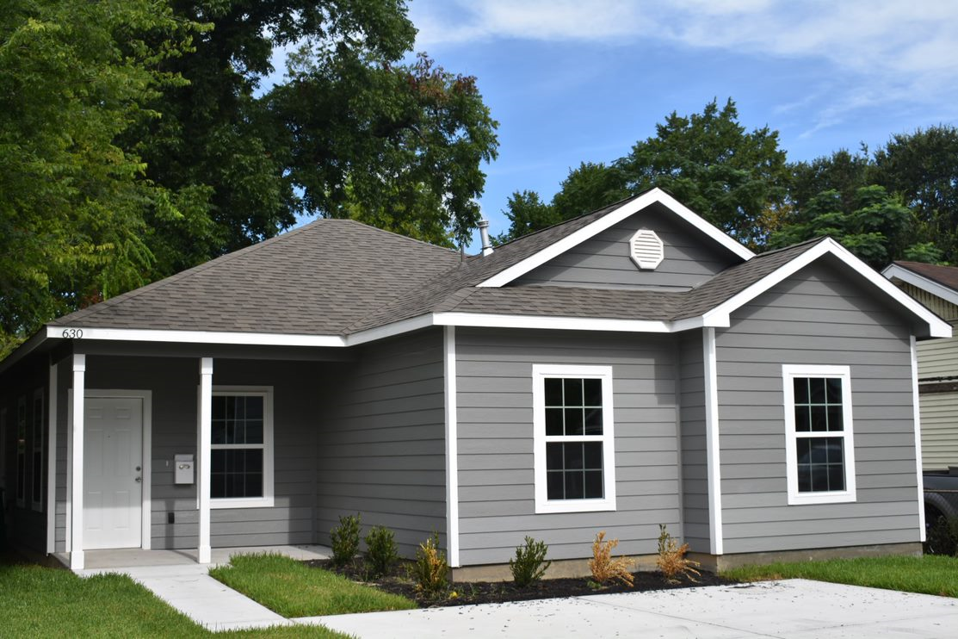
Disaster Recovery
Ms. Jaramillo's new home is located in Denver Harbor.

Slide 31
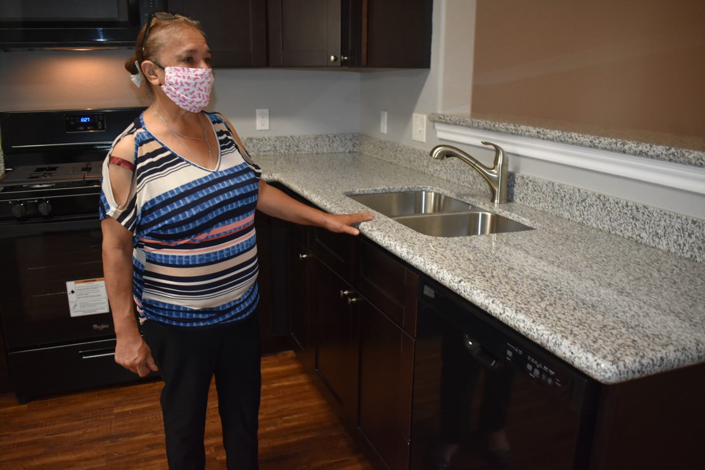
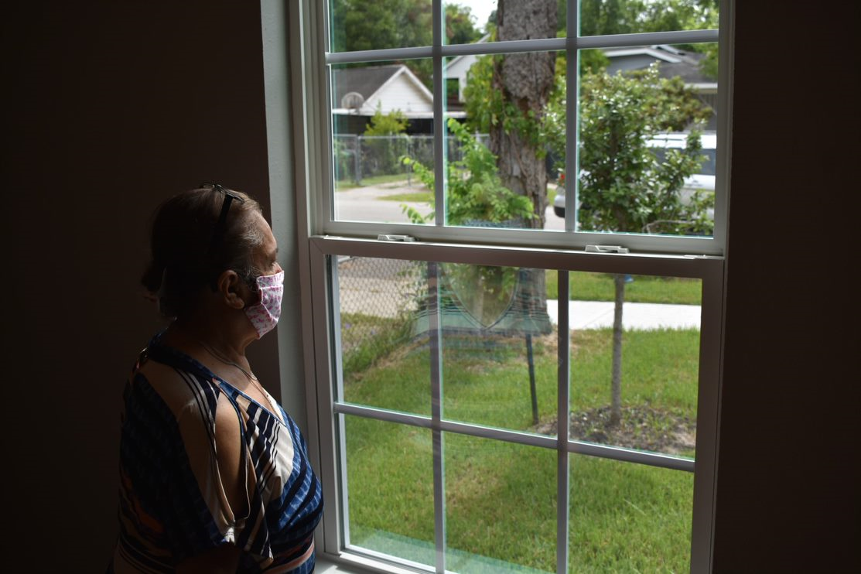
Disaster Recovery
Ms. Jaramillo admires her home's new kitchen and landscaping.

Slide 32
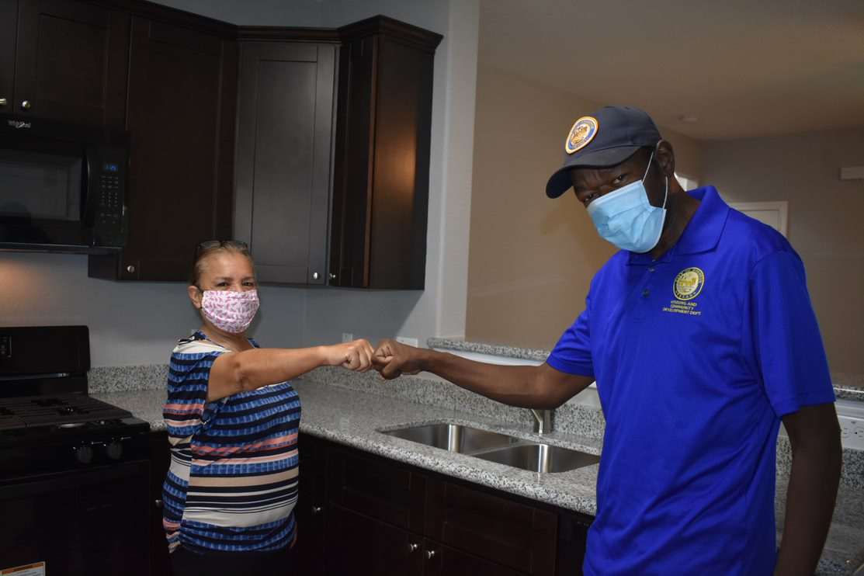
Disaster Recovery
Ms. Jaramillo said, "Everything is just beautiful. Never Give Up!"

Slide 33
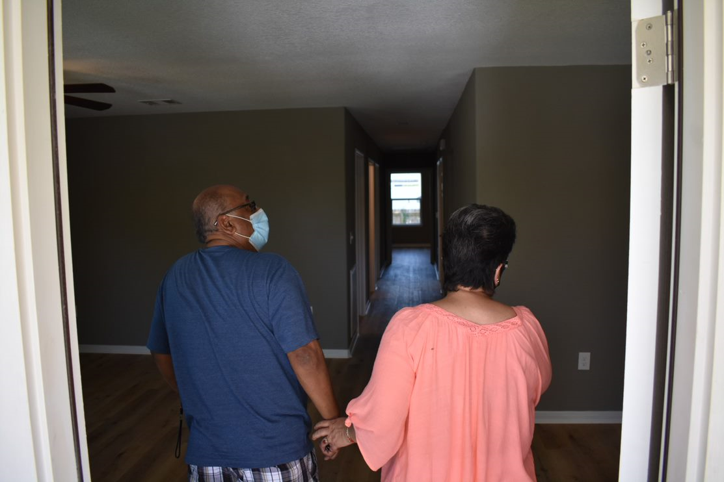
Disaster Recovery
Mr. & Mrs. Vasquez embraced each other as they entered their new home. Mr. Vasquez said, "Oh... Beautiful; On my God; It looks good. Beautiful, Beautiful, Beautiful!

Slide 34
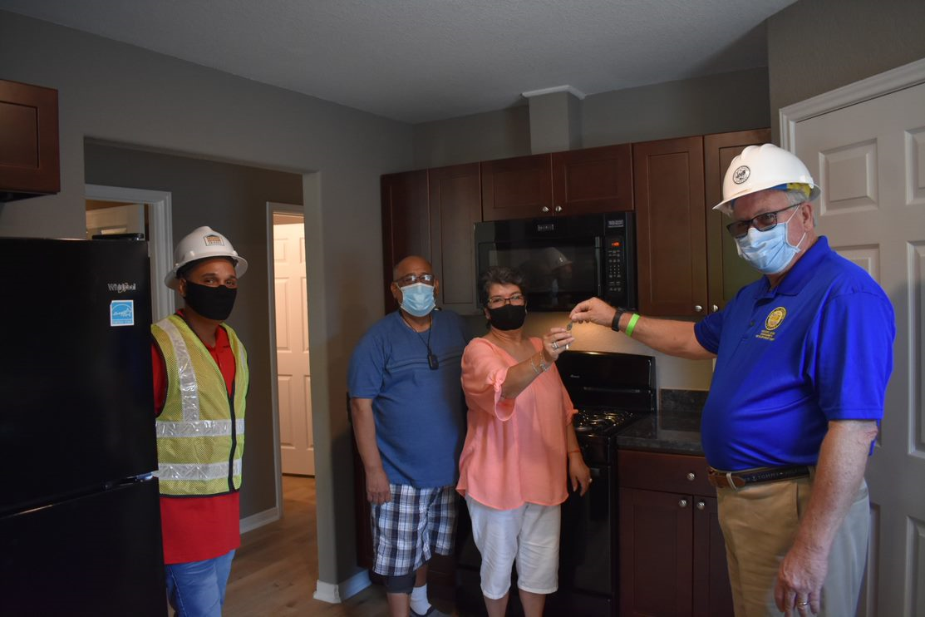
Disaster Recovery
The Vasquez family are survivors of Hurricane Harvey. Over three feet of water flooded their home in Denver Harbor.

Slide 35
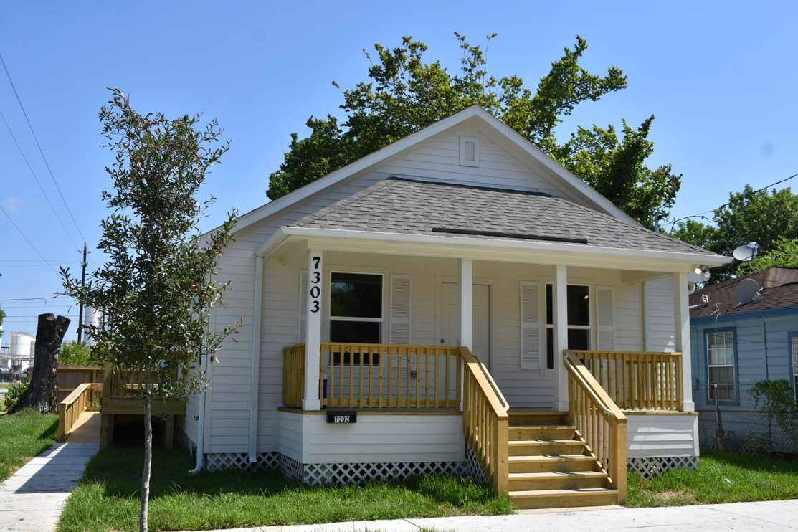
Disaster Recovery
The newly reconstructed Vasquez family home in Denver Harbor. ​

Slide 36
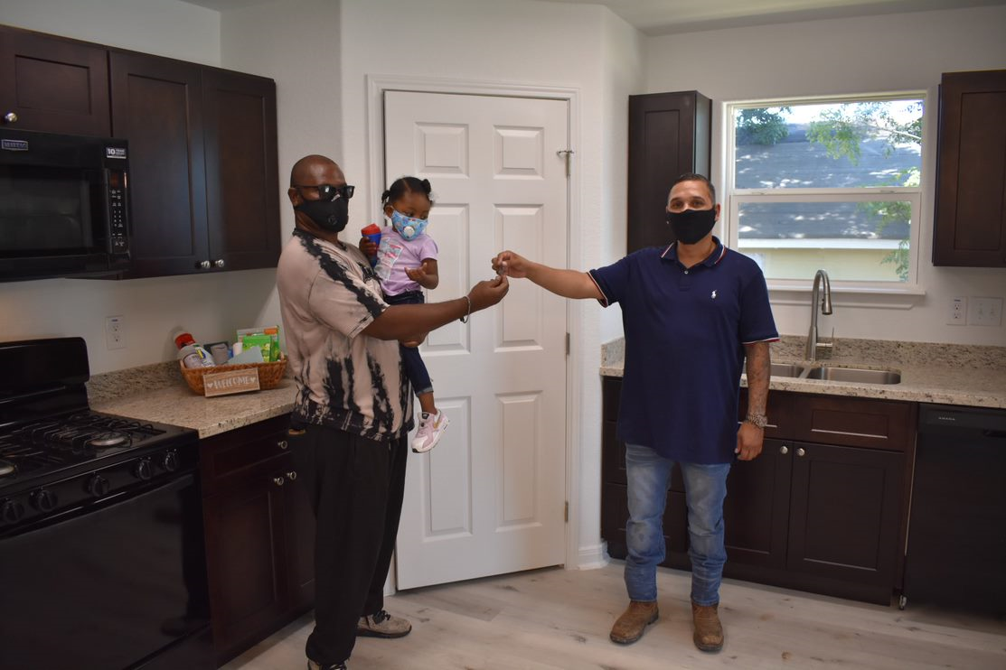
Homebuyer Assistance Program
Thanks to the Homebuyer Assistance Program, this U.S. Army Veteran is now a proud homeowner in Houston's Fidelity Community.

Slide 37
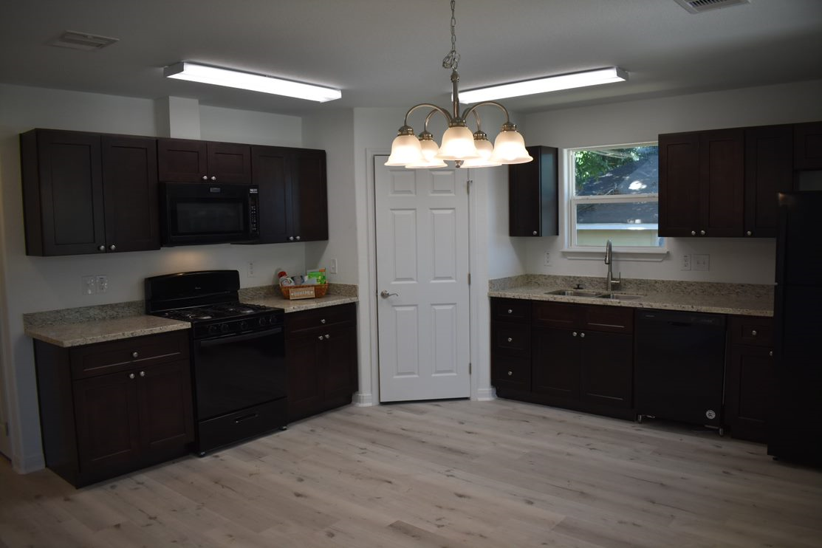
Homebuyer Assistance Program
Our new homeowner selected the cabinets and floors for his newly reconstructed home, as pictured here.

Slide 38
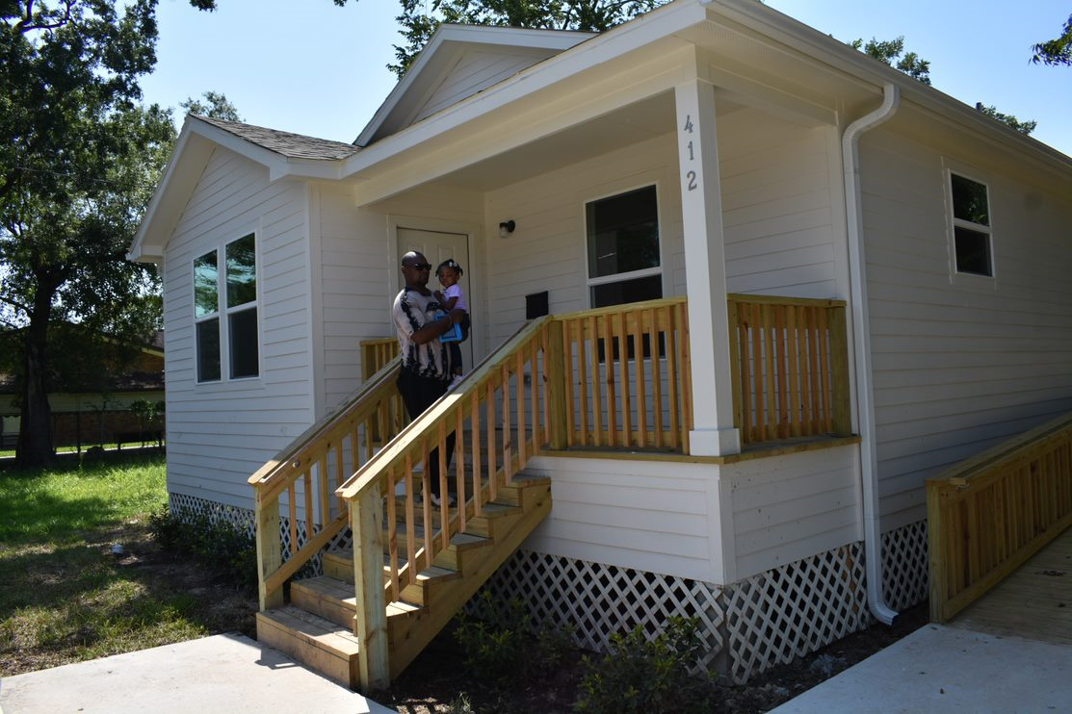
Homebuyer Assistance Program
As his daughter looks on, our homeowner expressed his gratitude to HCDD Staff for his new home. "Thank you! Thank you!"

Slide 39
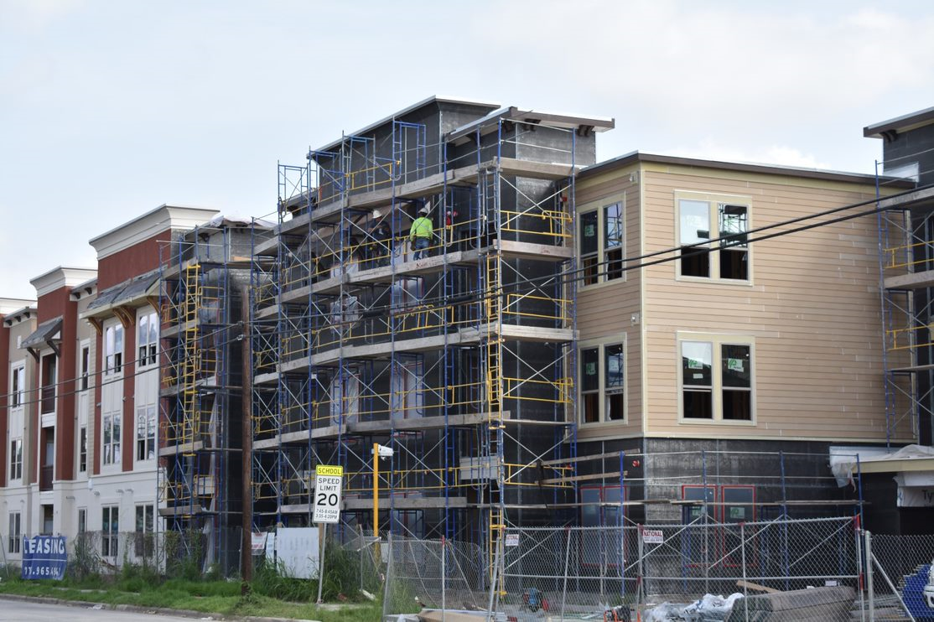
Campanile on Commerce
Campanile on Commerce Senior Living Apartments located at 2929 Commerce Street is now under construction in Houston's historic Second Ward.

Slide 40
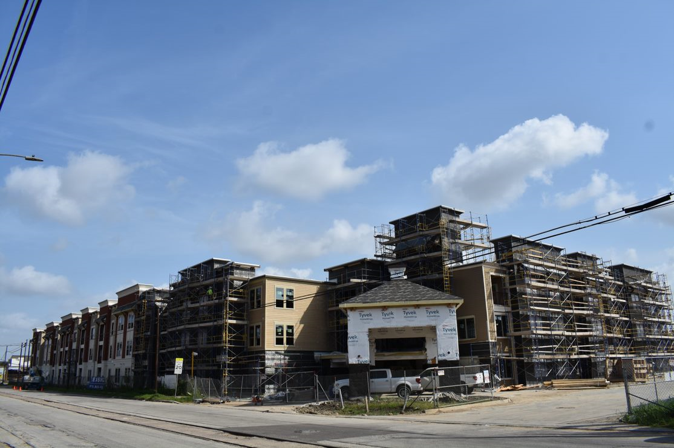
Campanile on Commerce
Campanile on Commerce will provide affordable housing designed for residents age 55 & older.

Slide 41
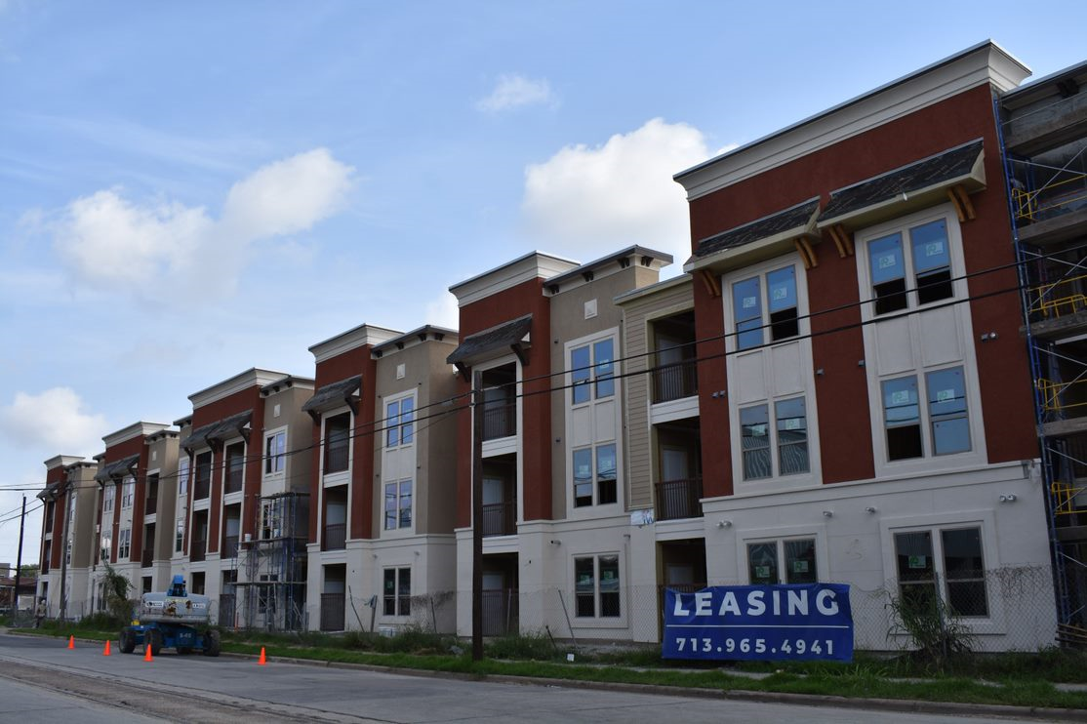
Campanile on Commerce
The community will offer a total of 120-units (one-bedroom & two-bedroom). On-site services include shuttle transportation, nutrition classes & credit counseling.

Slide 42
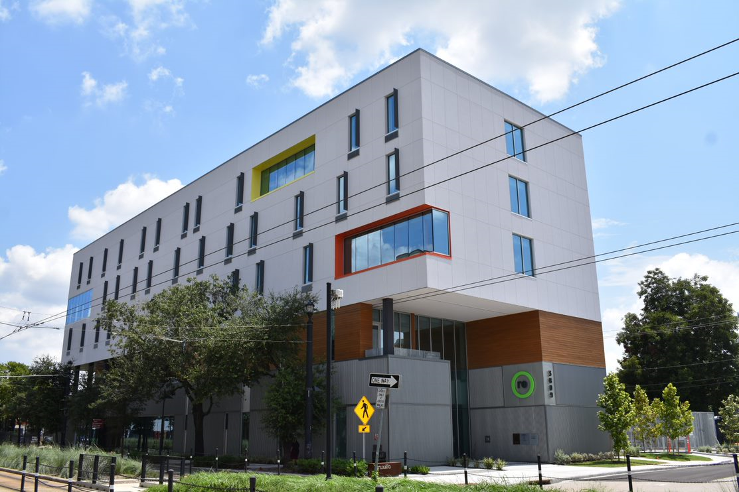
recenter
Located on 3809 Main Street, recenter is a five-story, 50,573 sqt. ft. building with supportive housing for low- & moderate-income men and women recovering from substance abuse.

Slide 43
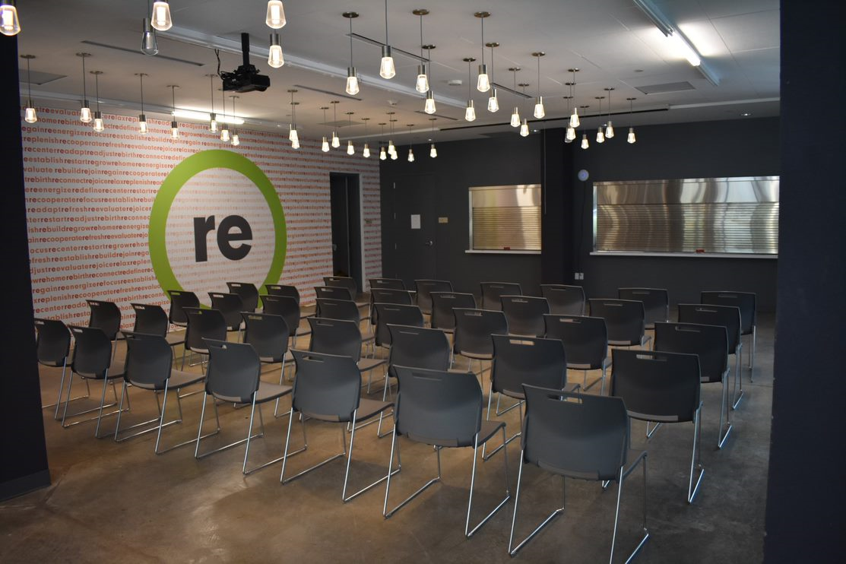
recenter
The recenter's first two floors consist of office, community room and program space for social services.

Slide 44
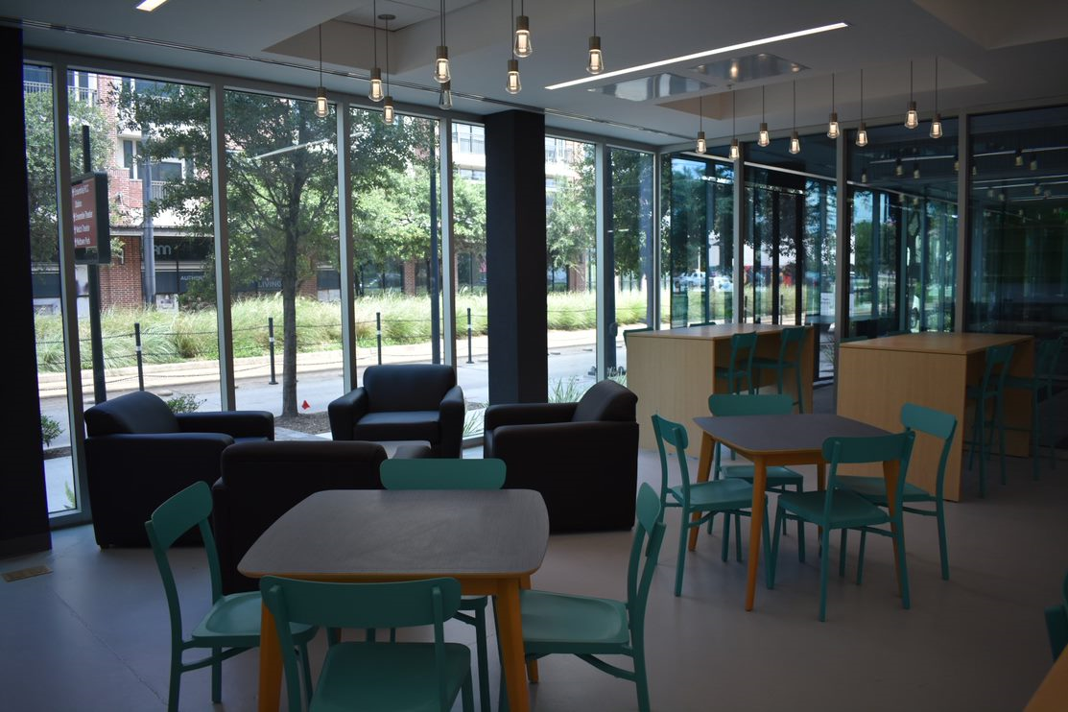
recenter
The recenter's amenities include computers, a terrace with garden, lounge area & dining hall.

Slide 45
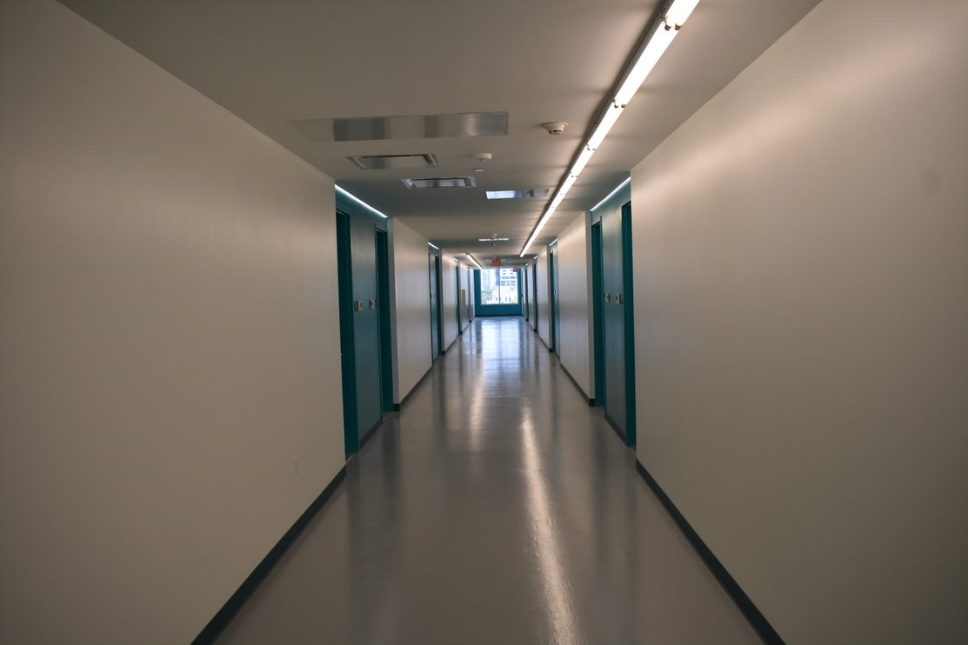
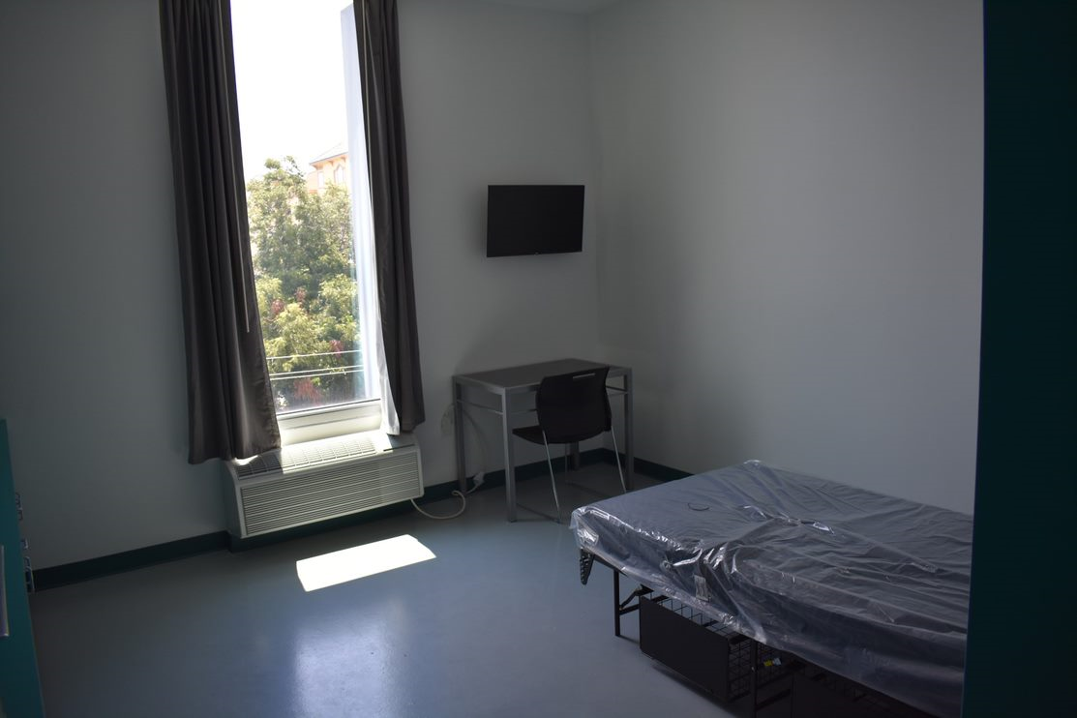
recenter
The recenter's upper three floors contain 62 single-occupancy residential units.

Slide 46
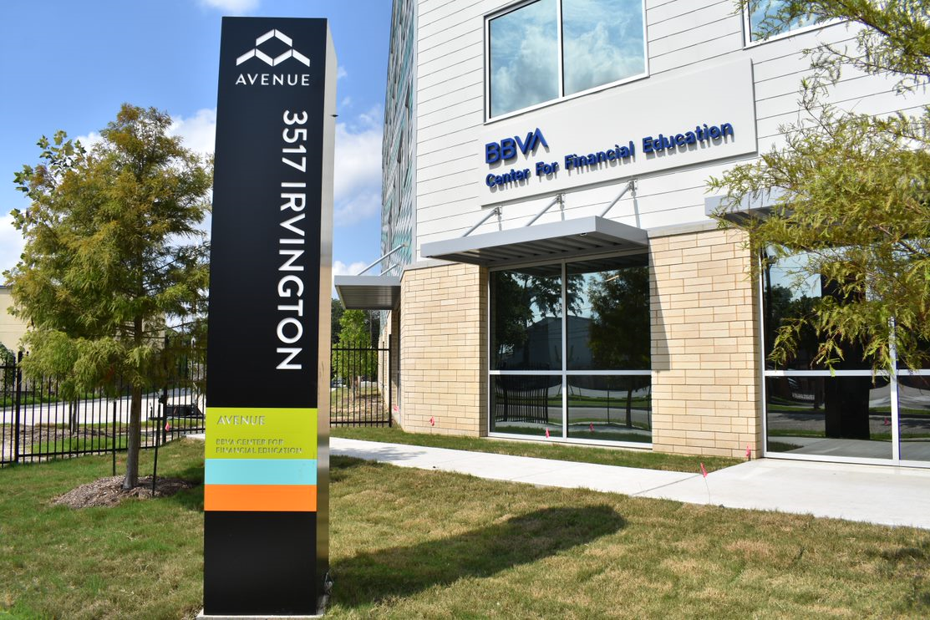
Avenue Center
Avenue Center is a mixed-use community resource HUB located at 3527 Irvington Blvd in the Near Northside.

Slide 47
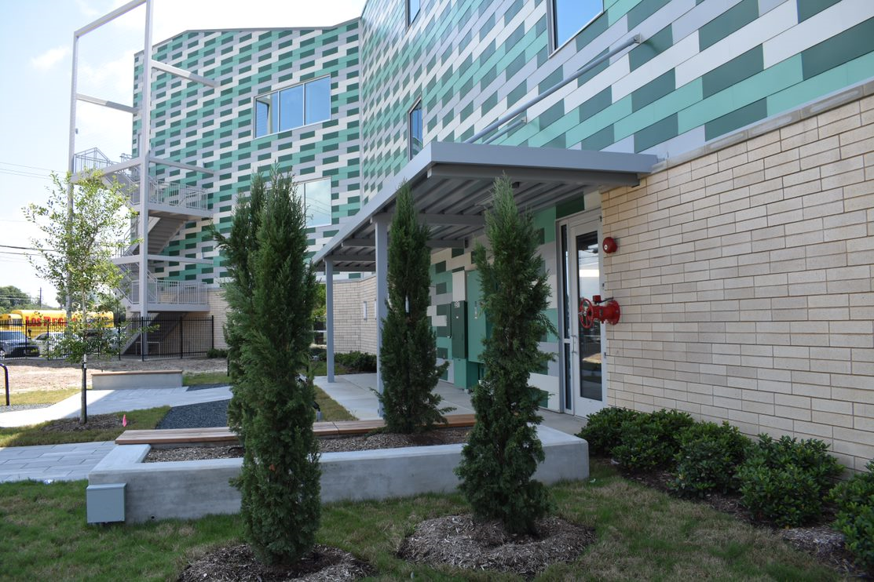
Avenue Center
This state-of-the-art, three story, 30,500 SF complex will serve as Avenue Community Development Corporation's headquarters.

Slide 48
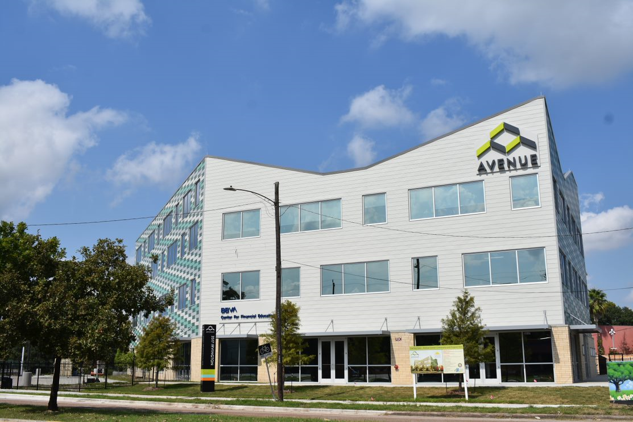
Avenue Center
The facility will feature a Homeownership Center, health clinic, realty offices, early childhood education center, solar power electric car charging station and generator.

Slide 49
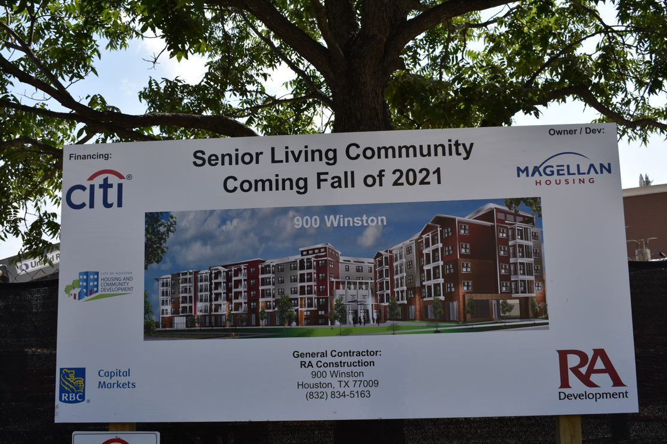
900 Winston Senior Living Community
Construction is now underway on this Senior Living Community located at 900 Winston near Houston's Heights neighborhood.

Slide 50
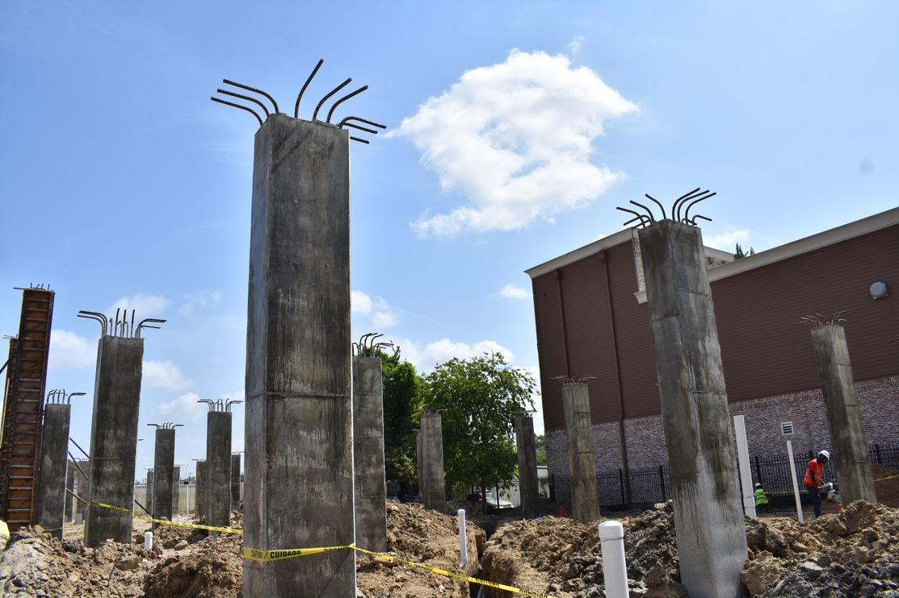
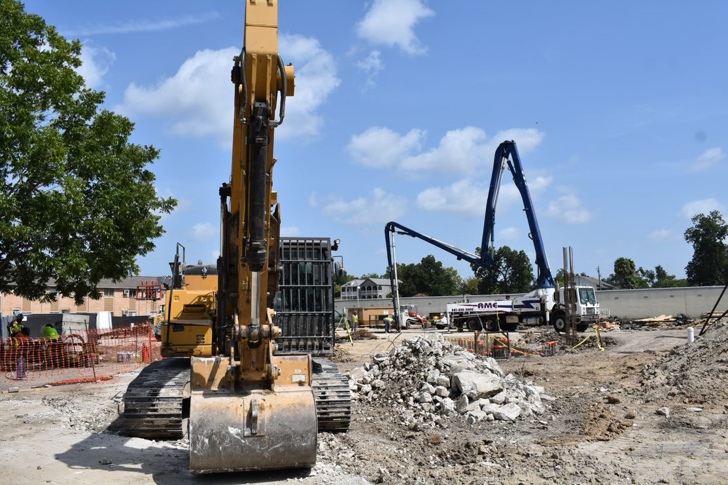
900 Winston Senior Living Community
900 Winston will be a 114 unit, mixed-income affordable housing community for seniors that will feature a fitness center, business center & meeting spaces.

Slide 51
Homebuyer Assistance Program
Provides up to $30,000 to help Houstonians purchase a home

Slide 52
Single Family Home Repair Program
New Home Development
Repairs and reconstructs existing homes for homeowners

Slide 53
New Home Development Program
New Home Development
NHD builds new homes for sale at affordable prices

Slide 54
Other Programs (Fiscal Year to Date)
3,596
Service Visits –
Public Services (Jun ‘20)
11
Projects under construction –
Public Facilities (FY21)
Note: Public Services numbers have a one-month lag in reporting due to the nature of these programs.

Slide 55
Spending by Program Area FY21 (to date) vs. FY20
New Home Development
Note: FY21 numbers
do not include
project delivery

Slide 56
THANK YOU!

Slide 57
Housing & Community Affairs Committee Presentation
Houston apartment association
August 18, 2020

Slide 58
About HAA
Non-profit trade association representing the owners, managers and employees of the apartment industry in Houston and surrounding areas.
Our members operate about 650,000 units representing over 90% in the Houston area.
Our mission
Education
Communication
Advocacy

Slide 59
HAA During the Pandemic
Advocacy:
Critical to help policymakers understand that apartment community workers are “essential personnel” to maintain homes for Houston renters.
Worked with city leaders and BakerRipley on May Phase 1 rental assistance program
Philanthropy - $100,000 donation to ACAM
Educating our members
County Judge’s Orders
Governor’s Orders
Texas Supreme Court Orders
CARES Act

Slide 60
Key Issue - Evictions
Eviction Policy Timeline
CARES Act suspended evictions on “covered properties” through July 24, then only after 30-day notice to vacate
Texas Supreme Court Moratoria – Series of orders suspended all residential non-payment evictions through May 18.
Courts given flexibility over deadlines through September
Courts have limited ability to hold jury trials through October 1

Slide 61
Key Issue – Evictions (continued)
Eviction is a last resort– Properties want to keep residents.
But…providing housing costs money.
Mortgage
Property Taxes
Utilities
Staff Payroll
Maintenance and Cleaning Supplies
Sample Survey – Since pandemic began, 218 respondents to HAA survey have deferred $2.9 million in rent, waived $1.5 million in fees.

Slide 62
Key Issue – Rental Assistance
Houston Phase 1 Rental Assistance (May) - $15 million available to families < 80% AMI
Program distributed funds to those in need quickly but was quickly exhausted.
Harris County Programs
Various programs involving direct assistance. New $25 million program will include rental assistance.
Surrounding Cities and Counties – Various rental assistance programs underway in Fort Bend County, Montgomery County, Brazoria County and the City of Pearland.
Federal – Negotiations underway to gain additional relief

Slide 63
Key Issue – Property Operations
Property common/amenity areas – Faced with unclear or conflicting requirements, many properties have closed amenity areas like fitness centers, community rooms and swimming pools. Others have tried to keep some or all open with enhanced cleaning and social distancing requirements.
Maintenance and Cleaning
Challenges created with maintenance technicians entering occupied units.
Added stress on property and staffs with more residents in their units all day.
Added utility and cleaning costs
Plumbing stress (Wipes aren’t flushable)

Slide 64
Resources for Your Constituents
HAA resources for residents here: https://haaonline.org/renters
Financial resources for renters: https://haaonline.org/financialhelp
HAA Resident Relations Department: (713) 595-0303 (Be patient)
Lone Star Legal Aid: (713) 652-0077
City of Houston Fair Housing: (713) 652-0077, Ext. 5
Habitability issues: Call 311 – Ask for Multifamily Habitability
Swimming Pool Issues: Call 311 – Ask for “Consumer Health Services”

Slide 65
Issues for When This Is All Over…
Property Taxes – Primary driver of need to increase rent.
Wages – Real wages for low-skill and unskilled labor aren’t keeping up with the real cost of providing rental housing
Solid Waste – Houston still pays for solid waste service out of general revenue, but only provides service to single-family homes.
Housing Vouchers
Insufficient supply of housing choice vouchers
Voucher Mobility (NestQuest)
Eviction Policy after the pandemic

Slide 67
Evictions in Houston and Harris County
August 18, 2020

Slide 68
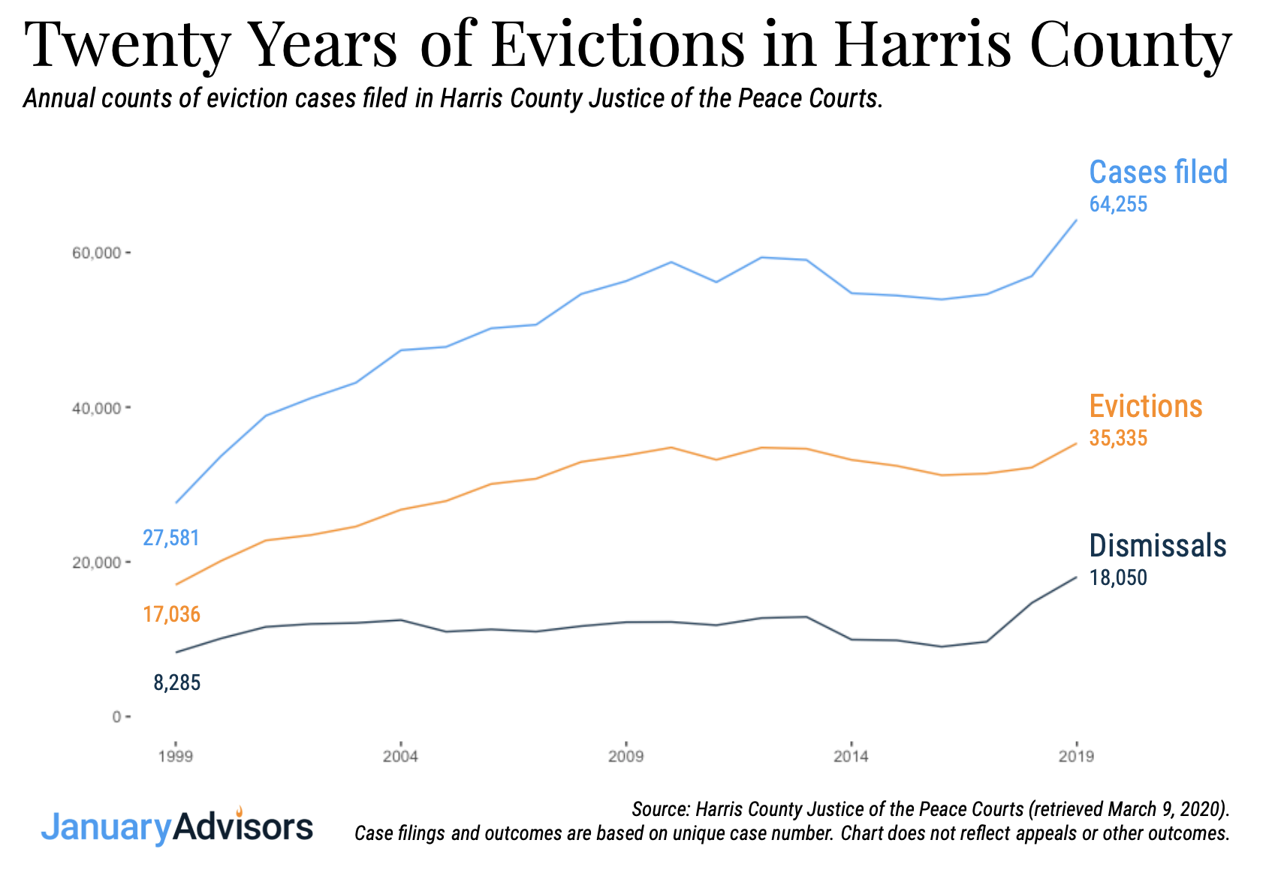
+ Houston Housing Collaborative
Notes:
What is an eviction as defined here?
Overview of what cases filed, evictions, and dismissals mean.

Slide 69
How many households had an eviction threat?
(doesn’t include appeals or duplicates)
+ Houston Housing Collaborative
Notes:
What is an eviction as defined here?
Overview of what cases filed, evictions, and dismissals mean.

Slide 70
cases with a final judgment or default judgment in favor of the plaintiff
+ Houston Housing Collaborative
Notes:
What is an eviction as defined here?
Overview of what cases filed, evictions, and dismissals mean.

Slide 71
only cases with a status of “Dismissed”
+ Houston Housing Collaborative
Notes:
What is an eviction as defined here?
Overview of what cases filed, evictions, and dismissals mean.

Slide 72
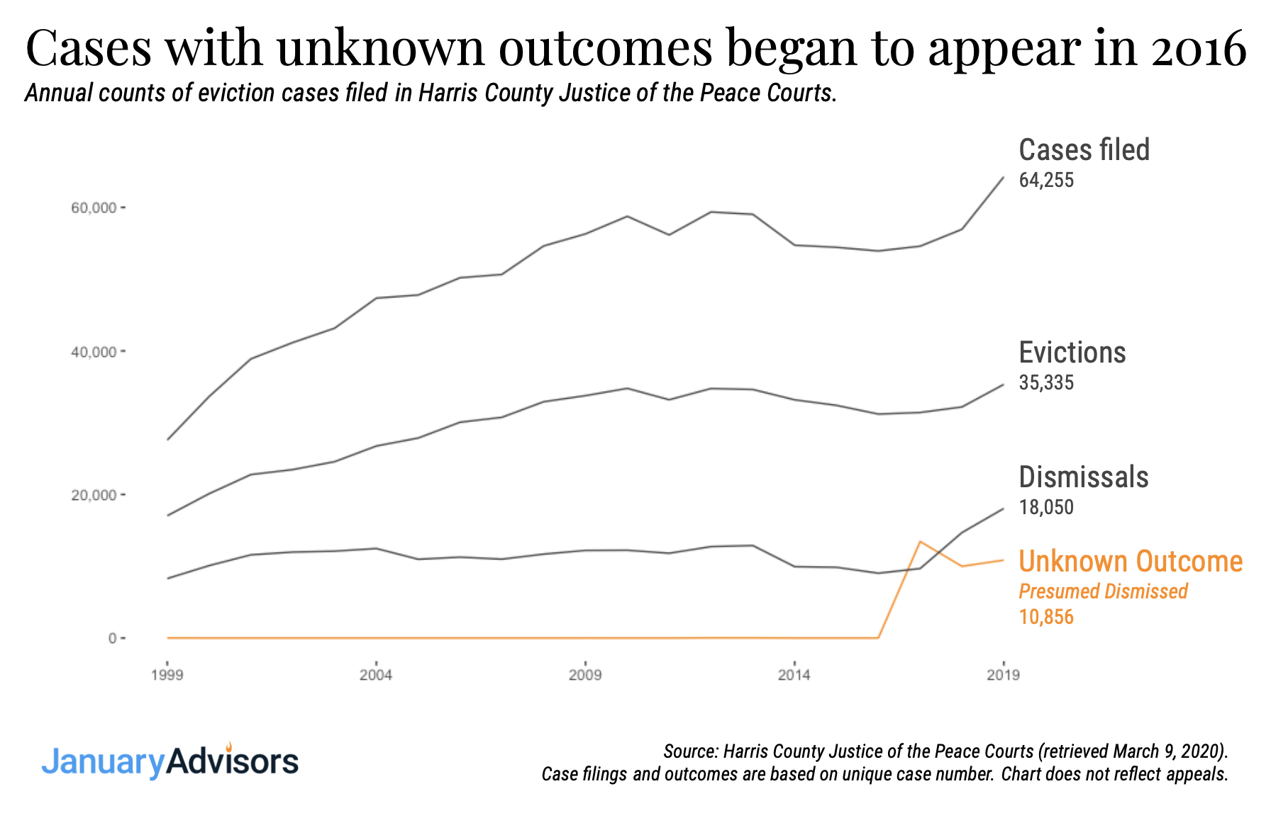
+ Houston Housing Collaborative

Slide 73
+ Houston Housing Collaborative
Notes:
What is an eviction as defined here?
Overview of what cases filed, evictions, and dismissals mean.

Slide 77
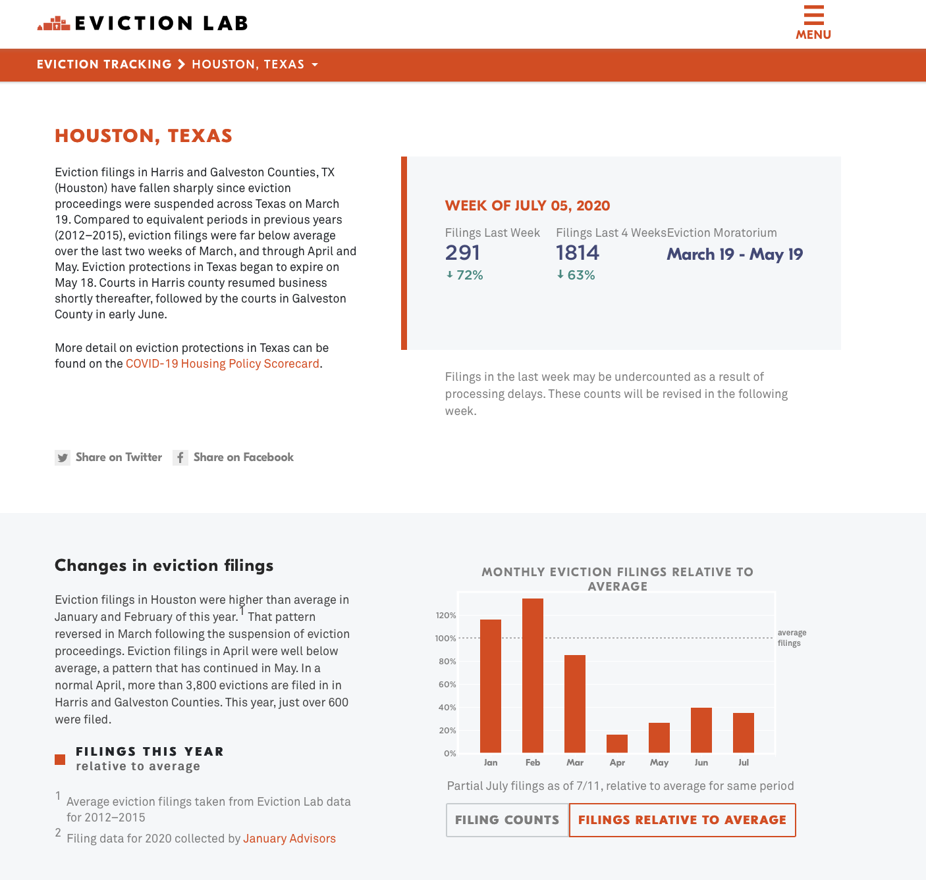

Slide 78
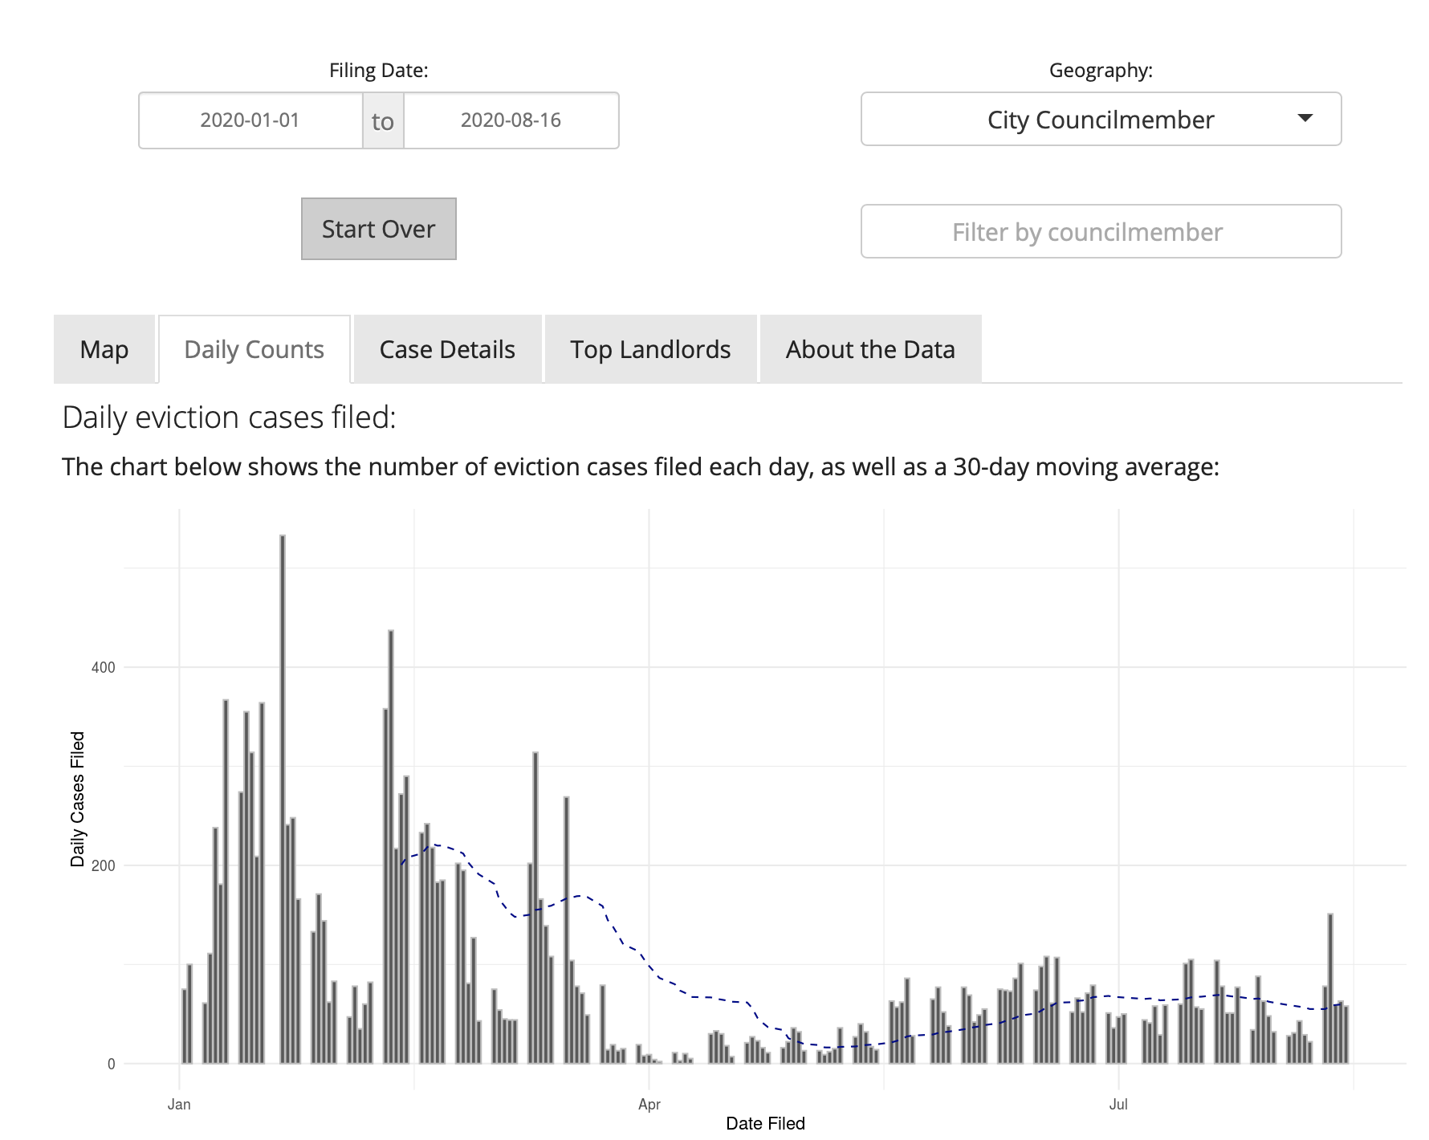
Eviction filings are down from pre-Covid levels
Eviction case filings are down due to CARES act and extended unemployment, but the steady trend is alarming.

Slide 79
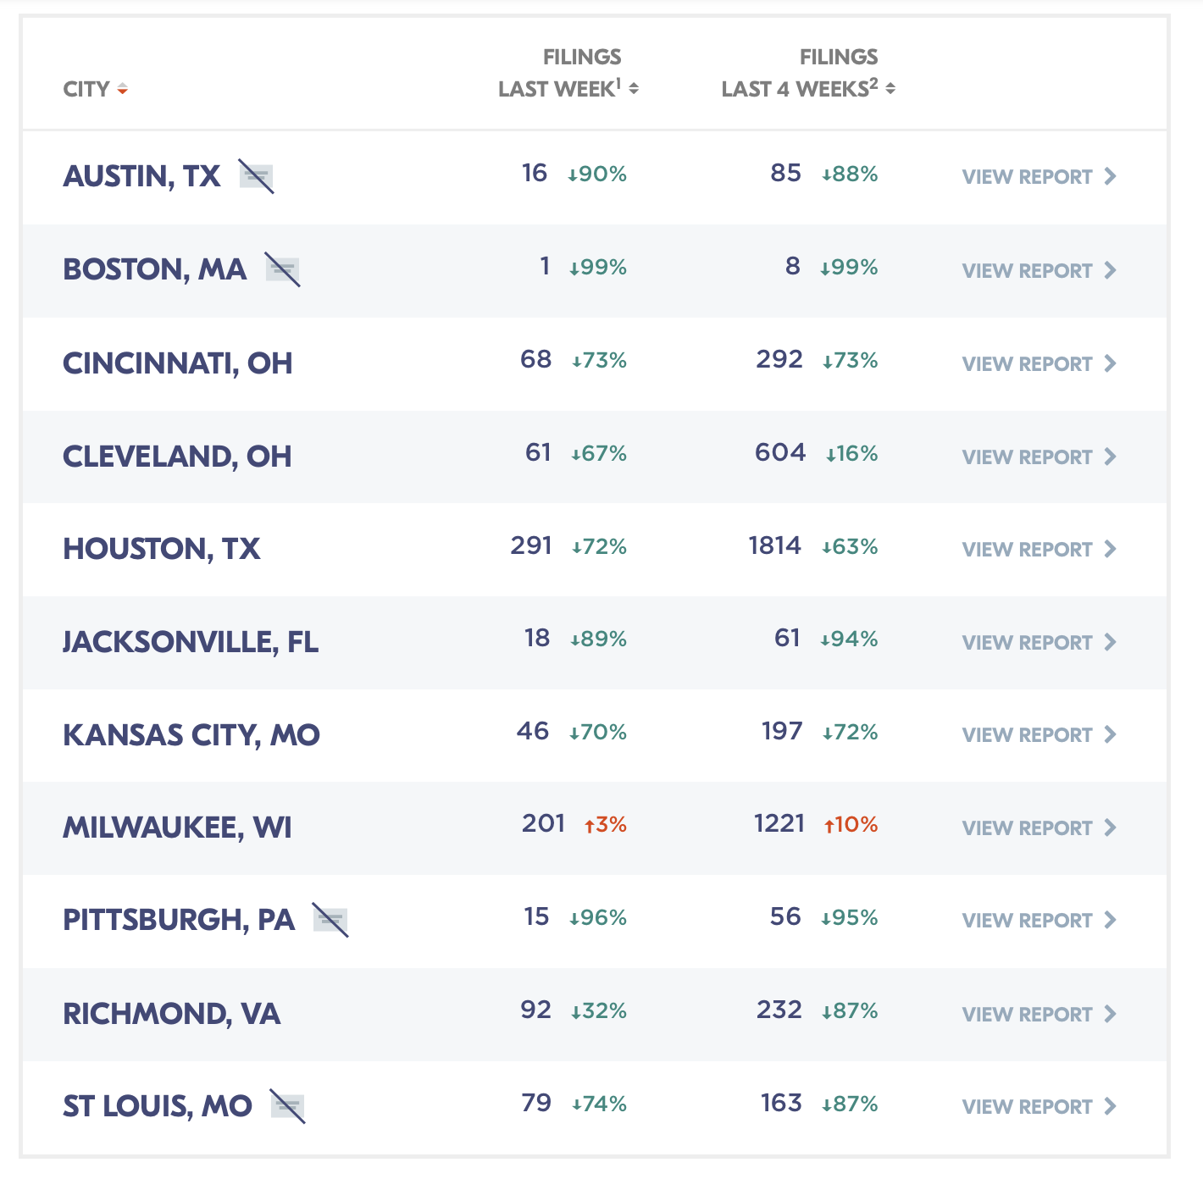
But Houston still has a lot more evictions that other cities.

Slide 80
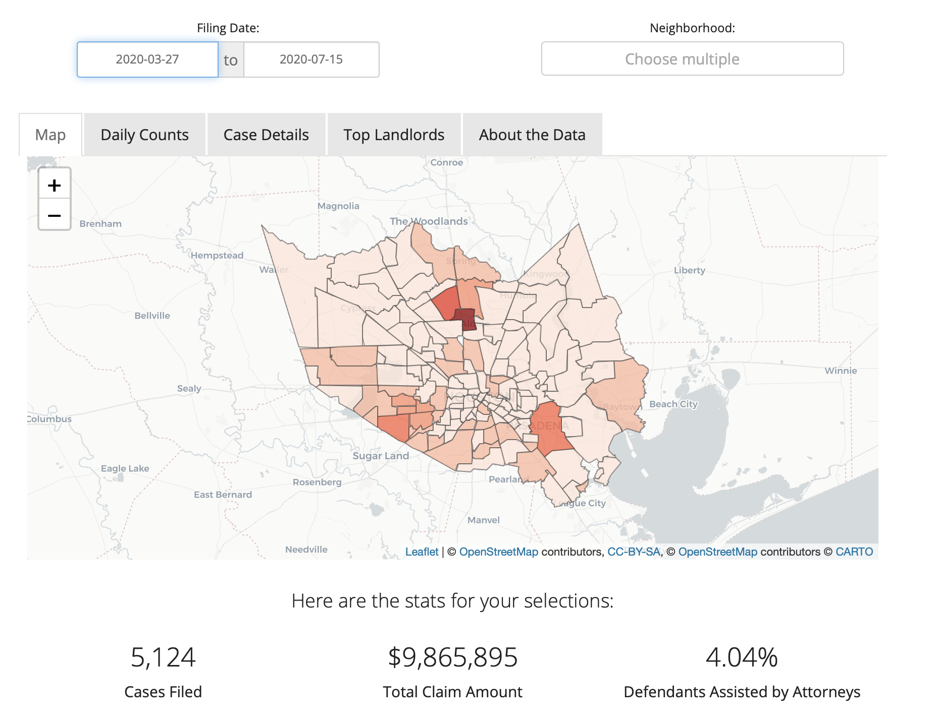
There’s a lot at stake for certain neighborhoods.

Slide 81
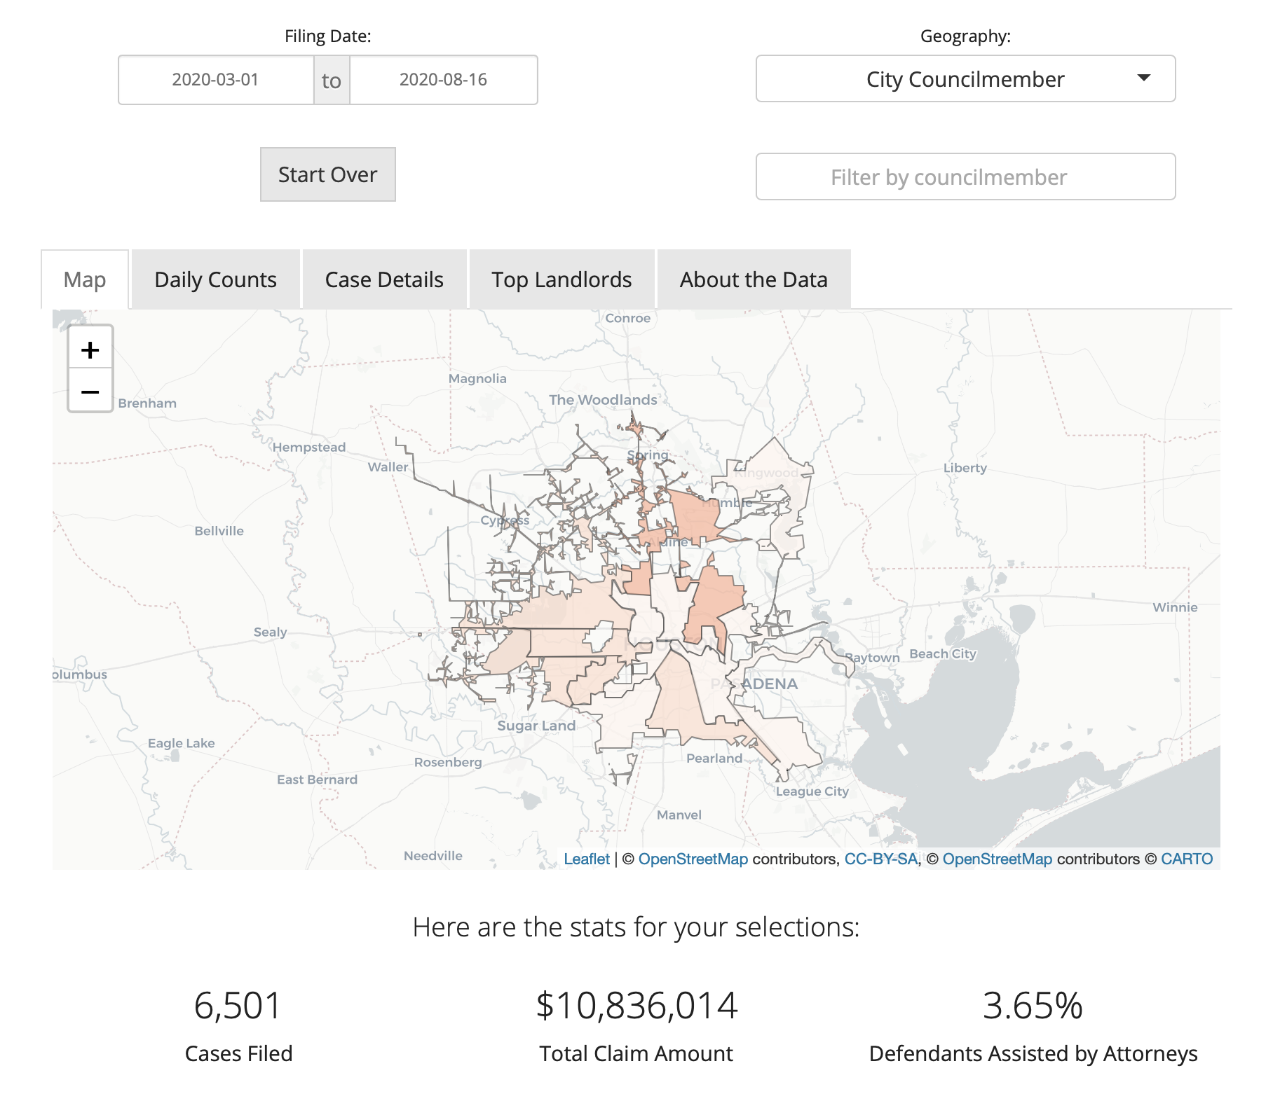
And very few tenants have legal assistance.

Slide 82
The Complete Communities neighborhoods are hard hit.
Neighborhood | Evictions Filed Since March 1, 2020
Acres Homes | 90
Alief - Westwood | 359
Fort Bend Houston | NA
Gulfton | 140
Kashmere Gardens | 82
Magnolia Park | 47
Manchester | 7
Near Northside | 38
Second Ward | 20
Sunnyside | 65
Third Ward | 97

Slide 83
So are certain city council districts.
Council District | Councilmember | Evictions Filed Since March 1, 2020
A | Amy Peck | 640
B | Jerry Davis | 1,039
C | Abbie Kamin | 325
D | Carolyn Evans-Shabazz | 661
E | David Martin | 380
F | Tiffany Thomas | 756
G | Greg Travis | 768
H | Karla Cisneros | 288
I | Robert Gallegos | 461
J | Edward Pollard | 764
K | Martha Castex-Tatum | 429

Slide 84
Policy Comments
Rental assistance is an imperfect and cumbersome method of administering funds. Direct financial assistance is better.
Achieve parity in City/County programs. Currently, City and County have different requirements, confusing an already complicated user experience. They should operate programs with the same rules.
We need a grace period ordinance. Housing stability depends on giving tenants more time to pay their accumulated debt. There is universal support for this ordinance.
Payment plans between landlords and tenants must be templatized and audited to ensure the City doesn’t encourage tenants to enter into new, possibly predatory legal agreements under duress.
Follow your open data policy. Be more transparent with the administration of public funds.

Slide 85
Questions?
Jeff Reichman January Advisors jeff@januaryadvisors.com @fileunderjeff
https://www.januaryadvisors.com/evictions

