Slide 1
Housing and Community
Affairs Committee
August 31, 2021

Slide 2
Agenda
I. Welcome/Introductions
II. Multifamily
III. Public Services
IV. Director's Comments
V. Public Comments

Slide 3
MULTIFAMILY
Ana Martinez, Deputy Assistant Director

Slide 4
Item II.a. Interlocal Agreement with Harris County (District B)
An Ordinance authorizing an Interlocal Agreement (ILA) between the City and Harris County Flood Control District (County),
To close on 17030 and 17050 Imperial Valley, Houston, Texas on behalf of both entities.
The County will fund the acquisition, relocation of tenants, and demolition. Once completed, the City will transfer the Property to the County.

Slide 5
Item II.a. Interlocal Agreement with Harris County (District B)
The City will enter into an Option Agreement under a separate Ordinance with AMG City View Apartments, LLC.
The property will be purchased with CDBG-DR17 funds, subject to applicable approvals and clearances.
The Project is made up of 19.8105 acres of land and 417,463 square feet of improvements.

Slide 6
Item II.a. Interlocal Agreement with Harris County (District B)
The purchase price totals $37,781,336.00
The City and County will each contribute $18,890,668.00.
Upon approval from the Texas GLO and HUD, the City will close on the Property and acquire title.

Slide 7
Item II.a. Interlocal Agreement with Harris County (District B)
Once the City has relocated the tenants and completed demolition, title to the Property will be transferred to the County.
The County will maintain the property in perpetuity for open space, recreational, or floodplain and wetlands management.

Slide 8
Item II.a. Interlocal Agreement with Harris County (District B)
​Sources |  | ​Uses
​City of Houston – CDBG-DR17 | ​$18,890,668.00 | ​Acquisition | ​$32,000,000.00
​Harris County Flood Control District – Bond Funds | ​$18,890,668.00 | ​Relocation | ​$5,381,336.00
​ | ​ | ​Demolition | ​$400,000.00
Total | $37,781,336.00 | Total | $37,781,336.00

Slide 9
Item II.b. W. Leo Daniels Tower Inc.
(District H)
An Ordinance authorizing an Agreement between the City and W. Leo Daniels Tower Inc., a nonprofit partner of The ITEX Group, LLC;
Providing a $10,000,000.00 CDBG-DR17 loan;
For the rehabilitation of an apartment community for low-to moderate-income (LMI), disabled and elderly residents at 8826 Harrell Street, Houston, TX 77093.

Slide 10
Item II.b. W. Leo Daniels Tower Inc.
(District H)
Built in 1979, W. Leo Daniels Tower is an eight-story apartment building in need of rehabilitation.
Once completed, it will offer 100 efficiencies and one-bedroom units for the disabled and elderly.
A HUD Section 202 Grant will subsidize these units so residents will pay no more than 30% of their income in rent.

Slide 11
Item II.b. W. Leo Daniels Tower Inc.
(District H)
The rehabilitation will provide quality supportive housing where residents can maintain close ties to friends and family.
Residents will have access to the Greater Jerusalem Baptist Church programs, including hot meals, a bus service, and health screenings.

Slide 12
Item II.b. W. Leo Daniels Tower Inc.
(District H)
The City’s loan term and affordability period will be 40 years, commencing when construction is completed.
Upon completion, the outstanding principal balance of the note shall accrue at 1% interest.

Slide 13
Item II.b. W. Leo Daniels Tower Inc.
(District H)
The Borrower will pay an annual installment equal to the lesser of:
1% annually on the outstanding balance of the loan plus accrued unpaid interest, if any, or
50% of net cash flow, provided the default rate interest of 10% per annum will accrue in the event of default.

Slide 14
Item II.b. W. Leo Daniels Tower Inc.
(District H)
Interest shall be calculated utilizing a 360-day basis for the actual number of days principal is outstanding.
Unpaid interest will accrue and will be payable from future available cash flow.
If the loan is not in default at the end of the 40-year term, the unpaid principal balance and interest will be forgiven.

Slide 15
Item II.b. W. Leo Daniels Tower Inc.
(District H)
Sources | Amount | Uses | Amount
City of Houston (CDBG DR-17) | $10,000,000.00 | Hard Cost |  | $13,850,369.00
Conventional Loan | $4,000,000.00 | Soft Cost |  | $4,730,420.00
4% Housing Tax Credit Proceeds | $10,449,992.00 | Acquisition Cost |  | $4,500,000.00
In-Kind Equity/ Deferred Developer Fee |  | Developer Fee |  | $2,580,625.00
Private Grant/Loan | $2,081,423.00 | Reserves |  | $870,002.00
Total Source of Funds: | $26,531,416.00 | Total Project Cost: |  | $26,531,416.00

Slide 16
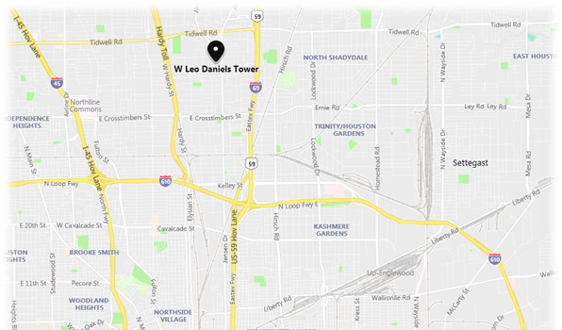
Item II.b. W. Leo Daniels Tower Inc.
(District H)

Slide 17
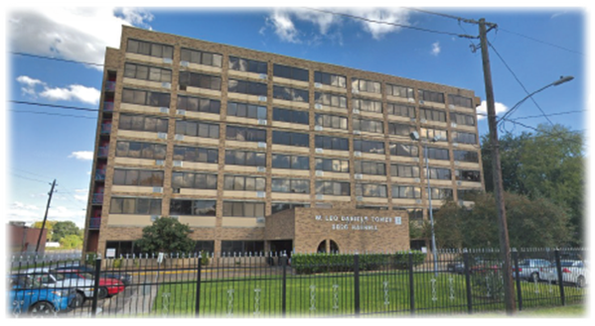
Item II.b. W. Leo Daniels Tower Inc.
(District H)
W. Leo Daniels Tower, 8826 Harrell St, Houston, TX 77093

Slide 18
Item II.c. New Hope Housing Savoy (District J)
HCDD recommends Council approval of an Ordinance authorizing a $13,200,000.00 CDBG-DR17 loan,
For a Contract between the City and Houston Area Community Development Corporation (Borrower),
For the land acquisition and new development of New Hope Housing (NHH) Savoy, located at 6301 Savoy Drive, Houston, TX 77036.

Slide 19
Item II.c. New Hope Housing Savoy (District J)
NHH Savoy will be a 120-unit four-story, elevator-accessible rental community offering one-, two-and three-bedroom units.
This community will serve households at 30%, 50%, 60%, and 80% of the Area Median Income.
It will provide Permanent Supportive Housing for disabled individuals and families at risk of homelessness.

Slide 20
Item II.c. New Hope Housing Savoy (District J)
New Hope Housing has a 26-year track record of developing quality, affordable rental housing.
The Savoy development will be the 11th property in NHH's portfolio and its third aimed at serving families.

Slide 21
Item II.c. New Hope Housing Savoy (District J)
This project is funded by CDBG-DR17 program funds awarded by HUD, through the Texas GLO.
With this funding, HCDD will support affordable rental units for low-to moderate-income households
The project will be administered in accordance with the City’s Harvey Multifamily Program Guidelines.

Slide 22
Item II.c. New Hope Housing Savoy (District J)
The loan will be non-amortizing and the affordability period will be 40 years and will commence when the construction period is completed.
Following project completion, the outstanding principal balance of the note shall accrue at 1% interest.
Borrower will pay an annual installment of interest from available cash flow.

Slide 23
Item II.c. New Hope Housing Savoy (District J)
Sources: |  | Uses:
City of Houston (CDBG-DR17) | $13,200,000.00 | Acquisition | $4,054,500.00
9% Housing Tax Credit | $14,128,529.00 | Hard Costs | $22,941,693.00
Charitable Contributions | $6,465,818.00 | Soft Costs | $3,621,601.00
In-Kind Equity/ Def. Developer Fee |  | Reserves | $363,269.00
GP Capital | $100.00 | Developer Fee | $2,813,384.00
Total Source of Funds: | $33,794,447.00 | Total Project Cost: | $33,794,447.00

Slide 24
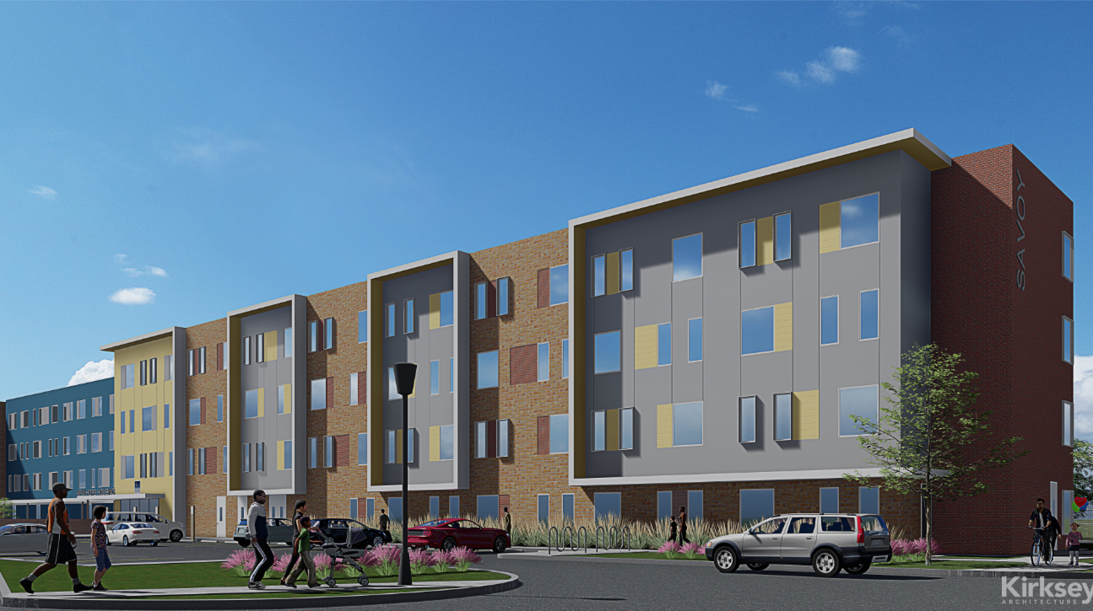
Item II.c. New Hope Housing Savoy (District J)

Slide 25
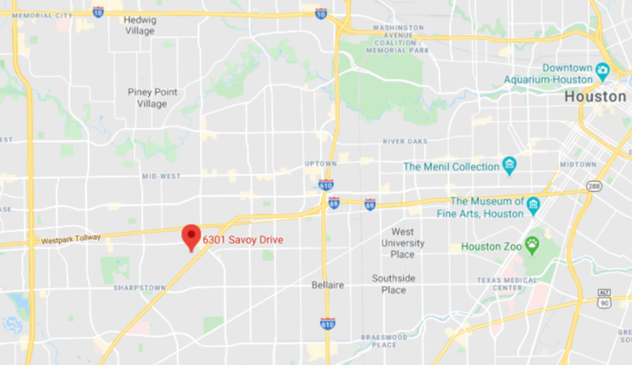
Item II.c. New Hope Housing Savoy (District J)

Slide 26
Item II.d. Webster Block Homes
(District D)
An Ordinance authorizing a Contract between the City and Project Row House Preservation, Inc., (Borrower),
To provide a $1,461,360.00 CDBG-DR17 loan,
For the new construction of multifamily homes serving low-to moderate-income renters in Houston’s historic Third Ward.

Slide 27
Item II.d. Webster Block Homes
(District D)
Webster Block Homes is the final phase of the restoration of an urban block of shotgun-style row houses.
This phase consists of the new construction of seven two-bedroom single family rental homes.
This phase will complement the first development phase of nineteen renovated homes.

Slide 28
Item II.d. Webster Block Homes
(District D)
Each unit will be rent restricted, targeting lower income households first.
One unit each will be reserved for a 30%, a 50%, a 60% and an 80% AMI household.
Proximity to the Metrorail provides access to Downtown Houston, the Texas Medical Center and other job centers.

Slide 29
Item II.d. Webster Block Homes
(District D)
The homes will be built to ENERGY STAR certified standards and will include:
A complete thermal enclosure system,
Heating and cooling system,
Water Management system, and
Energy-efficient lighting and appliances.

Slide 30
Item II.d. Webster Block Homes
(District D)
The loan and affordability period will be 20 years and will commence when the construction period is completed.
The loan will be non-amortizing throughout both the construction and affordability period and no payments will be required.

Slide 31
Item II.d. Webster Block Homes
(District D)
Sources | Amount | Uses | Amount
City of Houston Request | $1,461,360.00 | Hard Cost | $792,576.00
Kinder Foundation | $380,978.00 | Soft Cost | $1,000,095.00
Rockwell | $150,000.00 | Acquisition Cost | $380,978.00
In-Kind | $202,311.00 | Reserves | $21,000.00
Total Source of Funds: | $2,194,649.00 | Total Project Cost: | $2,194,649.00

Slide 32
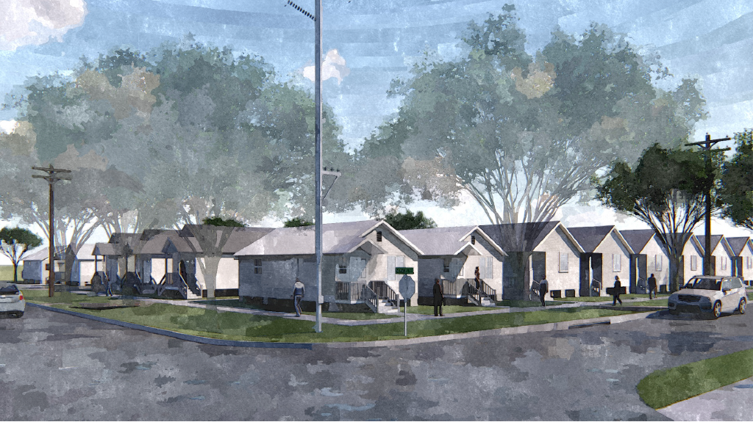
Item II.d. Webster Block Homes
(District D)
Artist’s rendering of the proposed Webster Block Homes development.

Slide 33
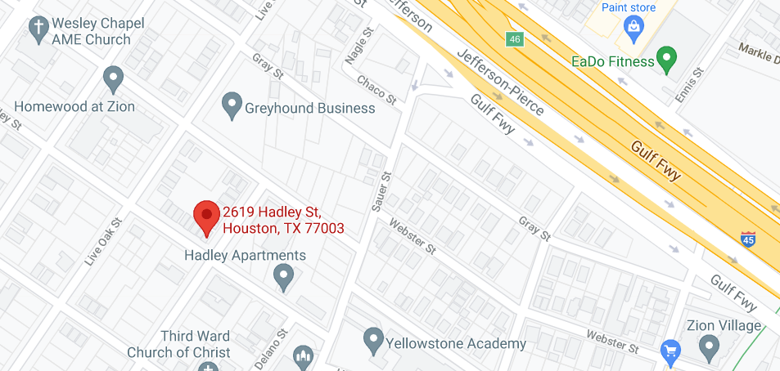
Item II.d. Webster Block Homes
(District D)

Slide 34
Item II.e. Old Spanish Trail Apartments (District D)
An Ordinance authorizing a $1,989,897.00 CDBG-DR1) loan for a Contract between the City and The St. Bernard Project, Inc. dba SBP Inc., (Borrower).
For the land acquisition and new construction of Old Spanish Trail (OST) Apartments, at 3500 Old Spanish Trail, Houston, TX 77021.
OST Apartments will serve low- to moderate- income renters.

Slide 35
Item II.e. Old Spanish Trail Apartments (District D)
The OST Apartments will provide seven house-scale multifamily rental homes for individuals and families.
The property will provide a mix of one- and two-bedroom units for households at 30%, 50%, 60%, and 80% of the Area Median Income.
The site is conveniently located near the Texas Medical center.

Slide 36
Item II.e. Old Spanish Trail Apartments (District D)
The OST Apartments will include energy efficient appliances in all units.
This project will incorporate green building practices in accordance with the ENERGY STAR Multifamily standards.

Slide 37
Item II.e. Old Spanish Trail Apartments (District D)
This project is funded by CDBG-DR17 program funds awarded by HUD, through the Texas GLO.
OST Apartments will provide seven affordable rental units for income-eligible households.
This project will be administered in accordance with the City’s Harvey Multifamily Program Guidelines.

Slide 38
Item II.e. Old Spanish Trail Apartments (District D)
The loan and affordability period will be 20 years and will commence when the construction period is completed.
Loan will be non-amortizing throughout both the construction and affordability period and no payments will be required.

Slide 39
Item II.e. Old Spanish Trail Apartments (District D)
SOURCES |  | USES
City of Houston Request | $1,989,897.00 | Hard Cost | $1,309,800.00
Cash Equity | $221,100.00 | Soft Cost | $321,197.00
 |  | Acquisition Cost | $470,000.00
 |  | Developer Fee | $100,000.00
 |  | Reserves | $10,000.00
Total Source of Funds: | $2,210,997.00 | Total Project Cost: | $2,210,997.00

Slide 40
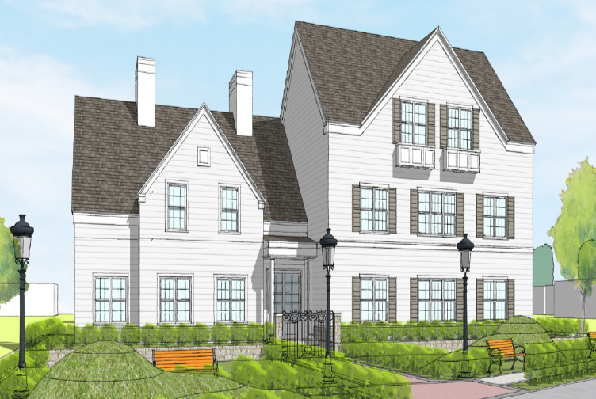
Item II.e. Old Spanish Trail Apartments (District D)
Rendering of the proposed Old Spanish Trails development.

Slide 41
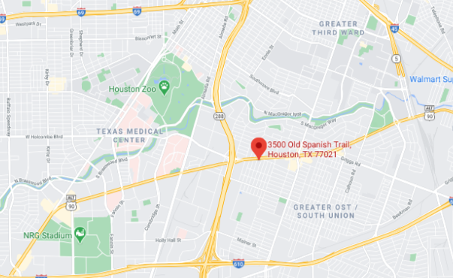
Item II.e. Old Spanish Trail Apartments (District D)

Slide 42
Item II.f. Tabor Street Homes (District H)
An Ordinance authorizing a $1,931,037.00 CDBG-DR17 loan,
For a Contract between the City and The St. Bernard Project, Inc. dba SBP Inc., (Borrower)
For the land acquisition and new construction of Tabor Street Homes, serving low- to moderate-income renters at 1404 Tabor Street, Houston, TX 77009.

Slide 43
Item II.f. Tabor Street Homes (District H)
Tabor Street Homes (TSH) will be a seven-unit house-scale multifamily rental development serving individuals and families.
The property will provide a mix of one-and two-bedroom units for households at 30%, 50%, 60%, and 80% of the Area Median Income.
TSH will feature energy efficient appliances in all units and will incorporate green building practices in accordance with the ENERGY STAR Multifamily standards.

Slide 44
Item II.f. Tabor Street Homes (District H)
The site is within walking distance to a park, community center, and retail,
TSH is situated within two miles of a grocery store, pharmacy, library, and hospital.
Bus routes and planned bike lanes along Cavalcade Street give residents multiple options for getting around safely.

Slide 45
Item II.f. Tabor Street Homes (District H)
This project is funded by CDBG-DR17 program funds awarded by HUD, through the Texas GLO.
TSH will provide seven affordable rental units for low to moderate income households.
This project will be administered in accordance with the City’s Harvey Multifamily Program Guidelines.

Slide 46
Item II.f. Tabor Street Homes (District H)
The loan and affordability period will be 20 years and will commence when the construction period is completed.
The loan will be non-amortizing throughout both the construction and affordability period and no payments will be required.

Slide 47
Item II.f. Tabor Street Homes (District H)
Sources | Amount | Uses | Amount
City of Houston Request | $ 1,931,037.00 | Hard Cost | $1,259,800.00
Cash Equity | $ 214,560.00 | Soft Cost | $315,797.00
 |  | Acquisition Cost | $460,000.00
 |  | Developer Fee | $100,000.00
 |  | Reserves | $10,000.00
Total Source of Funds: | $2,145,597.00 | Total Project Cost: | $2,145,597.00

Slide 48
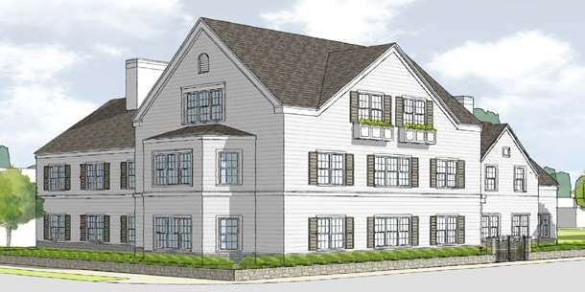
Item II.f. Tabor Street Homes (District H)

Slide 49
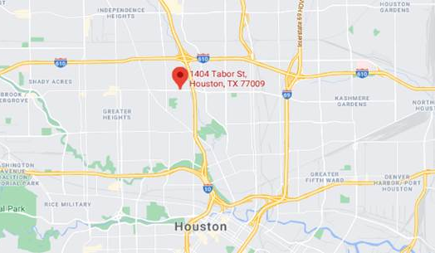
Item II.f. Tabor Street Homes (District H)

Slide 50
PUBLIC SERVICES
Melody Barr, Deputy Assistant Director

Slide 51
Item III.a. The Women’s Home
(District A)
An Ordinance authorizing a First Amendment to the Contract between the City of Houston and The Women’s Home;
Providing up to $611,801.95 in CDBG-DR17 funds;
For Health Care Services, Job Training and Social Services to low-to-moderate income residents affected by Hurricane Harvey.

Slide 52
Item III.a. The Women’s Home
(District A)
The Women’s Home will use the CDBG-DR17 funds to provide:
Case Management,
Mental Health counseling,
Substance abuse services,
Job Training and Education
The above services will be provided to 75 homeless women at the Life Learning Center.

Slide 53
Item III.a. The Women’s Home
(District A)
HCDD conducted a Request for Proposals (RFP) for CDBG contracts for fiscal year 2020 with a one-year extension option for fiscal year 2021.
The initial contract period was April 1, 2020 through March 31, 2021.
The contract was administratively extended through March 31, 2022.

Slide 54
Item III.a. The Women’s Home
(District A)
FUNDING SOURCE | AMOUNT | Percent
Administration Costs | $39,107.42 | 6.39%
Direct Program Service Costs | $572,694.54 | 93.61%
Total | $611,801.95 | 100%
As of June 2021, The Women’s Home has expended approximately 95% of funds and achieved 100% of their client goal.
There were no findings on their annual compliance monitoring.

Slide 55
Item III.b. Houston Area Urban League
(All Districts)
An Ordinance authorizing a First Amendment to the Agreement between the City of Houston (City) and the Houston Area Urban League (HAUL),
To provide up to an additional $300,000.00 in CDBG-DR17 funds
For Housing Counseling Services to a minimum of 350 low-to-moderate income households impacted by Hurricane Harvey.

Slide 56
Item III.b. Houston Area Urban League
(All Districts)
Services will include:
HUD certified Pre-Purchase education classes,
One-on-one Homebuyer counseling,
Post-purchase counseling, and
Foreclosure Prevention education

Slide 57
Item III.b. Houston Area Urban League
(All Districts)
The initial term of this Agreement was June 1, 2020 – May 31, 2021, with a one-year administrative extension through May 31, 2022.
This First Amendment will fund the extension period.
HAUL has received funding from the City since June 2020.

Slide 58
Item III.b. Houston Area Urban League
(All Districts)
Category | Amount | Percentage
Program Services | $264,441.51 | 88.15%
Program Administration | $35,558.49 | 11.85%
Total | $300,000.00 | 100%
HAUL has expended approximately 97% of their funds in the first 12-months and achieved 70% of their client service goal.
There were no findings on the annual compliance monitoring.

Slide 59
Item III.c. Buckner Children and Family Services, Inc. (All Districts)
A Second Amendment to the Agreement between the City of Houston (City) and Buckner Children and Family Services, Inc.;
Providing up to $100,000.00 in CDBG funds for housing and support services;
For families with children who are in danger of being separated.

Slide 60
Item III.c. Buckner Children and Family Services, Inc. (All Districts)
The project will provide housing and supportive services for:
Up to 30 families who meet the criteria outlined by the Texas Department of Family and Protective Services and;
Who are low-to moderate-income, which qualifies them for residence in New Hope Housing at Reed Road.

Slide 61
Item III.c. Buckner Children and Family Services, Inc. (All Districts)
Services will include family coaching, case management, and E.S.L. and G.E.D. classes.
Buckner adopts the Keeping Families Together model, which leverages supportive housing to offer stability to families with children.
This reduces foster care placement costs and reunites children with their families.

Slide 62
Item III.c. Buckner Children and Family Services, Inc. (All Districts)
Family is defined as:
“At least one adult and one child who are related biologically, emotionally, or legally and are living in the same household, and non-custodial parents with legal responsibility for children under 18.”
Families may consist of one parent, two parents, grandparents, foster parents or legal guardians caring for children under the age of 18.

Slide 63
Item III.c. Buckner Children and Family Services, Inc. (All Districts)
HCDD conducted a Request for Proposal (RFP) for Public Services contracts for FY 2019 with a one-year renewal option for FY 2020.
Buckner Children and Family Services, Inc. was one of the agencies selected.

Slide 64
Item III.c. Buckner Children and Family Services, Inc. (All Districts)
The initial term of this agreement was from March 1, 2019 – February 29, 2020.
The First Amendment extended funding from March 1, 2020 - October 31, 2021.
This Second Amendment will provide funding through October 31, 2022.

Slide 65
Item III.c. Buckner Children and Family Services, Inc. (All Districts)
CDBG FUNDING CATEGORY | AMOUNT | Percent
Program Costs | $100,000.00 | 100%
Administrative | $0 | 0%
Total | $100,000.00 | 100%
As of June 2021, Buckner had utilized 60% of their funding and met 87% of their client goal.
There were no findings on their annual compliance monitoring.

Slide 66
DIRECTOR'S COMMENTS
Tom McCasland, Director

Slide 67
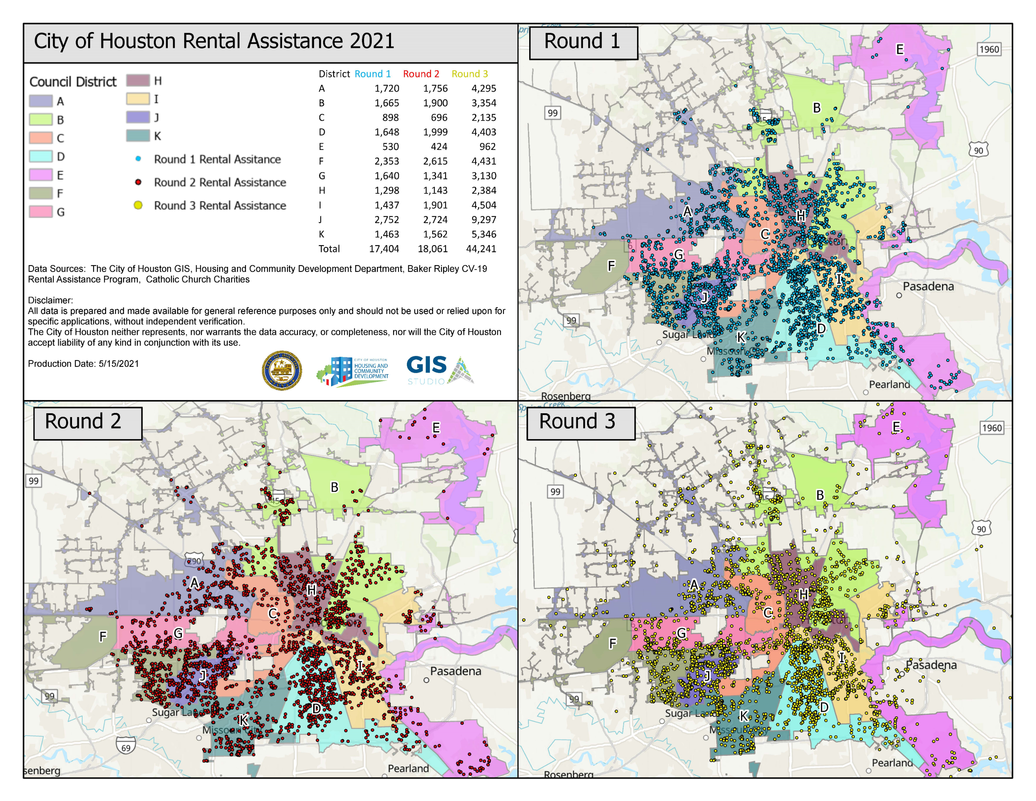

Slide 68
Houston Harris County Emergency Rental Assistance Program
As of August 30, 2021, ERAP has pledged and paid $184 million and helped more than 48,000 families
Total available Treasury funds to date $195.5 million
Over 10,000 landlords in the system, for a total of over 20,000 properties

Slide 70

Virtual Community Office Hours

Slide 71
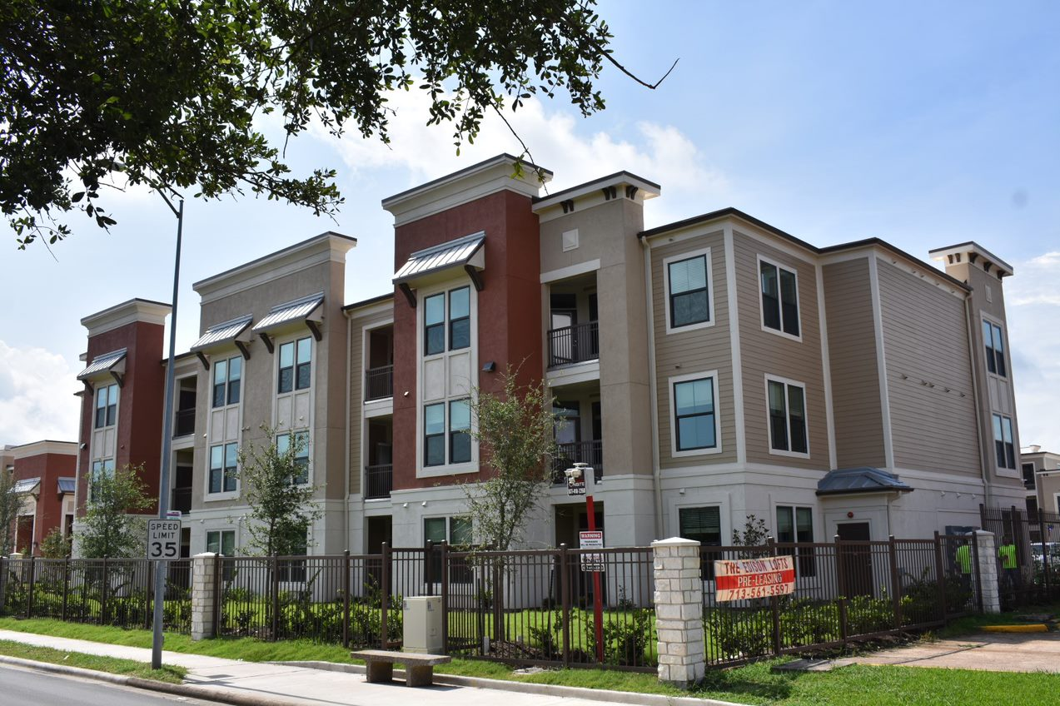
EDISON LOFTS GRAND OPENING 8.21.2021
7215 W. Fuqua (District K)
Edison Lofts was funded in part with an $8,000,000.00 CDBG DR-17 forgivable loan.

Slide 72
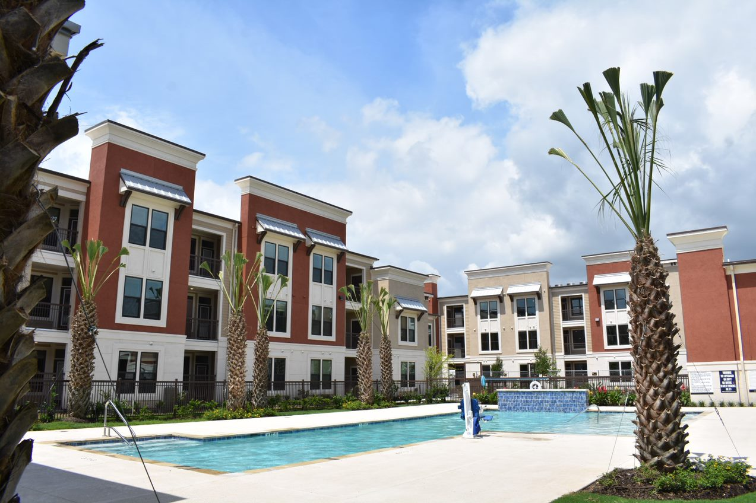
EDISON LOFTS GRAND OPENING 8.21.2021
7215 W. Fuqua (District K)

Slide 73
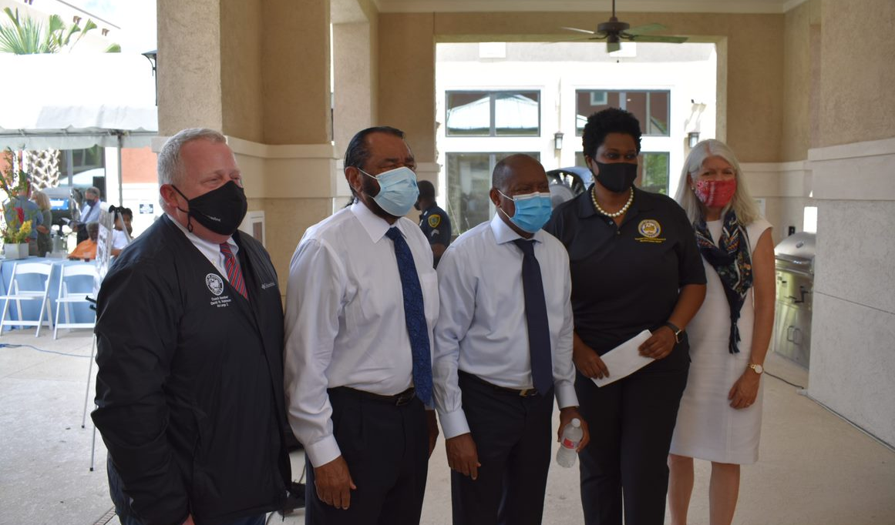
EDISON LOFTS GRAND OPENING 8.21.2021
7215 W. Fuqua (District K)
Mayor Turner, Council Members Robinson, Jackson and Cisneros with Rep. Al Green.

Slide 74
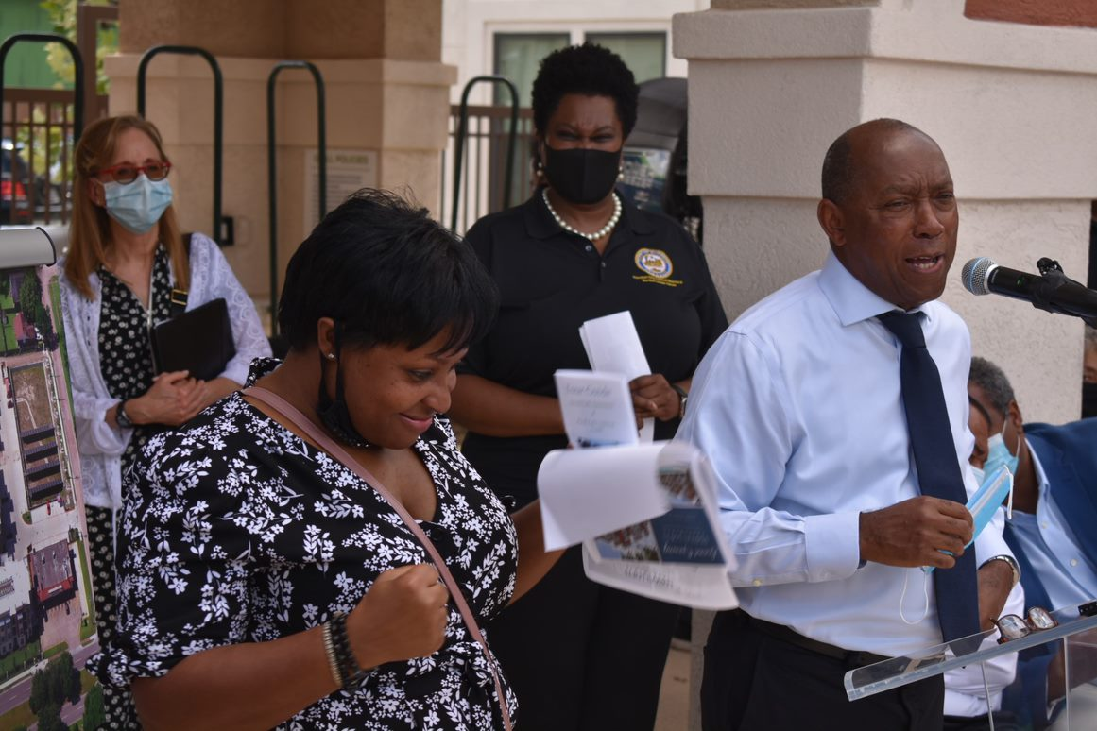
EDISON LOFTS GRAND OPENING 8.21.2021
7215 W. Fuqua (District K)
Houston Mayor Sylvester Turner making his remarks.

Slide 75
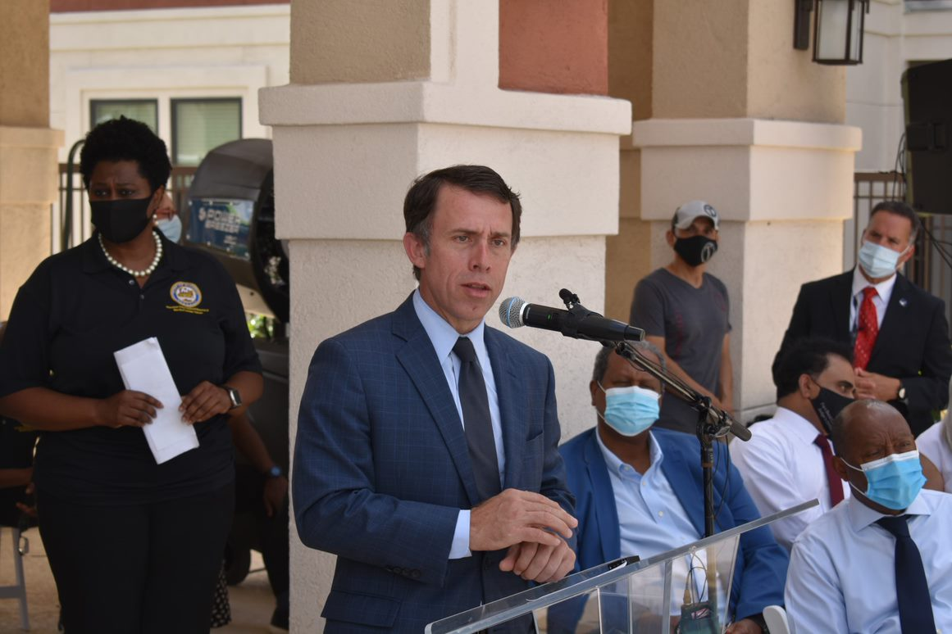
EDISON LOFTS GRAND OPENING 8.21.2021
7215 W. Fuqua (District K)
HCDD Director Tom McCasland addresses the attendees.

Slide 76
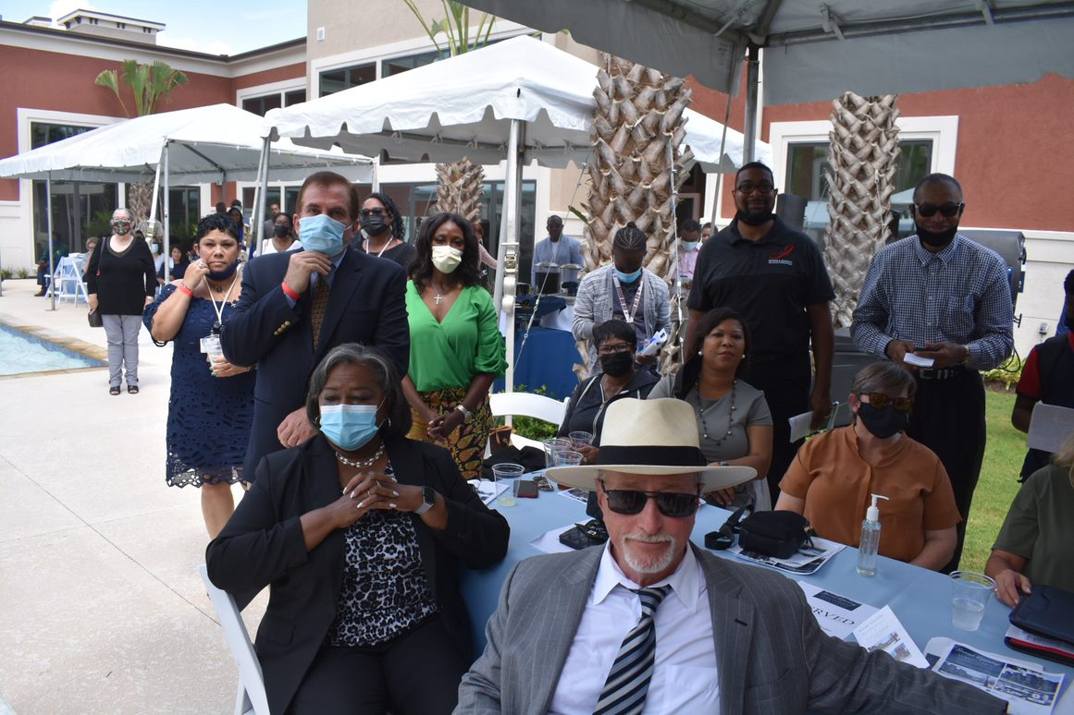
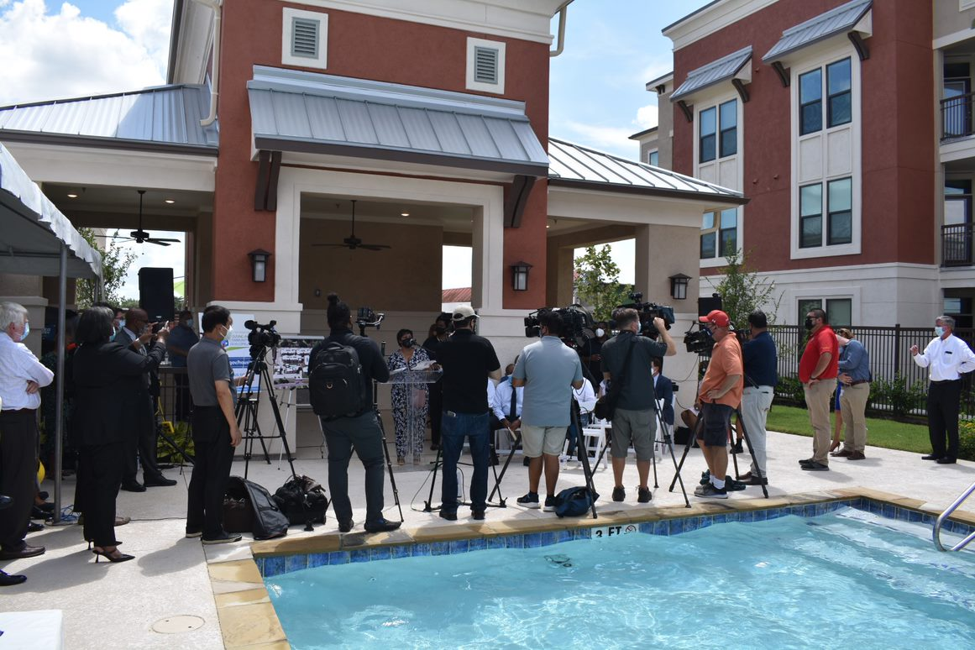
EDISON LOFTS GRAND OPENING 8.21.2021
7215 W. Fuqua (District K)
Onlookers and members of the media take in the festivities.

Slide 77
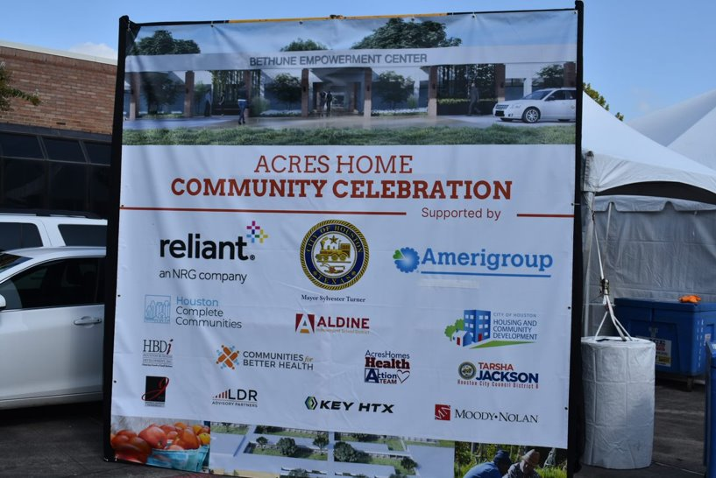
BETHUNE EMPOWERMENT CENTER
2500 S. Victory Dr. 77088

Slide 78
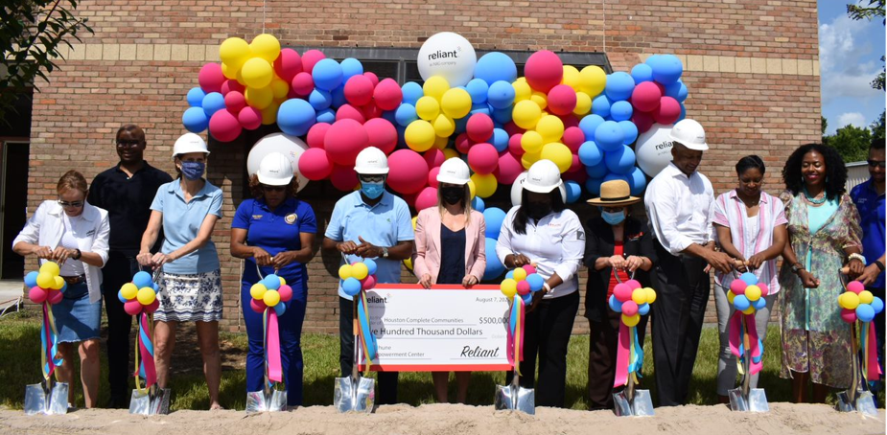
BETHUNE EMPOWERMENT CENTER
2500 S. Victory Dr. 77088
Mayor Turner, Reliant Energy and the Acres Homes community at the official launch of the Bethune Empowerment Center, Sowing Seeds Community Garden, and Acres Home Farmers Market.

Slide 79
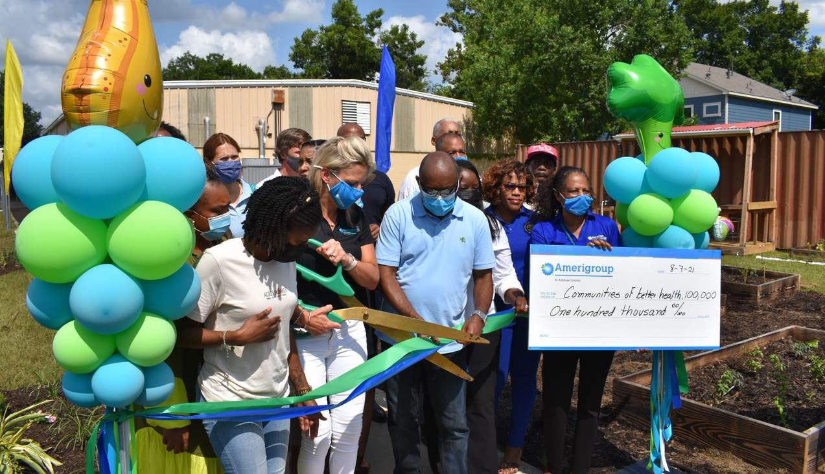
BETHUNE EMPOWERMENT CENTER
2500 S. Victory Dr. 77088
The Ribbon Cutting Ceremony for the
Sowing Seeds Community Garden.

Slide 80
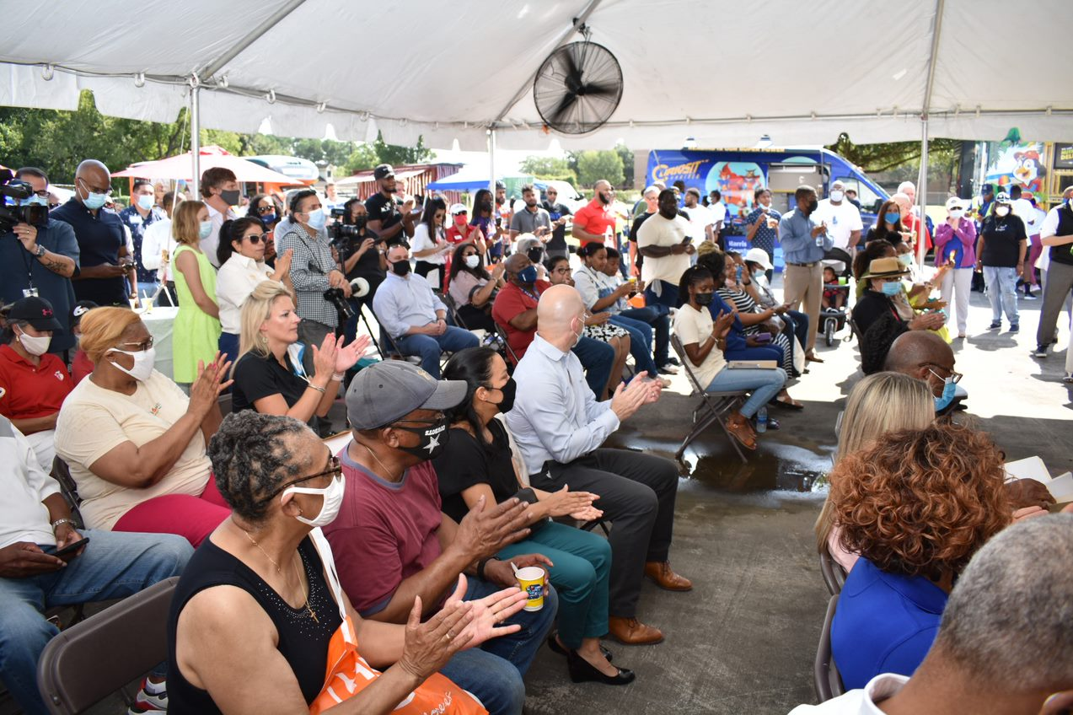
BETHUNE EMPOWERMENT CENTER
2500 S. Victory Dr. 77088
HCDD Senior Staff, including Ray Miller and Ana Martinez were among the many well-wishers at the event.

Slide 81
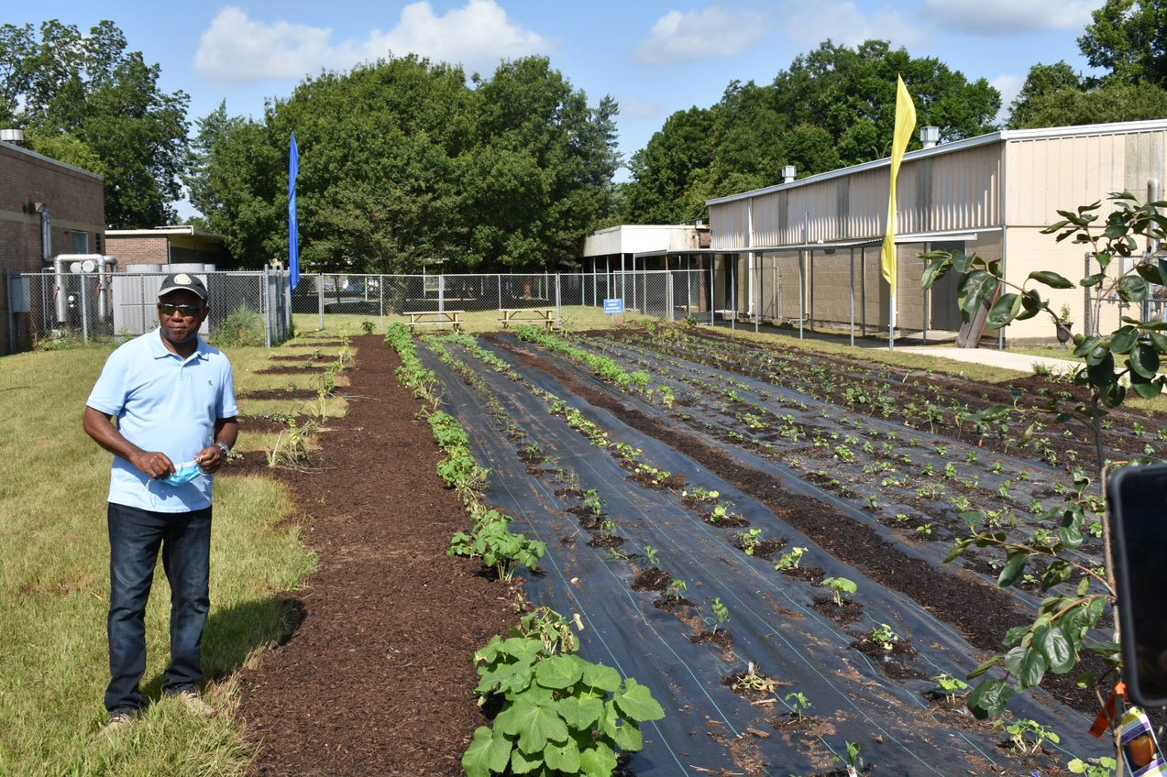
BETHUNE EMPOWERMENT CENTER
2500 S. Victory Dr. 77088
Mayor Turner touring the Sowing Seeds Community Garden.

Slide 82
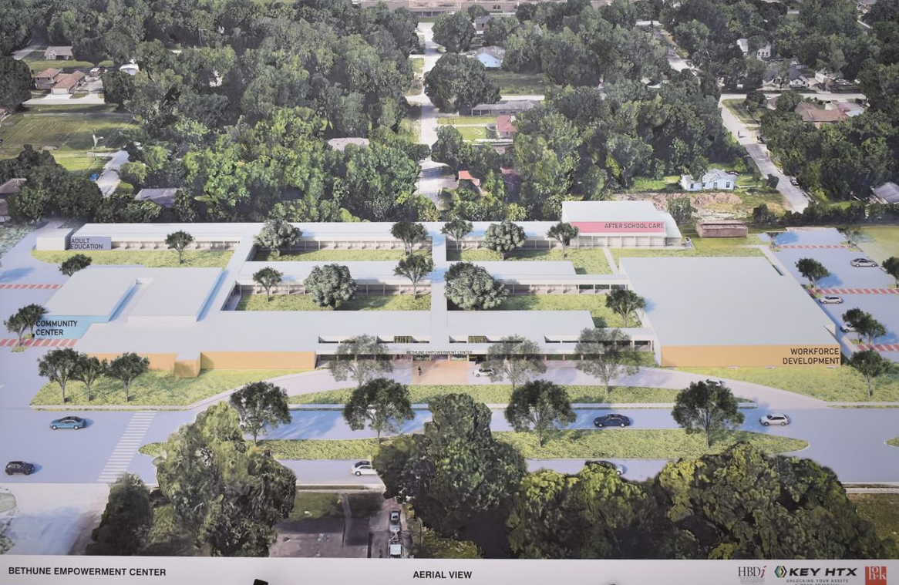
BETHUNE EMPOWERMENT CENTER
2500 S. Victory Dr. 77088
Rendering of the future Bethune Empowerment Center.

Slide 83
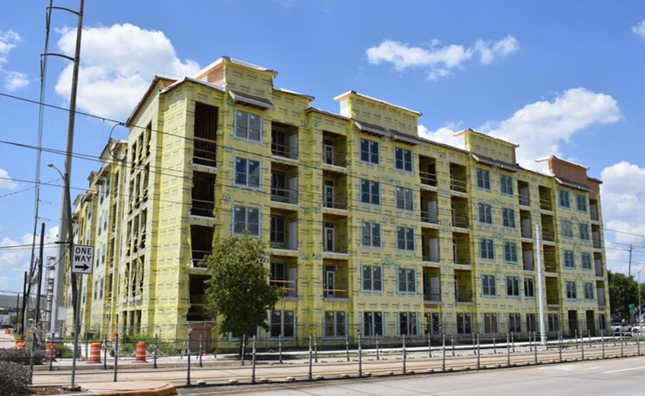
Under Construction: Scott Street Lofts
7245 Scott Street, Houston, TX 77021 (District I)
Scott Street Lofts is a123-unit affordable apartment community for seniors funded with CDBG-DR17 funds.

Slide 84
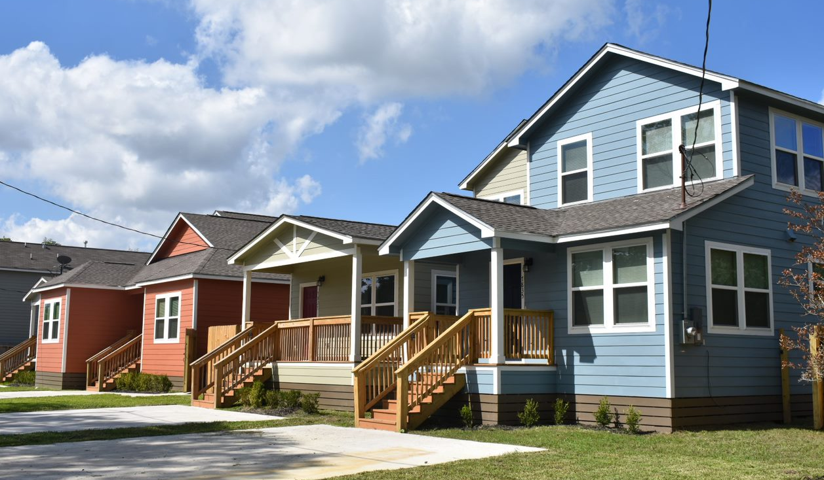
Tour of Homes with HCDD, Excello Homes and the Houston Land Bank - Acres Homes
(District B)

Slide 85
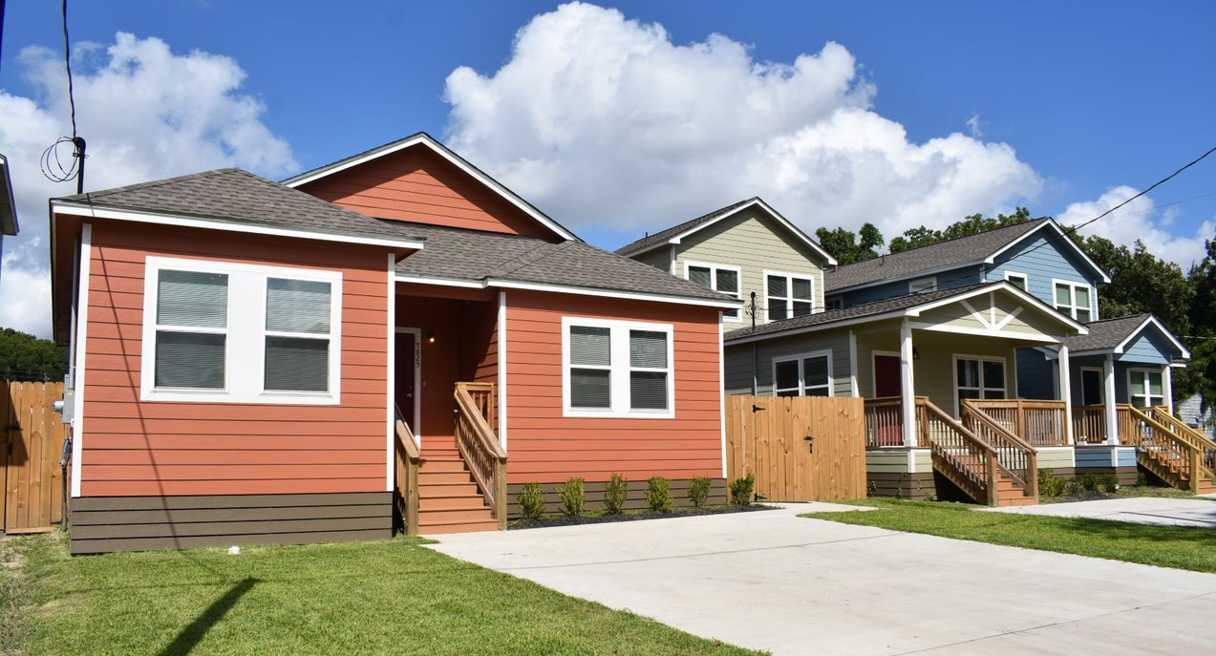
Tour of Homes with HCDD, Excello Homes and the Houston Land Bank - Acres Homes
(District B)

Slide 86
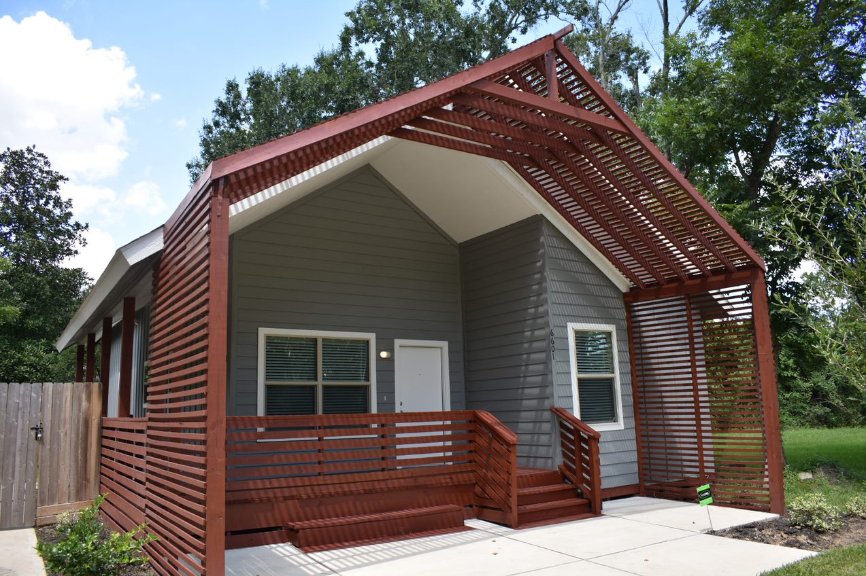
Tour of Homes with HCDD, Excello Homes and the Houston Land Bank - Acres Homes
(District B)

Slide 87
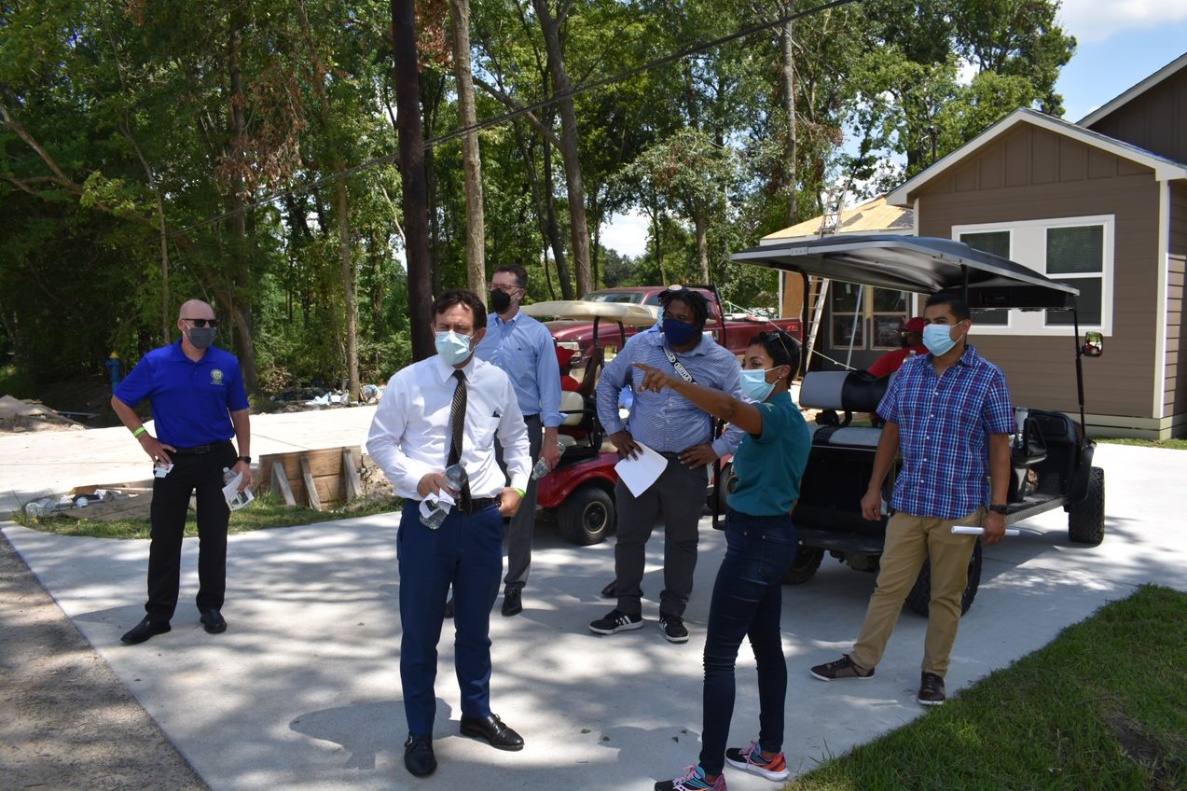
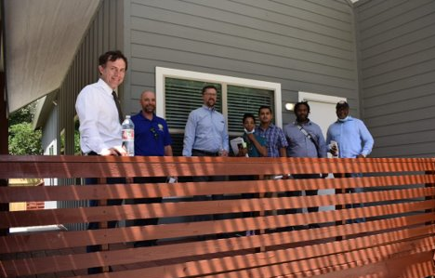
Tour of Homes with HCDD, Excello Homes and the Houston Land Bank - Acres Homes
(District B)

Slide 88

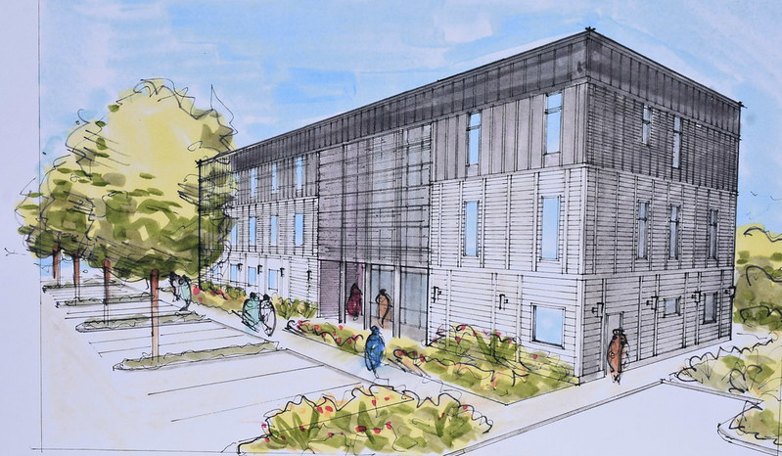
The Harmony House rehabilitation and expansion will provide 128 new beds and a health clinic for homeless individuals.

Slide 89
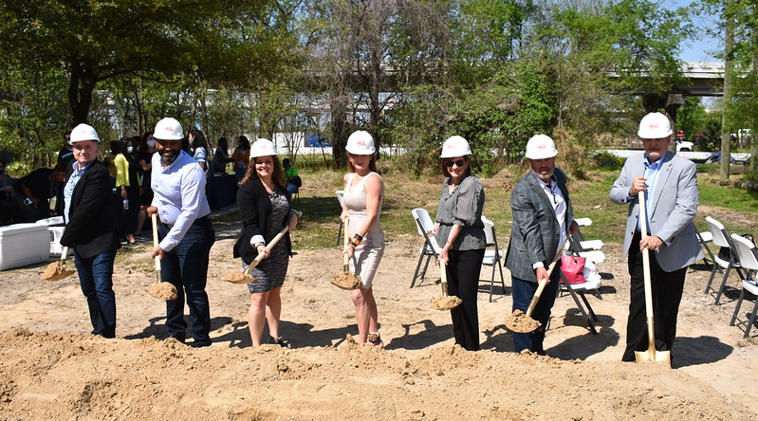
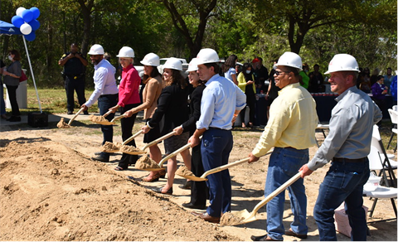
Harmony House Groundbreaking 3.24.2021
602 Girard St, (District H)
More than sixty people safely attended the groundbreaking, including District H City Council Member Karla Cisneros and Housing and Community Development Department (HCDD) Director Tom McCasland.

Slide 90
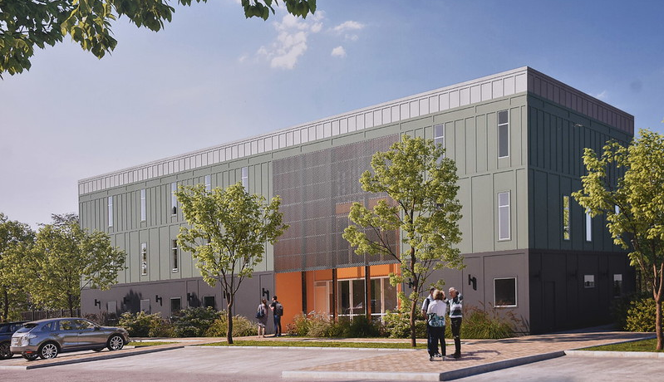
A rendering of the future Harmony House
rehabilitation and expansion.

Slide 91
Homebuyer Assistance Program
(Fiscal Year)
Provides up to $30,000 to help Houstonians purchase a home.

Slide 92
Single Family Home Repair Program
(Fiscal Year)
The HRP repairs and reconstructs existing homes for homeowners.

Slide 93
New Home Development Program
(Fiscal Year)
NHDP builds new homes for sale at affordable prices

Slide 94
Other Programs
(Fiscal Year)
Projects under construction
Multifamily (FY21)
1
Projects completed
Multifamily (FY21)
17
1
9
Projects under construction
Public Facilities (FY21)
3
3
Projects completed
Public Facilities (FY21)

Slide 95

Other Programs
(Fiscal Year 2021)
66,592
Persons Served
Public Services
As of Jun 2021

Slide 96
Spending by Program Area
FY21 (ended June 2021)
Total spending: $369,987,510

Slide 97


Comments & Questions

