Slide 1
Housing and Community
Affairs Committee
Keith W. Bynam, Director June 21, 2022

Slide 2
Agenda
I. Welcome/Introductions
II. Compliance & Grant Administration
III. Public Facilities
IV. Small Rental Program
V. Affordable Home Development Program
VI. Multifamily
VII. Director's Comments
VIII. Public Comments

Slide 3
II. COMPLIANCE & GRANT ADMINISTRATION
Derek Sellers, Deputy Director
Kennisha London, Assistant Director

Slide 4
II. Substantial Amendment to the 2019 Annual Action Plan (All Districts)
An Ordinance authorizing a Substantial Amendment to the current Community Development Block Grant – Coronavirus (CDBG-CV) budget in the 2019 Annual Action Plan,
And transferring $8,509,627.00 from the Public Facilities Activity to the Public Services Activity.

Slide 5
II. Substantial Amendment to the 2019 Annual Action Plan (All Districts)
In accordance with HUD’s Citizen Participation Plan regulations, the City is required to amend components of its Consolidated Plan/Annual Action Plan for a variety of reasons,
Including when a reallocation of funds increases or decreases the budget of an activity by more than 25% or
When an activity is added or deleted in the Plan(s).

Slide 6
II. Substantial Amendment to the 2019 Annual Action Plan (All Districts)
On March 27, 2020 the Coronavirus Aid, Relief, and Economic Security Act (CARES Act), Public Law-116-136, authorized a special allocation of CDBG-CV, HOPWA-CV, and ESG-CV to states and local jurisdictions to prevent, prepare for, and respond to the coronavirus (COVID-19).

Slide 7
II. Substantial Amendment to the 2019 Annual Action Plan (All Districts)
Community Development Block Grant - Coronavirus Funds
Activity | Delete/Decrease | Add/Increase
The CDBG-CV Budget is Amended as follows:
Public Facilities | ($8,509,627.00)
Public Services |  | $8,509,627.00
Total CDBG-CV Budget Changes: | ($8,509,627.00) | $8,509,627.00

Slide 8
III. PUBLIC FACILITIES
Ana Martinez, Deputy Assistant Director

Slide 9
III.a. Covenant House Texas (District C)
An Ordinance authorizing a Loan Agreement between the City of Houston and Covenant House Texas (CHT),
Providing $6,700,000.00 in Home Investment Partnership Grant American Rescue Plan (HOME-ARP) funds,
For the redevelopment of their Building for Life campus, which will support proven programs that help guide homeless youth to independence.

Slide 10
III.a. Covenant House Texas
(District C)
This property is approximately 2.7 acres and is located at 1111 Lovett Boulevard, Houston, TX 77006, in the Montrose neighborhood.
The structures on that property will be demolished and replaced with new construction.
The proposed project will provide an updated shelter, medical and mental health clinic, and safer housing to accommodate youth.

Slide 11
III.a. Covenant House Texas
(District C)
Amenities will include a large commercial kitchen and cafeteria, career center with computers and internet, outdoor courtyard and recreational facilities.
Age-appropriate areas for infants and toddlers, art and music rooms, library, digital library, two office spaces, and larger multipurpose rooms for youth activities.

Slide 12
III.a. Covenant House Texas
(District C)
CHT was founded as an affiliated site of Covenant House International in 1983 to meet the needs of homeless youth in Houston.
CHT provides emergency shelter and support services to the greater Houston area 24-hours/365-days a year.
CHT is dedicated to the protection of all homeless unsheltered youth, whether or not they are residents of the facility.

Slide 13
III.a. Covenant House Texas
(District C)
Sources | Amount | Uses | Amount
CoH HCDD – HOME-ARP | $6,700,000.00 | Hard Cost | $41,589,192.00
Harris County Community Service Dept. – CDBG DR | $3,500,000.00
Federal Home Loan Bank of Dallas – Affordable Housing Program (AHP) | $750,000.00 | Soft Cost | $5,534,799.00
Conventional Loan | $9,444,798.00
Capital Campaign | $26,829,193.00 | Acquisition Cost | $100,000.00
Total Source of Funds: | $47,223,991.00 | Total Project Cost: | $47,223,991.00

Slide 14
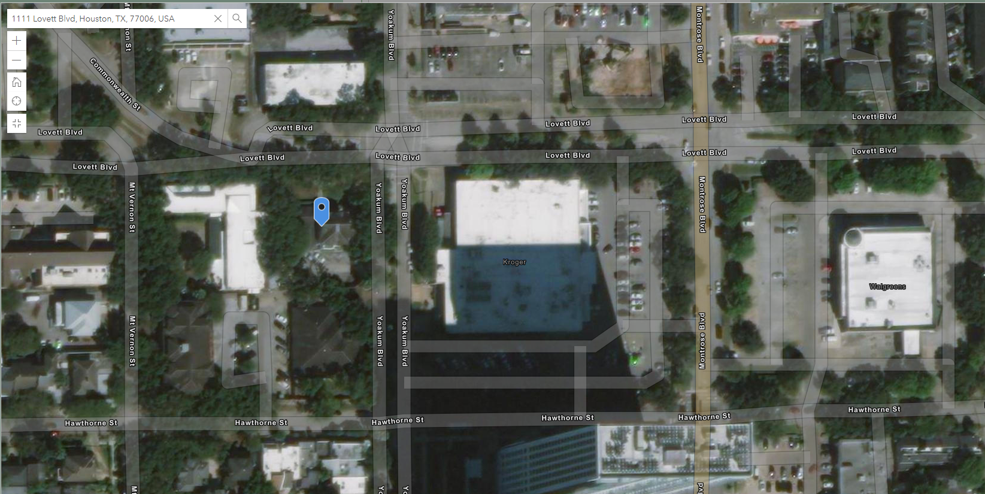
III.a. Covenant House Texas
(District C)
CHT will be located at the intersection of Lovett/Yoakum.

Slide 15
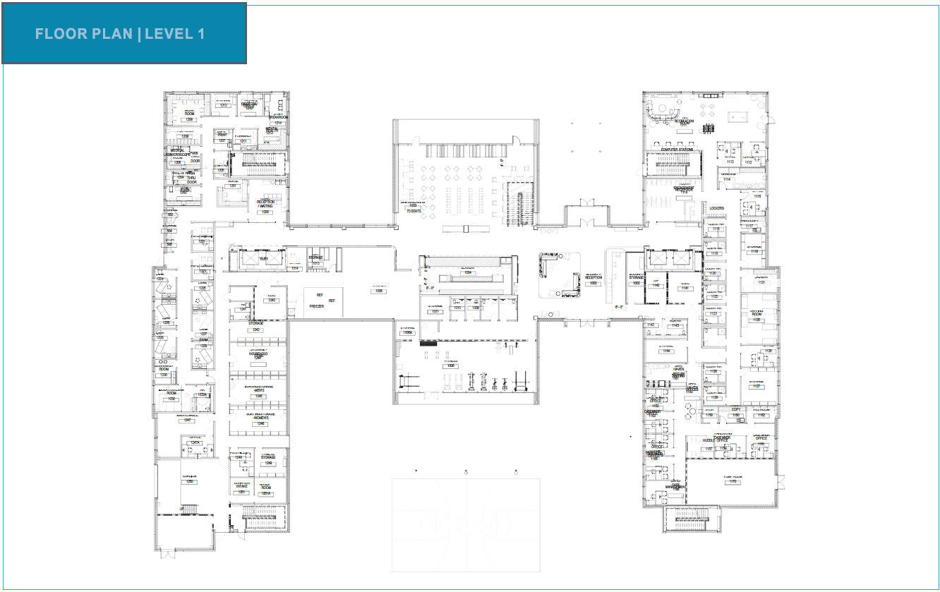
III.a. Covenant House Texas
(District C)
The total development for CHT is 104,000 SF

Slide 16
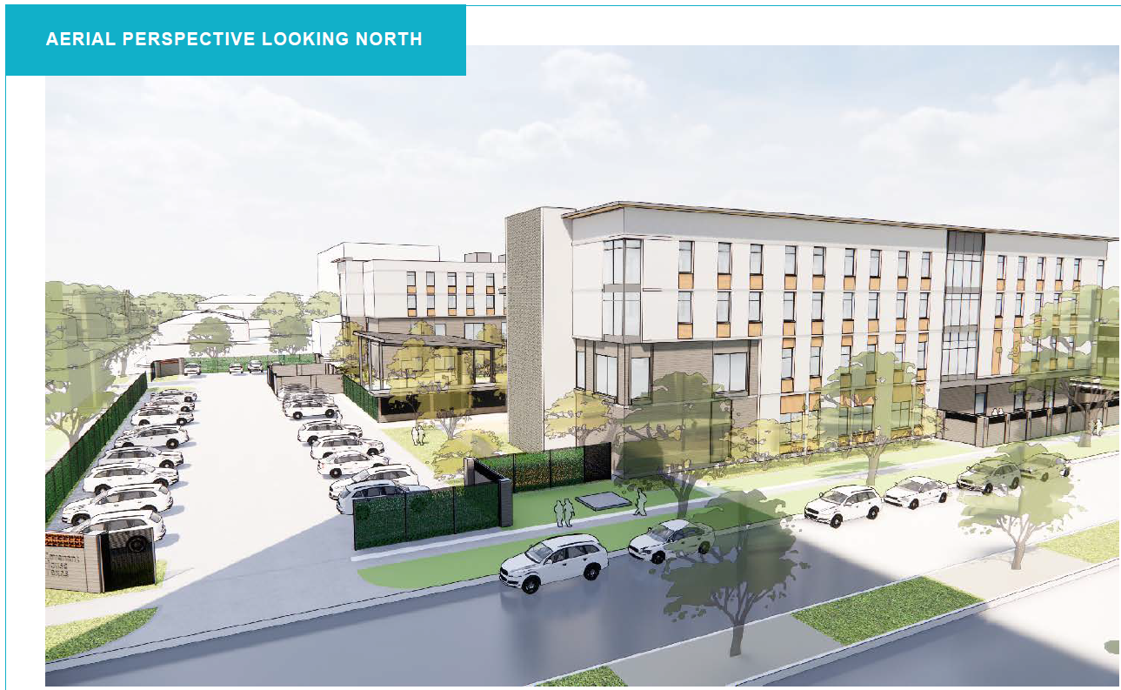
III.a. Covenant House Texas
(District C)

Slide 17
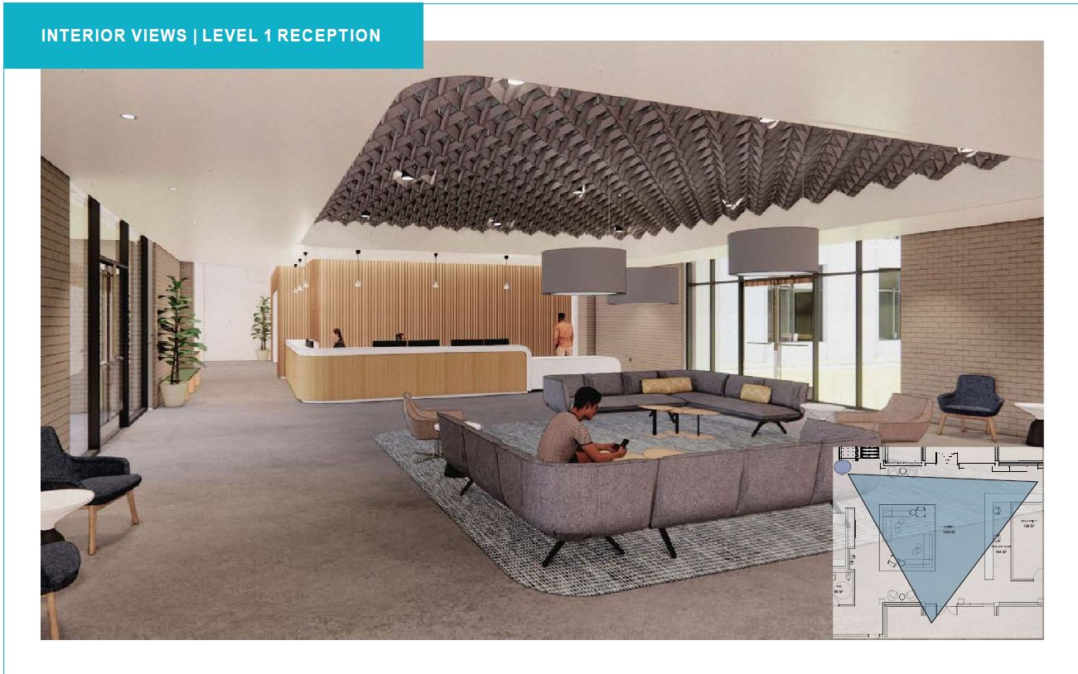
III.a. Covenant House Texas
(District C)

Slide 18
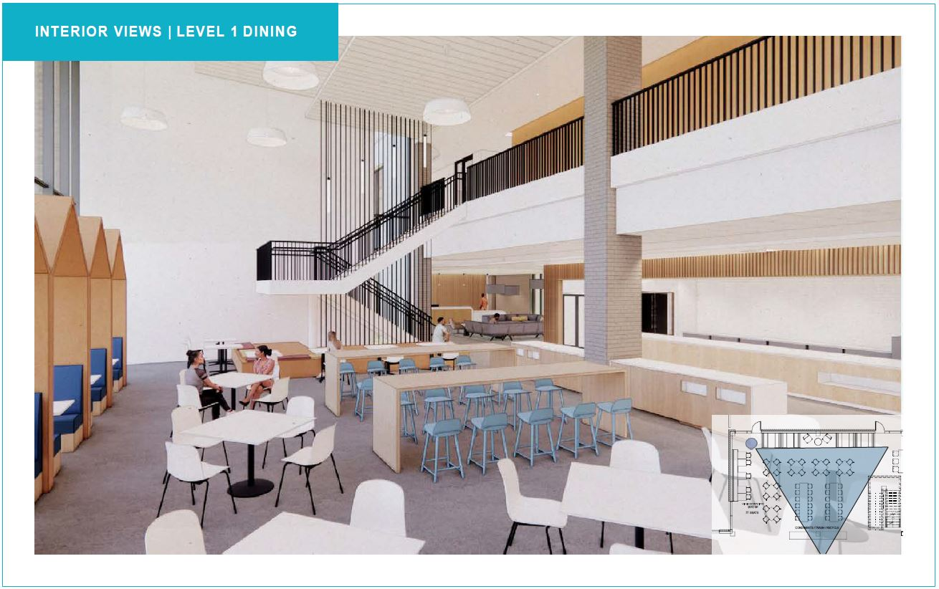
III.a. Covenant House Texas
(District C)

Slide 19
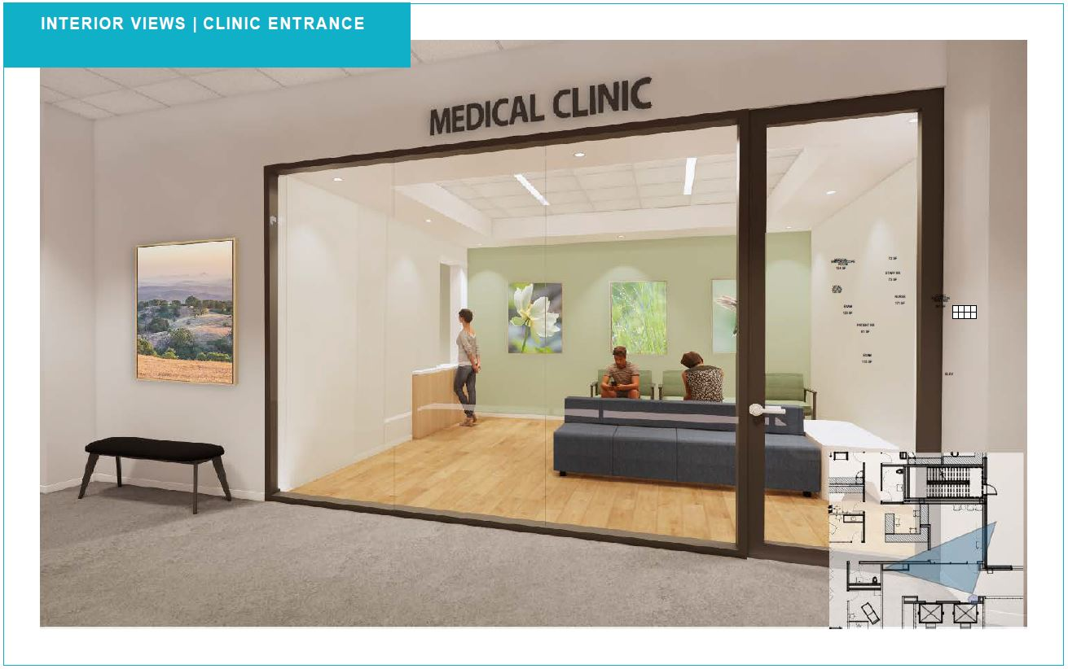
III.a. Covenant House Texas
(District C)

Slide 20
III.b. SERJobs Workforce Training Center (District I)
An Ordinance authorizing a Loan Agreement between the City of Houston and SER-Jobs for Progress of the Texas Gulf Coast, Inc (SERJobs),
Providing $1,343,307.00 in Community Development Block Grant (CDBG) funds,
For the renovation of a classroom at their SERJobs Workforce Training Center (WTC) incorporating a Ronald McDonald® - Children’s Health Education Enrichment Resource (C.H.E.E.R.) Room and for an emergency power generator.

Slide 21
III.b. SERJobs Workforce Training Center (District I)
The facility is located at 1960 Tellepsen, Houston, TX 77023 in Houston’s East End and currently offers eight classrooms, three hands-on training labs, training equipment, and office space, which serve low-income individuals.
Renovations will allow SERJobs the opportunity to incorporate a Ronald McDonald® C.H.E.E.R. Room, where children can experience “play with a purpose” while their parents or guardians are receiving employment support services.

Slide 22
III.b. SERJobs Workforce Training Center (District I)
Support services will include coaching, job readiness training, resume building, interview skills, employment services and placement, and other on-site activities.
The SER-Jobs WTC will also be supported by an emergency power generator for continued operations during extreme weather events and as a reserve shelter-in-place during emergencies.

Slide 23
III.b. SERJobs Workforce Training Center (District I)
For over 57 years, SER-Jobs for Progress of the Texas Gulf Coast, Inc has moved impoverished individuals from public assistance to self-sufficiency and is well regarded in the community for providing quality social services and linkages to vital community resources, while working diligently to change the lives of its constituents by facilitating meaningful workforce development activities.

Slide 24
III.b. SERJobs Workforce Training Center (District I)
Sources | Amount | Uses | Amount
CoH HCDD (CDBG Entitlement) | $1,343,307.00 | Hard Cost | $922,628.00
 |  | Soft Cost | $420,679.00
Total Source of Funds: | $1,343,307.00 | Total Project Cost: | $1,343,307.00

Slide 25
III.c. Fifth Ward Technology Center
(District B)
An Ordinance authorizing a Loan Agreement between the City of Houston (City) and Fifth Ward Community Redevelopment Corporation (Fifth Ward CRC),
Providing $750,000.00 in federal Community Development Block Grant (CDBG) funds
For the rehabilitation of their new Fifth Ward Technology Center (FWTC) located at 2600 Chew Street, Houston, TX 77020 in the Fifth Ward’s Kashmere Gardens Complete Community.

Slide 26
III.c. Fifth Ward Technology Center
(District B)
The FWTC will provide 10 offices of various sizes, over 60 individual desk options, conference rooms, a large training room, and a collaborative space that will offer affordable lease options for business owners.
This project will increase productivity, creativity, and will provide participants with opportunities to network with other entrepreneurs in a collaborative environment.

Slide 27
III.c. Fifth Ward Technology Center
(District B)
Organized in 1989, Fifth Ward CRC is an established entity focused on the comprehensive redevelopment of Houston’s 5th Ward.
The organization’s primary objective is to encourage an improved quality of life, through transformational projects and programming for both residents and businesses, in a growing and thriving historic community with great development and revitalization potential.

Slide 28
III.c. Fifth Ward Technology Center
(District B)
Sources | Amount | Uses | Amount
CoH HCDD (CDBG-Entitlement) | $750,000.00 | Hard Cost | $3,822,050.00
Economic Development Administration (EDA) | $3,700,000.00 | Soft Cost | $552,950.00
Fifth Ward CRC – Equity | $925,000.00 | Acquisition Cost | $1,000,000.00
Total Source of Funds: | $5,375,000.00 | Total Project Cost: | $5,375,000.00

Slide 29
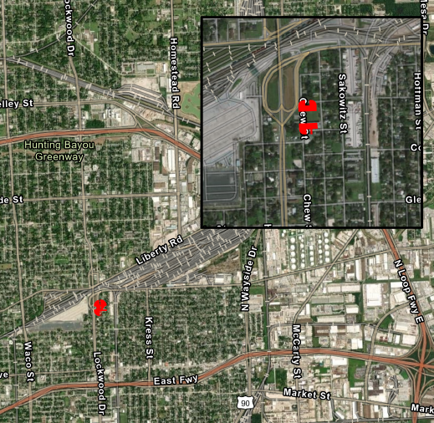
III.c. Fifth Ward Technology Center
(District B)

Slide 30
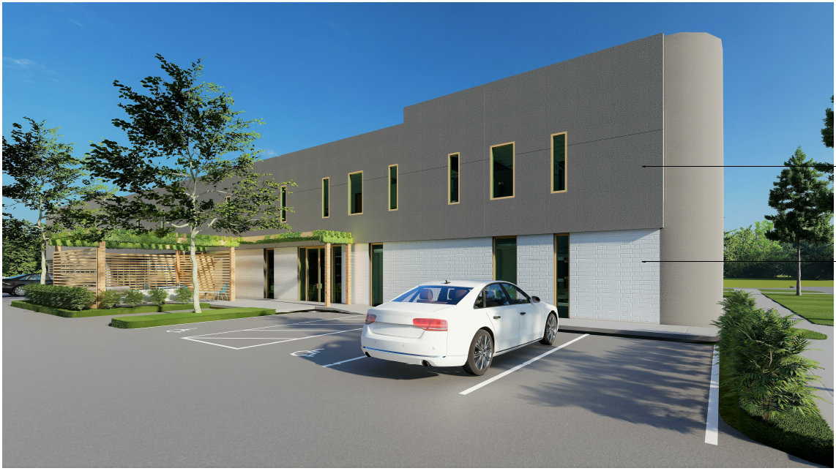
III.c. Fifth Ward Technology Center
(District B)

Slide 31
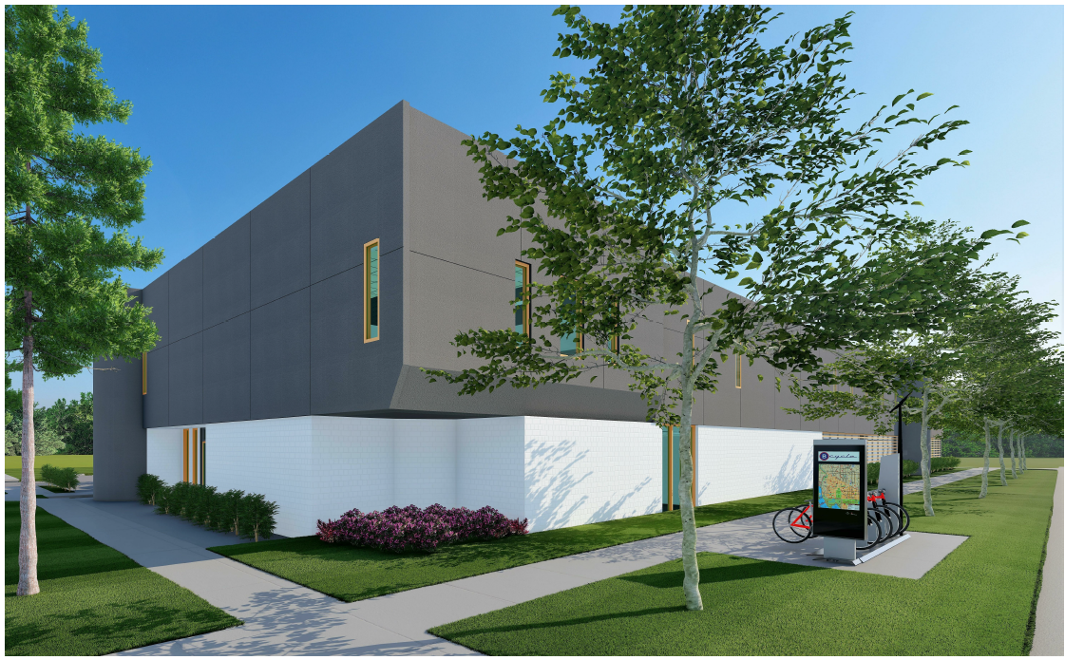
III.c. Fifth Ward Technology Center
(District B)

Slide 32
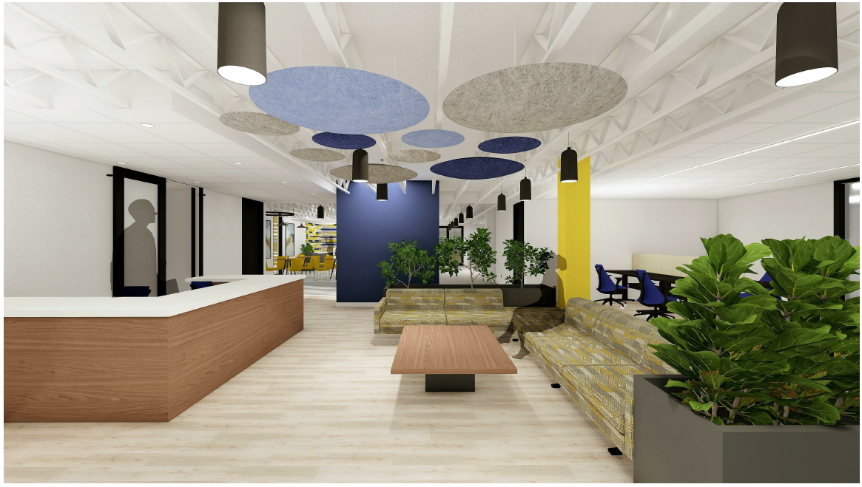
III.c. Fifth Ward Technology Center
(District B)

Slide 33
IV. Small Rental
Ray Miller, Assistant Director

Slide 34
IV.a. Fulton & James
(District H)
An Ordinance authorizing a supplemental investment of $306,031.00 for a Community Development Block Grant - Disaster Recovery 2017 (CDBG-DR17) loan,
For a Contract between the City of Houston and Avenue CDC, (Borrower),
For the land acquisition and new construction of Fulton and James, serving low- to moderate-income renters at 2004 & 2008 Fulton St. and 1105 James St, Houston TX 77009.

Slide 35
IV.a. Fulton & James
(District H)
On November 10, 2021, by Ordinance No. 2021-948, City Council approved an Ordinance approving $1,783,923.00 Community Development Block Grant - Disaster Recovery Harvey (CDBG-DR17) funds towards the new construction of Fulton and James, a four-unit Small Rental project.

Slide 36
IV.a. Fulton & James
(District H)
After Council approval of the initial $1,783,923.00 grant, HCDD received a separate request for a supplemental investment of $306,031.00 in CDBG-DR17 funds, bringing the City’s total investment to $2,089,954.00.
Fulton and James’ construction cost increases were fueled by record inflation and delays in permitting, necessitating additional funding to complete the project.

Slide 37
IV.a. Fulton & James
(District H)
The loan and affordability period will be 20 years and will commence when the construction period is completed.
The loan will be non-amortizing throughout both the construction and affordability period and no payments will be required.

Slide 38
IV.a. Fulton & James
(District H)
This project is funded by CDBG-DR17 program funds awarded by the United States Department of Housing and Urban Development, through the Texas General Land Office to provide affordable rental units for low to moderate-income households, by the City’s Harvey Small Rental Program Guidelines, implemented by the HCDD.

Slide 39
IV.a. Fulton & James
(District H)
Sources | Amount | Uses | Amount
City of Houston Initial Request | $1,783,923.00 | Hard Cost | $1,401,499.00
City of Houston Supplemental Investment | $306,031.00 | Soft Cost | $201,596.00
Cash Equity | $35,211.00 | Acquisition Cost | $713,711.00
 |  | Reserves | $1,500.00
Total Source of Funds: | $2,318,256.00 | Total Project Cost: | $2,318,256.00

Slide 40
IV.a. Fulton & James
(District H)
Unit Summary and LURA Breakdown
Unit Type | Total Units | HCDD Restricted | 30% AMI* | 50% AMI* | 60% AMI* | 80% AMI* | Market Rate
Three Bedroom | 4 | 4 | 1 | 1 | 1 | 1 | 0
*Restricted by the Housing Tax Credits. Maybe inclusive of HCDD restricted units. For multifamily housing, a minimum of 51% of the units must be occupied by low- or moderate-income households.

Slide 41
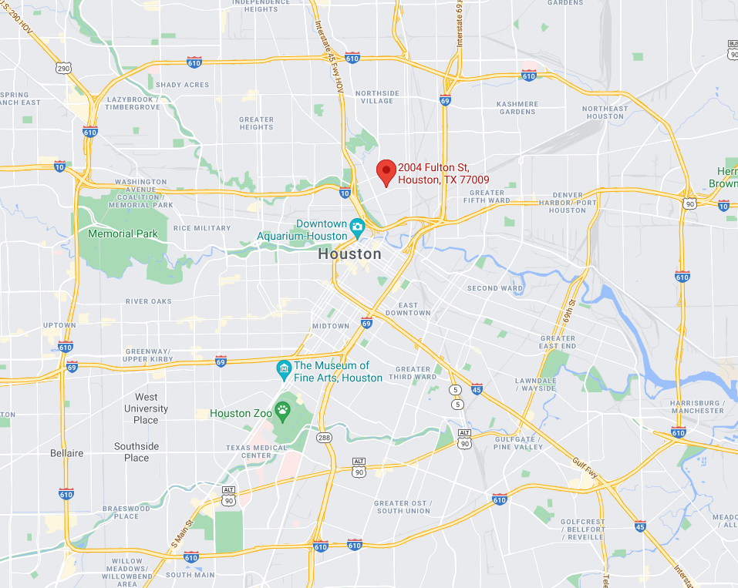
IV.a. Fulton & James
(District H)

Slide 42
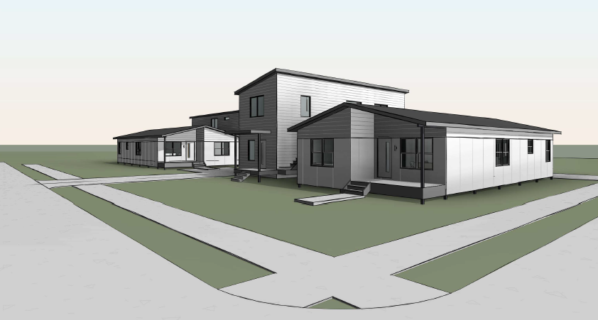
IV.a. Fulton & James
(District H)
Artist’s Rendering of Fulton & James

Slide 43
V. Large Tract Division Affordable Home Development Program
Olivia Bush, Division Manager

Slide 44
V.a. Agape Homes CDC
(District D)
An Ordinance authorizing an Agreement between the City of Houston HCDD Large Tract Division Affordable Home Development Program (AHDP) and Agape Homes CDC,
Providing a Loan of $2,190,000.00 Uptown TIRZ Series 2021 Affordable Homes Funds, for single-family development infrastructure at 6412 Calhoun Road, Houston, Texas,
To increase affordable single-family homeownership opportunities for households earning between 60% and 120% of the Area Median Income (AMI).

Slide 45
V.a. Agape Homes CDC
(District D)
Agape Homes CDC will oversee the horizontal and vertical construction necessary to prepare the lots for the new construction of 80 single-family homes, including 57 affordable homes and 23 market-rate homes.
The development’s home designs have a mix of two-, three- and four-bedroom single-family detached homes restricted to homeowners at 70% to 100% AMI.

Slide 46
V.a. Agape Homes CDC
(District D)
The loan term is a maximum of two years, from the date of project initiation to the completed construction of the last affordable home.
The affordability period per affordable home will be five years, commencing when the sale and City loan to the homebuyer has closed.
The construction loan is non-amortizing and the term is limited to 24 months.

Slide 47
V.a. Agape Homes CDC
(District D)
The City’s Deed of Trust is to be fully released upon closing the sales of 57 affordable homes and closing the respective City loans to homebuyers.
Partial releases of the City’s Deed of Trust securing the construction loan will be given for lots as the lots are sold.

Slide 48
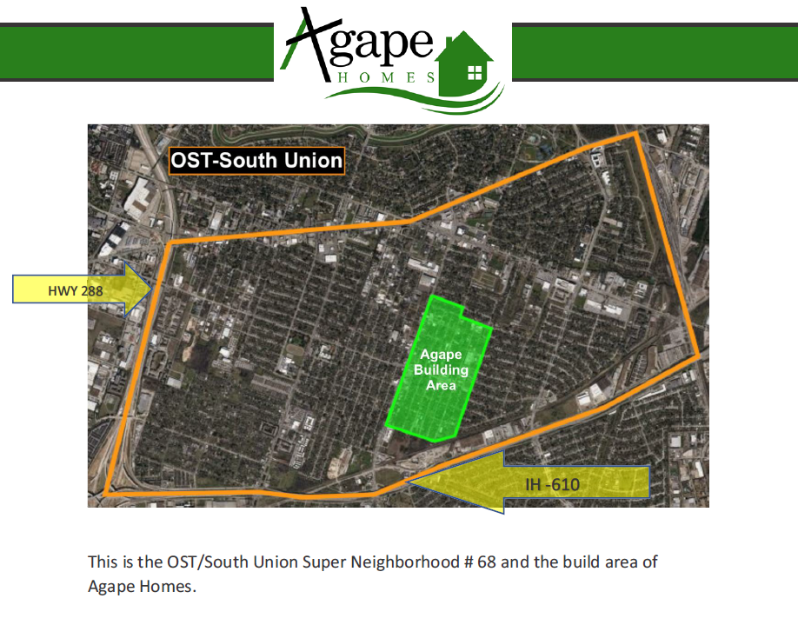
V.a. Agape Homes CDC
(District D)

Slide 49
V.a. Agape Homes CDC
(District D)
Sources | Amount | Uses | Amount
TIRZ – Bond (COH HCD) | $2,190,000.00 | Land Acquisition | $7,361,700.00
Home Sales | $18,399,930.80 | Site Work | $1,420,000.00
Land Subsidy | $3,212,019.60 | Hard Construction Costs | $13,290,000.00
 |  | Soft Cost | $1,730.250.40
Total | $23,801,950.40 | Estimated Total | $23,801.950.40

Slide 50
V.b. Oracle Mansfield Development
(District B)
An Ordinance authorizing a Loan Agreement between the City of Houston HCDD Large Tract Division’s Affordable Home Development Program (AHDP) and RZ Enterprises USA dba Oracle City Homes LLC,
Providing $7,980,000.00 in Uptown TIRZ Series 2021 Affordable Homes Funds, for infrastructure development at three sites in Acres Homes,
To increase homeownership opportunities for households between 60% and 120% AMI.

Slide 51
V.b. Oracle Mansfield Development
(District B)
The proposed Oracle Mansfield developments will be located in the Acres Homes Complete Community at the following locations:
1538-1658 W. Tidwell Street, Houston TX 77091
0 Mansfield Road, Houston TX 77091
0 Paul Quinn Street, Houston TX 77091
1236 Bland Street, Houston TX 77091

Slide 52
V.b. Oracle Mansfield Development
(District B)
The vacant land must undergo horizontal and vertical construction to prepare the lots for new construction.
Oracle City Homes, LLC will build 202 single-family homes, which will include 133 affordable homes and 69 market-rate homes.
The development’s home designs have a mix of two- and three-bedroom single-family attached and detached homes restricted to homeowners earning between 90% and 120% of the AMI.

Slide 53
V.b. Oracle Mansfield Development
(District B)
The loan term is to be a maximum of two years, beginning from the date of project initiation to the completion of construction of the last affordable home.
The affordability period on these homes will be five years commencing when the sale and City loan to the homebuyer has closed.
The construction loan term is limited to 24 months.

Slide 54
V.b. Oracle Mansfield Development
(District B)
The loan will be non-amortizing throughout the construction period.
The City’s Deed of Trust is to be fully released upon closing the sales of 133 affordable homes and closing the respective City loans to homebuyers.
Partial releases of the City’s Deed of Trust securing the construction loan will be provided as the lots are sold.

Slide 55
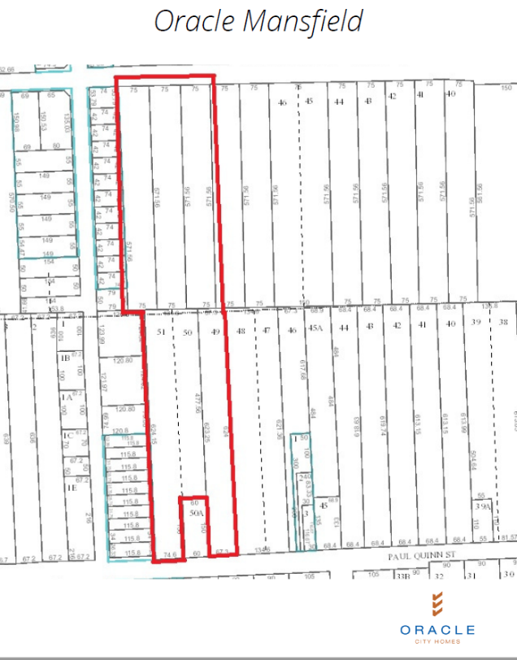
V.b. Oracle Mansfield Development
(District B)
1538 ½ W. Tidwell Street Houston TX 77091

Slide 56
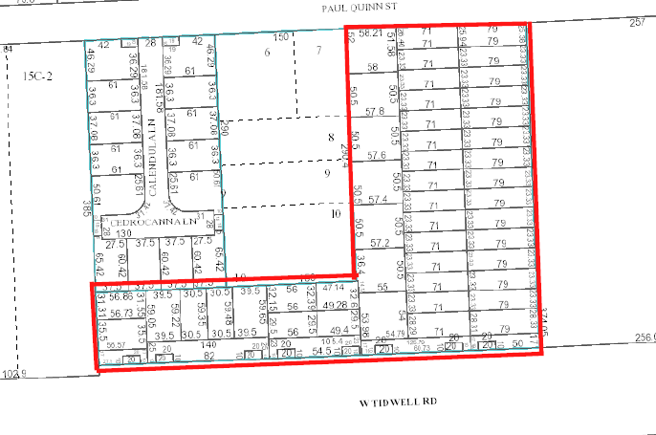
V.b. Oracle Mansfield Development
(District B)
0 Mansfield Rd. and O Paul Quinn St., Houston TX 77091

Slide 57
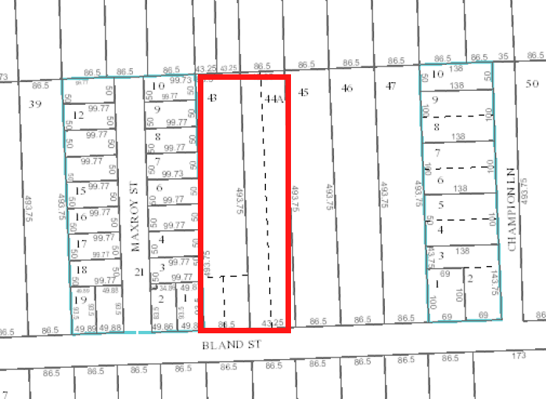
V.b. Oracle Mansfield Development
(District B)
1236 Bland Street Houston TX 77091

Slide 58
V.b. Oracle Mansfield Development
(District B)
Sources | Amount | Uses | Amount
TIRZ – Bond (COH HCD) | $7,980,000.00 | Land Acquisition | $4,939,000.00
Home Sales | $55,307,720.00 | Site Work | $6,262,000.00
 |  | Hard Construction Costs | $42,081,600.00
 |  | Soft Costs | $7,175,280.00
 |  | Developer Fee | $2,829,840.00
Estimated Total | $63,287,720.00 | Estimated Total | $63,287,720.00

Slide 59
VI. Multifamily
Ana Martinez, Deputy Assistant Director

Slide 60
VI. Summit at Renaissance Park
(District B)
An Ordinance authorizing an Amendment to the Loan Agreement between the City of Houston and TXZNH, LLC. (Ordinance No. 2021-611)
Due to the current volatility of pricing for labor and materials, the Developer is proposing to remove the Parking Garage and utilize the existing Surface Parking at the adjacent property.
The Developer is proposing that the resulting savings of $1,300,000.00 be reallocated to the Contingency line item.

Slide 61
VI. Summit at Renaissance Park
(District B)
Project Overview
Project Name: | Summit at Renaissance Park | Project Address: | 12121 Greenspoint Dr, Houston, TX 77060 (Greenspoint Mall)
Development Type: | New Construction / Family | COH Request Amount: | $14,900,000.00
Owner/ Developer: | Lee Zeiben, TXZNH, LLC. / AHG Properties, LLC. | HCDD Source: | CBDG-DR 17

Slide 62
VI. Summit at Renaissance Park
(District B)
Development Team
Owner/ Developer | Lee Zieben, TXZNH, LLC. / AHG Properties, LLC.
General Contractor | Steve Noble, Hudson Construction
Architect | Rommel Sulit, Forge Craft Architect
Consultant | Charisse Harris, Zieben Group
Lender | Sam D. Kramer, Cedar Rapid Bank & Trust (CRBT)
Investor | John Dickinson, PNC Real Estate

Slide 63
VI. Summit at Renaissance Park
(District B)
Unit Type | Total Units | HCDD Restricted | 30% AMI* | 50% AMI* | 60% AMI* | 80% AMI* | Market Rate
One Bedroom | 35 |  | 4 | 10 | 21 | 0 | 0
Two Bedroom | 62 |  | 4 | 10 | 48 | 0 | 0
Three Bedroom | 156 |  | 4 | 7 | 145 | 0 | 0
Four Bedroom | 72 |  | 5 | 6 | 61 | 0 | 0
Total | 325 | *166 | 17 | 33 | 275 | 0 | 0
Total Square Footage: 318,984 SF
*166 Units Restricted by Housing Tax Credits.

Slide 64
VI. Summit at Renaissance Park
(District B)
Amenities
Wet Floodproofing | Backwater Valves
Envelope Efficiency | Distributed Heating and Cooling
Emergency Lighting | Building Community Ties
Development of an Emergency | Management Manual
Energy Star | Solar Ready Design and Construction
EV Charging Stations | Permeable Pavement

Slide 65
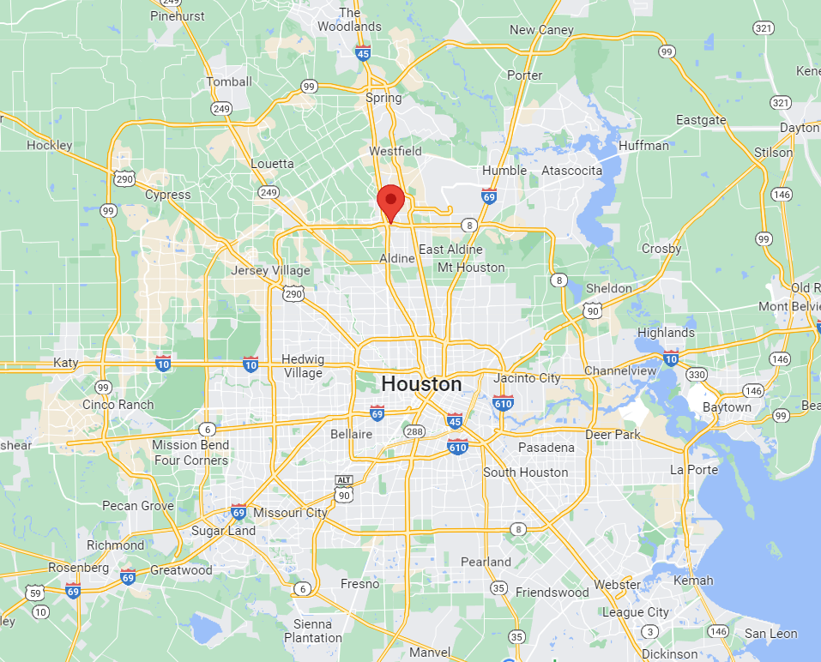
VI. Summit at Renaissance Park
(District B)

Slide 66
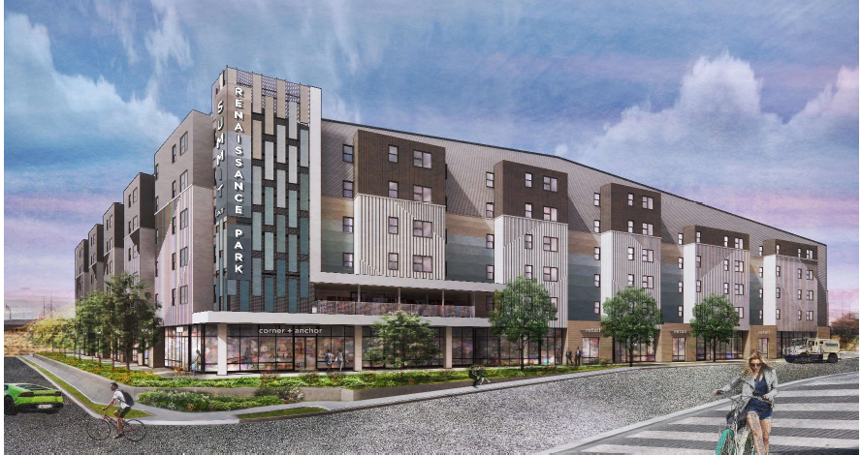
VI. Summit at Renaissance Park
(District B)

Slide 67
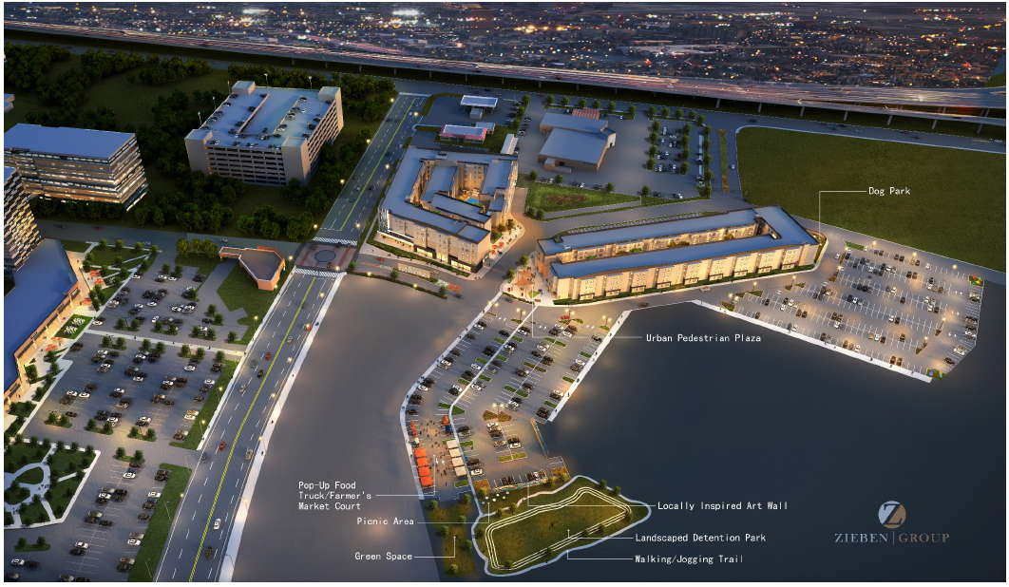
VI. Summit at Renaissance Park
(District B)

Slide 68
DIRECTOR’S
COMMENTS
Keith W. Bynam, Director

Slide 69
Director’s Comments
Intro/Agenda Overview
Keith W. Bynam, Director
CDBG-DR17 Grant Update, Temika Jones, Assistant Director and CFO
HCDD Production Report Overview,
Temika Jones, Assistant Director and CFO
HCDD Project Highlights,
Keith W. Bynam, Director

Slide 70
CDBG-DR 2017
Harvey Grant Update
Temika Jones, Assistant Director and CFO
Notes:
We will now move on to an update for the CDBG-DR 2017 Harvey grant.

Slide 71
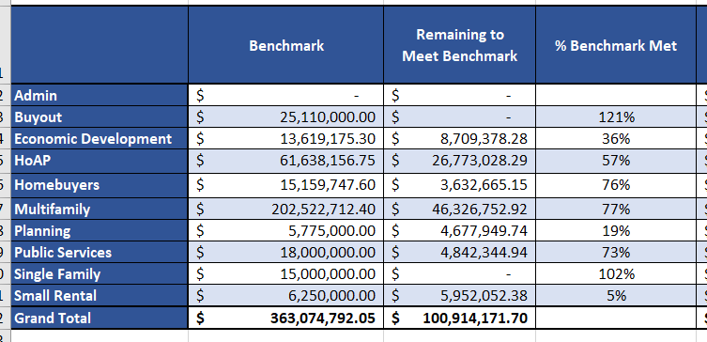
Item III.D HCD Financial Update
(CDBG-DR 2017 Harvey Grant Update)
As of June 15, 2022
Notes:
This table lists the performance benchmarks for June 30, 2022, which is approx. $134M more than the December 31, 2021 benchmarks. Included in this table is the % of reimbursement requests approved in relation to the benchmark total for each program.

Slide 72
HCDD
Production
Report
Temika Jones, Assistant Director and CFO
Notes:
We will now move on to an update for the CDBG-DR 2017 Harvey grant.

Slide 73
Homebuyer Assistance Program
(Fiscal Year - cumulative totals)
Provides up to $30,000 to help Houstonians purchase a home.

Slide 74
Single Family Home Repair Program
(Fiscal Year – cumulative totals)
The HRP repairs and reconstructs existing homes for homeowners.

Slide 75
New Home Development Program
(Fiscal Year – cumulative totals)
NHDP builds new homes for sale at affordable prices

Slide 76
Other Programs
(Fiscal Year)
Projects under construction
Multifamily (FY22)
1
Projects completed
Multifamily (FY22)
21
5
10
Projects under construction
Public Facilities (FY22)
3
Projects completed
Public Facilities (FY22)

Slide 77

Other Programs
(Fiscal Year 2022)
161,978
Persons Served
Public Services
As of April 2022

Slide 78
Spending by Program Area
FY22 (as of May 2022)
Total spending: $335,882,450
Note: Public Services and Other City Departments are one month behind; those are April numbers.

Slide 79
HCDD
Project Highlights
Keith W. Bynam, Director
Notes:
We will now move on to an update for the CDBG-DR 2017 Harvey grant.

Slide 80

Virtual Community Office Hours

Slide 81
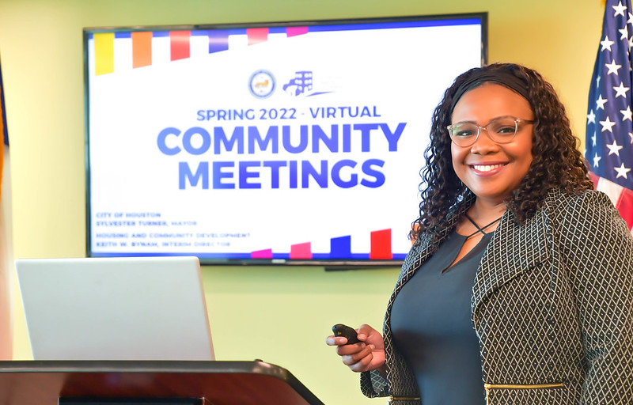
Spring 2022 Virtual Community Meetings
HCDD’s Kimmy Johnson welcomes you!

Slide 82
Spring 2022 Virtual Community Meetings
HCDD receives about $45 million in federal grants annually to assist families through:
Public improvements and infrastructure
Economic development
Supportive services
Affordable homes
Public Hearings enable the community to provide input as to what projects get funded for the upcoming program year.

Slide 83
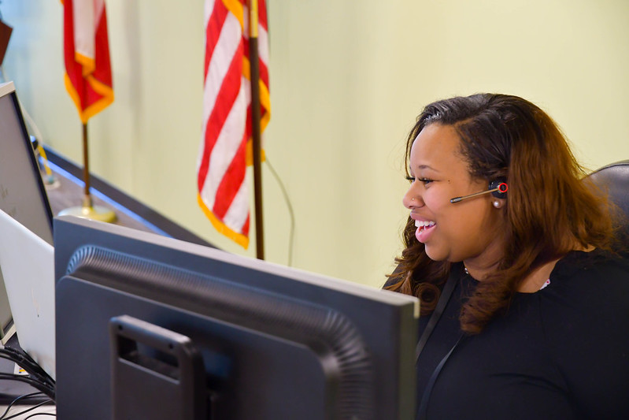
Spring 2022 Virtual Community Meetings
HCDD’s Kristin Robinson interacts with virtual attendees.

Slide 84
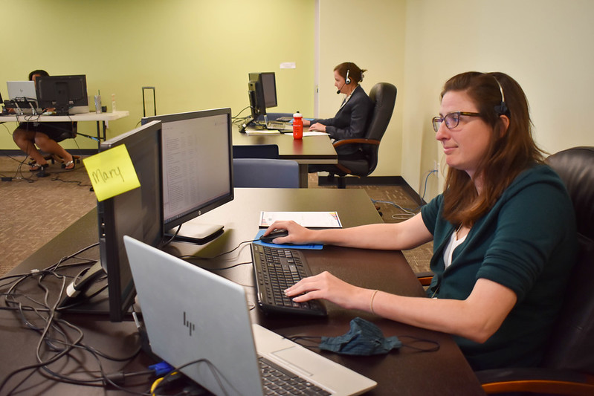
Spring 2022 Virtual Community Meetings
HCDD’s Mary Itz and Jessica Caraway help facilitate the discussion.

Slide 85
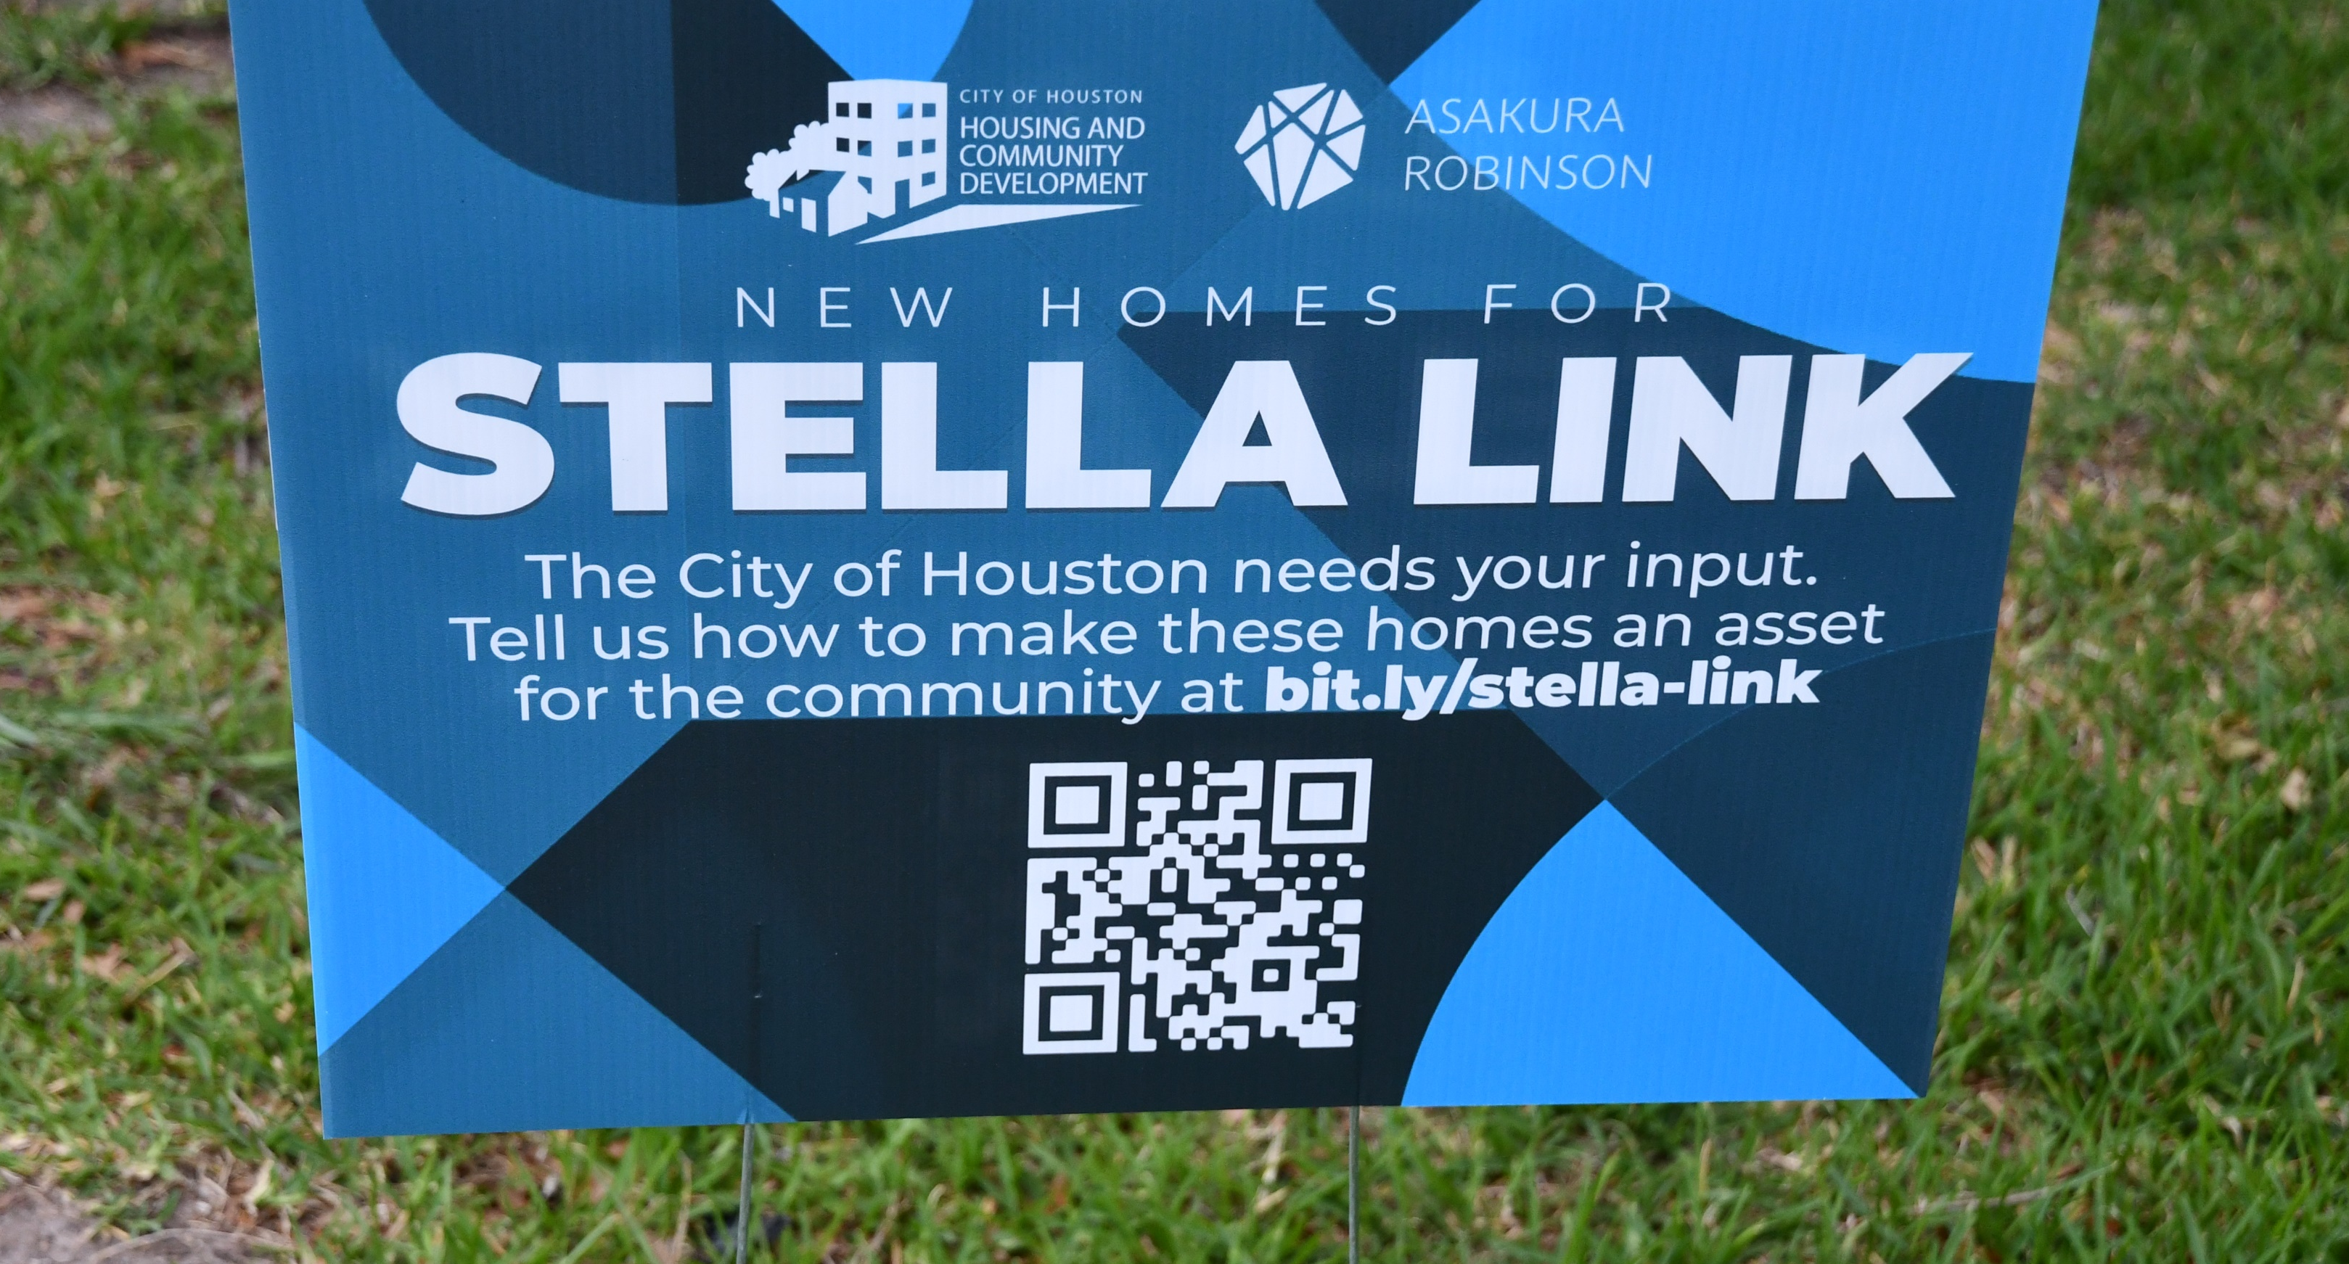
Stella Link
May 5, 2022 (District K)
This 10-acre master-planned development will be located at the southwest corner of Stella Link Road and South Braeswood Blvd.

Slide 86
Stella Link Public Hearings
May 5, 2022 (District K)
The first phase of the Stella Link development will include a 310-unit apartment property.
The second phase will include approximately 25,000 square-feet of dining and retail space through several buildings.
The third phase will include another 350 apartment units.

Slide 87
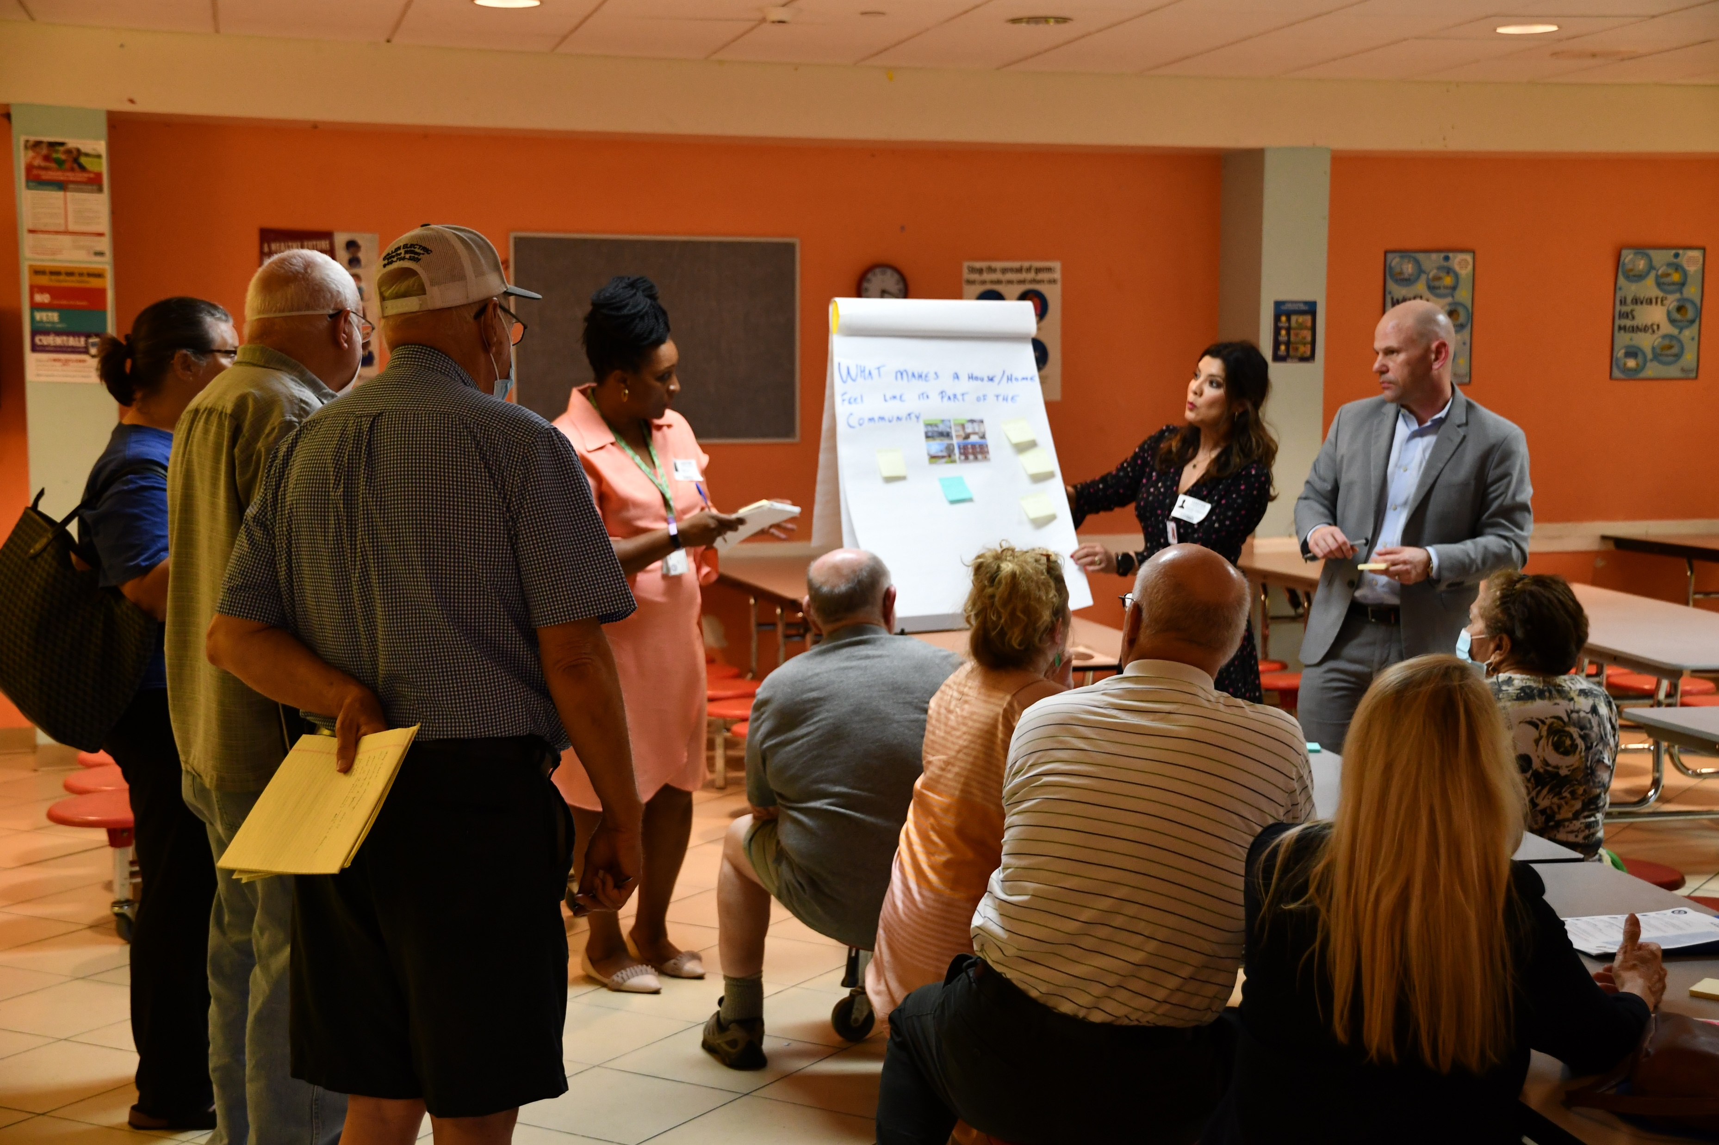
Stella Link Public Hearings
May 5, 2022 (District K)

Slide 88
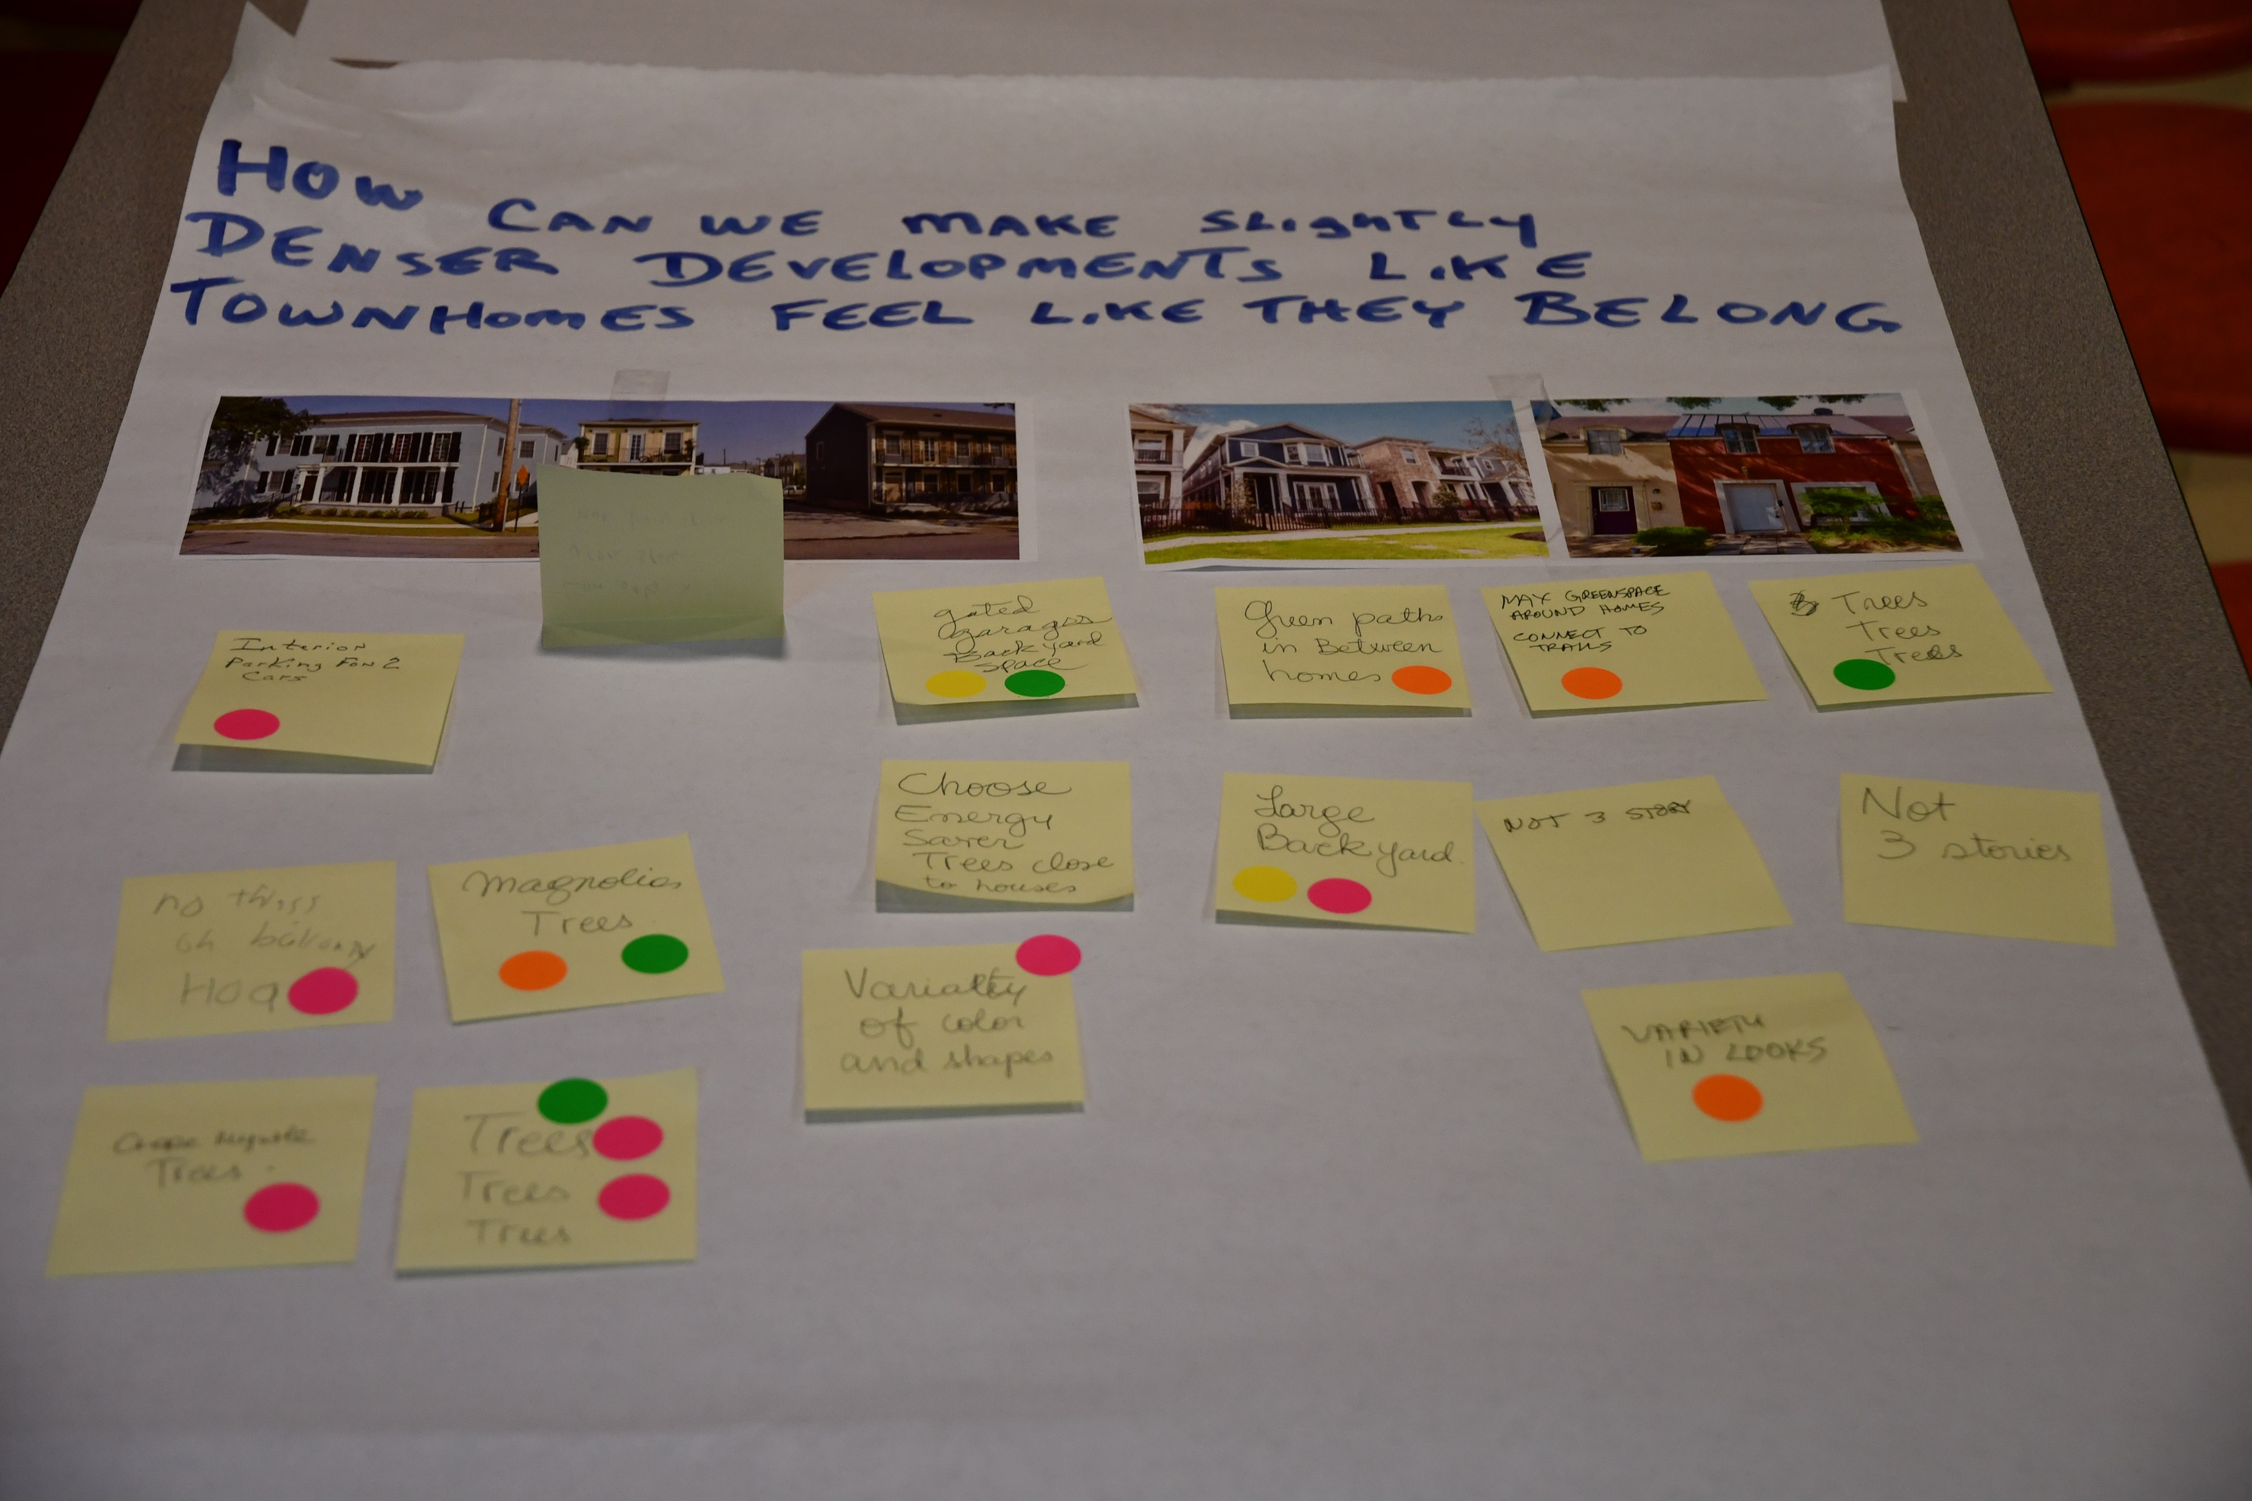
Stella Link Public Hearings
May 5, 2022 (District K)

Slide 89
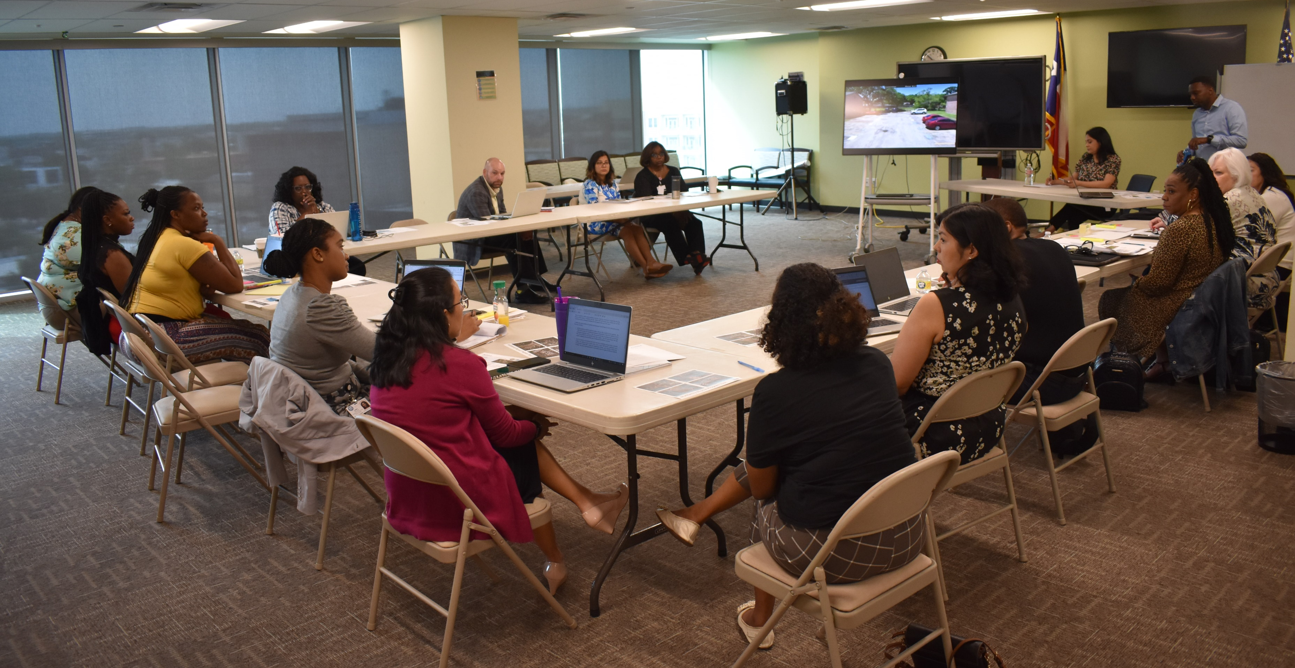
General Land Office Buyout Workshop
May 2, 2022

Slide 90
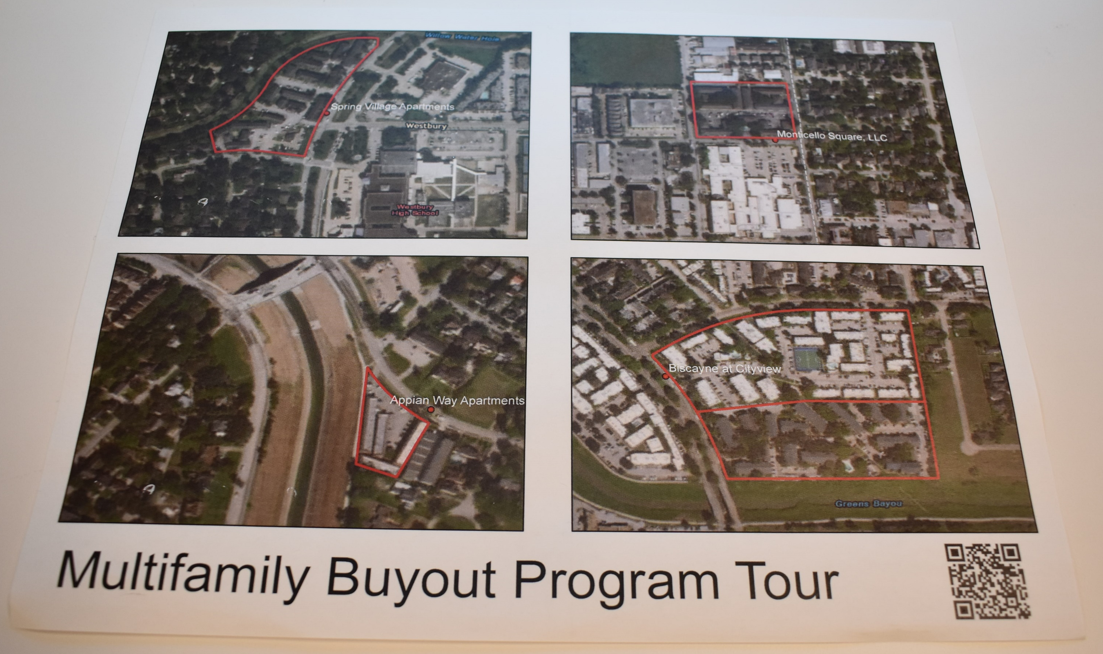
General Land Office Buyout Workshop
May 2, 2022
Four apartment communities were reviewed.

Slide 91
General Land Office Buyout Workshop
May 2, 2022
Spring Village Apartments (District K)
11810 Chimney Rock, Houston, TX 77035
Appian Way Apartments (District K)
3200 N. MacGregor Way, Houston, TX 77004
Biscayne at City View Apartments (District B)
17030/17050 Imperial Valley, Houston, TX 77060
Monticello Apartments (District J)
5312 Clarewood, Houston, TX 77081

Slide 92
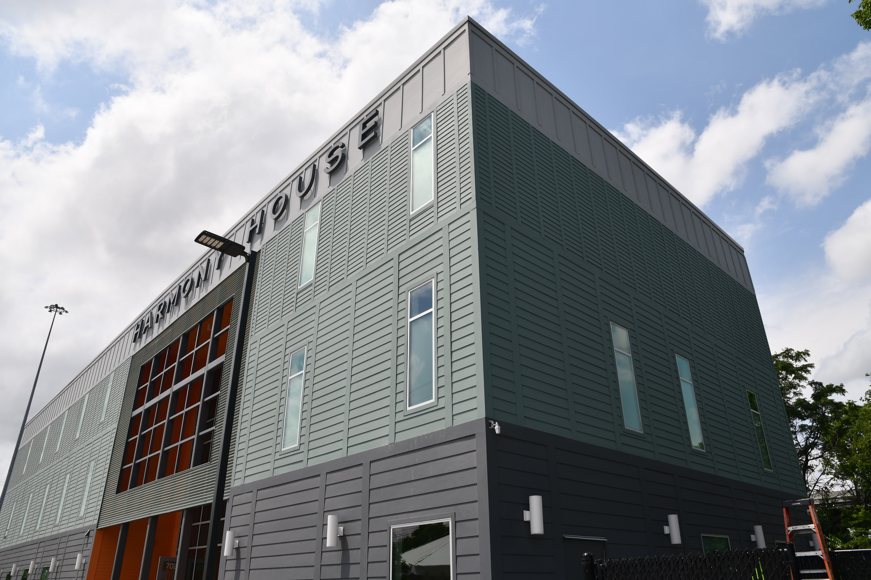
Harmony House Grand Opening May 6, 2022
602 Girard, 77007 (District H)

Slide 93
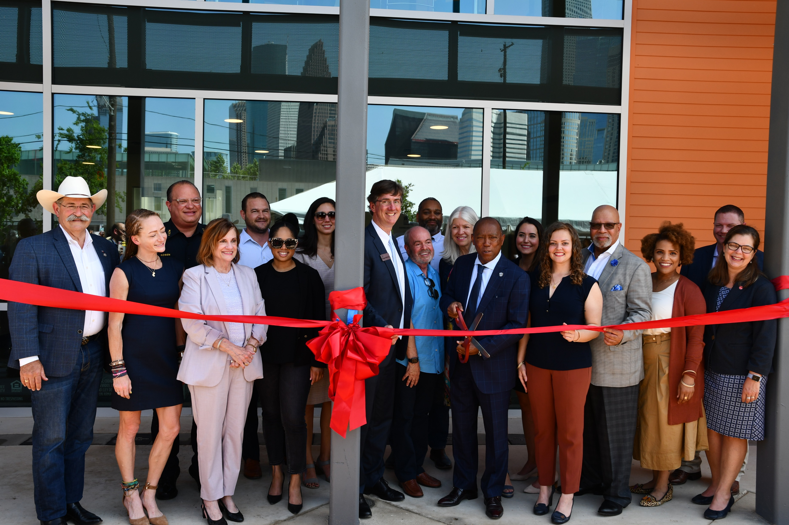
Harmony House Grand Opening
May 6, 2022

Slide 94
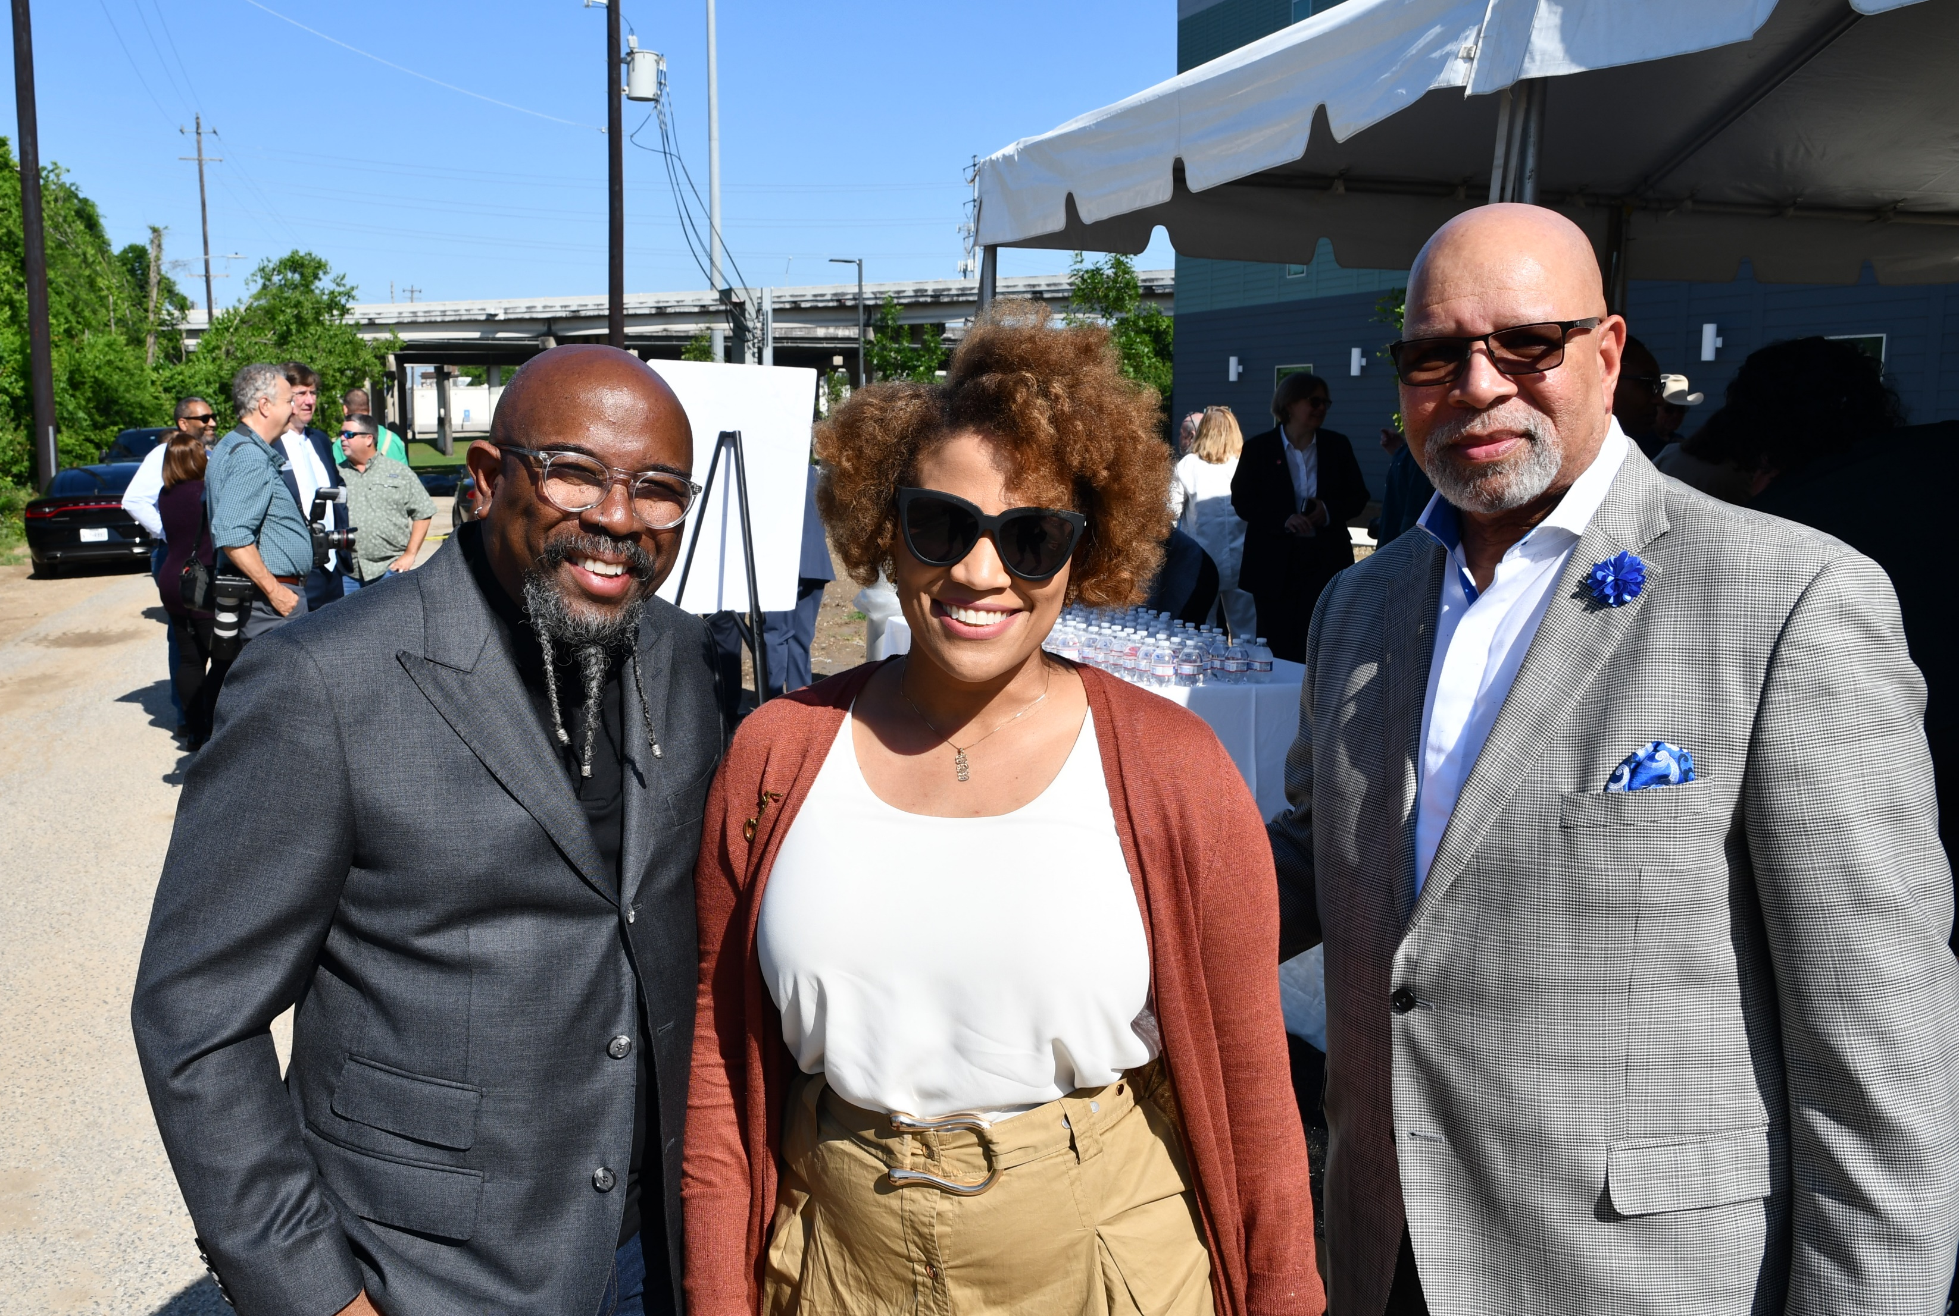
Harmony House Grand Opening
May 6, 2022

Slide 95
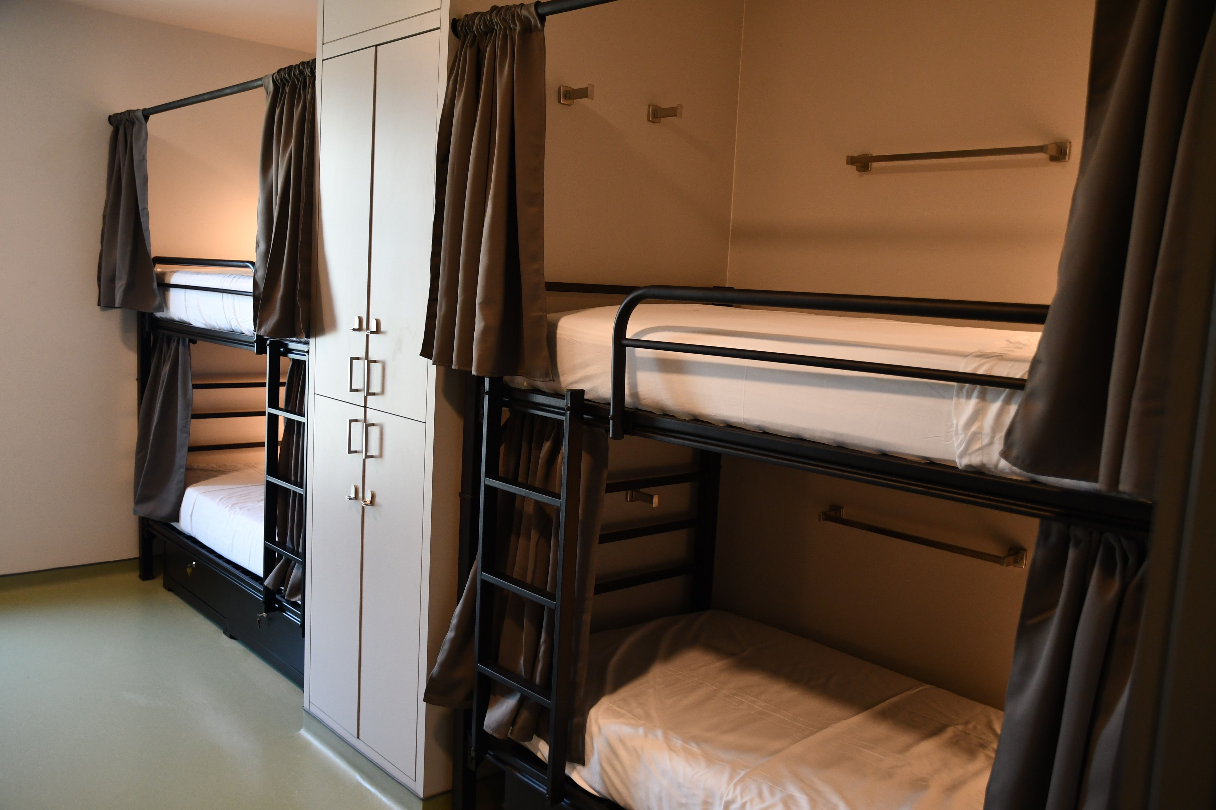
Harmony House Grand Opening
May 6, 2022

Slide 96
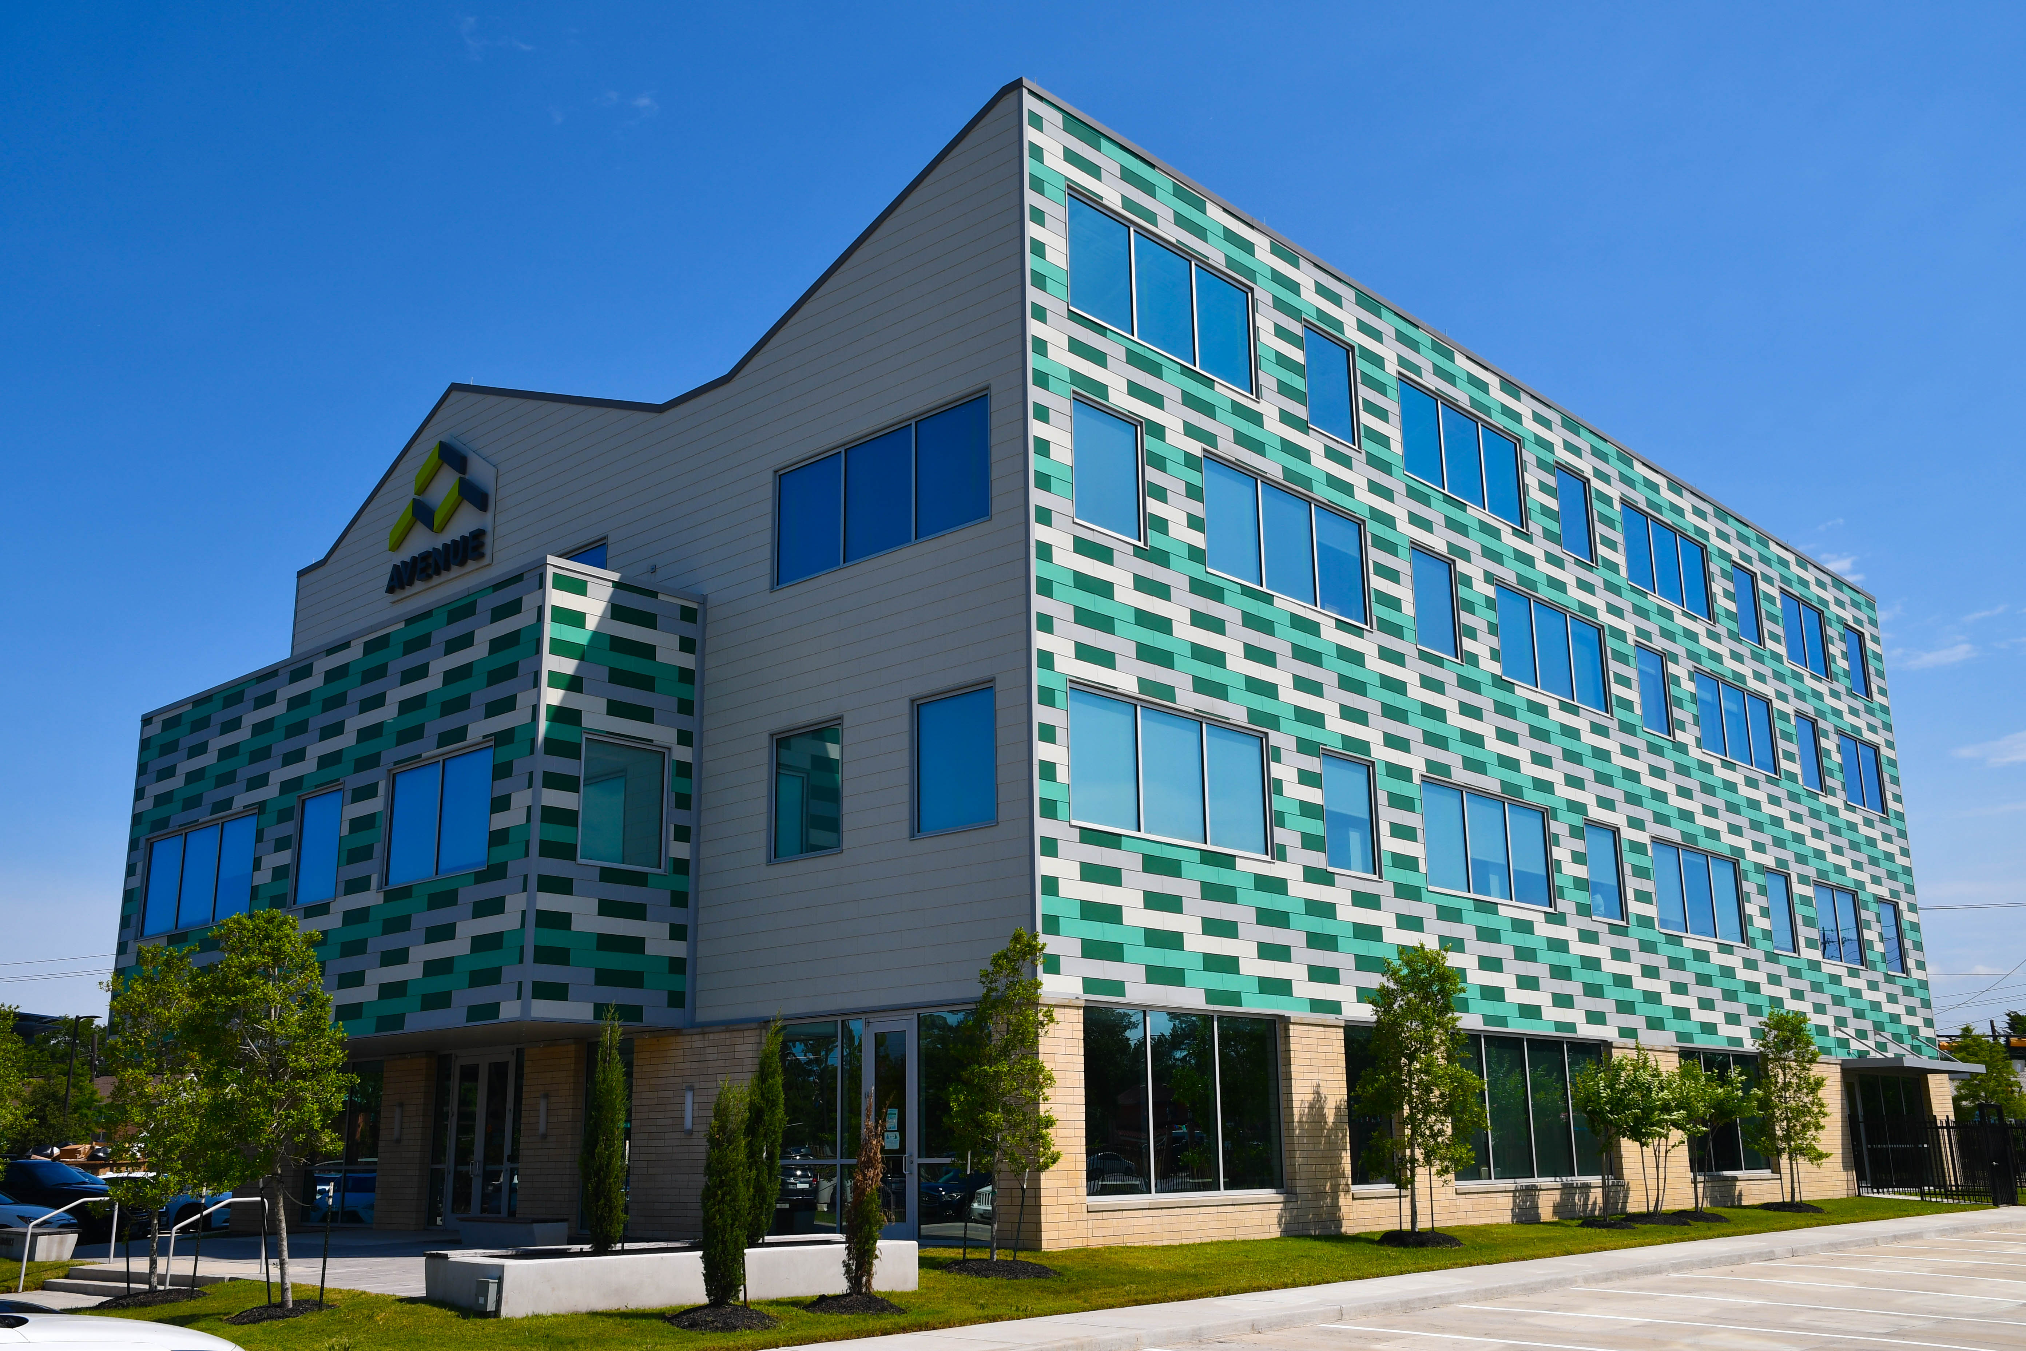
Avenue CDC Grand Opening
May 19, 2022

Slide 97
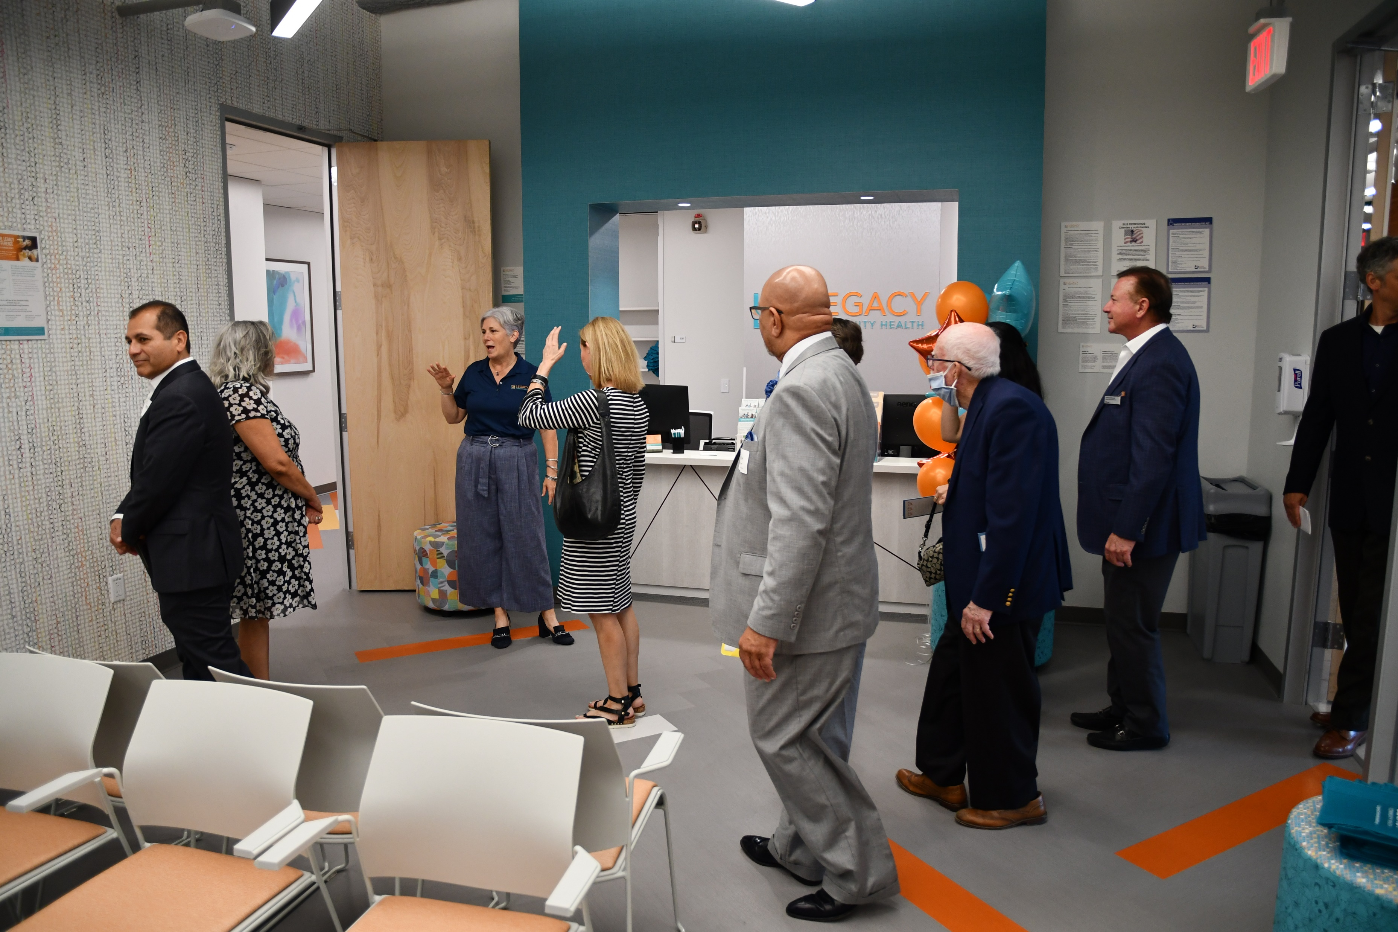
Avenue CDC Grand Opening
May 19, 2022

Slide 98
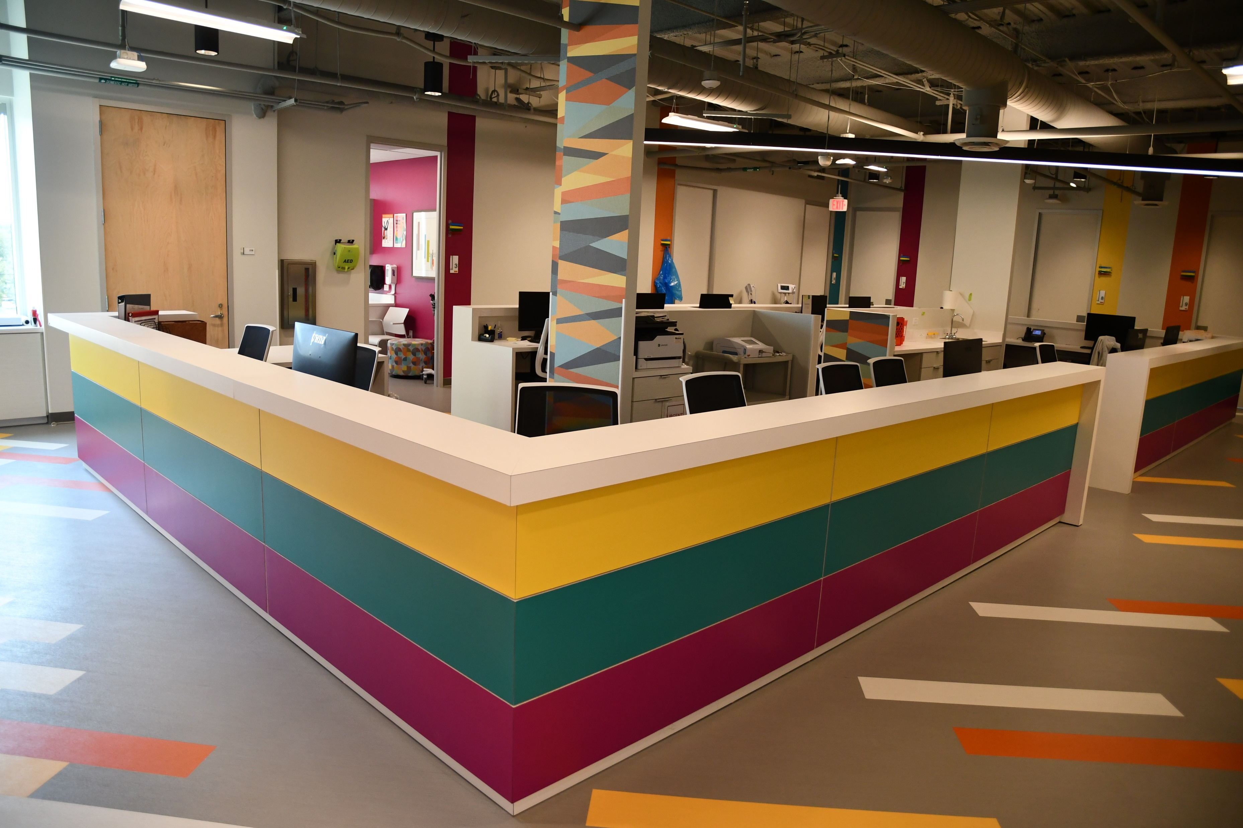
Avenue CDC Grand Opening
May 19, 2022

Slide 99
Update: NHH Savoy
6315 Savoy, Houston, 77036 (District J)
23% Complete as of May, 2022
Total Number of Units: 120
Total Restricted Units: 120 (30% - 80% AMI)
Total Project Cost: $33,794,447.00
HCDD Funding: $13,200,000.00 (CDBG - DR17)
Developer: Houston Area CDC/New Hope Housing
Architect: Garcia Associates, Architects, LLC.

Slide 100
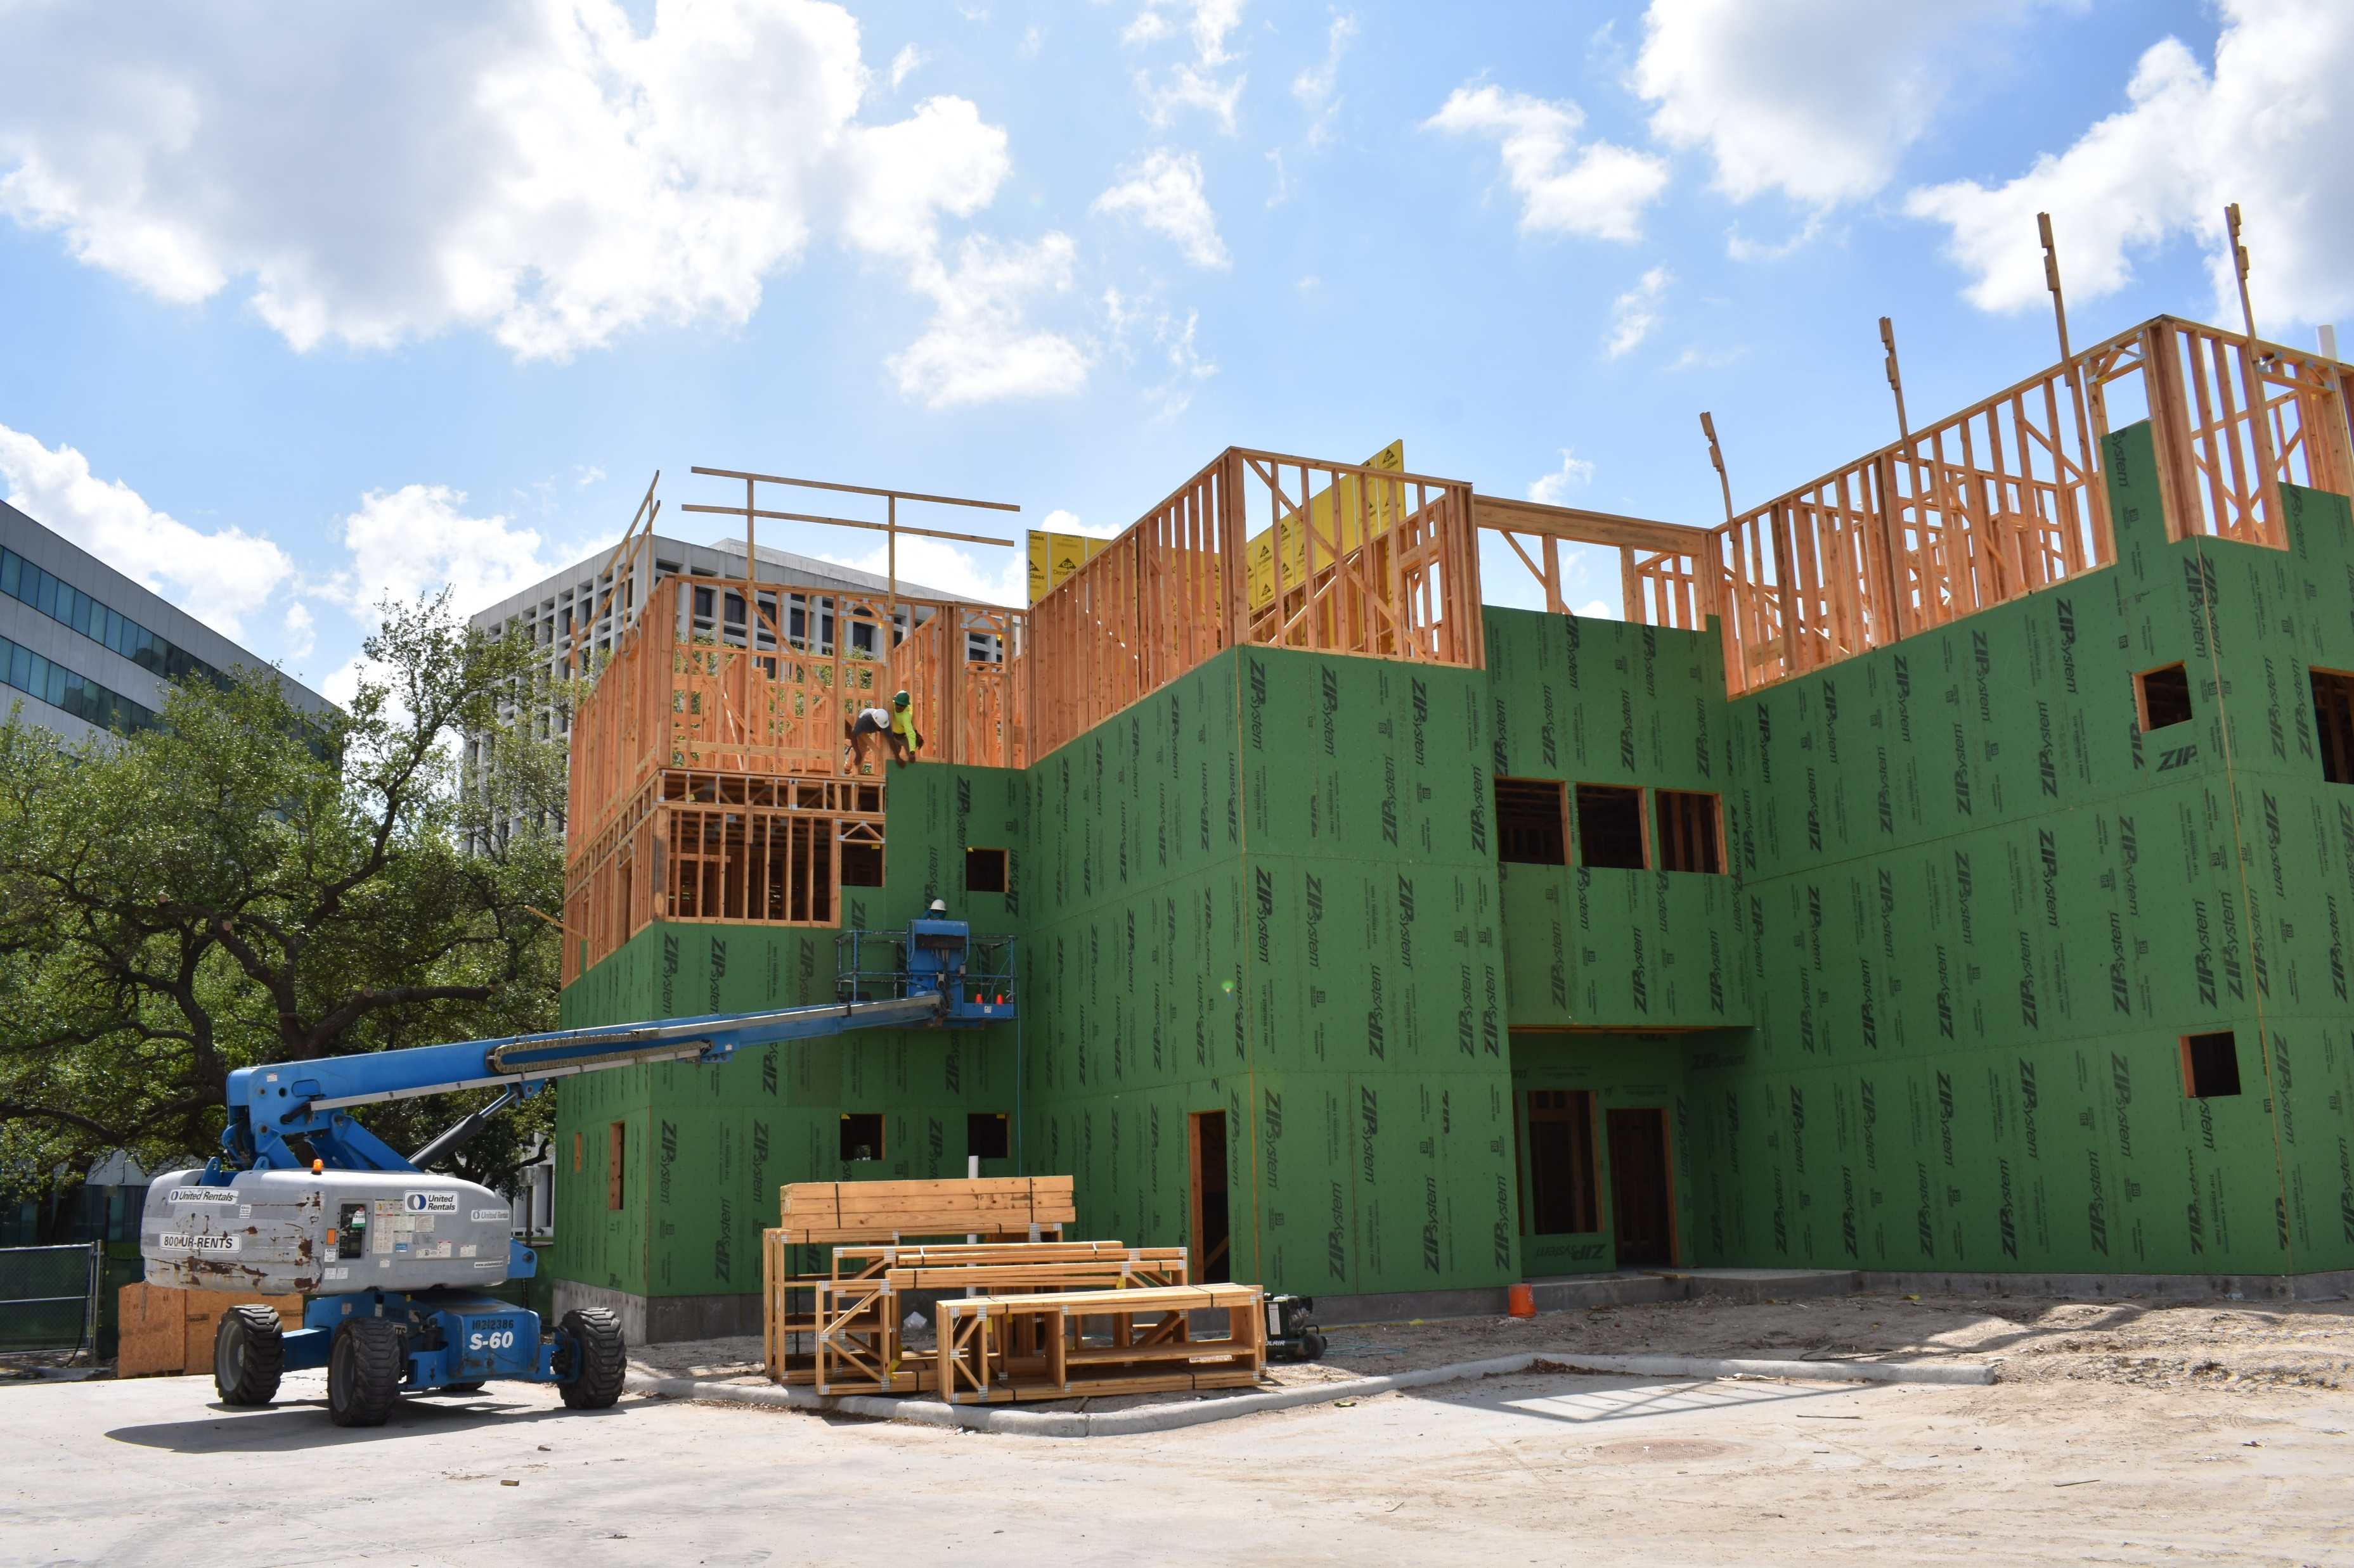
Update: NHH Savoy
6315 Savoy, Houston, 77036 (District J)

Slide 101
Update: Heritage Senior Residences
1102 Moy, Houston, 77007 (District H)
40% Complete as of May, 2022
Total Number of Units: 135
Total Restricted Units: 94 (30% - 80% AMI)
Total Project Cost: $40,356,370.00
HCDD Funding: $14,350,000.00 (CDBG - DR17)
Developer: Ensemble Holdings, LLC.
Architect: Mucasey & Associates Architects

Slide 102
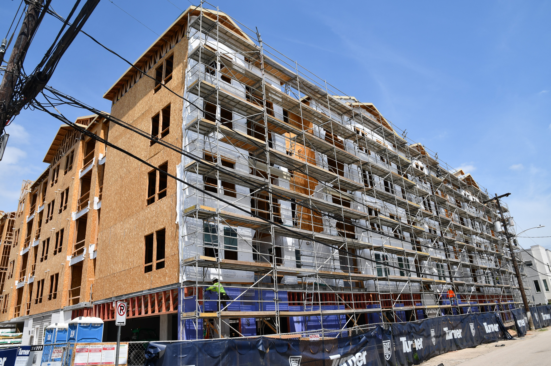
Update: Heritage Senior Residences
1102 Moy, Houston, 77007 (District H)

Slide 103
Update: Gale Winds Apartments Rehab
5005 Irvington, Houston, 77009 (District H)
100% Complete as of May, 2022
Total Number of Units: 18
Total Restricted Units: 10 (30% - 80% AMI)
Total Project Cost: $3,304,988.00
HCDD Funding: $1,650,000.00 (CDBG - DR17)
Developer: Avenue CDC
Architect: Avenue CDC

Slide 104
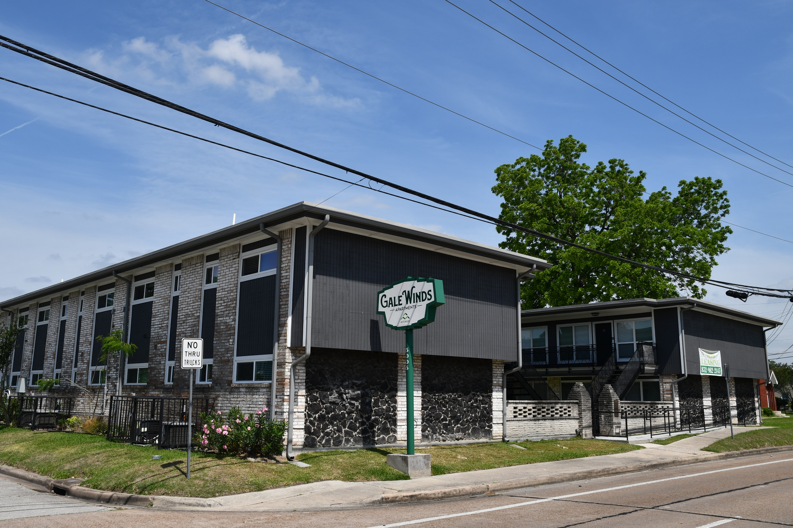
Update: Gale Winds Apartments
5005 Irvington, Houston, 77009 (District H)

Slide 105
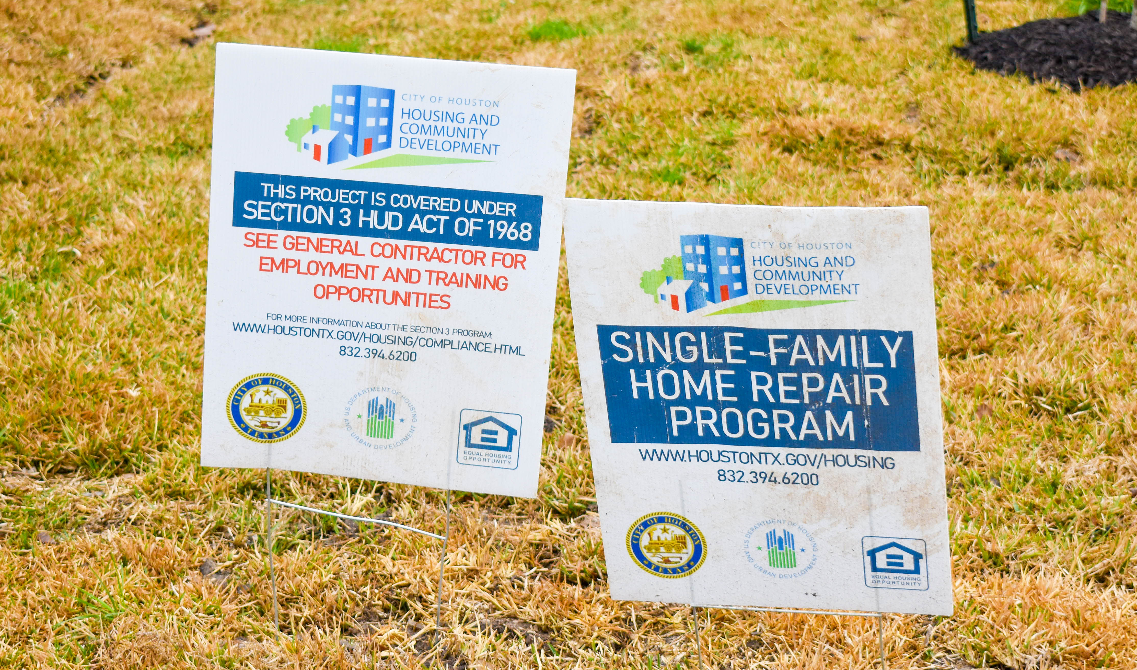
Single Family: Home Repair Program &
Homebuyer Choice Program

Slide 106
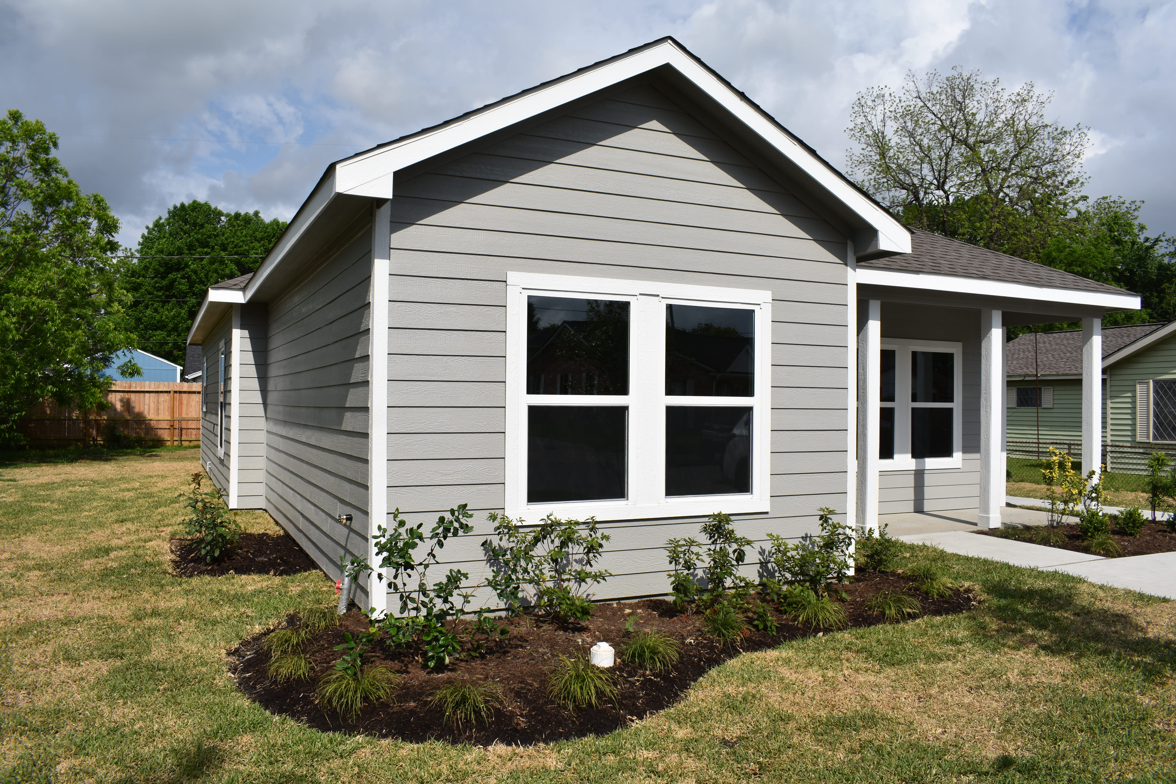
Home Repair Program – Key Exchange
Herridge Street, Independence Heights (District H)

Slide 107
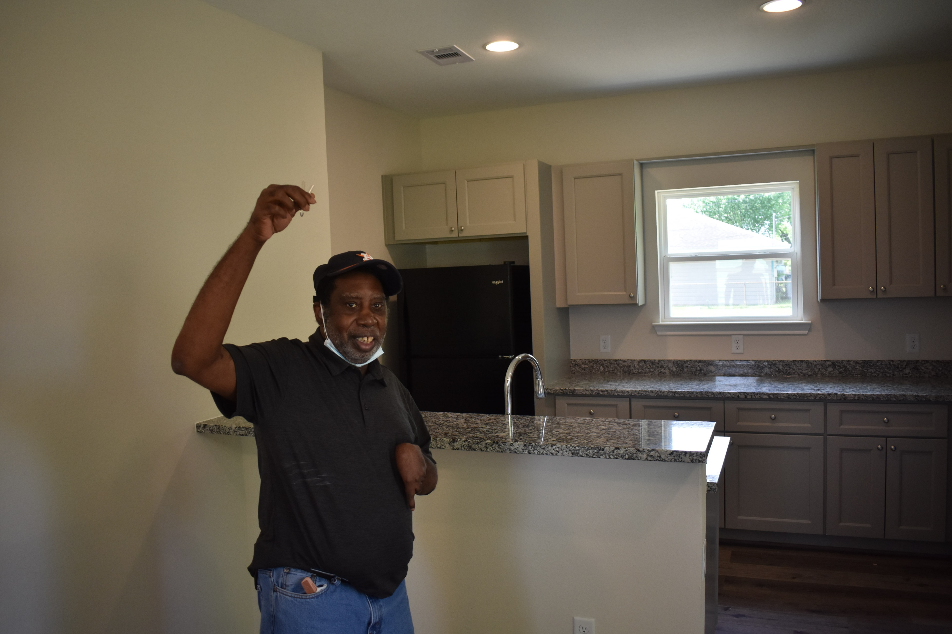
Home Repair Program – Key Exchange
Herridge Street, Independence Heights (District H)

Slide 108
For More Info on HCDD’s Projects…
https://www.flickr.com/photos/houstonhcdd
2100 Travis Street, 9th Floor
Houston, TX 77002
832-394-6200
hcdd@houstontx.gov

Slide 109


Comments & Questions

