Slide 1

Derecho & Hurricane Beryl Disaster Relief Program
A New Economy for Working Houston & Texas Gulf Coast Labor Federation Partnership
Notes:
AMY
New Economy for Working Houston has partnered with the Texas Gulf Coast Area Labor Federation to provide disaster clean up services to Houstonians in the wake of the Derecho and Hurricane Beryl.
JORGE
The Texas Gulf Coast Area Labor Federation, AFL-CIO unites the power of 95 unions and 60,000 union members to advocate for working families in 13 Houston-area counties. The unions that compose our labor council represent workers in the public sector, manufacturing, the building and construction trades, the transportation of people and goods, and the hospitality and other service industries.
We mobilize our members and community partners to demand a fair shot at better lives for all working people -- regardless of the color of our skin, the country we come from, our faith tradition, or whom we love.
AMY
New Economy for Working Houston (NEW Houston) is a relatively new 501(c)(3) that brings together the power of grassroots organizing and public policy innovation to win a just economy for Gulf Coast working families. We seek to build coalitions of community and labor groups and offer research and communications infrastructure to support the development of policy that improves the lives of Gulf Coast residents.

Slide 2
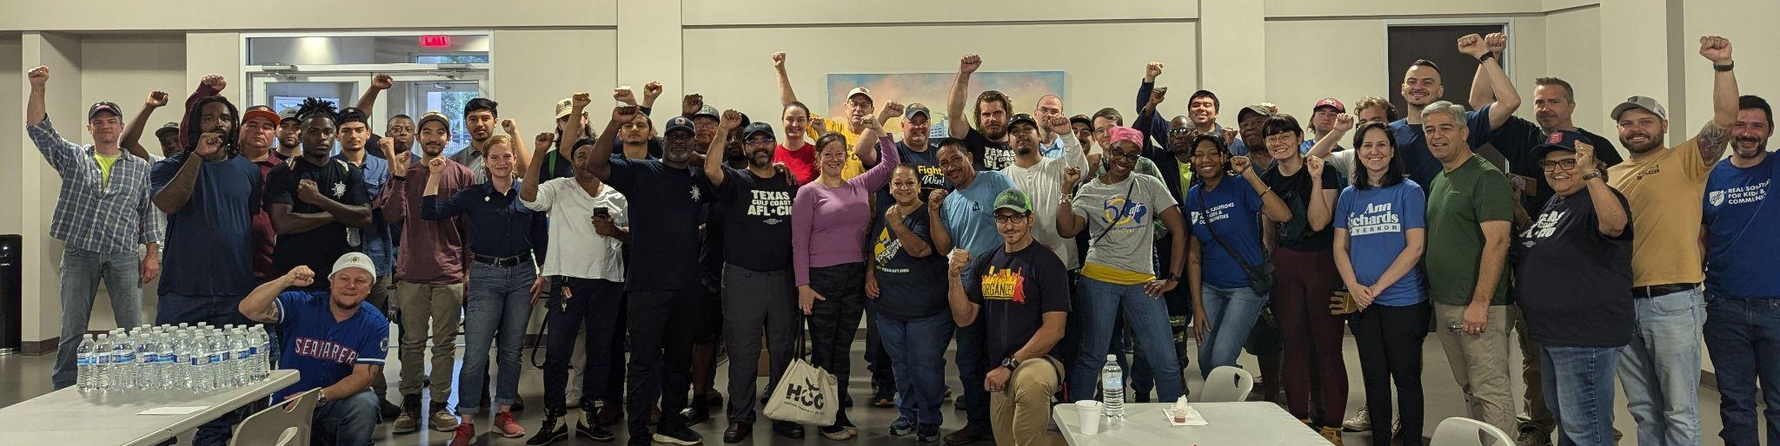
Why Storm Relief?
We live and work here! We care about our community and our neighbors and want to build a strong and resilient Houston!
Notes:
Jorge
As an organization that seeks to bring together labor and community, NEW Houston is proud to have been able to raise funds to hire union workers. Union workers have a long history of serving the communities in which they work. Here locally, union members have sprung into action in response to Hurricane Harvey and the Texas Gulf Coast Labor Federation worked to ensure people were able to stay housed as part of their COVID-19 response.
Union membership is made up of working Houstonians and we are proud to work to serve the community where we live and work.
We don’t want to see our neighbors living with fallen trees, debris-filled yards, and leaking roofs just because they can’t afford thousands of dollars in work after a storm.
We also don’t want to see neighbors’ homes damaged by unsafe, unskilled work being completed at their homes. That is why we put together a program to respond to storm damage following the derecho and Hurricane Beryl.
This is a new project and we’ve been very successful. We've learned a lot as we are doing this, and hope to be able to apply what we’ve learned, as we know more storms will be coming.

Slide 3
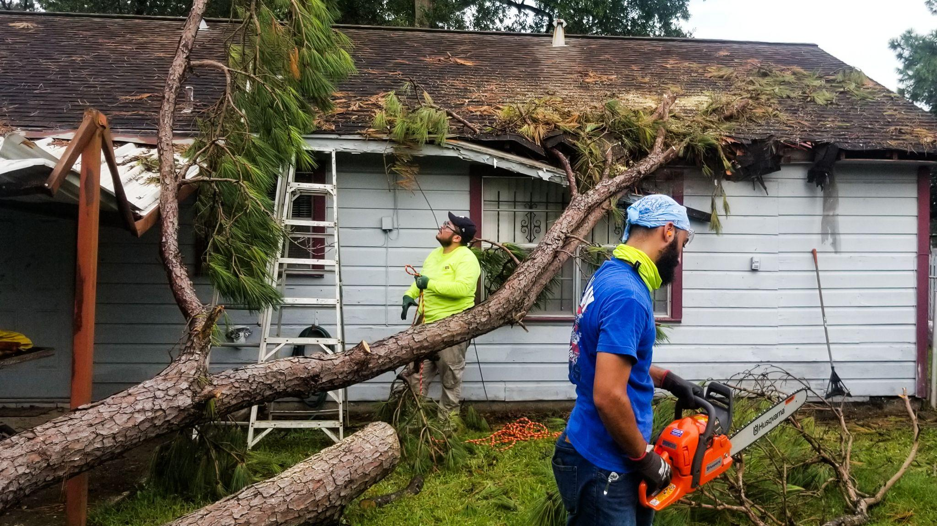
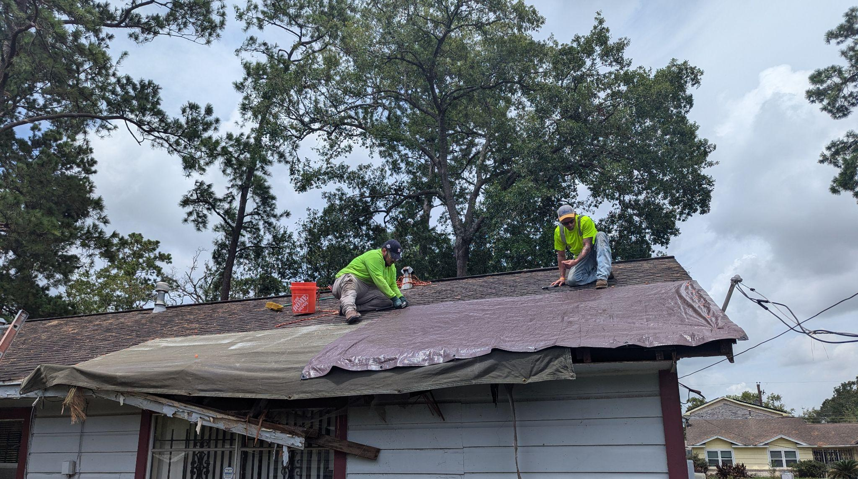
Our Program
Notes:
Building on work in wake of Dercho, after Beryl We worked with community organizations and county staff to identify residents needing service to their homes.
We have been provided with funding from Precinct2Gether, Precinct4Foward, the Texas AFL-CIO, Union Pacific, and the American Federation of Teachers and a lot of in-kind support from the TX Gulf Coast AFL-CIO.
Through our relationship with the Texas Gulf Coast AFL-CIO, we worked closely with unions and ALF staff to recruit unemployed and underemployed union workers.
We assign crews of workers to the homes that we are able to safely offer service.
New Economy for Working Houston values workplace standards and believes that a key part of our success with this project lies in doing things the right way.
The union workers on our crews are all OSHA 10 certified, meaning they have 10 hours of safety training.
Each shift is led by an experienced journey worker that is at least OSHA 30 trained.
Apprentices are paid $25 an hour, and journeyworkers are paid $40 an hour.
As part of our work with Hurricane Beryl we have hired around 35 workers.

Slide 4
What We Can Do
Remove fallen trees & branches that do not pose risk of causing further damage
Roof tarping
Some electrical repairs
Notes:
Insurance does not cover the cost of tree removal, and many residents cannot afford to have trees removed. NEW Houston removes trees and large branches that have already fallen and the removal of the debris does not pose a significant risk of causing further damage.
We also tarp roofs to prevent water damage.
We move all debris to the right of way for pickup by the city or county.
We can provide limited electrical repairs in rare circumstances, but it should be noted that the costs to complete these jobs are significantly higher due to materials and permitting costs.
NEW Houston does not currently offer rebuilding or interior repairs. It should be noted that we do hear from those needing interior repairs that cannot afford it, and also get requests from renters who have been unable to get repairs completed by their landlords.
Stumps are not removed at the jobs we complete unless they are fully free from the ground due to risk of underground gas and waterline damage.

Slide 5
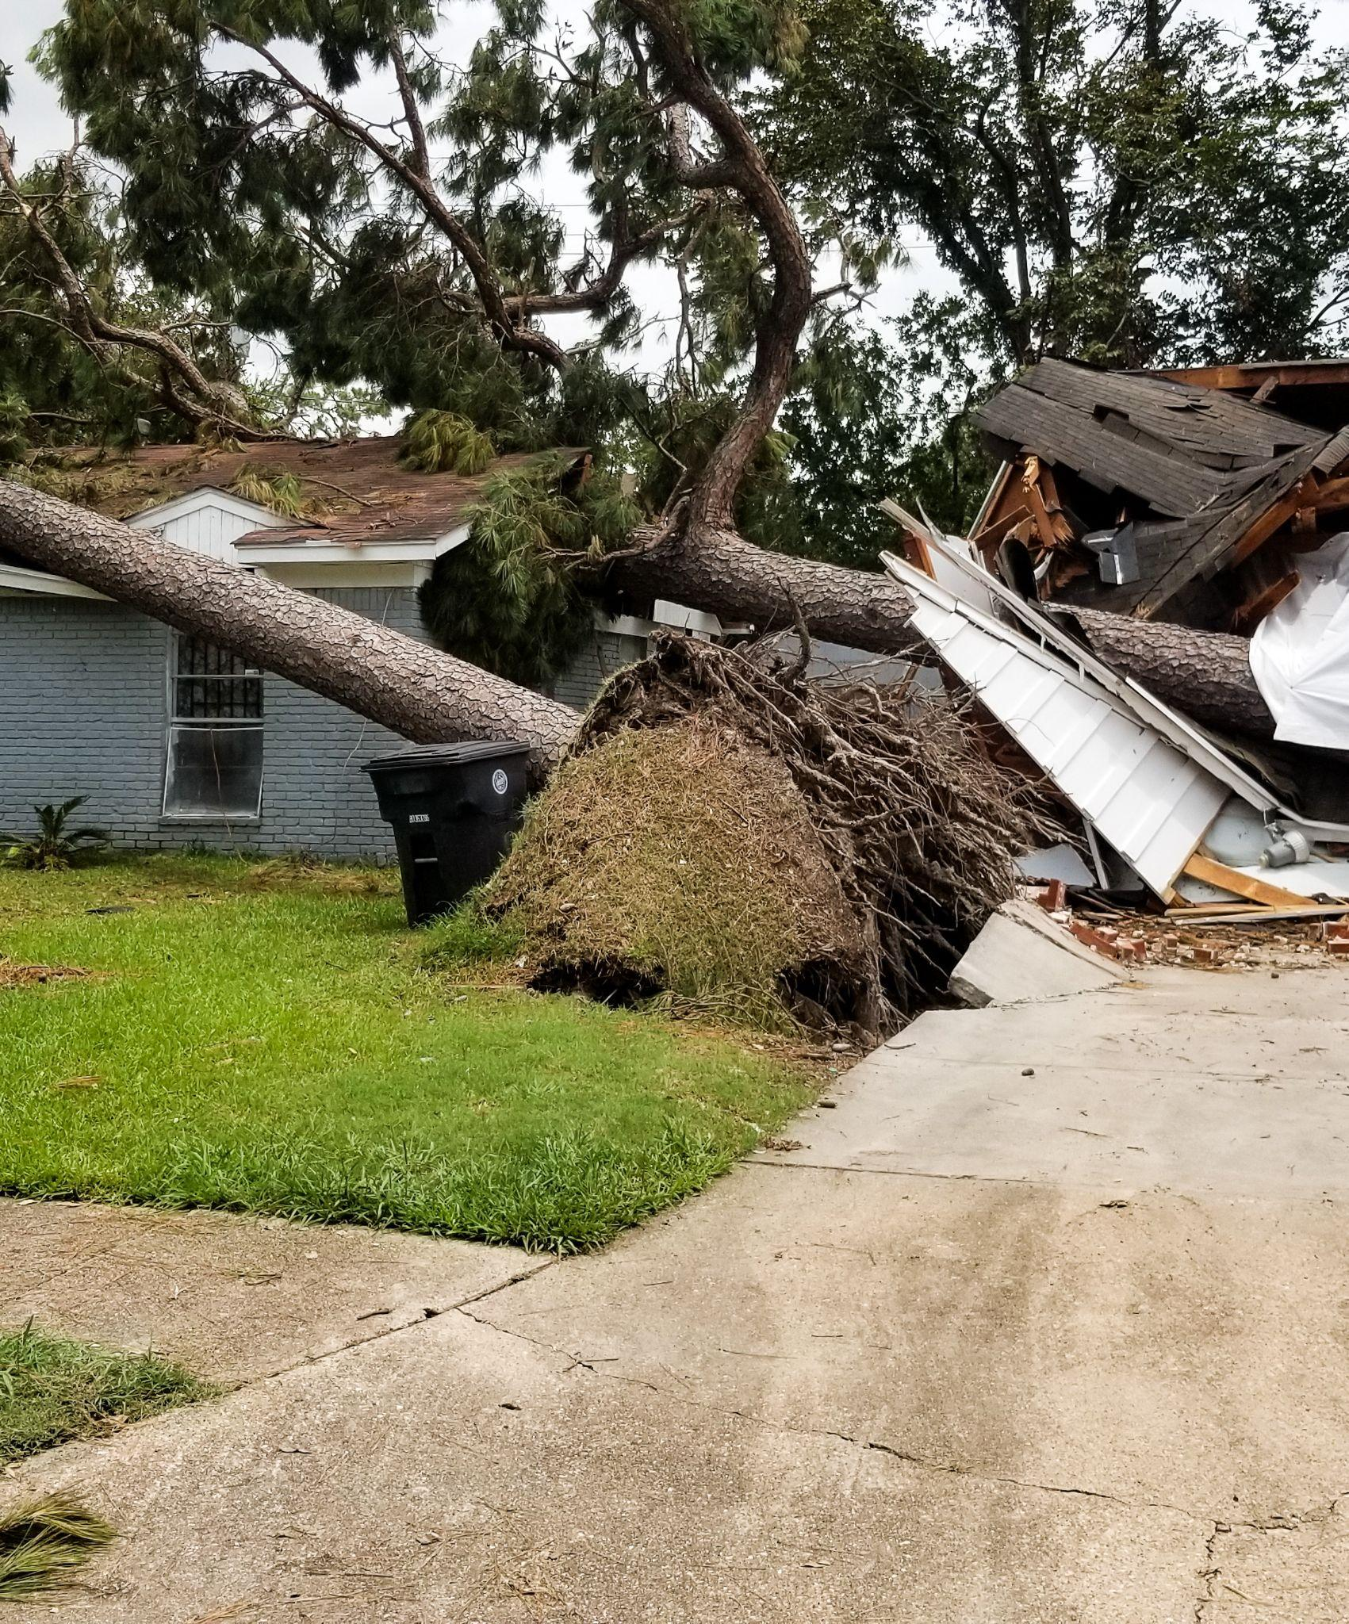
We cannot serve homes where the removal requires a crane or poses risk of further damage as it is removed.
Notes:
We cannot serve homes where the tree has caused significant structural damage, as the removal of the tree from the home could cause further damage. These jobs require training and equipment like cranes to ensure safe removal of the trees.
When we find that we are unable to serve a home, if we know of another resource, we do make referrals to other organizations to help ensure they get help that is available.

Slide 6
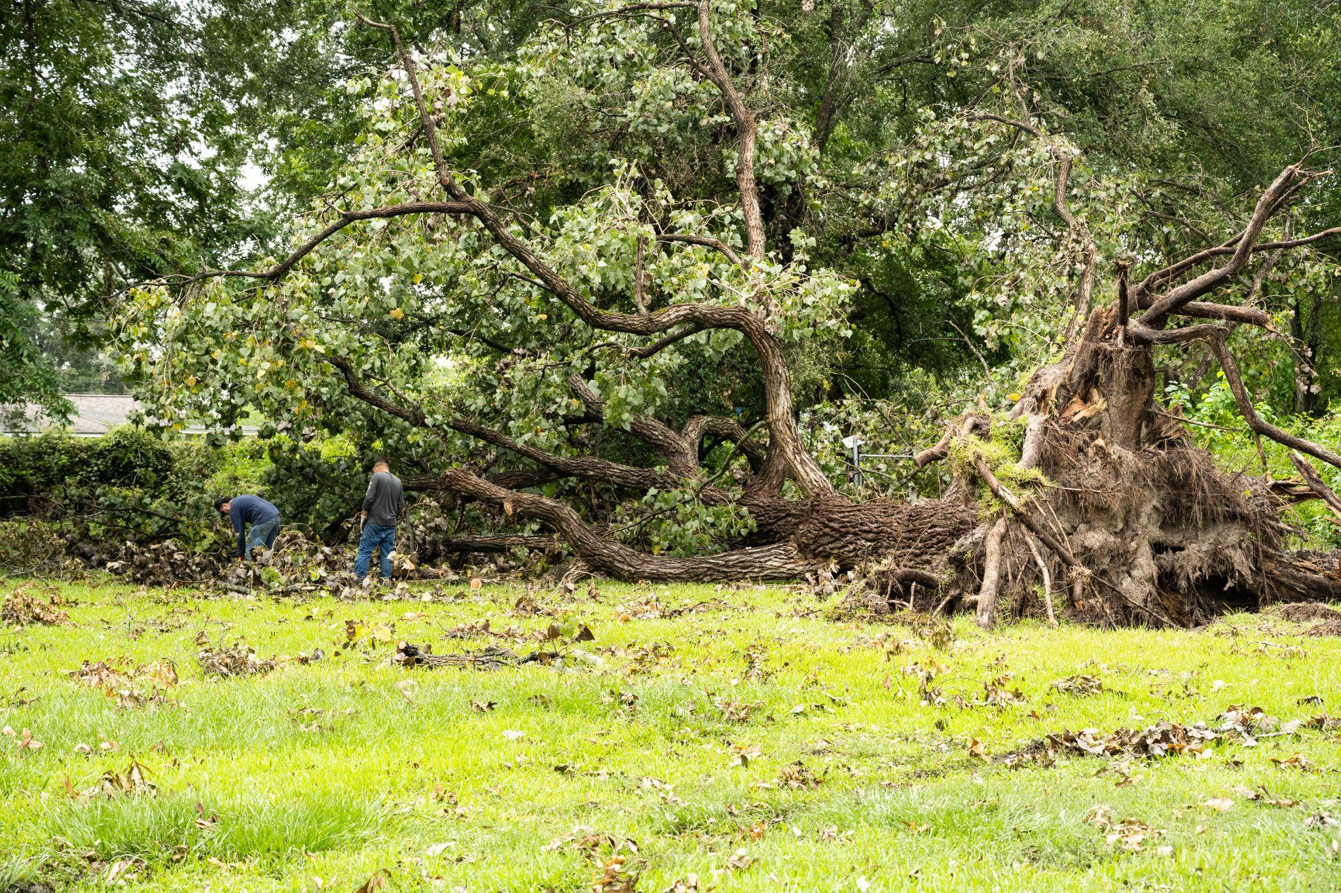
Comparing the Derecho to Beryl
Much larger jobs that would costs thousands of dollars to homeowners
Increase in reports of scammers
Reports of neglectful landlords
Notes:
Following the Derecho we sent crews out to neighborhoods in 4 hour shifts. Crews were able to complete 2-4 addresses per shift. Many jobs did not require the use of a chainsaw.
We served over 75 homes working every day for two weeks.
Beryl’s damage has included much larger trees. As a result we have purchased larger chainsaws. Each crew does one address per four hour shift, and most homes require at least two full shifts to complete.
So far we have completed around 24 homes in 7 weeks, with some interruptions due to weather.
We limited shifts to 3 per week to allow for better home vetting and mechanical repair of chainsaws.
Initial homes completed were more in need of rapid response, clearing entrances into homes and now the homes we are serving are mostly the large tree trunks volunteers were not able to address.
The costs of removing trees of this size would likely be in the thousands if the homeowner were paying a tree service to remove the trees. We do this work at no cost to the homeowner.
Each address is between one to two thousand dollars, with some requiring more time due to the size of the job.
We have seen increased instances of homeowners being scammed or experiencing high pressure tactics from individuals offering to remove trees following Hurricane Beryl.
We’ve seen a family charged to only have the tree removed from the street, which would have been done for free.
People paying workers for tree removal and the workers leaving the job half done and not returning.
And some just using very high pressure tactics and demanding exorbitant prices and insurance information to provide the service

Slide 7
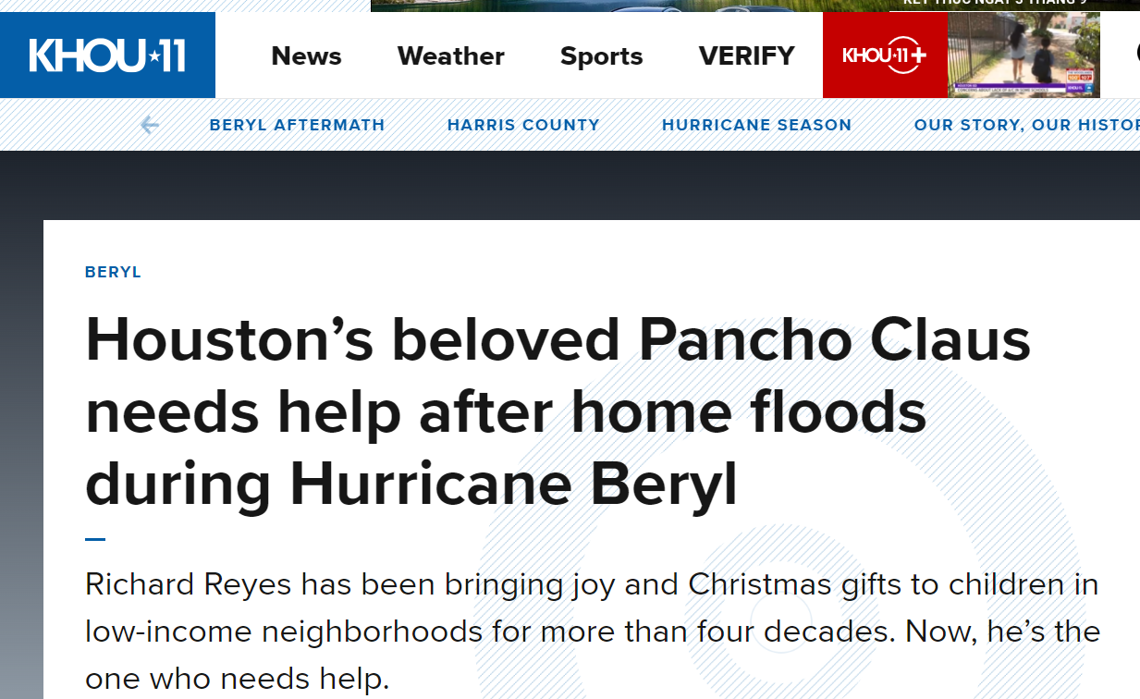
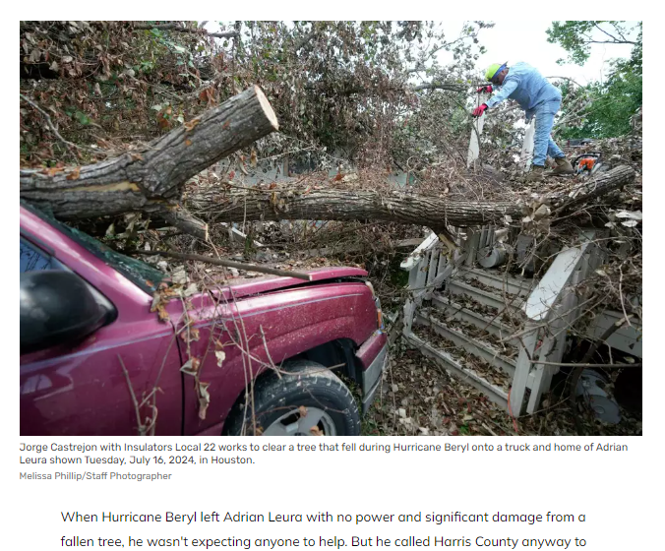
Homeowner Stories
Notes:
Pancho Claus - Richard Reyes
Upon hearing a news report that Richard Reyes, also known as Pancho Claus, was struggling to afford to clean up following the hurricane, we reached out to him to offer help. Our crews spent two shifts removing debris and cleaning up his property in order to help him move forward with his recovery efforts.
Insert Photos
Electrical Repairs
A retired homeowner on a fixed income was still without power a month following the storm. The storm caused damage to his home that was not a part of CenterPoint’s infrastructure and without money for repairs, the home’s power could not be restored. We worked with a union contractor to provide permitted electrical service work. NEW Houston paid the costs of materials, labor, and permitting for the home and provided labor for debris removal as well. This cost to NEW Houston was around $2700 because the contractor worked with us to do it at cost.
When homeowners cannot afford to hire licensed contractors, they are at risk of fines due to unpermitted work and unsafe electrical fixes.
We are very proud to help ensure this homeowner can live safely in his home.
Insert Photos

Slide 8
Resources
Our Services:
Contact your county commissioner or city council office
We can still take referrals but our funding is limited and we already have a list we are working through. So we cannot guarantee that we will get to every home referred.
Other Services:
For debris pick-up or other city services call 311
To find other community services call 211
Connective Needs Assessment Registry: connectivetx.org
Where to find Skilled Labor:
https://www.gcaflcio.org/union-building-trades

Slide 9
Become an Apprentice
gcaflcio.org/apprenticeships
Notes:
Union apprenticeships are a proven path to prosperity: you’ll “earn while you learn,” earning wages above industry average while developing essential knowledge both in the classroom and on jobsites – without having to pay a dime, unlike college – while preparing the highly skilled, highly productive workforce on which our shared prosperity depends.
Anyone who is interested in joining one of our programs should start by visiting gcaflcio.org/apprenticeships and filling out our interest form

Slide 10
Donate to NEW Houston
newhouston.org

Slide 11
Potential Solutions
Tree Removal Apprenticeships
Apprenticeships in tree felling and funding to offer tree removal to homeowners that cannot afford it could help Houston prevent further damage by making it possible to remove trees posing a risk.
Notes:
Tree felling is dangerous. We cannot currently remove trees that are still standing due to safety risks and risks of property damage.
We have heard from many homeowners that they had already been concerned about trees near their home falling but they had been unable to afford tree removal.
Apprenticeships in tree felling and funding to offer tree removal to homeowners that cannot afford it could help Houston prevent further damage by making it possible to remove trees posing a risk.

