Slide 1



Houston Federation of Teachers
AFT Local Union
American Federation of Teachers
Presented by
Corina Ortiz
Chief of Staff
Jessi Heiner
Digital Organizer

Slide 2





Houston Federation of Teachers
INTRODUCTIONS
HFT
Jackie Anderson
Corina Ortiz
Jessi Heiner
AFT Local
President
Chief of Staff
Digital Organizer
  Largest union in HISD with over 5,000 members
  National affiliate is American Federation of Teachers (AFT)
  HFT represents all non-administrative public school employees.
  Elected as HFT President by HFT union members
  Retired educator with more than 30 years of experience
  North Forest School District Alum, this is her second experience with a state takeover
  Texas State University graduate
  Chief of Staff
  Bilingual teacher in HISD for 10 years
  HFT Representative for 28 years
  University of Houston graduate
  Long-time volunteer in NES schools
  State-Licensed Childcare Director
  Former After School Program Director
  Utah State University graduate
HFT2415.ORG
@HFT_2415
713.623.8891
JANDERSON@HFT2415.ORG

Slide 3


Houston Federation of Teachers
Link to PowerPoint
Thank you for inviting us here today. This has been an extremely challenging year.
Teaching conditions are student learning conditions.
@HFT_2415
HFT2415.ORG
713.623.8891
JANDERSON@HFT2415.ORG

Slide 4
CURRENT STATE OF HISD
From a Teacher’s Perspective
General
Overview
Policy
Changes
Employee Retention
Takeover Timeline
Loss of Local Control
What is NES?
Union Consultation
Teachers Evaluations
District of Innovation
Staff cuts
Turnover
Certifications

Slide 5

Takeover Background
Texas Education Agency (TEA)
took over Houston ISD June 1, 2023
  At the time, HISD was rated a B by the state’s grading system
  TEA Commissioner Mike Morath appointed Superintendent Mike Miles and 9 Board of Managers

Slide 6
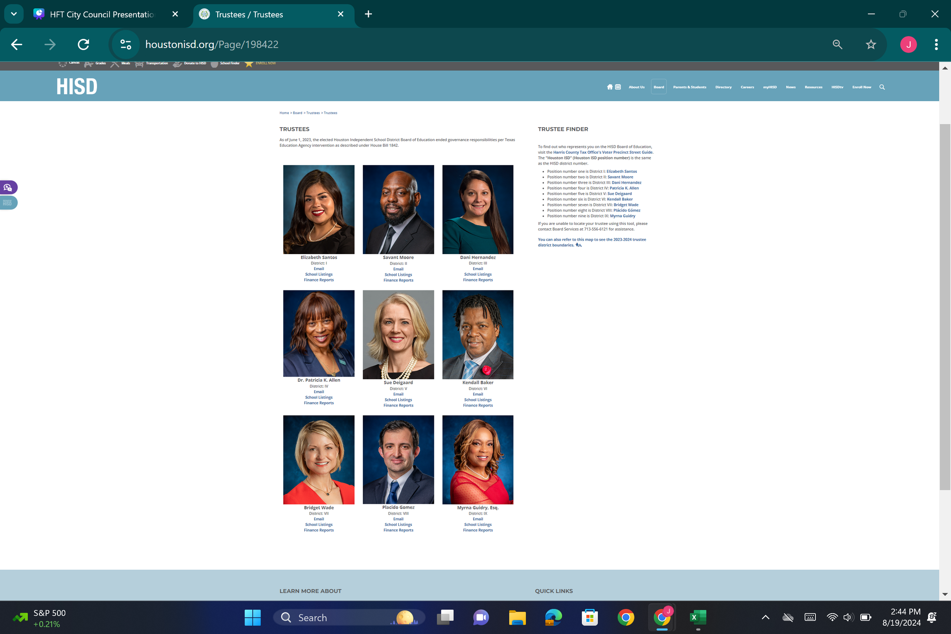

Loss of Local Control
Elected school board trustees still hold office, but no longer have authority to make decisions or vote
  The Board of Managers have no accountability to the public, only to one single person, Commissioner Mike Morath
  Members of the Board of Managers are not representative of the district. None live in or have children who attend NES schools, where the impacts are most significant

Slide 7
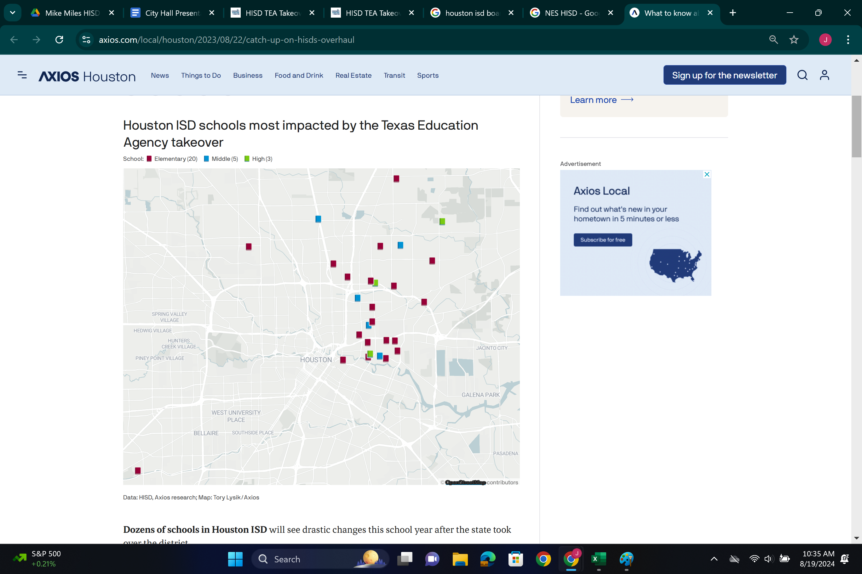
What is NES?
New Education System
Described by Supt Miles as a program to bring additional resources to underperforming campuses.
  Started with 28 schools, then 85, now 130
  Highest student populations of economically disadvantaged students of color
  Principal no longer has autonomy
  No peer reviewed research shows that NES improves academic performance
  Many NES policies are actually outdated and not best education practices and proven methods to improving academic performance

Slide 8
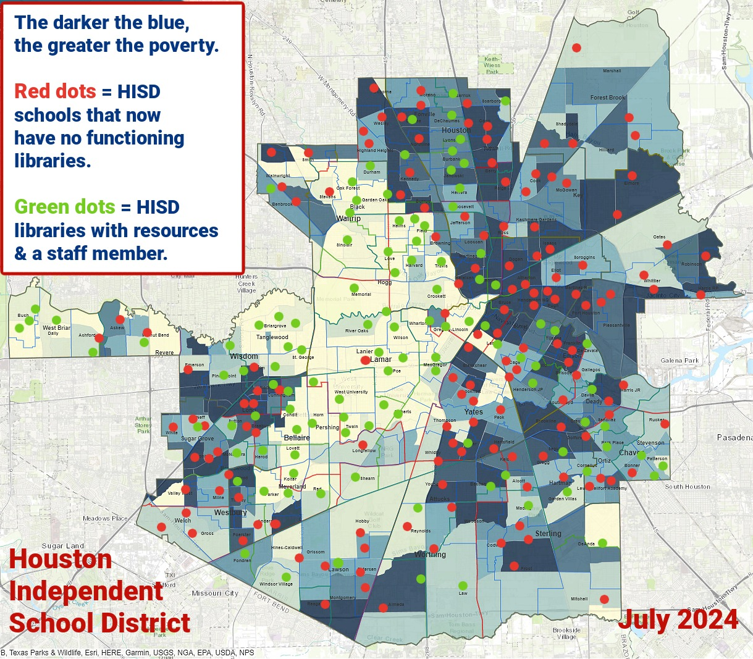
New Education System
Books & Libraries
  Library programs have been removed from all NES schools and many non-NES schools. Only 40 remain in HISD

Slide 9

New Education System
Books & Libraries
  To combat learning loss after COVID, Houston ISD spent $7.4 million federal dollars to upgrade its school libraries to meet state standards
  Libraries are now “Team Centers” where students are sent if they are having disciplinary issues
  Books were removed from the libraries and we don’t know where they ended up
No books are allowed to
be taught in NES schools

Slide 10

Student Impact
Wraparound (Psycho - Social) Services
  Wraparound Specialists provide students with resources that set prepare them for a more stable learning environment. They don’t just help the child, but the whole family.
  The number of Wraparound Specialists was reduced from 274 to 40.
  Sunrise centers are more costly and not located in our communities most in need.

Slide 11
New Education System
Longer Work Hours in NES
NES staff are required to work an equivalent of 1 extra day per week
  Work day extended by 1 hour per day
  Additional 75-minute before or after school duty required
  Weekly 75-minute “Demo-Day” professional development required every Thursday after school. This schedule conflicts with caretaker, daycare, and secondary jobs. This is also the same day as school board meetings, so NES teachers are not able to attend or speak at them
Changes in Absences and Teacher Policy
After the school year started, the absence policy in HISD changed, surprising all staff.
  They went from 7 days to 3 days of absence requiring a doctor’s note
  On 15th day of absence, you’re terminated. Even if you have sick days in the bank.

Slide 12
New Education System
Teacher Evaluation System
The district attempted to implement a teacher evaluation
system with a targeted distribution bell curve.
The proposed evaluation system was not evidence-based, which prompted the HFT to file a law suit to stop the new evaluation system.
The district stated they would follow the state mandated TTESS system, but they created their own evaluation system under the auspices of TTESS.

Slide 13

New Education System
  Curriculum is virtually all scripted PowerPoints and worksheets. No project-based learning, hands-on activities, or books. Teachers are not allowed to deviate from the district-mandated curriculum
  Students are required to take a quiz called a Demonstration of Learning (DOL) at the end of every lesson, which is 3-4 times per day.

Slide 14
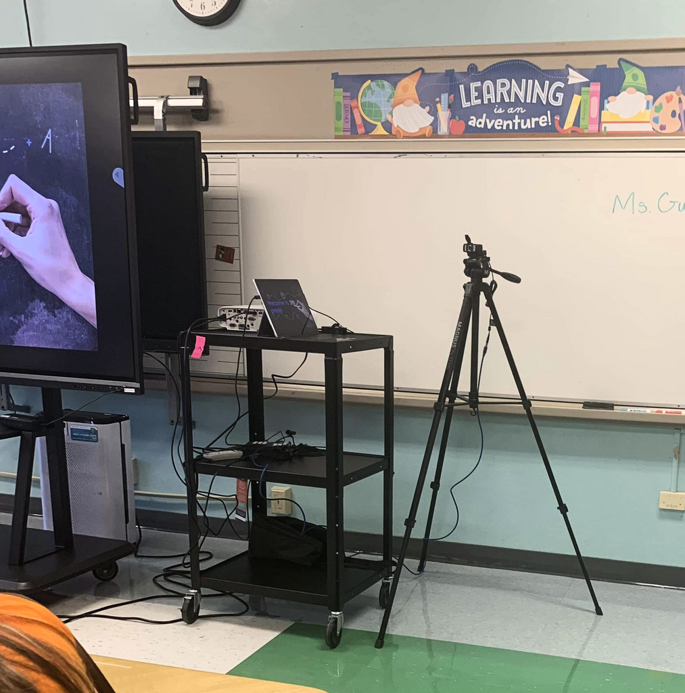

New Education System
Webcams in every NES classroom

Slide 15
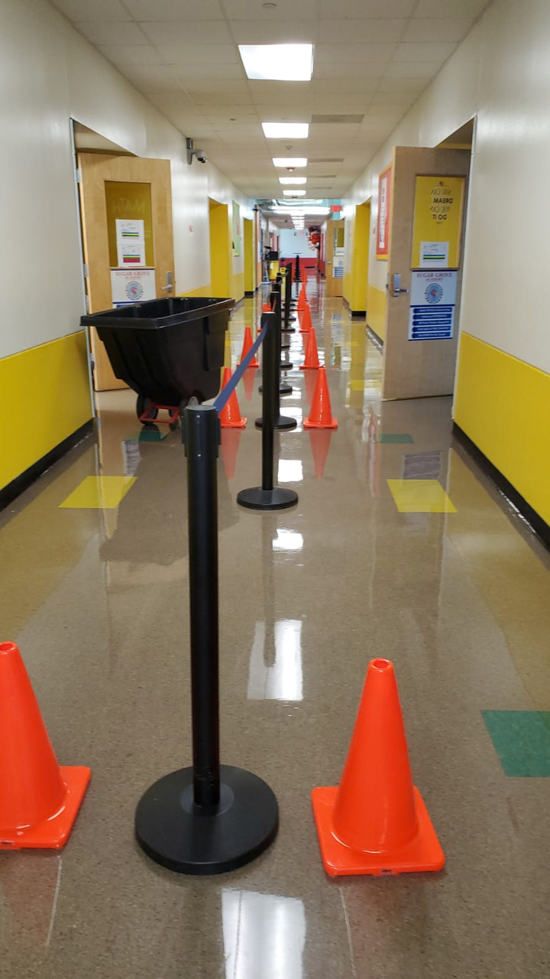
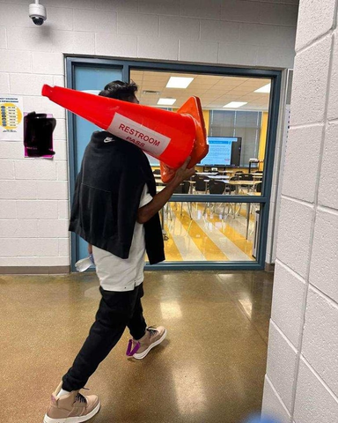
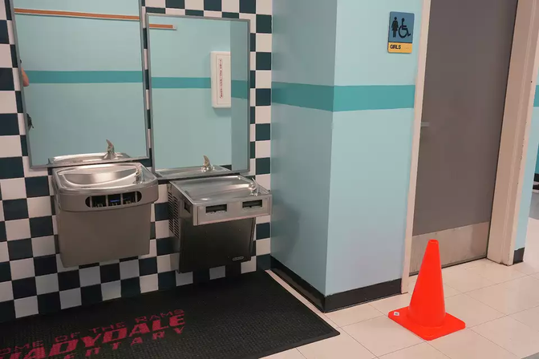

New Education System
  Students are required to walk silently and single file along the wall in the hallways
  Some NES hallways have physical barriers to not allow students or teachers to walk together
  Children are required to take a traffic cone to the bathroom and are not supposed to use the bathroom during instruction, resulting in increased accidents, UTIs, and young girls suffering hardships

Slide 16

Working Conditions
Non Negotiables
  MRS Strategies to check for learning every 4 minutes
  Timers embedded in slide decks
  Demonstration of Learning after 45 minutes of learning
  Forbidden to have closed doors
Spot Observations
  Administrators must complete spot checks on teachers several times per week. Some teachers have reported getting as many as 5 spot observations in one day
  “In the moment” coaching: administrators provide (often critical and unprofessional) feedback to teachers “in the moment” in front of the students.

Slide 17
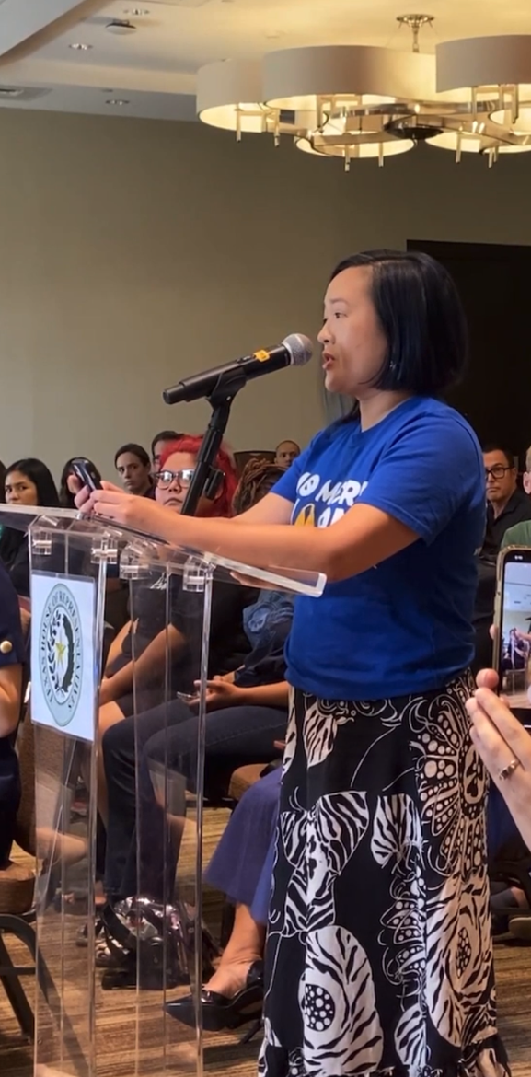
Adverse Personnel Actions
Teachers are written
up for the following:
  Not completing MRS Strategies every 4 minutes
  Dimmed Lighting
  Sitting at their desk for too long
  Letting students go to the bathroom during instruction
  Playing chess with students after final exam
  Student having their cell phone out
  Failing to use digital timer on slides
  Theater class being too noisey

Slide 18
Retaliation Experienced
  A teacher spoke at a board meeting about the problems with the Art of Thinking curriculum. The next day, she was escorted off campus
  A teacher played chess with his students after an exam and was walked off campus
  A teacher was terminated for not following the MRS strategy of not dimming the lights. TEA overturned the termination
  A principal refused to opt in to NES and resigned shortly afterward due to bullying
  Multiple principals at highly sought after schools were asked to resign or be terminated

Slide 19
Union Consultation
Consultation is the union relationship with HISD and process for collaborating to resolve employee concerns and complaints
  HFT was elected as the representative agent for all non-administrative HISD employees
  HFT has been the representative over 20 years
  Consultation has been nullified under Superintendent Miles, removing the ability to resolve concerns on a large scale

Slide 20

Staff Reductions
  All staff in the first 28 NES schools were fired and had to reapply for their jobs This included A-rated schools
  Special Education contractor positions
  Autism Department was dismantled
  Custodial Staff were all fired and had to reapply for their jobs, which included fewer benefits
  Library Services Dept
  Wraparound Specialist positions were reduced from one in every school to 40

Slide 21
Employee Retention
Staff Turnover Under the State Takeover:
5,031 teachers out of roughly 11,000 in HISD have left the district since the state takeover
10,000 total HISD employees have left the district
154 principal changes across 141 of 274 HISD campuses

Slide 22
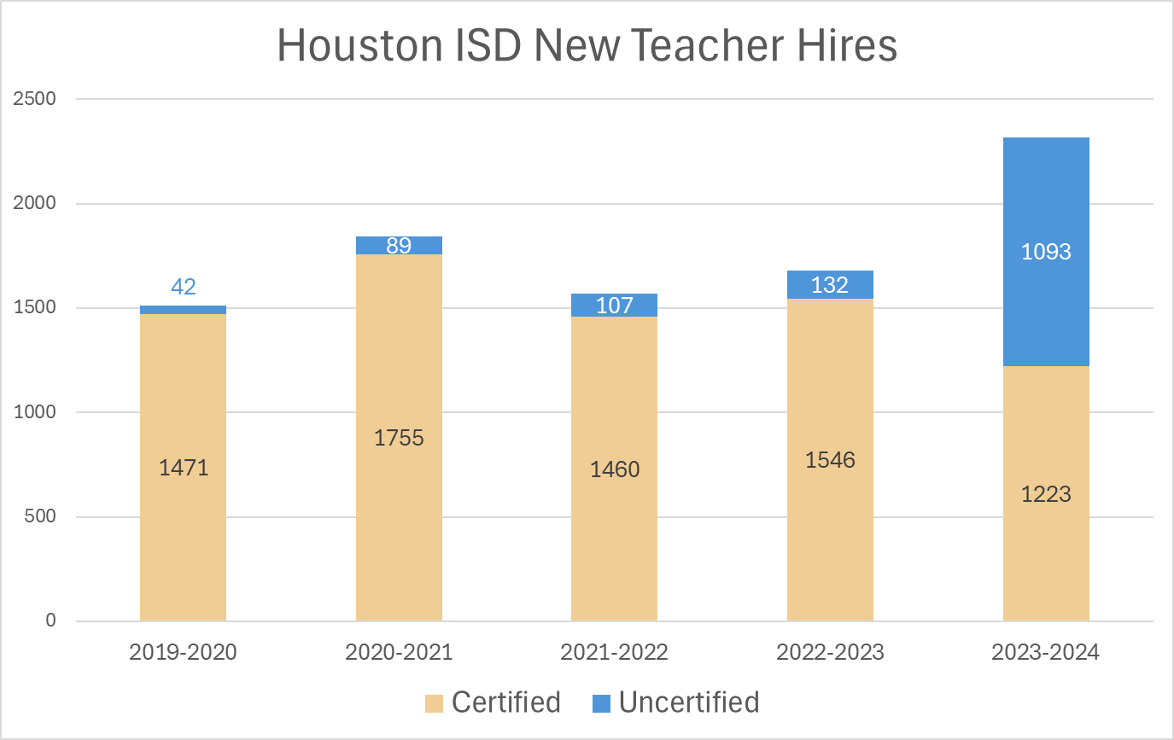
Certification Waivers
Certification Waivers
The Board of Managers waived certification requirements for:
  Superintendent
  Principals
  Assistant Principals
  Teachers

Slide 23
Employee Retention
Certification Waiver Ramifications
Grading and Graduation
  Teachers must be certified to input grades, causing concern with graduation
Special Education & Bilingual Compliance
  Students requiring special education accommodations are entitled to a certain number of instruction minutes with a certified teacher.
  Most of these students are in a general education classroom.
  Bilingual education has been replaced by dual language programs
  With this many uncertified teachers, it’s virtually impossible to remain in compliance with federal law

Slide 24

How Can We Work Together?
Teachers & School Staff
  Join HFT for legal representation, support system, and advocacy in large numbers
Community Members
  Speak at school board meetings
  Volunteer in schools
  Share teacher experiences anonymously
  Letter & email campaigns to political leaders
  Visit NoMoreHarm.org and help us advocate
Contact Us
  Need help with navigating how to advocate for educators and public education? Reach out!
HFT2415.ORG
@HFT_2415
713.623.8891
JANDERSON@HFT2415.ORG

