Slide 1
SEIU Texas
SEPTEMBER 12, 2024

Slide 2
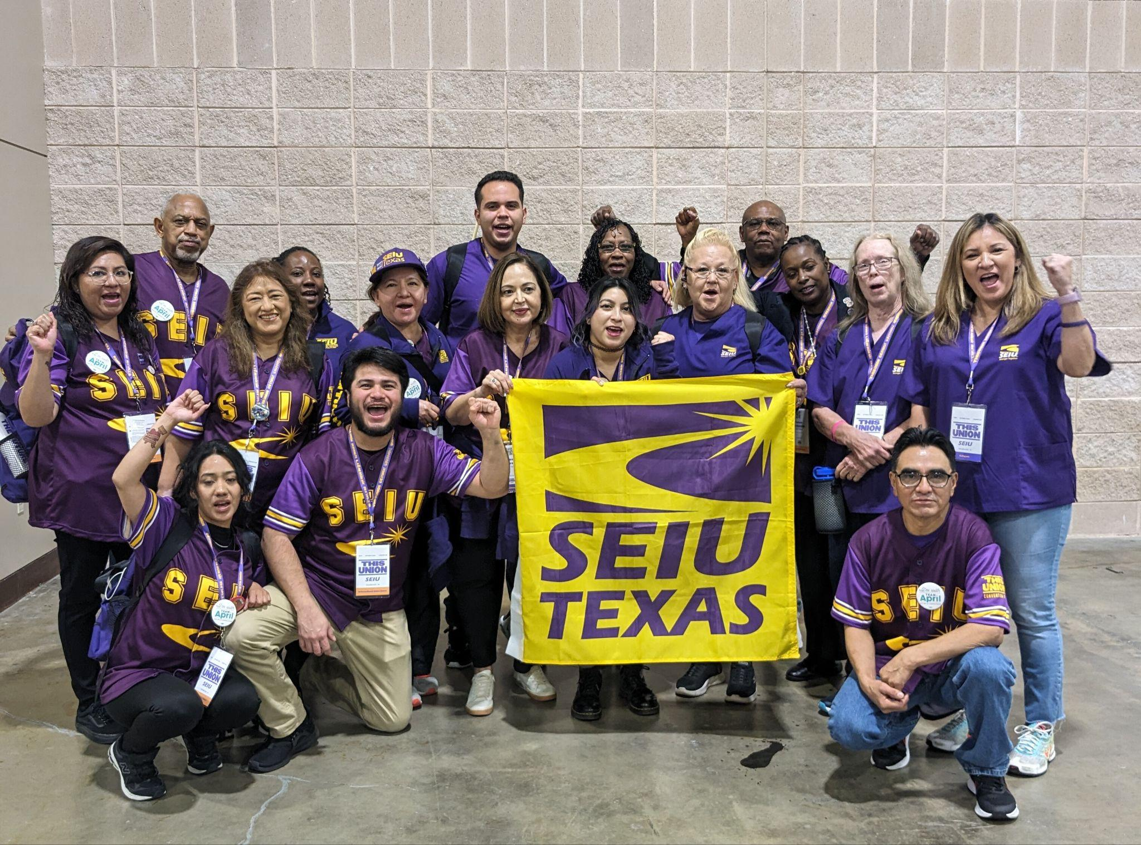
SEIU Texas unites roughly 6,000 airport workers, janitors, food service and hospital employees across Texas to secure better wages, benefits and working conditions. SEIU Texas empowers their members to become leaders amongst their peers and empower both their workplaces and communities.

Slide 3
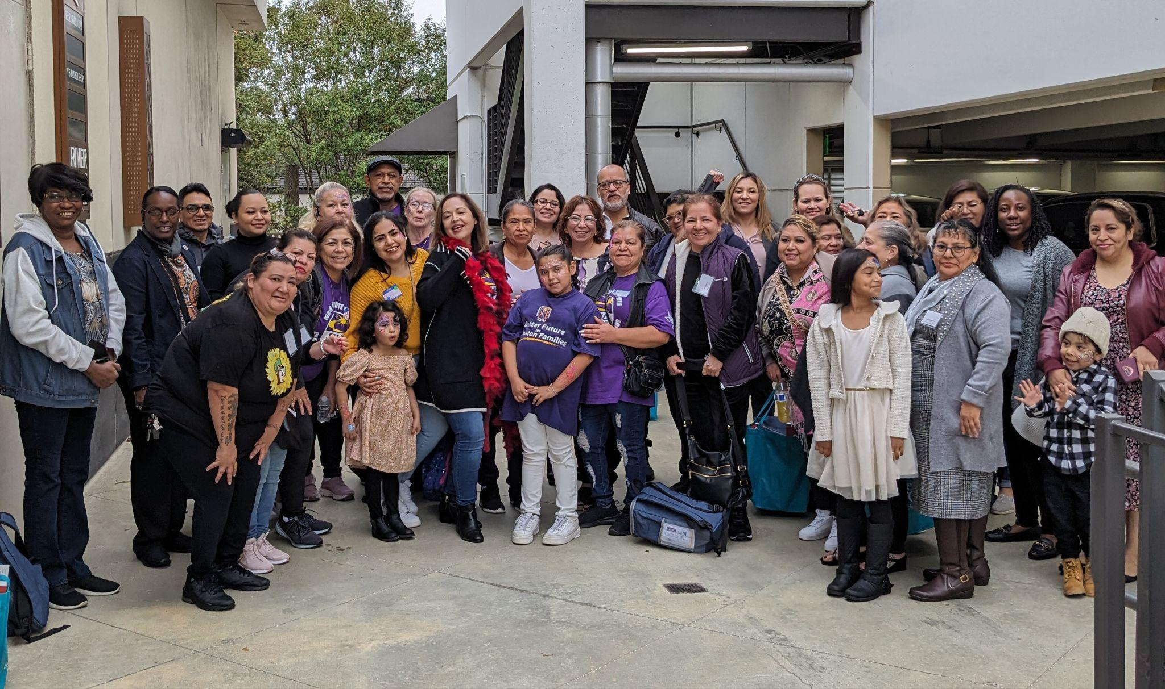
The value placed on work

Slide 4
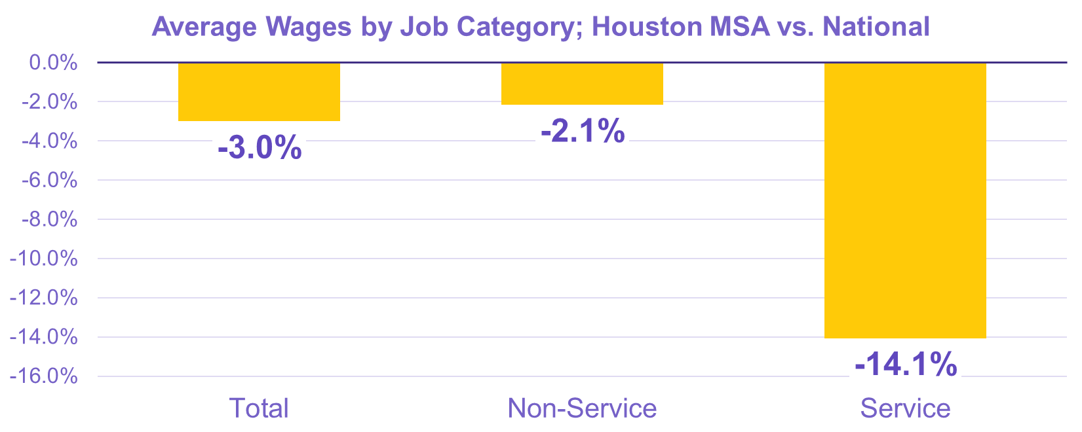
Houston Wage Comparisons

Slide 5
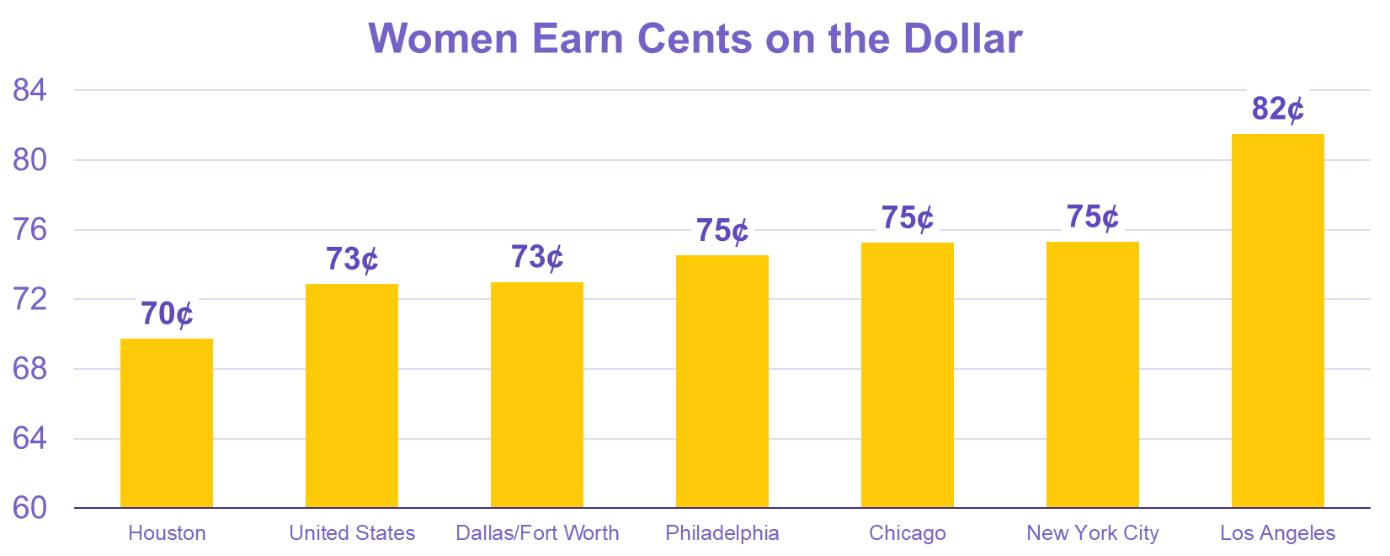
The Gender Pay Gap

Slide 6
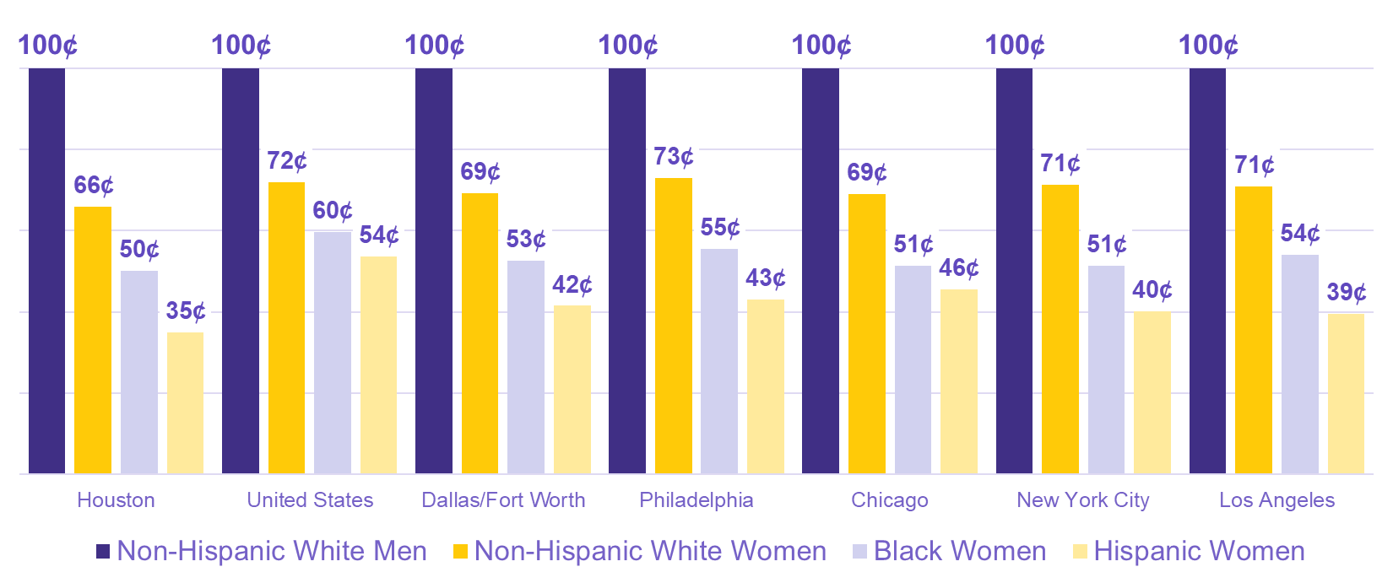
Race and Ethnicity Wage Gap

Slide 7
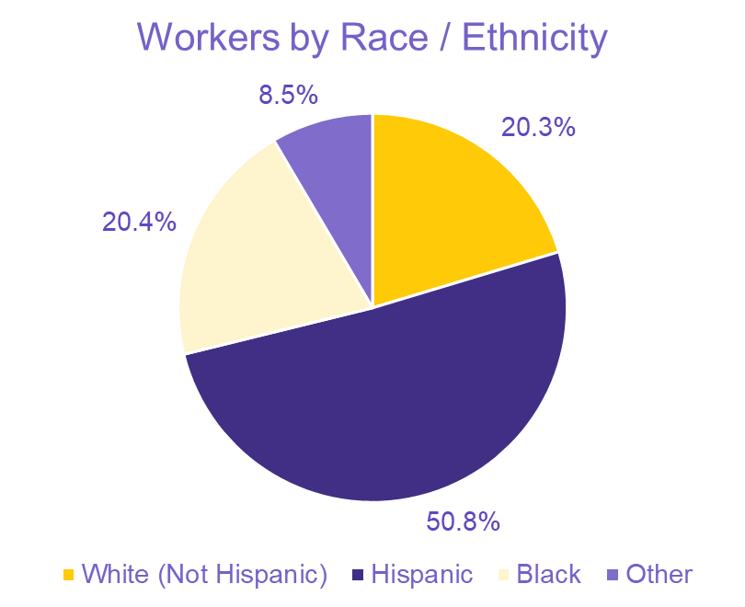
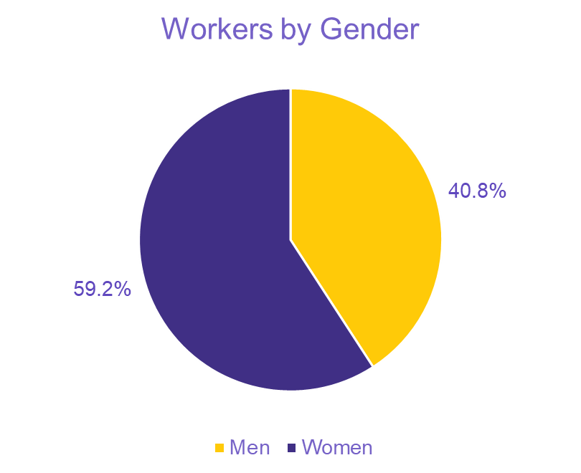
Demographics of Houston Service Workers

Slide 8
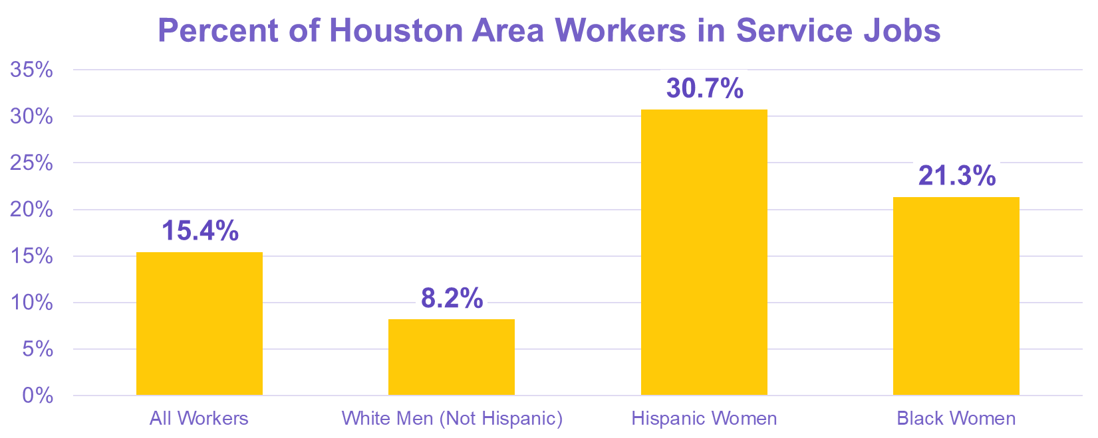
Houston Service Workers

Slide 9
SEIU Texas – Houston Successes

Slide 10
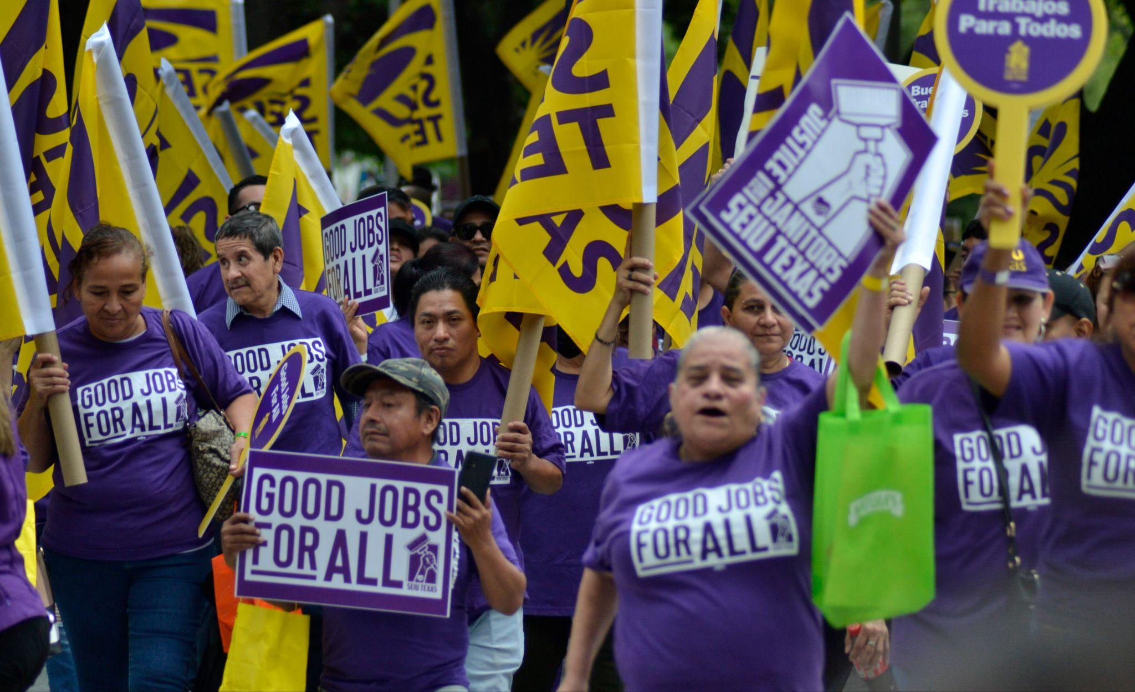
Houston Commercial Janitors

Slide 11
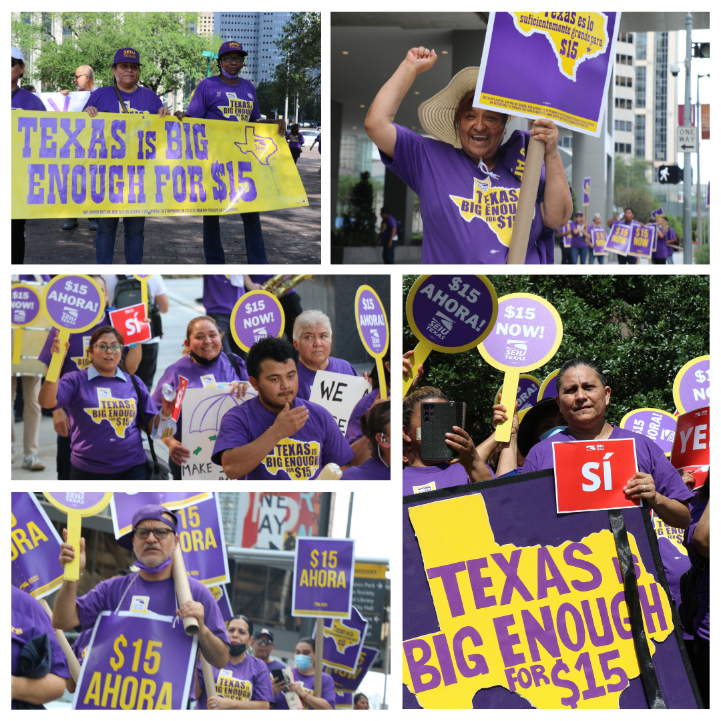
Houston Janitors

Slide 12
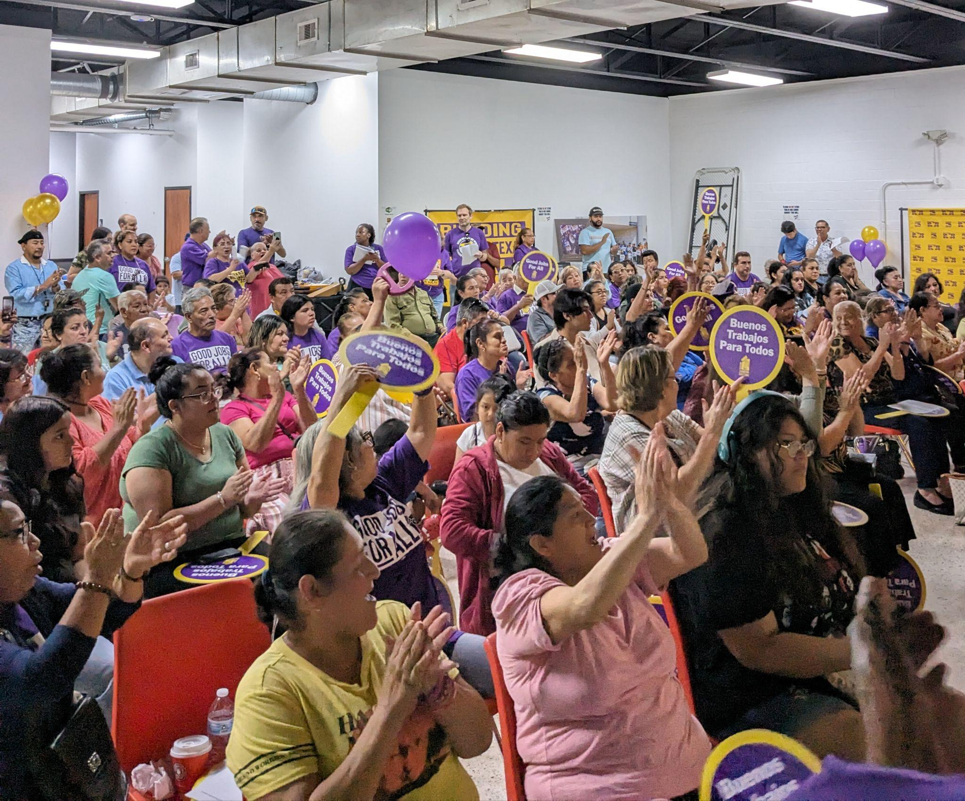
2024 Janitorial Contract

Slide 13
Houston Janitors
In June of 2024, Houston Janitors won their best contract in the history of SEIU Texas
Path to $15 per hour for full-time Day Porters (from $12.85)
Part-time janitors on a path to $14.10 per hour (from $11.75)
Additional paid holiday (from 6 paid holidays to 7)
Protected health benefits for workers

Slide 14
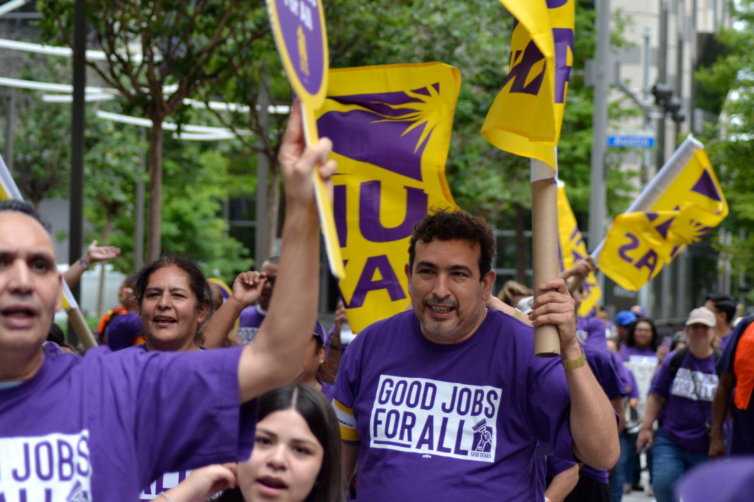
Houston Janitors – Next Steps
Notes:
Speaking notes should mention that we will continue to push for higher wages, more full-time work, increased benefits, worker safety, etc.

Slide 15
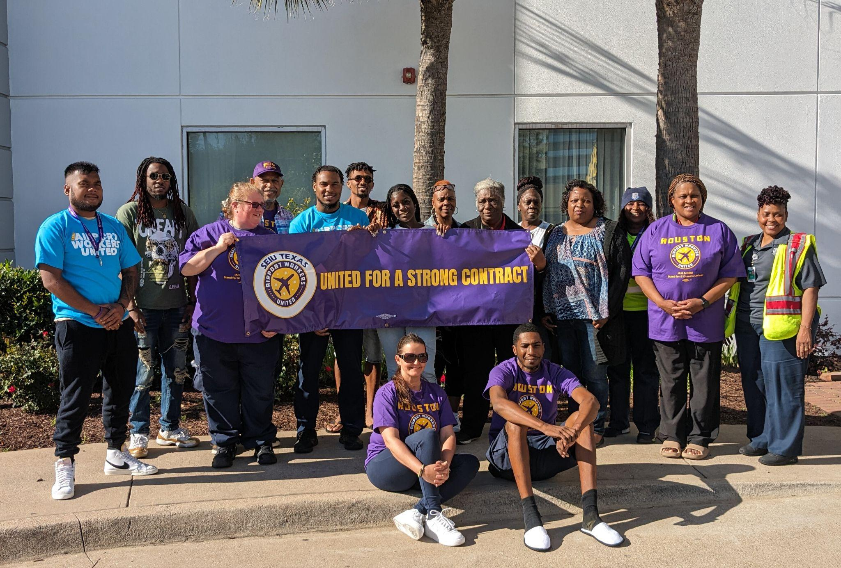
Houston Airport Workers

Slide 16
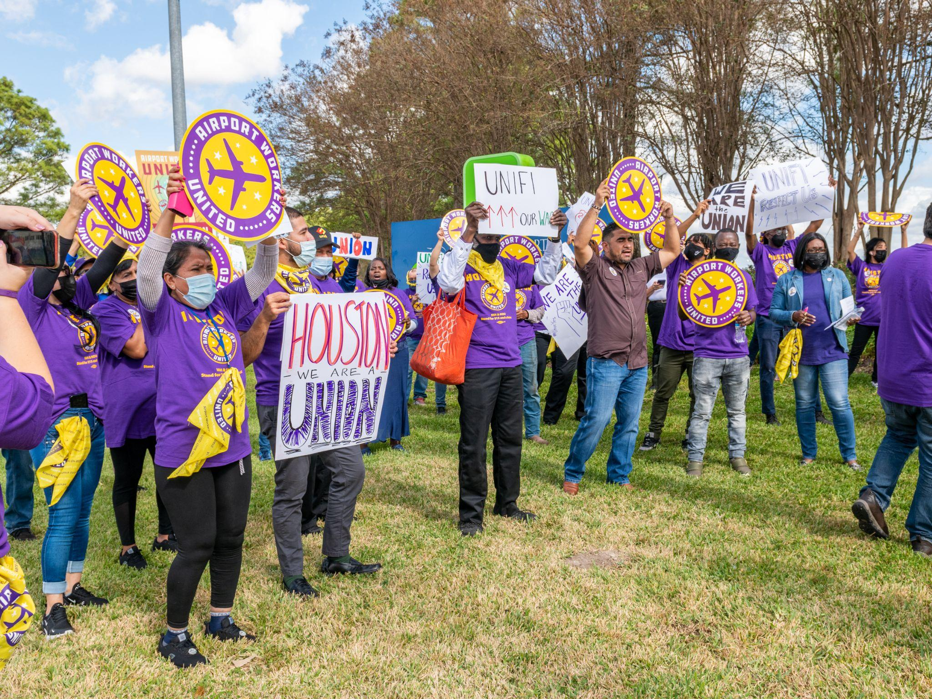
Houston Airport Workers

Slide 17
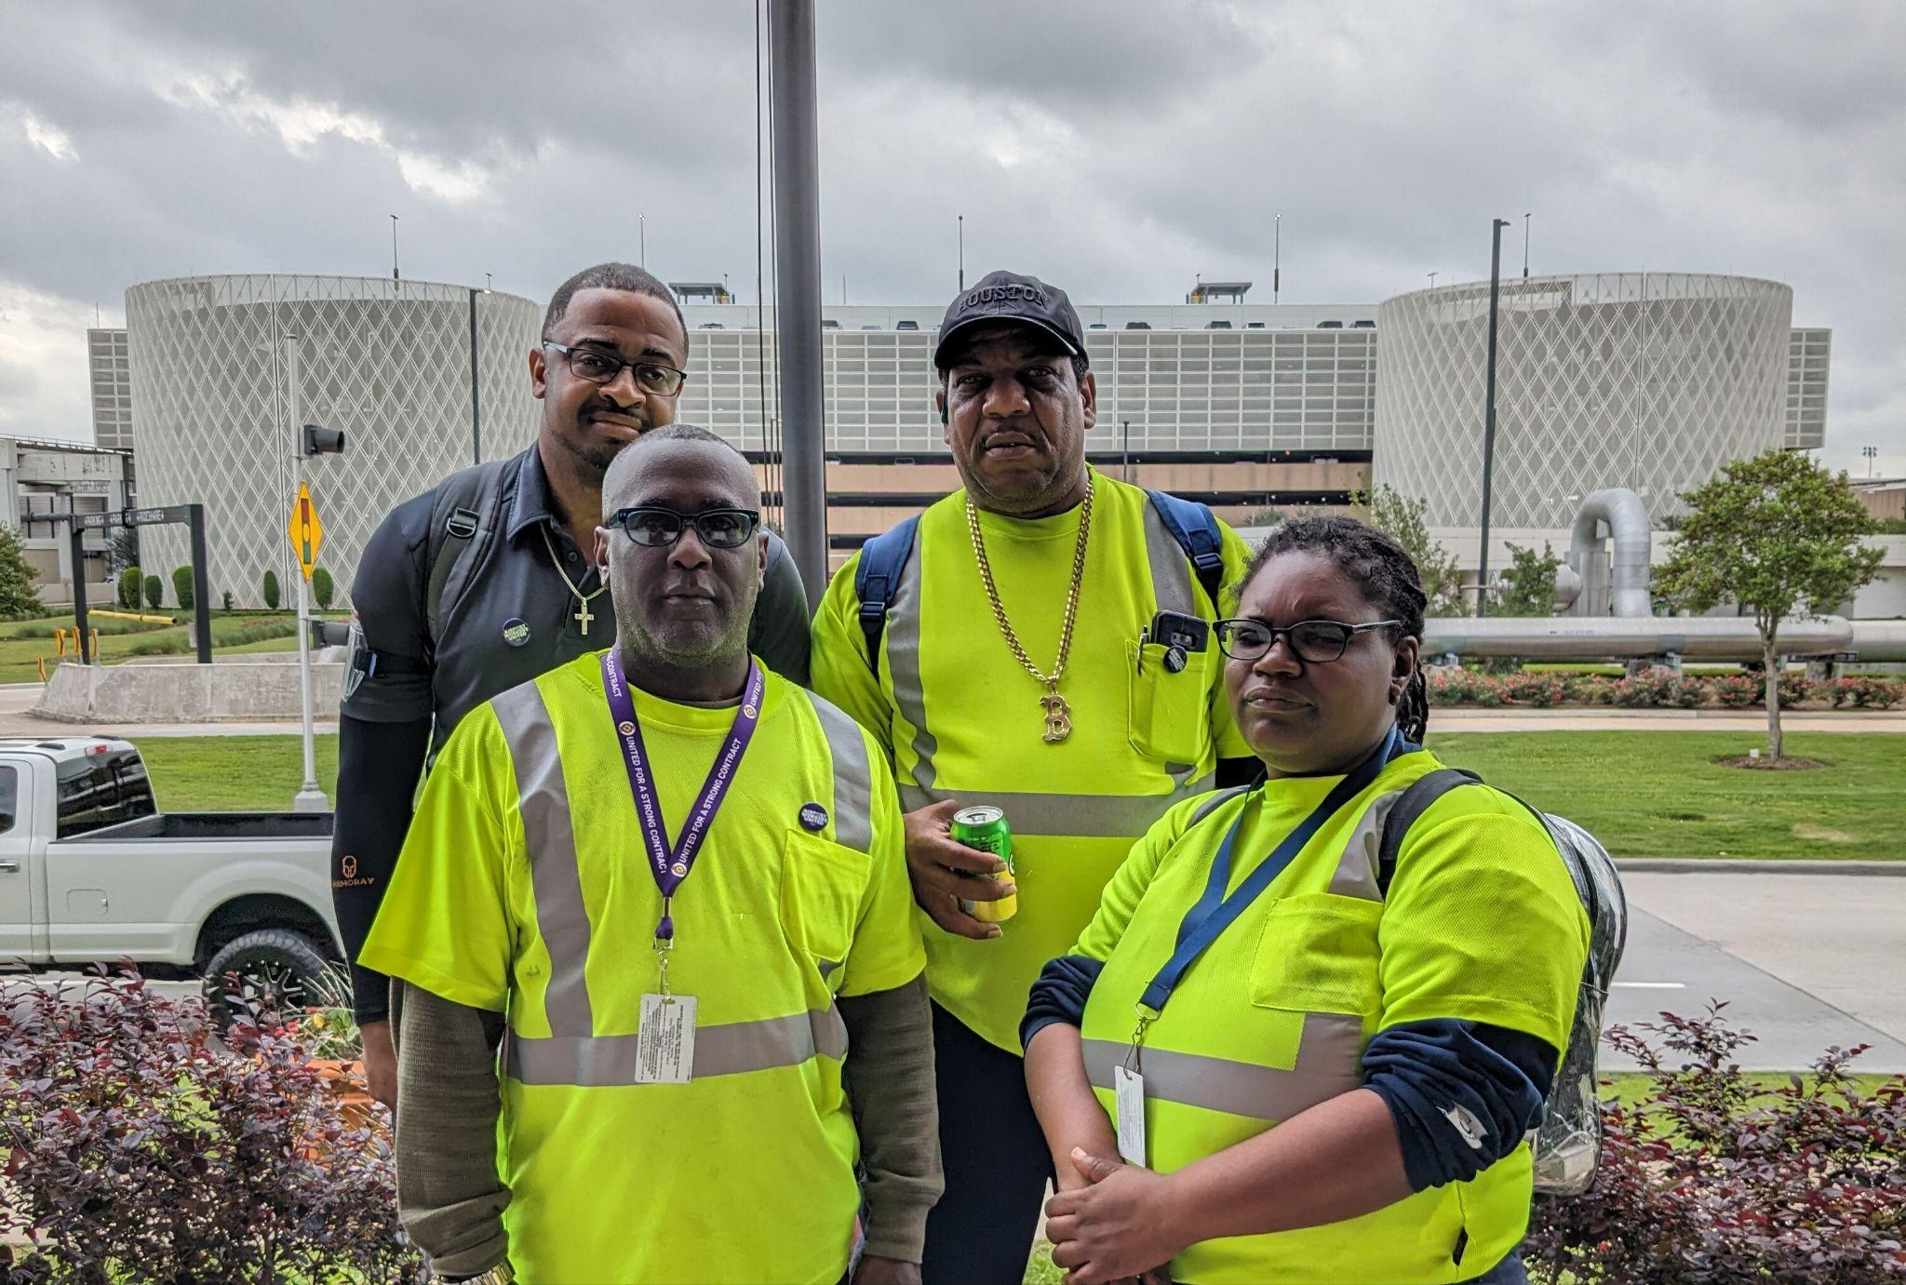
OUR OVER 1,800 AIRPORT WORKERS
Cabin Cleaners
Wheelchair Agents
Baggage Service Agents
Warehouse

Slide 18
Houston Airport Workers
In the spring of 2024, Houston Airport workers won their second contract with their employers at IAH and Hobby.
Worker Safety: requiring extermination of break rooms
Won better protection for pregnant workers
Won better language on employer-provided uniforms
Agreed to partnership to address parking issues

Slide 19
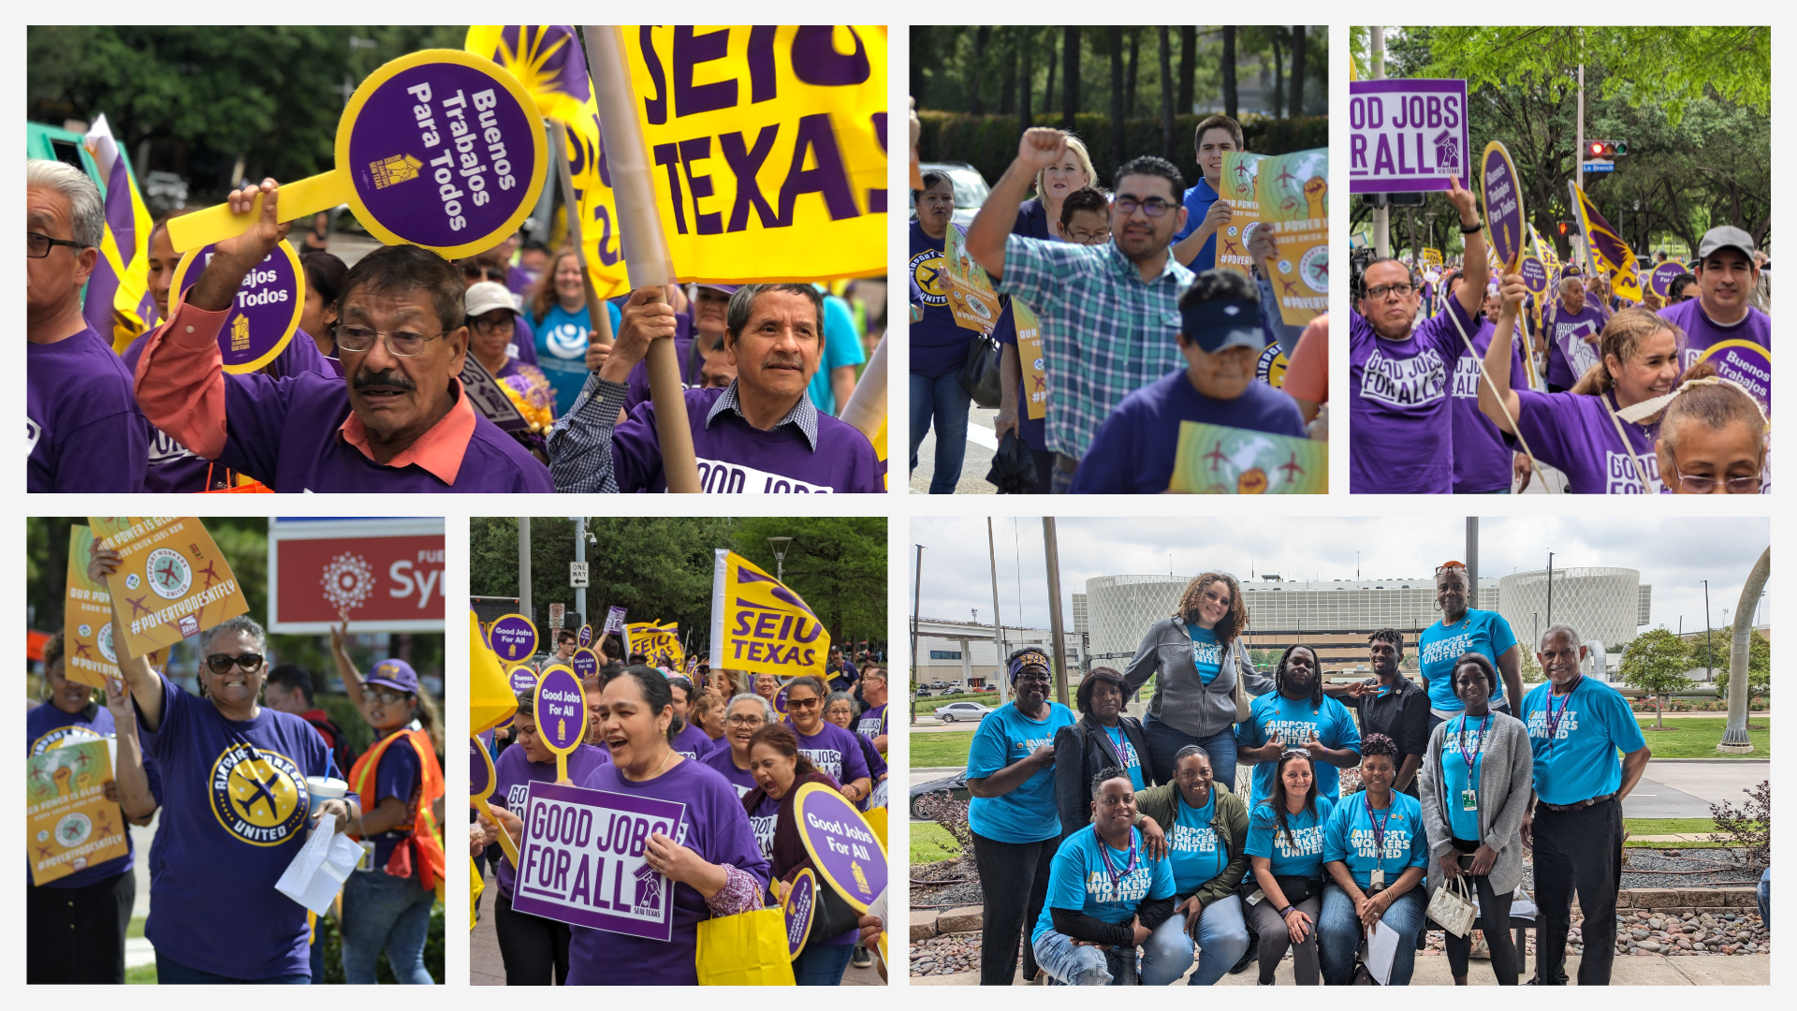
SEIU TX – Houston Successes
Notes:
For these two groups of workers in Houston, we’ve succeeded in:
Raising wage standards
Giving a voice at work
Through collective bargaining and, in the case of the Houston Airport workers, with the active participation and support of city government
SEIU Texas is in the middle of a new organizing campaign for security officers contracted by the City of Houston and the Houston Airport system, and we are excited about the number of workers from across Houston who have reached out because they know the power that comes from being a member of a union, and we look forward to helping to organize thousands of additional Houston workers in the coming years, who are working as janitors, security officers, in the airports, and in healthcare.

Slide 20

City Government

Slide 21
City of Houston
Executive orders for airport wages
Raising standards for contracted work through RFP process
Improved labor peace language in RFPs

Slide 22
Other Cities in Texas
Dallas
Living Wage Resolution, tied to MIT Index
Currently at $18.24 per hour
Fort Worth
Minimum wage for City employees just raised to $18 per hour in their city budget
Austin
Living wage program, increased during budget process, currently at $20.80 per hour

Slide 23
What’s Next
Notes:
This is where we can talk briefly about our wish list for what City government could do – including things like a Dallas-style living wage resolution, etc…. Everything will be in speaking notes rather than on the slide - so maybe some kind of visual on the slide?
Wish list things I can think of (feel free to add/subtract/expand)
Dallas-stype living wage resolution that increases each year without further council action
Expanding the use of good labor peace language in RFPs (currently included in some but not all RFPs from the city)
Beyond just good labor peace language - let's use worker-centered measures as part of the scoring of bids - so that it's less likely for low-bid contractors to win work, if those low bids are at the expense of the people doing the work
Ways of considering worker rights and wages with other city programs - such as tax incentives, grants, etc. - so that companies receiving benefits are companies that create good jobs that lift up communities, and not ones that take public money and then exploit their workers.

Slide 24
YOU CAN BE A PART OF RAISING WORKER STANDARDS IN TEXAS
For more information
Visit: seiutx.org
Email: info@seiutx.org

