Slide 1

CITY OF HOUSTON LEGAL DEPARTMENT
Proposition A Committee
Proposition A: Introduction & Guidelines
Danyahel “Danny” Norris
Senior Assistant City Attorney - Proposition A

Slide 2
OVERVIEW
•Mission
•Proposition A Background
•Proposition A Position
•Proposition A Submissions
•Proposition A So Far
•Questions & Answers
CITY OF HOUSTON LEGAL DEPARTMENT

Slide 3

CITY OF HOUSTON LEGAL DEPARTMENT
About the Legal Department
MISSION STATEMENT
The City of Houston Legal Department strives to provide the highest quality municipal legal services to the City, its elected and appointed officials, and its employees in the most efficient manner feasible through adherence to the following guiding principles:
Quality & Service
Achieving high customer satisfaction as judged by our clients.
Partnership & Teamwork
Working cooperatively internally and with our clients to achieve the City’s goals.
Integrity & Candor
Acting with a commitment to honesty and ethical behavior,
Dignity & Diversity
Demonstrating esteem for the worth of each individual,
Innovation & Imagination
Seeking novel and creative approaches to achieving the City’s objectives.
mission

Slide 4
Proposition A Background
CITY OF HOUSTON LEGAL DEPARTMENT

Slide 5

PROPOSITION A BACKGROUND
City Charter notes City Council Members have legislative power only. ​
-Use this power to approve annual budget, ordinances, and appointments by the administration.​
-Administrative power remains with the Mayor and his administration. ​
​
Prior to Proposition A, Council members could only call special meetings.​
-Such meetings only could take actions if there was quorum.​
CITY OF HOUSTON LEGAL DEPARTMENT ​

Slide 6
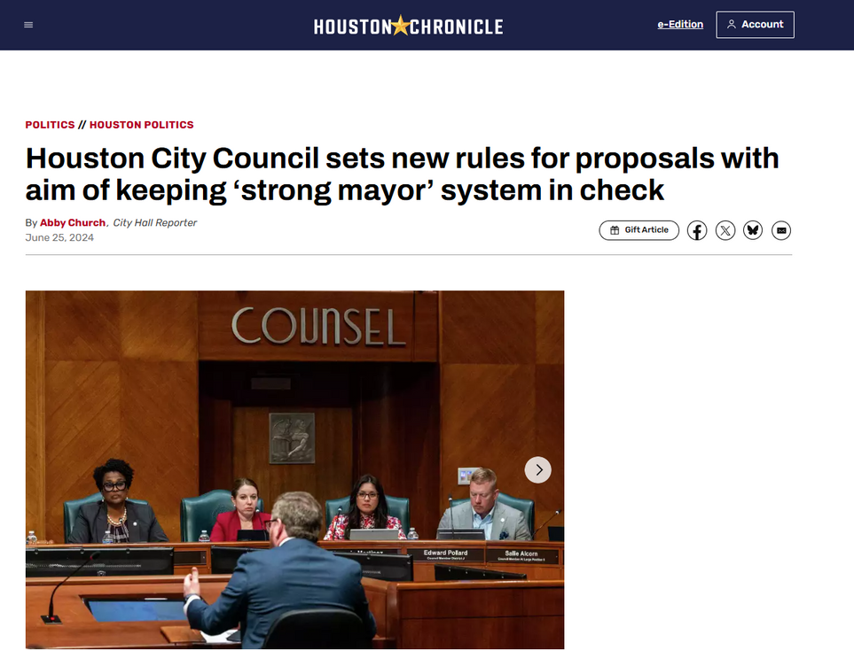
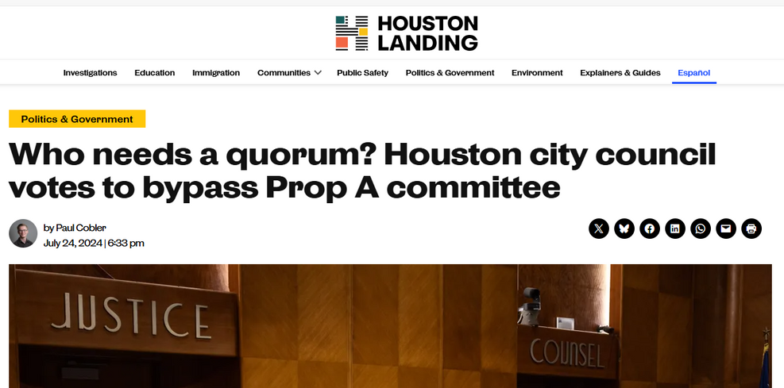
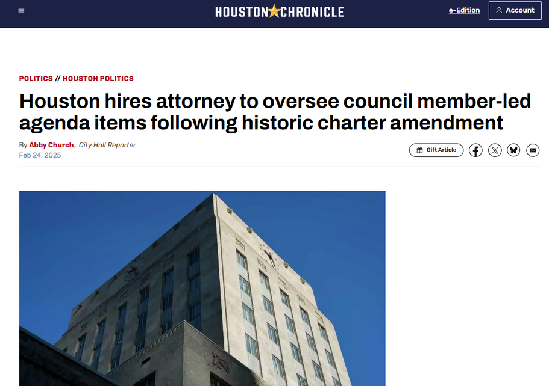
PROPOSITION A TIMELINE
2023 - Proposition A was approved by Houston Voters allowing 3+ City Council Members to add items to regular meeting agenda. ​
2023-2024 Council Members submitted without much legal guidance.
June 2024 – Legal position created for Proposition A in budget. ​
​
February 2025 – Proposition A position filled.​
CITY OF HOUSTON LEGAL DEPARTMENT ​

Slide 7
Proposition A
Position
CITY OF HOUSTON LEGAL DEPARTMENT

Slide 8
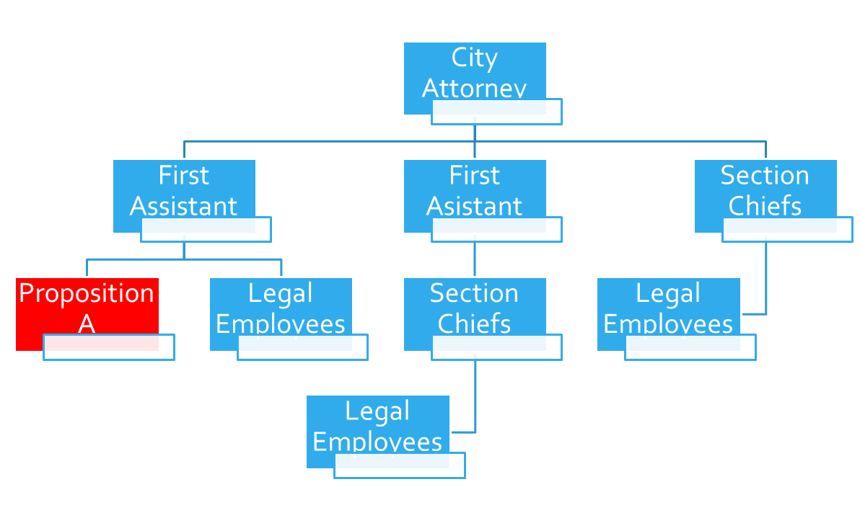
PROPOSITION A POSITION
•Housed in the legal department
-Meant to have access to the resources of department.
•Meant to be generally autonomous
-Similar to Office of Inspector General.
•Meant to inform and assist City Council members with their Proposition A requests
-Council members are encouraged to reach out to me whenever you are considering a Proposition A item.
-Will help inform if possible before a formal submission.
-Will help draft a version that should make it through.
•Currently developing a set of guidelines for Council to have for clarity purposes
CITY OF HOUSTON LEGAL DEPARTMENT ​

Slide 9
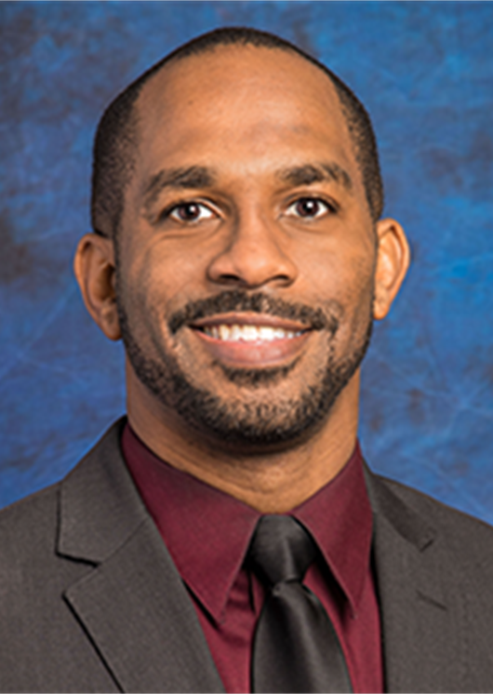
BACKGROUND OF THE PROPOSITION A ATTORNEY
•Practicing law since 2007
-Primarily intellectual property and transactional legal work
-Former President of the Houston Lawyers Association and former chair of the African American Lawyer Section of the State Bar of Texas
•Worked at TSU’s Law School from 2007-2020
-Associate Director of Law Library and Legal Instructor
-Some former students currently work with me in the legal department
•Served as a Trustee for the Harris County Department of Education 2018-2023
-First African American Board President
•Joined the Contracts Section of the Legal Department in 2022
-Worked mostly with HITS Department on Technology contracts
-Worked on the contract that secured the 2028 Republican National Convention to Houston in 2023
CITY OF HOUSTON LEGAL DEPARTMENT ​

Slide 10
Proposition A
Submissions
CITY OF HOUSTON LEGAL DEPARTMENT

Slide 11
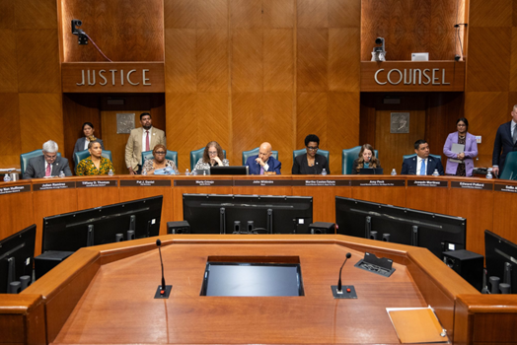
PROPOSITION A AUTHORIZATION
•Article VII, Sec. 3 of the City Charter
-Three or more City Council Members may request, in writing, that any lawful item(s), as specified in such request, be placed on the agenda of any designated, regular meeting of City Council, consistent with the notice requirements of the Texas Open Meetings Act.
-The Mayor shall ensure that such item(s) be placed on the agenda of the designated meeting, and shall continue to place the item(s) on the agenda of each subsequent regular meeting until the same shall be considered by City Council.
- Unless a request for an item(s) to be placed on the agenda of a City Council meeting specifies otherwise, it shall be treated as a request for the item(s) to be considered at a regular, as opposed to special meeting.
CITY OF HOUSTON LEGAL DEPARTMENT ​

Slide 12
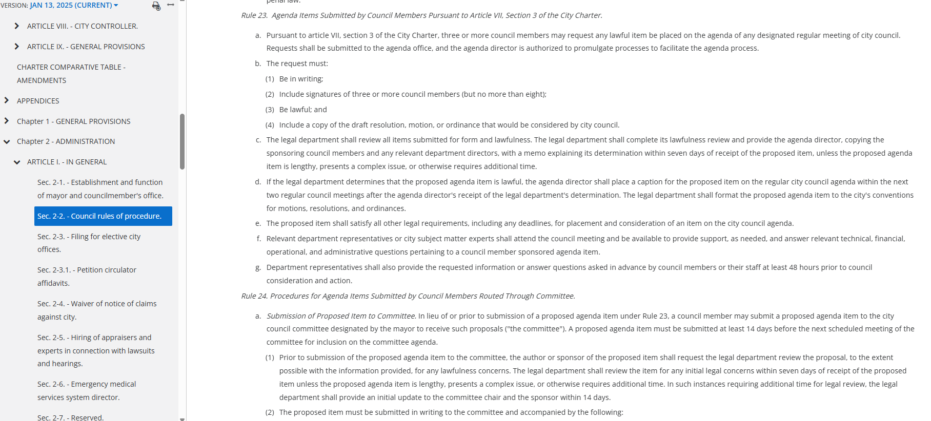
Guidelines for Submissions
•Submissions will be submitted according to Section 2-2 of the Code of Ordinances
-Rule 23: Submission by 3+ council members
-Rule 24: Proposition A Committee
CITY OF HOUSTON LEGAL DEPARTMENT ​

Slide 13
Rule 23: Agenda Items Submitted by 3+ City Council Members
•Proposition A Attorney will assist with the preparation of all Rule 23 Proposition A Submissions
a. Three or more council members may request any lawful item be placed on the agenda of any designated regular meeting of city council.
b. The request must:
(1) Be in writing;
(2) Include signatures of three or more council members (but no more than eight);
(3) Be lawful; and
(4) Include a copy of the draft resolution, motion, or ordinance that would be considered by city council.
CITY OF HOUSTON LEGAL DEPARTMENT ​

Slide 14
Rule 23Continued
•General Counsel will still perform the lawfulness search and memo.
c. The legal department shall review all items submitted for form and lawfulness. The legal department shall complete its lawfulness review and provide the agenda director, copying the sponsoring council members and any relevant department directors, with a memo explaining its determination within seven days of receipt of the proposed item, unless the proposed agenda item is lengthy, presents a complex issue, or otherwise requires additional time.
CITY OF HOUSTON LEGAL DEPARTMENT ​

Slide 15
Rule 23Continued
d. If the legal department determines that the proposed agenda item is lawful, the agenda director shall place a caption for the proposed item on the regular city council agenda within the next two regular council meetings after the agenda director's receipt of the legal department's determination. The legal department shall format the proposed agenda item to the city's conventions for motions, resolutions, and ordinances.
e. The proposed item shall satisfy all other legal requirements, including any deadlines, for placement and consideration of an item on the city council agenda.
f. Relevant department representatives or city subject matter experts shall attend the council meeting and be available to provide support, as needed, and answer relevant technical, financial, operational, and administrative questions pertaining to a council member sponsored agenda item.
g. Department representatives shall also provide the requested information or answer questions asked in advance by council members or their staff at least 48 hours prior to council consideration and action.
CITY OF HOUSTON LEGAL DEPARTMENT ​

Slide 16
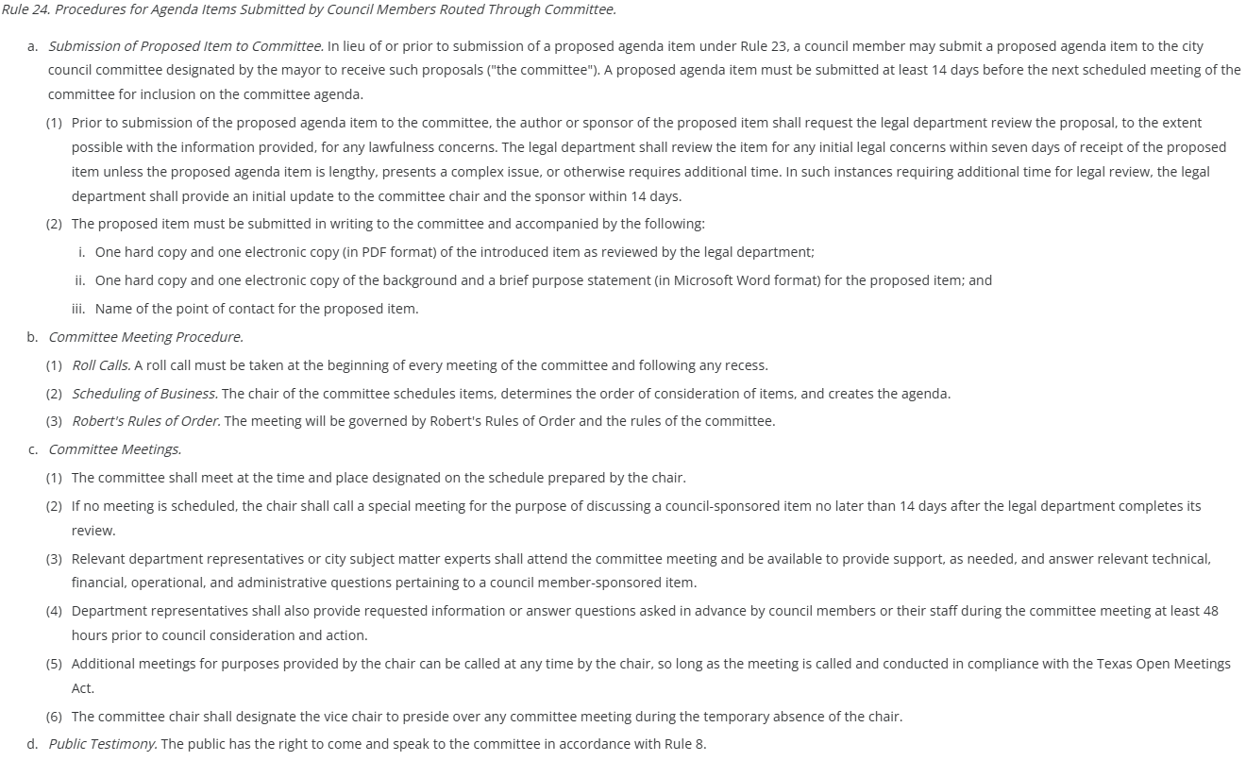
Rule 24:Procedures for Agenda Items Submitted by Council Members Through Committee
•Proposition A Attorney will help prepare all Proposition A Committee submissions for a lawfulness review.
• General Counsel will formally approve all lawfulness requests within the specified timeframes.
a. Submission of Proposed Item to Committee. In lieu of or prior to submission of a proposed agenda item under Rule 23, a council member may submit a proposed agenda item to the city council committee designated by the mayor to receive such proposals ("the committee"). A proposed agenda item must be submitted at least 14 days before the next scheduled meeting of the committee for inclusion on the committee agenda.
(1) Prior to submission of the proposed agenda item to the committee, the author or sponsor of the proposed item shall request the legal department review the proposal, to the extent possible with the information provided, for any lawfulness concerns. The legal department shall review the item for any initial legal concerns within seven days of receipt of the proposed item unless the proposed agenda item is lengthy, presents a complex issue, or otherwise requires additional time. In such instances requiring additional time for legal review, the legal department shall provide an initial update to the committee chair and the sponsor within 14 days.
(2) The proposed item must be submitted in writing to the committee and accompanied by the following:
i. One hard copy and one electronic copy (in PDF format) of the introduced item as reviewed by the legal department;
ii. One hard copy and one electronic copy of the background and a brief purpose statement (in Microsoft Word format) for the proposed item; and
iii. Name of the point of contact for the proposed item.
CITY OF HOUSTON LEGAL DEPARTMENT ​

Slide 17
Rule 24 Continued
b. Committee Meeting Procedure.
(1) Roll Calls. A roll call must be taken at the beginning of every meeting of the committee and following any recess.
(2) Scheduling of Business. The chair of the committee schedules items, determines the order of consideration of items, and creates the agenda.
(3) Robert's Rules of Order. The meeting will be governed by Robert's Rules of Order and the rules of the committee.
c. Committee Meetings.
(1) The committee shall meet at the time and place designated on the schedule prepared by the chair.
(2) If no meeting is scheduled, the chair shall call a special meeting for the purpose of discussing a council-sponsored item no later than 14 days after the legal department completes its review.
(3) Relevant department representatives or city subject matter experts shall attend the committee meeting and be available to provide support, as needed, and answer relevant technical, financial, operational, and administrative questions pertaining to a council member-sponsored item.
(4) Department representatives shall also provide requested information or answer questions asked in advance by council members or their staff during the committee meeting at least 48 hours prior to council consideration and action.
(5) Additional meetings for purposes provided by the chair can be called at any time by the chair, so long as the meeting is called and conducted in compliance with the Texas Open Meetings Act.
(6) The committee chair shall designate the vice chair to preside over any committee meeting during the temporary absence of the chair.
d. Public Testimony. The public has the right to come and speak to the committee in accordance with Rule 8.
CITY OF HOUSTON LEGAL DEPARTMENT ​

Slide 18
Rule 24 Continued
e. Committee Report.
(1) No action taken by a committee shall infringe upon a sponsoring council member's right to have the proposed item submitted to the full council for consideration and a vote under article VII, section 3 of the City Charter.
(2) Vote Requirements for Taking Action on an Item. An action on a proposed item from the committee requires an affirmative record vote of the majority of the members present of the committee. If a quorum is not established at the beginning of the committee meeting for which a proposed item is on the agenda such that no vote on the proposed item can be taken at that meeting, in lieu of appearing on the agenda of a subsequent committee meeting, the proposed item may be submitted in writing by three or more council members pursuant to Rule 23 and article VII, section 3 of the City Charter.
(3) After consideration of an item on the committee's agenda, the committee may do the following:
i. Agree with placement on the city council agenda within the next two regular council meetings.
ii. Disagree with placement on the city council agenda.
iii. If the proposed item requires further evaluation and drafting assistance, refer the item to the administration.
1. The administration shall:
a. Direct the relevant department(s) and the legal department to assist the sponsoring council member(s) with development of the proposed item, including drafting assistance, evaluation of legal, administrative, and policy issues, and fiscal analysis, as necessary; and
b. Submit the item to the city council committee that is most relevant to the subject matter of the proposed item.
2. The assigned departments will provide updates to the committee chair of the designated subject-matter committee on the status of the proposed item, which shall be included in the chair's report.
3. Once the sponsoring council member(s), the relevant department(s) and the legal department have jointly reviewed and determined the proposed item has been completed, it shall be presented to the designated subject-matter committee, and then at least three but no more than eight council members may submit the proposed item in compliance with subsection b of Rule 23 to the agenda director for placement on the regular city council agenda within the next two regular council meetings after the agenda director's receipt of the item.
iv. Amend the item and agree with placement on the city council agenda within the next two regular council meetings.
v. Postpone consideration of the item.
(4) If a motion to place an item on the city council agenda fails, the committee will no longer consider the item.
CITY OF HOUSTON LEGAL DEPARTMENT ​

Slide 19
Proposition A
So Far
CITY OF HOUSTON LEGAL DEPARTMENT

Slide 20

Proposition A So Far
•Varies by Council Member
-Some members use it more frequently than others.
•Until legal position was created, Council Members were mostly on their own to work on items.
•Now, Council Members can have legal guidance in advance of their items being submitted to the agenda office or the Proposition A Committee.
•Process is still developing
-Less than 2 years into Proposition A
-Can be revised, if necessary to ensure it works for the members of Council.
CITY OF HOUSTON LEGAL DEPARTMENT ​

Slide 21
Questions?
​
Contact Info:
Danyahel “Danny” Norris
danny.norris@houstontx.gov
832-393-6483
CITY OF HOUSTON LEGAL DEPARTMENT

