Slide 1


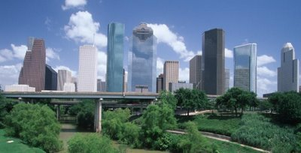
Houston Police Department
Vice Division
Information Brief
Captain Dan Harris
February 9, 2016

Slide 2
Agenda
Vice Division Investigations
2015 End of Year Accomplishments
Vice Division 2016 Goals
Anatomy of a Vice Operation . . . . And Beyond
  The Vice Conundrum
  The Importance of Assistance Organizations
Questions

Slide 3







Vice Investigations
HT & HS
  Streets
  Internet
  Hotels
  Brothels
  Escort Services
  Message Estab. / Spas
    Adults
    Juveniles
    Int’l
    Domestic
Prostitution
  Streets
  Internet
  Hotels
  Brothels
  Escort Services
  Residences / Apartments
  Massage Estab. / Spas
    Human Trafficking
    Child Sexual Exploitation
Sexually Oriented Businesses
  Topless / Nude
  Hostess / Bikini / Taxi
  Adult Novelty
  Adult Arcades
  Adult Video
  Adult Bookstores
    Human Trafficking
    Prostitution
    City Ordinances
Gambling
  Game Rooms
  Behind the Scenes Locations
    Money Laundering
    Tax Laws
    City Ordinances
Clubs
  Clubs & Bars
  Unregistered / Hidden locations
    Human Trafficking
    Prostitution
    Liquor Law Violations
    Ordinance Violations
Liquor
  Clubs & Bars
  Restaurants
  Convenience Stores
    Texas Beverage Code
    Texas Tax Laws
    City Ordinances
Tobacco
  Clubs & Bars
  Convenience Stores
  Texas Tobacco Laws
  Tax Laws

Slide 4
Vice Division 2015 Accomplishments
Education & Professionalization
  Police Agency Site Visits – Best Practices
  40-hour Vice Investigator School & Vice Training Manual
Initiatives and Operations – Demand Side & $$
  The Doll House
  Modification of Massage Establishment Ordinance
Support Greater Effort to Combat Human Trafficking
  Relocated the Human Trafficking Unit to Midwest
  Special Advisor to the Mayor for Human Trafficking
  Collaborate with Assistance Organizations
  Formation of LE VICE

Slide 5
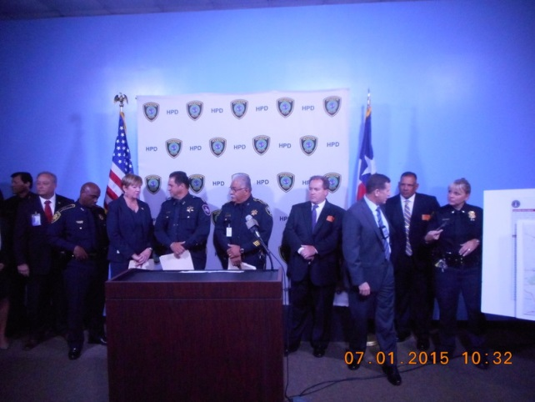
Law Enforcement Partners – Le Vice
LE Partners
FBI
DPS
TABC
Comptrollers
Criminal Justice Partners
DHS HSI
HCSO
LE Partners
Constable Precinct 2
Constable Precinct 3
Constable Precinct 4
Constable Precinct 5
Constable Precinct 6
Constable Precinct 7
Constable Precinct 8
HPD Vice
HPD Narcotics Forfeiture Abatement Seizure Team
HCDA’s Office
Harris County Attorney’s Office
City of Houston Legal Department
Houston Fire Department Fire Marshal
Constable Precinct 1

Slide 6
Vice Division 2016 Goals
FY2016 Grant:
Enhanced Collaborative Model to Combat Human Trafficking
ID Human Trafficking Victims
Support NGO / Assistance Agencies
Demand Reduction
Reduce Recidivism
Arrests – Penal Code
Chapter 125 Actions
Money Laundering / Organized Crime / Tax
Labor Trafficking
Public Education through Mass Media

Slide 7

Anatomy of a Vice Operation…
And Beyond
“Operation Hypothetical”
Goals:
Address community complaints
“Shape the Environment” – public & criminals
Target “Johns” (demand side) & “Pimps” (traffickers)
Identify and assist trafficking victims & non-victims

Slide 8
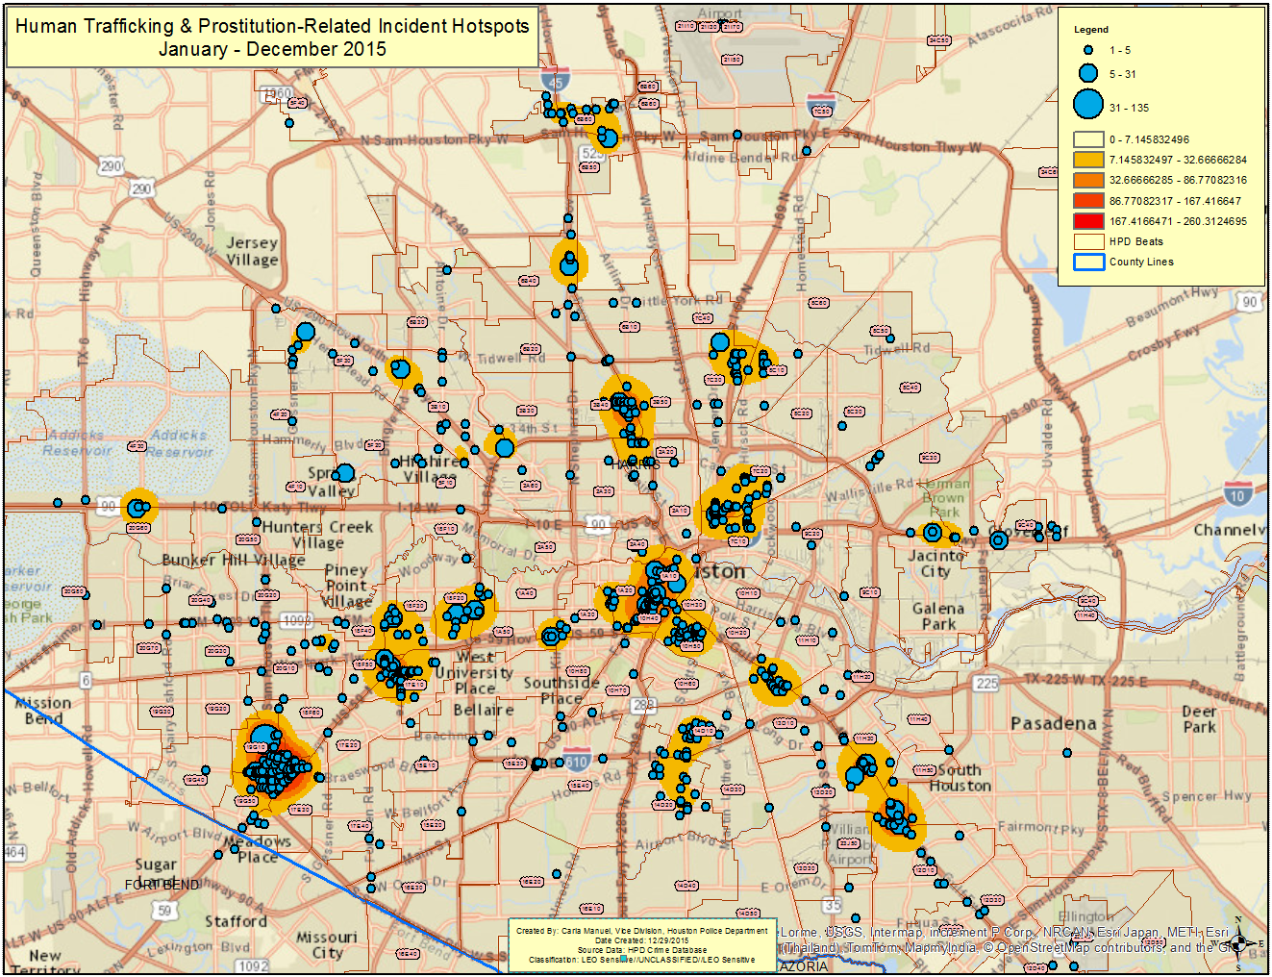
Step 1: Select a Location
Hotspot Target Locations

Slide 9
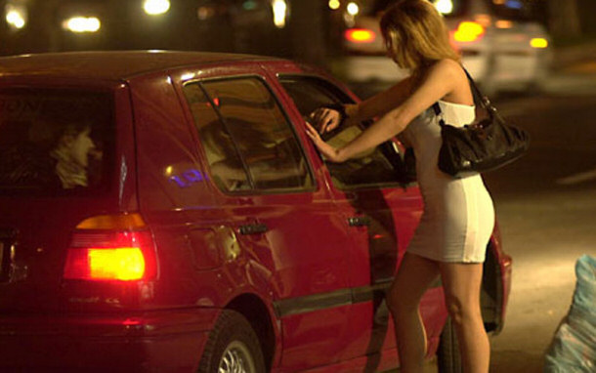
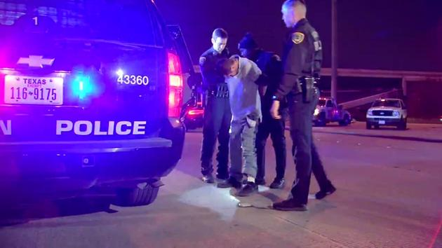
Step 2: Conduct Covert & Overt Ops
Covert Operations – Vice Division
  Street Sweeps
  Decoy Operations
  Business Locations
Overt Operations – Patrol Division
  Zero Tolerance
  Repeat…Again…

Slide 10





Step 3: Process Victims & Non-Victims
Drop Charge & Release
Determine Victim Status
Harris County Jail
Pretrial Diversion
The Vice Conundrum
Serve Time

Slide 11


Step 4: Assess Needs & Assist
Criminal Justice System
The Importance of Assistance Organizations
Drop Charge & Release
Pretrial Diversion
Link with the best Provider
Shelter
Food
Clothing
Health care
Money
Security
Assess Her Needs
Serve Time
Self-Initiator

Slide 12
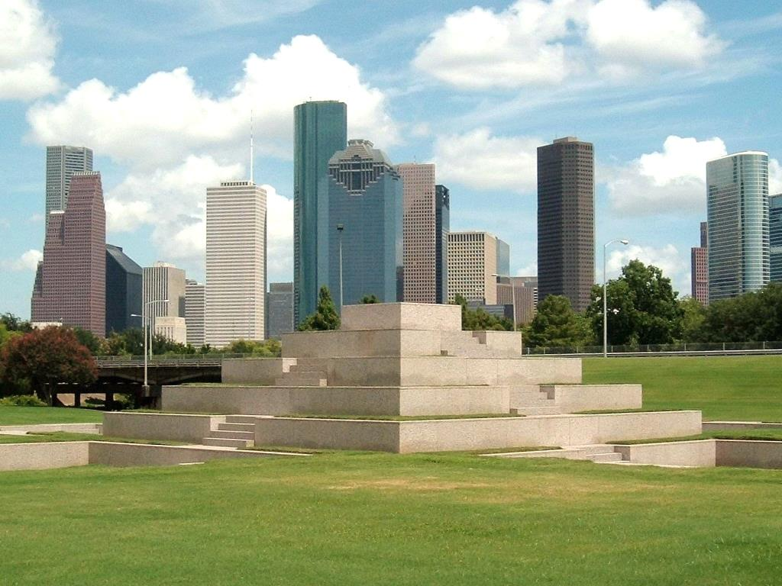
Questions or Comments?

