Slide 1


Slide 2

Ten Days of Activities
January 27, 2017
  Super Bowl Central VIP Event
January 28 – February 5, 2017
  Super Bowl Central open to the public
January 28 – February 5, 2017
  NFL Experience
February 5, 2017
  Super Bowl LI

Slide 3
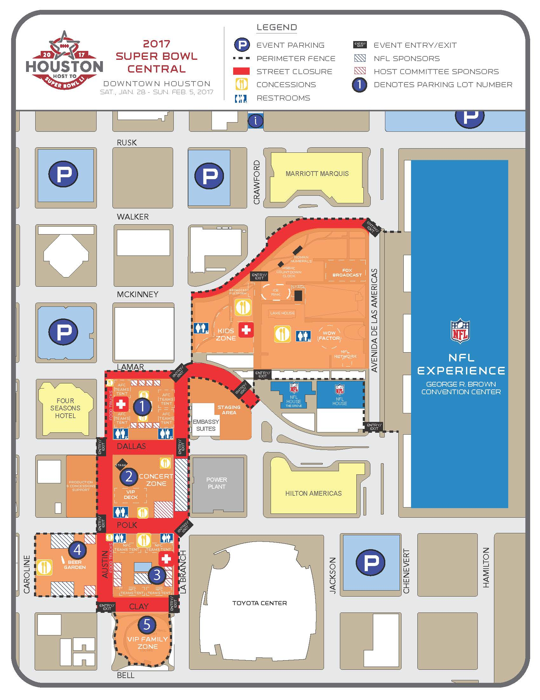
Super Bowl Central Footprint

Slide 4
Events/Venues
Super Bowl 51
  NRG Stadium
NFL Experience
  GRB
Super Bowl Central
  Discovery Green & adjacent blocks
Media Center
NFL Headquarters Hotel
Team Hotels (2)
Team Practice Sites (2)
NFL sanctioned events
Non-sanctioned Events
Potential demonstrations
Flash mobs (e.g. Galleria)

Slide 5
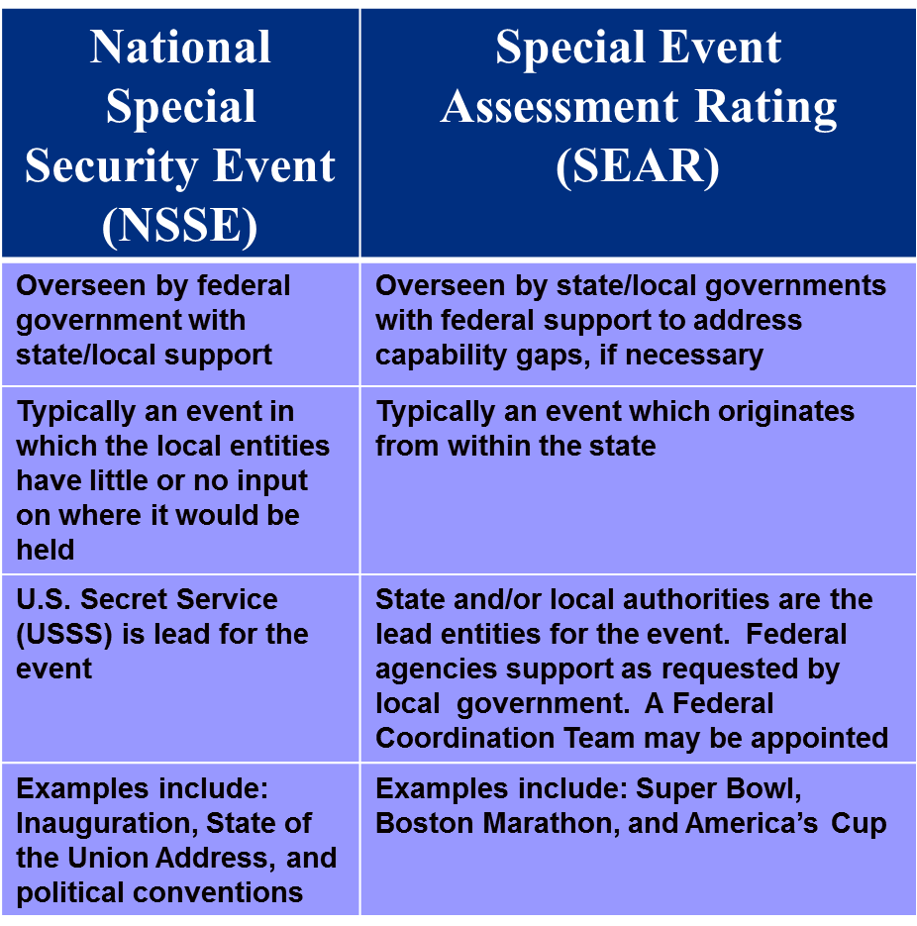
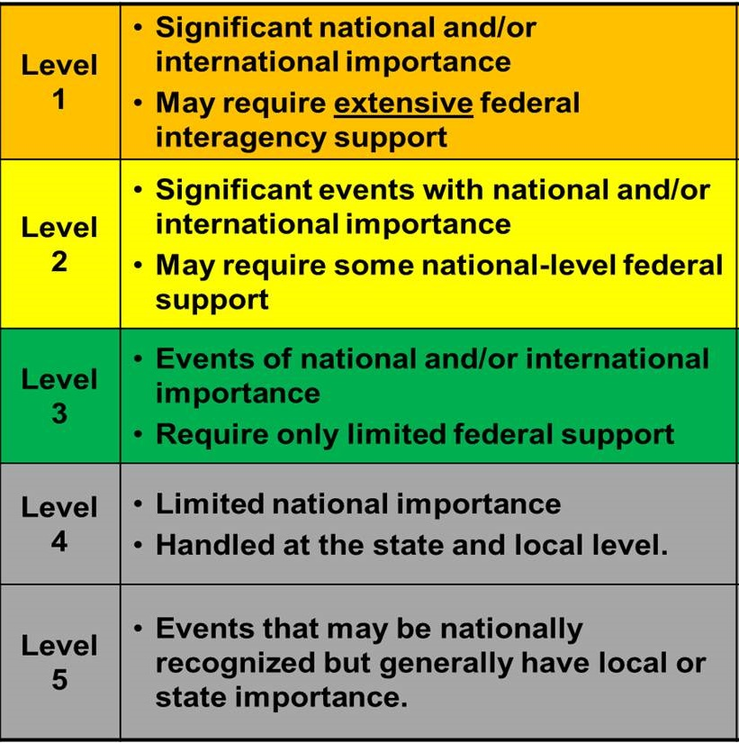
Types of Special Events

Slide 6
Potential Attack
Scenarios to Consider
Chemical
Biological
Radiological/Nuclear
Explosive
Aircraft
Armed Assault
Prevent-Protect-Respond-Recover

Slide 7
Local Agencies
HPD (lead agency)
HCSO
Other local law enforcement agencies
Houston OEM
HFD
PWE
Other City Departments

Slide 8
Federal Partners
Federal Coordinator
FBI
Secret Service
ATF
CBP
DHS Agencies, e.g. HIS, DNDO, etc.

Slide 9
Coordination/Control/Situation Awareness
Location: Houston Emergency Operations Center (HEC)
Participants: HPD, Federal and Local partners, NFL, OEM, all involved City Departments, National Weather Service, FAA
Technology: Video, Video Downlink, Vidsys, Data Casting, Digital Sand Box, HSIN, and others
Various WMD Detection Technology (at venues and in the field)

Slide 10
Lessons Learned
Super Bowl 38 - Houston experience in 2004
On-site observation at previous Super Bowls
NCAA Final Four
NBA All Star
MLB All Star
Houston Teams games
Numerous Other Major Events (RNC, G-8 Economic Summit, World Energy Congress, major conventions)
Dignitary Visits

Slide 11
Questions?

