Slide 1


Houston Recovery Center
Houston City Council, Public Safety and Homeland Security Committee May 10, 2016

Slide 2

The City of Houston created the Houston Recovery Center to:
Divert individuals from jail
Reduce the jail population
Preserve law enforcement resources
Preserve medical resources
Provide a chance for many to escape the revolving door of substance abuse and incarceration

Slide 3
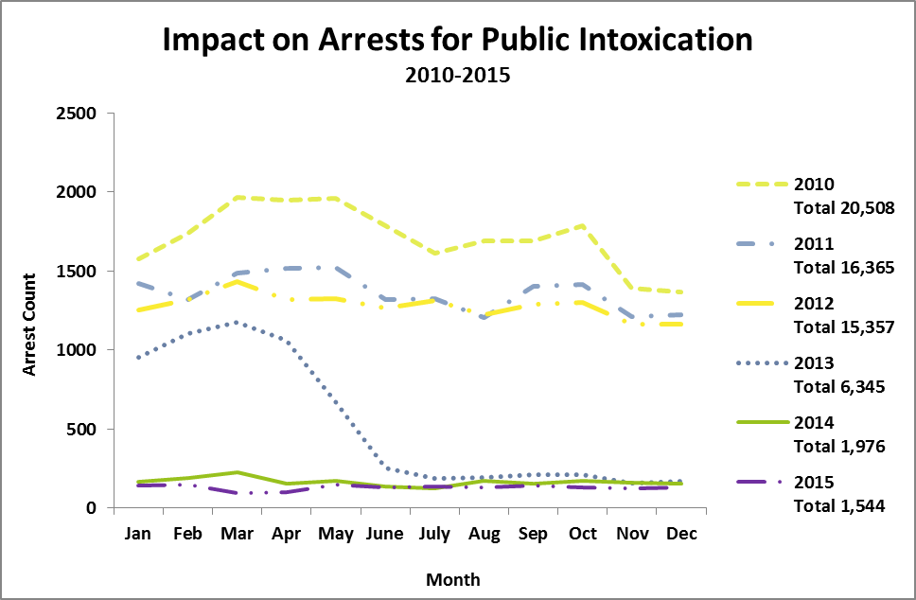
Our Impact
The Sobering Center program opened April 2013 to one division of HPD, then to all of HPD May 2013
HRC has reduced the jail population 90% from 2010-2014

Slide 4
Every Diversion Counts- Even the First
Received a call from a client 120 on May 7, 2016. Client had been brought to the sobering center program May 16, 2013 and hasn’t had a drink since then. He now owns his own home and is about to get married. He’s writing his story to continue sharing what a great place the Houston Recovery Center is.

Slide 5
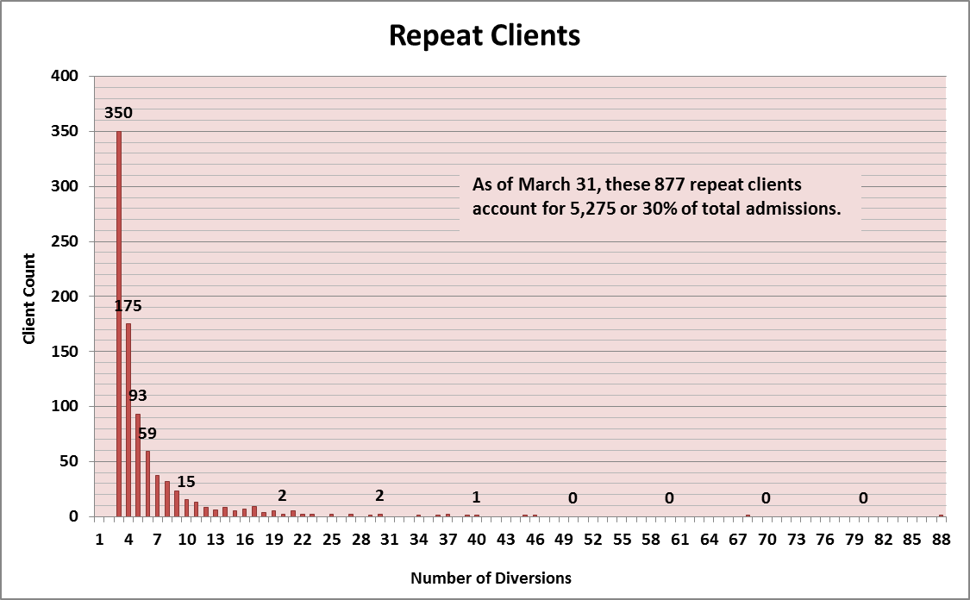
Sobering Center Clients

Slide 6
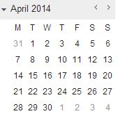
Personal Addiction Recovery Team (PART)
March 2016 Update
Program Launch 4/1/2014
During 24 Months of Enrollment:
388 individuals enrolled
378 individuals referred to a safe facility
163 individuals in recovery coaching
42 individuals receiving case management
28 individuals currently in treatment/detox

Slide 7
PART Client Profile
Living Status
Notes:
Surprised us that PART had almost 100% homeless enroll
I copied the sobering center chart as a picture and just regular, copy-paste to see which one you prefer. –Ashley

Slide 8
PART Client Profile
Mental Health
Notes:
Self report indicators
Normal to see mental health combined with substance use disorders
Licensed professional now added to our staff
Add Psych Technicians to sobering unit due to mental health issues

Slide 9
PART Client Profile
Criminal History

Slide 10

Profile Client J
Male
56 years old
Homeless*
Using 41 years*
DOC: Alcohol
86 arrests prior to program enrollment*

Slide 11
Client J Timeline
Enrolled in PART – 17 months of activity
After 17 months* client engages in treatment
8 Failed Detox Admissions
95 EMS Transports | 65 Hospitalizations
76 Arrests | 6 Jail Admissions
44 HRC Visits: | 5 Walk-Ins | 8 Extended Visits (13 hrs)

Slide 12
Program and Collaborations
  Telephone Follow-Up, Launched 2013: individuals admitted to the sobering center program agree to receive follow-up phone calls at a safe number to review their action plan
  Care Coordination Planning Team, Launched September 2013: a collaborative working to improve care coordination for all groups interacting with clients
  Criminal Justice Program, Launched January 2015: reaches in to clients at Harris County jail who want recovery assistance post discharge or while on probation
  HRC Van, Launched June 2015: transports engaged clients to and from services supporting their treatment and recovery plan
  PART-PREP(Pre-Recovery Engagement Plan), Launched March 2016: supports frequent clients wanting to address critical health and life issues before engaging in addiction recovery programs
  Telephone Recovery Support, Launched March 2016: provides twelve weeks of telephone recovery coaching for individuals who would like follow-up from the Houston Recovery Center
  Public Intoxication Transportation Program, Launches May 2016: outreach to the downtown community for recovery services in coordination with the Houston Police Department

Slide 13
Challenges and Opportunities
Increased access to treatment, especially detox
Expand our ability to serve as a resource for EMS and emergency centers
Expand access to affordable recovery housing
Overcome space needs for program expansion

Slide 14
Houston Recovery Center-
A Sobering Center on the Map
In-Person Visitors:
Phone Visitors:
Austin, Texas
Baltimore, Maryland
Corpus Christi, Texas
Edmonton, Canada
Everett, Washington
Los Angeles, California
Pasadena, Texas
People’s Republic of China (Xinhua News Agency)
Prescott, Arizona
Salt Lake City, Utah
Austin, Texas; professionals and students
Baltimore, Maryland
Brown University
England (radio interview)
Evansville, Indiana; students
Kansas City, Kansas
New Mexico

Slide 15

THANK YOU
To schedule a tour, please contact Ashley Ochoa at 713.236.7801; aochoa@houstonrecoverycenter.org.

