Slide 1


Response Time and Staffing Analysis Model for the Houston Fire Department

Slide 2

Houston Fire Department
Introductions
Our Process
Overview
Specific Recommendations

Slide 3
Introductions
  William Bryson
  Cathy Gleason
  Ken Riddle
  Kevin Roche
  Nancy Trench
Chris Callsen, Amos Chalmers, Randy Griffin, Charles Hood, Charles Jennings, Brett Lacey, Gary Ludwig, Richard Marinucci, Larry Schwarz, Denise Smith, Eric Tade, Robert Tutterow, Andy Whitehead, Mike Wieder, Sally Young

Slide 4
Our Process – First-Hand
Fire Executive Staff
Fire Management
  Prevention, Logistics, Operations and Special Operations, Training, Administration
Firefighters and Fire Officers
Medical Director
Mayor’s Office
Finance, Emergency Management, Dispatch, Fleet, Human Resources
Houston Black Firefighters Association
Houston Professional Firefighters Association - International Association of Fire Fighters Local 341
Houston Female Firefighters and Fire Officers

Slide 5
Our Process – First-Hand
Dispatch System Data Review
Computerized Deployment Modeling
SOP and Document Review
Standards and Best Practices
Benchmarking
Close Coordination with Fire Department Administration

Slide 6
Our Premise
Outside Experts
  Unencumbered by the “way things are done”
A Critical Eye
Realistic and Achievable Recommendations
Recognition of Best Practices

Slide 7
Fire and EMS in Houston
City of Houston
Complicated Transportation System
Significant Industrial Presence
Significant Educational and Medical Presence
Lack of a Single Central Core
Historic Peripheral Growth and Current Urbanization

Slide 8
Fire and EMS in Houston
Houston Fire Department Description
  Dedicated Staff – System Efficiency
  Reductions in Support Staff
  Emergency Unit Staffing in Compliance with National Standard
  Deferral of Capital Expenditures
  Very, Very Busy Response System
Budget and Governance
  Fire – 21-23 percent of General Fund - $509M
  Fire Revenue - $75M – ambulance/prevention
  Sales Tax Rate Restriction – Texas
  Property Tax Growth Restriction - Houston

Slide 9
Ideas Considered
EMS Model Changes
Ambulance Service Privatization
Peak-Time Ambulances, Medic Units, and Squads
Emergency Unit Staffing
Work Shift Change from 4 to 3 shifts
Cost Recovery
Ambulance Billing Efficiency

Slide 10
EMS Model Changes
HFD All-Hazards Deployment Model is a Best Practice
Help at the Customer’s Side
Preservation of Finite Resources
  Call Processing at Dispatch
  BLS/ALS Response
  ETHAN
  PoP Engines
Suggestions on Expanded EMS and Role of Squads

Slide 11
Ambulance Service Privatization
Fully Integrated EMS Provided by the HFD
Likely Need for Subsidy if Privatized
12 Largest Cities (population)
  12 Provide EMS
  9 Provide Ambulance Service
  2 Use 3rd Public Service
Issues with Service Abandonment and Underserved Areas

Slide 12
Peak-Time Ambulances, Medic Units, Squads
Houston Fire Staffs Constant Staffs 58 BLS Ambulances and 34 Medic Units
Our Assumption that HFD did not Need All Units 24/7
Performance Analysis and Modeling Show All Units Needed Plus Peak-Time Capability
Peak-Time Units - Used During Most Active Times

Slide 13
Emergency Unit Staffing
HFD Constant-Staffs Engines, Ladders, Towers at 4
HFD Constant-Staffs Ambulances, Medic Units, Squads at 2
Consistent with NFPA 1710
Consistent with other Large US Cities
Reduction in On-Duty Unit Staffing
  Negative Performance Impact
  Negative Customer Service Impact
  Negative Firefighter Safety Impact

Slide 14
Emergency Unit Staffing
Minimum On-Duty Staffing
Fire Department/ City | Population | Engine Company | Ladder Company | Tower Company | Ambulance/Medic
Austin | 888,204 | 4 | 4 | 4 | NA
Chicago | 2,709,466 | 5 | 5 | 5 | 2
Dallas | 1,257,000 | 4 | 4 | 4 | 2
Houston | 2,239,558 | 4 | 4 | 4 | 2
Indianapolis | 1,200,000 | 4 | 4 | 4 | NA
Los Angeles | 3,792,621 | 4 | 5 | NA | 2
New York City | 8,400,000 | 6 | 6 | 6 | 2
Philadelphia | 1,567,442 | 4 | 5 | 5 | 2
Phoenix | 1,513,000 | 4 | 4 | 4 | 2
San Antonio | 1,400,000 | 4 | 4 | 4 | 2
San Diego | 1,381,000 | 4 | 4 | 4 | NA
San Francisco | 864,816 | 4 | 5 | NA | 2

Slide 15
Work Shift Change from 4 to 3 Shifts
Current Schedule
  Firefighters and Fire Officers work 46.7 Hours per Week
  Work 1 out of 4
  Additional Hours - 10 “debit days” per Year
Three Shift Schedule
    Firefighters and Fire Officers work 46.7 Hours per Week
  Work 1 out of 3
  Work Week Reduction - 20 “Kelly Days” per Year
Firefighters and Fire Officers Scheduled for Work Approximately 102 Times per Year – Both Shift Configurations
No Appreciable Savings in Absence of Increase in Average Work Week

Slide 16
Cost Recovery
Current – Ambulance Fees, Fire Prevention Fees, Hazmat Program
Few Opportunities for Cost Recovery by Fire Departments
Changes in the Health Care System

Slide 17
Ambulance Billing Efficiency
Cooperative Effort Between Finance and Fire
Billing Quality Control
Partial Day Coverage
  Should be Expanded

Slide 18
Areas of Analysis
Logistics
Professional Development
Deployment – Emergency Operations
Emergency Medical Services
Dispatch and Technology
Staffing of Emergency Operations
Life Safety Bureau
Arson Bureau
Safety and Health Programs

Slide 19
Logistics

Slide 20
Logistics Recommendations
Fleet Replacement Fund
Return Fleet Maintenance Responsibilities to the control of the Fire Department.
Training for Fleet Mechanics - Emergency Vehicle Certification (EVT) program.
Self-Contained Breathing Apparatus (SCBA) Replacement

Slide 21
Logistics Recommendations
Dedicated General Services Division (GSD) Facility Maintenance Crew
Install Diesel Exhaust Systems in Fire Stations
Dedicated Procurement Personnel in Fire
Explore Purchasing Partnerships – Hospital System - EMS Supplies

Slide 22
Professional Development

Slide 23
Professional Development Recommendations
Involve Uniformed HFD members in the Recruiting Process - Diversity
Utilize the Candidate Physical Abilities Test (CPAT)
Analyze the Causes of Cadet “Washouts” – Mitigation
Standardized Driver Training Program
Fire Officers Continuing Education
Career Development Plan
Refresh Facility Master Plan for the VJTF

Slide 24
Deployment – Emergency Operations

Slide 25
Deployment – Emergency Operations
NFPA 1710
Standard for the Organization and Deployment of Fire Suppression Operations, Emergency Medical Operations, and Special Operations to the Public by Career Fire Departments
  240 seconds travel – first engine on-scene
  480 seconds travel – initial full alarm
  610 seconds travel – highrise initial alarm
  240 seconds travel – EMS
  480 seconds travel – Advanced Life Support
  90th Percentile

Slide 26
Deployment – Emergency Operations
Current HFD Performance
First on-Scene – less than 50% in 240 seconds – 90th percentile = nearly 7 minutes
Advanced Life Support – average 7.5 minutes – 90th percentile = 12.5 minutes
Ambulance/Medic Response Time – 90th percentile = 11:33
Residential Structure Fire Initial Alarm – average 7:18 – 90th percentile 10:33
Commercial Structure Fire Initial Alarm – meets standard 5% of the time
High Rise First Alarm – meets standard 20% of the time

Slide 27
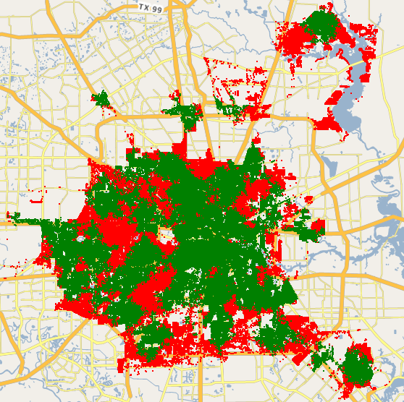
Address Coverage – Structure Fire - 8 Minutes

Slide 28
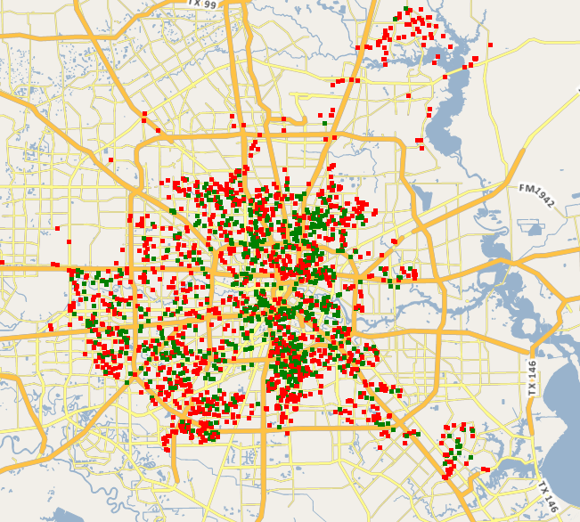
Actual Coverage – Structure Fire - 8 Minutes

Slide 29
Deployment – Emergency Operations
Projected Performance
Convert Squads to Medics – ALS Response Time down, lower workload per ambulance, shorter ambulance response time
Utilize AVL Location for Dispatch – 30 second system-wide response time improvement
Convert all Squads and Ambulances to ALS – reduce ALS response times, smooth unit activity

Slide 30
Deployment – Emergency Operations Recommendations
Add EMS Transport Resources - Full-Time or Peak-Time
Table 7 - Expected Impact of Additional Peak-Time Ambulances
Number of Additional 12-hour peak-time ambulances | Additional Benefit from baseline | Expected percentage of transport vehicles travel time within 480 seconds
5 | +2% | 75%
10 | +4% | 77%
15 | +6% | 80%
50 | +14% | 87%
60 | +15.5% | 88.5%
70 | +17% | 90%

Slide 31
Deployment – Emergency Operations Recommendations
New Fire Station (901) - Southwest Houston
(approximately Chimney Rock and Beechnut, District C) in the areas served by fire stations 37 (7026 Stella Link, District C), 48 (11616 Chimney Rock Road, District K), and 51 (6902 Bellaire Boulevard, District J)
New Fire Station (902) - North Central Houston
(approximately North Freeway and Mount Houston, District B/H) in the areas served by fire stations 58 (10413 Fulton Street, District H), 67 (1616 West Little York Drive, District B), and 74 (460 Aldine Bender Road, District B)
New Fire Station (903) - Sam Houston Parkway Corridor
(approximately Cullen and Beltway 8, District D) in the areas served by fire stations 47 (2615 Tidewater Drive, District K) and 55 (11212 Cullen Boulevard, District D)
Hazmat Unit, Technical Rescue, Safety Officers

Slide 32
Emergency Medical Services

Slide 33
Emergency Medical Services Recommendations
Hire Firefighters with EMT Certification - Diversity
Alternate Paramedic Training Schedule
EMS Continuing Education
EMS Support Staff Needs Assessment/Workload Analysis
Evaluate EMS Supervisor Administrative Duties

Slide 34
Emergency Medical Services Recommendations
Continue to Evaluate the Efficacy of the Medical Priority Dispatch System
Consider Changes to the Medical Credentialing Process and the Utilization of Paramedics within the HFD
Continue the ETHAN Program - Explore Alternative Funding
Continue Care Houston - Seek Funding and Opportunities - Methods to Manage Demand

Slide 35
Dispatch and Technology

Slide 36
Dispatch and Technology Recommendations
Utilize Automatic Vehicle Location (AVL) Technology
Streamline Call Taking Process
Prompt Responders - Acknowledgement

Slide 37
Staffing of Emergency Operations

Slide 38
Staffing of Emergency Operations Recommendations
Staff Emergency Operations at 3,634 FTE (plus/minus 3%)
  Staffing in Emergency Operations (plus Life Safety, Staff, Logistics, etc.)
  Constant Staffing
  Most Efficient Balance Between FTE and Overtime
  Staffing Factor = 4.3

Slide 39
Life Safety Bureau

Slide 40
Life Safety Bureau Recommendations
Basic Resources – vehicles, computers
Inspection Management System
Business and Organizational Best Practices -strategic plan, standard operating procedures, internal communications plan

Slide 41
Life Safety Bureau Recommendations
Access to Fire Experience Data
Community Risk Reduction Strategy – Target Risk Based on Data
Increase Bureau Involvement – Construction Review Process - FPE’s

Slide 42
Arson Bureau

Slide 43
Arson Bureau Recommendations
Mission Statement
Fleet Management Plan
Additional Certifications for Fire Investigators

Slide 44
Firefighter Safety and Health Programs

Slide 45
Firefighter Safety and Health Program Recommendations
Annual Medical Evaluations
Comprehensive Wellness/Fitness Program
Tobacco-Free Work Environment
Cancer Awareness/Prevention Program

Slide 46
Savings and Efficiencies
Emergency Call Taking and Dispatch
Overtime Management
Increased Efficiency in Life Safety Bureau
  Deployment of Technology
  Involvement in Construction Process
  Focus on Risk
Hazmat Fee Changes
Response Time Reductions
Recruitment
Purchasing

Slide 47
Summary
Highly Active Emergency Response System
Efficient Use of Resources
Challenging Service Area
Dedicated Staff
Fiscal Constraints
Need for Investment
Prioritization of Needs

Slide 48
Thank you – to HFD and City of Houston Staffs
Questions?

