Slide 1


Houston Fire Department
Public Safety Committee Meeting
Samuel Peña
Fire Chief
April 11, 2017

Slide 2
Objectives
H-Occupancy Facility Inspection Status
Regular system of Fire Inspection

Slide 3
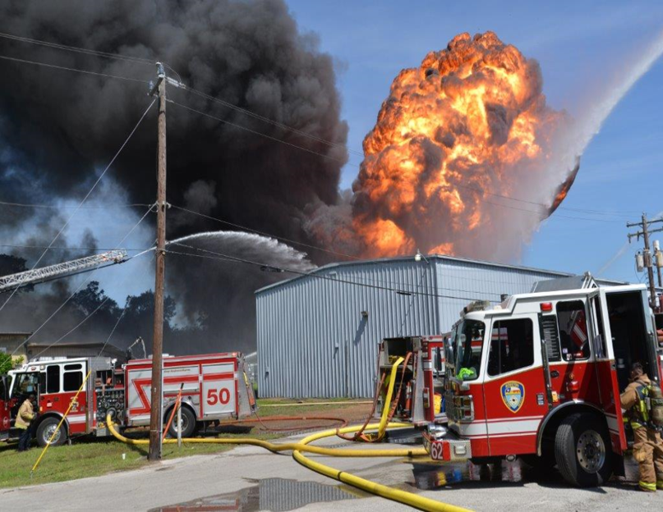
8960 Spring Branch Dr.

Slide 4
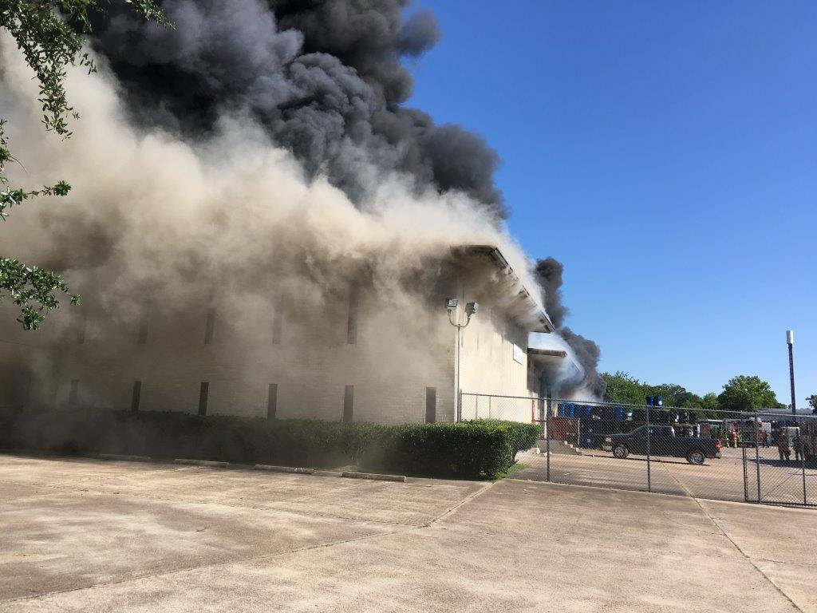

Slide 5
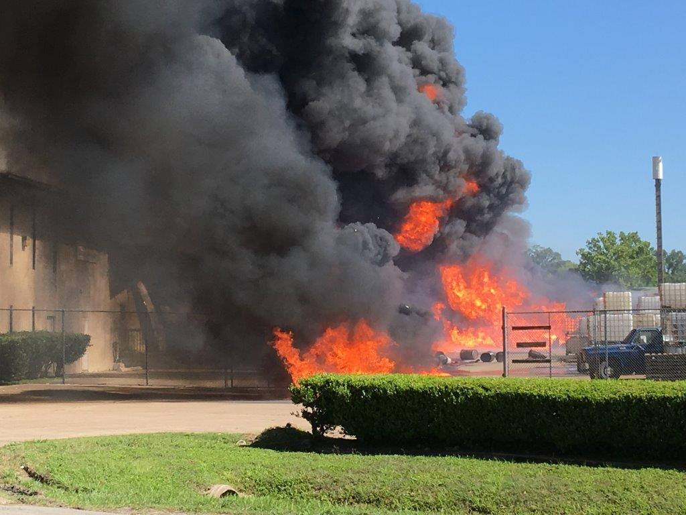

Slide 6
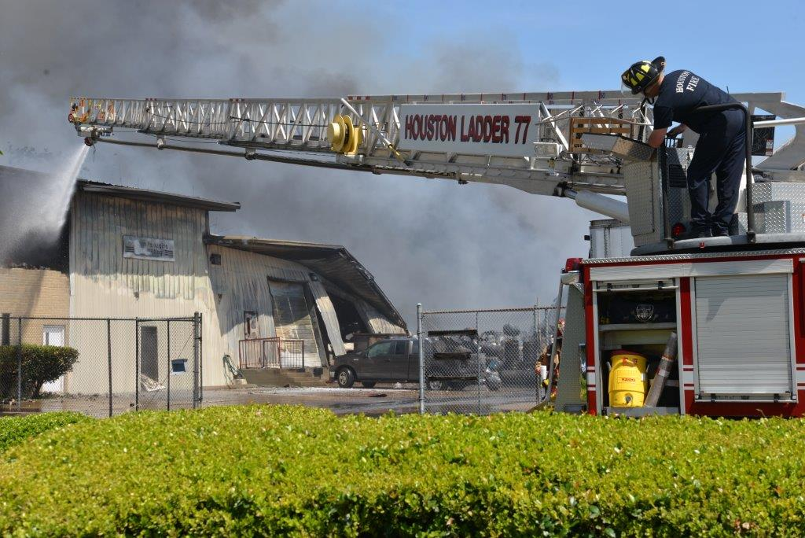

Slide 7
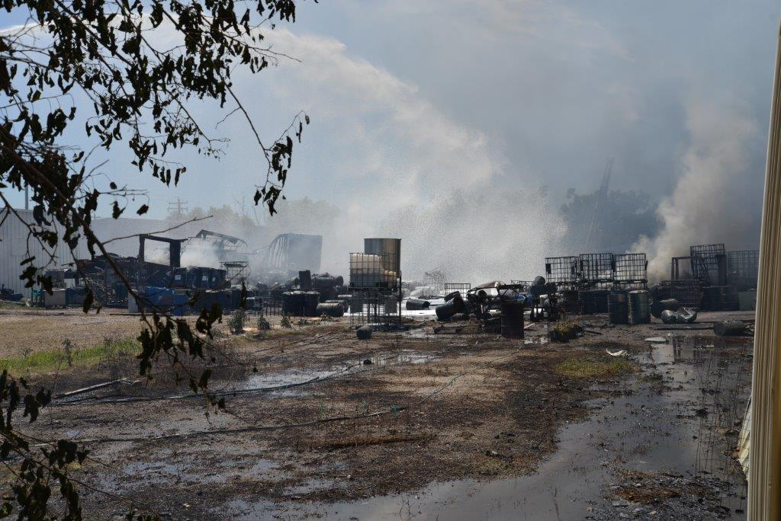

Slide 8
Identifying Risk
Exceeded 10,000 lbs of non-Extremely Hazardous Substance (ESH) 25 TAC 295.182(B)(4)(A)
Failure to submit a Tier II form/report that includes all hazardous chemicals stored above the reportable threshold
Facility had not been inspected in several years

Slide 9
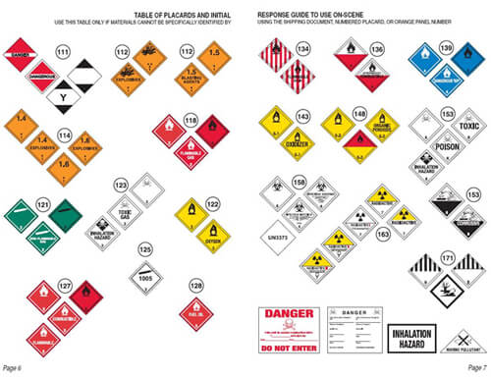
Identifying Risk
Thousands of chemicals handled and stored in plants and factories
75% of HazMat incidents happen at fixed locations
80% of DOT incidents are in non-bulk packages
98% of HazMat incidents caused by package failure and human error

Slide 10
Identifying Risk
Annual Average of 1,600 Structure fires
6,295 Miscellaneous HazMat Commercial Businesses identified by PWE
2782 facilities requiring permits to store hazardous materials of various quantities
174 H-Occupancies as defined by the Hazardous Enterprise Ordinance

Slide 11
Identifying Risk
Technology Challenges with Smart CM and ILMS
Deficient data integrity and information sharing between departments
Faulty risk-based approach to inspections
Deficient information sharing between divisions
Understaffing

Slide 12
Regular System of Fire Inspections
Identifying Fire Risk at the Operational Level
Coordinating elements of response that mitigate risk
Prioritizing the risk to be addressed

Slide 13
Regular System of Fire Inspections
Potential Elements of Prioritization Model
  Historical Incident Frequency
  Code Compliance Hx
  Date of Last Inspection
  Fire Activity
  Age of Property
  Suppression Systems
  Building Use
  Population Density
  Flammable/Combustible Quantities

Slide 14


Regular System of Fire Inspections
Common RMS
(INFOR)
Properties for Inspection
Prioritized Fire Inspection and Personnel Allocation
Fire Risk Predictive Model
Fire Incidents
Commercial Property Permits
Parcel Condition-Code Enforcement
Permits
Business Licenses and Cof O
Crime and Emergency Incidents

Slide 15
Outcomes
Improve Permitting and Inspection Process
Data-driven Inspection Prioritization Program
Identification of Permit Non-Compliance
Commercial Property Risk Reduction

Slide 16
Houston Fire Department
Public Safety Committee Meeting
QUESTIONS?

