Slide 1


Slide 2

City of Houston’s Strategic Plan
1st Objective: Institutionalize the City of Houston’s Response
Strategy: Engage City of Houston Departments and Implement Trainings
  Engage Houston Health Department and Airport System.
    Health Department will require training for its 1,200 employees.
  Houston Municipal Court and Houston Police Department (Vice and Jail Division).
  Collaborate with Procurement to detect labor trafficking in vendor supply chains. Mayor Turner scheduled to sign AP.
  Enable Office of Business Opportunity to prevent labor trafficking by incorporating assessment questions in forms used for on-site interviews with contractors.
Strategy: Analyze and Pass Ordinances and Departmental Policies
  Massage Establishment Ordinance unanimously passed on December 2nd, 2015.

Slide 3
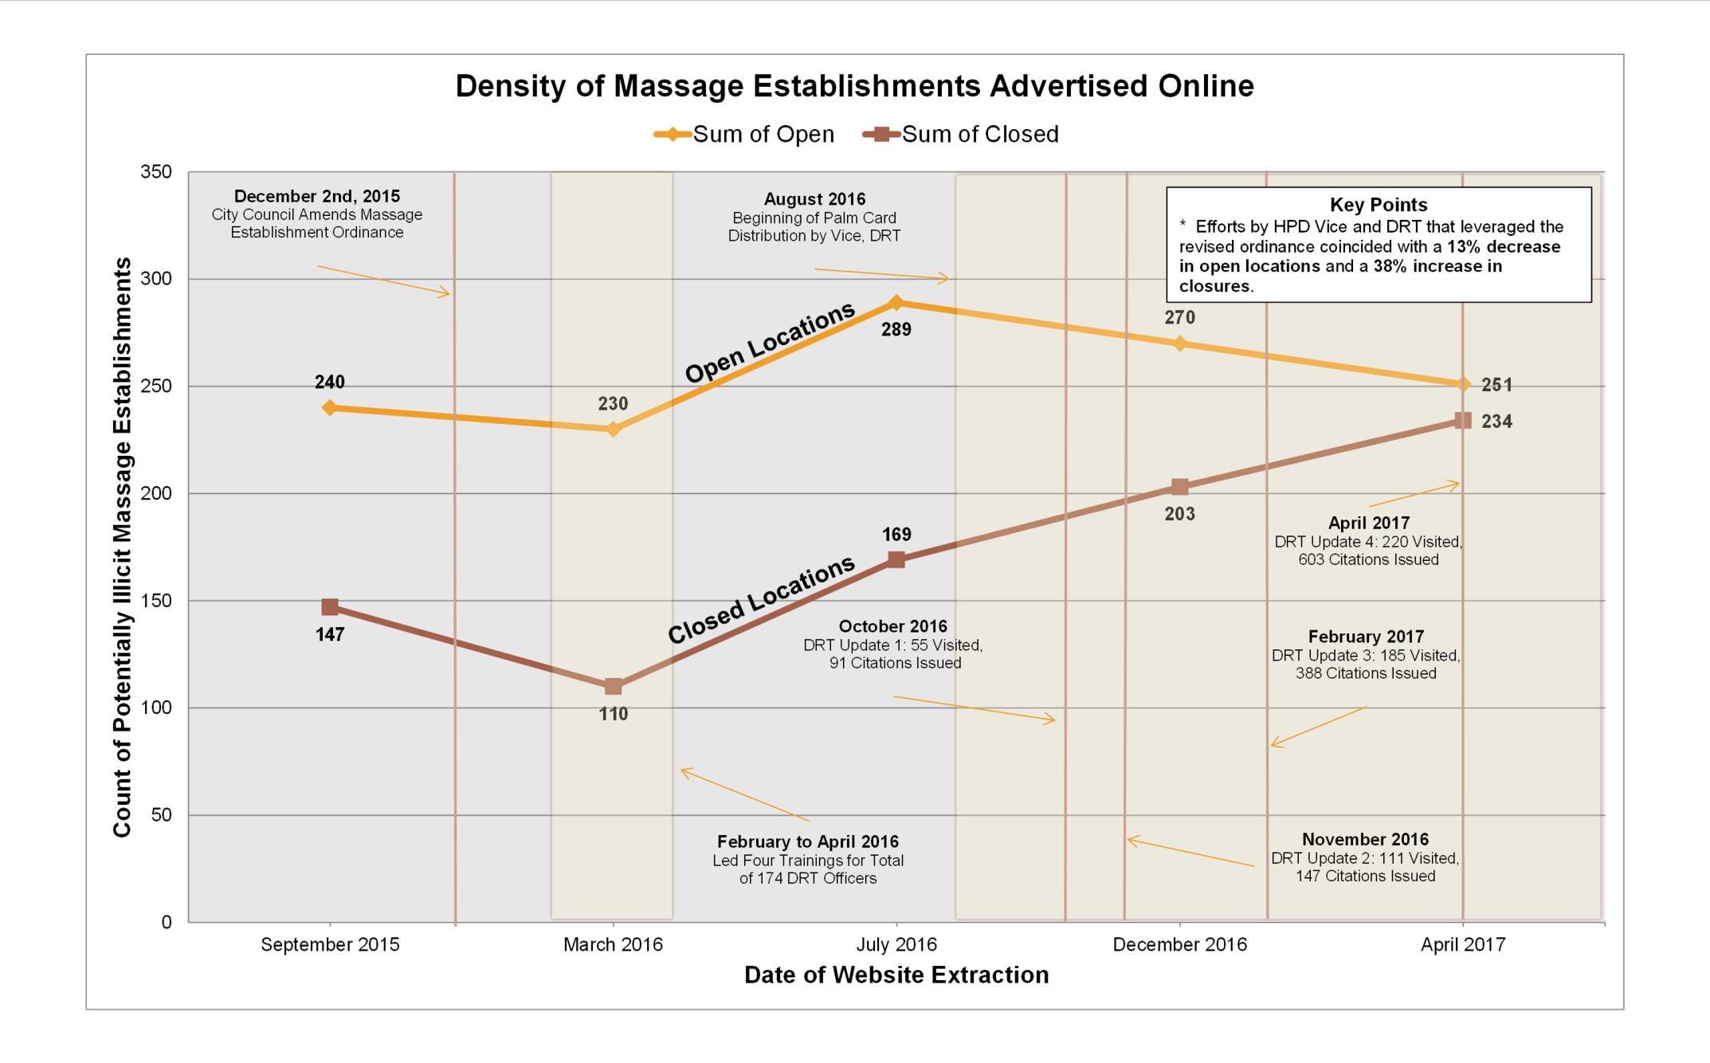
City of Houston’s Strategic Plan
Impact of Amended Massage Establishment Ordinance as of April 21, 2017

Slide 4
City of Houston’s Strategic Plan
1st Objective: Institutionalize the City of Houston’s Response
Municipal Court Diversion Pilot
  Launched Municipal Court diversion program on June 17th, 2016.
Establish trust with potential trafficking victims by supporting their civil legal needs.
Those cited with following Class C Misdemeanor charges are connected with legal service professionals:
    CC1464 Manifesting the purpose of engaging in prostitution or solicitation of prostitution.
    OP1 Fail as a massage therapist to obtain a certificate of registration.
    OP5 Representing oneself as a massage therapist without holding a certificate of registration.
    OP10 Performing massage therapy as a massage therapist at/for a sexually oriented business.
Open not only to those trafficked in illicit massage businesses. Serves domestic and international victims.
Lawyers refer victims to social service agencies. Charges are dismissed if victim satisfactorily attends legal services screening.
Partnership between HPD, Municipal Court, Tahirih Justice Center, Catholic Charities, Boat People SOS, and Lone Star Legal Aid.

Slide 5
City of Houston’s Strategic Plan
Municipal Court Diversion Program—Results as of April 20, 2017
Participation in Municipal Court Diversion Program
 | Number Served | Number Declined Services | Number Appeared | Number Scheduled to Appear | % Served by Total Possible (Served / Scheduled) | % Seeking Services (Served / Appeared)
Grand Total | 31 | 5 | 36 | 69 | 45% | 86%
Trafficking Indications in Number Served
 | Low Trafficking Indications | Moderate Trafficking Indications | High Trafficking Indications
Grand Total | 12 | 5 | 14

Slide 6
City of Houston’s Strategic Plan
2nd Objective: Raise Awareness and Change Public Perception
Strategy: Hold Events to Raise the Level of Dialogue and Engage Influencers
  2015: Held “Up the Ante” human trafficking symposium on October 29th, 2015. Featured Bradley Myles, Siddharth Kara, Brooke Axtell, and Dorchen Leidholdt.
  2016: Screened Siddharth Kara’s Hollywood feature film, Trafficked; concluded with a panel discussion featuring Mr. Kara, actors Anne Archer and Patrick Duffy, and Anne Chandler (Tahirih Justice Center).
Strategy: Develop and Launch “Watch for Traffick” Media Campaign
  Led two-phase campaign (Aug. – Dec. 2016, Jan. – mid-Feb. 2017) with Houston Police Department, United Against Human Trafficking, and the DA’s Office.
  A Houston-based consulting firm donated all creative capital.
  Watch for Traffick has 9 images, 2 sex trafficking and 7 labor trafficking images.
  Channel 2, HTV, 950 Metro Buses, 60 YC, SM and Direct Outreach.
Cost of Media Campaign to City of Houston
Cost |  | Grants |  | City Funds Expended
$78,114.04 | - | $75,000 | = | $3,114.04

Slide 7

City of Houston’s Strategic Plan
2nd Objective: Raise Awareness and Change Public Perception
Example of Watch for Traffick PSA

Slide 8

City of Houston’s Strategic Plan
2nd Objective: Raise Awareness and Change Public Perception
Example of Watch for Traffick PSA

Slide 9
City of Houston’s Strategic Plan
2nd Objective: Raise Awareness and Change Public Perception

Slide 10
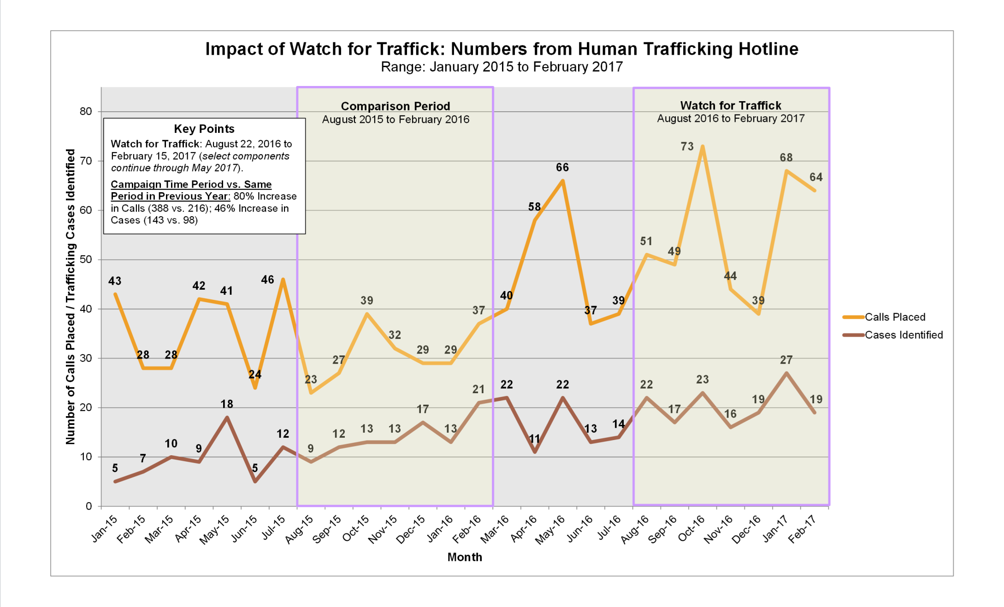
City of Houston’s Strategic Plan
2nd Objective: Raise Awareness and Change Public Perception

Slide 11
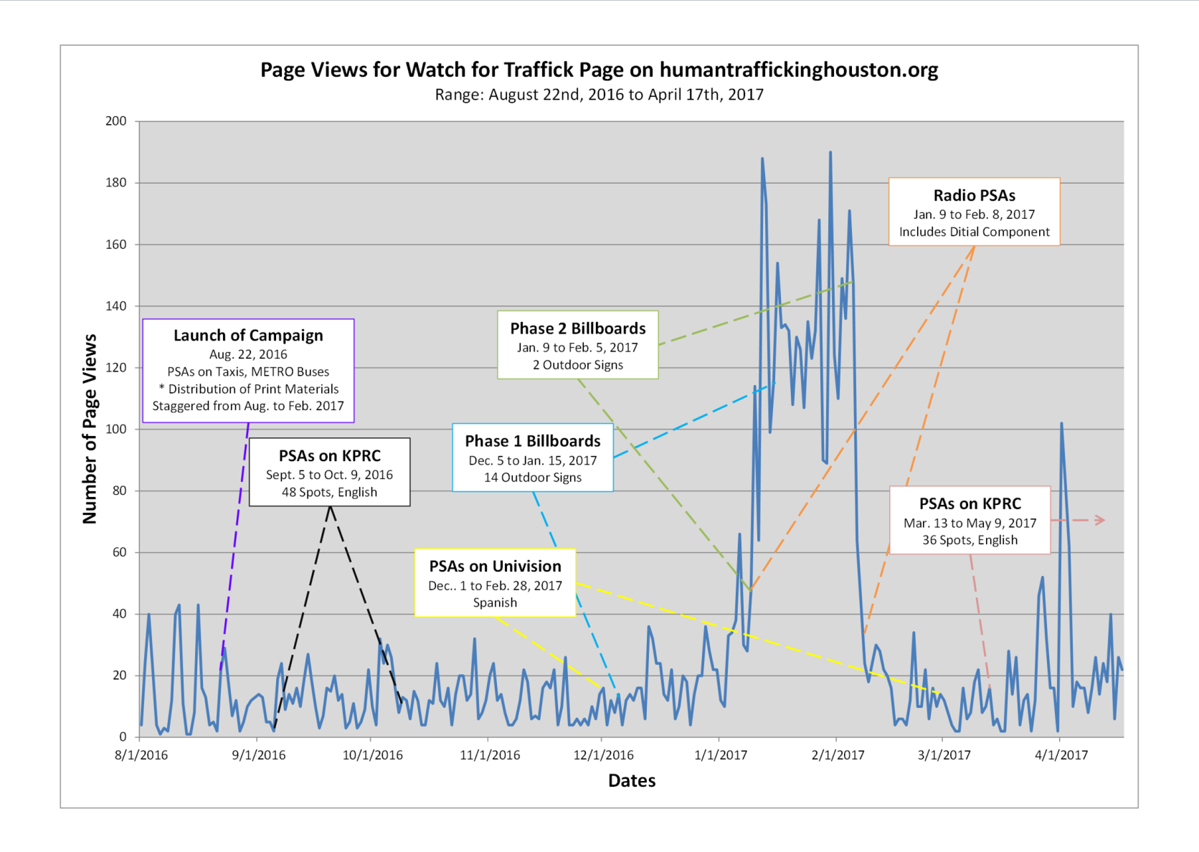
City of Houston’s Strategic Plan
2nd Objective: Raise Awareness and Change Public Perception

Slide 12
City of Houston’s Strategic Plan
3rd Objective: Coordinate Victim Services and Engage in Direct Outreach
Strategy: Coordinate Victim Services
  COH has shelter beds on reserve for direct outreach agencies.
  Addresses need for emergency shelter beds.
  Also creates pathways to transitional housing and rapid re-housing solutions.
  Initially in place for the Super Bowl, extending long term until we have additional options for transitional housing.
  Placed 10 people over a 5 week pilot period and have since placed more.
  Strategy: Build Bridge to City’s Coordinated Access System
  Develop coordinated assessments for at-risk intersecting populations.
  If housing is an identified need, ease access to housing resources.
  Develop programmatic supports around housing.

Slide 13
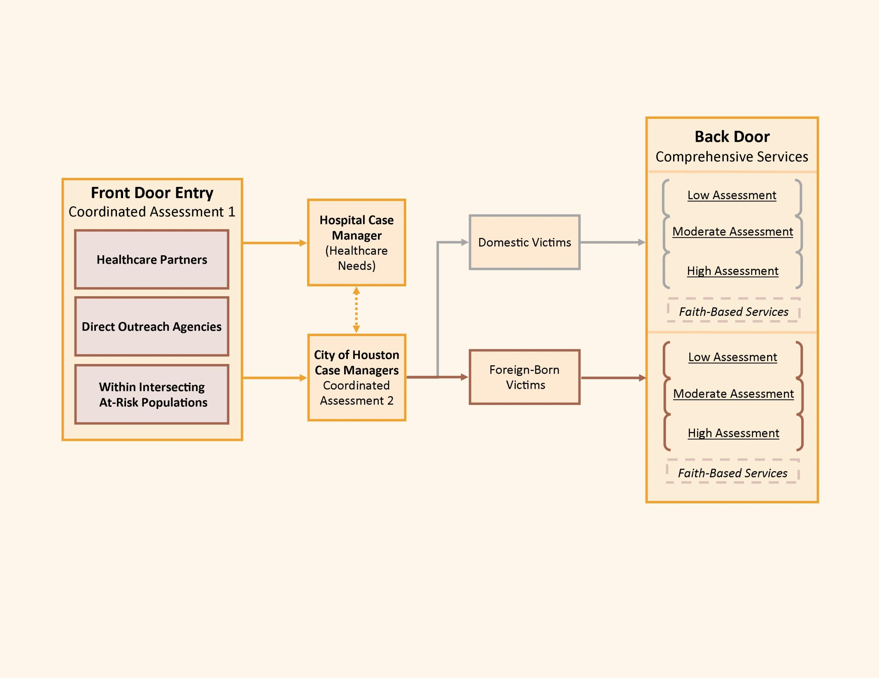
City of Houston’s Strategic Plan
3rd Objective: Coordinate Victim Services and Engage in Direct Outreach

Slide 14
City of Houston’s Strategic Plan
3rd Objective: Coordinate Victim Services and Engage in Direct Outreach
Strategy: Increase Victim Self-Identification through Direct Outreach
  Creation and distribution of palm-sized cards for victims.
    Double-sided, perforated, list intake-style questions.
    Tailored to specific industries and venues and available in 5 non-English languages:
      Cantinas: English, Spanish, Arabic, Mandarin, Urdu, and Vietnamese.
      Massage Establishments: English, Spanish, Korean, Mandarin, Vietnamese, and Thai.
      Food Establishments: English, Spanish, Arabic, Mandarin, Urdu, and Vietnamese.
      Street Outreach: English, Spanish, Arabic, Mandarin, Urdu, and Vietnamese.
    Distributing Agencies
      Houston Health Department: Food Establishments.
      Texas Alcohol and Beverage Commission: Food Establishments and Cantinas.
      Houston Police Department-Vice: Massage Establishments and Street Outreach.
      Houston Police Department-Differential Response Team: Massage Establishments.
      Department of State: Food Establishments, Cantinas, and Massage Establishments.
      FBI: Food Establishments, Cantinas, Massage Establishments, and Street Outreach.
      Coded by distributing agency and card type to allow City to track impact.

Slide 15
Addressing Illicit Massage Businesses
Results of Palm Card Distribution
HPD
Agency: Houston Police Department, Differential Response Team Card Type(s) Distributed: Cards for Illicit Massage Establishments Note: Numbers are Cumulative
 | October 10th, 2016 | November 8th, 2016 | February 9th, 2017 | April 21st, 2017
Locations Visited | 55 | 111 | 185 | 220
Citations Issued | 91 | 147 | 388 | 603
Palm Cards Distributed | 41 | 84 | 147 | 237
Individuals Present | 46 | 84 | 147 | 274
Level of Trafficking | Low, Moderate, and High | Low, Moderate, and High | Low, Moderate, and High | Low, Moderate, and High

Slide 16
City of Houston’s Strategic Plan
4th Objective: Implement Joint Initiatives of the
Houston Area Council on Human Trafficking (HAC-HT)
Background
  HAC-HT is a 42-member, multi-disciplinary task force.
  Stakeholders are convened to collaborate on joint anti-human trafficking initiatives framed by the vision and goals of the Mayor’s Office.
  Execute a community-based response to human trafficking at scale.
  Law enforcement is represented, but HAC-HT does not operate in a law enforcement capacity.
Strategy: Engage Taxi Industry to Increase Tip Reporting
  Partnered with the Greater Houston Transportation Company (Yellow Cab and Taxis Fiesta).
    Drivers receive English- and Spanish-language texts and e-mails that list red flags.
    Messages are delivered in coordination with dates of events held at Houston venues (GRB Convention Center, NRG Center/Park, Minute Maid Park, and BBVA Compass Stadium).
    Donated free ad space on trunks to display Watch for Traffick PSAs.

Slide 17
City of Houston’s Strategic Plan
Impact of Taxi Industry Initiative as of March 31st, 2017

Slide 18
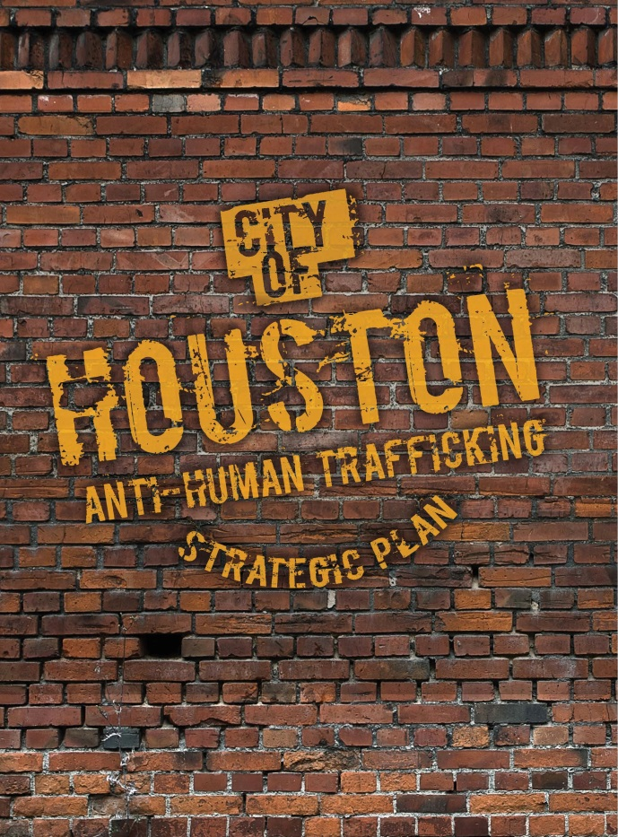
City of Houston’s Strategic Plan
5th Objective: Serve as the National Model for Municipal Response
Strategy: Build capacity of partner cities through free downloadable Strategic Plan and toolkits available at:
  www.humantraffickinghouston.org.
  Short registration form is required, allows City to track impact of its resources.
  6 initiative-specific toolkits available.
  Contain resources that can be modified by users to support their organization’s branding efforts.
  Generic files without our logos for your use.
  Word, Publisher, PDF files.
  Select files require InDesign.

Slide 19
City of Houston’s Strategic Plan
5th Objective – Preview of Available Toolkits
Massage Establishment Ordinance
  Learn what is involved in amending the ordinance. Contains documents City used to amend its ordinance.
Taxi Industry Initiative
  Use the included e-mail and text message templates to start your own partnership with a local transportation company. Templates can be modified.
Palm Cards
  Grow your direct outreach efforts with 3 sets of palm-sized cards translated into five non-English languages. Content can be edited using InDesign.
Municipal Jail Sign
  Reach out to victims who may happen to be caught in the criminal justice system. The sign can be hung over jail phone banks. Content can be edited using InDesign.
Media Campaign
  Raise awareness in your city with multi-modal Watch for Traffick PSAs.
Task Force
  NGOs and govt. representatives can used included documents to build their own task force from the ground up.

Slide 20
City of Houston’s Strategic Plan
Reach of Plan and Toolkit Downloads as of April 17th, 2017

Slide 21
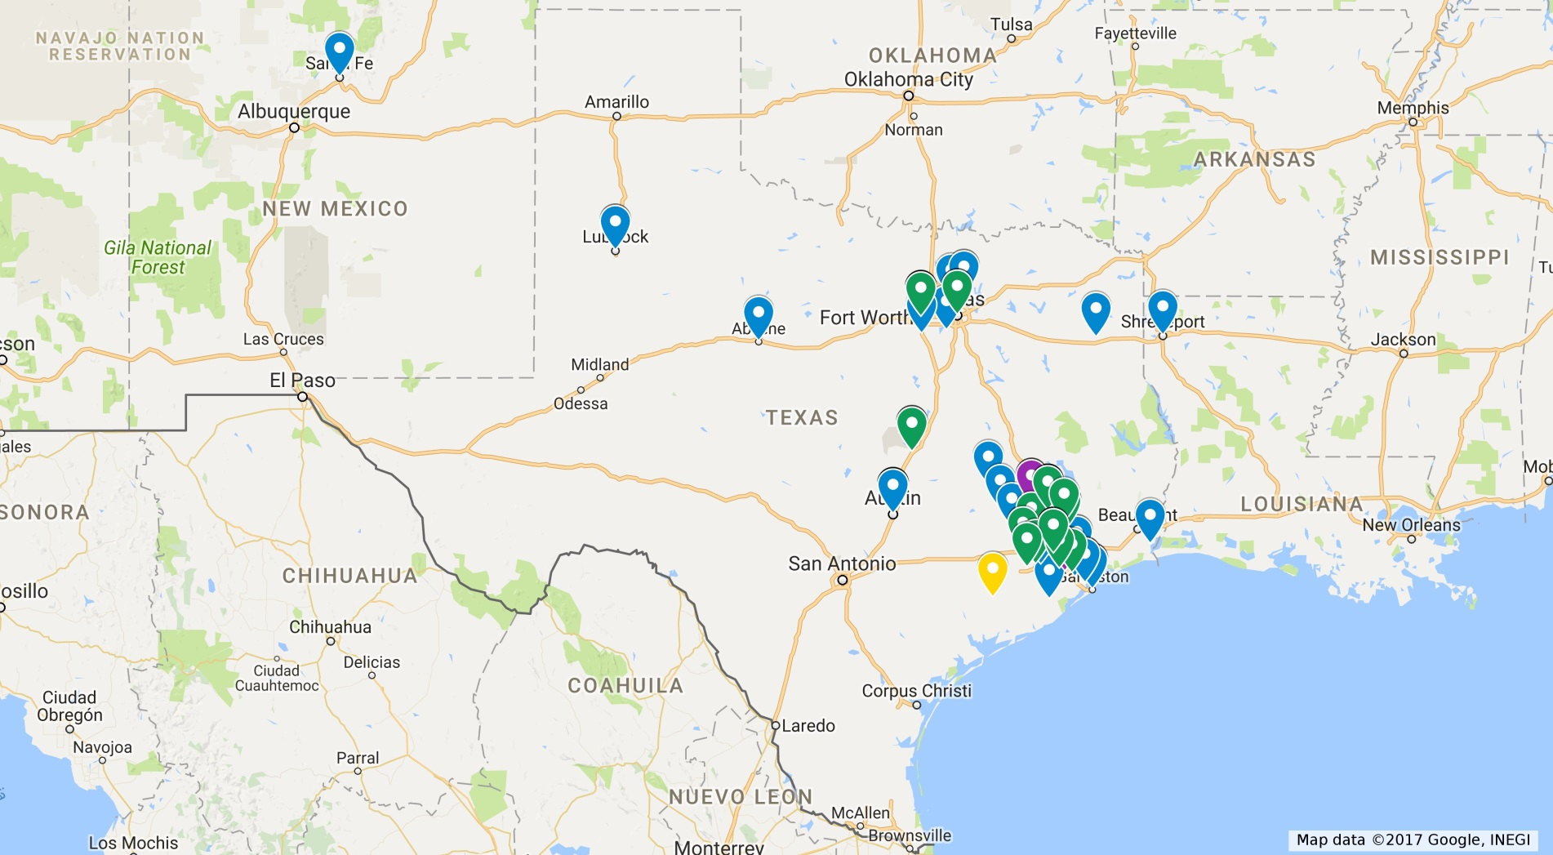
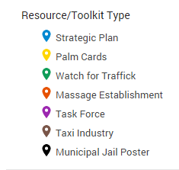
City of Houston’s Strategic Plan
Reach of Plan and Toolkit Downloads as of April 17th, 2017
Texas (by city)
Total Number of Downloads: 314 downloads in 44 cities

Slide 22
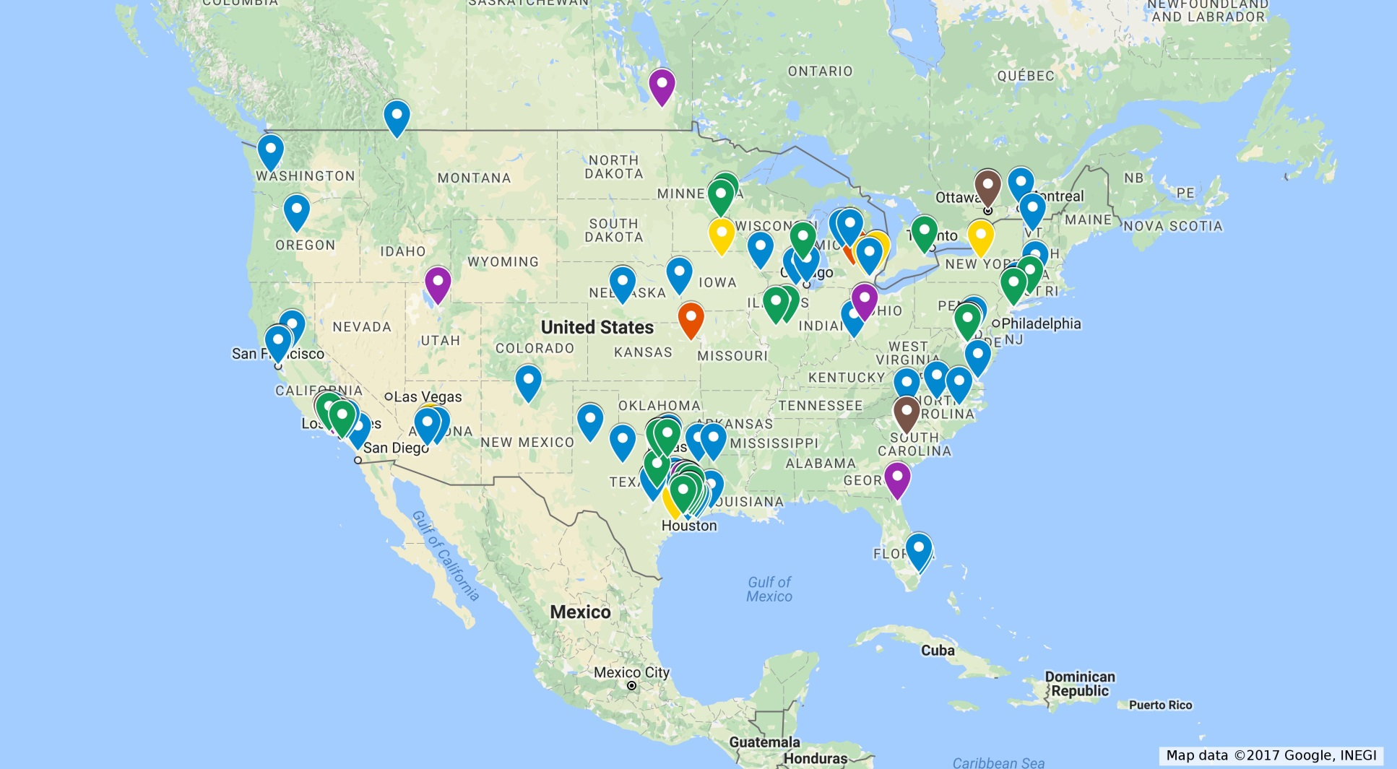
City of Houston’s Strategic Plan
Reach of Plan and Toolkit Downloads as of April 17th, 2017
U.S. and Canada (by city)
Total Number of Downloads: U.S. (states outside Texas): 95 downloads in 26 states; Canada: 6 downloads

Slide 23
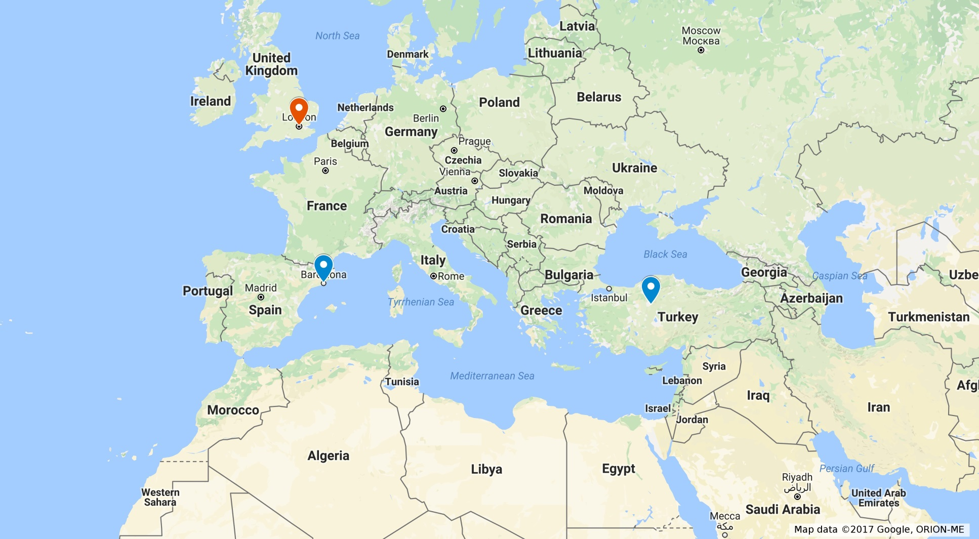
City of Houston’s Strategic Plan
Reach of Plan and Toolkit Downloads as of April 17th, 2017
International (by city)
Total Number of Downloads: 3 downloads in 3 countries

Slide 24
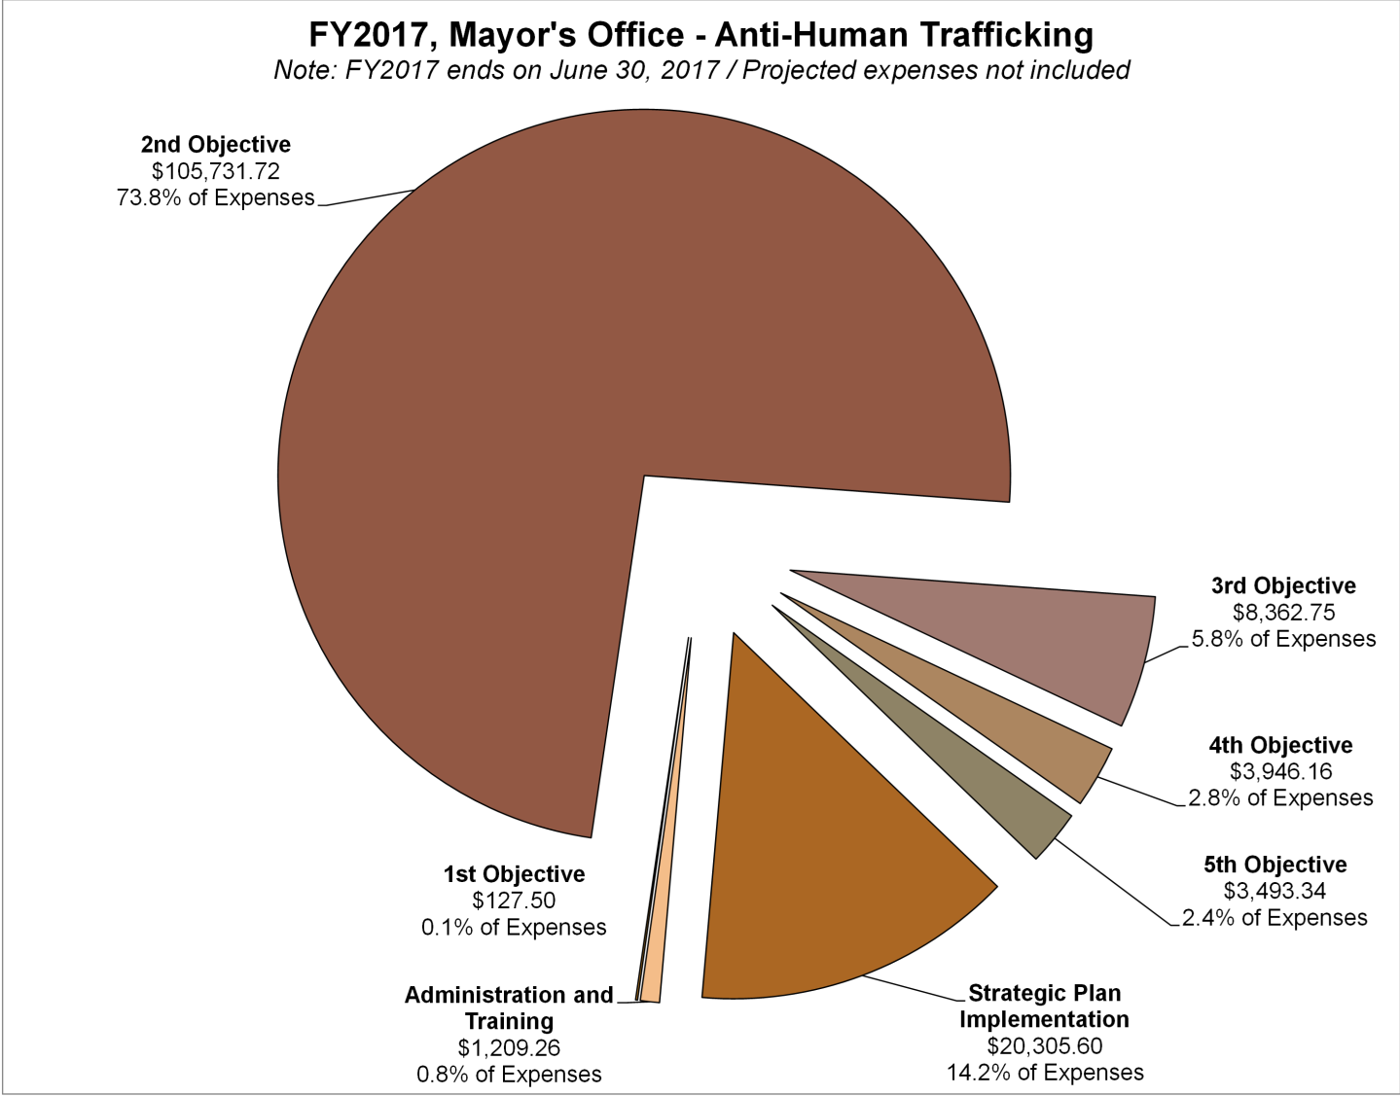
City of Houston’s Strategic Plan
Financial Snapshot - Expenditures
Mayor’s Office Resources
$50,000
Grants and Private Support
$112,000
Total
$162,000
Expenditures
$143,176.33
Remaining in FY2017
$18,823.67

Slide 25
City of Houston’s
Anti-Human Trafficking Strategic Plan
Presented by:
Minal Patel Davis
Special Advisor to the Mayor on Human Trafficking
Office of Mayor Sylvester Turner
Office: (832) 393-0977
Cell: (832) 596-9965
E-Mail: Minal.Davis@houstontx.gov
Website: HumanTraffickingHouston.org

