Slide 1




Harris County/City of Houston
Joint Processing Center
Public Safety/Homeland Security Committee
June 2017
1

Slide 2
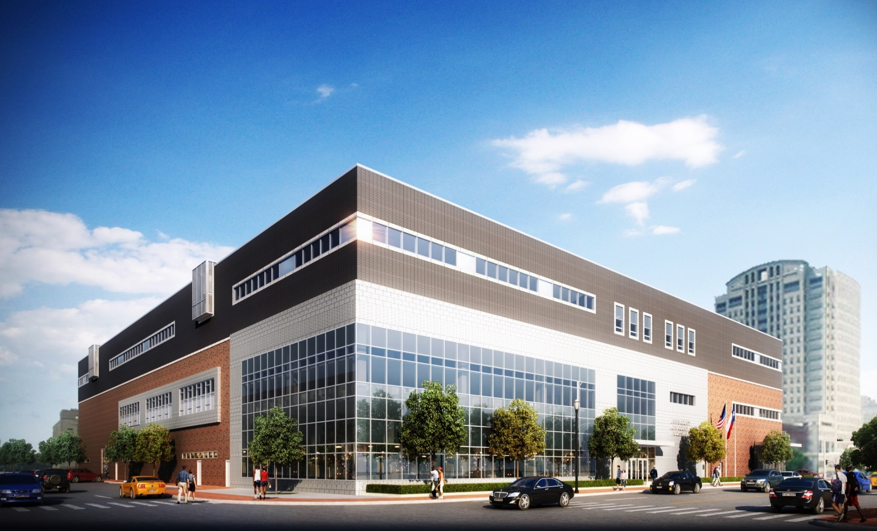
Harris County/City of Houston
Joint Processing Center
2
Notes:
Future JPC Building – History of the project – Major Summerlin
Key Points:
Five (5) Open Waiting/Processing areas
Short-term Assessment Center and Workforce Housing to include Video Visitation
Front-Door Diversion Workspace
Intake Health Screening, Receiving, Property processing and storage
Pre-release staging, Booking, Prints, Classification and Dress-out
Re-entry Program Area
Large Law Enforcement sally port with a capacity of 50 vehicles
HPD (Houston Police Department) work areas, interview rooms, administrative area

Slide 3


JPC Project – overview and status
Project Architect: PGAL
Programming/Consulting Firm: Pulitzer/Bogard & Associates
Construction Firm: Clark Construction and Horizon Group Int.
The JPC was designed using the Open Booking and Direct Supervision concepts to create a more normative environment, enhance prisoner safety, and improve operational efficiencies.
  The JPC Operational and Financial Agreement was signed by the Harris County Sheriff, Houston Chief of Police, and Houston Municipal Judge in October 2015.
The JPC construction budget is approximately $78.9 million.
3
Notes:
JPC Project Overview – Major Summerlin
Project Architect – PGAL
Programming/Consulting Firm – Pultizer/Bogard & Associates
Construction Firm – Clark Construction and Horizon Group International

Slide 4
Current Timelines
The project is current on schedule and on budget. These are conservative estimates.
In March 2018, construction will be finished and punch list completed. The building is turned over to HCSO.
In April 2018, the building will be certified by state and local regulatory authorities and opened for processing all county inmates. HPD county Inmates will begin transition to direct booking at the JPC.
In June 2018, all HPD inmates will be received at the new facility.
4
Notes:
Processing Flows – Major Summerlin

Slide 5
Financial Summary
The City will pay 30% of the capital cost, expected to be $30 million. (Design, Construction, FFE, Software, Land)
The City will make monthly operating payments:
City’s estimated annual payments in the initial year = $14 million (based on 2015 cost estimates and 17,000 municipal prisoners)
City’s payments will be based on the County’s actual cost with an adjustment based on the actual number of municipal prisoners brought to the facility.
The City will pay a portion of the actual start-up (primarily hiring and training) costs incurred by the County up to a maximum of $1 million.
5

Slide 6
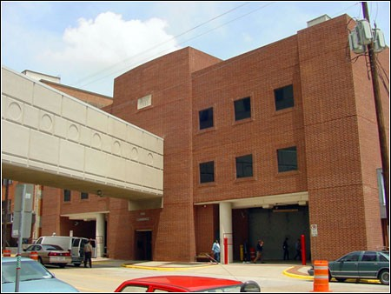
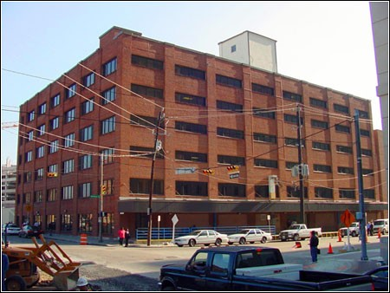
REPLACE old, undersized
Harris County FACILITIES
IPC
1201 Commerce Street
Central Records
49 San Jacinto
6
Notes:
Replace old undersized Harris County facilities – Major Summerlin

Slide 7
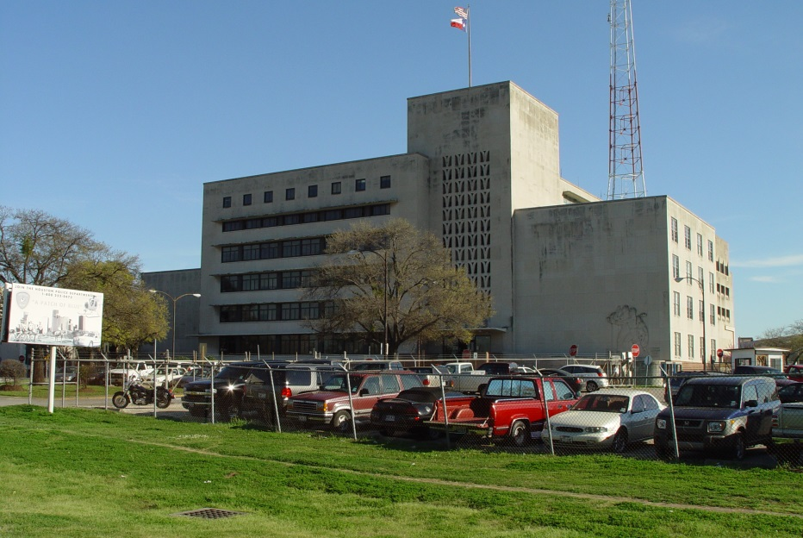
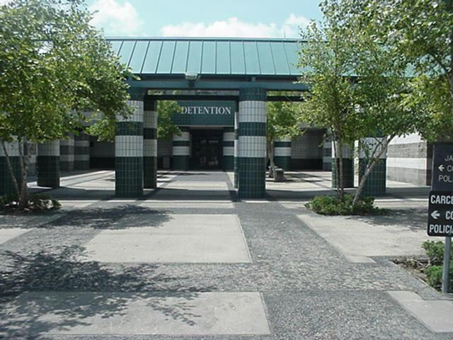
Houston police department
CLOSE city jail facilities
Central Jail
61 Riesner St. Built 1950
Southeast Jail
8300 Mykawa Rd. Built 1992
7
Notes:
Closing City Jail facilities – Major Dougherty

Slide 8
  Eliminate existing duplication of jail services by consolidating all City of Houston (COH) and Harris County prisoner processing operations into one modern facility
  Allow the COH to close its jails, saving taxpayers $3 million or more annually
  Allow the COH to redeploy 100 Houston Police Officers from city jail operations to local law enforcement duties
8
Notes:
Major Dougherty
Eliminate existing duplication of jail services by consolidating City of Houston and Harris County prisoner processing operations
Allow City of Houston to close its jails, saving taxpayers $4 million annually
City of Houston will be able to redeploy 100 peace officers to other local law enforcement duties.

Slide 9
JPC space program
Location: 700 North San Jacinto St, Houston, Texas
Size: 240,000 gross square feet and will consist of a basement level and three floors.
Secure Tunnel Connection to existing Harris County Jail Facilities and Courts
High-volume Prisoner Processing with a total design capacity of 1,520 detainees
Includes Diversion, Re-entry and Outreach Space
Intake Medical / Mental Health Clinic
552 Short-term Assessment beds.
9
Notes:
JPC Space Program – Major Summerlin
Location – Downtown Houston adjacent to our current jail facilities
Size – 240,000 gross square feet
Secure tunnel connection to existing Harris County jails and courts
High-volume prisoner processing with a capacity of 1,520 detainees
Space for diversion, re-entry and outreach programs
Intake medical and mental health clinic
552 short-term assessment beds

Slide 10
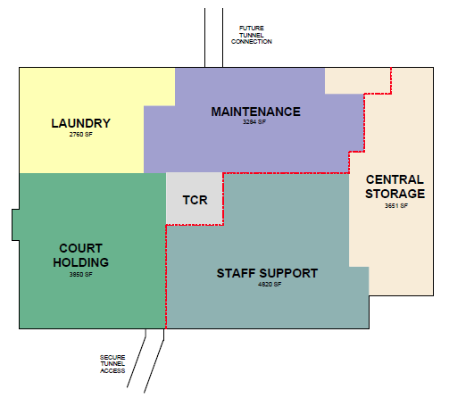
BASEMENT
Dedicated employee entrance
Staff lockers
Training Classroom
Maintenance Workshop
Central Storage
Laundry
Court holdover cells
Tunnel Control Center
10

Slide 11
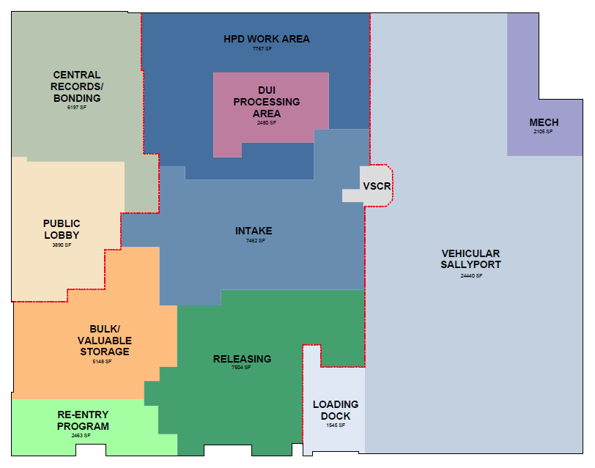
FIRST FLOOR
Sally port (50 vehicles) Sally port Control Center
HPD Work Area Intake Area / Health Screening
Valuable and Bulk Property Storage Public Lobby
Evidence Rooms Central Records
County/City Bonding Releasing, Dress-Out
Re-entry Services DUI Processing
11

Slide 12
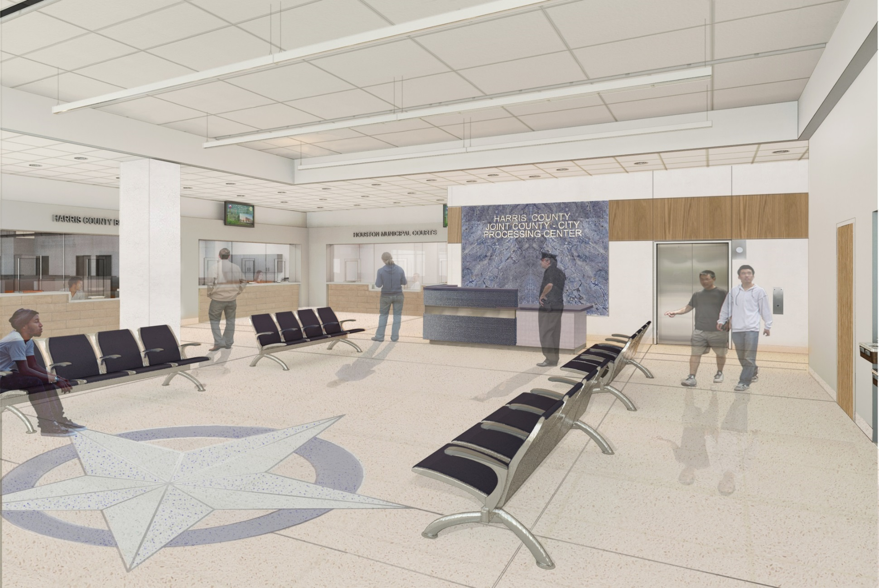
Main Lobby - Bonding Windows
12
Notes:
Main Lobby – County and City Bonding Windows – Major Dougherty
Public will be able to post bonds/pay fines for Harris County and City of Houston charges

Slide 13
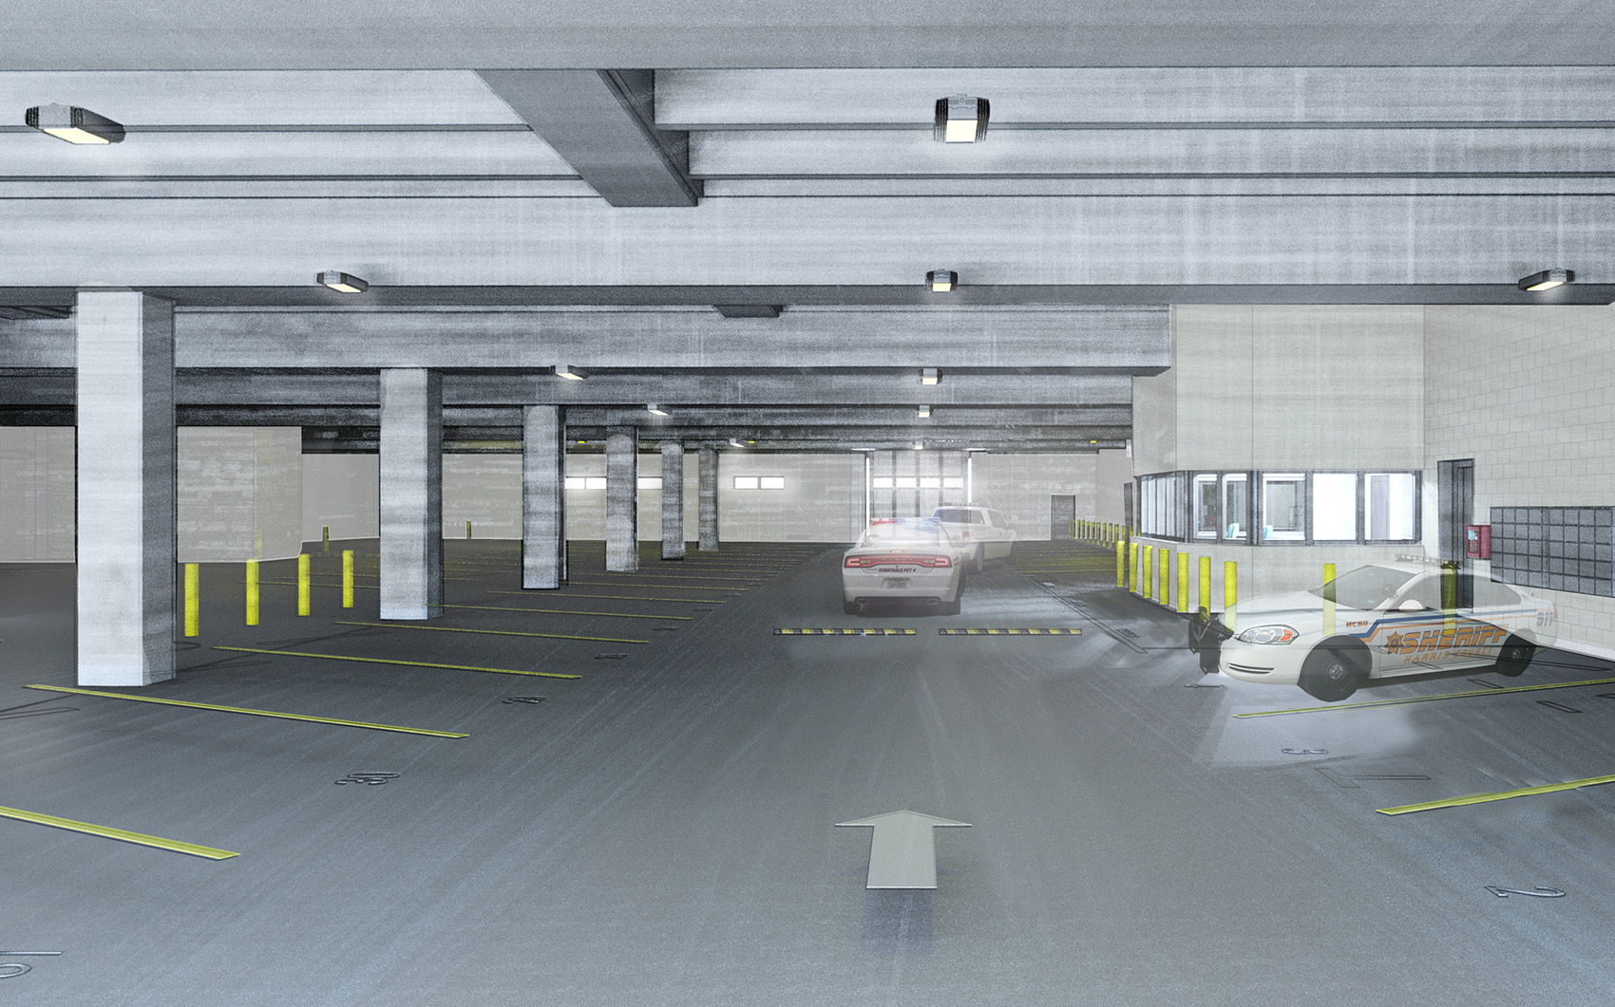
Officer Sally Port
13
Notes:
Sally Port – Major Dougherty
Capacity for 50 vehicles

Slide 14
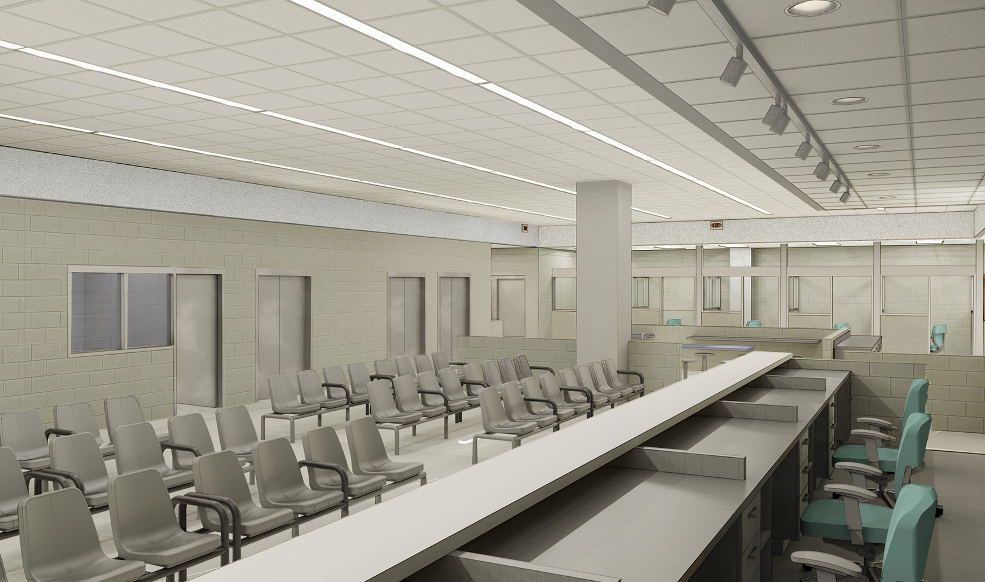
Intake Area
14
Notes:
Intake Area – Major Dougherty

Slide 15
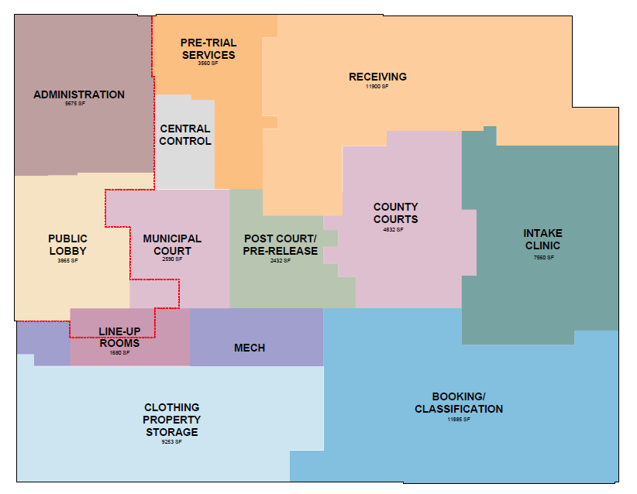
SECOND FLOOR
Public Lobby
HCSO Administrative Area
Central Control Center
Two (2) Line-up Rooms
Public Video Visitation Kiosks
Dress-In; Clothing Storage
Court Rooms
AFIS
Secure Holding cells
Intake Medical / Mental Health Clinic
Receiving, Booking, Classification and Pre-Release Staging - Open Seating/Processing Areas
15

Slide 16
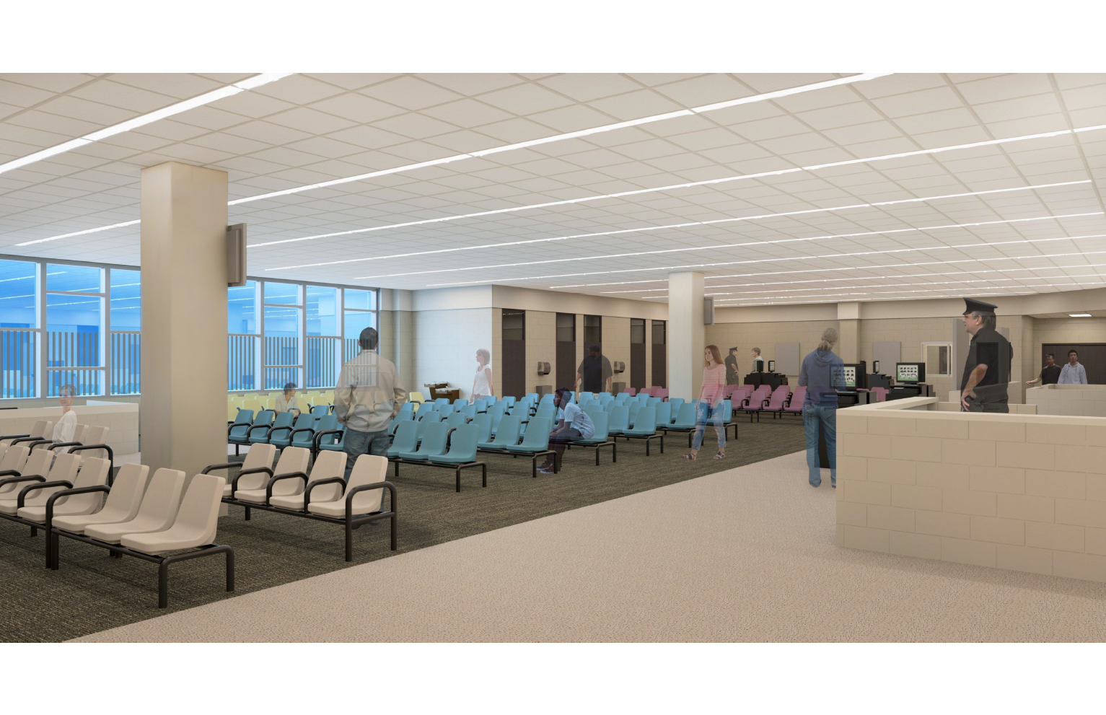
Open Receiving Area – Similar to Airport Seating
Prisoners under the direct supervision of HCSO Officers
16
Notes:
Open Receiving Area – Major Summerlin
Similar to Airport Seating
Prisoners under the direct supervision of Harris County Officers
Direct Sunlight

Slide 17
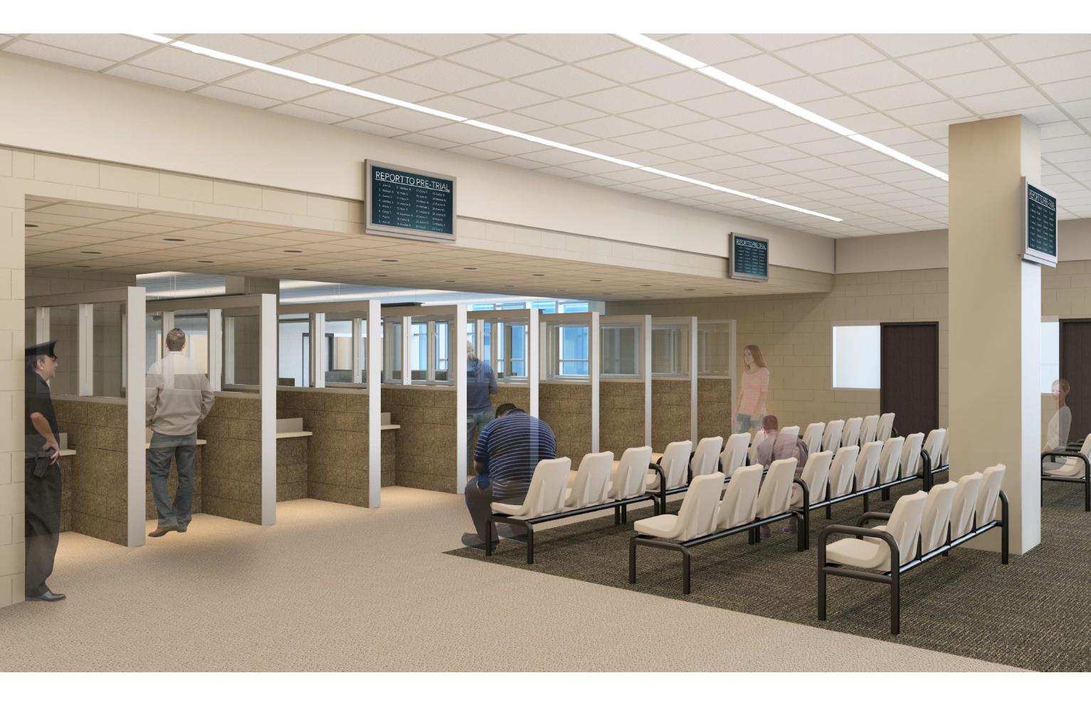
Receiving Area
Pretrial Services Interview Stations
17
Notes:
Receiving Area – Major Summerlin
Ten Pretrial Interview stations

Slide 18
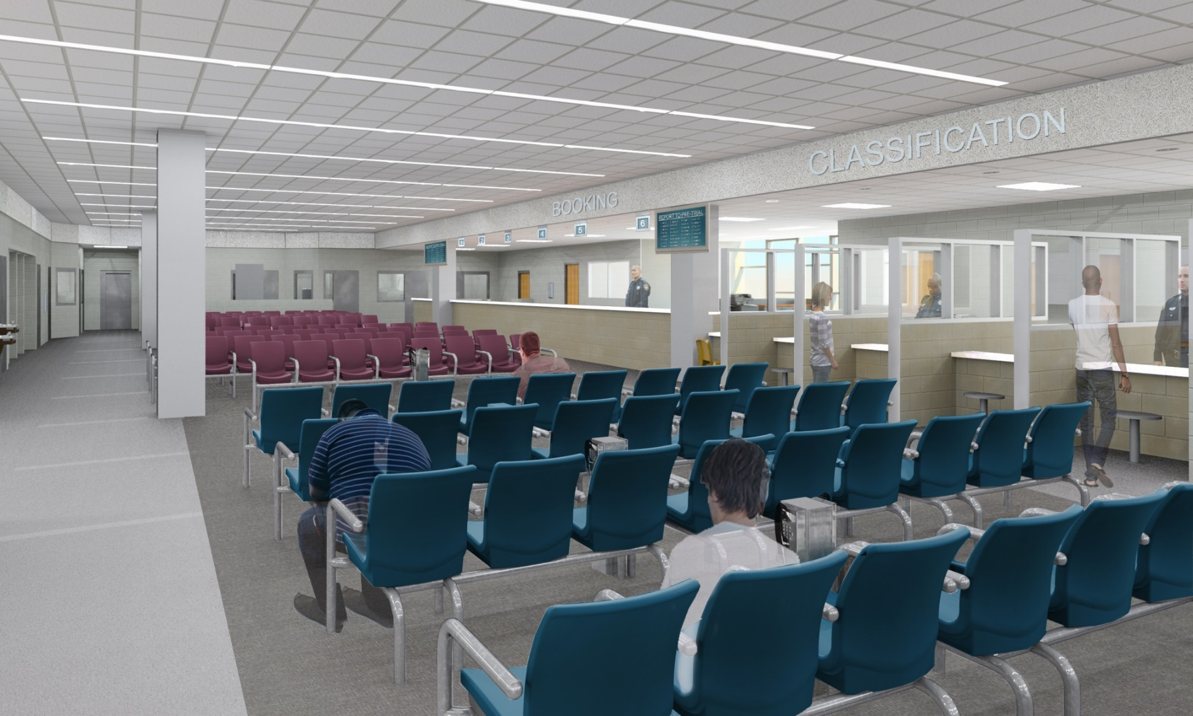
Open Booking/Classification Area
18
Notes:
Open Booking/Classification – Major Summerlin

Slide 19
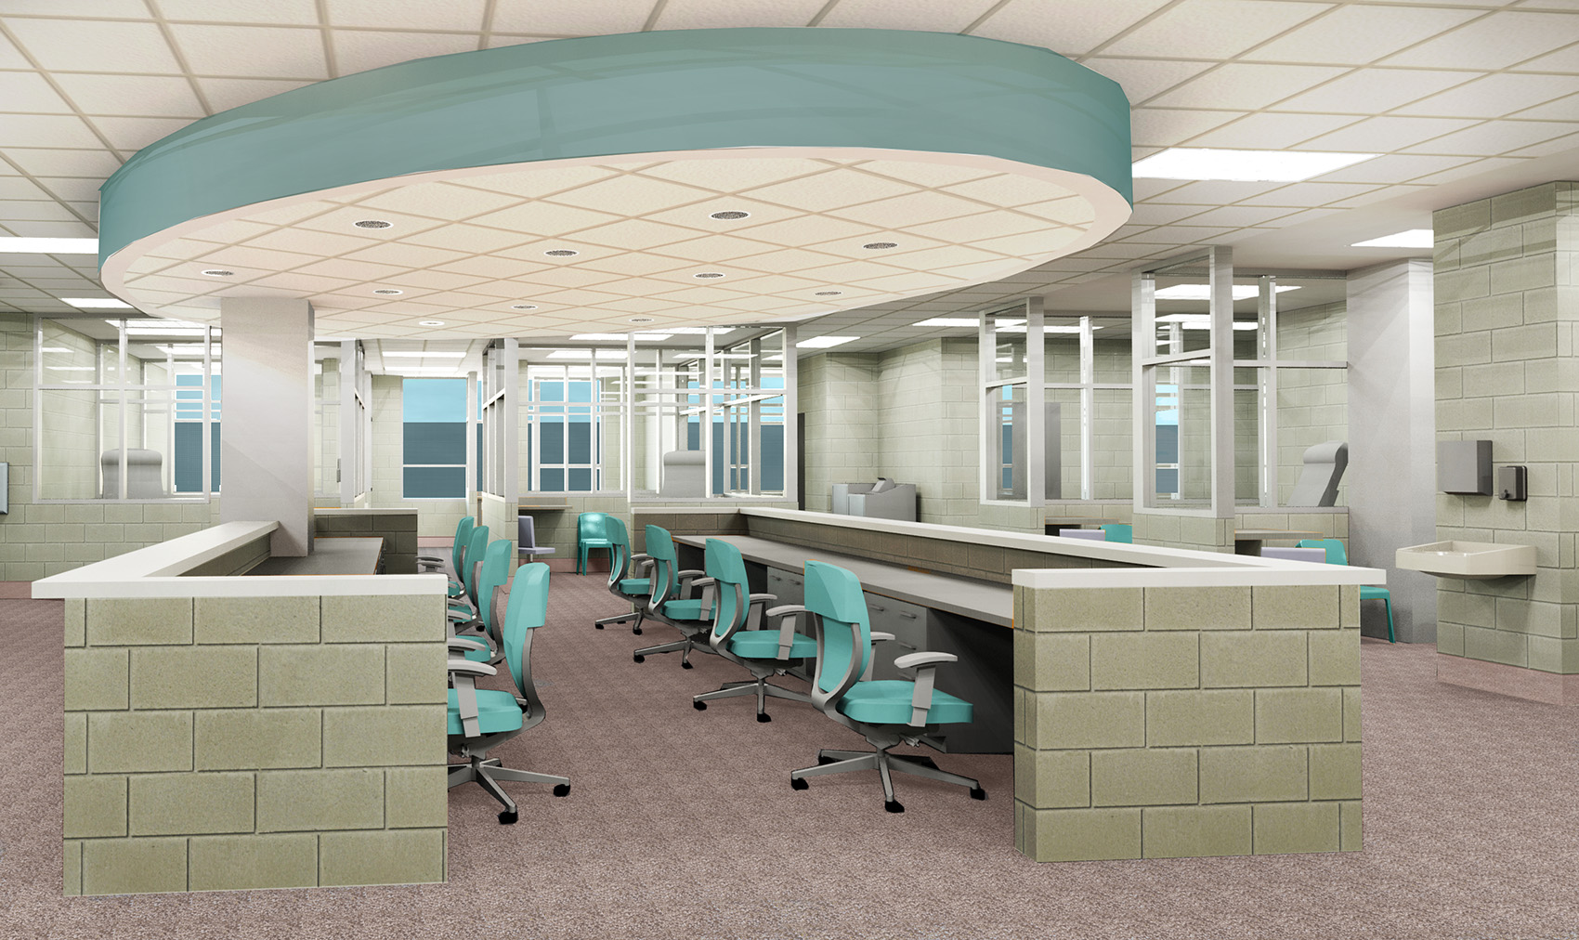
Clinic Area-Nurses Station
19
Notes:
Clinic Nurses Station – Major Summerlin

Slide 20
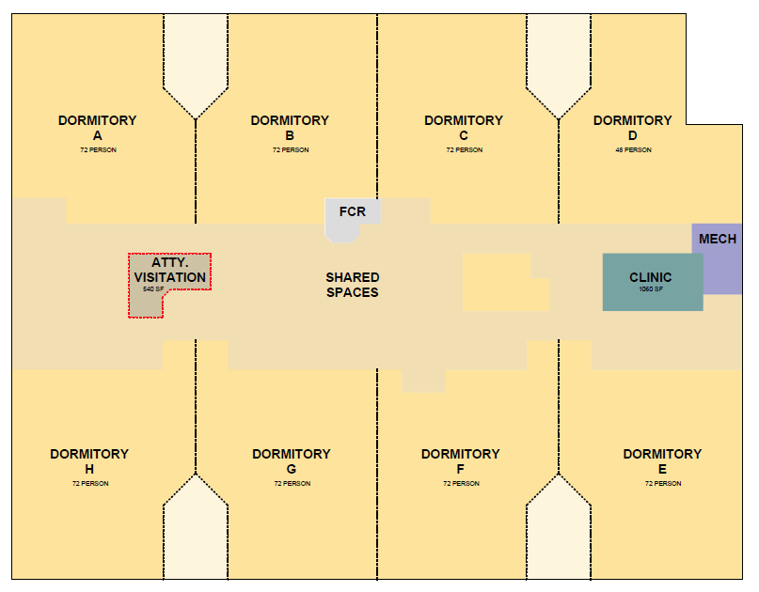
THIRD FLOOR
Housing:
Eight (8) Direct Supervision Cellblocks,
552 beds
Floor Control Center
Video Visitation
Attorney Booths
Recreation
Chaplain and Re-entry
Classification
Commissary Storage
Miscellaneous Support Function
20

Slide 21
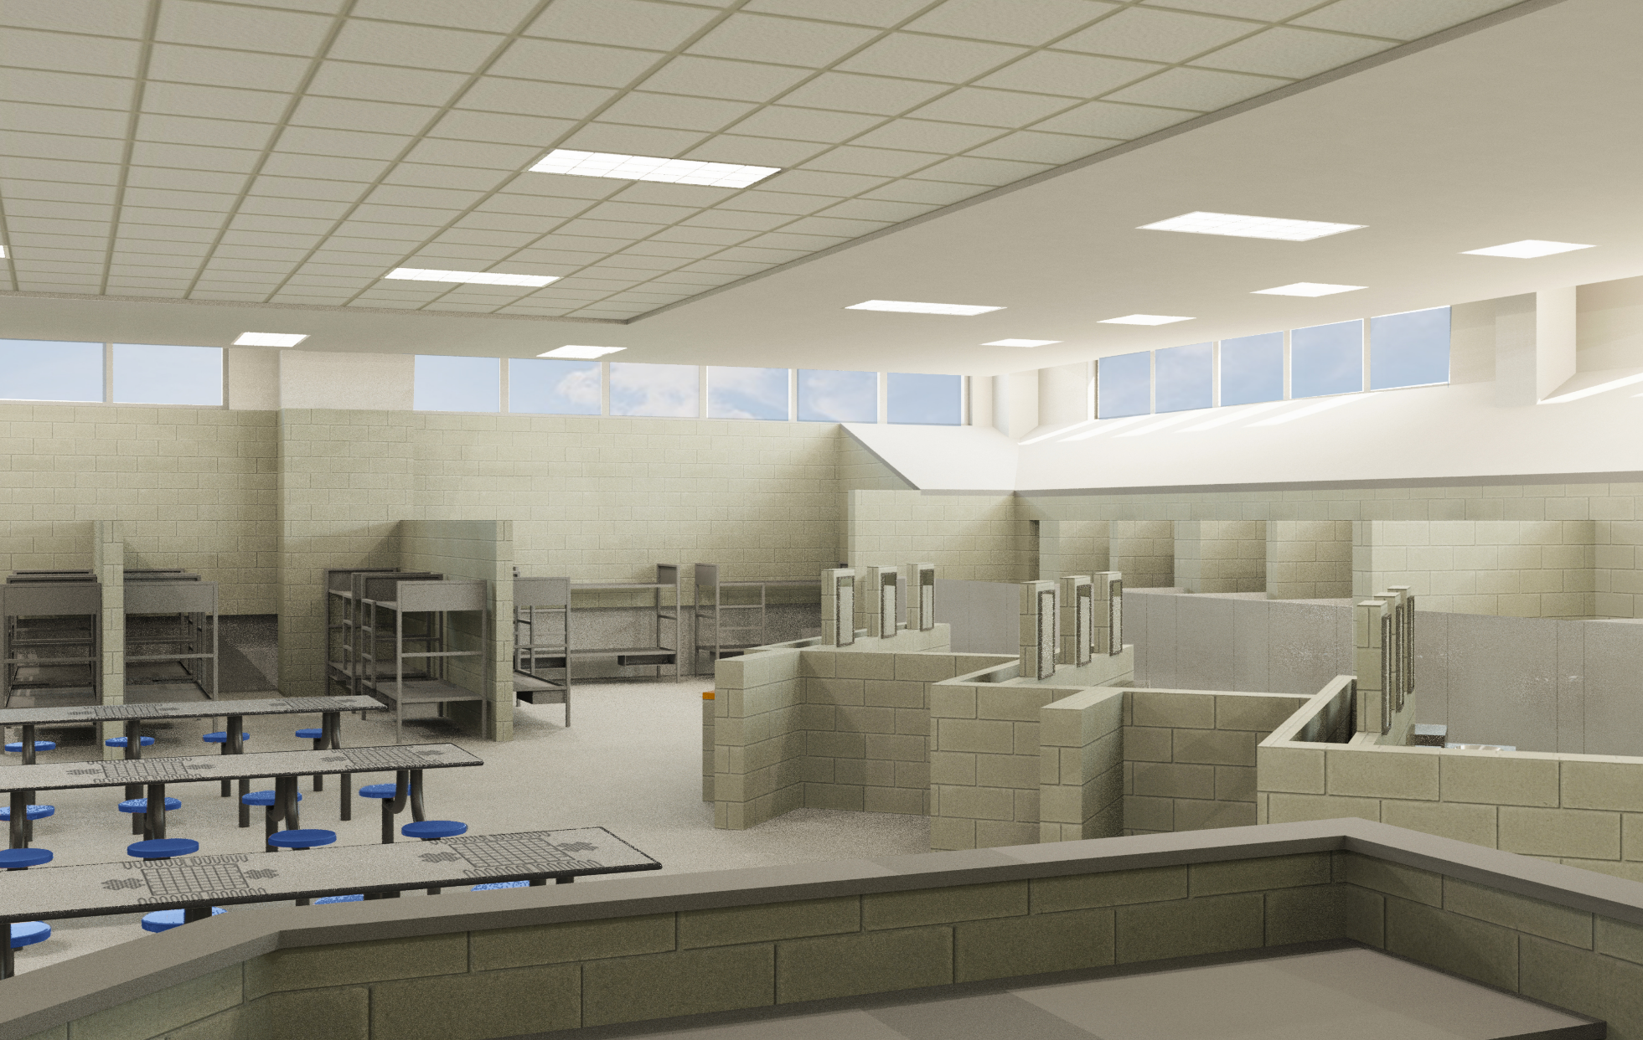
Housing Area
Direct Supervision of HCSO Officers
21
Notes:
Housing Area – Major Summerlin

Slide 22
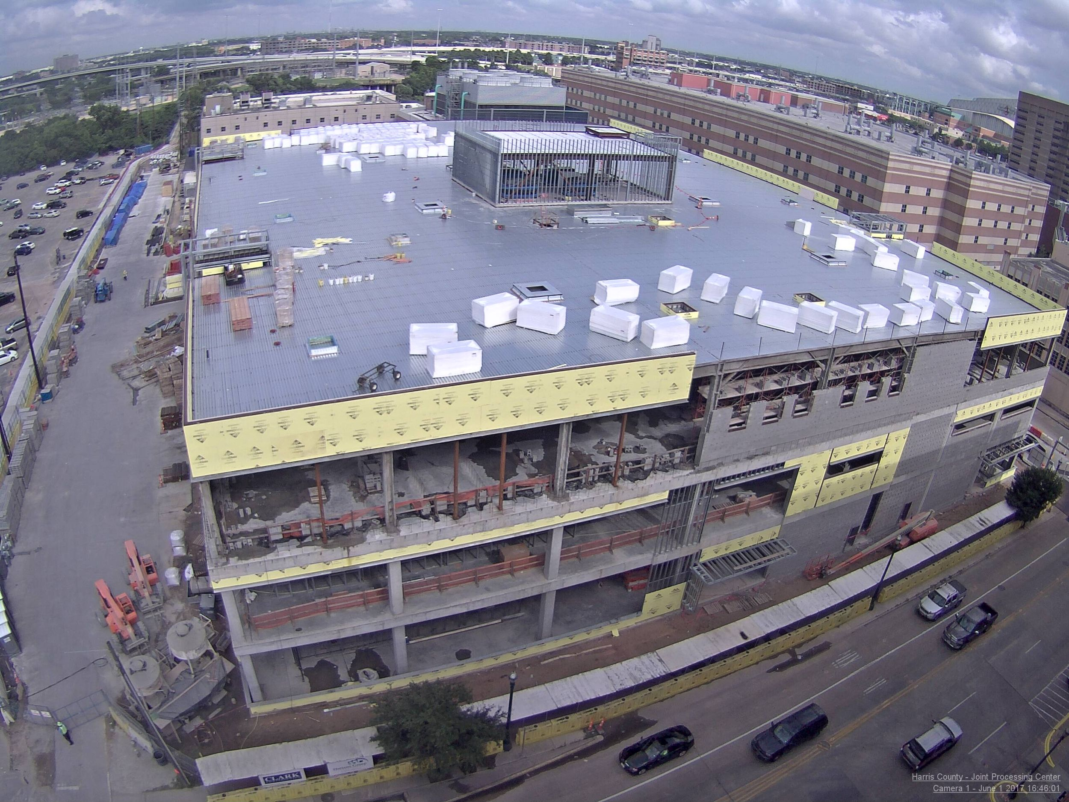
22

Slide 23
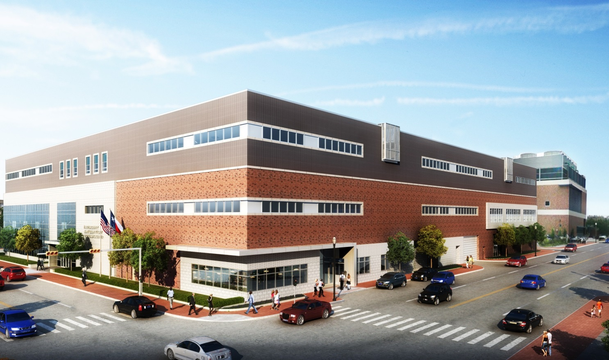
JOINT PROCESSING CENTER
700 N. San Jacinto, Houston TX 77002
23

Slide 24

Questions?
Contact Information
Major Greg Summerlin
Email: Gregory.Summerlin@Sheriff.hctx.net
Phone: 713-274-4754
Major Patrick Dougherty
Email: Patrick.Dougherty@Sheriff.hctx.net
Phone: 713-755-8411
24

