Slide 1
The Fentanyl Threat and Changes to the Drug Testing Policy
H.P.D. Narcotics Division
August 8, 2017

Slide 2
Why are we talking about this ?
Notes:
News head lines

Slide 3

Ohio exposure
Notes:
Why did suspects not od, but officer did?. Tolerance level. Imagine giving 2 beers to kid that never had beer, how would he react? How many beers would it take for alcoholic before they feel the effect. We are not accustomed to opioids.

Slide 4
What is an opiate…
Types of Opiates (Natural)
  Heroin
  Morphine
  Codeine
  Opium
Types of Opioids (Synthetic)
  Fentanyl
  Carfentanyl
  OxyContin
  Hydrocodone
  Methadone
Notes:
Difference between opiates and opioids. (natural v synthetics)

Slide 5
Types of Opiates
Notes:
Pictures ofopiates

Slide 6
Types of Opioids
Notes:
Pictures of opioids

Slide 7
Fentanyl….the game changer
May 2017 Pasadena narcotics seized 8 kilos of fentanyl
July 2017 HPD seized 14 kilos of fentanyl
Canada seized 1 kilo of carfentanil
26 OD’S in Harris County 2016
100 grams is enough to supply all of the medical center
Notes:
Recent seizures and the relevance to toxicity.

Slide 8
Fentanyl
Fentanyl is an extremely potent Opioid
  50 to 300 times stronger than morphine
Fentanyl is cheap
  Cost between a hundred to a few thousand dollars to make and all ingredients can be bought from China
No field test available for Fentanyl
Now being used to lace multiple types of narcotics
Deaths from Fentanyl overdose is on the rise
Fentanyl is spreading across the country and is no longer just affecting the addicts!!!
Notes:
Strength of fentanyl.

Slide 9
FENTANYL ANALOGS
ANALOGS
Potency compared to Morphine
FENTANYL
ALFENTANIL
SUFENTANIL
LEFENTANIL
CARFENTANIL
OHMEFENTANIL
50 – 300
72
2400
7000
7000 – 10,000
20,000 – 50,000
Notes:
Various forms of fentanyl analogs. Carfentanil elephant tranqualizer

Slide 10
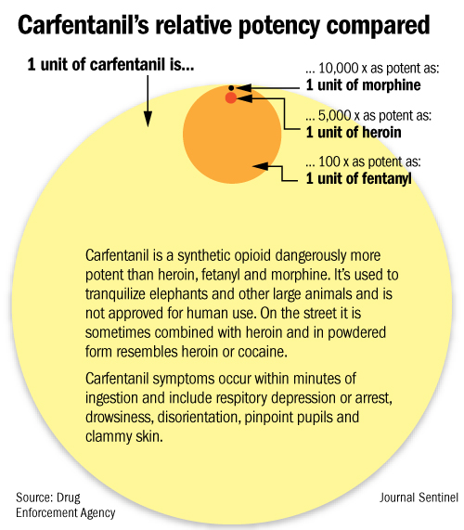
Potency
Notes:
Potency charts

Slide 11
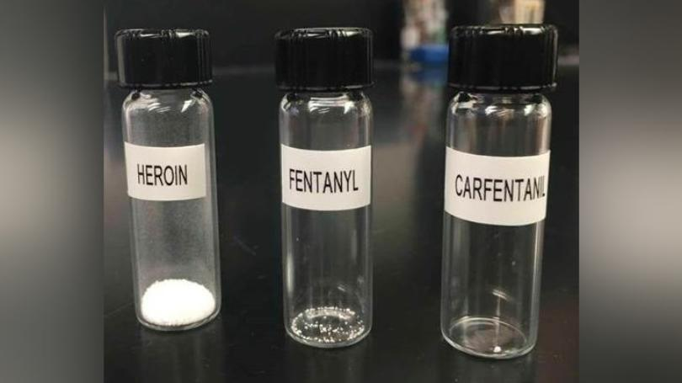
Lethal Amounts
Notes:
Picture of heroin, fentanyl and carfentanil. (carfentanil is much more then lethal dose. Lethal dose would not show in bottle)

Slide 12
Why do people take it?
Most don’t realize that they are taking fentanyl.
    Due to low cost, it is used as a cutting agent for heroin.
    It is used, along with filler compounds, to make fake hydrocodone and OxyContin pills.
Those that know they are taking Fentanyl do so because it offers the possibility of a “stronger high”
Fentanyl-related overdose deaths increased from 550 deaths in 2013 to more than 2,000 deaths in 2014 and 2015.
Notes:
Why do people take fentanyl?. Many are not aware that they are taking it.

Slide 13
We love stats…
According to the National Forensic Laboratory Information System (NFLIS), which does not
distinguish between pharmaceutical and illicitly manufactured fentanyl, there were nearly 5,400 reports of fentanyl lab submissions for 2014 and over 14,600 in 2015 by federal, state and local forensic laboratories in the United States. In the first six months of 2016, over 13,500 fentanyl seizures were identified by forensic
laboratories.
Notes:
Forensic lab results from 2014, 2015 and first 6 months of 2016

Slide 14
We love stats…
Of the 14,440 fentanyl reports identified in 2015, more than three-quarters were identified by laboratories in the Northeast (5,896 reports) and Midwest (5,253 reports). About one-fifth of fentanyl reports were identified by laboratories in the South (3,013 reports). Few fentanyl reports were identified by laboratories in the West (278 reports).
Notes:
.Northeast and midwest had most reports. Few reports so far from west

Slide 15
We love stats…
By 2006, the number of States reporting fentanyl seizures more than doubled to 37, and by 2011, the number increased to 43.
By 2015, all but one
state reported analyzing fentanyl
Notes:
Fentanyl lab reports 2001 compared to 2015

Slide 16
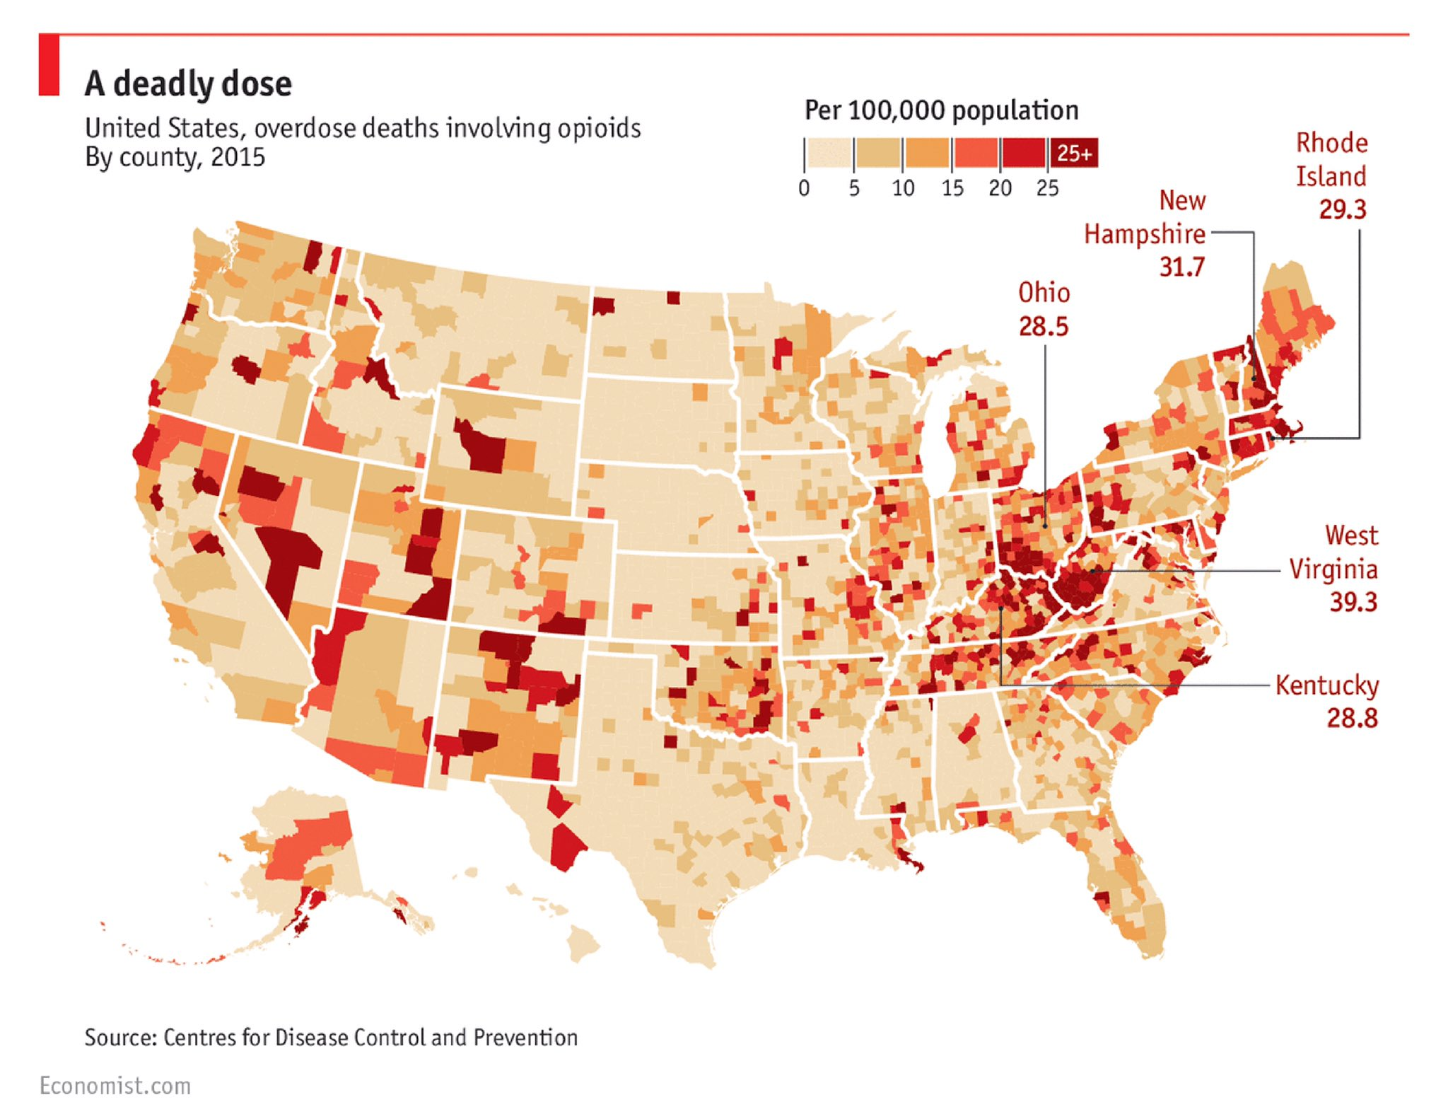
Notes:
Opioids deaths in 2015. Note that some states appear to have none or little. East coast and west coast many od, and blue color areas such as W Virginia. Blue color jobs where patients were prescribed medicine by doctors, made into addicts and then taken off.

Slide 17
What does Fentanyl look like?
Notes:
Picture to lead to fentanyl slide

Slide 18
Fentanyl
Notes:
Pictures of legal and illegal fentanyl

Slide 19
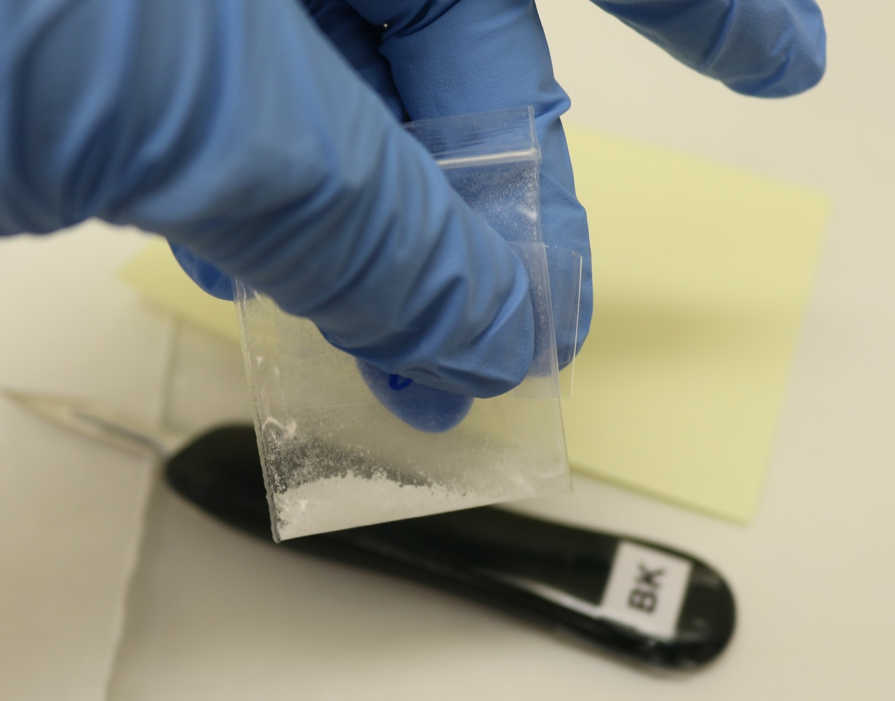
What about carfentanil?
Notes:
Carfentanil recovered in HPD case. Officer responded to OD call. Patient transported, FTP for meth and officer filed to-be. Point 8 grms, enough to kill 4000 non addicts.

Slide 20
Why is fentanyl not leaving?
Cost of heroin production
  Need field and farmer (90% from Afghanistan)
  Shipping, processing
  $50,000 per kilo
Cost of Fentanyl
  Individual components can be had under $400
  $1 per gram from China (1 Kilo is $1000)
Notes:
Why synthetics are here to stay. Its cheaper then heroin.

Slide 21
“Market Value”
Let’s say Fentanyl produces 1 million addict user units…
  Cost of product
  Cost of press
  Cost of binder
  Now how about Carfentanil?
Hardcore addicts buy heroin to see product.
Since Fentanyl is 100X more potent then heroin, when used as cutting agent, 1 kilo of heroin could potentially become 100 kilos.
Notes:
Why do addicts buy heroin? They want to see what they buy. Most addicts want a high not die. They know that pure fentanyl is hard to manage and kills.

Slide 22
Symptoms of a Fentanyl exposure
Confusion.
Dizziness.
Difficulty thinking, speaking, or walking.
Pale face.
Blue- or purple-colored lips, fingernails, or extremities.
Throwing up.
Choking sounds.
Pinpoint pupils Seizures.
Notes:
Fentanyl exposure symptoms.

Slide 23
Symptoms of a Fentanyl exposure
Slowed heart rate.
Excessive drowsiness.
Frequent fainting spells (nodding off).
Limp body.
Unresponsive.
Coma.
Difficulty breathing.
Hypoventilation (slow, shallow breathing).
Respiratory arrest.
Notes:
Symptoms continued

Slide 24
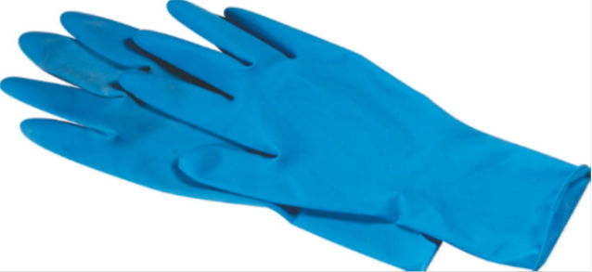
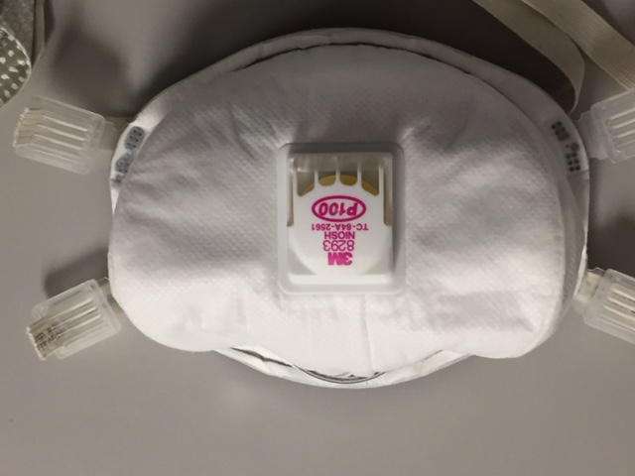
Be Safe
Do not wear latex gloves when handling evidence, always wear nitrile gloves (double glove in case of glove breakage)
Wear a tight fitting mask/respirator that is rated P100 or N100.
Notes:
How can we protect ourselves. P100 or N100 masks department is buying. Nitrile gloves being purchased as well.

Slide 25
BE SAFE
Wear goggles or glasses
Wear long sleeves or preferably a water resistant jacket or disposable coveralls to protect your arms.
Notes:
Wear goggles collecting evidence when possible. Long sleeves.

Slide 26
Accidental Exposure
Wash with water and soap immediately.
Pay attention to the washing process in order to prevent scratches to yourself and creating a break in the skin.
If on clothes, remove clothes and wash. Do not shake out.
Do not use hand sanitizers, they may contain alcohol which increases skin absorption.
Notes:
If on skin or on clothes. Was with water and soap. Take off shirt and wash. Do not use hand sanitizers.

Slide 27
Now what about the new policy change with the DA’s office
Narcotic Processing Procedure.docx
Notes:
Field for department

Slide 28
New Procedures
Color: describe the color and is it consistent with past experience of officer
Texture: describe the texture and is it consistent with past experience of officer
Packaging: is it the type known to be used in drug trafficking and by drug users
Paraphernalia: Presence of drug paraphernalia with the contraband
Statements: Incriminating or identifying statements by the defendant or witnesses as to the identification of the contraband
Location of Contraband: in a defendant’s actual possession vs. hidden location
Odors: Odors in immediate vicinity of the contraband, chemical or plant (do not smell the substance)
Furtive Movements: defendant made furtive movements
Demeanor: nervousness of the defendant
Notes:
Pc statement for filing charges

Slide 29
New Procedures
High Crime/Narcotics Area: area where arrest was made is a high crime area known for narcotics use
Officer’s Prior PCS Arrests: Prior arrests for PCS by the arresting officer in which (s)he made identifications of contraband which were confirmed by a lab
Prior Arrests/Convictions: prior arrests/convictions of the Defendant for possession or delivery of a controlled substance.
Drug Identification Booklet: Referenced by the Drug Identification Booklet approved by the Houston Forensic Science Center (available on the portal)
Training & Experience: Arresting officer’s experience, training, and expertise
Second Officer Opinion: Opinion of second officer (mandatory requirement before arrest)
NOCC Officer Opinion: Opinion of NOCC intake officer (mandatory when entering DIMS summary)

Slide 30
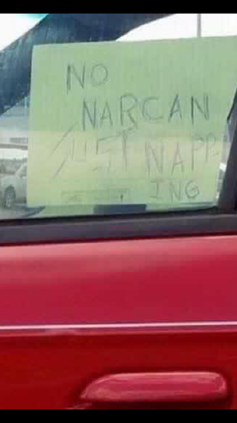
The Future
Department is looking at Naloxone (Narcan)
  Very temperature sensitive (59-77)
  Shelf life (about 18 months)
  Cost ($75 per two doses)
  When department obtains Narcan a class will be taught
  Have caution forms available to hand out.
Notes:
Narcan for department

