Slide 1
Houston Fire Department
Fleet, Equipment and Training needs

Slide 2
Purpose
To gain a better understanding of the readiness of the Fire Department fleet and its ability to respond to emergencies with trained and qualified personnel and a robust fleet that meets operational standards.
To identify necessary improvements and recommended actions for enhanced operational readiness

Slide 3
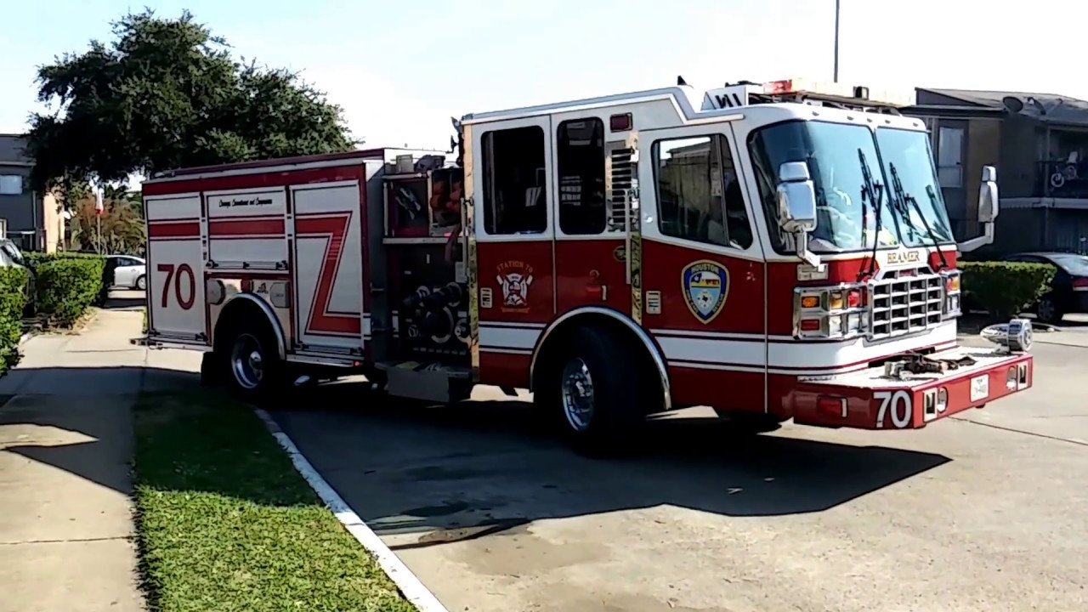
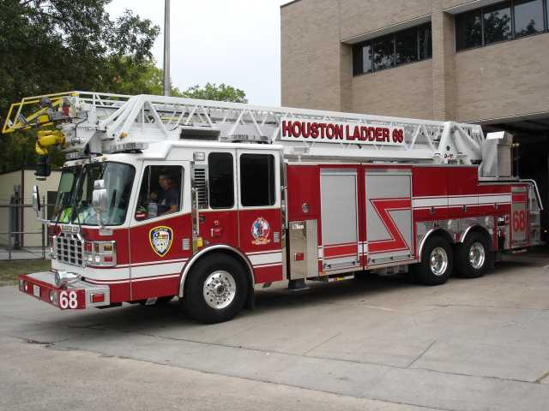
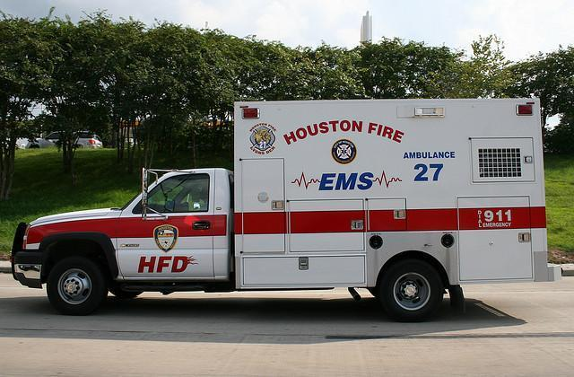
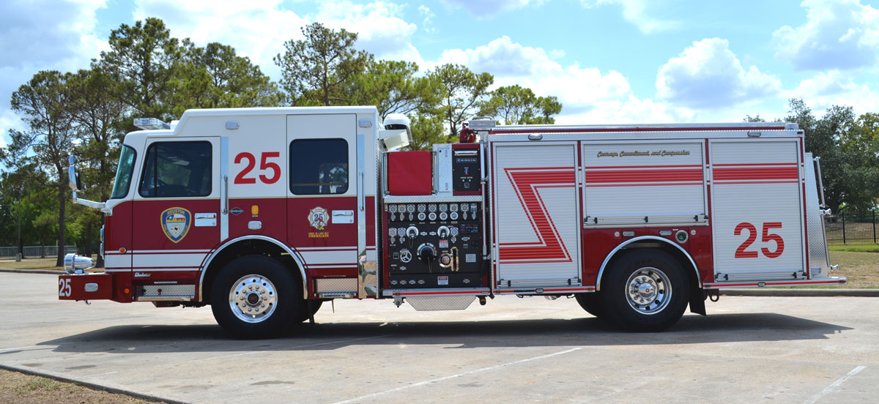
Fleet

Slide 4
Fire Apparatus Consensus Standards
National Fire Protection Association (NFPA) 1901
  Standard for Automotive Apparatus
NFPA 1911
  Standard for the Inspection, Maintenance, Testing, and Retirement of in-service Emergency Vehicles
NFPA 1914
  Standard for Testing Fire Department Aerial Devices
NFPA1917
  Standard for Automotive Ambulances
Fire Apparatus Manufacturers Association (FAMA)

Slide 5
NFPA 1911; Appendix D
…a fire apparatus is an emergency vehicle that must be relied on to transport fire fighters safely to and from an incident and to operate reliably and properly to support the mission of the fire department.
A piece of fire apparatus that breaks down at any time during an emergency operation not only compromises the success of the operation but might jeopardize the safety of the fire fighters relying on that apparatus to support their role in the operation.
An old, worn out, or poorly maintained fire apparatus has no role in providing emergency services to a community.

Slide 6
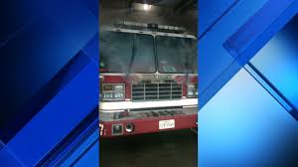
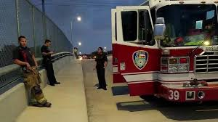
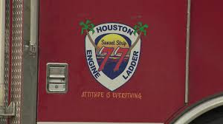
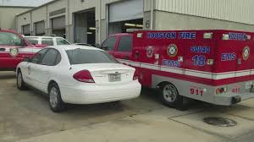
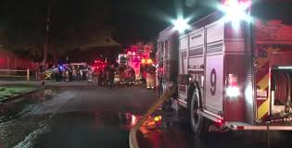

Slide 7
HFD Response Activity
Date Range | Fire Related Incidents | EMS Related Incidents | Total Count | % Year over Year Increase
Jan 1 – Dec 31, 2016 | 42,109 | 293,858 | 335,967 | ~.90%
Jan 1 – Dec 31, 2015 | 43,056 | 289,907 | 332,963 | ~4.5%
Jan 1 – Dec 31, 2014 | 41,747 | 276,880 | 318,627 | ~6.5%
Jan 1 – Dec 31, 2013 | 42,064 | 257,107 | 299,171

Slide 8
Fleet Composition - Frontline
Vehicle Type | Vehicle Count | Avg. Age | Recommend Replacement Age | % at or over Replacement Age | Min Staffing
Engines | 88 | 9 | 12 yrs | 26% | 352
Aerials | 38 | 9 | 15 yrs* | 8% | 152
Ambulances | 92 | 6 | 8 yrs ** | 48% | 184
* 37% within 2yrs of Replacement Age
** One Ambulance Engine & Transmission Replacement @ 4 years

Slide 9
Fleet Composition - Reserve
Vehicle Type | Vehicle Count | Avg. Age | Recommend Replacement Age | % at or over Replacement Age | % Availability
Engines | 24 | 17 | 18 yrs | 100% | ~15%
Aerials | 17 | 19 | 20 yrs | 100% | ~20%
Ambulances | 27 | 11 | 10 yrs | 100% | ~70%

Slide 10
Historical Purchase - Engines

Slide 11
Historical Purchase - Aerials

Slide 12
Historical CIP Requests- Engines

Slide 13
Historical CIP Requests - Aerials

Slide 14
Historical CIP Requests - Ambulances

Slide 15
Recommended Service Life Progression
Engines
Frontline
12 yrs
88 units
Ready Reserve
4 – 6 yrs
28 Units
Aerials
Frontline
15 yrs
38 Units
Ready Reserve
5 yrs
10 Units
Ambulances
Frontline
8 yrs*
105 Units
Ready Reserve
2 yrs
30 Units
*Engine and Transmission Change @ 4yr mark

Slide 16
Recommended Replacement Quantity
Vehicle Type | Annual Quantity | Annual Investment
Engines (~$516,000) | 9 | $4,644,000
Ladder/Tower (~$883,000) | 4 | $3,532,000
Ambulance (~$170,000) | 16 | $2,720,000
 |  | $10,896,000

Slide 17
Recommendation
In order to ensure that a full complement of apparatus is available to support the department’s current deployment plan, we recommend an aggressive apparatus replacement plan that acknowledges the high call volume and heavy demands placed on the apparatus.
New Apparatus should be budgeted for and procured on a consistent, ongoing basis. Replacement of apparatus should not be differed because of the strain that such actions place on the fleet.
Apparatus should not be rotated from high-volume to low-volume stations adhere to the replacement schedule outlined

Slide 18
SWIFTWATER RESCUE FACT SHEET
• An average of 200 Americans drown each year in flash flooding-more than in airline crashes or domestic terrorism. Flash flooding is the top weather-related killer, ahead of earthquakes, tornadoes, and hurricanes.
• The most common causes of drowning in swiftwater are cars crossing flooded roadways and being swept away, and children playing near flooded creeks. Many others are would-be citizen rescuers.
• An average of three professional rescuers drown each year while attempting a swiftwater rescue. Forty-five have died this way since 1983.
• In 1995 three firefighters died attempting swiftwater rescues, compared to fifteen who died during structural fires. There were also at least 8-10 "near misses". Considering the relatively small number of calls, swiftwater rescue is probably the most dangerous thing a firefighter can do.
Most rescuer deaths and near misses are preventable. They are almost always due to lack of knowledge about the special dangers of swiftwater, inappropriate personal protective equipment (i.e. turnouts instead of a PFD), and lack of proper equipment and training.
Ray, Slim. “Lessons Learned on Flood Management” CFS Press, 2002.

Slide 19
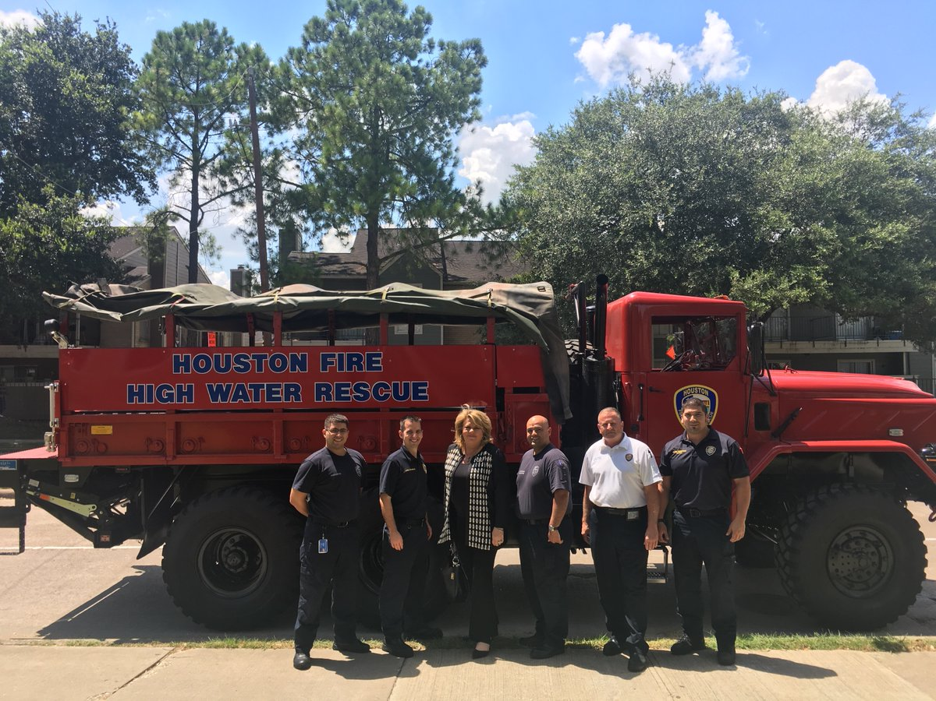
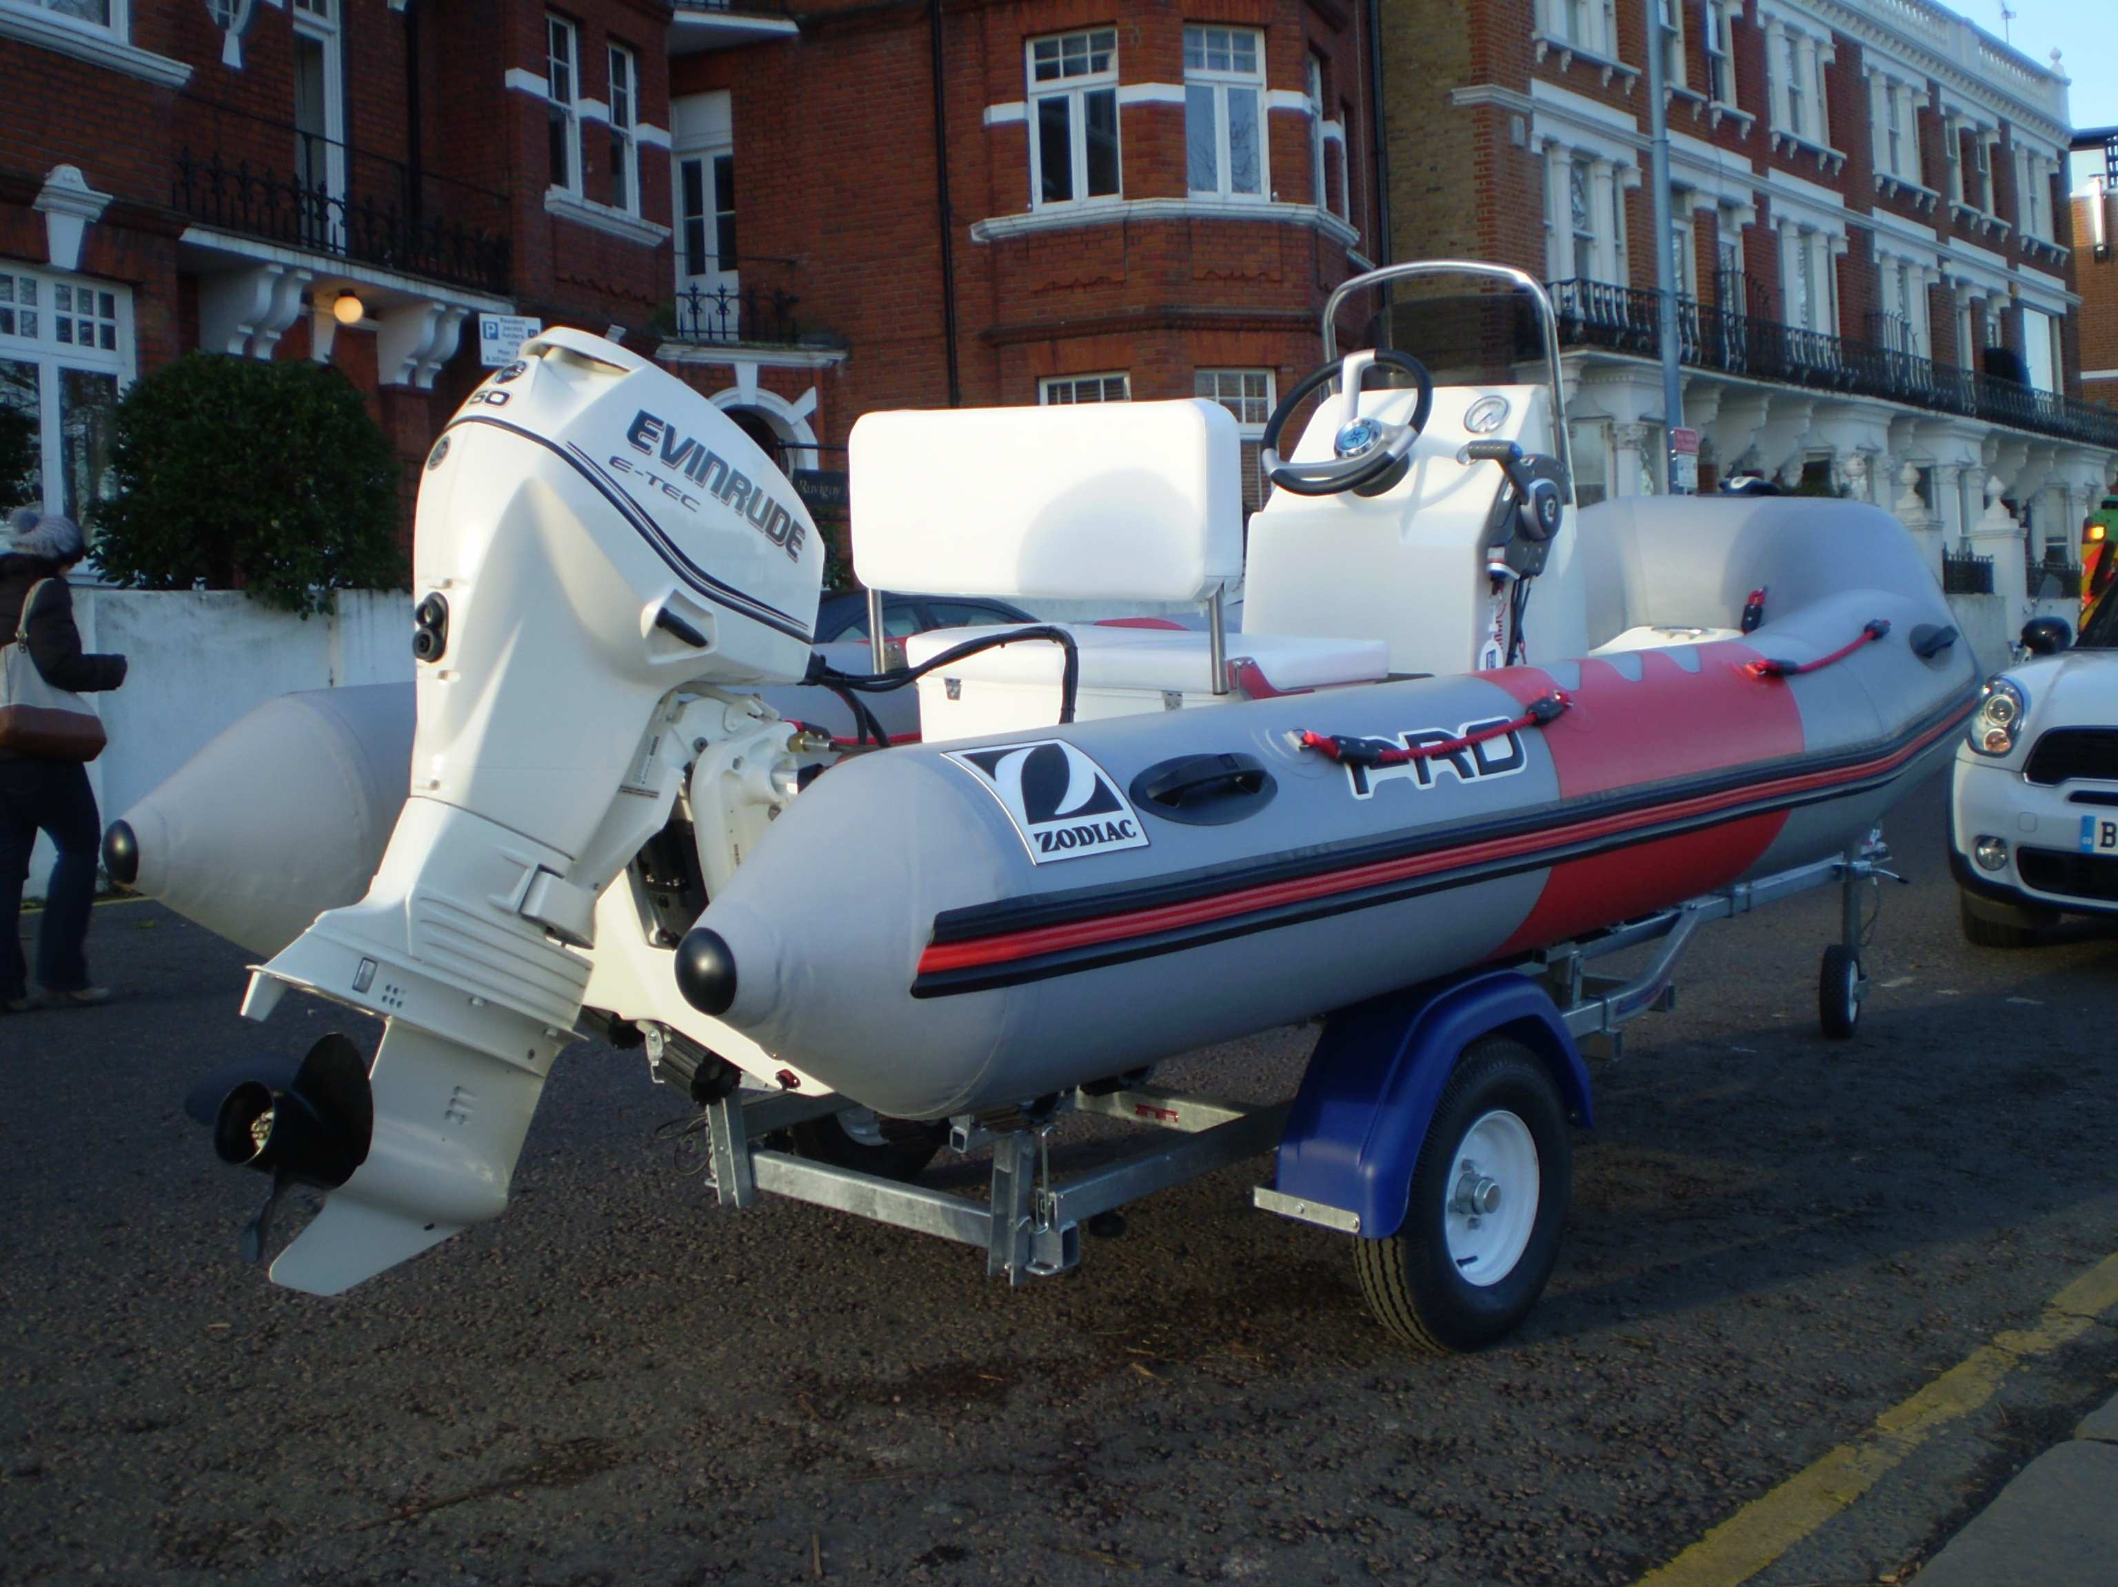
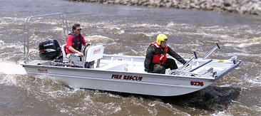
Swift Water Response Program

Slide 20
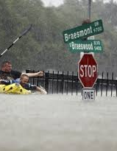
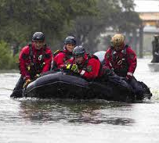
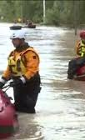
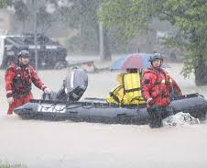
May 25, 2015 – Memorial Day Flood
  1242 calls for service in 12 hour period beginning @ 2100hrs with flooding in
    Meyerland
    Memorial and Dairy Ashford
    I-10 and I-45 near North Side
    Belfort and Broadway area
    Belfort and Hillcroft area
    Ley Rd and N Wayside
    Downtown
Tax Day 2016
    Greens Point
    Little York and Rosalyn
    Meyerland
    Fondren and W Bellfort
    Westbury Area
    I-10 and I-45 near North Side
    Kingwood
    Addick’s Reservoir
Harvey 2017
    Kingwood;
    Northeast of SH-59 and North of 610
    I-10 and I-45 near North Side
    Downtown
    Allen Parkway
    Meyerland
    Hobby Airport Area
    Southeast – Alameda Mall
    Southeast 288 at Macgregor

Slide 21
Swift Water Response Profile
Current HFD Assets
Current HFD Personnel
Equipment Type | Current Inventory
Evacuation Boat | 10
Zodiac Rescue Boat | 6
High Water Vehicle | 1
Waverunner Jet Ski | 4
Prime Mover | 4
PFD | 150
PS Drone | 1
Training Type | Current Trained
Basic Flood Water /Evac Boat | 130
Swift Water/ Rescue Boat | 60
High Water Vehicle | 6

Slide 22
Swift Water Response Equipment
Equipment Type | Current Inventory | Requested Inventory | Delta | Program Improvement Cost
Zodiac Rescue Boat | 6 | 10 | 4 | $104,000
Evacuation Boat | 10 | 20 | 10 | $213,000
High Water Vehicle | 1 | 8 | 7 | $574,000
Waverunner Jet Ski | 4 | 8 | 4 | $35,800
Prime Mover | 4 | 10 | 6 | $480,000
PFD | 150 | 300 | 150 | $5,300
PS Drone | 1 | 2 | 1 | $30,000
Additional Equip | --- | --- | --- | $292,400
 |  |  | Equipment PI Impact: | $1,734,500

Slide 23
Swift Water Response Training
Training | Current Trained Personnel | Requested Trained Personnel | Delta | Program Improvement Cost
Basic Flood Water & Evacuation Boat | 130 | 360 | 230 | $80,500
Swift Water Ops/Tech Rescue Boat | 60 | 120 | 60 | $240,000
High Water Vehicle | 6 | 100 | 94 | $10,000
Training Program Improvement Impact |  | 580 | 384 | $330,500

Slide 24
Swift Water Response Program
Equipment Program Improvement Impact | Training Program Improvement Impact | Total Program Improvement Impact |  | Annual Proficiency Training Cost
$1,734,500 | $330, 500 | $2,065,000 |  | $100, 760

Slide 25
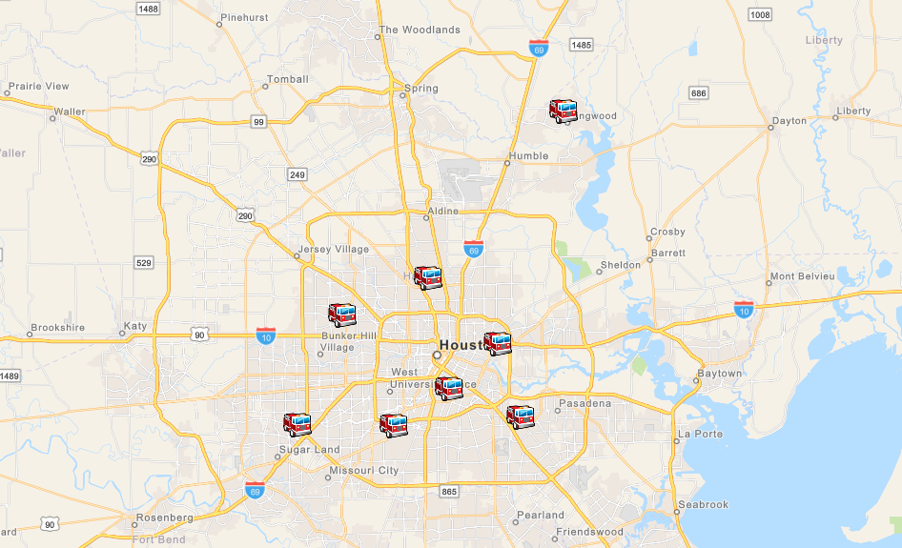
Proposed HWV Locations

Slide 26
Questions?

Slide 28
Zodiac Boats
Quantity: 4
Equipment: Zodiac F 420
Cost: $26,000 per unit; $104,000 total
Purpose: Search & Rescue
Details: 40HP Evinrude E40DRGL, fuel cell, trailer

Slide 29
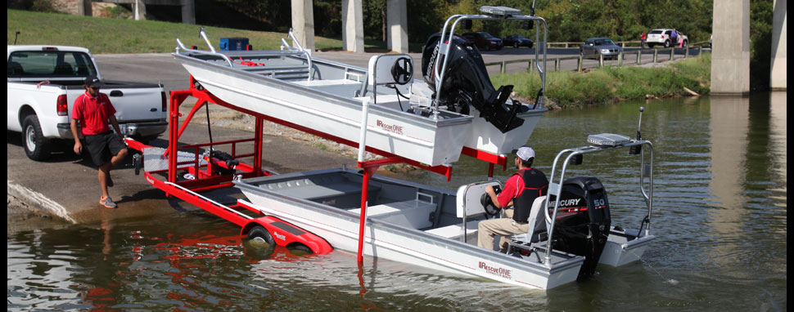
Evav Boats w/Trailer
Quantity: 10
Equipment: 1673-X2™ GEN2, 40hp Evinrude, TwinTransport
Cost: $21,300 per unit; $213,000 total
Purpose: Search & Rescue
Details: 10 Boats w/motors, 5 Trailers

Slide 30
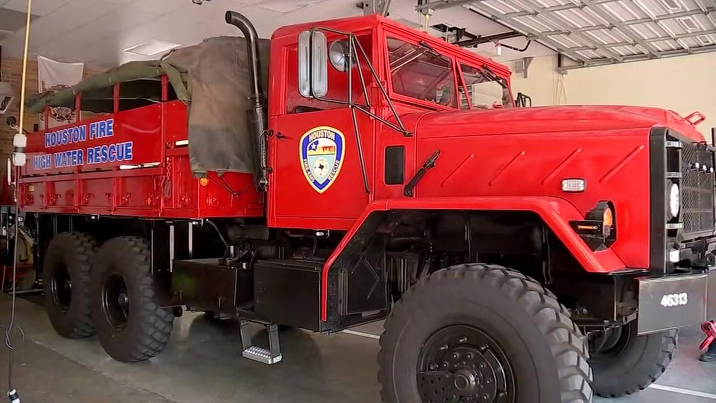
Highwater Vehicles
Quantity: 7
Equipment: HWV-M923 A2 5 Ton 6X6
Cost: $82,000 per unit; $574,000 total
Specs: Available through Fleet
Purpose: Highwater Rescue / Member Mobility
Details: 1 Unit per quadrant, plus 4 additional
Proposed Stations: 5*,21,25,29,41,58,73,102
*Station 5 HWV already in service/purchase by Council Member Stardig

Slide 31
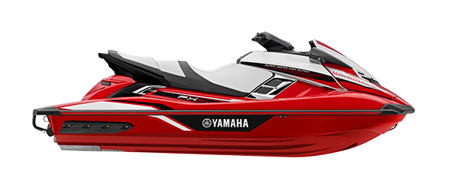
Waverunners
Quantity: 4 Waverunners, 2 Double Trailers
Equipment: Yamaha EX Sport
Cost: $7,700 per unit; $2,500 per trailer; $35,800 total
Purpose: Search & Rescue

Slide 32
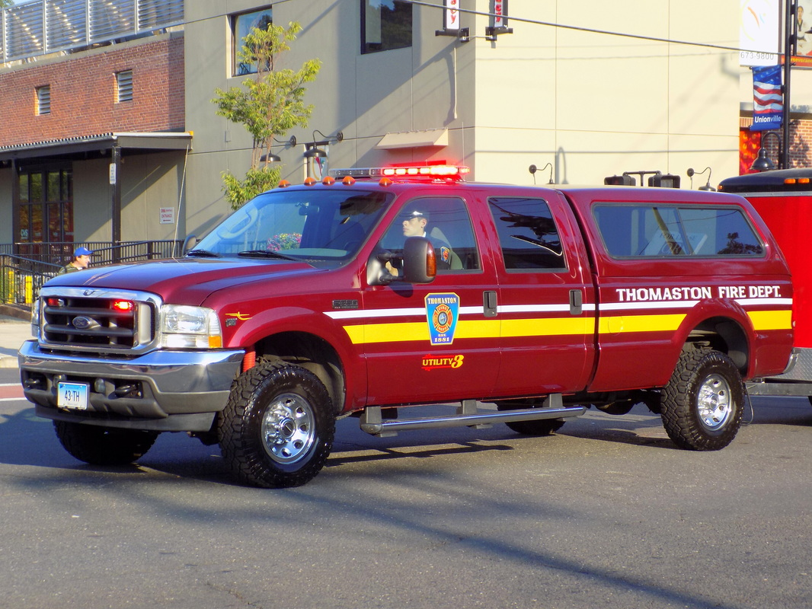
Prime Movers
Quantity: 6
Equipment: Ford F-250 4x4 w/Camper Shell, Slide-out, & Winch
Cost: $80,000 per unit; $480,000 total
Purpose: Deploy Zodiac and Evac Boats
Details: 3 units for Zodiacs, 4 units for Evac, 3 units for existing units

Slide 33
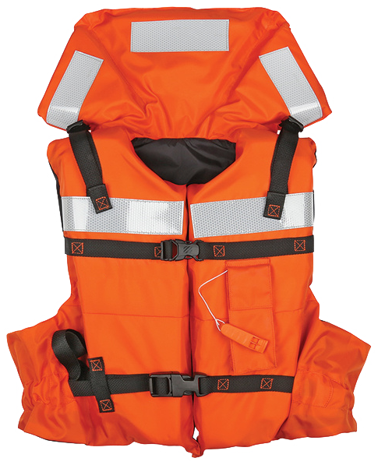
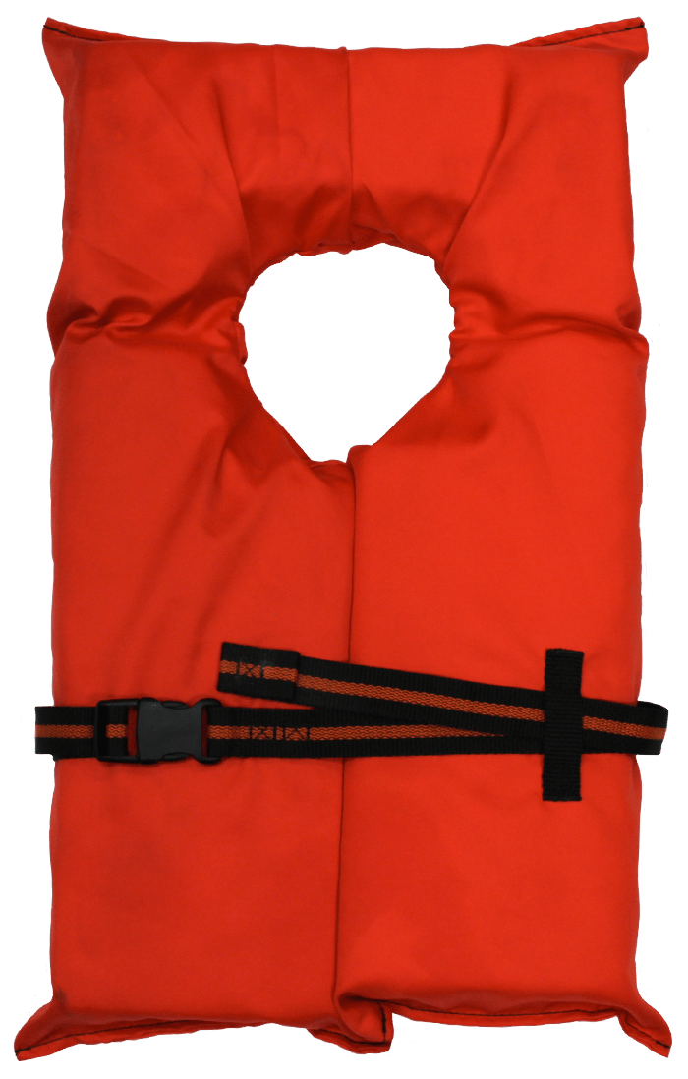
Personal Floatation Devices
Rescuer Personal Floatation Device (Type 5)
Units: 50
Victim Personal Floatation Device (Type 2)
Units: 100
Total: $5,300

Slide 34
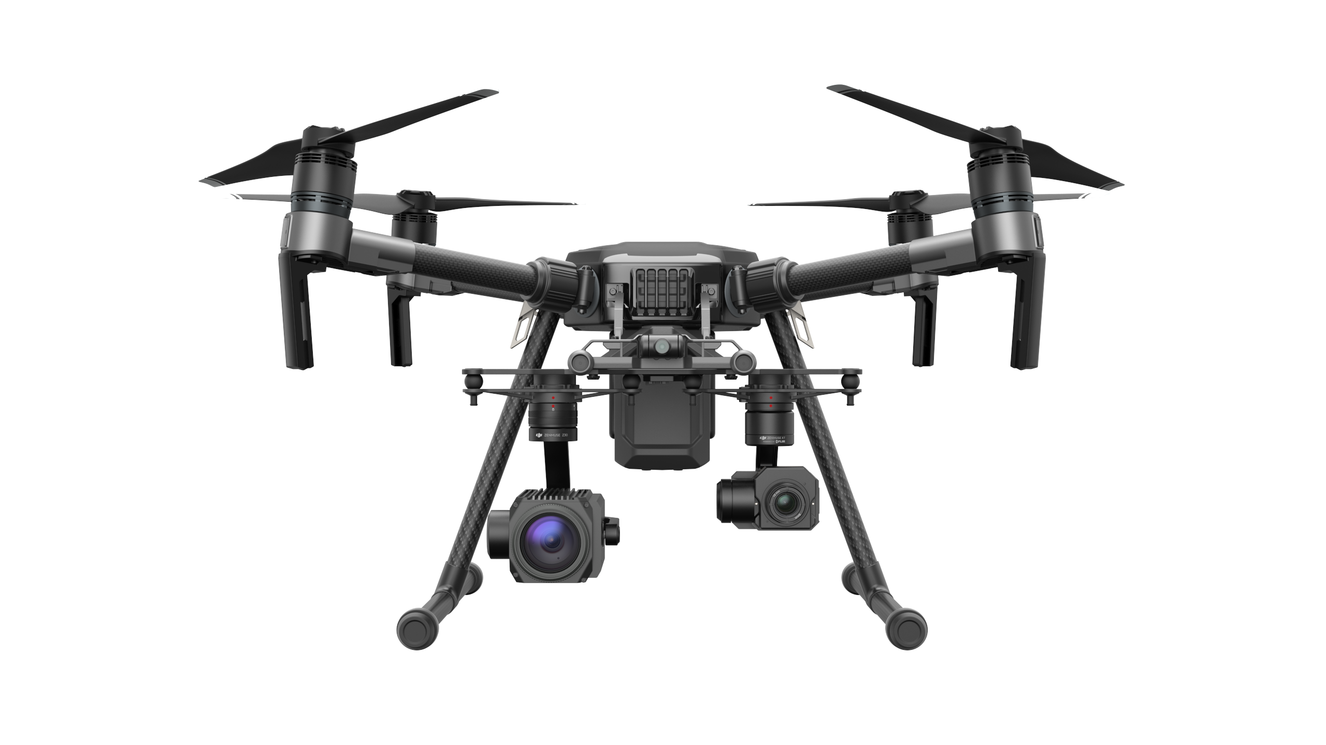
Public Safety Drone
Quantity: 1
Equipment: DJI Matrice 210
Cost: $30,000 per unit
Purpose: Situational Awareness, Firefighter Safety, Search & Rescue
Details: Industrial Level UAS with Optical Zoom, Thermal, IR, &
Limited protection from the elements

Slide 35
Additional Equipment
Survival Package for Strike Team
- Drysuit, boots, helmet, knife, whistle, PFD, throw rope, radio harness, eye protection, gloves
Units: 80 Price/Unit: $2,150 Total: $172,000
Replace Damaged Equipment
Drysuit, boots, helmet, etc.
Total: $120,400

Slide 36
Population & Demographics
(2010 U.S. Census)
4th most populous city in U.S. with 2.1 million within 644 sq miles.
  8.1% age 5 or younger
  9.0% age 65 or older
  22.5% of the population lives at or below the poverty level

Slide 37
Fleet Composition – Frontline All
Vehicle Type | Vehicle Count | Avg. Age | Recommend Replacement Age | % over Replacement Age | Min Staffing
Engines | 88 |  | 12 yrs | 27% | 352
Aerials | 38 |  | 15 yrs | 8% | 152
Ambulances | 92 |  | 8 yrs (4yr E&T) | 48% | 184
Rescue Truck | 3 |  |  |  | 13
HazMat | 3 |  |  |  | 10
SC/DC | 23 |  |  |  | 44
HWV | 1 |  |  |  | 0
Rescue Boat | 6 | >10 |  |  | 0
Evac Boat | 10 | >20 |  |  | 0
ARFF | 26 | - | - | - | 34
Other | 29 | - | - | - | 40
Notes:
The lack of a dedicated equipment replacement program, combined with the heavy use of this equipment, has created a condition where the current state of the department’s apparatus fleet is critical with vehicles that do not meet current National Fire Protection Association standards and require constant maintenance.
Additionally, On any given day, all department reserve engines are being utilized in front-line service.

Slide 38
Example Total Cost of Ownership Curve
Notes:
As vehicle ages, its capital cost diminishes as operation costs increases. The combination of these two costs procuses a U-shaped TCO curve. Idealy, an asset should be replaced at the age (r accumulated miles or hours of use) at which the TCO is at a minimum – that is, at the bottom of the U-shaped curve.
The TCO is different for different types of Vehicles, and indivisual vehicles of a given type.

Slide 39
FAMA Apparatus/Vehicle Replacement Consideration:
Excellent Condition (E)
Less than five years old
Fewer than 800 engine hours
No know mechanical defects
Very short downtime and very few operating expenses
Excellent parts availability
Very good resale value
Meets all present NFPA 1901 and 1911 edition safety standards
Very Good Condition (VG)
More than five but less than ten years old
More than 800 but fewer than 1600 engine hours
No known mechanical or suspension defects present
Low downtime and above average operating costs
Good parts availability
Good resale value
Meets NFPA 1901 and 1911 safety standards
Good Condition (G)
More than ten but less than 15 years old
Some rust or damage to the body or cab
More than 1,600 but less than 2,400 engine hours
Some existing mechanical or suspension repairs necessary
Downtime and operational costs are beginning to increase
Notes:
Fire Apparatus Manufacturer’s Association (FAMA) developed the “Fire Apparatus Duty Cycle White Paper”. The paper is an in-depth analysis of many aspects of apparatus replacement, including the key factors to be considered in a typical apparatus replacement schedule including:
Type of department;
Fire department workload;
Population served;
Demographics served; and,
Topography of region served
From Excellent to Fair to Poor
In the emergency service business, apparatus should routinely be classified as excellent or very good. The best way to understand this is to draw an analogy to a commercial airliner. Would the average person be comfortable flying on a jet rated good, or would one really want one rated excellent, or at least very good? In a business where the ability to pump water to a fire, raise a ladder to te roof or a building or get a critical patient to the hospital depends 100% on the condition of the apparatus, “Good isn’t very much better than “Fair” or “Poor”
Some vehicles are in “good” physical condition, or have “good” engines, but are bare bones from the standpoint of user comfort because AC are inop, or air leaks delay travel waiting on pressure to build so breaks will function properly, or the air ride suspension system on the ambulance will work. Can these units squeak by? Yes. Are they optimal in terms of safety, reliability, comfort, etc? No. Numerous apparatus will operate but lack reliable air conditioning. In the heat of a Houston summer, it is simply not acceptable to not have air conditioning on the apparatus or in an ambulance.

