Slide 1
Proposed Ordinance Changes: Boarding Homes/Lodging Facilities/Correctional Facilities/Alternate Housing Facilities
Public Safety and Homeland Security Committee
February 13, 2018

Slide 2

Background
  March 2016: fire in a boarding home and fire in an unlicensed lodging facility resulted in three deaths and the emergency evacuation of 29 elderly and disabled residents.
  In response, Mayor Turner formed an internal working group comprised of City departments to review and revise relevant ordinances:
    Administration & Regulatory Affairs Department
    Houston Fire Department
    Houston Police Department
    Houston Public Works
    Department of Neighborhoods
    Planning Department
    Legal Department
    Mayor’s Office of People With Disabilities
    Mayor’s Office of Homeless Initiatives

Slide 3
Background - continued
Stakeholder Meetings
  Industry stakeholder meetings
    November 6, 2017 – Boarding Homes Operators
    November 6, 2017 – Lodging Facility Operators
    December 8, 2017 – Alternative Housing Facilities
  Community stakeholder meetings
    January 3, 2018 – Third Ward Multi-Service Center
    January 4, 2018 – Southwest Multi-Service Center
    January 8, 2018 – Acres Home Multi-Service Center
    January 10, 2018 – Marshall Middle School
    January 11, 2018 - Mayor’s Commission on Disabilities
    January 11, 2018 – Kashmere Multi-Service Center
    January 30, 2018 – St. Christopher’s Episcopal Church

Slide 4
Proposed Regulatory Framework
Types of permits proposed:
  Permits issued by PWE
    Boarding Home
    Lodging Facility
  Permits issued by ARA
    Correctional Facility (Currently in Chapter 28, permitting will transfer from Planning Department to ARA).
    Alternate Housing Facility

Slide 5
Boarding Homes:
General Information
Definition: Facilities that provide lodging and personal care services to three or more persons with disabilities and/or elderly persons.
Current Regulatory Requirement: Registration only, no permit required
117 facilities are currently registered.
Authorization: State Law – Health and Safety Code, Title 4, Subtitle B, Chapter 260, Boarding Home Facilities

Slide 6
Boarding Homes:
Current and Proposed New Requirements
  Annual permit (currently require only a registration) with process for revocation/denial/appeal
  1st year building code inspection which may require a Certificate of Occupancy
  Annual life safety inspection prior to permit renewal
  Framed beds
  Annual owner/operator criminal history background check*
  Posted and practiced fire evacuation plan*
  Accessible fire extinguishers*
  Operable smoke alarm and carbon monoxide detectors*
  Readily available first aid supplies*
  *items currently required for boarding home registration

Slide 7
Lodging Facilities:
General Information
  Definition: Facilities that are used and occupied, for compensation, as the sole residence for the permanent or temporary occupancy for living quarters for three or more unrelated people.
  Also known as:
    Boarding houses
    Rooming houses
    Tenement houses
    Bunk houses
    Flop houses
  Does not include:
    Short-term rentals
    Vacation/rental homes
    Apartments, hotels, condos

Slide 8
Lodging Facilities:
Proposed New Requirements
  Annual permit with process for revocation/denial/appeal
  1st year building code inspection, which may require a Certificate of Occupancy
  Annual life safety inspection prior to permit renewal
  Framed beds
  Posted and practiced fire evacuation plan
  Accessible fire extinguishers
  Operable smoke alarm and carbon monoxide detectors
  Readily available first aid supplies

Slide 9
Correctional &Alternate Housing Facilities:
General Information
Definitions:
  Correctional Facility – A facility for the housing and rehabilitation or training of adults on parole, early or pre-release, or any other form of executive, judicial or administrative release from a penal institution
  Alternate Housing Facility – A residence owned by an individual, private legal entity, non-profit or faith based organization which is not owned by, operated by, established by or contracted with TDCJ where three or more unrelated parolees reside

Slide 10
Correctional/Alternate Housing Facilities:
Proposed New Requirements
  Annual, non-transferable permit with process for revocation/denial/appeal
  Distance Requirements - 1,000 feet from schools (Public/private), public parks, and other AHFs/Correctional Facilities
  Certificate of Occupancy
  Annual life safety inspection prior to renewal
  Maximum Occupancy – 75 persons*
  Posted and practiced fire evacuation plan
  Accessible fire extinguishers
  Operable smoke alarm and carbon monoxide detectors
  Readily available first aid supplies
  Grandfather for existing locations – Facilities approved by TDCJ as of the effective date of the ordinance will be grandfathered for the distance requirements and have 18 months to comply with the remaining sections of the ordinance.
  * items currently in correctional facility permitting

Slide 11
Questions?

Slide 12
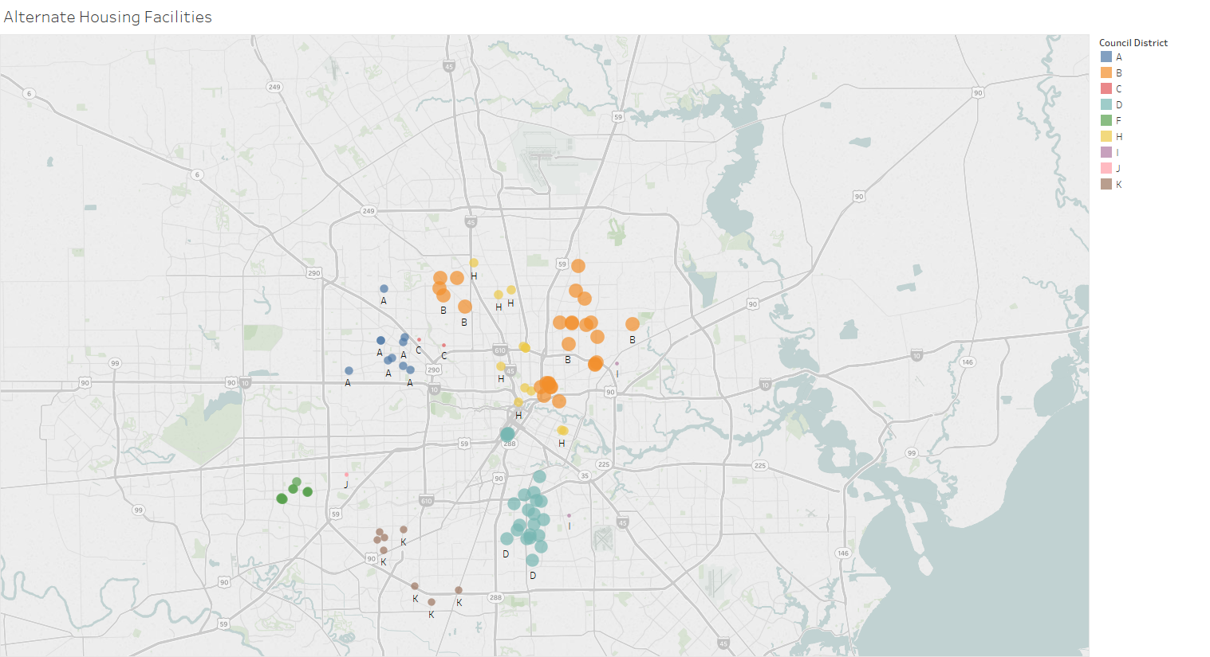
Alternate Housing Facility Map
Council District | AHF
B | 27
D | 24
F | 12
H | 12
A | 10
K | 8
C | 2
I | 2
J | 2
E | 0
G | 0
Grand Total | 99

Slide 13
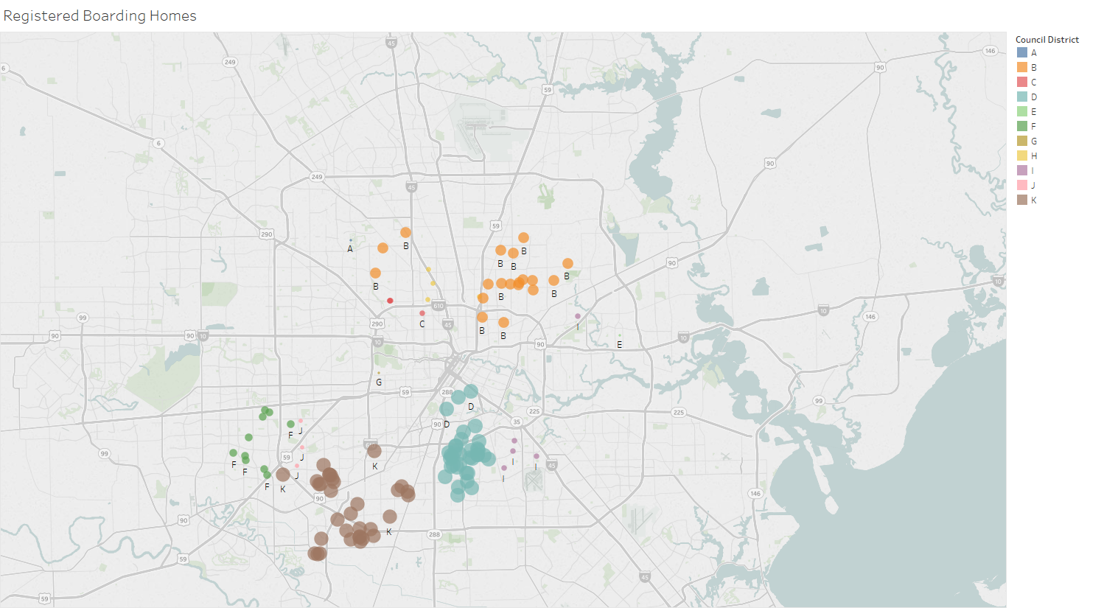
Registered Boarding Home Map
Council District | Boarding Homes
D | 35
K | 33
B | 19
F | 10
C | 5
I | 5
H | 4
J | 3
A | 1
E | 1
G | 1
Grand Total | 117

Slide 14
Alternate Housing Facilities in Texas
Top 10 Cities
1. Houston | 99
2. Austin | 34
3. Dallas | 30
4. Ft Worth | 13
5. Temple | 8
6. Waco | 7
7. Burleson | 5
8. San Angelo | 5
9. Abilene | 4
10. Garland | 4

Slide 15
Boarding Home Regulations in Texas
City | Terminology | Type | Number of Persons | Fee | Building Inspection | Certificate of Occupancy
Austin | NA (Boarding and Rooming House)
Dallas | Boarding Home | Zoning, License | Three or more | $500 | Yes | NA
El Paso | Boarding Home | Zoning, License | Minimum: 3 Maximum: 6 | $264 | Yes | Yes
Fort Worth | NA (Boarding House)
Houston* | Boarding Home | Registration | Three or more | $130.57 | Fire Safety Only | No
San Antonio | Boarding Home | Zoning, Permit | Minimum: 3 Maximum: 6 | Inspection: $1000 | Yes | Yes
*Current regulations

Slide 16
Lodging Facility Regulations in Texas
City | Terminology | Type | Number of Persons | Fee | Building Inspection | Certificate of Occupancy
Austin | Rooming and Boarding House | Zoning, Annual Operating License | 7 or more | $308, $11 per unit | Yes | Yes
Dallas | Lodging or boarding house | Zoning, Registration | 5 or more | $6 per unit | Yes | Yes
El Paso | Lodging house | Zoning, License | 5 or more | $45 | NA | Yes
Fort Worth | Boarding House | Zoning, Registration | 5 or more | NA | Yes | Yes
Houston | NA (Lodging Facility)
San Antonio | Rooming house | Zoning | Must Comply with Property Maintenance Code

Slide 17
Alternate Housing Regulations in Texas
City | Terminology | Regulations | Distance Requirement
Austin | Transitional Housing | Zoning, conditional use permit | NA
Dallas | Halfway House | Zoning, special use permit | 5280 ft.
El Paso | Halfway House | Zoning, special use permit | NA
Fort Worth | Halfway House | Zoning, planned development zones | 1320 ft.
Houston* | Correctional Facility | Correctional Facility permit | 750 ft.
San Antonio | Correctional Facility/Transitional Home | Zoning, special use permit | 1000 ft.
*Current regulations

