Slide 1


Proposed Amendments to the
Hazardous Enterprises Ordinance
Chapter 28, Article VII
Presented by Brian J. Crimmins
Chief of Staff, Planning & Development Department

Slide 2
Ordinance Background
Response to the 1995 Pleasantville Warehouse Fires
Adopted December 1996; minor changes in 2002 & 2006
“Safety issues that are associated with having certain hazardous occupancies located near residences, health care facilities, and schools”
Supplements other local, state, and federal regulations by adding distance requirement from residential and sensitive uses

Slide 3
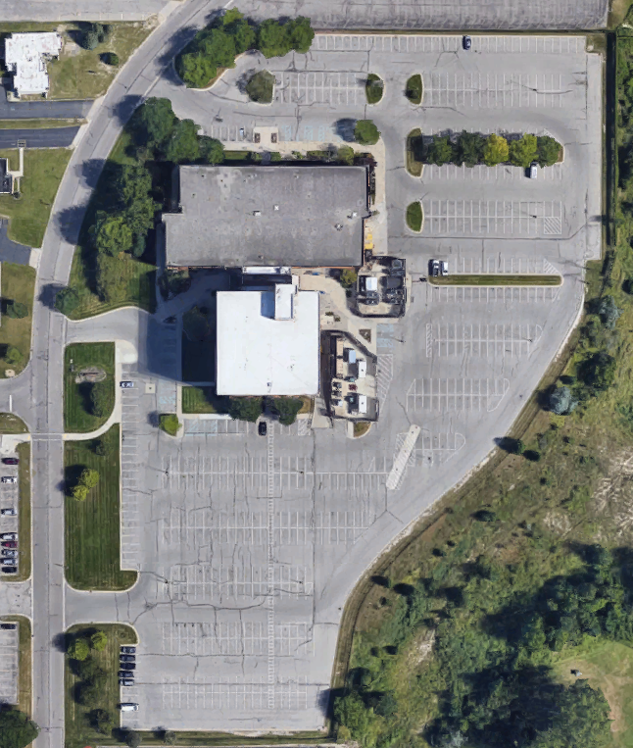
Types of Permits
Unrestricted Permit
  Entire property
Restricted Permit
  Only designated building

Slide 4
Unrestricted Permit
Restricted Permit

Slide 5
Permit Approved Unless:
False or incomplete information
Residential is more than 1/3 of area within 1,000 feet
Sensitive use within 1,000 feet
Permit revoked within last 2 years

Slide 6
Proposed Amendments
Strengthen and clarify enforcement
Expand “sensitive use” to include church, library, and public park
Clarify permit required for “any improvement” that is a hazardous use

Slide 7
Proposed Amendments
Allow restricted permit for designated areas of building
Improve notification requirements
  Align with other notification processes
  Increase notification period to 30 days
  Add District Council Member

Slide 8
Proposed Amendments
Establish a variance process
  Fire Marshal review and recommendation
  Fee to recover cost to City [amount pending]
  Planning Commission public hearing
Public notification of hearing:
  Property owners within 1,000 feet (30 days before)
  District Council Member
  Registered neighborhood associations

Slide 9





Variance Process
Variance
Submitted
Notifications
Sent
Department
Review
Public
Hearing
Commission
Action

Slide 10
Variance Criteria
Documentation supports granting variance;
Not a hazard to human health or the environment to manufacture, process, store, or use hazardous material;
Appropriate mitigation and safeguards;
Public notice provided;
Meets intent of ordinance; and
Not injurious to public health, safety, or welfare

Slide 11
Proposed Amendments
Remove “registrations” related to 1996 effective date
Minor technical amendments by Legal Department

Slide 12
Questions?

