Slide 1
Mayor’s Office of Public Safety and Homeland Security 4/10/18
George T. Buenik – Director
34-year veteran of HPD – Retired as an Executive Assistant Chief
Currently oversee 287 employees
244 at HEC
27 at City Hall Annex
16 at OEM
Mission: To assist the city in its preparedness activities to prevent, protect, respond to, and to recover from disaster and major emergencies

Slide 2
Areas of Responsibility
Public Safety and Homeland Security
The Houston Emergency Center (HEC)
The Office of Emergency Management (OEM)
Emergency Operations Center (EOC)
Houston Crackdown
Regional Community Preparedness
Public Safety Video Network

Slide 3
Homeland Security Office
Coordinate Homeland Security for a five county area
20 out of 27 employees are Grant funded
Grant Coordinators, Administrators, Planners, Trainers, and Financial personnel
Manage grants:
Securing the Cities - $30 million over 5 years
Urban Area Security Initiative - $23 million Houston Region ($10 million City)
Port Security Grant Program - $3.5 million (received in 2017)
Complex Coordinated Terrorist Attack - $1.7 million
Countering Violent Extremism - $500,000
State Homeland Security Grant - $286,000 (expected)

Slide 4
Securing The Cities
$30 million grant program (over 5 years)
Regional Terrorism Prevention and Response
Detecting, Deterring, and Defending against terror attacks that use radiological or nuclear material
Training for First Responders
Radiation Detection Devices, Backpack Detectors, and Mobile Systems

Slide 5
Urban Area Security Initiative (UASI)
$23 million Grant-funded projects for the region
Community Preparedness
Houston Regional Intelligence Service Center (Fusion Center at HEC)
Regional Planners
Technology – Digital Sandbox and Public Safety Video Camera System
Fire Rescue equipment
Tactical Medical Team
HPD Air Support equipment
SWAT, Bomb, and Dive Teams

Slide 6
Port Security Grant Program
$3.5 million in Grant funded projects FY2017
HFD underwater search and rescue
Cameras and imaging systems
Portable X-ray machine
Dive Suits
Hazmat vehicle
Chemical Detectors
Training for specialized teams

Slide 7
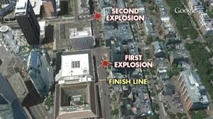
Complex Coordinated Terrorist Attack
$1.7 million grant funded program to
Develop best practices and ensure that public safety personnel are ready to respond in a coordinated manner
Conduct capability gap analysis
Develop scenario-based training
Conduct a Table Top Exercise
Develop a public safety video
Boston Marathon

Slide 8
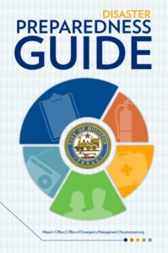
Community Preparedness
Houston Ready – 5 county region
Make a Plan, Build a Kit, Stay Informed, Know your Neighbors
Run.Hide.Fight. and Make the Call iwatch terrorism prevention
Houston CERT – Community Emergency Response Team
Citizens trained how to help themselves and others
Assist in disaster response
Extreme Weather Expo on June 2nd – 3,000 expected

Slide 9
Countering Violent Extremism Grant
$500,000 grant funded program to
Reduce terrorism risk and empower the community
Focuses on reducing the vulnerability of youth to extremist ideologies in a five-county area
Goal is to create and implement training for parents and youth to educate them on violent extremism
Program will be led by a steering committee comprised of community leaders, service providers, and non-profit partners

Slide 10
State Homeland Security Grant Program
$286,000 expected in grant funding
HPD Bomb Squad equipment
HPD Special Response Group equipment
Houston Regional Catastrophic Preparedness Initiative Planner
Terrorism
IED Attack
Natural Hazards
Cyber Terror

Slide 11
Homeland Security Projects
Hurricane Harvey After Action Report
Continuity of Operations After Action Report
Wildfire Table Top Exercise – April 23, 2018
Extreme Weather Expo at GRB – June 2, 2018
Army Cyber Institute Exercise at GRB – July 23, 2018

Slide 12
Hurricane Harvey After Action Report
Areas for Improvement
Command, Control, and Coordination - 6
Rescue Operations and Evacuations - 3
Resource Personnel and Management - 8
Emergency Purchasing and Finance - 4
Shelter Operations and Mass Care - 4
Continuity of Operations - 2
Information Technology - 3
Mutual Aid - 4
Damage Assessment and Debris Management - 3
Other Areas - 7

Slide 13
Continuity of Operations After Action
Five Objectives
Evaluate Command and Control
Assess Alternative Work Sites
Assess Personnel Management
Evaluate Communicating with Personnel
Discuss Technology Capability
Strengths and Areas for Improvement identified

Slide 14
Regional Wildfire Table Top Exercise April 23, 2018
Test the Significant Wildfire Incident Concept of Operations by focusing on mutual aid requests, resource management, and information coordination for wildfires affecting multiple jurisdictions within the 13-county region
Participants include:
Fire Leadership / EMS
Emergency Management
Texas A&M Forest Service
State & Regional partners

Slide 15
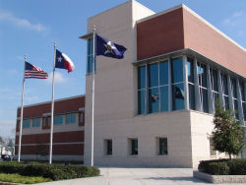
Houston Emergency Center (HEC)
Chief David Cutler – Director
244 Total HEC personnel
175 Telecommunicators (Call Takers)
Handle 2.8 million calls a year for emergency and non-emergency
2 million 911 calls
762,000 Police calls – 10 digit number
49,000 Fire calls – 10 digit number
2,500 EMS calls – 10 digit number
5,800 Text messages

Slide 16
HEC Projects
Working with HITS on a CAD update / replacement
Timeline for completion – 2 to 4 years
Greater Harris County 9-1-1 will supply HEC with 12 more call taker consoles and 20 laptops to expand call-taking capacity

Slide 17
Office of Emergency Management
Chief Rick Flanagan – Emergency Management Coordinator
Assists City departments in preparing for, responding to, and recovering from disasters and major emergencies
Develops plans for dealing with disasters
Activates the Emergency Operations Center (EOC) where all top level department decision makers coordinate their response

Slide 18
Houston Crackdown
Ray Andrews – Program Director
Coordinates community volunteer projects in alcohol and drug abuse through prevention, education, treatment, and rehabilitation
Referral network for substance abuse programs and events
Over 8,000 people reached in programs and services

Slide 19
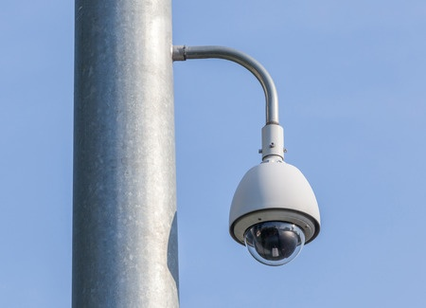
Public Safety Video Network
To improve the security posture of critical infrastructure, Key Resources, and large public venues
Consists of 925 video camera with access to 400 private sector cameras
Main areas of coverage
Downtown and Discover Green
Buffalo Bayou and Tinsley Park
Texas Medical Center
NRG, Toyota, Minute Maid, and BBVA

Slide 20
Everbridge
Mass Communication System platform that will send out Alert Houston notifications
Capable of storing 500,000 contacts
Can send out emails, text messages, and voice messages
Can “Geo Target” specific areas
Internal Employee notifications
Automatic Translation for Five languages (Spanish, Vietnamese, Chinese, Arabic, French)

Slide 21
Questions

