Slide 1
Houston Public Safety & Homeland Security Committee
WEA Updates
Francisco Sánchez, Jr.
Deputy EMC, Harris County
August 14, 2018

Slide 2
Agenda
What is WEA?
Major WEA Changes
What This Means Locally
Recommendations
1

Slide 3
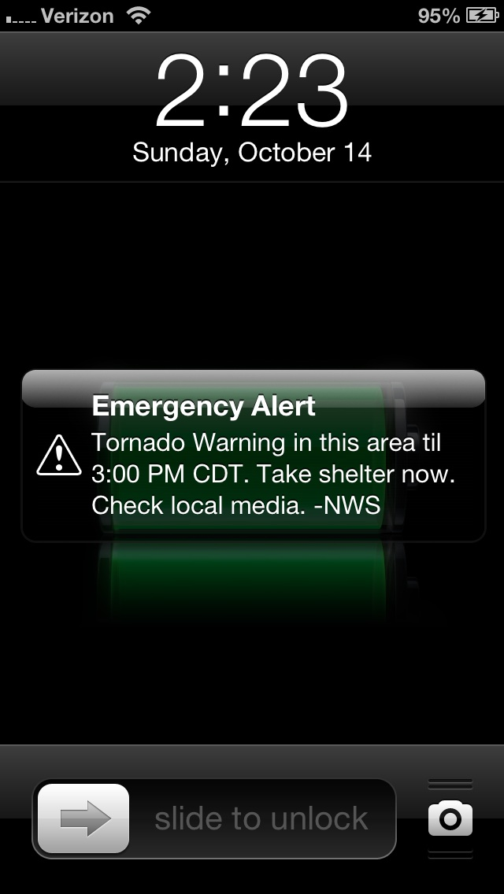
What is WEA
Wireless Emergency Alerts (WEA)
Public/Private Partnership
Alerts issued by the President
Alerts involving imminent threats to safety of life, issued in two different categories:
  extreme threats
  severe threats
AMBER Alerts
Public Safety Messages
2
Notes:
WEA is Wireless Emergency Alerts. This is a communication system that allows customers to receive geographically targeted alerts about imminent threats to safety in their area – all on their cell phone.
WEA is a public/private partnership between the Federal Communications Commission (FCC), Federal Emergency Management Agency (FEMA), and wireless industry, in which wireless companies voluntarily participate in WEA to enhance public safety.
The type of alerts that will be sent out via WEA are: 1) any alert issued by the President; 2) alerts involving imminent threats to safety or life – such as extreme threats and severe threats; 3) AMBER alerts about missing children; and 4) Public Safety Messages
*Source: Moving WEA Forward 1 pager

Slide 4
Major WEA Changes
90 Characters to 360 Characters
Improved Geo-Targeting
Only English to English and Spanish Alerts
Alert Message Preservation
3
Notes:
By May 1, 2019, alerts will be able to contain 360 characters – right now they can only contain 90. This increase is important because it generally takes more than 90 characters to inform people of what is happening, what they should do, why it is important they listen, and who the information is coming from. Increasing the character count to 360 will ensure the public is better informed on what is happening around them. By November 30, 2019, WEA will have better improved Geo-Targeting technologies. This will ensure that the information is getting to those who need it the most while reducing warning fatigue. Another change will go into effect on May 1, 2019, as well. Alert originators will have the option of sending the alert in not only English, but Spanish as well. This will help to ensure that the Spanish-speaking community is able to understand the alert and can take the appropriate action in response to an emergency. By November 11, 2019, WEA messages will be preserved on phones for a minimum of 24 hours. This will allow recipients to refer back to the information they received from the WEA message.
*Source: Moving WEA Forward 1 pager

Slide 5


Advocacy to Date
Topic | Adopted | Deferred | Implemented?
Increased Characters |  |  | May 2019
Additional WEA Category |  |  | May 2019
Embedded References
Many-to-One Feedback
Multimedia Alerts
Spanish Messaging |  |  | May 2019
Other Languages
Network-based Geotargeting
Device-based Geotargeting |  |  | November 2019
Live WEA Testing
Alert Logging
Improved User Preferences
WEA Attention Tone in PSAs
Sharing of Coverage Maps
WEA Message Preservation |  |  | May 2019
Consumer Choice at POS |  |  | May 2019
4
Notes:
Ben K.

Slide 6
What This Means Locally
More prepared public
  Improved geo-targeting
  Spanish alerts
  Available on a wide range of devices
  More available information
5
Notes:
With the recommendations and changes that will soon become live with WEA, we will have a better prepared public – increasing our community resilience. The improvements that are going to be made to the geo-targeting system will ensure only those who need the information will receive it. For example, during Hurricane Harvey, alerts could only be sent to the entire county, there was no way to pinpoint where the information was going. This limited the ability to target certain areas that were facing different emergencies. Improved geo-targeting will reduce warning fatigue while targeting the people who need the important information. Harris County has a large Spanish-speaking population. Having the ability to send out alerts in Spanish will ensure that the message is able to be interpreted by all those effected by an emergency. WEA messages must become available on a wide-range of devices including braille technology. Emergency messages must be able to reach all effected parties – so WEA must become more adaptive. This is important to increasing the resiliency of the community. Finally, by increasing the amount of information available, with changing the maximum character count of alerts from 90 to 360 characters and by allowing webpages information to be included in the messages, the public we be more informed on the emergency happening in their area – again increasing the resiliency of the community as a whole.
*Source: Moving WEA Forward 1 pager and CSRIC Working Group 2 Comprehensive Re-Imagining of Emergency Alerting

Slide 7
Recommendations
Technical Enhancements to EAS
Improve Geographic Targeting on Mobile and Stationary Devices
Alerting Devices Should Leverage Common Alerting Protocol to Convey Impact to the Alert Recipient
Increase the Delivery Speed of Alert Information to Alert Redistributors
Enhance Public Alerting Systems with Multimedia Which Facilitates Public Action-taking
6

Slide 8
Recommendations (cont.)
Make Public Alerting Systems Resilient and Redundant
Improve the Accessibility of Alert Information for All People
Improve the Accessibility of Actionable Alert Information for Individuals Who Are the Deaf or Hard of Hearing
Improve the Accessibility of Alert Information for the Blind and Visually Impaired
7

Slide 9
Recommendations (cont.)
Increase Outreach to Encourage the Integration of Public Alert Information Across Consumer Electronics, Electronic Media, and Public Displays
Continue Research on Improvements to Public Alerting
Make Alerting Systems Capable of Handling a Real-Time Stream of Alert Information
Improve Alerting by Leveraging Enhancements to the Common Alerting Protocol (CAP) Standard
8

Slide 10
Recommendations (cont.)
Provide Alert Recipients With the Ability to Receive Alerts Which are Relevant to Them
Enhance Alerts with Multimedia Which Facilitates Public Action Taking
Facilitate the Alert Recipient in Providing Feedback to the Alerting Authority
Develop Standards for Public Safety Information in Consumer Electronics
9

Slide 11
Questions?
10
Notes:
Francisco S.

Slide 12
Houston Public Safety & Homeland Security Committee
WEA Updates
Francisco Sánchez, Jr.
@DisasterPIO
Francisco.Sanchez@oem.hctx.net
11

