Slide 1

Update – Year 2
Public Safety and Homeland Security Meeting
11/29/2018

Slide 2
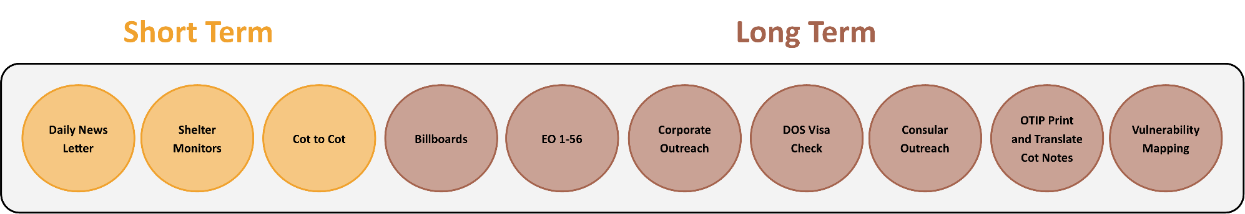
City of Houston’s Strategic Plan
Short- and Long-Term Disaster Response
Harvey Background
  Displaced persons may be more vulnerable to predators like human traffickers.
  Mayor’s Office developed preventative short- and long-term responses.
Short-Term
  Educated residents at shelters on nexus between natural disasters and human trafficking through information in daily newsletters and on all hallway screens.
  Anti-trafficking team of staff and volunteers went cot-to-cot at shelters to place notes in English and Spanish, warn residents about recruitment tactics by traffickers in shelter settings and/or online.
  Information also warned about false job offers that may lead to labor trafficking.
  Let displaced persons know help is available should they need it.

Slide 3
City of Houston’s Strategic Plan
Short- and Long-Term Disaster Response
Long-Term
  Redesigned Watch for Traffick media campaign to indicate nexus between natural disasters and potential rise in trafficking.
  Finalized EO to ensure City engages in safe labor contracting practices.
  Developing long-term effort to educate corporations on Signal case and encourage oversight for their contracts.
  Case involved Indian guest workers trafficked for their labor after Katrina through abuse of the H2B visa program.
  The DOS is on alert about visa fraud and potential investigations related to Harvey.
  Proactively sent City’s list of contractors and subcontractors to DOS.
  Creating a forum to share information on H2B visa applicants with relevant consular offices so they can share with their citizens.

Slide 4

City of Houston’s Strategic Plan
Short- and Long-Term Disaster Response
Long-Term
  Received significant grant from private law firm to boost capacity of partners engaged in direct outreach with vulnerable populations.
  Translated cot note into multiple languages for outreach, costs reimbursed by federal OTIP office.
  Provided outreach organizations with vulnerability map with priority outreach areas, based on cross of structural damage map with 4 demographic maps indicative of at-risk indicators.
  Also provided lists of schools, churches and apartment complexes within each target area.

Slide 5


City of Houston’s Strategic Plan
Associated Image: Labor and Sex Trafficking Billboards

Slide 6
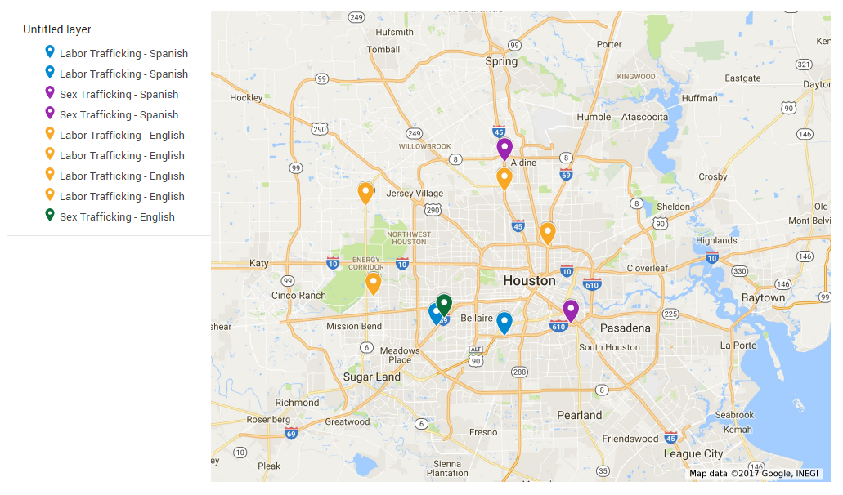
City of Houston’s Strategic Plan
Associated Image: Placement of Billboards

Slide 7


City of Houston’s Strategic Plan
City Departments – Procurement and Legal
Executive Order by Mayor Turner
EO makes counter-human trafficking a priority issue in City purchasing decisions.
Declares that the City will use its purchasing power to conduct business with enterprises that are taking positive steps to root out human trafficking from their supply chains.
Leads by example by ensuring that City does not do business with dubious contractors.
Raises awareness of human trafficking and boosts corporate action.
Encourages contractors to proactively follow ethical employee labor and recruitment practices.
Part of every City contract after implementation date of 11/19/2017.
Allows for waivers in case companies we work with do not understand how to comply.
Gained national attention and coverage in Bloomberg Law’s White Collar Crime Report stating Houston was on the “Compliance Vanguard.”
Encouraging corporations to follow our example and take steps to address their supply chains and impact labor trafficking in their sphere of influence.

Slide 8
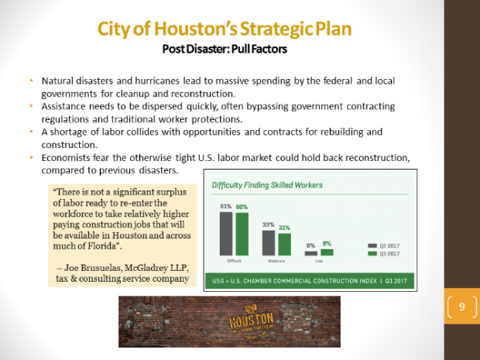
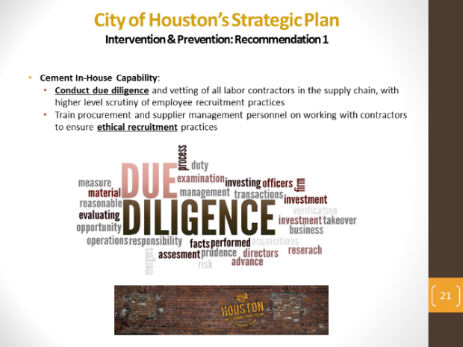
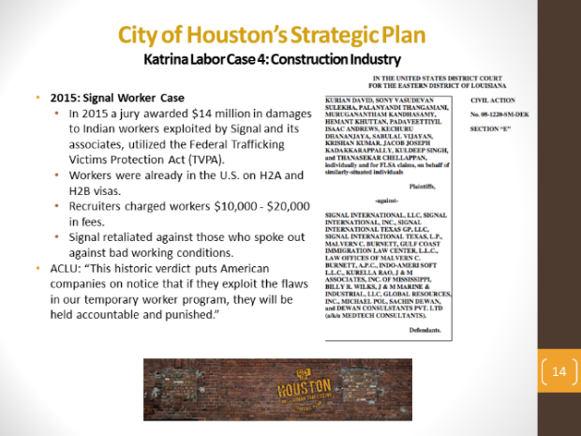
City of Houston’s Strategic Plan
Corporate Risk Mitigation Presentations
Opportunity to advance discussion with corporate audience of how labor trafficking may affect their supply chains post-disaster.
Presentation goes into post-disaster risks, push and pull factors, 4 case studies drawn from post-Katrina LA that impacted construction, hospitality, and education sectors, advances intervention and prevention recommendations.
Frames trafficking in language relevant to businesses, traditional non-profit approach of speaking to businesses using victim narratives misses opportunity for systems dialogue.
Some corporate presentation sections below.
Post-Disaster Risks Push and Pull Factors
4 Post-Katrina Case Studies
Intervention & Prevention Recommendations

Slide 9
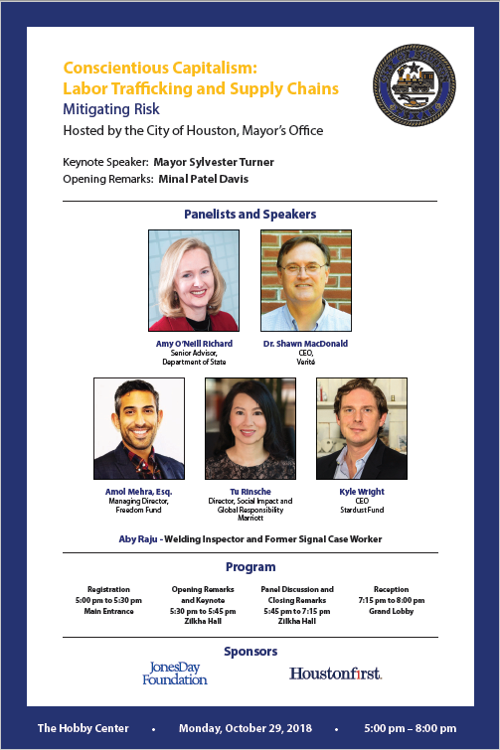
City of Houston’s Strategic Plan
Mayor’s Office Events
2018 event engaged corporate leaders on trafficking as risk mitigation and compliance issue.
Post Hurricane Harvey context and legal precedents set in wake after Katrina.
Discussion of corporate response strategies, conscientious supply chain management, responsible sourcing, ethical recruitment.
35 corporations attended.
Speakers included:
  Amy O’Neill, DOS Senior Advisor.
  Dr. Shawn MacDonald, CEO, Verité.
  Amol Mehra, Managing Director, Freedom Fund
  Tu Rinsche, Director of Social Impact and Global Responsibility, Marriott
  Kyle Wright, CEO, Stardust Fund.

Slide 10
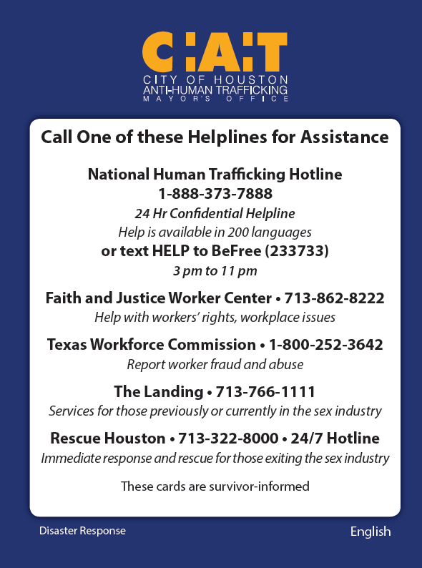
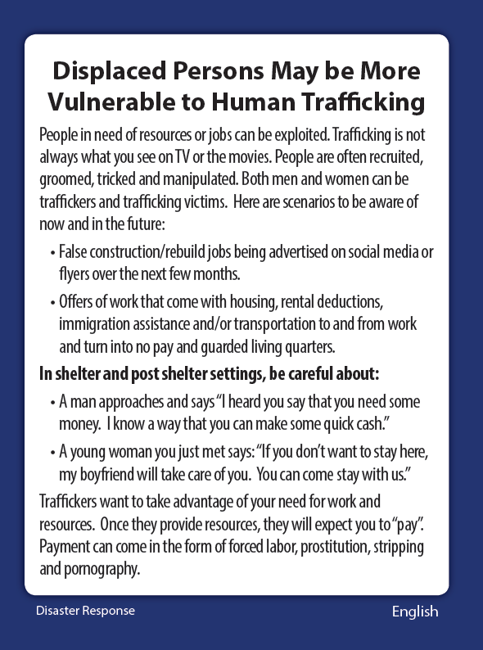
City of Houston’s Strategic Plan
Associated Image: Disaster Response Palm Card
1st Version: English, French, Vietnamese, Mandarin, Tagalog, Thai
2nd Version: English, Spanish, Arabic, Urdu, Farsi, and Hindi

Slide 11
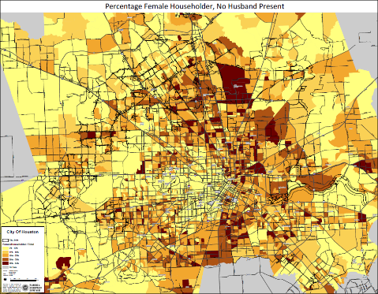
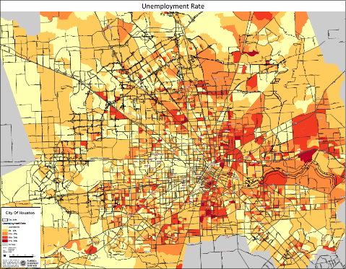
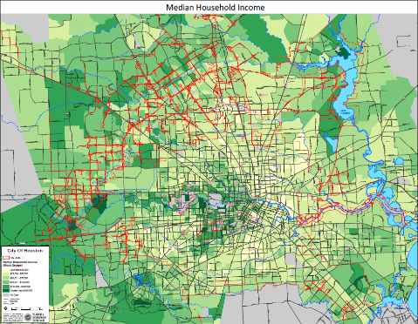
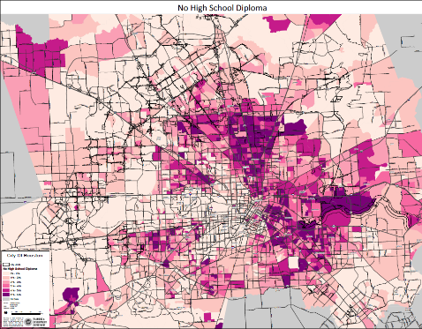
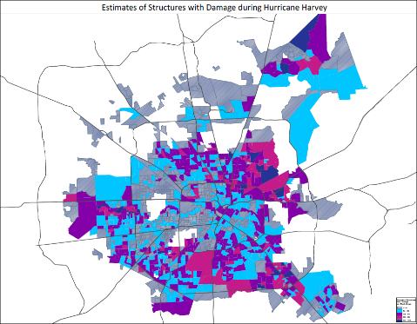
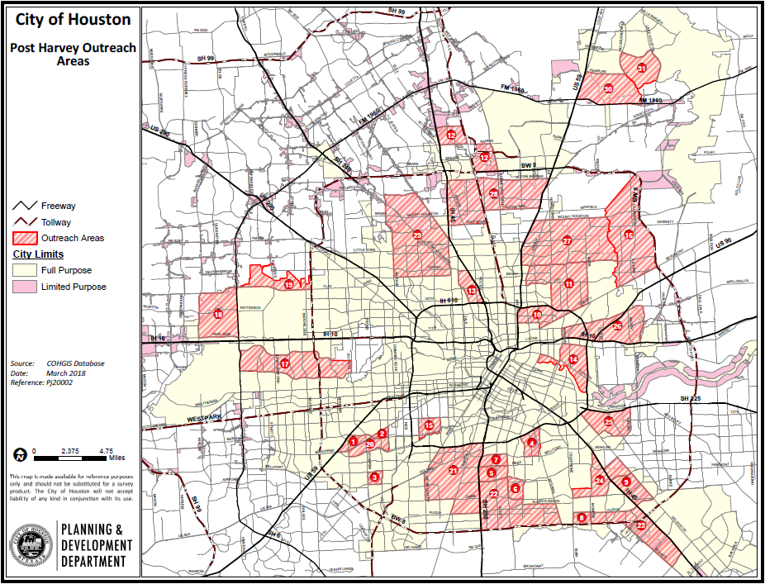
City of Houston’s Strategic Plan
Associated Image: Demographic Maps Crossed to Identify Vulnerable Areas
Female-Led Households
Unemployment Rate
Median Household Income
No HS Diploma
Structural Damage

Slide 12
City of Houston’s Strategic Plan
Cross System Screening, Shelter, and Psych. Services
  Establish Screenings Within Existing Systems
    Screened over 1,000 homeless youth ages 18-24, have intersecting vulnerabilities.
    Instituted screenings in public health spaces.
    Refer people with high indicators to City of Houston anti-trafficking case managers.
  Shelter Collaborative
    Filled emergency shelter gap for clients that partner agencies encounter in crisis.
    Shelter collaborative has expanded, houses 2 City case managers at shelter space.
    167 placements stayed 4,665 nights from all agencies.
    City case managers served 63 clients, provided 1,145 kinds of services in 5 months.
    Of the 63, positive outcomes include 3 clients moving into apartments, 3 obtaining housing through CA, 4 securing employment, and 2 continuing their education.
  Systems Approach at Hospital-Level
    Filled mental health needs, placed Psychology Fellow and CM at County Psychiatric Unit.
    Fellow received 125 referrals, 77 screened positively, all offered services.
    This public health approach is unique and compliments the traditional LE paradigm.

Slide 13
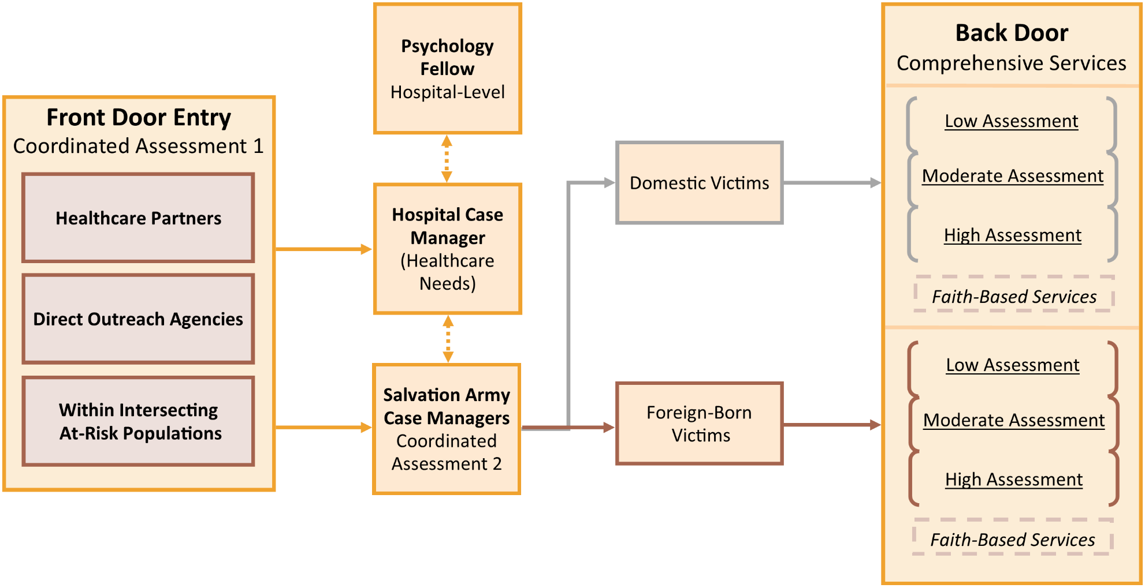
City of Houston’s Strategic Plan
Associated Image – Coordinated Screening and Services Platform

Slide 14
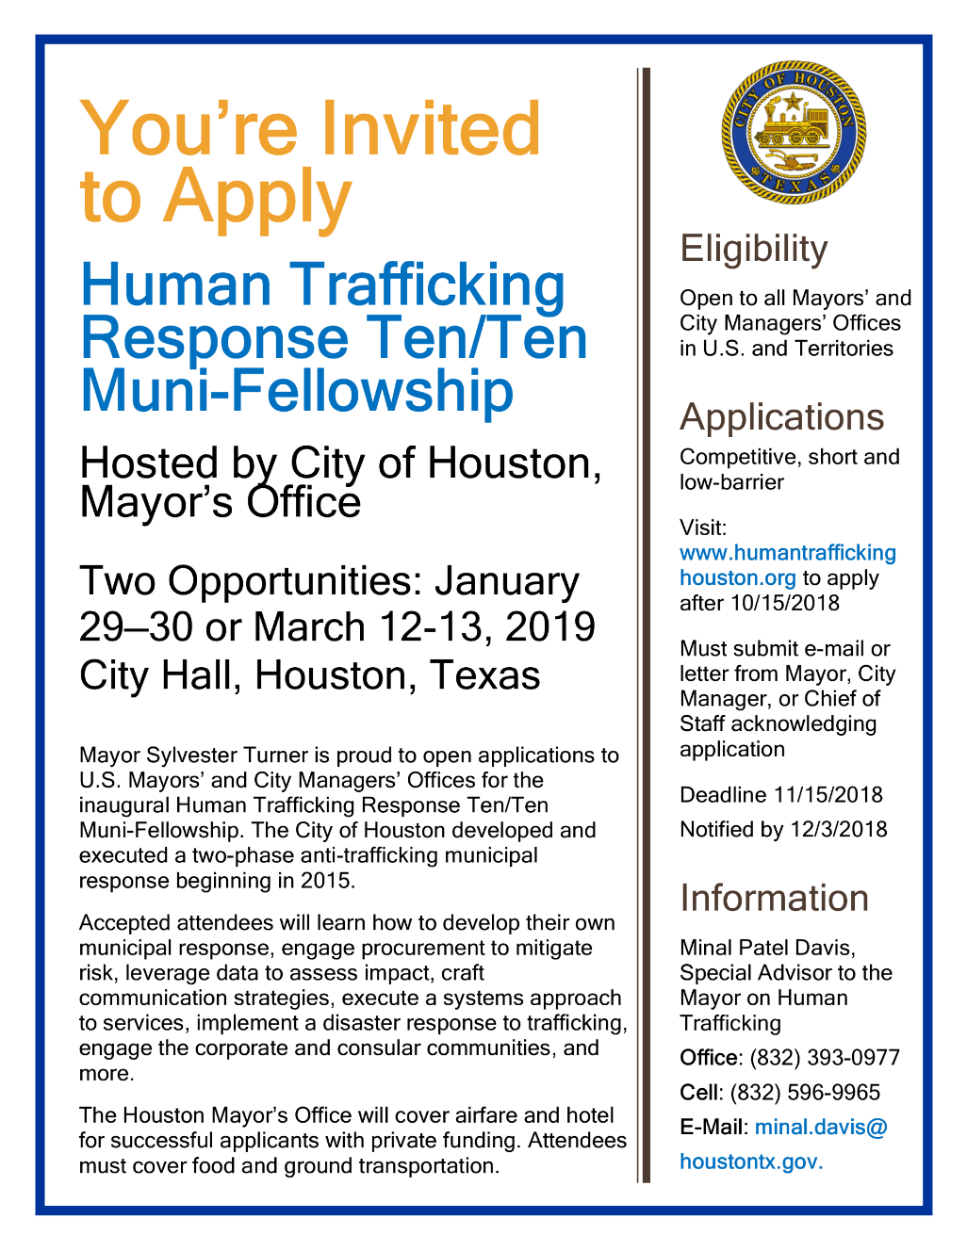
City of Houston’s Strategic Plan
Building Response Capacity of Municipalities
Position is first-of-its kind in the U.S., embedded within municipal government with direct Mayor report.
Atlanta, Chicago, and Minneapolis have since added Senior HT Fellows in their Mayor’s Offices.
Mayor Turner launching Ten/Ten muni-fellowships to 20 municipal leaders from 20 cities beginning January 2019.
2 day immersion, presentations, workshops, breakout sessions covering Houston’s Municipal response.
Private funder covering airfare and hotel, city attendees cover food and ground transportation.

Slide 15
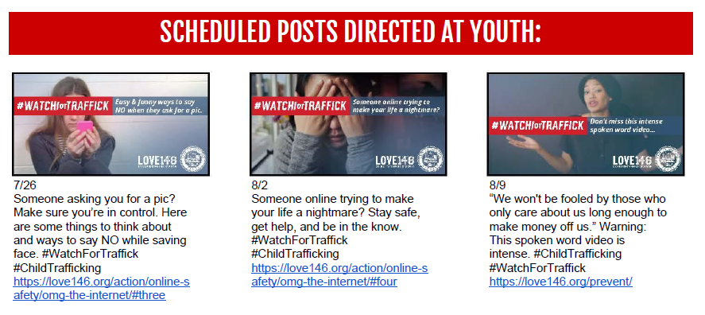
City of Houston’s Strategic Plan
Social Media Anti-Luring Campaign
Generated 3.8 million impressions, 12 posts for caregivers ages 35-55 and 12 posts for youth ages 12-24.
Coordinated campaign posts with 21 local and national partners.

Slide 16
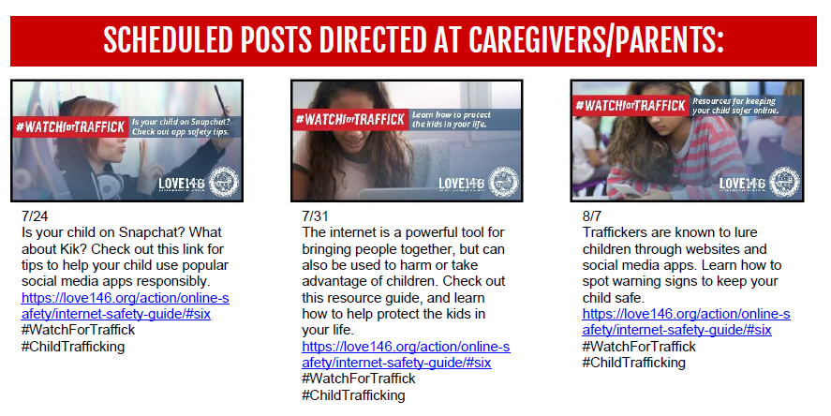
City of Houston’s Strategic Plan
Social Media Anti-Luring Campaign

Slide 17
City of Houston’s Strategic Plan
Joint Mayor’s Office and HPD Initiative
Massage Establishment Continuum
  Amended municipal ordinance governing massage establishments to expand definition and include all establishments that advertise sex for sale.
  Empowered DRT to canvas all IMBs in city during the year.
  Inspections shifted burden from potential victim to ticketing owner/operator of brothel.
  Lowered ads promoting sex for sale by parlors from 289, then 251, and to 228 after 2 canvasses.
  Implemented Municipal Court Diversion Program as screening touchpoint for potential victims of trafficking who are arrested for 1 of 4 different charges.
December 2015
City Council Passes Amended ME Ordinance
Feb. - April 2016
Led Four Trainings for Total of 174 DRT Officers
Oct. – Dec. 2017
DRT Inspects 141 Additional Locations, Issues 307 Citations
Aug. 2016 - April 2017
DRT Inspects 220 Locations, Issues 603 Citations
July 2016
Municipal Court Diversion Program Officially Launches
March - June 2016
Development of Victim Outreach Materials for LE

Slide 18
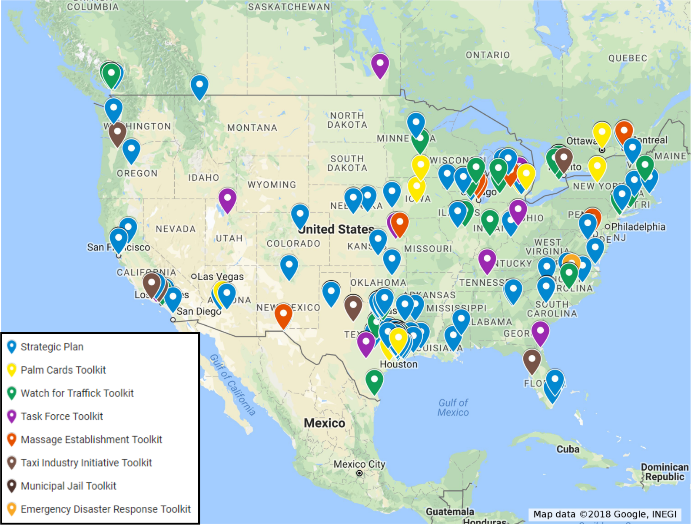
City of Houston’s Strategic Plan
Reach of Plan and Toolkit Downloads – 4/26/2017 to 3/31/2018
U.S. and International (by City)
Total Number of Downloads: 260 downloads across 87 U.S. Cities in 30 U.S. States and 4 Countries

Slide 19
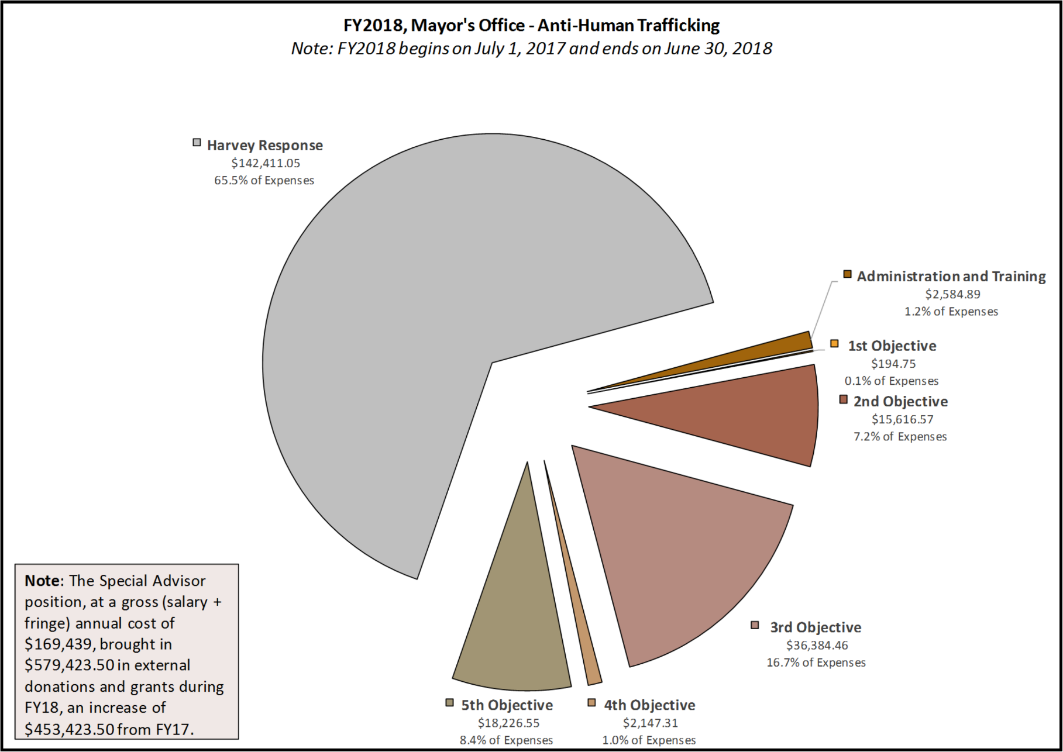
City of Houston’s Strategic Plan
Costs and Opportunities: Financial Snapshot of FY2018

Slide 20



City of Houston’s Strategic Plan
Presented by:
Minal Patel Davis
Special Advisor to the Mayor on Human Trafficking
Office of Mayor Sylvester Turner
Office: (832) 393-0977
Cell: (832) 596-9965
E-Mail: minal.davis@houstontx.gov
Website: www.humantraffickinghouston.org
@houantitraffick
@houantitraffick
@cohantihumantrafficking

