Slide 2
Communication During an Air Quality Event
How does HHD alert the public about air quality events?
Presented by:
Loren H. Raun, PhD
Chief Environmental Science Officer
Interim Bureau Chief, Bureau of Community and Children’s Environmental Health
Houston Health Department, City of Houston
Presented to: Public Safety & Homeland Security Meeting
Presented on: Tuesday June 11th, 2019 at 10:00 am

Slide 3
Outline
Background
Key Personnel Involved
Steps to Informing City Officials and Residents of an Air Quality Event
Where to find Outdoor Air Quality Information

Slide 4
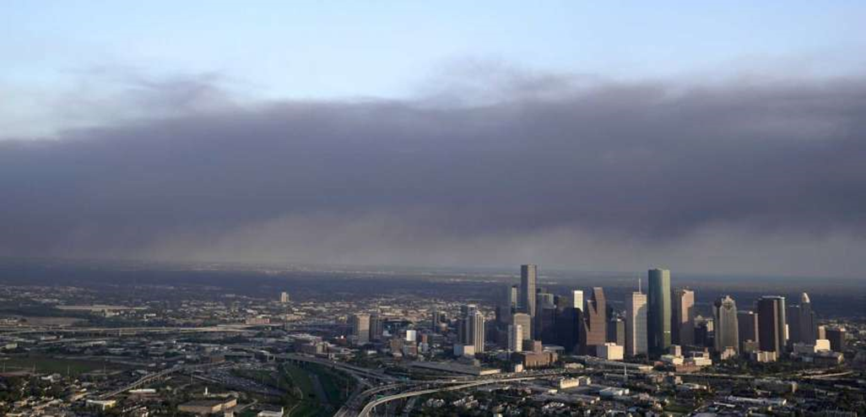
Background
The ITC tank fire highlighted concerns about air quality in the City of Houston.
Considering this, the Houston Health Department would like to share how we communicate air quality alerts to residents and elected officials.
Notes:
Source: https://www.chron.com/houston/article/No-Deer-Park-fire-related-ailments-reported-at-13703989.php

Slide 5
Who are some of the key personnel involved?

Slide 6
Key Personnel
Bureau Chief of the Bureau of Pollution Control and Prevention (Daisy James)
Public Health Authority (Dr. David Persse)
Assistant Director of the Environmental Division (Patrick Key)
Chief Environmental Science Officer (Dr. Loren Raun)
Chief Communications & Public Affairs Officer (Scott Packard)
  Public Information Officer/HHD City Council Liaison (Porfirio Villarreal)
Director of the Houston Health Department (Stephen Williams)
Mayor Sylvester Turner

Slide 7
What are the steps to inform city officials and residents of an air quality event?

Slide 8
Step 1: Alerting the Bureau of Pollution Control and Prevention (BPCP)
The Bureau Chief of BPCP can be notified of an event that may require official involvement via several methods:
311 calls from the public;
Calls from:
  The Public Health Authority (Dr. David Persse);
  The Assistant Director of the Environmental Division (Patrick Key); or
  The Director of the Houston Health Department (Stephen Williams).
Notes:
Alerting the BPCP: The Bureau Chief of the Bureau of Pollution Control and Prevention (Daisy James) is notified of an event which may require their involvement via a variety of ways, including : 311, the news, a call from the Public Health Authority (Dr. Persse), the Assistant Director of the Environmental Division (Patrick Key), or the Stephen Williams

Slide 9
Step 2: Deciding to deploy BPCP monitoring equipment
After being alerted of an event, the BPCP chief needs to determine if the deployment of monitoring equipment to supplement fixed site network is necessary.
The BPCP chief collects all available data/information, including:
Type of pollutant;
Wind direction; and
Proximity to residences.
The BPCP chief confers with other City officials, including the Public Health Authority, Environmental Division Assistant Director, and the Chief Environmental Science Officer, as needed.
Notes:
Deciding to deploy BPCP monitoring equipment to supplement fixed site network: The BPCP Chief collects all available data/information and then confers with the Environmental Division Assistant Director. The ED Assistant Director may confer with Dr. Persse and the Chief Environmental Science Officer (Dr. Loren Raun), as needed. City officials consider the fixed site monitoring data and available information, the type of pollutant, the wind direction, and the proximity to residences.

Slide 10
Step 3: Communicating internally during deployment
If the decision is made to deploy BPCP monitoring equipment, the BPCP Chief is in constant contact with BPCP personnel.
The BPCP Chief relays all activities and findings to the Environmental Division Assistant Director (usually over the phone).
The BPCP Chief relays all information to the Public Health Authority and the Chief Environmental Science Officer (usually over the phone).
Notes:
Communicating internally during deployment: The BPCP Chief is in constant contact with BPCP personnel and relays all activities and findings to the ED Assistant Director, usually over the phone. The ED Asisstant Director relays the information to the Public Health Authority and the Chief Environmental Science Officer, usually over the phone.

Slide 11
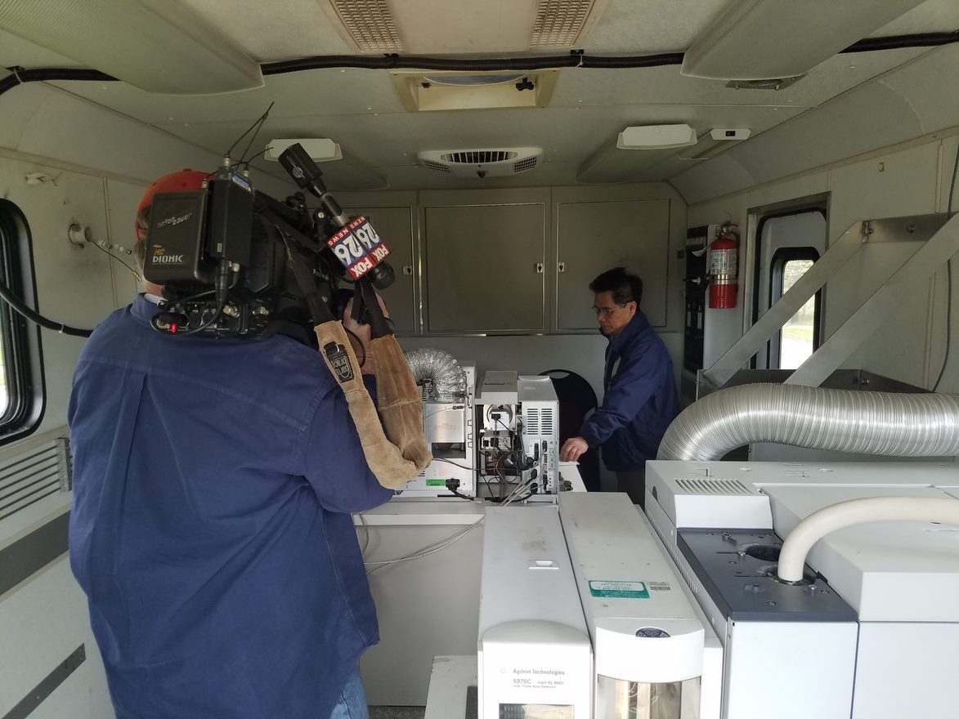
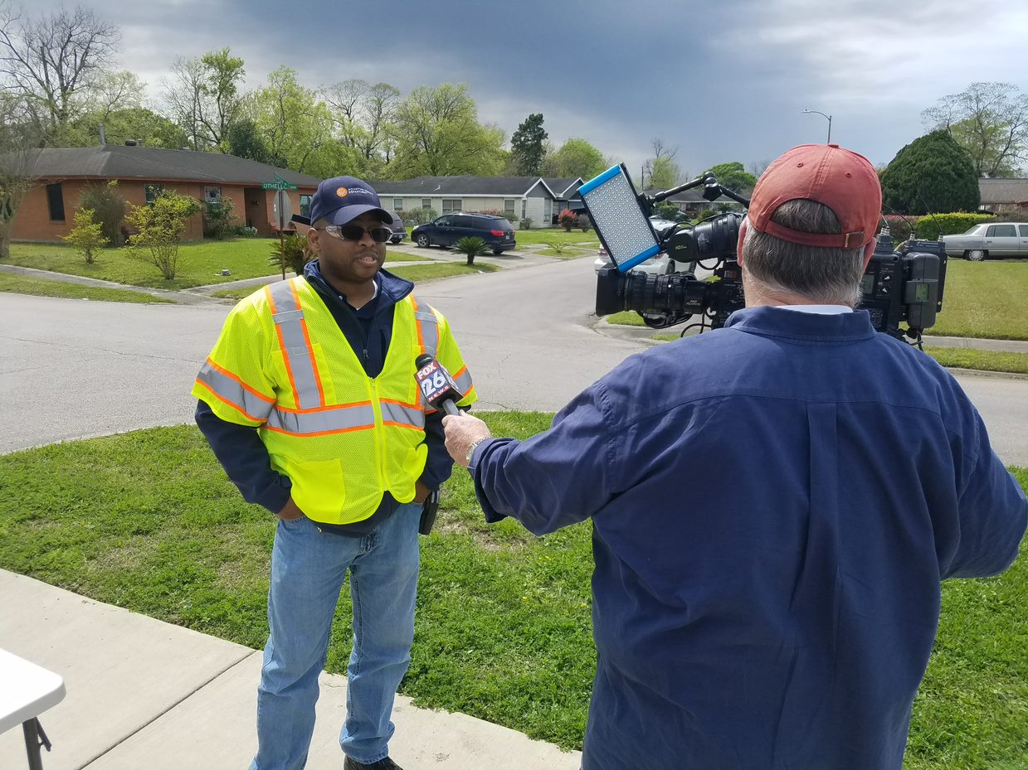
BPCP personnel monitoring equipment during ITC fire deployment

Slide 12
Step 4: Communicating results to the public
The Mayor, himself, may relay information, or the Public Health Authority or other designated City officials such as the Chief Environmental Science Officer.
All communication with the public is coordinated by the Health Department Chief Communications and Public Affairs Officer.
Approach depends on the size and complexity of the event.
The primary methods to deliver information are:
The news media; and
City of Houston online platforms; and
Geotargeted notifications via the AlertHouston system.
Notes:
Communicating results with the public: Public communication approaches depend on the size and complexity of the event. However, the primary methods to deliver information to the public are the news media and City of Houston online platforms. Assuming the event requires ongoing public updates over an extended period of time, regular news releases would be issued with the latest air quality information. These news releases would offer complex air quality data in an easy-to-understand presentation such as graphs or maps. This information would be amplified and centralized on the HoustonEmergency.org website and affiliated social media platforms. Each update would clearly indicate the time it was issued and the time of the next update. Regular news conferences would be conducted to offer updates and context about the event. In most instances, the mayor of the City of Houston will be the primary spokesperson for the event. During news conferences the mayor would call upon health officials, likely the Local Health Authority, to provide context about air quality data.
In non-emergency situations, air quality information is presented on the Houston Health Department website. The outdoor air quality page offers information on the Air Quality Index (AQI), air quality forecasts, Ozone Action Day alerts and Asthma Air Aware Day warmings. This information is frequently amplified on City online platforms.

Slide 13
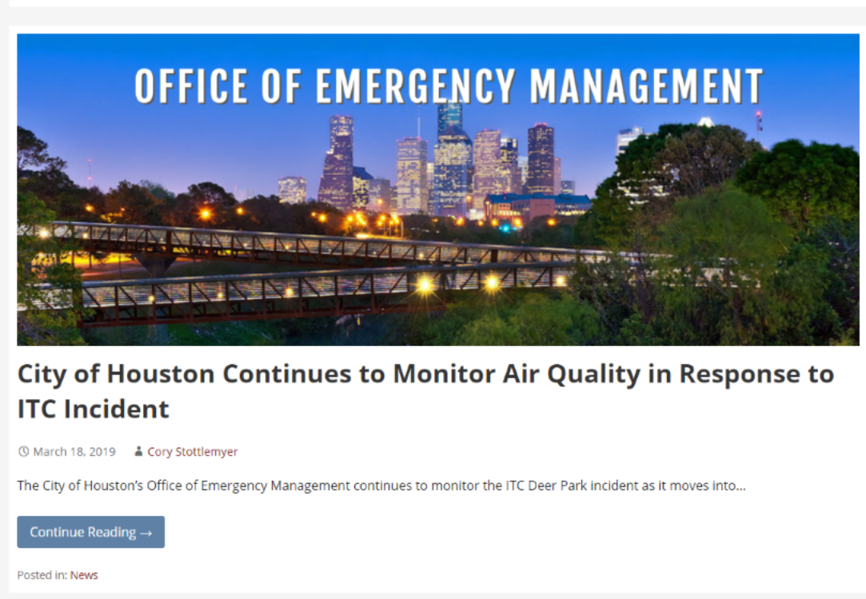
City of Houston Office of Emergency Management webpage update during ITC Fire

Slide 14
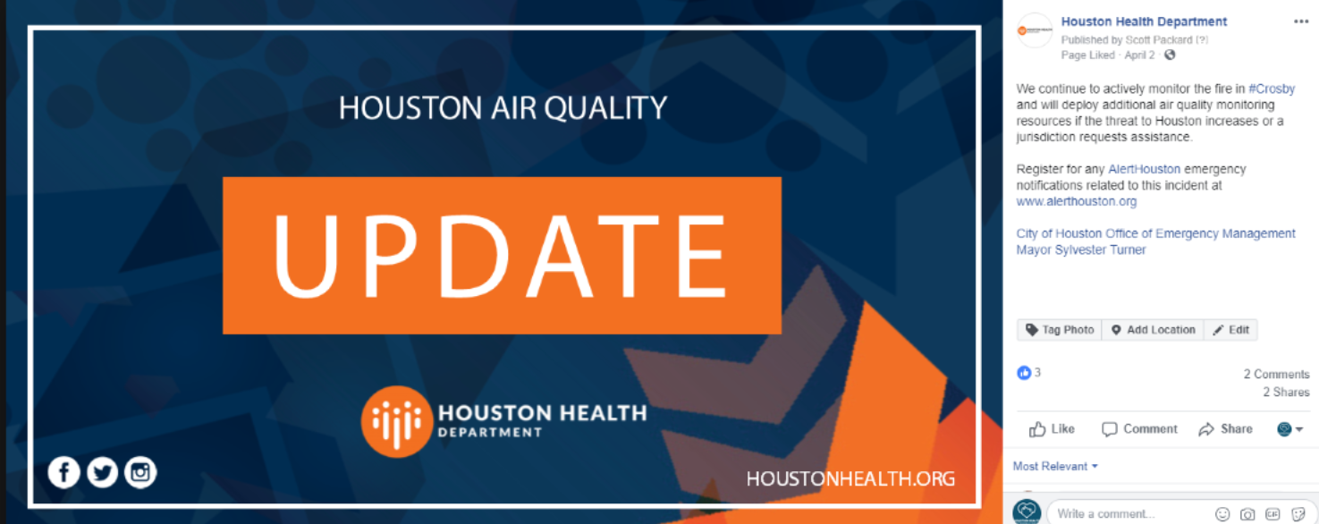
Houston Health Department social media update during Crosby fire

Slide 15
Step 4: Communicating results to the public (cont.)
Regular news releases are issued with the latest air quality information.
The news releases offer complex air quality data in easy-to-read formats such as graphs or maps, and
Each update clearly indicates the time it was issued and the time of the next update.
Emergency notifications, including protective actions, will be shared via AlertHouston.
This information would be amplified and centralized on the HoustonEmergency.org website and affiliated social media platforms.
Regular news conferences are conducted to offer updates and context about the event.
In most instances, the mayor of the City of Houston will be the primary spokesperson for the event.
During news conferences the mayor would call upon health officials, likely the Public Health Authority, to provide context about air quality data.
Notes:
Communicating results with the public: Public communication approaches depend on the size and complexity of the event. However, the primary methods to deliver information to the public are the news media and City of Houston online platforms. Assuming the event requires ongoing public updates over an extended period of time, regular news releases would be issued with the latest air quality information. These news releases would offer complex air quality data in an easy-to-understand presentation such as graphs or maps. This information would be amplified and centralized on the HoustonEmergency.org website and affiliated social media platforms. Each update would clearly indicate the time it was issued and the time of the next update. Regular news conferences would be conducted to offer updates and context about the event. In most instances, the mayor of the City of Houston will be the primary spokesperson for the event. During news conferences the mayor would call upon health officials, likely the Local Health Authority, to provide context about air quality data.
In non-emergency situations, air quality information is presented on the Houston Health Department website. The outdoor air quality page offers information on the Air Quality Index (AQI), air quality forecasts, Ozone Action Day alerts and Asthma Air Aware Day warmings. This information is frequently amplified on City online platforms.

Slide 16
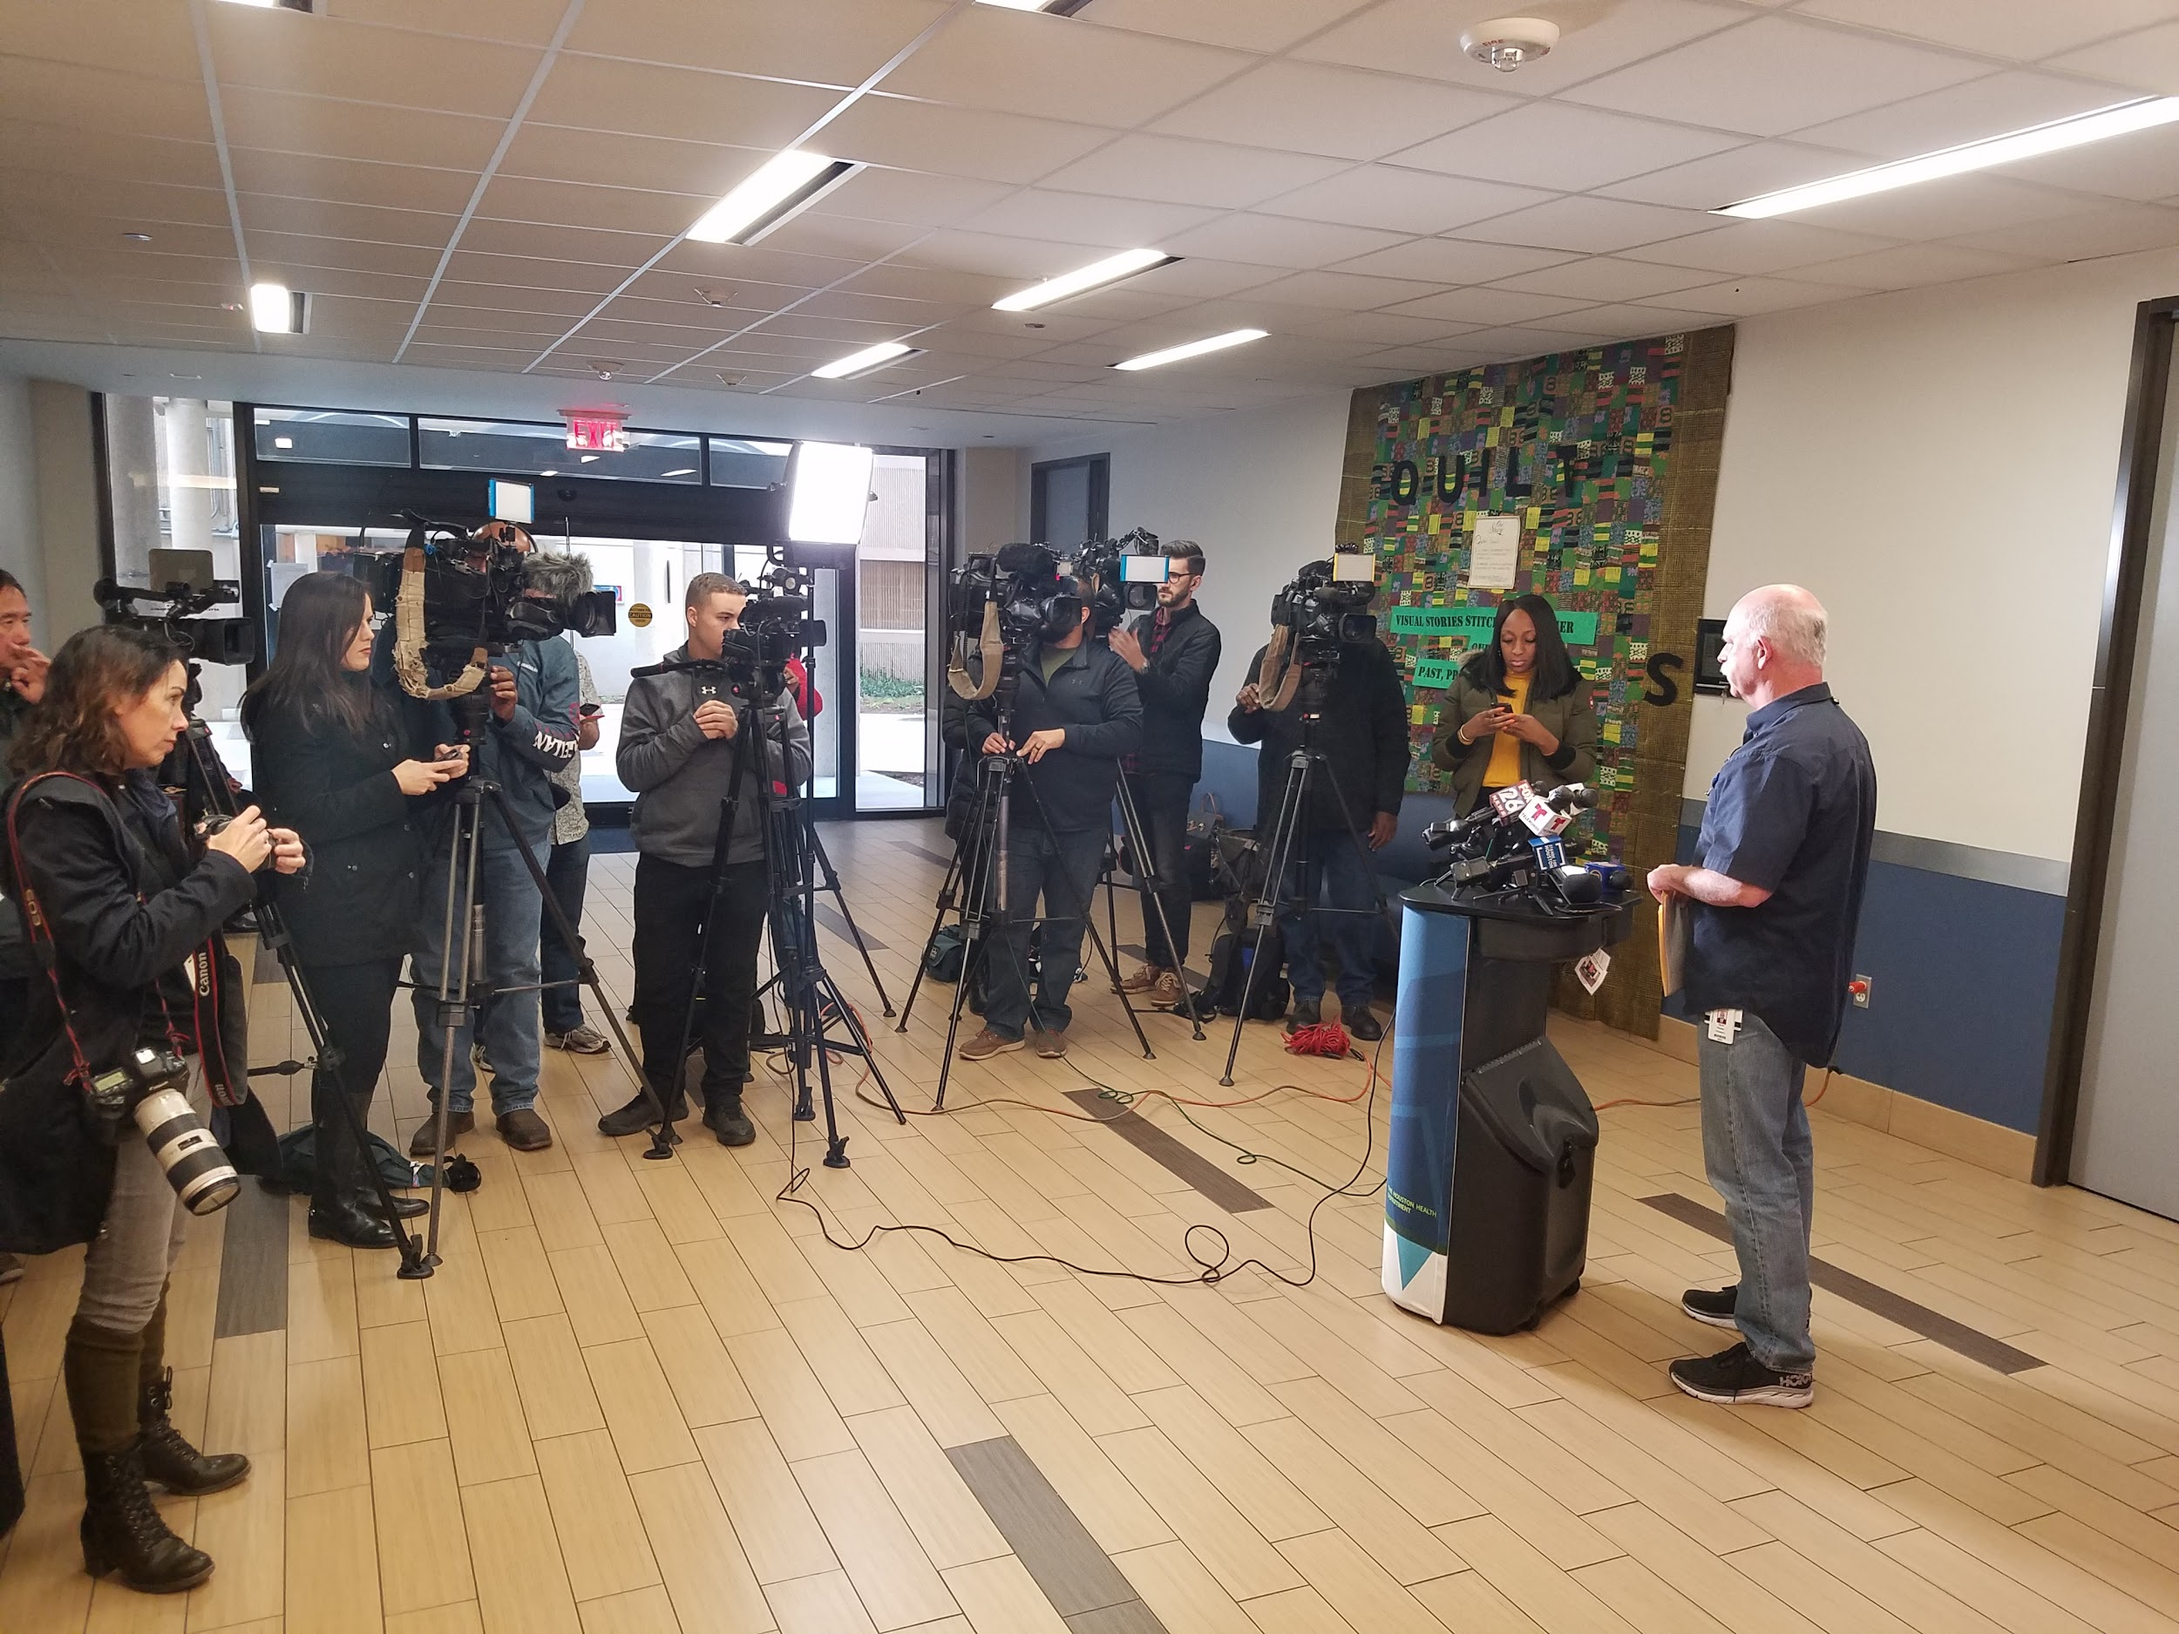
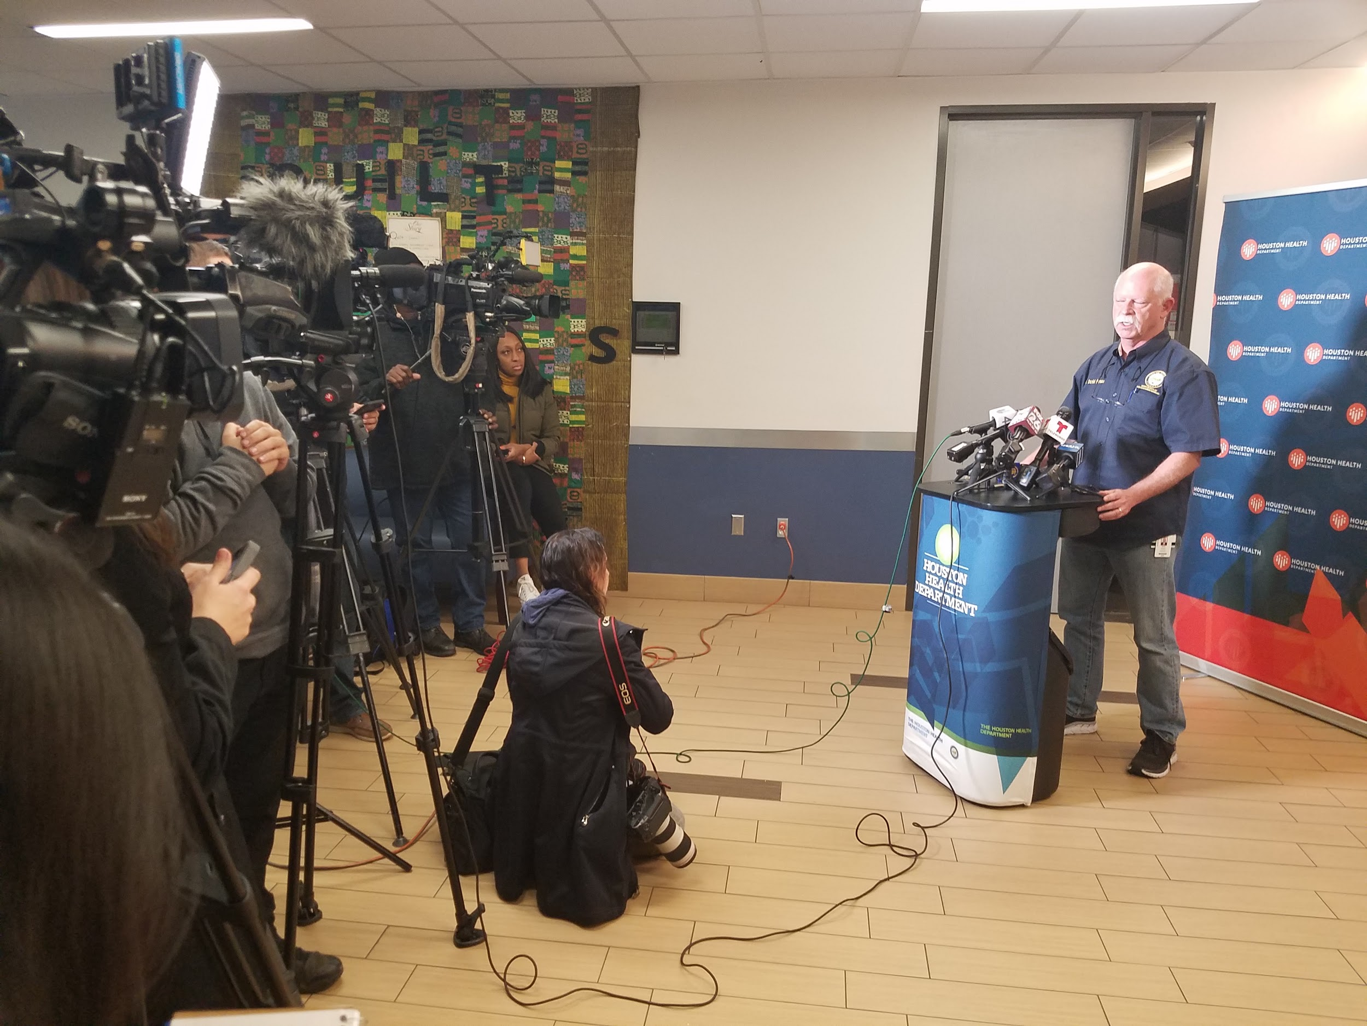
Dr. Persse (Public Health Authority) providing information via a news conference

Slide 17
Where can residents find information regarding outdoor air quality?

Slide 18
Where to find air quality information
In non-emergency situations, air quality information is presented on the Houston Health Department website.
The outdoor air quality page offers information on:
  Air Quality Index (AQI);
  Air quality forecasts;
  Ozone Action Day alerts; and
  Asthma Air Aware Day warnings.
This information is frequently amplified on City online platforms.
https://www.houstontx.gov/health/Environmental/bpcp/outdoor_air.html

Slide 19
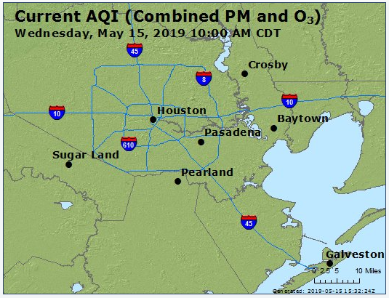
Air Quality Index (AQI)
A daily monitor hosted by EPA/AirNow that tells you how clean or polluted your outdoor air is, along with associated health effects that may be of concern.
https://www.airnow.gov/index.cfm?action=airnow.local_city&cityid=236

Slide 20
Air Quality Forecasts and Ozone Action Days
Air Quality Forecast
Based on the EPA's Air Quality Index scale for ozone, PM2.5, and PM10, made for 14 forecast regions across the state. It is updated daily on normal TCEQ work days and may also be updated on weekends or holidays when air pollution levels are high.
Ozone Action Days
These are declared on hot, sunny, still days when conditions are most favorable for the accumulation of unhealthy levels of ground-level ozone. Residents can sign up through TCEQ to receive an email alert for these days.
https://www.tceq.texas.gov/airquality/monops/ozone_email.html

Slide 21
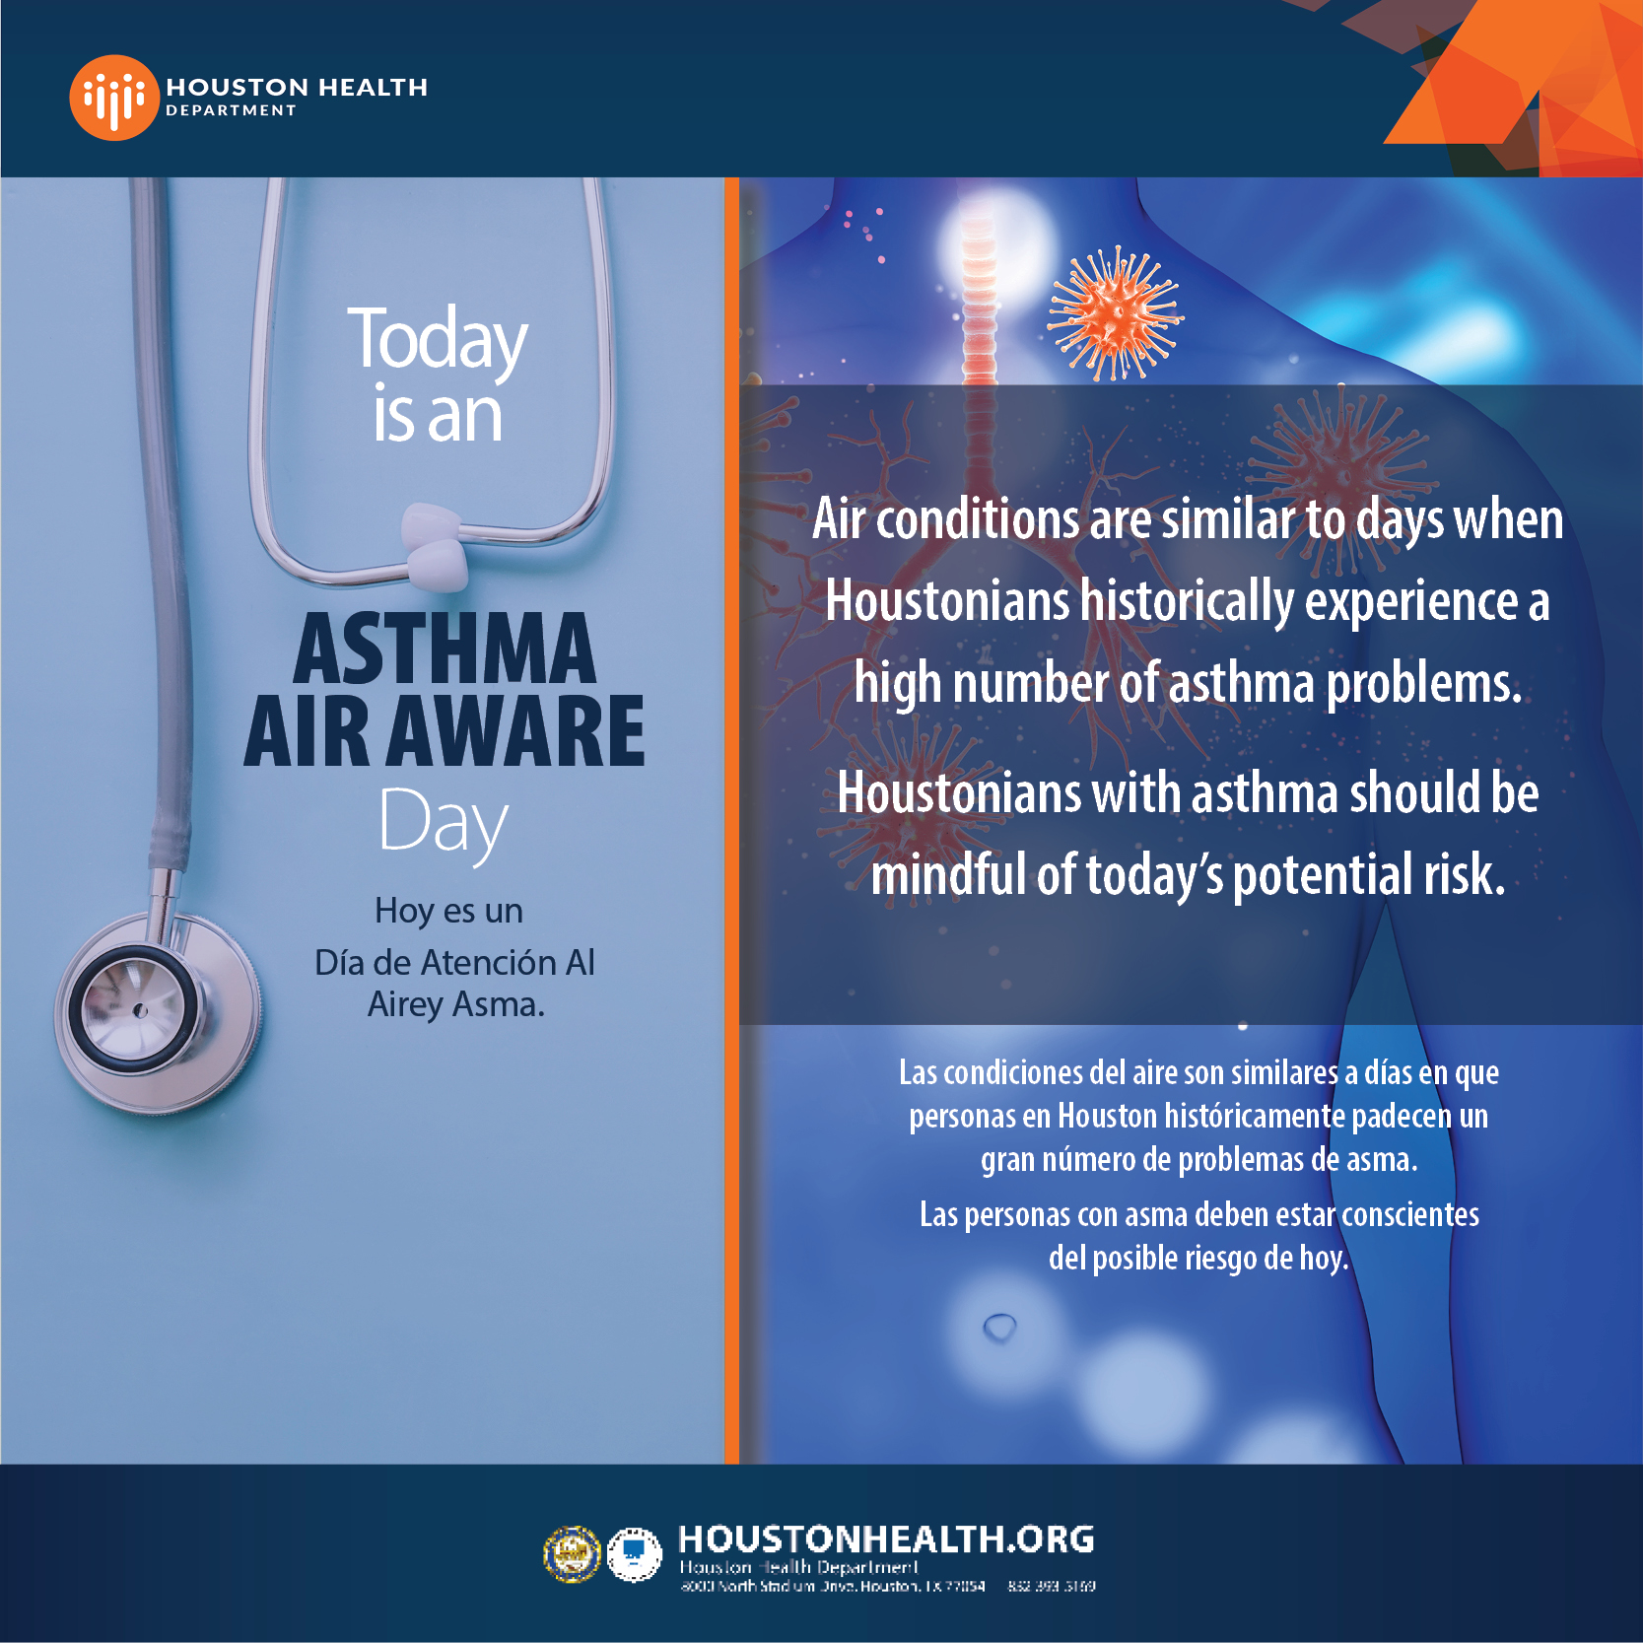
Asthma Air Aware Day
The Houston Health Department issues an Asthma Air Aware Day Warning when outdoor air conditions are similar to days when Houstonians historically experienced a high number of asthma problems. Houstonians with asthma should be mindful of the potential risk on Asthma Air Aware Days.

Slide 22
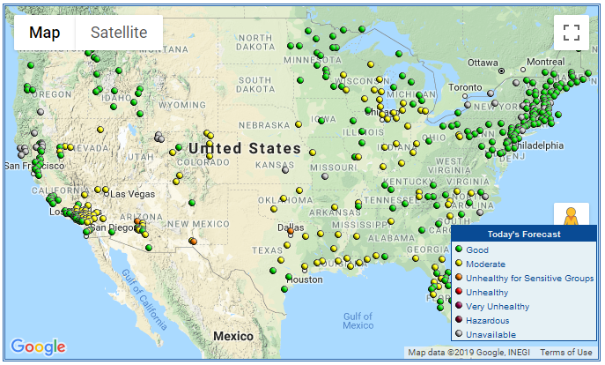
EnviroFlash
An online system that provides up-to-date information allowing residents to make decisions based on air quality forecasts. EnviroFlash comes from a partnership between the US EPA and a state or local air quality agency - notifying residents about air quality so they don't have to go searching for it!
http://www.enviroflash.info/

Slide 23
Questions?

Slide 24
Thank you!

