Slide 1


GREATER HOUSTON POLICE ACTIVITIES LEAGUE
PROGRAMMING
August 13, 2019

Slide 2

Greater Houston Police Activities League
GHPAL Mission
The mission of the Greater Houston Police Activities League (GHPAL) is to reduce juvenile crime and violence through “Relational Policing” which includes building trusting relationships between youth, law enforcement and the community.

Slide 3
Formation of Police Activities League/Greater Houston Police Activities League
PAL was originally formed in 1983 by the Houston Area Exchange Club and then under Chief Lee P. Brown
In 2004, Mayor Bill White and Chief Harold Hurtt implemented a series of budget cuts in HPD, which resulted in the termination of HPD’s DARE Program, Explorer Post and PAL unit.
PAL was re-launched as GHPAL in 2017 under Chief Art Acevedo
GHPAL is a 501-C 3 Organization, with a GHPAL Foundation Board and members
GHPAL is a citywide program, operated by 14 full-time GHPAL officers
The GHPAL provides a safe and positive afterschool environment and summer curriculum to promote positive interactions with core members, but also other youth across the city, through programming and special events.

Slide 4

GHPAL Outcomes
Building trust with youth
Building trust with communities and other stakeholders
Healthy Living / Wellness
Sports – Athletic Development
Cultural enrichment
Crime prevention awareness
Provides positive mentors for at-risk youth
Notes:
According to the NATIONAL PAL, there are over 300 PAL Member Chapters either within law enforcement agencies or operating as a 501 c 3 Not for Profit organization.
A large number of PAL organizations are operated by Non-Profit’s utilizing volunteers. Their biggest challenge is officers whereas GHPAL is 100 % Officer ran.

Slide 5

GHPAL Recruitment for Members to Participate in Core/Consistent Programming:
School Districts
Boys and Girls Clubs of Houston
Houston Parks and Recreation Department
Community Centers
Apartment Complexes

Slide 6






GHPAL Community Partners
Houston Texans
Houston Rockets
Academy Sports and Outdoors
Houston Parks and Rec
Boys and Girls Clubs
GHPAL board members
McDonalds
Notes:
According to the NATIONAL PAL, there are over 300 PAL Member Chapters either within law enforcement agencies or operating as a 501 c 3 Not for Profit organization.
A large number of PAL organizations are operated by Non-Profit’s utilizing volunteers. Their biggest challenge is officers whereas GHPAL is 100 % Officer ran.

Slide 7
Program Tracking System
NFocus Solutions – web-based tracking system. The company’s clients include law enforcement, the military, first responders, government agencies and non-profits. This tracking system will allow us to gauge the effectiveness of programs, number of attendees and more data. Features include:
Program Management
Activity Tracking
Dashboards for real-time tracking of key performance indicators
Performance, Activity and Attendance Reporting
Mobile Scanning for 14 PAL officers to scan members attending events via their cell phones, tablets, or PC’s.
TraxTalk Notification App (automatically notifies parents when their child scans in or out of a facility)
Member ID card printing
Hosting, daily data backup, data storage and security
Unlimited tech support
Software licenses, implementation services, training database set-up and configuration

Slide 8
GHPAL Funding
The following grants were received in 2017-2018-2019
The Houston Texans - $10,000
Clutch City Foundation/Houston Rockets - $6,000
BNSF Railway - $5,000
Academy Sports and Outdoors -$5,000
Houston Police Officers Union - $5,000
Houston Police Federal Credit Union - $1,000
Servepro Industries - $5,000
Target - $1,000
HPD Special Funds #2201 - $25,000
Federal Asset Forfeiture Funds -$50,000, officer overtime for after-hours and weekends
Federal grant pending - $5,998 for Nfocus software initial set-up
Notes:
According to the NATIONAL PAL, there are over 300 PAL Member Chapters either within law enforcement agencies or operating as a 501 c 3 Not for Profit organization.
A large number of PAL organizations are operated by Non-Profit’s utilizing volunteers. Their biggest challenge is officers whereas GHPAL is 100 % Officer ran.

Slide 9
GHPAL Funds have been used for the following:
200 members t-shirts
Advisor polo’s and t-shirts
Tracking software
Sports equipment
Pop-up tents
6 foot tables
Basketball jerseys
National PAL conference registration & travel fees
Large inflatable for citywide field days
Liability Insurance
Field trips and refreshments
Miscellaneous vendor rental fees.
Notes:
According to the NATIONAL PAL, there are over 300 PAL Member Chapters either within law enforcement agencies or operating as a 501 c 3 Not for Profit organization.
A large number of PAL organizations are operated by Non-Profit’s utilizing volunteers. Their biggest challenge is officers whereas GHPAL is 100 % Officer ran.

Slide 10
GHPAL Potential Annual Expenses
Tracking software yearly fees $1,899
GHPAL insurance annual fee $4,450 for 200 core members; 500 youth citywide
National PAL conference registration, travel expenses for up to three attendees, estimated $5,000
School bus rentals estimated $3000
Field Trips estimated $3,000
Facility Rental Fees for programs estimated $3,000
Trophy purchases for tournaments/competitions estimated $2,000
Equipment purchases estimated $3000
Notes:
According to the NATIONAL PAL, there are over 300 PAL Member Chapters either within law enforcement agencies or operating as a 501 c 3 Not for Profit organization.
A large number of PAL organizations are operated by Non-Profit’s utilizing volunteers. Their biggest challenge is officers whereas GHPAL is 100 % Officer ran.

Slide 11
GREATER HOUSTON POLICE ACTIVITIES LEAGUE
PROGRAMMING

Slide 12

While there are numerous admirable youth programs in existence, GHPAL is unique in that it adds one very VITAL and important component…….
Police Officers
Notes:
According to the NATIONAL PAL, there are over 300 PAL Member Chapters either within law enforcement agencies or operating as a 501 c 3 Not for Profit organization.
A large number of PAL organizations are operated by Non-Profit’s utilizing volunteers. Their biggest challenge is officers whereas GHPAL is 100 % Officer ran.

Slide 13
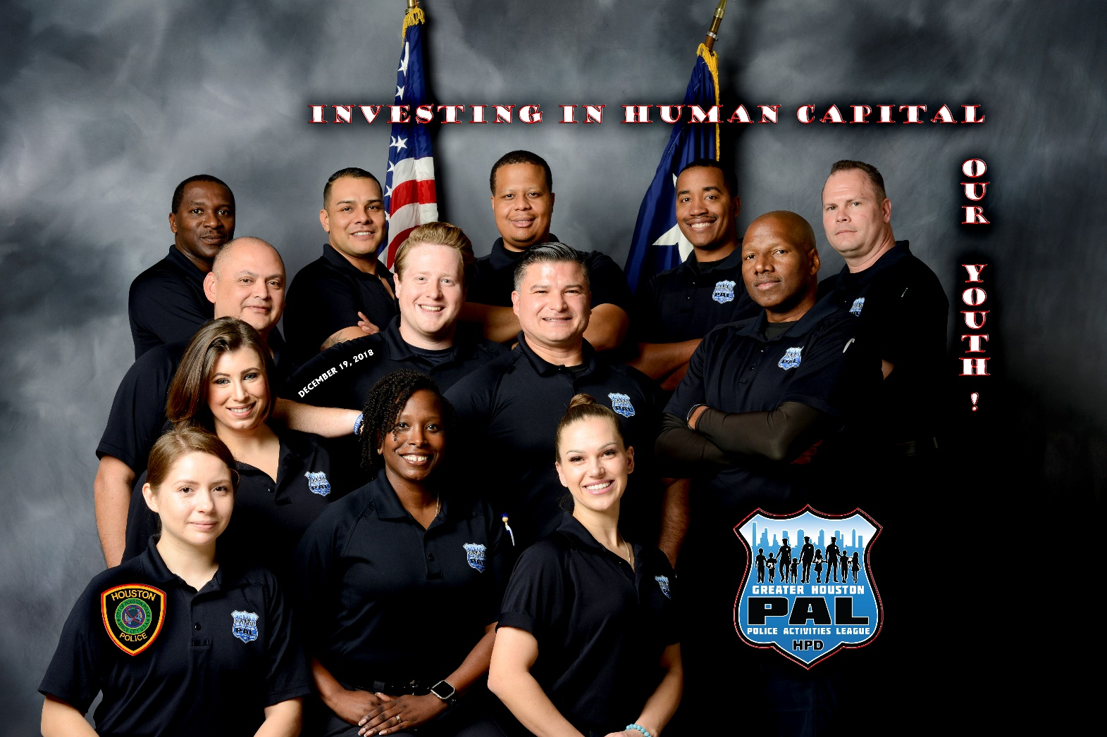

Slide 14
Current List of GHPAL Core Youths
Central Patrol - Officer Kimberley Hendrick
  Thirty-two (32) core members
Kingwood Patrol - Officer Christopher Morales
  Six (6) core members
North Patrol - Officer Natasha Myers
  Seven (7) core members
North Belt Patrol – Dustin Bearden
  Eighteen (18) core members
Northeast Patrol – Aurelia Aguilar
  Eight (8) core members
Clear Lake Patrol – Officer Anthony Triplett
  Seven (7) core members
Eastside Patrol – Megan Michon
  Seven (7) core members – Just returned from Injury on Duty Status
Northwest Patrol – Officer Richard A. Williams
  Eight (8) core members
South Gessner – Officer Terrance Burrell
  Four (4) core members
Southwest Patrol – Darrell Elzy
  Eleven (11) core members
Westside Patrol – Officer Andres Hernandez (Reserved Military)
  Fifty-eight (58) core members
South Central – Charles Webb
  Forty-seven (47) core members
Southeast Patrol – Scott Zacchaeus
  Six (6) core members
Midwest Patrol – Flavio Zermeno
  Seventeen (17) core members
Total Core Youth in GHPAL: 236

Slide 15
What are the requirements to become a GHPAL core member and what does a core member mean?
Core Member – Identified youth (8-18 yoa) that:
  Consistently participates in activities no less than 2 hours bi-weekly / 4 hours monthly with a 1-4 ratio (Social and Cultural Enrichment, Educational, Academics, Athletics and Mentoring)
  Eligible to attend special events (Shop with a Cop, Sporting event Tickets, Sports Clinics and Training Camps, Self-Development workshops)
  Have a positive and influential role model that will work with them in any aspect of their life and help them to succeed in problem areas identified through interaction.

Slide 16
GHPAL Programming - Activities Include:
Social & Cultural Activities
  Team Building Activities
  Mentoring
  Field Trips (Horse Stables, Zoo, Movies, etc…)
  Arts / Crafts
  Museum Visits
Athletic Activities
  Flag Football
  Basketball
  Soccer
  Tennis
  Gymnastics
  Boxing / Jiu Jitsu
Academic Activities
  Helping with Homework
  Literacy (Reading / Writing)

Slide 17
Consistent vs. Core Programs
Consistent Programs
Core Programs
Programs created at the divisional level designed to meet the needs of the communities within ones area of responsibility.
Citywide Programming created to serve communities throughout the City of Houston on specific dates and times every week for the core GHPAL members.

Slide 18



CORE PROGRAMMING
The Greater Houston Police Activities League (GHPAL) has partnered with the Parks and Recreation Department to actively recruit area youth to participate year-round sporting activities .
The activities will be conducted at parks located throughout the city.
The activities will occur simultaneously at each of these locations.
Each location will have GHPAL officers overseeing and coaching the following activities with youths that live in the community that are within close proximity to the park:
Each League would have two different age groups (10-13 YOA / 14-17 YOA)
Soccer (January – March)
Basketball (May – July)
Flag Football (September – November)
Notes:
Recruiting from Neighborhoods and Apartment Complexes that feed into the Park along with existing CORE GHPAL members
We are currently working with Houston Parks and Recs regarding logistical matches (Scheduling / Condition of the Fields – Insurance)
From 330 – 1730
Soccer Jan – March
Two days out of the week (one for each group)
Dynamic Stretching/Warm-Up
Teach Basic Concepts
Basic Tactics “Support, First Defender, Shift and Sag”
Passing/Dribbling
Defense/Offense
Goal Kicking/Goal Keeper
Competitions
Basket Ball Two days out of week (During May) /
During June – July Two Days a week With Each age group same day 10-12 / 2-4
Two days out of the week (one for each group)
Dynamic Stretching/Warm-Up
Basic/Advances Passes
Shooting Drills
Passing/Dribbling
Defense/Offense
Pair Passing/Cuts
Rebound Techniques
Competitions
Flag Football Two days a week one day per age group
Dynamic Stretching/Warm-Up
Football Drills
Practice Plays
Basic Throwing/Catching
Basic Offense Skills – Running/Centering the Ball
Basic Defense Skills - Blocking
Competitions

Slide 19
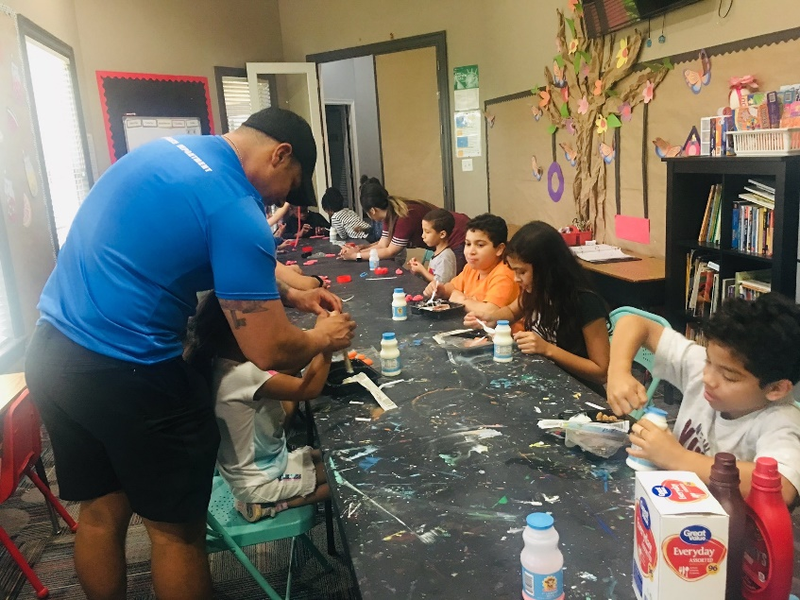
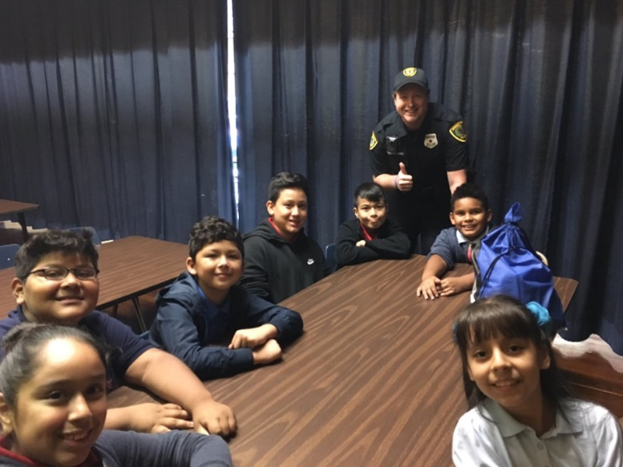
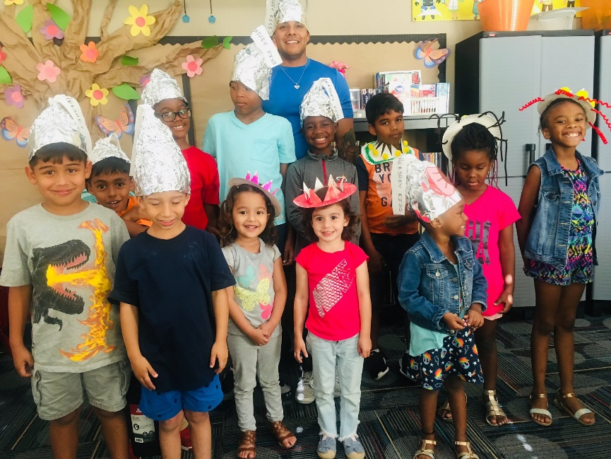
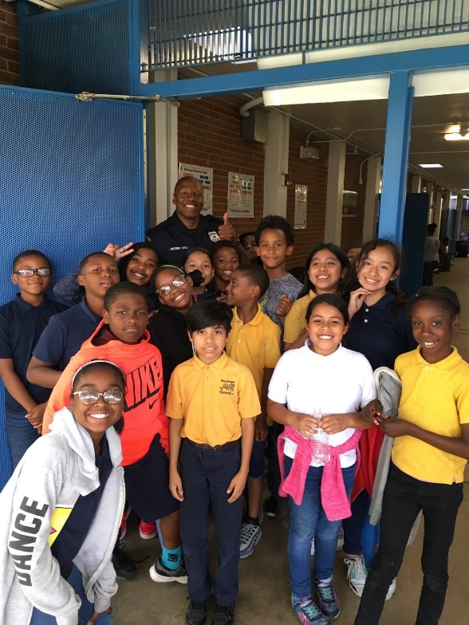
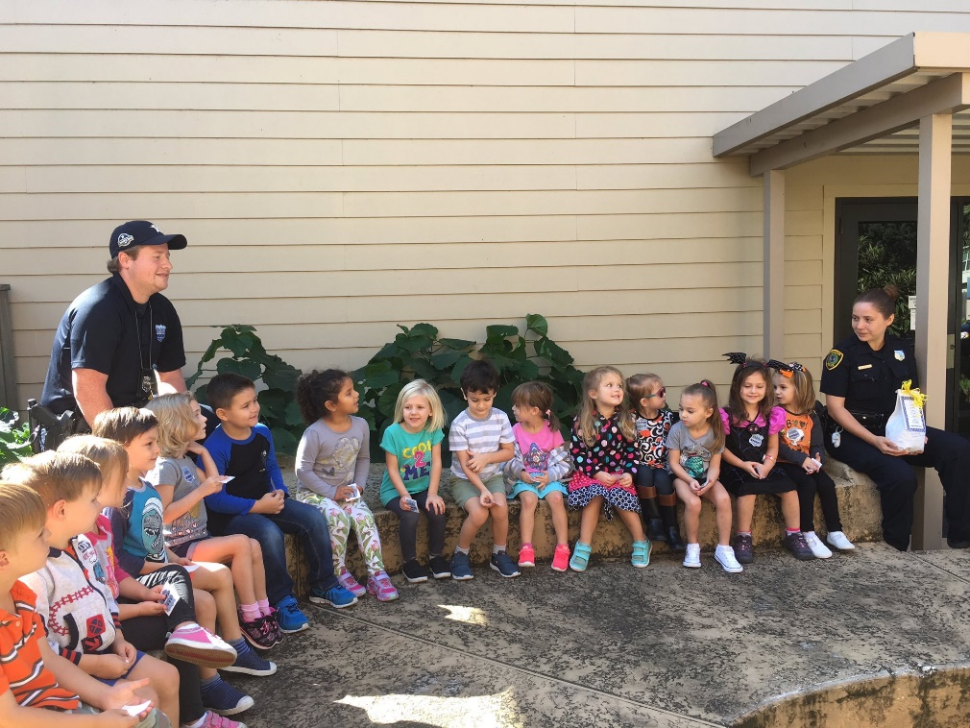
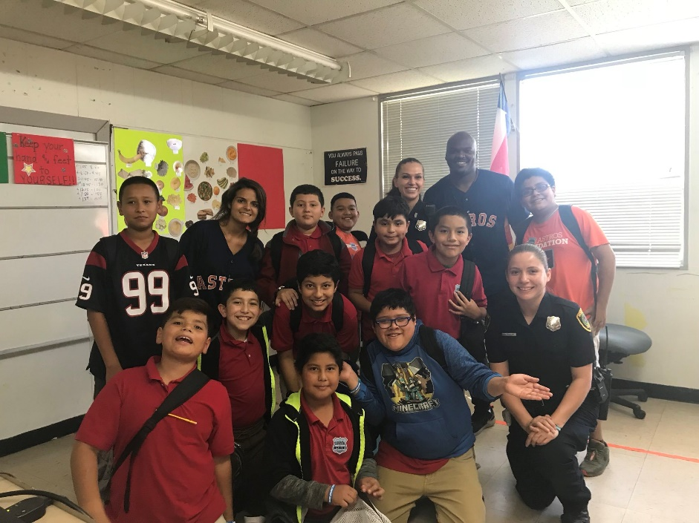
Social / Cultural Programming

Slide 20
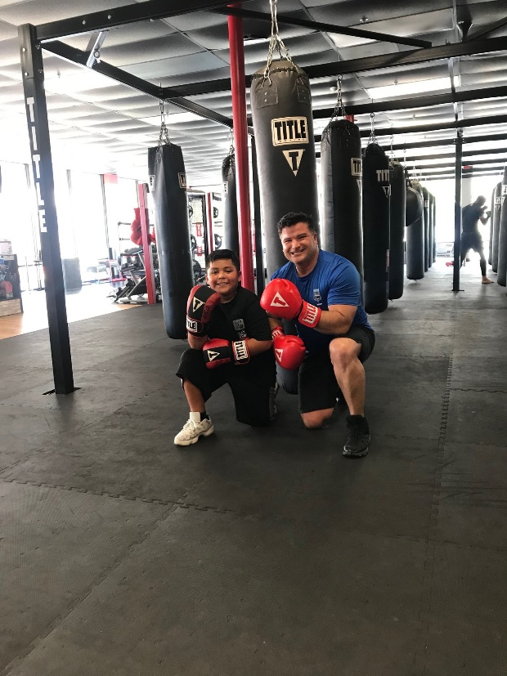
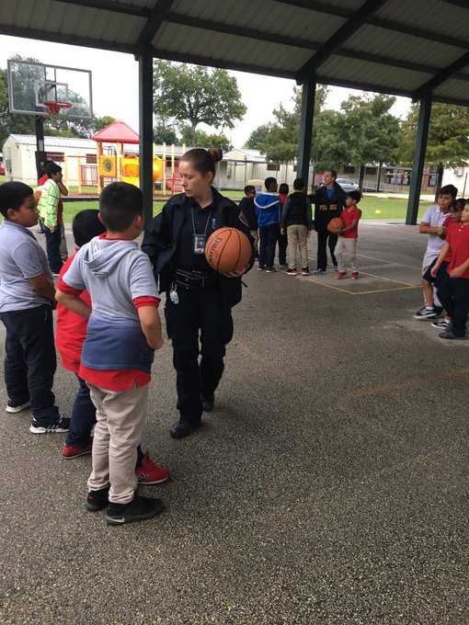
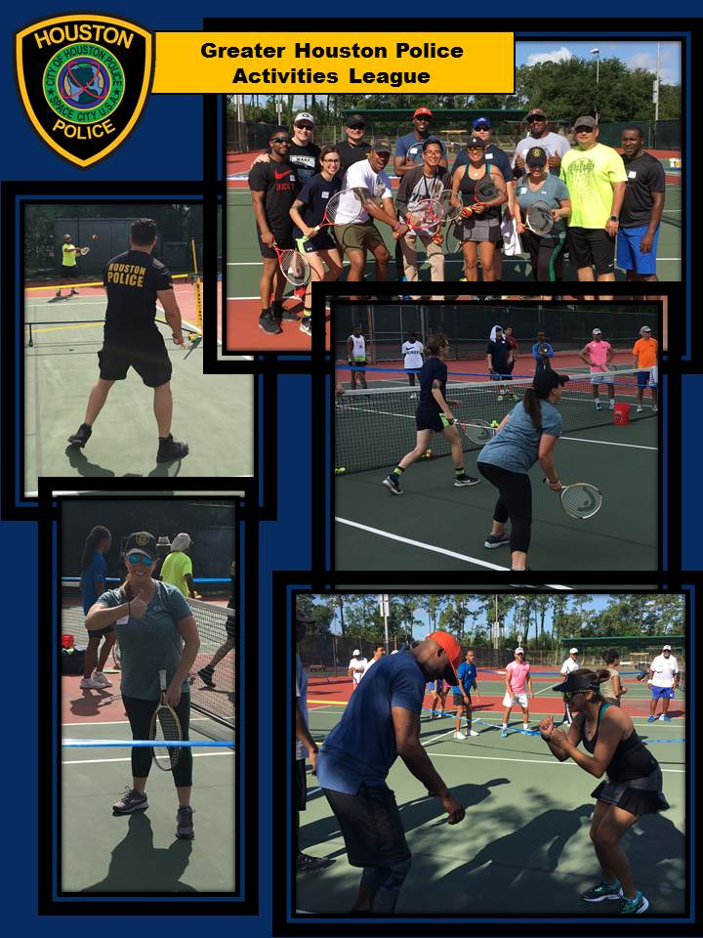
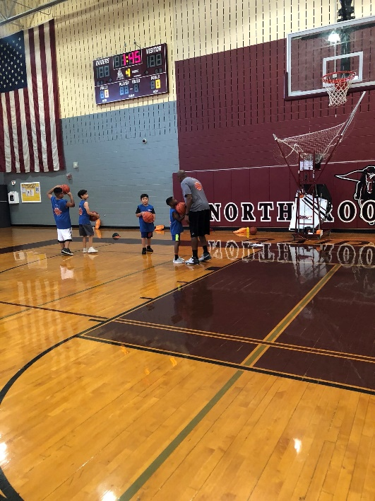
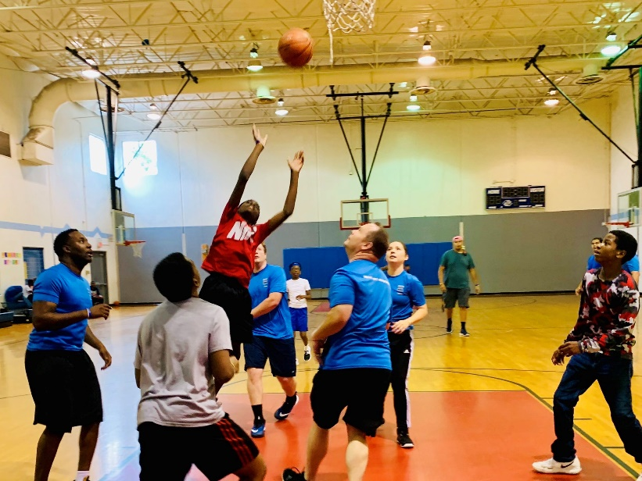
Athletic Programming

Slide 21
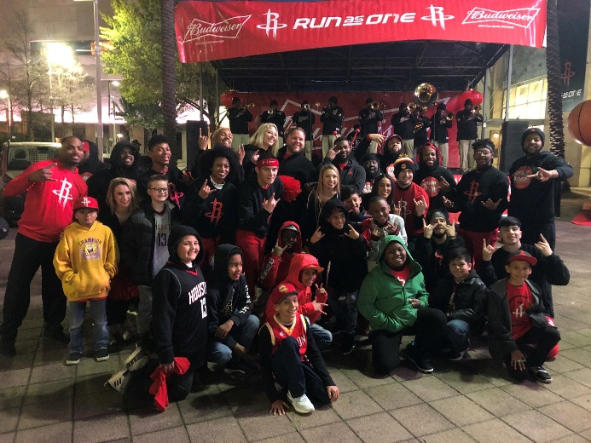
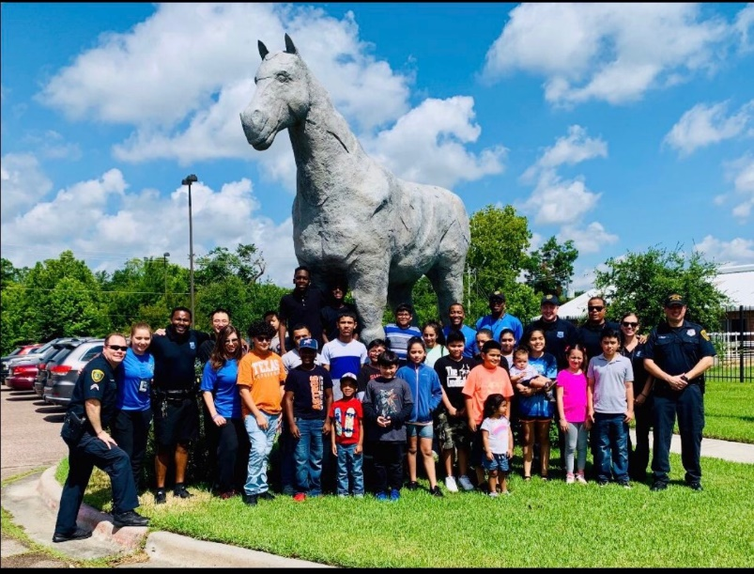
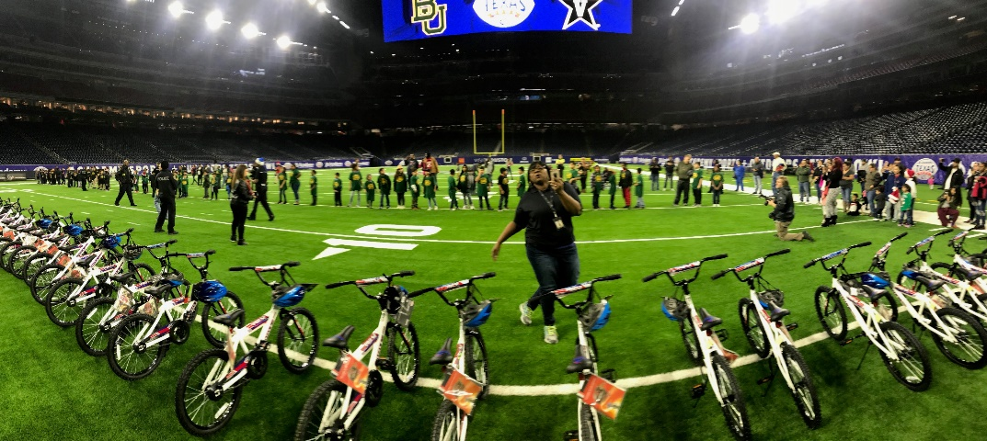
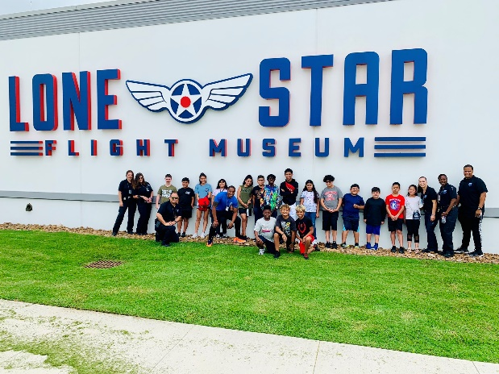
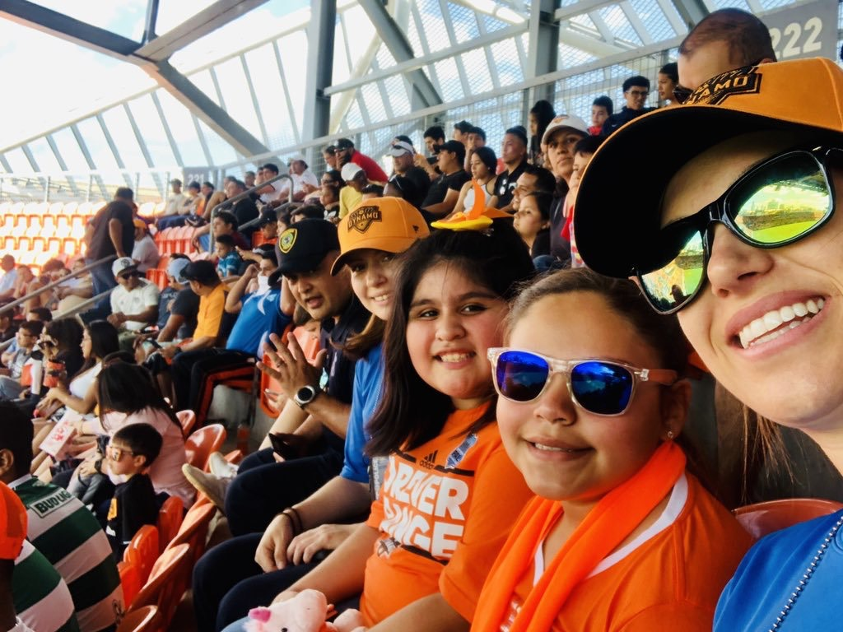
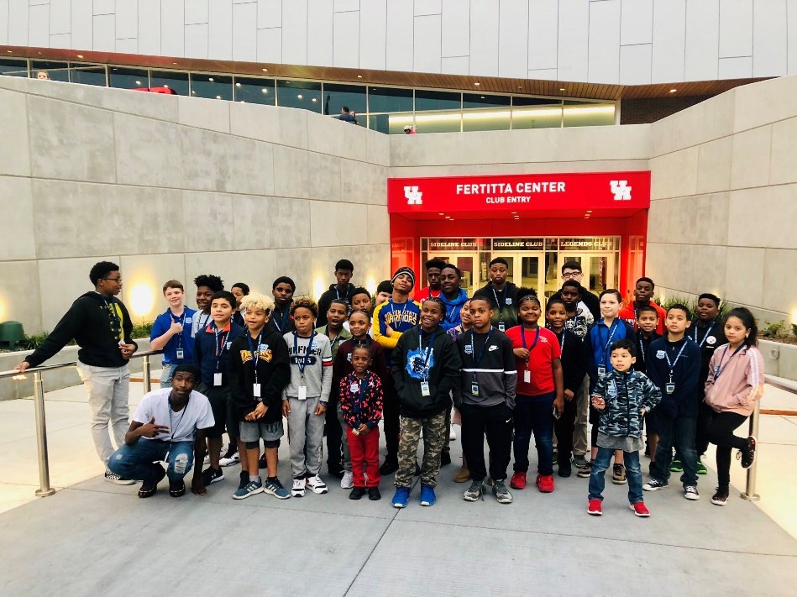
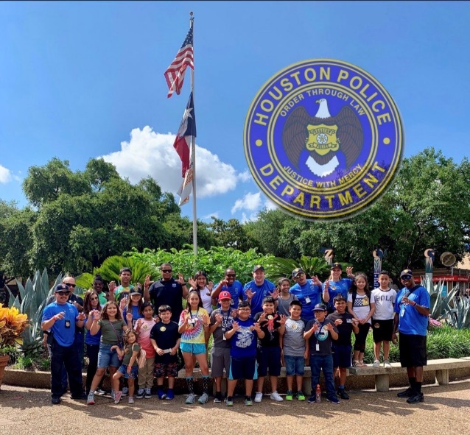
GHPAL OUTINGS

Slide 22
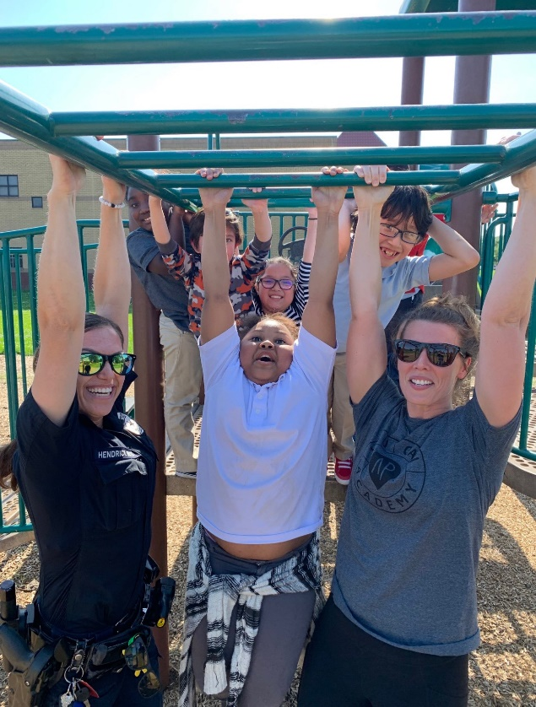
Central Patrol
Kimberley Hendrick
Core Kids - Thirty-two (32)
Summer Consistent Program Total – Four (4) 12 Summer Camps
Consistent Programs During School Term Total – (8)

Slide 23
2019 | July |  |  | Officer Kimberley Hendrick - Central PAL | Red = Social Gray = Cultural | Blue = Academic Black = Athletic
MONDAY | TUESDAY | WEDNESDAY | THURSDAY | FRIDAY | SATURDAY | SUNDAY
01 | 02 | 03 | 04 | 05 | 06 | 07
Mason Park 9:30-11am & *Denver Harbor w/ Officer Aguilar core kids 12-3pm* | PAL Field Trip: HPD Stables - 2 Core Kids 10-11:30am & Meeting @ Memorial Park 12:30-1:30 pm | Ingrando Park 10am-12pm & *Moody Park - Core kids 12-3pm* | HOLIDAY | Tennis Camp Event @ Memorial Park 8am-1pm & YMCA 1-3pm
08 | 09 | 10 | 11 | 12 | 13 | 14
PAL Field Trip: Zoo - 2 Core Kids 10am-1pm | Matt Musils Basketball Camp 7am-1pm | Matt Musils Basketball Camp 7am-1pm | Matt Musils Basketball Camp 7am-1pm | Tennis Camp Event @ Memorial Park 8am-12pm & Raspa w/Cop 12-2 pm w/ Officer Michon
15 | 16 | 17 | 18 | 19 | 20 | 21
PAL Field Trip: Flight Museum - 2 Core Kids 10am-1pm | Texans Teens Club Flag Football Tournament 11am-2pm | Woodland Park Tennis 9-11:15am & *Moody Park - Core kids 12-3pm* | Hutcheson Park Tennis 9-10am, Willowcreek Apts 10-11am w/ Officer Michon, DH w/ Officer Aguilar 12-2pm, & Texans TC Bball Tournament 2-3 pm | Tennis Camp Event @ Memorial Park 8am-11am & YMCA 1-3pm
22 | 23 | 24 | 25 | 26 | 27 | 28
Mason Park Tennis 9-10am w/ Officer Michon, HPD GREAT Camp (EP) 10am-12pm & *Moody Park - Core kids 12-3pm* | HPD GREAT Camp (EP) 10a-12pm & PAL Field Trip: Bowling - 2 Core Kids 2-5pm | Greenspoint Summer Camp w/ Officer Bearden 9:30-11:30am | Hutcheson Park Tennis 9-10am, Willowcreek Apts w/ Officer Michon & *Denver Harbor w/ Officer Aguilar core kids 12-3pm* | Tennis Camp Event @ Memoiral Park 8am-12pm & YMCA 1-3pm
29 | 30 | 31 | 01 | 02 | 03 | 04
HPD GREAT Camp (BBP) 10am-12pm | HPD GREAT Camp (BBP) 10am-12pm & PAL Field Trip: Movie - 2 Core Kids 2-5pm | HPD GREAT CAMP (BBP) 10am-12pm & *Moody Park - Core kids 12-3pm* | HPD GREAT CAMP (BBP) 10am-12pm & *Denver Harbor w/ Officer Aguilar core kids 12-3pm* | HPD GREAT Camp (BBP) 10am-12pm & YMCA 1-3pm

Slide 24
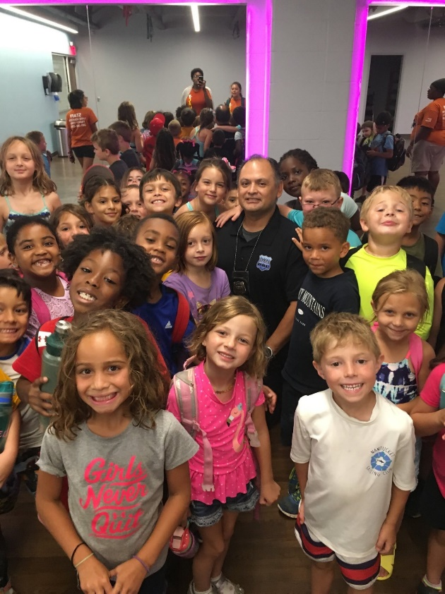
Kingwood Patrol
Christopher Morales
Core Kids - Six (6)
Summer Consistent Program Total - Two (2) 10 Summer Camps
Consistent Programs During School Term – Six (6)

Slide 25
2019 | July |  |  | Kingwood Officer Morales | Red = Social Gray = Cultural | Blue = Academic Black = Athletic
MONDAY | TUESDAY | WEDNESDAY | THURSDAY | FRIDAY | SATURDAY | SUNDAY
01 | 02 | 03 | 04 | 05 | 06 | 07
 |  | 10:00 PAL Field Trip: HPD Stables 4:15 p.m. Basketball w/Core Kids
08 | 09 | 10 | 11 | 12 | 13 | 14
10:00 PAL Field Trip: Houston Zoo 6:00 p.m. Lake Houston YMCA Adaptive | 7 a.m. Matt Musil's Hoops for Kids Baseball | 7 a.m. Matt Musil's Hoops for Kids Baseball 4:15 p.m. Basketball w/Core Kids | 7 a.m. Matt Musil's Hoops for Kids Baseball | 1 p.m. Water World (YMCA Lake Houston)
15 | 16 | 17 | 18 | 19 | 20 | 21
6 p.m. Lake Houston YMCA Adaptive Basketball |  | 4:15 p.m. Basketball w/Core Kids
22 | 23 | 24 | 25 | 26 | 27 | 28
9 a.m. Houston Zoo 6 p.m. Lake Houston YMCA Adaptive Basketball | 8 a.m. Assist Ron Pull Cars & Bike 11 a.m. Basketball (Spring B&G Club) | 9:30 a.m. Greenspoint Summer Camp (Safety/Interaction with Police | 5:30 p.m. Tip a Cop Special Olympics
29 | 30 | 31 | 01 | 02 | 03 | 04
6 p.m. Lake Houston YMCA Adaptive Basketball |  | 4:15 p.m. Basketball w/Core Kids
05 | 06 | Notes:
 |  | July 24th Basketball with Core Kids Basketball every Wednesday at Creekwood Middle School

Slide 26
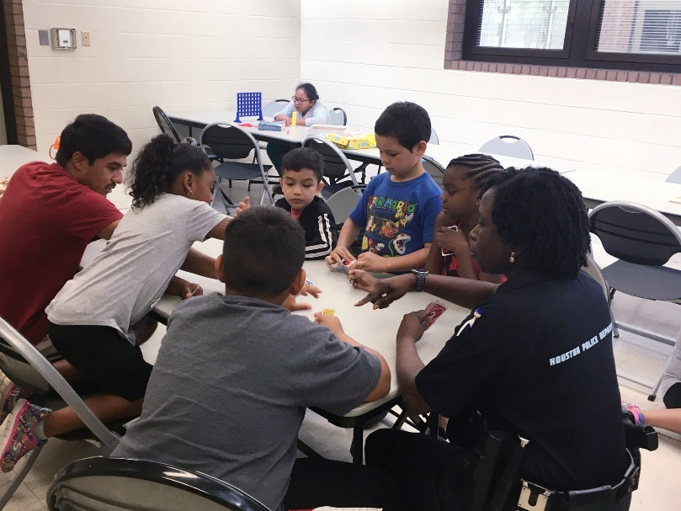
North Patrol
Natasha Myers
Core Kids – Seven (7)
Summer Consistent Program Total- Three (3) 5 Summer Camps
Consistent Programs During School Term – Eleven (11)

Slide 28
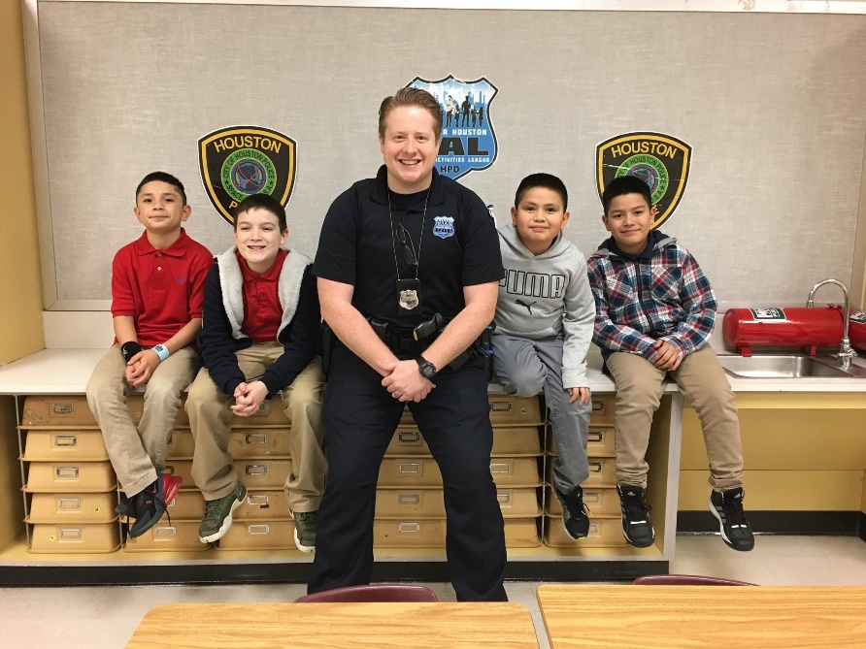
North Belt Patrol
Dustin Bearden
Core Kids – Eighteen (18)
Summer Consistent Program - Two (2) 8 Summer Camps
Consistent Programs During School Term – Six (6)

Slide 30
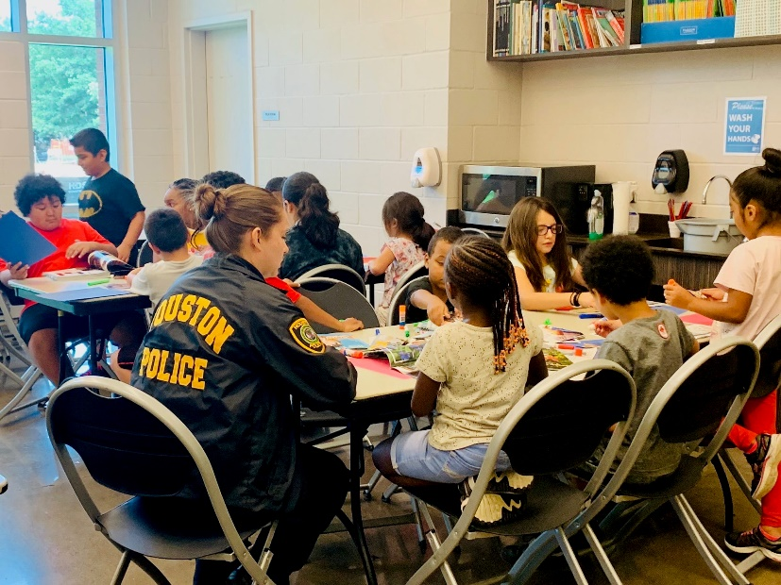
Northeast Patrol
Aurelia Aguilar
Core Kids – Eight (8)
Summer Consistent Program Total – Four (4) 13 Summer Camp
Consistent Programs During School Term – Seven (7)

Slide 32
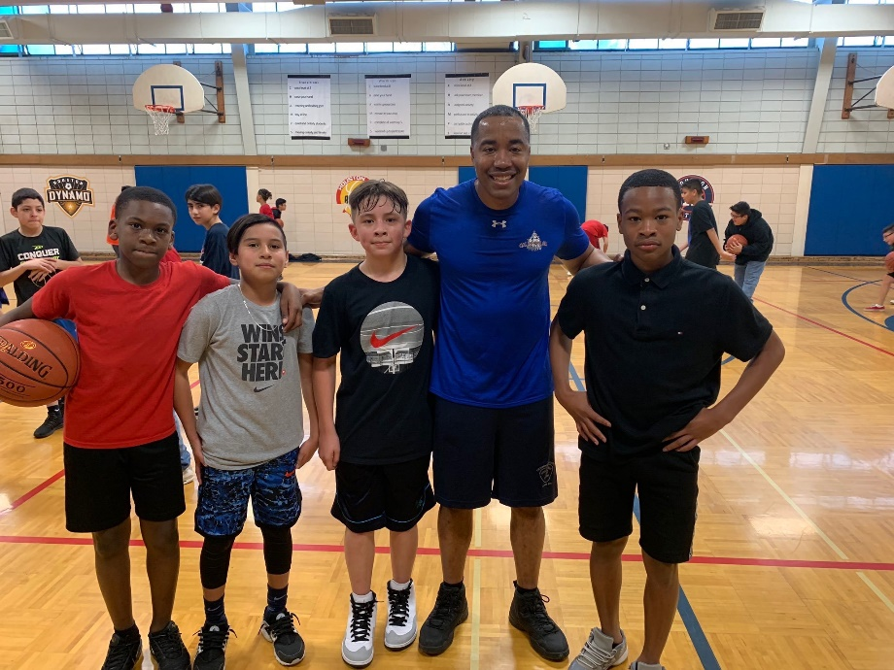
Clear Lake Patrol
Anthony Triplett
Core Kids – Seven (7)
Summer Consistent Program Total – Two (2) 9 Summer Camps
Consistent Programs During School Term – Nine (9)

Slide 34
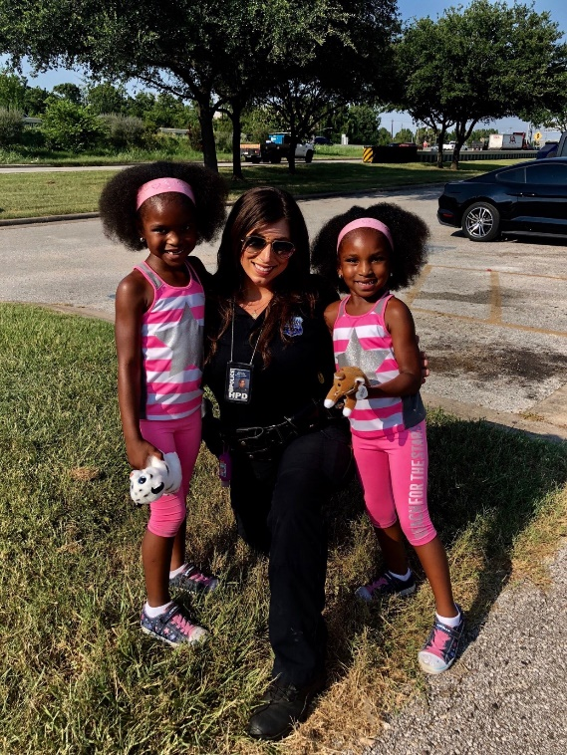
Eastside Patrol
Megan Michon
Core Kids – Seven (7)
Summer Consistent Program Total - Three (3) 9 Summer Camps
Consistent Programs During School Term (Officer Michon recently returned from IOD Status) -No Activity

Slide 36
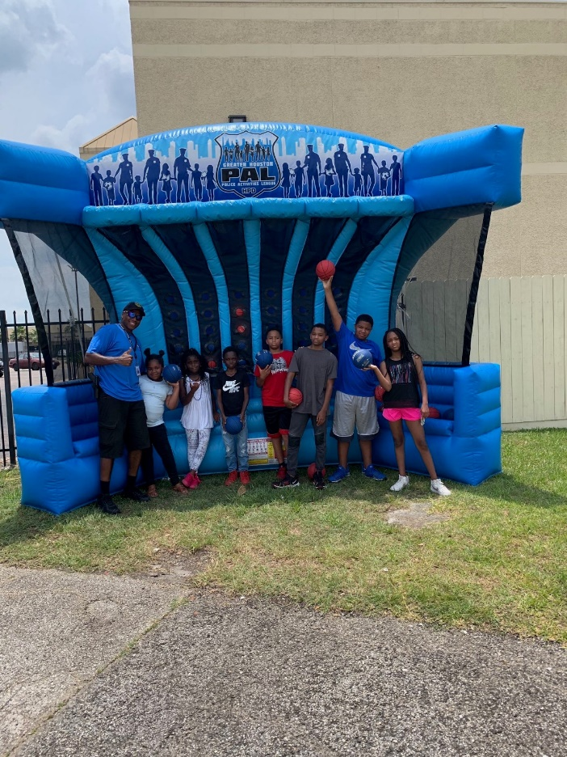
South Central
Charles Webb
Core Kids – Forty-Seven (47)
Summer Consistent Program Total – Five (5) 7 Summer Camps
Consistent Programs During School Term – Five (5)

Slide 38
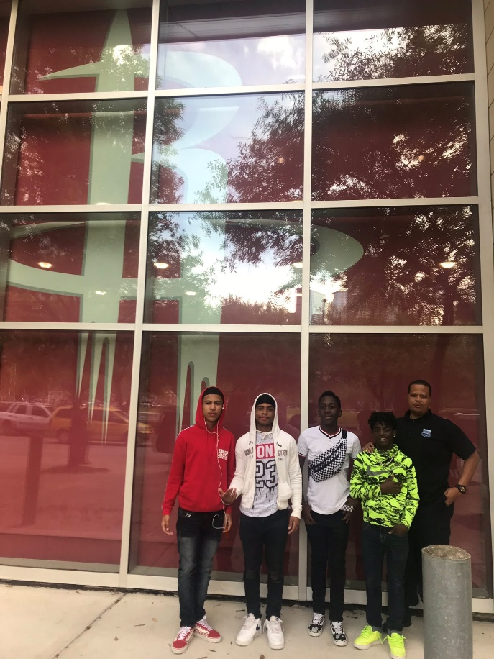
Southeast Patrol
Scott Zacchaeus
Core Kids – Six (6)
Summer Consistent Program Total – Three (3) 3 Summer Camps
Consistent Programs During School Term – Four (4)

Slide 40
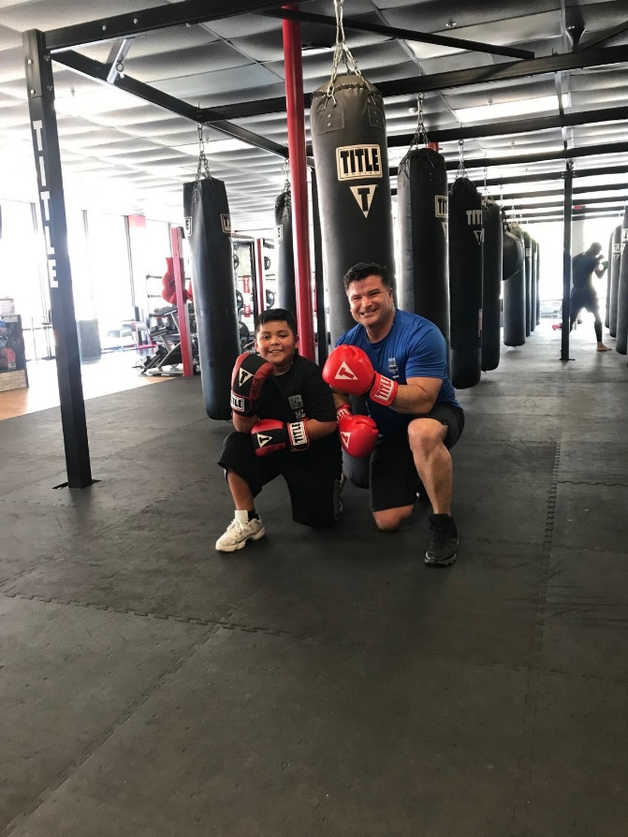
Midwest Patrol
Flavio Zermeno
Core Kids – Seventeen (17)
Summer Consistent Program Total - Five (5)
Consistent Programs During School Term – Five (5)

Slide 42
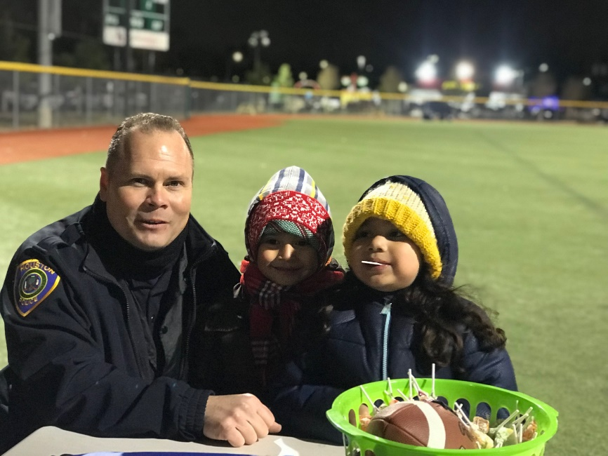
Northwest Patrol
Richard A Williams
Core Kids – Eight (8)
Summer Consistent Program Total – Eight (8) 4 Summer Camps
Consistent Programs During School Term – Eight (8)

Slide 44
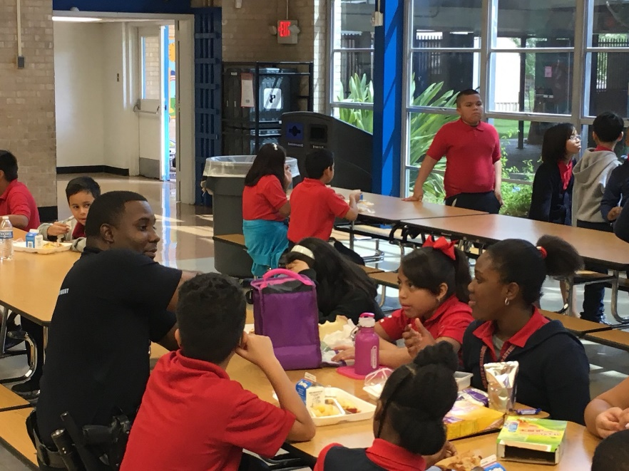
South Gessner Patrol
Terrance Burrell
Core Kids – Four (4)
Summer Consistent Program Total – Four (4) 5 Summer Camps
Consistent Programs During School Term – Six (6)

Slide 46
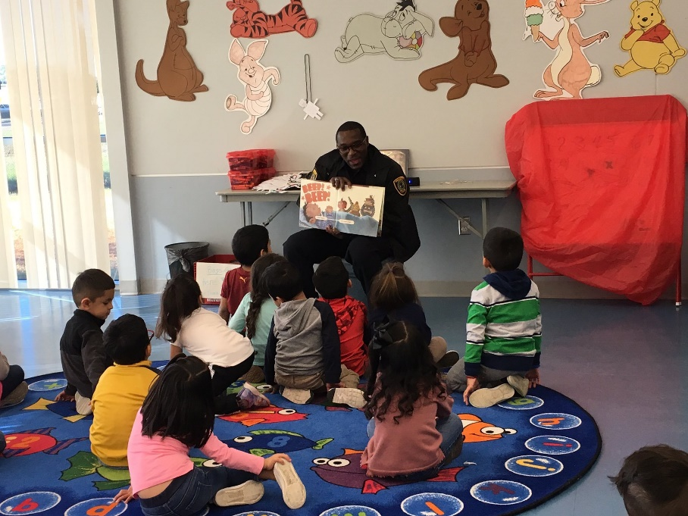
Southwest Patrol
Darrell Elzy
Core Kids – Eleven (11)
Summer Consistent Program Total – Six (6) 2 Summer Camps
Consistent Programs During School Term - Six (6)

Slide 48
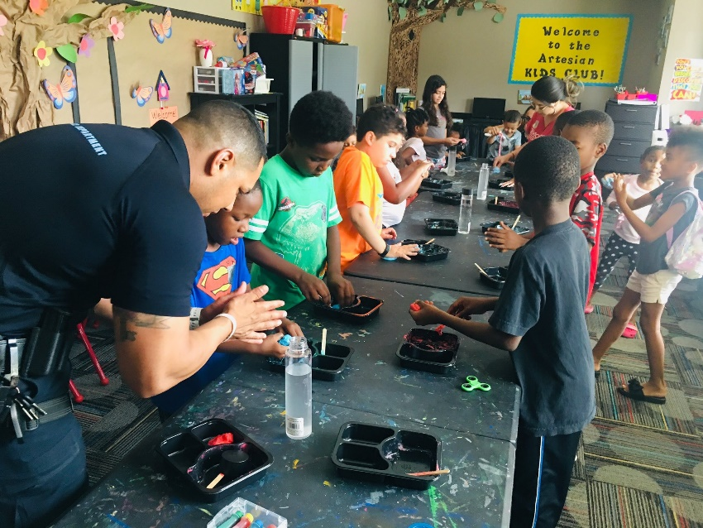
Westside Patrol
A.R. Hernandez
Core Kids – Fifty-Eight (58)
Summer Consistent Programs – Nine (9)
Consistent Programs During School Term – Five (5)

Slide 50
GHPAL Foundation – President Steven Moore
The GHPAL Foundation was formed in 2017
Fundraise for the organization
Solicit potential sponsors to support GHPAL
Provide financial assistance, open & manage bank accounts for 14 PAL officers and conduct yearly financial audits.
Support structured programming by volunteering and mentoring youth
Promote GHPAL throughout city

