Slide 1




Houston Police Department
Office of Budget & Finance
GRANTS OVERVIEW
Public Safety and Homeland Security Committee
Chair: Council Member Abbie Kamin
Rhonda Smith, CFO/Deputy Director
Courtney Lytle, Grant Manager
April 20, 2023

Slide 2
Agenda
Active and Pending Grants
HPD Grant Overview
Forthcoming Grants to Council
Questions & Comments

Slide 3

Did You Know
Grants make up 5% of HPD’s total FY23 funding
HPD’s success rate of grant applications = 72%*
91% of HPD’s General Fund budget is Personnel Costs
  Grant Funds are critical in supplementing HPD’s need to meet operational demands for equipment, supplies, and services.
*FY2022 success rate based on 39 applications submitted and 28 grants that were funded.

Slide 4
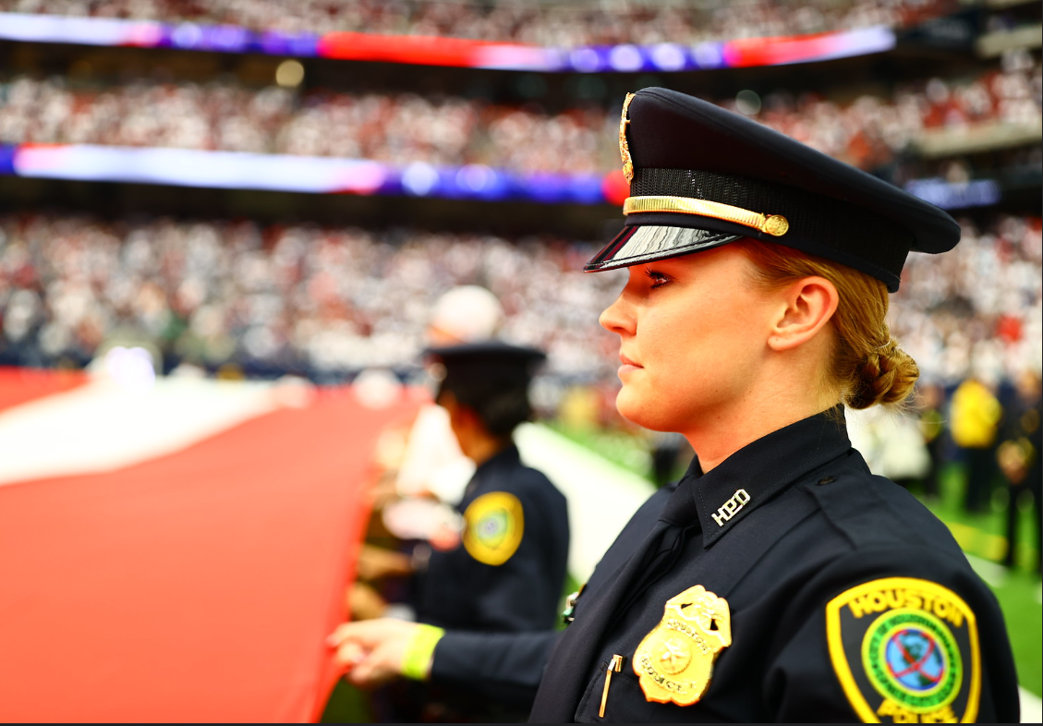
Grant Unit Objectives

Slide 5
Purpose
The Grant Unit’s purpose is to provide HPD with
supplemental resources to achieve goals that impact the department and community.
    Engage in outreach initiatives to assist in educating divisions on the grant acquisition and grant management process.
    Cultivate relationships with local, state and federal partners to maximize funding opportunities.

Slide 6
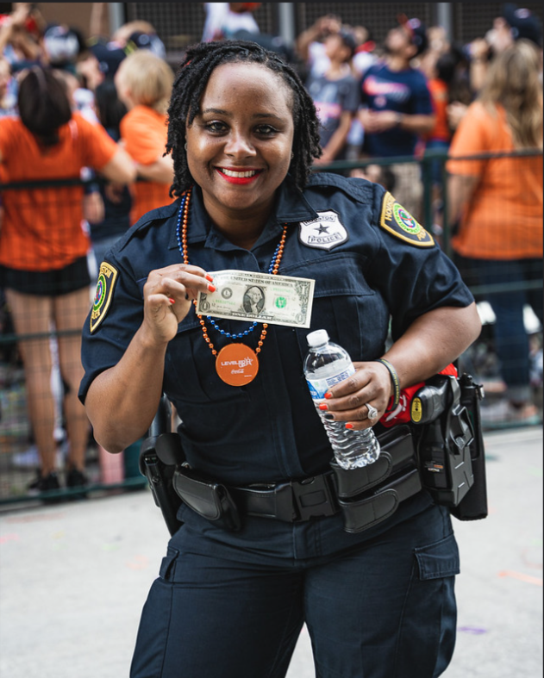
Sources of Funding

Slide 7


Federal and State Funding
Grant Funding Sources include:
United States Department of Justice (USDOJ)
Office of Justice Programs (OJP)
Bureau of Justice Assistance (BJA)
Office for Victims of Crime (OVC)
Office of Juvenile Justice and Delinquency Prevention (OJJDP)
Motor Vehicle Crime Prevention Authority (MVCPA)
Texas Department of Transportation (TxDOT)
Office of the Governor-Criminal Justice Division
Houston Galveston Area Council (H‐GAC)
7

Slide 8
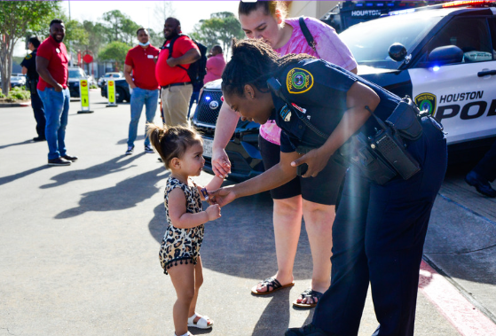
Active and Pending Grants
8

Slide 9
Active and Pending Grants (4/18/2023)
OVERTIME
SUPPLIES
EQUIPMENT
CONTRACTS
TRAINING
TRAVEL
$11.04M
$1.58M
$18.24M
$0.16M
$8.23M
SALARIES
OTHER
$0.91M
$29.80M
$2.08M
AMOUNT | SOURCE | # of GRANTS
$61.07 M | Federal | 33
$9.60 M | State | 17
$70.67 M |  | 50
Active Grants 50
Pending Applications 22
Pending Amount $12.5M
Note: Grant Funds represents total active awarded funds that may cover multiple fiscal years.
9

Slide 10
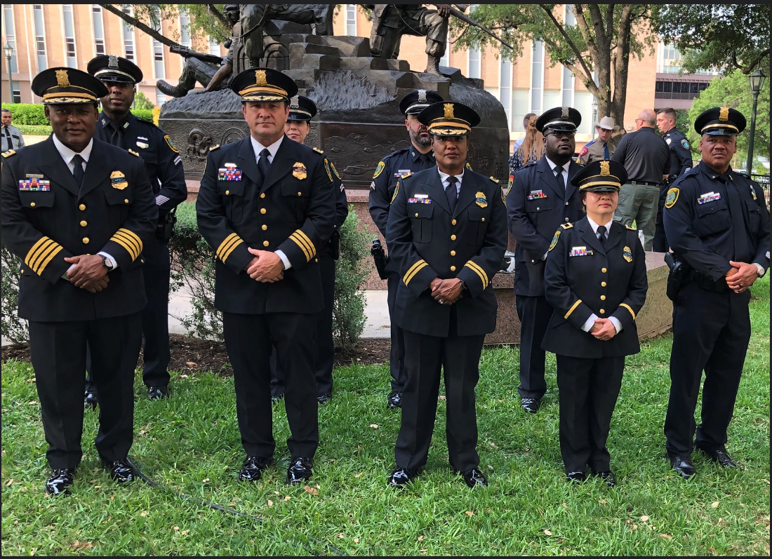
Forthcoming RCA to Council
10

Slide 11

Forthcoming RCA to Council
FY23 Local Law Enforcement Crime Gun Intelligence Center
Seeking: $700,000
Duration: 36 months
Division: Southeast Crime Suppression Team
  Comprehensive program that seeks to gather intelligence linked to gun crimes
  The goal of this initiative is to discover larger national criminal organizations conducting shootings and other gun-related
Proposed funding will be used for:
Overtime hours for officers, sergeants and one lieutenant to gather intelligence for the Criminal Justice Information System analytical work that will need to be conducted during this initiative.
All firearm-related violent crime and gang crime investigations will be conducted during this initiative.
Partners include:
  Bureau of Alcohol, Tobacco, Firearms & Explosives (ATF)
  Harris County Sheriff’s Office (HCSO)
  Federal Bureau of Investigation (FBI)
  Pasadena Police Department
  High Intensity Drug Trafficking Areas (HIDTA)
  United States Attorney’s Office (USAO) for the Southern District of Texas
Note: If granted this will be the city’s 2nd award
11

Slide 12

Forthcoming RCA to Council
FY24 First Responders Mental Health Program
Seeking: $150,000
Duration: 12 months
Division: Peer Support Unit
  The proposed project is designed to provide additional resources for law enforcement officers to cope with traumatic events as well as provide them with the necessary tools to help them in the future. This project will expand the Peer Support Unit to address the mental health needs and well-being of both HPD’s first responders and the first responders of surrounding law enforcement agencies.
Proposed funding will be used for:
Training
100 employees to become peer mentors (40 hours of training)
Group and Individual (GRIN) class
Training in Applied Suicide Intervention Skills Training (ASIST) class
Mandatory Trainings for Wellness, Resiliency and Coping class for the Houston Police Department. These classes are taught by the HPD Psychological Services Division
Cordico App
Resources for assistance in employee’s mental health and wellbeing
Education
Provide outreach regarding the various Peer Support Unit resources.
Helping other agencies by providing peer support and training their department to have peer mentors.
Note: If granted this will be the city’s 1st award.

Slide 13
Forthcoming RCA to Council
FY24 General Victim Assistance Grant Program
Seeking: $197,167
Duration: 12 months
Division: Victim Services Unit
  Victim Services Division proposes to continue to serve survivors of homicide and criminal fatality accidents by employing three retired officers with prior criminal investigation experience to work as victim advocates. Immediately upon joining VSU, the newly hired employees begin new advocate orientation and training.
  Training courses include:
    Wellness, Resiliency, and Coping with Stress
    Crime Victim Rights
    On-scene Victim Advocacy Training
Proposed funding will be used for:
Salary for three full-time senior victim advocates (retired law enforcement officers)
Provides victims, and their families, with support, referrals and information on victim rights, the judicial process, community resources and programs.
Note: If granted this will be the city’s 3rd award.

Slide 14
Forthcoming RCA to Council
FY24 Violent Crime Program
Seeking: $125,000
Duration: 12 months
Division: Northeast
  The overall goal of this initiative is to arrest and deter violent crime through the Northeast area of Houston with primary focus in the responding jurisdiction. By removing these violent criminals from the community, we will be able to significantly and positively impact the rate of victimization within Harris count and the city limits of Houston.
Proposed funding will be used for:
Overtime for officers (11) and sergeant (1) in the Northeast Dayshift Tactical Unit to plan and execute operations in hostile environments and make arrest of violent criminals. HPD will utilize the grant funds for overtime to track and surveil violent offenders with a primary focus on the Northeast area of Houston, and throughout Harris County. We will employ plain clothes officers to work with criminal intelligence analyst to address violent offenders. We will also work with multiple agencies both local and federal such as Alcohol, Tobacco, Firearms and Explosives (ATF) for prosecution, and have their operational support.
Note: If granted this will be the city’s 1st award.

Slide 15
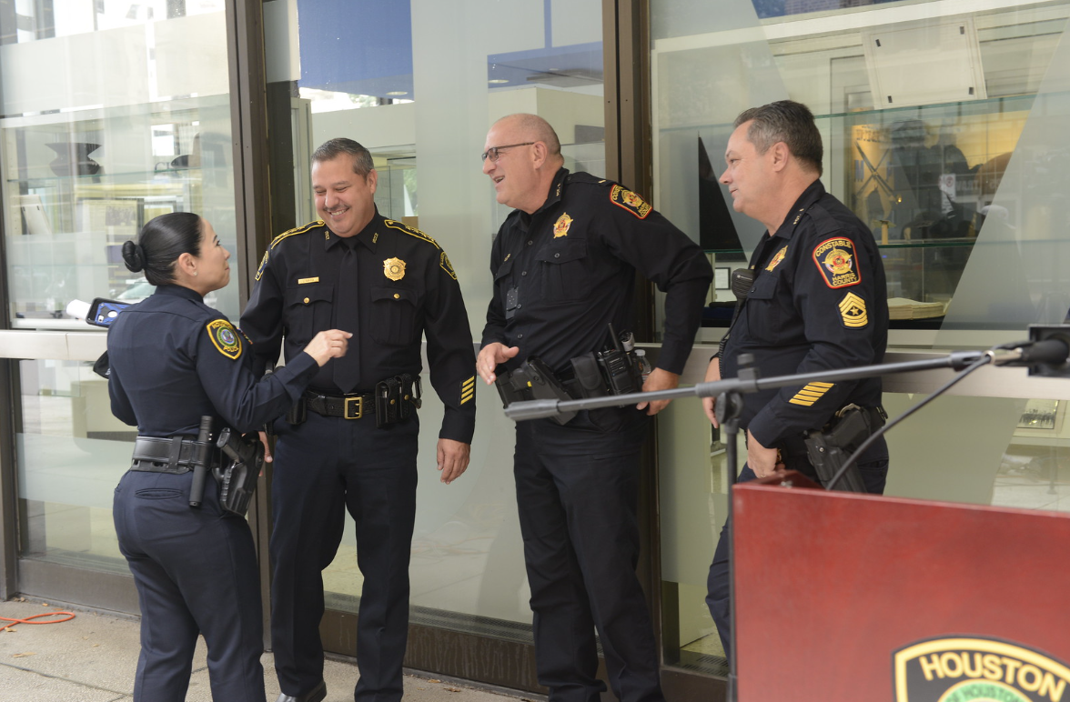
Other Notable Forthcoming Grants

Slide 16

Other Notable Forthcoming Grants
FY24 Project Safe Neighborhoods
FY24 Rifle Resistant Body Armor initiative
FY24 Internet Crimes Against Children
FY24 Criminal Hazmat Team Formation
FY24 Police Integrity & Validation Program
FY24 Safe Policing thru Community Engagement
FY24 Law Enforcement Response to Mass Casualty Events
FY24 HPD Domestic Violence Initiative
FY24 Updating Technology & Augmenting the Future
FY24 Westside Violent Crime/Gang Initiative
FY24 Body Worn Camera Enhancement Program
FY24 Explosive Detection K-9 Strategic Utilization & Deterrence
FY24 Taking a Stand/Reducing Violent Crime in Our Communities Grant
FY23 Motor Carrier Safety Assistance High Priority Grant (MCSAP)
16

Slide 17
Questions and Comments
?

Slide 18
Appendix
Grant Compliance
Other Forthcoming Grants
Grant Application & Award Cycle

Slide 19
Grant Application and Award Cycle
Award Approval & Acceptance
Review Conditions
Management of the Grant
Closeout
Notification of grant opportunity
Complete draft proposal/budget
Review for submission
Submit final application
19

Slide 20
Grant Compliance
Mayor Directives AP 4‐1
Controller's Office Financial Reporting - Annual Comprehensive Financial AFR
Finance Department-Uniform Grant Management Standards, Single Audit
HPD General Order 200‐07

Slide 21

Other Forthcoming RCA to Council
FY24 Project Safe Neighborhoods
Seeking: $125,000
Duration: 12 months
Division: Gang
  The Gang Investigators will assist the Crime Suppression Teams and the Homicide Division with their high-profile investigations by targeting violent gangs and organized criminal groups and will conduct their own investigations on violent crime and weapons cases.
Partners include:
  HPD Gang Division
  HPD Homicide Division
  HPD Crime Suppression Teams
  Texas Anti-Gang (TAG) Task Force
Proposed funding will be used for:
Overtime will be distributed to the crime suppression teams and Homicide Division on a case-by-case basis.
Note: If granted this will be the city’s 5th award.

Slide 22
Other Forthcoming RCA to Council
FY24 Rifle Resistant Body Armor initiative
Seeking: $5,671,200
Duration: 12 months
Division: Office of Planning and Data Governance
  HPD is applying for funds to replace Level III body armor for 2,400 officers within the Traffic or Highway Patrol category.
Note: If granted this will be the city’s 3rd award.
Proposed funding will be used for:
The proposed grant will allow 2400 Bulletproof Vest Kits.

Slide 23
Other Forthcoming RCA to Council
FY24 Internet Crimes Against Children
Seeking: $429,786
Duration: 12 months
Division: Special Victims Unit
  The national ICAC program assists state and local law enforcement agencies in developing an effective response to cyber enticement and child pornography cases. This help encompasses investigative and forensic components, training and technical assistance, victim services, and community education. Due in large part to the technological aspects of these cases, the ICAC Task Force Program promotes a multi-jurisdictional, multi-agency, team approach to investigating and prosecuting ICAC cases.
Partners:
71 Affiliate Agencies
Comprised of local, state, NGOs & private entities that assist in education and prevention efforts.
This eight-county area is also referred to as the Houston-Galveston-Brazoria Consolidated Metropolitan Statistical Area (Houston CMSA) and encompasses the following counties: Brazoria, Chambers, Fort Bend, Galveston, Harris, Liberty, Montgomery, and Waller.
Proposed funding will be used for:
Funds will be used for personnel salary, overtime, travel and training, lease vehicles and fuel.
Note: If granted this will be the city’s 8th award.

Slide 24
Other Forthcoming RCA to Council
FY24 Criminal Hazmat Team Formation
Seeking: $114,222
Duration: 12 months
Division: Major Offenders Division-Environmental Investigations Unit (EIU)
  The goal of this project is to strengthen public safety in the city of Houston by creating a Criminal Hazmat team that will be responsible for responding to and investigating incidents involving hazardous materials under the category of Chemical, Biological, Radiological, and Nuclear (CBRN) hazards.
Partners:
HPD’s EIU will provide services to various agencies, individuals, and groups through this project
Houston Fire Department Hazmat Unit
Hazardous Building Inspection Team of the Houston Fire Department
National Guard Civil Support Team
Texas Commission on Environmental Quality
Environmental Protection Agency
Federal Bureau of Investigation
Proposed funding will be used for:
Equipment: HazSim Training Equipment, Hazmat Entry Suits, Self Contained Breathing Apparatus Suit, Air Monitoring Equipment, laptops and satellite communication equipment
Training: 40HR Tactical Chemistry Class
Personnel: Officer and Sergeant overtime
Note: If granted this will be the city’s 1st award.

Slide 25
Other Forthcoming RCA to Council
FY24 Police Integrity & Validation Program
Seeking: $125,000
Duration: 12 months
Division: Major Offenders Division
  The implementation of the “Police Integrity and Validation” program will serve to apprehend criminals attempting to defraud and physically harm unsuspecting citizens by acting under the false guise of impersonating law enforcement and/or security.
  The goal of this project is to arrest and prosecute targeted criminals by disrupting and dismantling their organizations. Our strategy will focus on investigating violent crimes committed by individuals and gang members posing as police officers and other public servants by targeting the leadership of group-led criminal organizations.
Partners:
Harris County Sheriff Office
Homeland Security Investigations
Federal Bureau of Investigations
Proposed funding will be used for:
Personnel: Officer, sergeant and lieutenant overtime
Equipment: laptops
Note: If granted this will be the city’s 1st award.

Slide 26
Other Forthcoming RCA to Council
FY24 Law Enforcement Response to Mass Casualty Events: First Assess Secure Treat (FAST)
Seeking: $125,000
Duration: 12 months
Division: North Division
  This project will implement the First Assess Secure Treat (FAST) model within the Houston Police Department’s (HPD) North and North Belt Crime Suppression Teams, focusing on both the tactical response, as well as the medical response of the officers. This project will equip our front-line officers with training, tools, and medical supplies to conduct both effective tactical responses and save lives during a mass casualty event. The grant funds will be used for travel and training, equipment, supplies and direct operating expenses, which will allow the officers to enter the building or scene first, assessing tactical and medical needs, securing rooms, roadways, persons, or vehicles, and treating those needing medical attention quickly.
Proposed funding will be used for:
Personnel: Overtime for Officers (9) and sergeant (1)
Equipment: Kinetic Breaching Tool, Chest seals, Torniquets, and other medical supplies
Travel/Training: Tactical Medics Group LLC -Enhanced Tier 3 Tactical Combat Casualty Care Training
Note: If granted this will be the city’s 1st award.

Slide 27
Other Forthcoming RCA to Council
FY24 Taking a Stand/Reducing Violent Crimes in Our Communities Grant
Seeking: $100,000
Duration: 12 months
Division: South Gessner Division
  South Gessner CST Unit seeks funding to proactively investigate areas associate with high crime rates, to reduce the numbers of aggravated assaults and robberies within the area by arresting and prosecuting criminals to increase the number of arrests associated with violent criminals.
Proposed funding will be used for:
Personnel: Officer, sergeant and lieutenant overtime
South Gessner Dayshift Tactical Unit, Division Gang unit and Nightshift Tactical unit to strategically plan operations in hostile environments and make arrest of violent criminals.
The overtime funding will assist 17 officers.
Note: If granted this will be the city’s 2nd award.

Slide 28
Other Forthcoming RCA to Council
FY24 Updating Technology and Augmenting the Future
Seeking: $98,859
Duration: 12 months
Division: South Gessner Division
  Grant funds will be used to purchase supplies and direct operating expenses to upgrade the technology at the HPD South Gessner Division. The upgrade will improve public safety by supporting operations, aiding with enforcement strategies, detecting and responding to crimes, gathering and analyzing evidence, improving efficiency, and increasing officer safety.
Proposed funding will be used for:
Equipment: Replacement of computers at South Gessner – 25 units, Monitors
Full Size MCH By Cloud Defensive (flash lights) – 25 units
Note: If granted this will be the city’s 1st award.

Slide 29
Other Forthcoming RCA to Council
FY24 Westside Violent Crime/Gang Initiative
Seeking: $74,082
Duration: 12 months
Division: Westside Division
  The purpose for the Westside Violent Crime/Gang Crime Initiative is to provide training and procure equipment for the Westside Division Crime Suppression Teams (CST) to have the most effective and efficient strategy to combat organized violent serial crimes. The grant funds will allow the CST teams to conduct expedited criminal investigations, targeted offender tactics, covert and technological surveillance, pawn investigations, warrant executions, gang investigations, federal referrals/indictments, and reliance on real time crime analysis data to quickly solve these crimes and dismantle the organized criminal enterprise.
Proposed funding will be used for:
Training: Texas Gang Investigators Association Annual Conference & Texas Tactical Police Officers Association (TTPOA) Annual Conference
Equipment: Laptops, digital camera, binoculars, Specialized Tactics for Operational Rescue and Medicine (S.T.O.R.M.) Kits
Note: If granted this will be the city’s 2nd award.

Slide 30
Other Forthcoming RCA to Council
FY24 Body Worn Camera Enhancement Program
Seeking: $1,299,375
Duration: 12 months
Division: Office of Technology Services
  Office of Technology Services seeks funding to support the expansion of our existing body-worn camera (BWC) program and digital evidence management system (DEMS). Our primary objective for this funding is to expand our DEMS system to comply with Brady, Michael Morton Act and Texas SB111 as they relate to digital evidence.
Proposed funding will be used for:
Equipment: Expand the digital evidence management system’s (DEMS) storage capacity and improve communication/compatibility between its DEMS and the Harris County District Attorney’s Office’s case management system.
The improvement of communication with the District Attorney’s office was completed via a programming interface between HPD’s system and the DA’s system.
Note: If granted this will be the city’s 2nd award.

Slide 31
Other Forthcoming RCA to Council
FY24 Explosive Detection K-9 Strategic Utilization & Deterrence
Seeking: $63,456
Duration: 12 months
Division: Airport Division
  The "Explosive Detection K9 Strategic Utilization & Deterrence Initiative" aims to promote public safety through intelligence-based investigations, deter crime, prevent terrorism, and improve community relations.
  Overtime program will focus on Homeland Security and community engagement with law enforcement officers and their canine partners.
  Funds would allow the unit to work closely with criminal intelligence divisions, federal, state, and local agencies to better provide specialized support service.
Proposed funding will be used for:
Personnel: Officer and sergeant overtime
Officers/sergeants will strategically plan operations focusing on intelligence-based threats and positive interactions with the community.
The overtime funding will assist 14 officers and will be utilized based on operational needs of the assignment.
Note: If granted this will be the city’s award.

Slide 32
Other Forthcoming RCA to Council
FY24 Taking a Stand/Reducing Violent Crimes in Our Communities Grant
Seeking: $98,934
Duration: 12 months
Division: Major Offenders Division
  The overall objective of this grant is to enhance the monitoring of violent repeat offenders / parolees in the southeast area of Houston. All officers working overtime on The Houston Police Department's Parole / Domestic Violence Initiative will investigate known suspects committing violent crimes looking for people on parole.
Proposed funding will be used for:
Personnel: Officer and sergeant overtime
Note: If granted this will be the city’s 2nd award.

Slide 33
Other Forthcoming RCA to Council
FY23 Motor Carrier Safety Assistance Program (MCSAP) High Priority Grant
Seeking: $734,745
Duration: 24 months
Division: Truck Enforcement Unit
  Grant fund will allow the HPD’s Truck Enforcement Unit to expand the key components of their work, which includes: inspection of commercial motor vehicles, hazardous material motor vehicles and passenger-carrying of commercial motor vehicles; traffic enforcement to regulate speed, seat belt usage and aggressive driving; education of both commercial motor vehicle drivers and owners of safe driving habits; education of citizens on the dangers of unsafe driving behaviors around commercial motor vehicles; and safety initiatives involving marked and unmarked units around work zones and targeted roadways.
Proposed funding will be used for:
Personnel: Officer and sergeant overtime
Note: If granted this will be the city’s 4th award.

