Slide 1

Notes:
Thanks to the Mayor, council, Fire Chief, and city partners in public safety..
Frequency of complex incidents (hurricanes, floods, tornadoes, protests, special events, and other incidents requiring a multi-agency, multi-disciplinary response).
Order of presentation
Historical comparison
Current resource upgrades
Beta testing of draft plans
Planning/preparedness
Response
Post-response
Discussion

Slide 2
Houston Fire Department Flood Water Assets
Pre-Hurricane Harvey
Post Hurricane Harvey
Evacuation Boats – 10 (24 years)
Jet Skis – 5 (13 years)
Rescue Boats – 6 (11 years)
High-Water Vehicles – 0
High-Water Boosters – 0
Prime Movers – 0
Evacuation Boats – 10 (24 years)
Evacuation Boats – 2
Jet Skis – 9
Rescue Boats – 14
High-Water Vehicles – 9
High-Water Boosters – 8
Prime Movers – 10
Evacuation Boats – 21
Notes:
All additional units received since 2017 are new.
All existing equipment that wasn’t replaced has been refurbished to current standards.
Partnership with PWE:
10 dump trucks converted for high-water use assigned to HFD (entered in CAD).
25 dump trucks converted for high-water use assigned to HFD (entered in CAD).

Slide 3
Houston Fire Department Tactical Deployment
Technical Rescue Team – 60 personnel
Water Strike Team – 80 personnel
Wildland Group – 42 personnel
Incident Management Team – 112 officers
Department Operations Center – 3 to 4 hours nights/weekends
Incident Support Team – 1 to 2 hours response time nights/weekends
Complex Incident Response Program and Training
Wide-Area Search – 1 square mile/hour
Technology
Equipment
Notes:
Technical rescue team receiving formal swift water training.
140 personnel receiving formal swift water training.
SAW capabilities
All personnel assigned to stations with water assets have and continue receiving biannual training in response to water-related incidents.
IMT and DOC purpose and capabilities
IST purpose and capabilities
Wide-area search capabilities
Technology – smart phones, software upgrades, gps-enabled radios, Mobile Command Vehicle 8
Equipment – wide area search kits, gas kits,

Slide 4
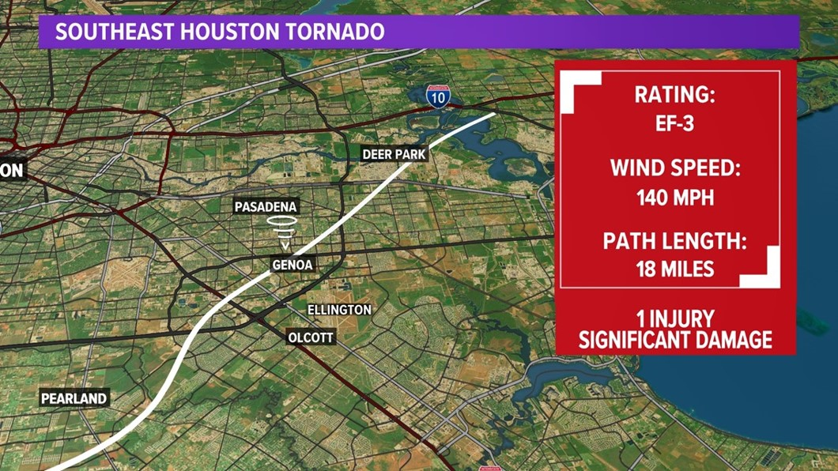
Sagemont Tornado Houston, January 24, 2023
No Notice Incident
103k people without power
9000 Houstonians impacted
Recon complete within the hour
Operations began immediately
3 extricated from vehicles
3 pulled from structural collapse
All buildings searched and people accounted for in less than 12 hours
Notes:
Effective response to no notice incidents requires detailed preparedness, clear sequential planning, and extensive coordination with partners.
True beta test of resources, planning, and training.
Initial response less than four minutes
OEC recognized complex incident
IST less than 30 minutes

Slide 5
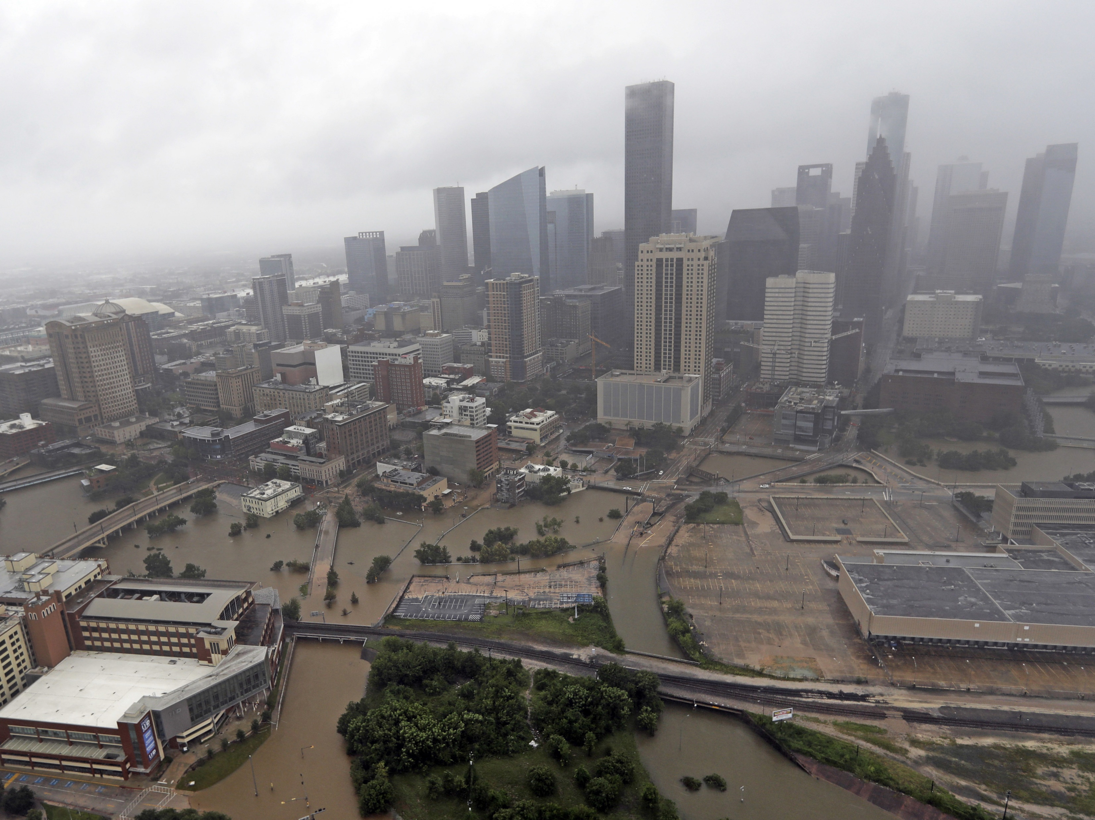
HFD Hurricane Preparedness Plan
120-96 hours: Monitor
96-72 hours: Prepare
72-60 hours: Plan
60-40 hours: Coordinate
40-24 hours: Partial Activation
24 hours: Full Activation
Notes:
Monitor forecast accuracy.
Coordinate, collaborate, communicate with city partners.
Maintain situational awareness.
Assist partner agencies in mitigating hazards.
Participate in common messaging.
Logistics assessments: FIN, SPD for spending and procurement.
Review city and department policies.

Slide 6
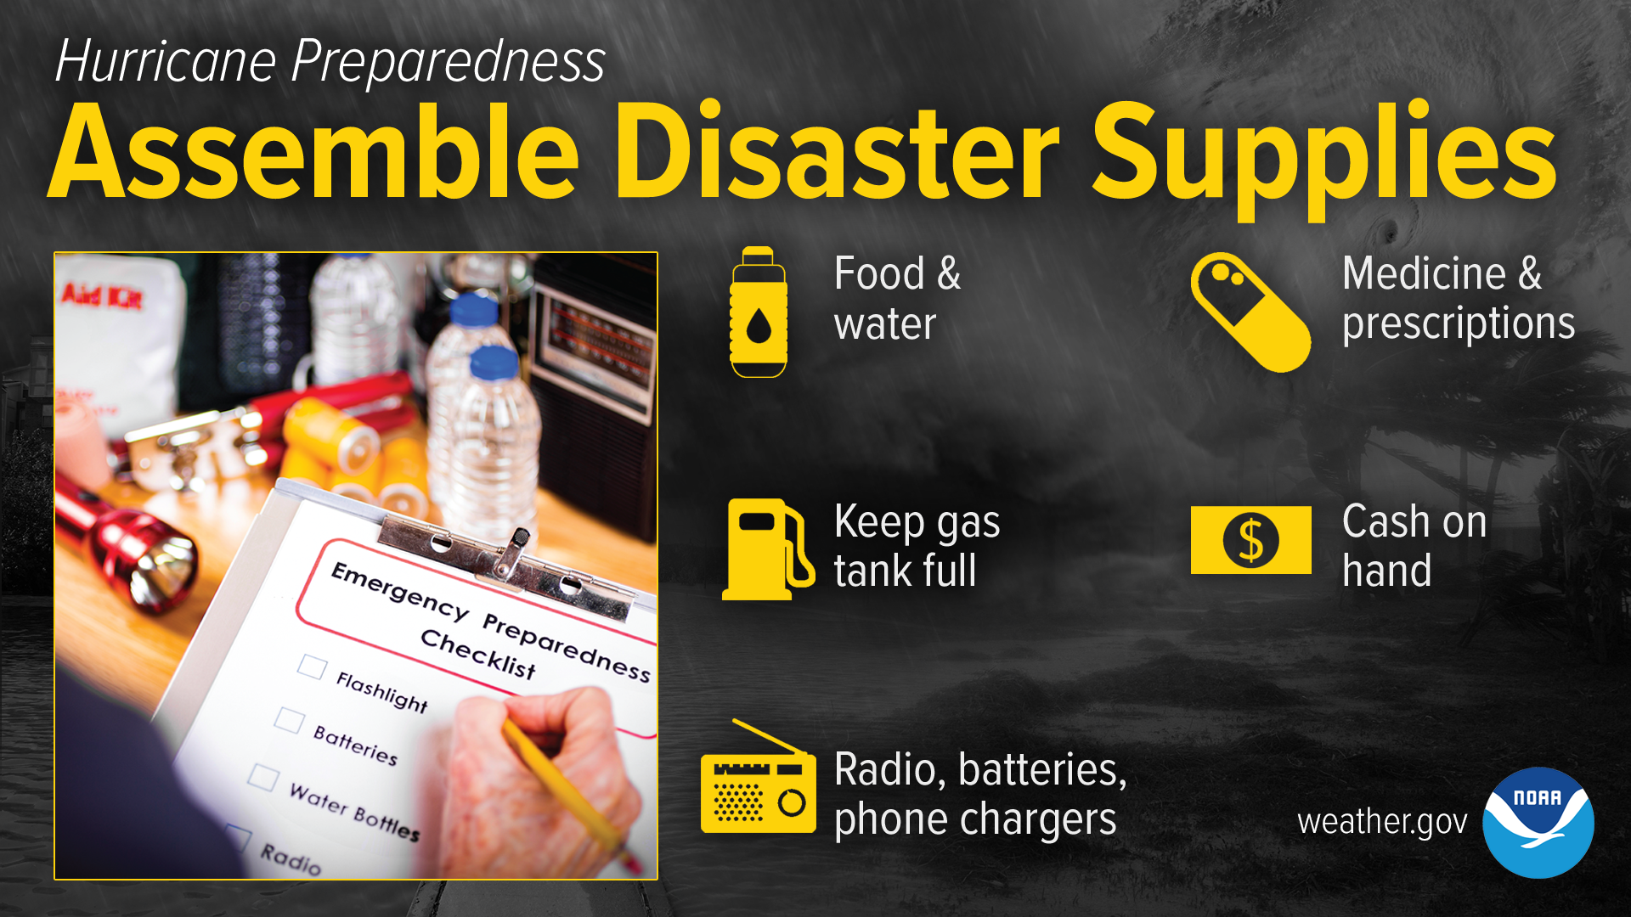
Notes:
Food and water supply
At least five days
Medicine supply
Enough medicine for at least one week
Basic first aid items
Emergency power sources
Flashlights
Batteries
Portable phone chargers
Generator safety
Safety and personal items
Important documents
Pet needs
Vehicles fueled

Slide 7
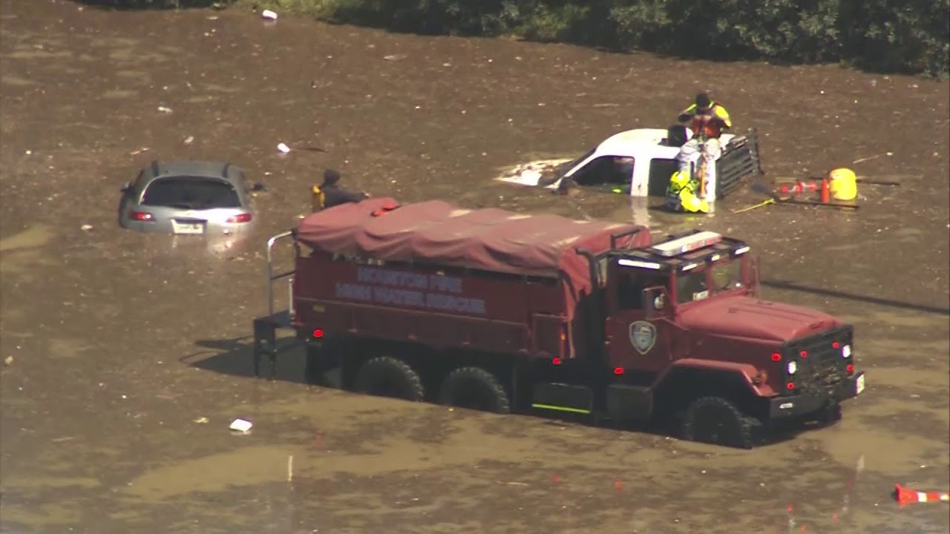
Partial Activation (40-24 hours)
Forecast accuracy
Multi-agency planning
10 PWE converted to HWV
Water Strike Team activation
Wildland Group activation
Department Operations Center
Notes:
Confidence level of forecast
Effects felt before landfall
Impact to the city
Benefits of multi-agency planning
Objectives
Tactics
Resources (HWVs and boats available in the metro area)

Slide 8
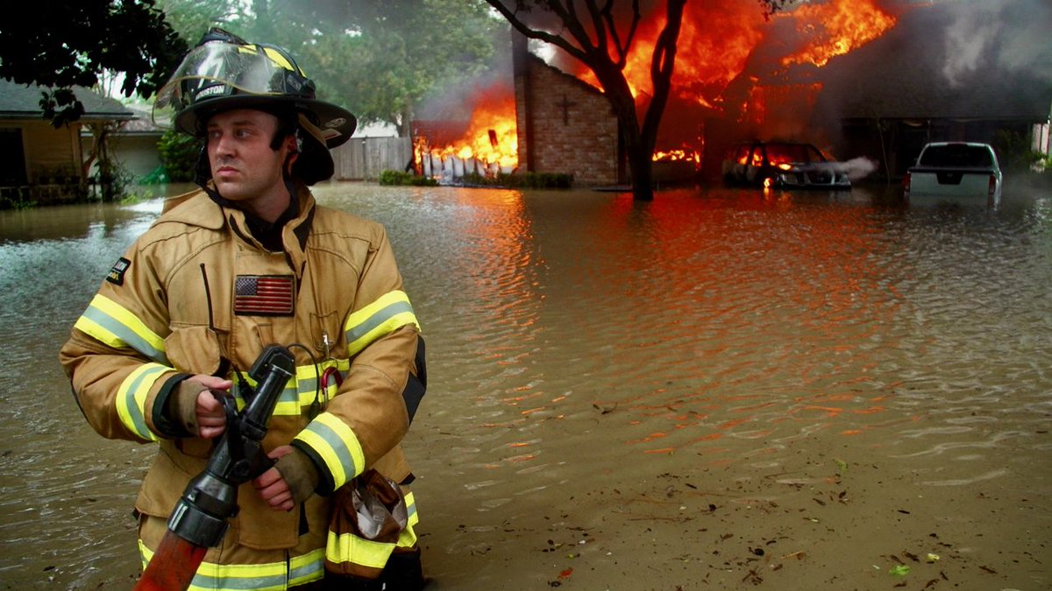
Full Activation (24 hours)
Full activation
20+ PWE converted to HWV
HFD Rescue recalled
Shift recall
Incident Priorities
Notes:
Incident priorities
Life safety (rescue, evacuation)
Incident stabilization (recon, fire suppression, gas leaks, evacuation)
Property conservation
Societal restoration

Slide 9
City of Houston - OEM
PIO
Liaison (Deputy Chief)
Operations
Planning
Logistics
Finance
Public Safety Branch
Other City Departments
HPD
HFD
PWE
Solid Waste
Health Department
HAS
Operations
Planning
Logistics
Notes:
Unified Command – “The Big Picture”

Slide 10
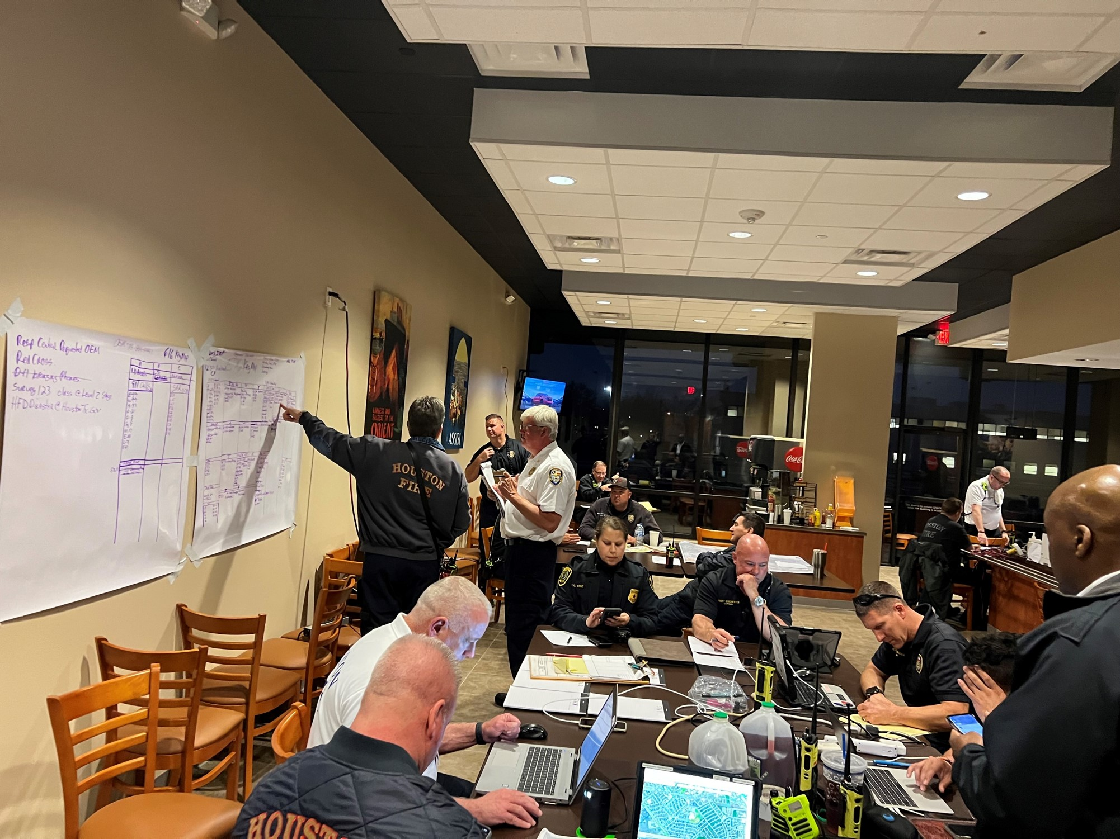
HFD Department Operations Center
24-hour operations
Command and General Staff
Citywide emergency response management
USAR response
Notes:
Command and General Staff
Finance
Logistics
Operations (USAR, E. Resp.)
Planning
Bifurcation of response
Emergency response (911 calls)
USAR

Slide 11
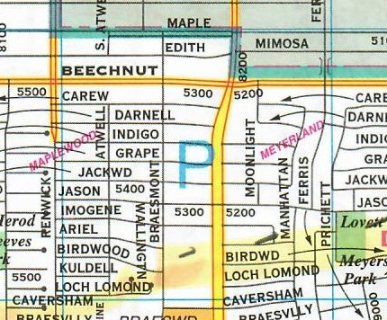
Wide-Area Search and Rescue
1
2
3
4
5
6
7
8
9
Notes:
Establish areas as Complex Incidents
Describe what this does
Slicing the pie (as shown in the picture)

Slide 12
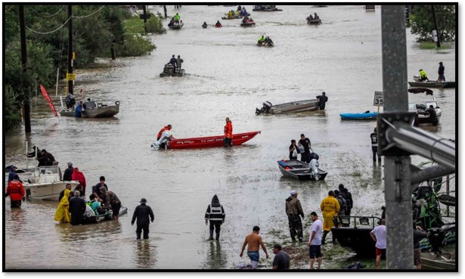
HFD Evacuation Operations
Area of dry land
Field-level decision
HFD/HPD “drop and go”
Life safety mitigated
HPW/Metro transport to reception centers
Notes:
Rescue/evacuation
Lily pads
Reception centers
Areas of last resort

Slide 13
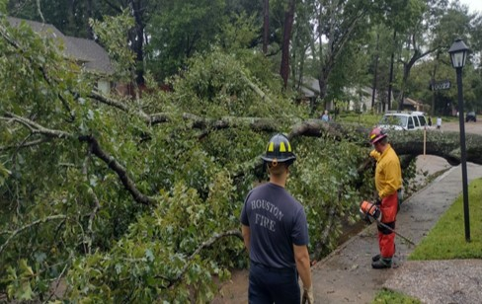
Societal Restoration

Slide 14
Fire Fighters Foundation of Houston
Major Donor List
2017-2022
Apache Corporation
AT&T
Chevron Products Company
Cigna Health & Life Insurance Co
CITGO Petroleum Corporation
Exxon Mobil Corporation
HEB Grocery LP
Hilton Americas-Houston
Houston Association of Insurance Agents
Houston BOMA
Impact Fluid Solutions
KBR Charitable Foundation
Koch Companies Public Sector, LLC
KS Management Services LLC
Linebarger Goggan Blair & Sampson, LLP
Lion Group, Inc.
Lyondell
Molson Coors Beverage Company LLC
OnStar, Global Emergency Services Out
Silver Eagle Distributors Charitable Fund
Southeast Texas Regional Advisory Council
TC Energy Foundation
The Ben Roethlisberger Foundation
The Benevity Community Impact Fund
TSYS
Union Pacific Foundation
United Airlines
Notes:
An excess of $6 million has been generously donated by the Firefighters Foundation of Houston.

