Slide 1
CED Equipment Update
Presented by: Executive Assistant Police Chief Larry Satterwhite
Police Administrator, Frank Rodriguez
JUNE 14, 2023

Slide 2
Objectives
Define the term Conducted Energy Device (CED) and briefly describe the technology and operation of the CED
List CEDs previously used by HPD
Discuss features of the T10 model

Slide 3
What is a Conducted Energy Device
A conducted energy device (CED), is a less-lethal weapon designed to incapacitate combative, threatening and non-compliant individuals allowing them to be approached and handled in a safer manner.
The CED deploys small barbed probes intended to puncture the skin and remain attached to the target. The probes are connected to the main device by thin, insulated copper wire and deliver a modulated electric current designed to disrupt voluntary control of muscles, causing "neuromuscular incapacitation or NMI."
CEDs will not eliminate all physical confrontations with suspects and are generally not intended for use when confronting a suspect armed with a potentially lethal weapon.

Slide 4
Previous CED Model Notes
  The range of all prior models was a maximum of 21-25 feet. Effective ranges were generally less due to the difficulty of placing both probes.
  HPD has utilized CEDs manufactured by AXON (formerly known as Taser International)

Slide 5
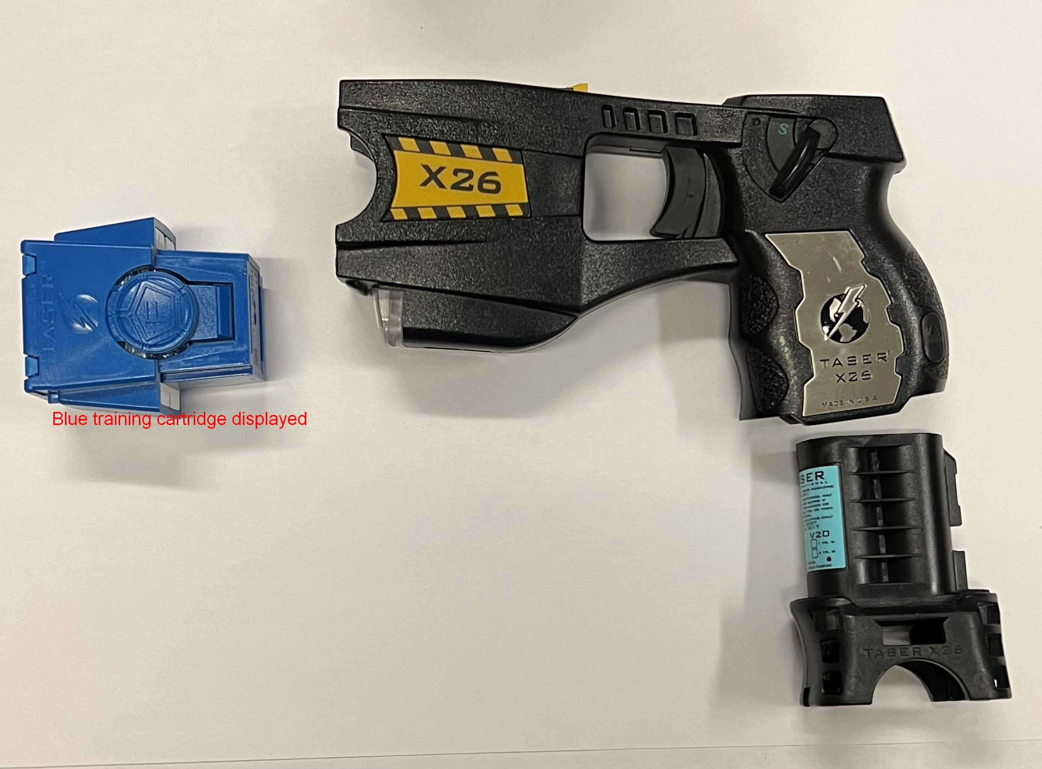
X-26 Taser
2005 - 2013
  Prior to 2005, only supervisors were authorized to utilize a CED
  The device had a single cartridge with the ability to carry a second attached to the battery
  Maximum range of 21 feet

Slide 6
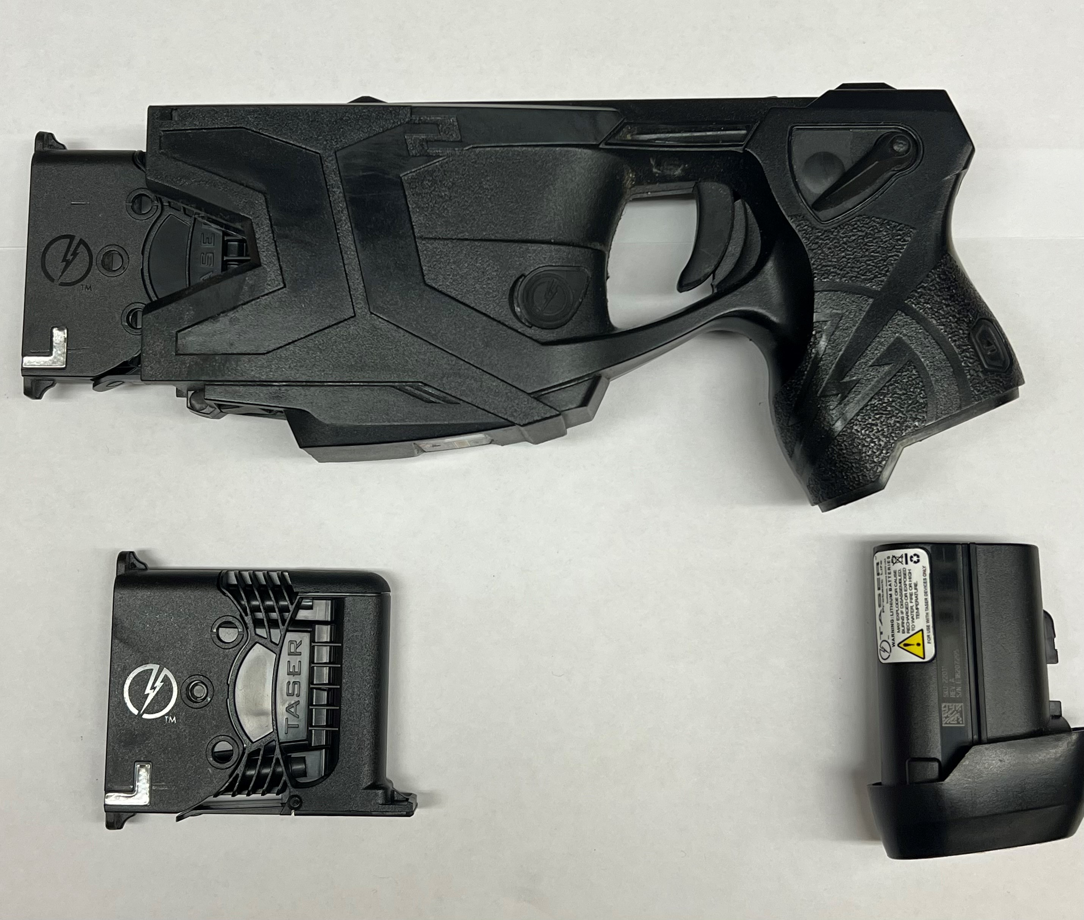
X-2 Taser
The X2 was first issued in 2013.
  Approximately 3,431 are currently issued.
  The device had two cartridges loaded into separate bays allowing a second shot without reloading.
  All warranties on the issued devices and equipment have now expired and the device is at end of life

Slide 7
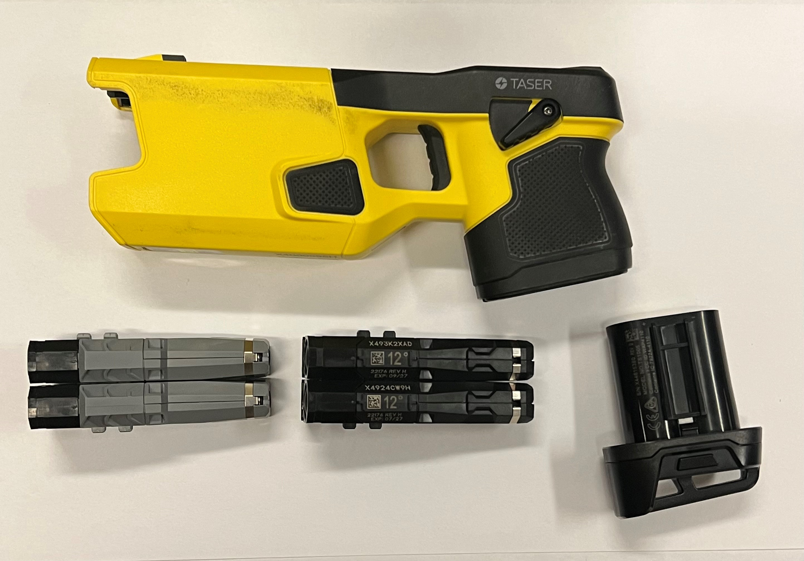
Taser 7
In 2019 the T7 was tested and began to replace the X2.
  Approximately 1,330 have been issued to date.
  The T7 had multiple improvements including a more accurate probe design and the ability to utilize probes (up to 3) from either cartridge if any probes missed when fired.
  Introduced rechargeable batteries and a networked system for downloads and software updates.
  The T7 had two types of cartridge, both a near and longer range.

Slide 8
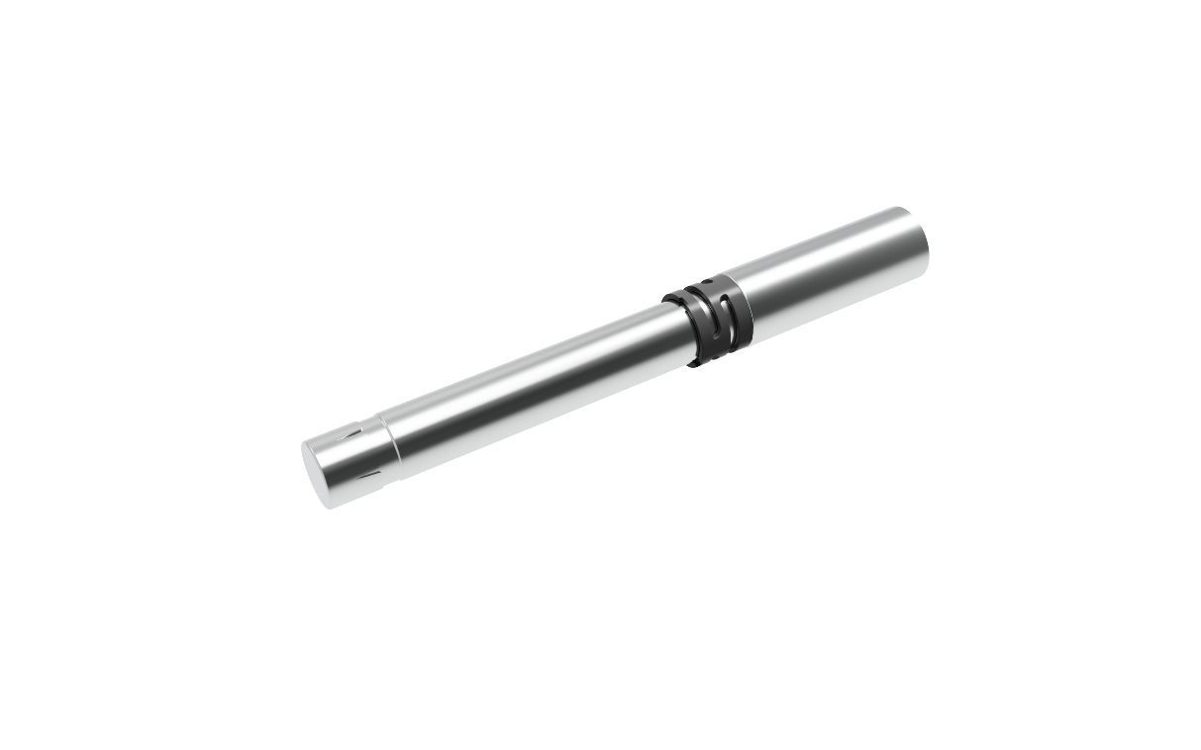
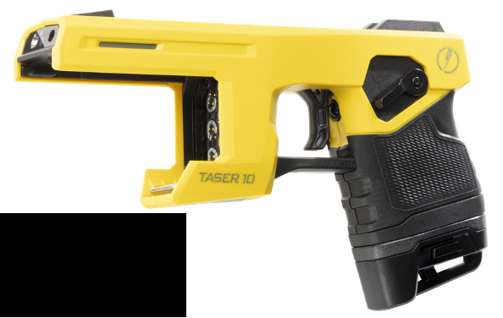
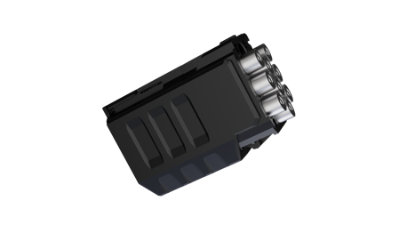

Taser 10 COMPONENTS
Cartridge(s)
TASER 10 Energy Weapon
Standard Duty Magazine
Slide obtained from manufacturer materials.

Slide 9
T10 Features
Capable of deploying up to 10 individually targeted probes from a detachable magazine.
  Each activation will deploy one probe, so a minimum of two are required.
  Allows the officer to create the proper probe spread to achieve NMI
  The total amount of electricity received does not increase with more probes deployed.
  The device will continue to test any connected probes in an attempt to achieve the best connection possible.
Maximum range is increased to 45 feet. (Effective recommended range of 40 feet.)
Probes are redesigned with an impact absorber to reduce the risk of over-penetrating skin.
Retains the same battery, recharging station, and network attached system installed with the T7.

Slide 10
T10 Features Continued
Updated software allows extensive tracking and reporting of the performance and health of devices. Information saved includes:
  The number of probes deployed
  Details about the amount of electricity and the path between probes used to deliver it
  And now adds the approximate distance of deployment
High voltage module is removed.
  No longer a “drive-stun” mode
  There is a reduced risk of the ignition of flammable vapors
Warning Alert is added to replace the warning arc and can be performed without deploying cartridges.
  Up to 1000 lumens of flashing light is focused on the target and a loud alert sound serves as an audible warning.

Slide 11
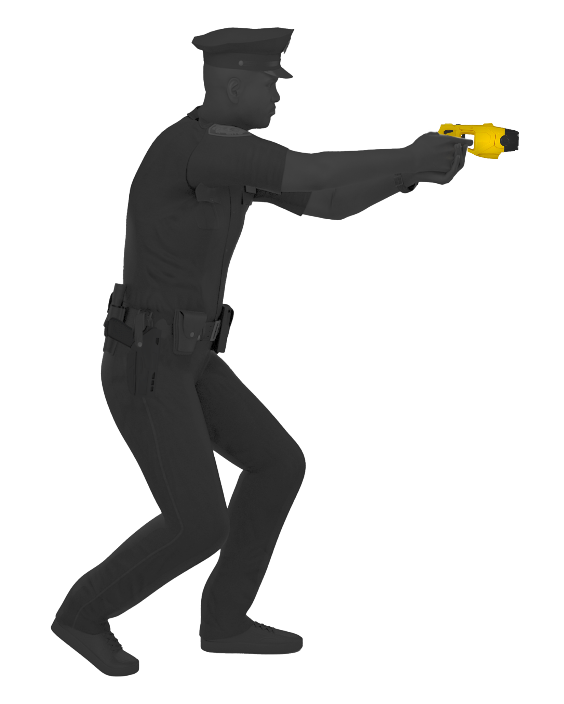
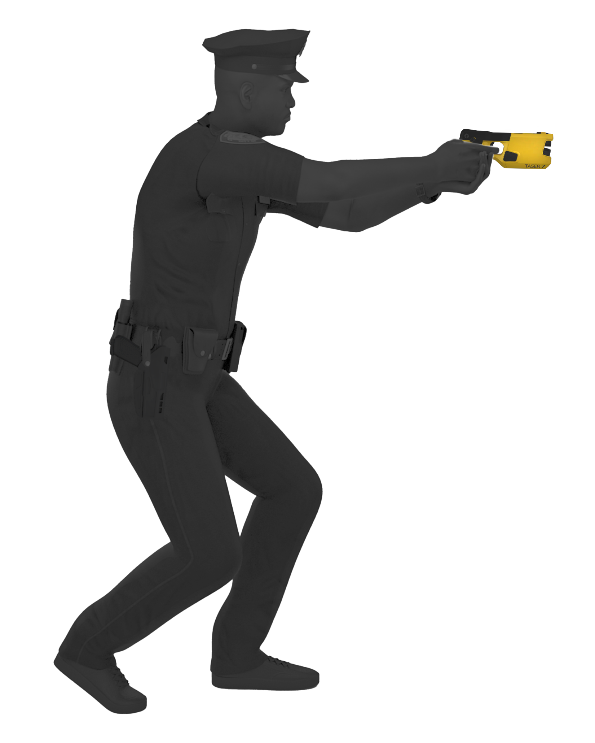

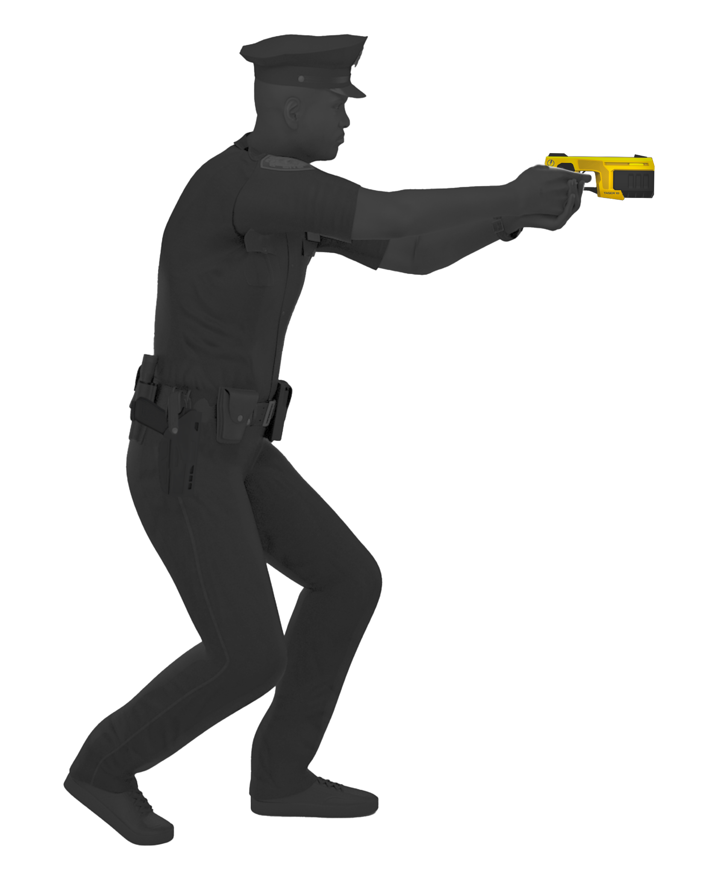
TASER ENERGY WEAPON SPREAD
TASER X26
TASER 7
5ft
10ft
15ft
20ft
25ft
30ft
35ft
40ft
45ft
Notes:
The TASER 10 allows users to create their own spread – it’s surprisingly easy and intuitive.

Slide 12
Upcoming Council Request:
CED Contract
A Request for Council Action for the CED contract will be forthcoming soon

