Slide 1
Public Safety and Homeland Security Committee:
Firearm Injury Data Integration
Dr. Loren Hopkins, PhD, Chief Environmental Science Officer, Houston Health Dept.
Dr. Bindi Naik, MD, MPH, Chief of Pediatric Surgery and Trauma, UTMB and Rice University Baker Institute for Public Policy
Presentation Date: July 20, 2023

Slide 2
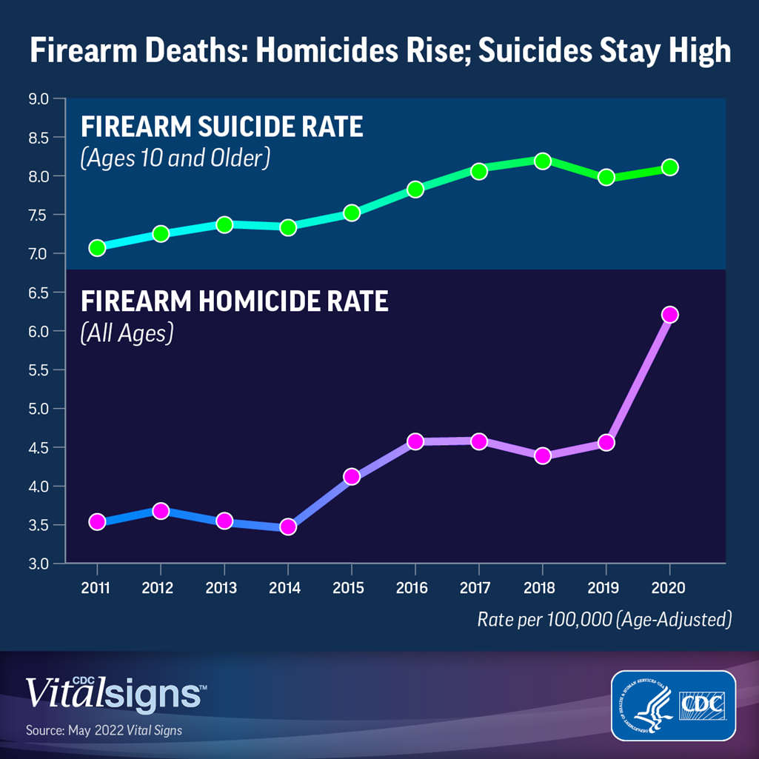
Background
Despite including “Reduce firearm-related deaths” and “Reduce non-fatal firearm-related injuries” as Healthy People 2030 goals, the issue has not improved.
Since 2020, death by firearm is now the LEADING cause of death in children, more than from motor vehicle crashes or illness. Firearm suicide and homicide has increased for both adults and children.
All trauma centers in Houston have seen a huge increase in firearm injury victims since the pandemic, and this has been steadily rising since 2018.
Notes:
LOREN
A study published in 2022 was performed to compare the prevalence of violent penetrating injuries during the first COVID-19 pandemic year, March 2020 to February 2021, with the previous 5 years. The study collected and analyzed data from Boston Medical Center, an urban level I trauma center that is the busiest trauma center in New England, for all patients who presented with a violent penetrating injury. The cross-sectional study included almost 2400 patients, and found that there was a significant increase in patients who presented with firearm injuries, but not stabbing injuries, during the first pandemic year compared with the previous 5 years.
This upward trend in firearm injuries since the pandemic began has been observed across the nation, and can be seen in both adult and pediatric populations.
Researchers in a study conducted by UTHealth Houston collected and analyzed data for pediatric patients admitted to a level 1 trauma center in Houston from 2019 to 2021 with firearm-related injuries, and observed an increase in pediatric firearm-related injuries during the pandemic, despite also seeing a decrease in total pediatric ED visits during the same period of interest.

Slide 3
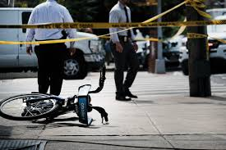

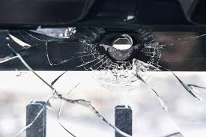

NON-FATAL
ASSAULT / HOMICIDE
INTERPERSONAL VIOLENCE
MASS SHOOTINGS
UNINTENTIONAL
ACCIDENTAL
FATAL
SUICIDE
INTENTIONAL SELF-HARM
BYSTANDER
STRAY BULLET
Notes:
LOREN
There are many types of firearm injury, and non-fatal injuries are 2-3 times more common. Thus, we need to count injuries AND deaths to fully define the problem – it’s not just the homicides.

Slide 4
Approach
INJURY PREVENTION FRAMEWORK (CDC)
Detailed understanding of who, what, when, where, and why firearm-related injuries and deaths occur is needed to target interventions and break the trend of increasing firearm violence.
The Houston Health Department (HHD) collects, analyzes, and presents data across disparate databases and surveillance systems to define:
Who is most vulnerable for a firearm event?
What types of firearm events are occurring? (intent)
When and Where are the firearm events most often occurring?
Why are the firearm events occurring? (risk factors, vulnerable populations)
Notes:
LOREN

Slide 5
Previous Work with this Approach
Data-driven approaches have been key to implementing successful prevention/intervention efforts, not just for violence:
City of Houston COVID-19 Response
  Integrated positivity, vaccination, and wastewater data to identify and address geographical hotspots and populations to target efforts.
City of Houston, Out-of-Hospital Cardiac Arrest (OHCA)/Bystander CPR
  Identified hotspots of high OHCA, low bystander CPR rates, and high-risk demographics to effectively target culturally appropriate community-based intervention planning
This approach provides timely integrated data that can be brought together quickly that can be actionable.
Notes:
LOREN

Slide 6
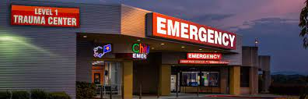






Data Collected Retroactively (2018-2020)
LEVEL I TRAUMA CENTERS
MEDICAL EXAMINER RECORDS
POLICE RECORDS
Non-fatal injuries
Fatal injuries
Residence and shooting locations
Shooting intent
Social correlates
All crimes involving guns
Shooting locations
Fatal injuries
Residence and shooting locations
Shooting intent
Social correlates
GEOSPATIAL ANALYSIS USING CENSUS BUREAU AND PLANNING AGENCY (H-GAC)
Neighborhood-level risk factors, hot spots
Notes:
BINDI
HPD collects data on homicides. But aside from this there is no central collection of firearm injuries and deaths. Therefore, our team linked data from these sources over a 3 year period

Slide 7
ADULT FIREARM INJURIES AND DEATHS IN HARRIS COUNTY
N=4,737
67% increase
200
76% increase
150
100
DATA FROM ALL LEVEL 1 TRAUMA CENTERS AND ME OFFICE
Notes:
BINDI

Slide 8
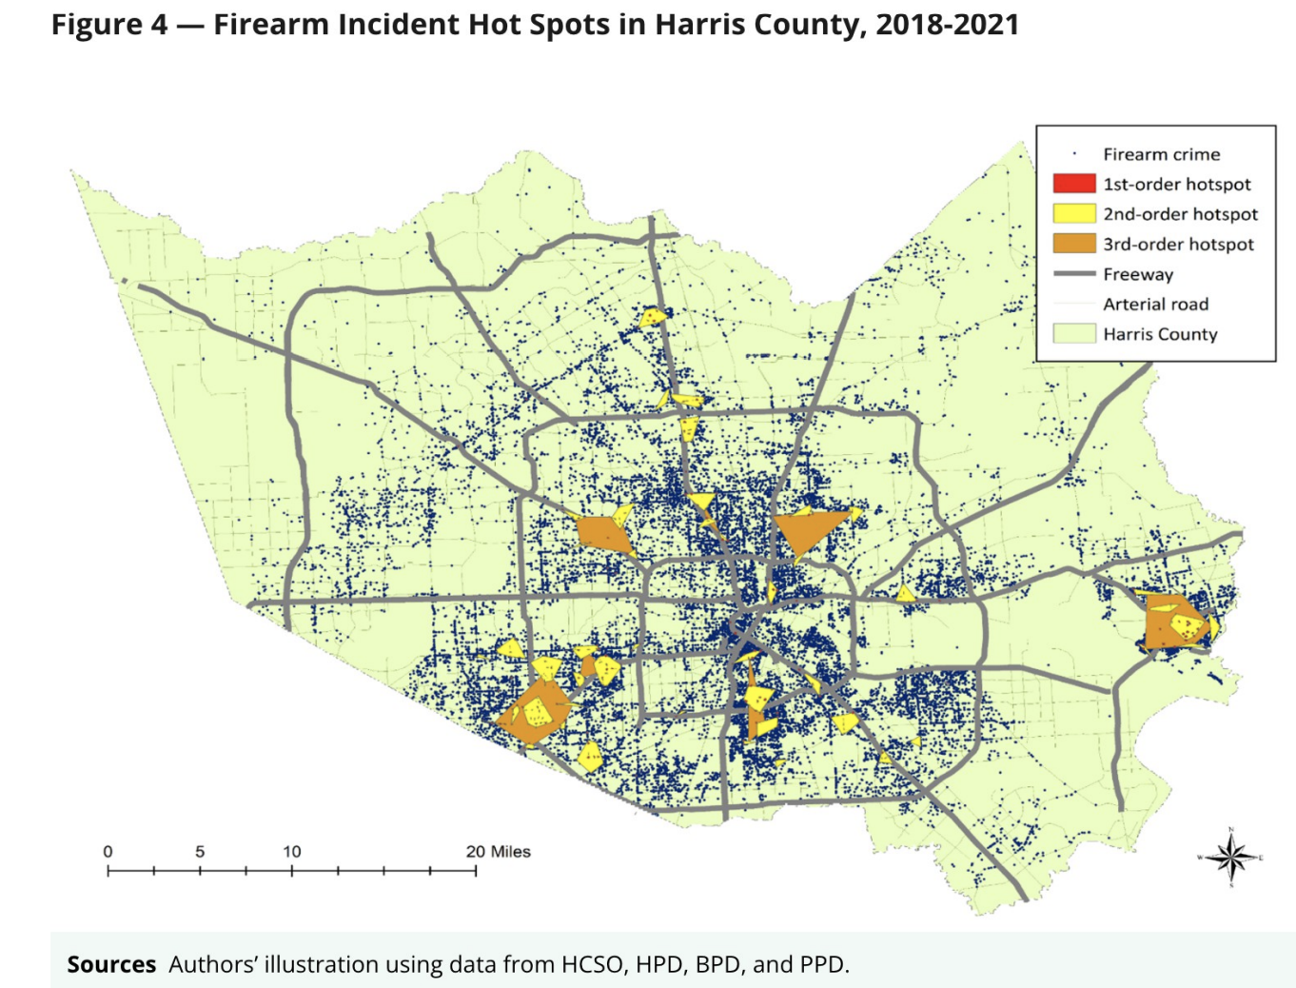
“HOTSPOTS”
FIREARM CRIME DATA FROM HPD, HCSO, Baytown PD and Pasadena PD
1,800 firearm deaths
8,600 firearm injuries
Notes:
BINDI
54,000 crimes with a gun – this Is much higher than the data from the trauma centers and ME office.
Therefore, it is important to combine sources.

Slide 9
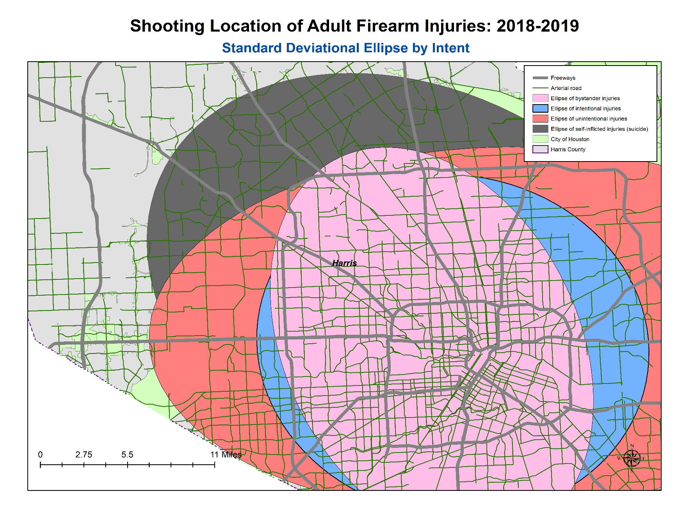
SUICIDE
BYSTANDER
ACCIDENTAL
ASSAULT
Notes:
BINDI
Differences in shooting intent – span different areas of the county

Slide 10
Vulnerable populations
54% Black*
32% Hispanic
90% Male
Mean age 32*
62% Unmarried
93% Low income
30% Alcohol abuse
40% Drug abuse
*Except for suicide: 59% White, non-Hispanic
*Young children are affected as well – 16% <12 y
Notes:
BINDI

Slide 11
Premises for Firearm Crimes in Harris County
50% Car
27% Sidewalk
19% Parking lot*
12% Homes
9% Apartments
7% Stores (convenience 3% gas 3%)
29% Within 300 feet of an alcohol-serving establishment
Notes:
BINDI

Slide 12
Since most suicide and accidental shootings occurred at home, safe gun storage could have prevented 1/3 or more of pediatric firearm injury and death
Notes:
BINDI

Slide 13

Injury Prevention Intervention Targets
    Promote safe household firearm storage education and awareness to parents of all races, in urban and suburban neighborhoods, lock giveaways
    Increase community and law enforcement engagement in hot spot neighborhoods
    Install parking lot and strip mall lighting and cameras
    Limit access to parks after 6pm in hot spot neighborhoods
    Increase green spaces in hot spot neighborhoods
    Increase social support for low-income Black and Hispanic families
    Identify depressed children in middle and high schools and adults and utilize safety and suicide prevention resources in higher suicide areas, including in White, Non-Hispanic suburban and rural areas
    Increase mental health services in schools and for veterans
    Promote out-of-home firearm storage
Notes:
BINDI
And based on this, these are targets for injury prevention.

Slide 14
We gained valuable data from linking data sources, but identified these problems:
Trauma centers are valuable source for data, but there is a lot of missing data b/c no standardized collection
Manual data collection was too time-consuming
Retrospective data lags behind – need real-time info
Missing data from non-trauma center hospitals/urgent cares
Notes:
BINDI

Slide 15
TRAUMA CENTERS
ESSENCE DATABASE
MEDICAL EXAMINER DATA
911 CALL LOGS
POLICE RECORDS
Fatal and Nonfatal injuries
Residence and shooting locations
Demographics
Shooting intent
Risk factors
Social factors
(Standardized data intake tool)
ED and Urgent Care
Fatal and Nonfatal
Demographics
Shooting intent
Zip code of residence
Fatal and Nonfatal
Shooting locations
Fatal
Residence and shooting locations
Demographics
Manner of death
Risk factors
Fatal and Nonfatal
Minor Injuries and Crimes with Guns
Shooting locations
Crime locations
HOUSTON HEALTH DEPARTMENT FIREARM DATA INTEGRATION
Geospatial And Statistical Analysis
Actionable Injury Prevention Targets, ex. hotspots, risk factors
DATA TO ACTION
Notes:
BINDI

Slide 16
Approach
Automated Power BI-drive firearm injury dashboard that will contain valuable, real-time data on:
Firearm injury/death victim demographics
Shooting intent and context
Locations and hotspots of concern
Socioecological risk factors
Temporal trends
Notes:
LOREN
The dashboard serves as a tool to monitor and track firearm injuries and will supplement the efforts of other HHD programs for violence prevention to inform decision-making and where to target efforts. The dashboard data, displayed via filters by year, date range, sex, age group, and race/ethnicity across systems, pinpoint what type of interventions are needed.

Slide 17
Data Sources
Multiple data sources will be integrated and statistically evaluated for overall themes and trends as no one dataset provides enough information alone.
Houston Health Department (HHD) ESSENCE: Syndromic surveillance, primarily composed of emergency department (ED) and urgent care visits for firearm injury
Houston Fire Department (HFD) 911/EMS Pre-Hospital Transport: Ambulance calls that provide location of shooting incident, whether dead-on-arrival
Houston Health Department (HHD) Vital Statistics: Mortality data, including manner of death
Harris County Medical Examiner (ME) Data: Mortality data, with context surround the death
Trauma Centers: Firearm injury and deaths, social risk factors of victims
Notes:
LOREN
ESSENCE: An in-house database that contains near real-time syndromic surveillance data for primarily emergency department and urgent care visits. The HHD’s ESSENCE systems serves the entirety of Texas Public Health Region 6/5S, which encompasses 16 counties. There are currently over 160 facilities who report to the ESSENCE system. Records in ESSENCE can be queried using a combination of key terms in the Chief Complaints and Discharge Diagnosis fields. ED/UC visits due to firearm injuries are identified using a combination of a built-in query for Firearm Injuries and incorporating additional key terms so the data pull is based on terms such as “Gun Shot Wound”, “GSW”, “Firearm”, and specific ICD-10 diagnosis codes etc.
911/EMS data: 911 EMS/Ambulance calls are collected and provided through the City of Houston’s Fire Department. The records are identified using a “Cause of Injury” field that is defined as “Gun shot wound”. The data provides additional information such as the shooting location, whether the victim was dead-on-arrival.
Vital Statistics: The HHD has an in-house Vital Statistics Bureau that collects mortality data and provides the program with data for firearm deaths. The records are also categorized by manner of death (e.g., homicide ,suicide, accident, indeterminate, etc.).
ME Data: To further supplement the mortality data, the HHD also has received data from the Harris County Medical Examiner Office. This data source provides additional information on the context behind the firearm death, pulling data from HPD police records about the scene of the shooting, including more details on whether the shooting was gang-related, a domestic dispute, robbery, etc. For accidental deaths, it provides information on whether it occurred between two children, or two adults, etc.
US Census Bureau: To obtain socioeconomic characteristics by geography, such as poverty rates, educational attainment, etc.

Slide 18
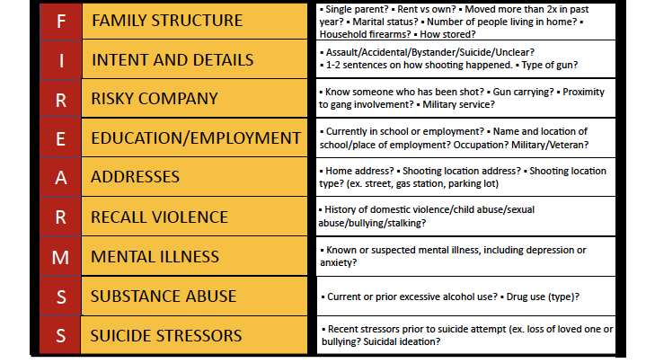
Data Sources
TRAUMA CENTERS
Notes:
LOREN
This is the type of valuable data that can be collected from the trauma centers If this proposal is funded

Slide 19
Data Sources - Limitations
No one data source provides the full picture of the issue by itself, and therefore must integrate several data sources to obtain a more comprehensive overview.
Examples of limitations:
ESSENCE data do not capture individuals who died at the scene, nor provide shooting locations.
Vital Statistics data has large delays in receiving data, and does not provide shooting locations or content behind death.
911/EMS data does not capture individuals who did not receive transportation via ambulance (e.g., dropped off by friend/family).
Notes:
LOREN
EMS data is shaky (e.g, age), if someone is shot, don’t ask too many questions and just try to approximate age. Similar for home address, if it’s not easily found on DL, won’t be recorded.

Slide 20
Data Linking and Integration
While the data sources are disparate, there are still ways in which the data may overlap across the various systems.
Ex. 911/EMS Pre-Hospital Transport data will capture individuals who were documented as dead-on-arrival, and these same individuals will also be captured in the Vital Statistics and Medical Examiner mortality data.
Linking data allows us to get a more holistic view of a firearm injury.
Notes:
LOREN

Slide 21
Data Analysis
Statistical analysis of integrated data will be performed at regular intervals and the following data will be displayed:
Trends across demographics characteristics (e.g., age, sex, race/ethnicity), socioeconomic characteristics (e.g., income, crime), time, and space
Spatial analysis will be completed using GIS mapping software to define geographical “hotspots” with high rates of firearm incidents.
Spatial distribution stratified by shooting intent
Spatial firearm injury data will be overlayed with socioeconomic census tract data to reveal if underlying factors may be contributing to the hotspots that are observed
Socioeconomic models based on shooting intent (updated as necessary) using logistic regression or spatial clustering methods.
Notes:
LOREN

Slide 22
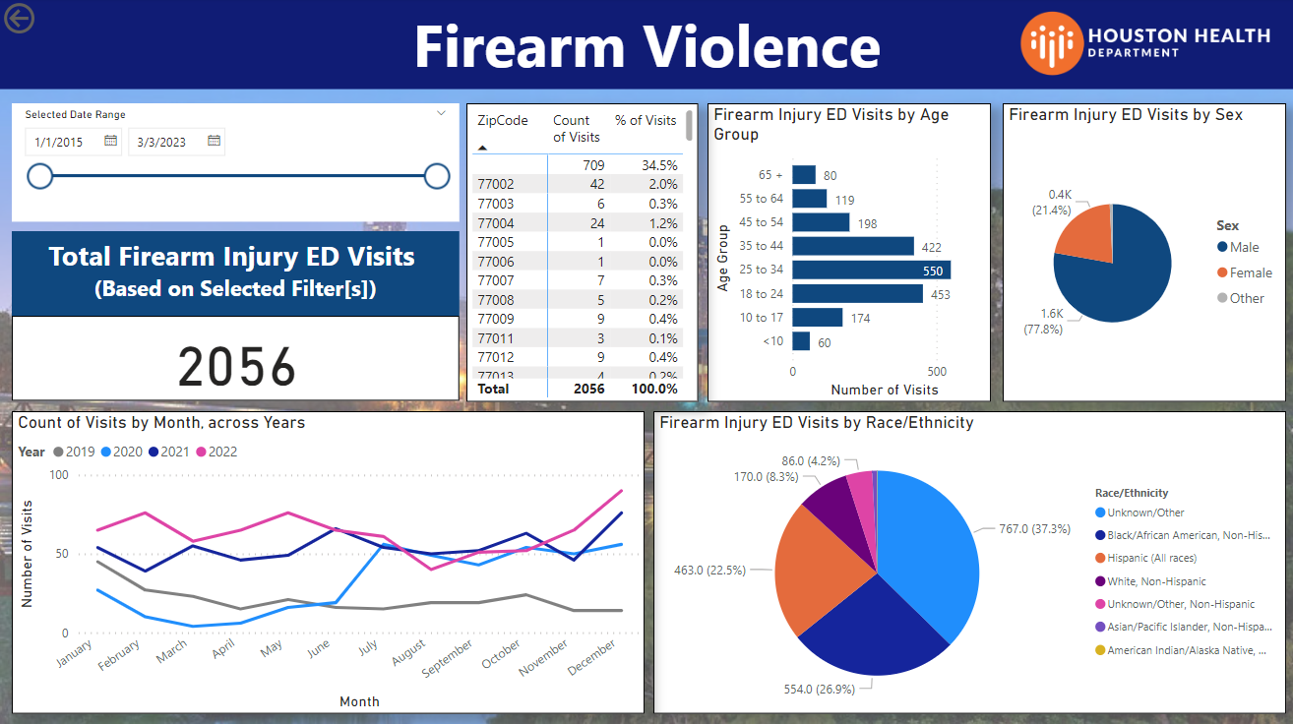
Preliminary Results - PROTOTYPE
Notes:
LOREN
Snippet of ESSENCE tab

Slide 23
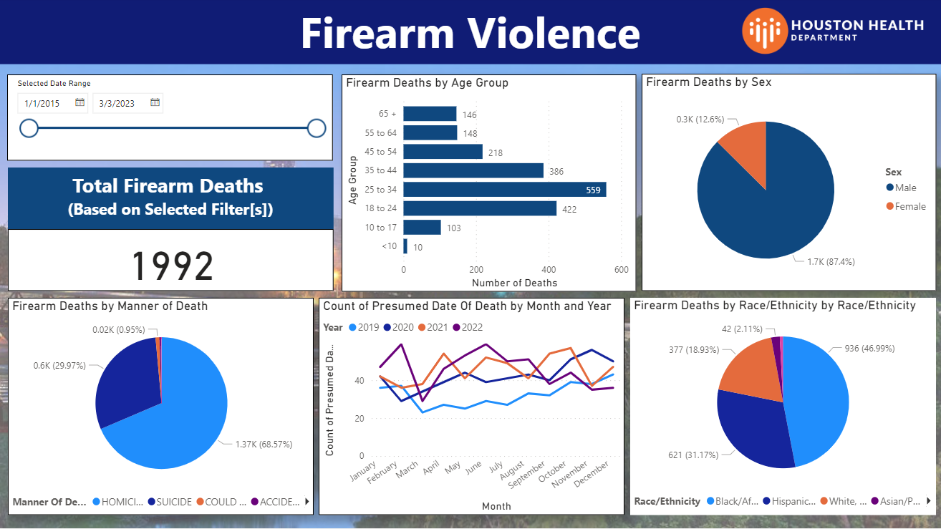
Preliminary Results - PROTOTYPE
Notes:
LOREN
Snippet of Vital Statistics tab

Slide 24
Preliminary Results
DEEP DIVE IN MEDICAL EXAMINER DATA
Homicides accounted for 69.3% (1973/2849) of sample ME records.
Some categories observed from preliminary analysis of sample ME Homicide data*:
*Some records may fit under multiple categories
**Assault was used as a “catch-all” for records that did not fit in the other categories
Gang-related (3.8%)
Domestic Dispute (9.2%)
Altercation (19.5%)
Driving-related (5.3%)
Robbery (7.4%)
Drugs/Substance involved (9.7%)
Child involved (1.3%)
Assault (51.4%)
Notes:
LOREN
Homicides accounted for ~69.3% (1973/2849) of ME sample records.
As mentioned, ME data also contains more details about the scene of death. Records are manually reviewed and categorized. We had some categories already in mind when we first began reviewing the data such as gang-related, domestic dispute, robbery, but as we began reviewing the data, we observed more categories that cropped up repeatedly in the data such as drive-by, altercations. We also had a “catch-all” category of “Assault” for records that did not seem to fit in any of the delineated categories.

Slide 25
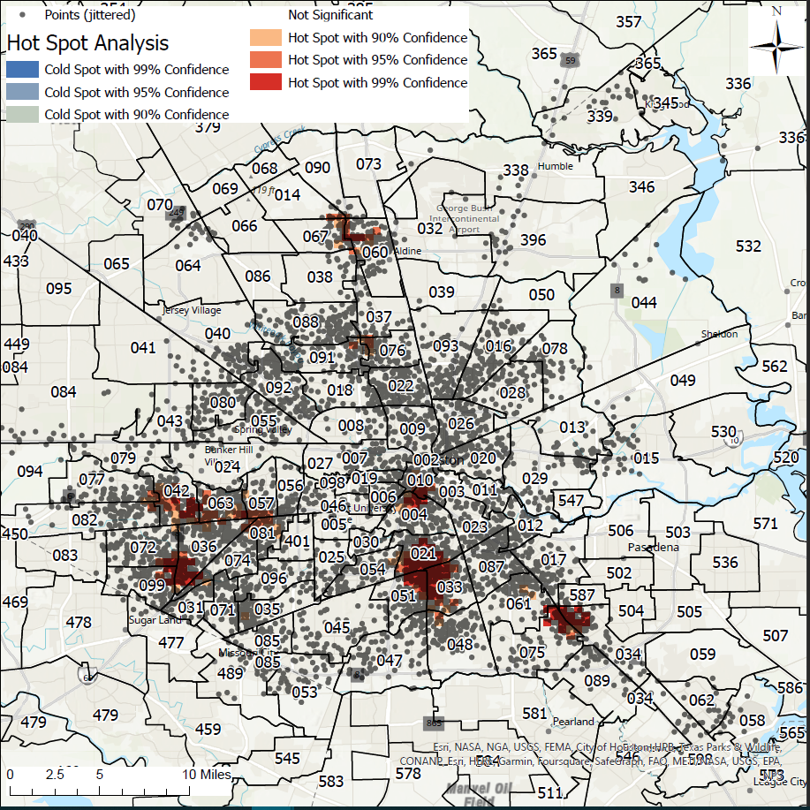
Sample map of shooting locations, from sample 2019-2022 EMS/911 Call data.
Red patches indicate “hot spots” where we observe a higher density of events.
*Point locations are jittered for privacy
Notes:
LOREN

Slide 26
Significance
Opportunity to develop synergy between different departments that are working on the same issue.
Centralized location bringing together disparate pieces for one comprehensive picture.
Develop an advisory group of subject matter experts from the various departments that can have oversight.
  Ensure adherence to HIPAA and data protections
  Adherence to data quality standards
Notes:
BINDI

Slide 27
Next Steps
Potential Benefits of this Work:
Share findings with the regional firearm violence prevention Coalition composed of City leadership, public health programs, and law enforcement at regular intervals
Use findings to support internal Data-to-Action efforts
Partner with local gun violence prevention programs (e.g., One Safe Houston, Houston Police Department, Houston Independent School District)
Conduct assessment of interventions over time
Notes:
BINDI
If funded, we will…

Slide 28
Potential Funding for Intervention
The data and analysis from this dashboard can be used to apply for funding that will focus on gun violence prevention and intervention efforts.
Potential Funding (based on previous grant opportunities):
US Department of Justice grants
  FY 2023 Office of Justice Programs Community Based Violence Intervention and Prevention Initiative - $2,000,000
  FY 2023 Project Safe Neighborhoods Formula Grant Program - $215,000 on avg.
  FY 2021 Byrne Criminal Justice Innovation Program - $1,000,000
CDC Division of Violence Prevention grants
  FY 2021 Preventing Violence Affecting Young Lives (PREVAYL) - $1,250,000
Notes:
BINDI
These are grants that have been offered in the past, and could be indicative of future funding opportunities. The data and analysis from the dashboard can be a stepping stone for applying for these grants and lead into prevention/intervention efforts.

