Slide 1

Houston police department
PUBLIC SAFETY COMMITTEE fy25 Budget amendmentS
J. Noe Diaz, JR. Chief of Police
Patricia cantu, assistant chief
Rhonda Smith, CFO & Deputy Director

Slide 2
Budget Amendment
CADET HIRING INCENTIVE
The Cadet Hiring Incentive is currently under review by the Administration.
2

Slide 3
Summary
HPD cadets are among the lowest paid in the state and nation. To improve recruitment and retention for new officers, a salary increase and hiring incentive for incoming cadets was referred to the Public Safety Committee for consideration. Strategic and sustainable long-term measures are necessary to ensure HPD remains competitive and can attract and retain a sufficient number of qualified officers to meet the needs of Houston’s growing population.
ARPA funding for hiring incentive ends June 2024 for new cadet classes
ARPA $10K incentive has tremendously aided in attracting and retaining cadets
3
Notes:
HPD is one of the largest law enforcement agencies in the nation, however, HPD's stating base pay is the lowest amongst its many other Texas counterparts.
It is imperative that HPD remain competitive in the law enforcement market in order to continue attracting the most qualified applicants possible. A proposed solution to recruiting and retaining Cadets is to increase the base annual starting salary by $ 10,000, from $42,161 to $52,161. In addition to a base salary increase, it is also proposed to offer a onetime hiring incentive of $5,000 to all new cadets. This would increase their $42K salary to $57K (with the $5K bonus) and align us with San Antonio who has a workforce of approximately 2,500 vs. HPD’s workforce of over 5,000.
HPD has the largest law enforcement agency in Texas, however, we are one of the lowest paid. The Incoming Salary is $42K compared to $70K in Dallas and $56K in San Antonio. The ARPA $10K incentive has tremendously aided in attracting and retaining cadets, however, ARPA funding ends June 2024. HPD is requesting an increase of incoming salary to $52K and $5K incentive to remain competitive with other police departments. Cost $871K (one class of 75 including $5K bonus).

Slide 4

HPD Economic Relief Funding (Cadet Retention – ARPA)
Spans 2 fiscal years from November 2022 until June 2024 (Class #256 to #266 + L-13-23)
$2,500 within first 30 days
$2,500 at midway point
$5,000 upon completion of training and TCOLE certification
719 cadets across 12 classes have received at least a partial payment
$10,000 incentive pay for new cadets, total budget of $7,270,000
Broken into 3 payments
4
Notes:
Of the classes that have been eligible for all 3 payments, 100% have received the first, 96% have received the second, and 92% have received the final payment. This includes classes 259-263 and Lateral Class 13-23.
Total Cadets 349
Cadets 1st Pmt 349
Cadets 2nd Pmt 337
Cadets 3rd Pmt 322
Note: Classes 256-258 only received one payment after completion of TCOLE. Classes 264-266 haven’t completed and therefore haven’t received all payments yet.
Past or Current Classes
Class 256 – 61 Cadets - $610,000
Class 257 – 59 Cadets - $590,000
Class 258 – 51 Cadets - $510,000
Class 259 – 49 Cadets - $470,000
L-13-23 – 10 Cadets - $ 92,500
Class 260 – 64 Cadets - $647,500
Class 261 – 76 Cadets - $770,000
Class 262 – 64 Cadets - $657,500
Class 263 – 68 Cadets - $687,500
Class 264 – 56 Cadets - $285,500 (Have not received final payment)
Class 265 – 73 Cadets - $182,500 (Have not received final payment)
Class 266 – 68 Cadets - $170,000 (Have not received 2nd and final payment)
Future Classes
Class 266 – 68 Cadets
Fiscal Year Schedule
FY Budget
FY23 $2,770,000
FY24 $3,562,500
FY25 $ 937,500
Total $7,270,000
Initially, the last class was #265 with a start date of April 15th, 2024 - enough funding available to include Class 266 (started on June 24, 2024)

Slide 5
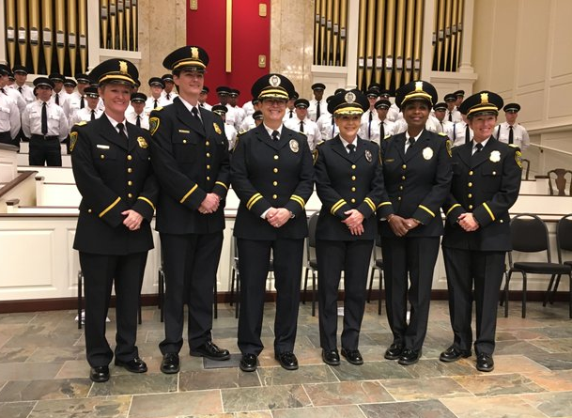
ARPA Funding (Pre-ARPA vs. Post-ARPA Cadet Count)
Houston Police Department Cadet Graduates Prior / Post ARPA
 | Prior to ARPA - $10k |  |  |  | Post ARPA - $10k
 | Total Qty |  | 566 |  | Total Qty |  | 617
Count | Class # | Start Date | Cadet Graduates |  | Class # | Start Date | Cadet Graduates
1 | 255 | 3/28/2022 | 67 |  | 256 | 6/20/2022 | 61
2 | 254 | 12/20/2021 | 47 |  | 257 | 9/6/2022 | 59
3 | 253 | 10/18/2021 | 52 |  | 258 | 11/14/2022 | 51
4 | 252 | 8/16/2021 | 61 |  | 259 | 1/23/2023 | 45
5 | 251 | 6/14/2021 | 61 |  | 260 | 4/10/2023 | 64
6 | 250 | 3/29/2021 | 41 |  | 261 | 6/26/2023 | 76
7 | 249 | 1/19/2021 | 64 |  | 262 | 9/5/2023 | 64
8 | 248 | 11/2/2020 | 46 |  | 263 | 11/13/2023 | 68
9 | 247 | 8/17/2020 | 64 |  | 264 | 1/29/2024 | 56
10 | 246 | 5/4/2020 | 63 |  | 265 | 4/15/2024 | 73
 | Total Qty |  | 566 |  | Total Qty |  | 617
 | Prior ARPA | 566
 | Post ARPA | 617
 | Variance | 51
Graduating Cadets
5
Notes:
Fall Classes are historically lower class-sizes (ex: #264)
ARPA incentives have allowed HPD to MAINTAIN recruiting post-COVID
Class #260 was the first full recruited class to include the $10K hiring incentive (#256-#259 were existing classes at the time of the $10K incentive roll out).
Class #266 expected to graduate in Jan. 2025.
Lateral Class L-13-23 also included in ARPA funding.

Slide 6
FY25 CADET CLASSES
Count | Class # | Start Date | Grad Date
1 | 267 | 8/19/2024 | 3/13/2025
2 | 268 | 10/14/2024 | 5/8/2025
3 | 269 | 12/9/2024 | 7/3/2025
4 | 270 | 2/3/2025 | 8/28/2025
5 | 271 | 3/31/2025 | 10/23/2025
6 | 272 | 5/27/2025 | 12/18/2025
6

Slide 7
Challenges
Challenges in recruiting nationwide:
Fewer applicants wanting to join law enforcement
COVID pandemic
Negative portrayals and attitudes toward police
Lengthy and comprehensive hiring process
Generational differences (current generation looks for flexibility in work life, which is difficult in the police field)
Other factors applicants consider:
Other agencies offer higher pay and larger hiring bonuses
Retirement benefits are better at other agencies
7
Notes:
Additional factors applicants consider:
Media scrutiny
Officer safety concern
Crime rate is higher in Houston versus a smaller police department who offer higher pay

Slide 8
Year 1 Pay Comparison
LOCAL
TEXAS
NATIONAL
SUGARLAND $75K
Population: 110K, 155 officers
ARLINGTON $78K
Population: 395K, 900 officers
LOS ANGELES $86K
Population: 3.8M, 8,959 officers
PASADENA $73K
Population: 152K, 274 officers
DALLAS $70K
Population: 1.3M, 3,640 officers
PHILADELPHIA $61K
Population: 1.6M, 5,544 officers
MISSOURI CITY $65K
Population: 77K, 100 officers
SAN ANTONIO $56K
Population: 1.5M, 2,500 officers
CHICAGO $55K
Population: 2.6M, 11,780 officers
KATY ** $65K
Population: 26K, 91 officers
HOUSTON $42K
Population 2.3M, 5,166 officers
HOUSTON $42K
Population 2.3M, 5,166 officers
HOUSTON $42K
Population 2.3M, 5,166 officers
8
Notes:
In order to stay competitive with other police departments, HPD must address cadet pay. Instead of a permanent increase in pay, hiring incentives have been implemented in the past, most recently thru ARPA funding.
Some factors leading to a competitive pool of candidates:
Competing with other PDs offering higher salaries AND incentives (Austin PD)
Great Resignation movement in PD’s across the nation
George Floyd, COVID
Media scrutiny, benefits, pay/bonuses, perception of crime
Note: All PDs listed here have their own academy, except for Missouri City PD and Katy PD.
Sugarland
Length of Academy
Approximately 6 months depending on the academy (WCJC or Fort Bend County Gus George)
$62K Starting salary for cadets
How long does the start salary last for cadets?
6 months (from hire date until cadet graduation). Once they become TCOLE certified, they go up to minimum officer pay.
Does salary change for cadets during the first year?
Yes. Salary changes from cadet to certified once they have graduated.
How much is the increase from cadet salary to a TCOLE certified officer (after cadet graduation) salary?
$62K to $75K.
Is the LEA currently offering a hiring incentive?
Yes
$10,000 hiring incentive for lateral officers only (3 or more years TCOLE)
Pasadena
Length of Academy
34 Week Academy
Starting salary for cadets
$73,000.00
How long does the start salary last for cadets?
1 year after hire date
Does salary change for cadets during the first year?
No
How much is the increase from cadet salary to a TCOLE certified officer (after cadet graduation) salary?
No increase. Cadet salary remains the same after graduation.
How much is the increase from cadet salary to a 1st year officer salary?
$6000 increase to $79,000.00
Is the LEA currently offering a hiring incentive?
Yes
$5,000.00 on Day 1 of the Academy. Additional $5,000.00 after completion of the First Year. This is in addition to the increased 1st year salary.
Yes
$10,000 hiring incentive for lateral officers only (3 or more years TCOLE)
Missouri City
MCPD has 2 tracks to hire officers:
Track 1: This track represents the traditional hiring process. All applicants must be either be Texas Commission on Law Enforcement (TCOLE) certified or will be certified within 120 days of the testing date.
Length of Academy
N/A
Starting salary for certified TCOLE officers
Starting officer salary is $65,237.00 with $10,000 signing bonus
How long does the start salary last for cadets?
N/A
Does salary change for cadets during the first year?
N/A
How much is the increase from cadet salary to a TCOLE certified officer (after cadet graduation) salary?
N/A
How much is the increase from cadet salary to a 1st year officer salary?
N/A
Is the LEA currently offering a hiring incentive?
Yes
Track 1 = There is a first-year $10,000 incentive for TCOLE certified officer only, subject to the City's hiring incentive council-approved ordinance.
Track 2 – Police Cadet. Under this track applicants are not TCOLE certified. Applicants must have either a four year college degree, a minimum of two years full time continuous service in the military, currently enrolled in a TCOLE Approved Law Enforcement Academy or be a full time employee with the City of Missouri City.
Length of Academy
Track 2: MCPD does not have their own academy (They recruit from an area independent police academy, approximately 6 months)
Starting salary for cadets (non-TCOLE certified)
$54,750
How long does the start salary last for cadets?
6 months (from hire date until cadet graduation)
Does salary change for cadets during the first year?
Yes (after cadet graduation)
How much is the increase from cadet salary to a TCOLE certified officer (after cadet graduation) salary?
$13,360 increase to $68,110
How much is the increase from cadet salary to a 1st year officer salary?
$15,062 increase to $69,812
Is the LEA currently offering a hiring incentive?
No hiring incentive
Katy
Length of Academy
No academy class (they recruit from an independent police academy)
Starting salary for cadets
N/A
How long does the start salary last for cadets?
N/A
Does salary change for cadets during the first year?
N/A
How much is the increase from cadet salary to a TCOLE certified officer salary?
N/A
How much is the increase from cadet salary to a 1st year officer salary
N/A
Is the LEA currently offering a hiring incentive?
No
Note: Katy PD only hires TCOLE certified officers, and their salary starts at $65k. For TCOLE certified officers with 10 years experience, their salary starts at $78,800. Katy PD has annual increase in salary of 2.5% minimum.
Arlington
Length of Academy
32 Weeks = 8 Months
Starting salary for cadets
$78,074.00
How long does the start salary last for cadets?
1 Year
Does salary change for cadets during the first year?
No
How much is the increase from cadet salary to a TCOLE certified officer salary?
No Increase
How much is the increase from cadet salary to a 1st year officer salary
$3,717.00 increase to $81,764
Is the LEA currently offering a hiring incentive?
No
Dallas
Length of Academy
10 Months
Starting salary for cadets
$70,314.00
How long does the start salary last for cadets?
1 Year
Does salary change for cadets during the first year?
No
How much is the increase from cadet salary to a TCOLE certified officer salary?
No Increase
How much is the increase from cadet salary to a 1st year officer salary
$2,108.00 increase to $72,422
Is the LEA currently offering a hiring incentive?
No
Note: For lateral entries, the minimum is 3 year officer, $76,831 to a maximum of 5 year officer, $81,509.00. Lateral academy is typically 12 weeks but varies.
San Antonio PD
Length of Academy
32 Weeks = 8 Months
Starting salary for cadets
$57,000.00 ($27/hr)
How long does the start salary last for cadets?
1 Year
Does salary change for cadets during the first year?
No
How much is the increase from cadet salary to a TCOLE certified officer salary?
No Increase
How much is the increase from cadet salary to a 1st year officer salary
$6,000.00 increase to $63,000.00
Is the LEA currently offering a hiring incentive?
No
Houston
Length of Academy
6 Months
Starting salary for cadets
$42,000.00
How long does the start salary last for cadets?
1 year after hire date
Does salary change for cadets during the first year?
No
How much is the increase from cadet salary to a TCOLE certified officer (after cadet graduation) salary?
No increase. Cadet salary remains the same after graduation.
How much is the increase from cadet salary to a 1st year officer salary?
$20,500.00 increase to $62,574.00
Is the LEA currently offering a hiring incentive?
No. $10,000 hiring incentive ended June 2024.
Note: Upon TCOLE certification, HPD officers receive Equipment Allowance ($2,002), TCOLE in-service ($1,400), Education Pay ($3,640 to $8,840), Bilingual ($1,820)
Austin PD
$15k Hiring Incentive
Harris County
$44K
Population: 1.1M
2,545 officers
Other Sources: Municipality Websites, US Census Bureau, Google Research (Cmd Conn, PA Russeo, Cmd. Tien)

Slide 9
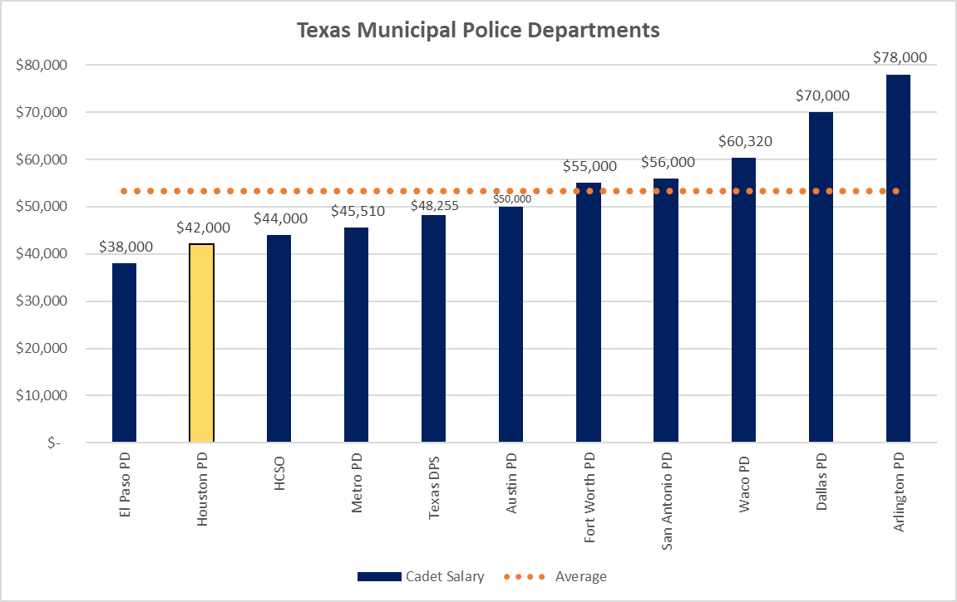
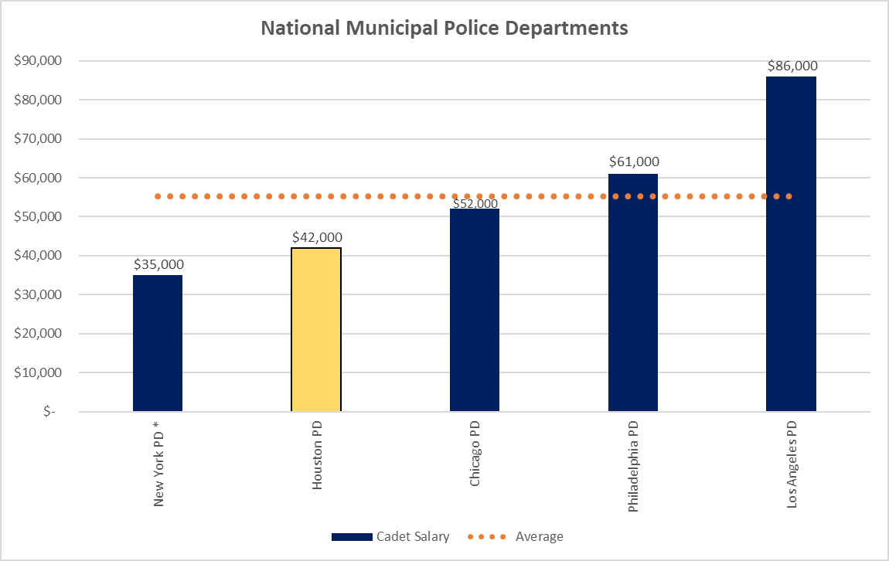
Cadet Pay – State & National
TEXAS
NATIONALLY
*HPD is one of the lowest paid Police Departments in the state of Texas and the United States.
9

Slide 10

Cadet Hiring Incentive Competition
Other Departments w/ Hiring Incentives:
Austin - $15k
Pasadena - $10k
Sugarland - Salary increased to $70k after TCOLE Certification
10
Notes:
Here’s an example of an advertisement that the Austin PD is running to attract qualified cadets.

Slide 11
Cost Summary
Cost of $10K pay increase and $5K hiring incentive is $1.7M per class
FY25 Cost Impact (assuming 6 classes) = $4.5M
Note: HPD is actively working with the Administration on reviewing this proposal.
11
Notes:
Assuming July 1 start date:
$8.4M for 5 classes
$10.1M for 6 classes
Actual Funding required in FY25 for 6 classes:
Supported by Administration: Addition of 6th class (@$42K) $2.71M (net of $700K from ShotSpotter savings)
Salary increase to $52K: additional Funding for 6 classes $3.07M
$5K Incentive (#267,#268,#269 only for FY25) $1.47M
TOTAL $4.54M
Note: assuming $5k incentive is to be paid after TCOLE certification; therefore, only classes 267, 268, and 269 will get the incentive in FY25 (scheduled to graduate in FY25).

Slide 12
Budget Amendment
EMPLOYMENT PROGRAM FOR
RETIRED OFFICERS
(EPRO)
EPRO is currently under review by the Administration.
12

Slide 13
EPRO Program Description
The Houston Police Department’s Employment Program for Retired Officers (EPRO) helps alleviate labor shortages by bringing retired officers back on a part-time basis. EPRO’s enable current officers to focus on police operations.
Program Details:
Operating since July 2022 to present
Participants hired by employment agency - HPD selects employees
Vetted and honorably retired
Work Assignments:
Part-time, currently averaging 20 hours per week (max 40 hours bi-weekly)
Supports Classified personnel
13
Notes:
Program Overview:
The Houston Police Department’s Employment Program for Retired Officers (EPRO) helps alleviate labor shortages by bringing back retired officers on a part-time basis.
EPRO participants enable current officers to focus on responsibilities specific to their classification.
Program Details:
The current EPRO program was approved and began in July 2022, operating for the past two years.
Previously used by HPD, the program has provided tangible benefits to the organization.
EPRO participants are hired through an employment agency, with HPD selecting the employees.
Retirees participating in the program are vetted and have retired honorably.
Work Assignments:
EPRO participants work part-time at various divisions, averaging 20 hours per week, and no more than 40 hours per bi-weekly pay period. The number of hours may change based on specific job assignment.
Assignments involve specific tasks typically performed by Classified personnel.
Continuous review allows for the transfer of EPRO participants between divisions to maximize their impact.
Intangible Benefits:
The program raises employee morale by showing efforts to address workforce shortages.
Utilizing committed individuals who wish to contribute positively impacts overall team spirit.

Slide 14
EPRO Program
Hiring Criteria
  Honorably retired Classified Officer
Job Duties:
Complete Investigative Reports
Enter Supplemental Reports
Complete Background Investigations (for Civilians)
Review Lesson Plans for Cadets
Cadet Testing
Administrative Reports
Dispose of property for investigative divisions
Respond to Citizen Inquiries
* If not for EPRO, these tasks would be done by Classified Officers.
Current Budget, $1.5M
  41 Positions
Proposed Additional Budget, $2.2M
  Up to 60 Positions
Total Proposed Budget, $3.7M
  Up to 100 Positions
Salary
  $30/Hour
14
Notes:
HIRING CRITERIA
Honorably retired Classified Officer
Budget, $1.5M
41 Positions
SALARY
$30/Hour
EMPLOYMENT STATUS
Part-Time
BENEFITS
None
JOB DUTIES:
Complete Investigative Reports
Enter Supplemental Reports
Complete Background Investigations (for Civilians)
Review Lesson Plans for Cadets
Cadet Testing
Administrative Reports
Dispose of property for investigative divisions
Respond to Citizen Inquiries
If not for EPRO, these tasks would be done by Classified Officers.
Benefits of having EPRO:
Invaluable Experience
Cost Effective
Operational Efficiency
Increases Office Morale
Knowledge of Laws and Policy
Understanding of Police Culture

Slide 15
Job Responsibilities of Additional EPROs
Case Management Unit
  Adult Sex Crimes or Crimes Against Children
Crimes Against Children (CACU) Unit:
  Children’s Protective Services (CPS) Referrals received by the Crimes Against Children’s Unit
Sex Offender Registration Unit:
  Complete registration process on sex offenders.
15
Notes:
HPD’s goal is to have 100 EPRO Officers to assist Classified personnel
Current Budget only allows for 41 EPRO’s
Increase HPD funding by $2.2M for 60 additional EPRO’s
Here are a few options for Special Victims Division EPROs duties and responsibilities:
Crimes Against Children (CACU) Unit:
o Children’s Protective Services (CPS) Referrals received by the CACU.
o Review CPS Referrals for processing and investigation.
o Research CPS referrals and generate incident reports as needed.
o Route Sex Abuse Cases to Intake Sergeant for assignment.
o Route Physical Abuse Cases to Intake for case preparation or investigative squad as needed.
Sex Offender Registration Unit:
o Sex Offender Registration
o Complete registration process on sex offenders.
o Verify that sex offenders have a duty to register in accordance with state law.
o Verify that offenders are required to register within the city limits of Houston, Harris, County, Texas.
o Make entries into Offender Watch Database.
o Use RMS for address verification provided by offenders.
o Initiate and return phone calls as needed.
Case Management Unit:
o Adult Sex Crimes or Crimes against Children
o Complete criminal history checks for case prep.
o Request 9-1-1 audio recordings from Houston Emergency Center (HEC).
o Preserve BWC videos.
o Assist with records retention duties.
Productivity documented:
The work done on each case investigation to prep it will be documented on a Case Assignment Sheet. For daily productivity tracking, an e-workcard for the fixed post position with tabs customized to track will be utilized.

Slide 16
EPRO – Current Assignments
Division | Count
Auto Theft | 2
Community Affairs | 1
Crime Analysis Command Ctr | 1
Downtown | 1
Employee Services | 1
Gang | 4
Major Assaults & Family Violence | 1
Major Offenders | 1
Narcotics | 1
North | 2
Property | 4
Property & Financial Crimes | 1
Risk Management | 2
Robbery | 3
South Gessner | 1
Special Victims** | 8
Training | 3
Victim Services | 1
Westside | 1
Vacant | 2
Grand Total | 41
41 EPRO positions budgeted, $1.5M
90% Retention Rate, 39 Currently Filled
Need 60 additional EPRO’s, $2.2M
(Special Victims and Major Assaults/Family Violence)
Recruiting efforts under way (150+ applicants in pipeline)
*Note: 6 EPRO’s were re-assigned to the Special Victims Division to assist with Investigations.
These are the divisions the EPRO’s were assigned from:
Property & Financial Crimes (2)
Homicide
Major Offenders
Robbery
Narcotics
16
Notes:
*Note: 6 EPRO’s were re-assigned to the Special Victims Division to assist with Investigations.
These are the divisions the EPRO’s were assigned from:
Property & Financial Crimes (2)
Homicide
Major Offenders
Robbery
Narcotics

Slide 17
Cost Summary
$2.2M for up to 60 additional EPRO’s
EPRO is currently under review by the Administration.
17
Notes:
HPD’s goal is to have 100 EPRO Officers to assist Classified personnel
Current Budget only allows for 41 EPRO’s
Increase HPD funding by $2.2M for 60 additional EPRO’s

Slide 18
Budget Amendment
TEN (10) NEW LIEUTENANT POSITIONS
HPD will revisit the need for additional Lieutenants at a later time as we address staffing needs.
18
Notes:
HPD will revisit the need for additional Lieutenants at a later time as we address staffing needs.

Slide 19
Budget Amendment
Harris County MOU for Cadet Training
HPD Legal is actively developing a Memorandum of Understanding with Harris County.
19

Slide 20
Memorandum of Understanding - Status
HPD has had Preliminary Discussions w Harris County Sherriff’s Office (HCSO) regarding use of space for HPD training
Harris County is expanding their current facility to allow for additional training
MOU is currently being drafted by HPD Legal to encompass use of HCSO facility space for training purposes, RMS System training, In-Service training, Cadet Classes and other training with Non-Profit partners (eg. Houston Area Women’s Center)
HCSO has allotted space for HPD to attend TCOLE Mandated at their facility
20
Notes:
HPD has had Preliminary Discussions w Harris County Sherriff’s Office (HCSO) regarding use of space for HPD training
Harris County is expanding their current facility to allow for additional training
MOU is currently being drafted by HPD Legal to encompass use of HCSO facility space for training purposes, RMS System training, In-Service training, Cadet Classes and other training with Non-Profit partners (eg. Houston Area Women’s Center)
HCSO has allotted space for HPD to attend TCOLE Mandated at their facility

Slide 21
Current Outside Partners
Agency Accommodates
Acres Homes Multi Service Center 200
Champion Forest Baptist Church 200+
Children’s Assessment Center 150 max
Fifth Ward Multi-Service Center 250
Harris County Department of Education 350 max
Hiram Clarke Multi-Service Center 200 max
Houston Emergency Center 50+
Houston Police Officer Union 150 max
Houston’s First Baptist Church 200+
Kashmere Multi-Service Center 150
Lighthouse Church 500+
Northeast Multi-Service Center 100
Third Ward Multi-Service Center 400
TranStar 150 max
Wheeler Avenue Baptist Church 50+
21
Notes:
Acres Homes Multi Service Center- 6719 W Montgomery Rd, Houston,TX,77091 NONE
Champion Forest Bapist Church- 16518 Jersey Dr, Jersey Village, Tx 77040 Leadership Mandatory, SWAT
Children's Assessment Center - 2500 Bolsover St., Houston, TX 77005 VICE Investigator School
Fifth Ward Multi-service Center - 4014 Market St, Houston, TX 77020 None
Harris County Department of Education (HCDE) -6300 Irvington Blvd., Houston, TX 77022 Legal Update Leadership, Officer Safety and Anti-Defamation, Exploring the Depths of Human Trafficking, Motor Vehicle Pursuits
Hiram Clarke Multi-Service Center- 3801 w. Fuqua Houston,Tx 77045 Leadership Mandatory
Houston Emergency Center 5320 North Shepherd Dr., Houston, TX 77091 None
Houston Police Officer Union 1600 State St., Houston, Texas, 77007 Motor Vehicle Pursuits, Balancing the Badge
Houston's First Baptist Church-7401 Katy Fwy, Houston, TX 77024 None
Kashmere Multi- Service Center-4802 Lockwood Dr, Houston, TX 77026 None
Lighthouse Church - 6650 Rankin Rd., Humble, TX 77396
Northeast Multi-Service Center-9720 Spaulding St, Houston, TX 77016
Third Ward Multi-Service Center-3611 Ennis St, Houston,TX 77004
TranStar - 6922 Katy Fwy, Houston, TX 77024
Wheeler Avenue Baptist Church- 3826 Wheeler St., Houson, TX 77004 Grant Writing, Classified Supervisor Meetings

Slide 22
Summary
OVERVIEW – HPD ACADEMY FACILITIES AND TRAINING
Current site was established in 1980 at 17000 Aldine Westfield
Initially designed as a state-of-the-art facility 70-acre complex w 1M SF of floor space
Classrooms, auditorium, driving track, firearms range, tactical village
  Replaced the old Riesner complex
22
Notes:
Current site was established in 1980 at 17000 Aldine Westfield
Initially designed as a state-of-the-art facility 70-acre complex w 1M SF of floor space
Classrooms, auditorium, driving track, firearms range, tactical village
Replaced the old Riesner complex

Slide 23
HPD Academy Overview
Four major buildings centered around a courtyard & amphitheater and specialized Training Areas
Four (4) Facilities Specialized Training Areas
  Academic Building
    7 theater-style classrooms
    3 multi-purpose computer rooms
    Auditorium (150 seats) & overall capacity of 650+
  Physical Training Building
    Full athletic court, weight room, physical therapy, lockers/showers
  Technological Center
  Administration Building
Firearms Building: Indoor 24-lane range with computerized target systems.
Drivers Training: Two tracks for precision and high-speed vehicle handling.
Continuing Education Unit: Oversees in-service officer training & curriculum development.
Certification: Certified by the Texas Commission on Law Enforcement (TCOLE).
23

Slide 24

Questions
24

Slide 25

HPD Purpose and Mission
25

