Slide 1

COMPLETE COMMUNITIES:
FINANCIAL EMPOWERMENT CENTER
Mayor Sylvester Turner’s plan for a more equitable Houston

Slide 2

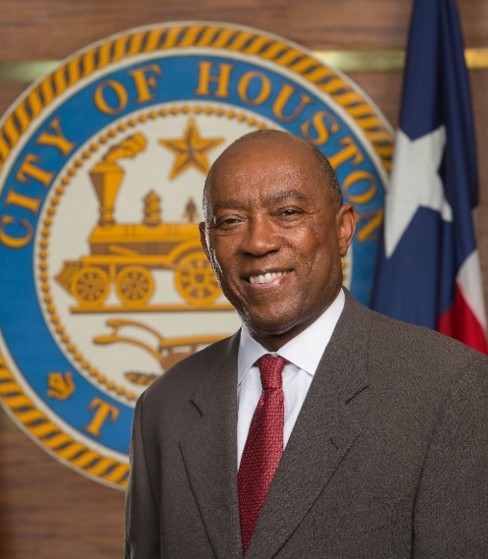
CITY OF HOUSTON - COMPLETE COMMUNITIES
MESSAGE FROM THE MAYOR:MISSION
Complete Communities is Mayor Sylvester Turner’s plan to revitalize Houston’s most under-resourced neighborhoods.
“As Houston continues to grow, so do the diverse needs of our residents and neighborhoods. Ensuring that all Houstonians have equal access to quality services and amenities requires a cross-sector approach. By tapping the strengths of our community members, nonprofits, businesses and philanthropic partners, together, we can build a stronger and more resilient city.”
-Mayor Sylvester Turner

Slide 3
Cities for Financial Empowerment Fund
CFE Fund
COH
FEC
Bank On
Summer Jobs Connect
The CFE Fund works with city leaders and their partners to address residents' financial instability.
The fund leverages municipal engagement to improve the financial stability of low and moderate income households through innovative programs and policies—and measures its success accordingly.

Slide 4
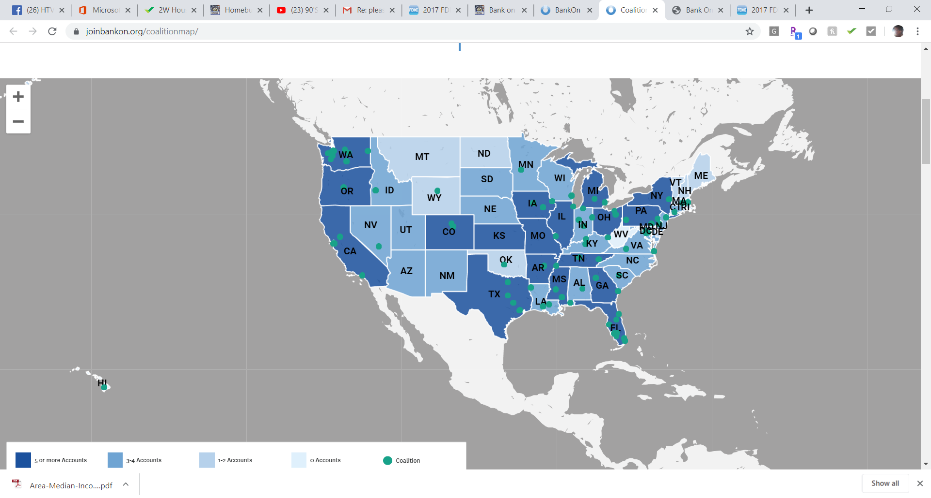
Bank on Houston
Bank on Houston goals :
  Raise awareness among unbanked consumers, especially the low to moderate income market, about the benefits of account ownership and spur them to open accounts.
  Make quality money management education more easily available to low to moderate income Houstonians.

Slide 5
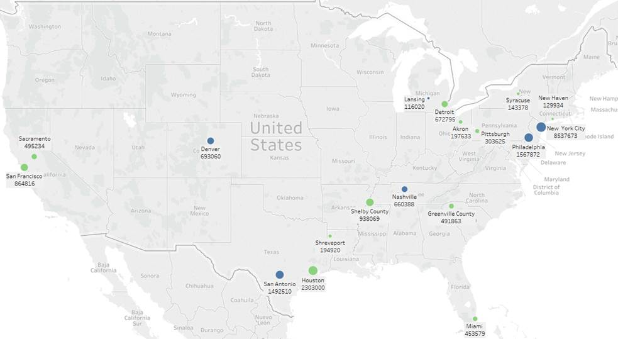
What is a Financial Empowerment Center (FEC)
Funded through Bloomberg Philanthropies’ Cities for Financial Empowerment Fund (CFE Fund)
First piloted in New York under Mayor Michael Bloomberg in 2008, the FEC model was replicated successfully in 2013 in Denver, Lansing, Nashville, Philadelphia, and San Antonio.
Houston received a CFE Fund planning grant in 2017 and added to the second wave of expansion with 11 other cities.
Pilot Round of Cities
Second Round of Cities

Slide 6
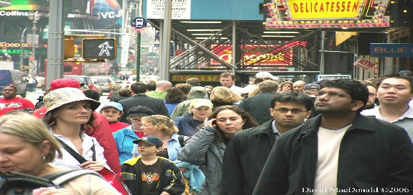


The Need
More than 65 million adults in the United States do not have a checking or savings account
55% of households do not have enough savings to replace a month of their income
35% of Americans have a debt in collections
Sources:
The Pew Charitable Trusts. 2015. “The Precarious State of Family Balance Sheets.”
FDIC National Survey of Unbanked and Underbanked Households.” Federal Deposit Insurance Corporation.

Slide 7
The Need in Houston
11.8% of Houstonians do not have a checking or savings account
Over 43% of Harris County households do not have enough savings to replace a month of their income
22% of Houstonians have used alternative financial services
Sources:
United Way of Greater Houston A.L.I.C.E. report
FDIC National Survey of Unbanked and Underbanked Households.” Federal Deposit Insurance Corporation.
  Source: U.S. Department of Housing and Urban Development (HUD)

Slide 8
Core Elements of the FEC Model
The Financial Empowerment Center initiative provides free, one-on-one financial counseling as a public service to all residents.
Free
One-on-One
Professional
Integrated
Data Driven
Government-Branded
Sustainable
Confidential

Slide 9




FEC Impact to Date
Nearly a quarter of unscored clients working on credit established a score
Roughly a third of clients who tried to reduce their debt or increase their savings succeeded
80, 000 clients served
171,000+ client sessions
$94 million in debt reduced
$9 million in savings achieved

Slide 10
FEC Timeline – Houston Program
2017
Planning and Development Department (PDD) submitted a FEC planning grant application to the Cities for Financial Empowerment (CFE Fund) and was awarded a $20,000 grant.
2018
PDD researched, drafted and submitted to the CFE Fund a plan to implement the FEC Model in Complete Communities neighborhoods as an implementation grant application.
2019
Matching funds were solicited and secured to meet the two-year funding requirements of the implementation grant.
CFE Fund awards Houston with a $250,000 implementation grant.
The Alliance, a United Way agency, was secured as the nonprofit provider of the financial counseling.
Implementation of FEC Program transferred from PDD to Office of Complete Communities

Slide 11
FEC Houston Partners
Funding Sources:
Local Government:
Office of Complete Communities
Nonprofit provider:
The Alliance, a United Way Agency
CFE Fund
CCIF
HCDD-TIRZ
(CFE) Cities for Financial Empowerment Fund
(CCIF) Complete Communities Improvement Fund
(HCDD) Housing and Community Development

Slide 12
FEC Budget
Year 1
Year 2
(CFE) Cities for Financial Empowerment Fund
(CCIF) Complete Communities Improvement Fund
(HCDD) Housing and Community Development

Slide 13
Houston FEC Model
Cities For Financial Empowerment Fund
Funds for the Financial Empowerment Center program
City of Houston
Administrative oversight
The Alliance
Hires and manages the financial counselors
Trains the FEC counselors
Data evaluation and metrics
Secures matching funds
Daily operations of Financial Empowerment Centers
Data collection and analysis
Provides secure data collection tools
Request for City Council Action

Slide 14
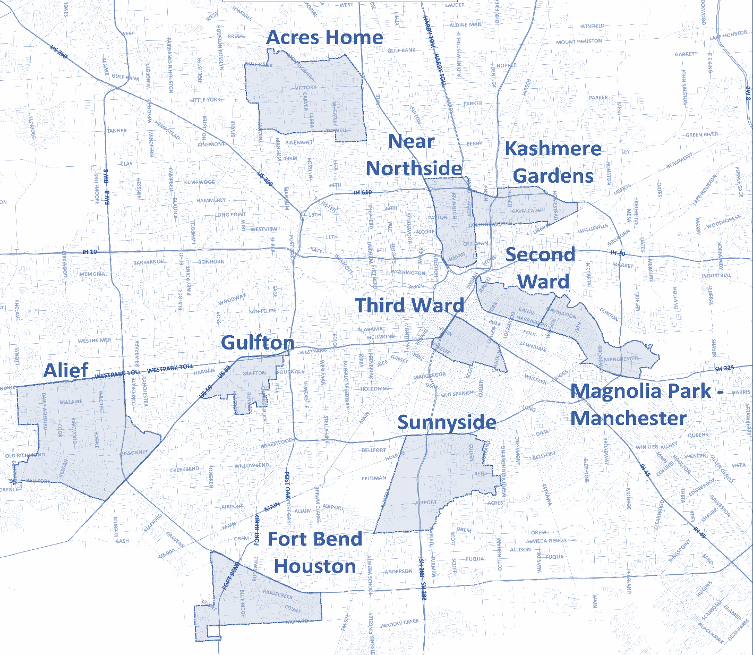
Houston FEC Locations
Acres Home Multi-Service Center
Magnolia Park-Manchester
Multi-Service Center

Slide 15
FEC Next Steps
October 2019
Financial counseling and data analysis training for The Alliance financial counseling staff.
November 2019
City Council Action to accept the grant from the CFE Fund
December 2019
Grand Opening and Ribbon Cutting in Acres Home and Magnolia-Park Manchester
Finalizing grant agreements
Quality of Life Committee presentation
Job posting for Financial Empowerment Program Coordinator in the Office of Complete Communities
Outreach and Communications

Slide 16
Shannon Buggs, Director
Mayor’s Office of Complete Communities
City of Houston
shannon.buggs@houstontx.gov
O: 832-393-1085 / M: 832-459-7810
Suzane Abedi, Assistant Director
Mayor’s Office of Complete Communities
City of Houston
suzane.abedi@houstontx.gov
O: 832-393-8681 / M: 832-712-3693
Christa Stoneham, Manager
Mayor’s Office of Complete Communities
City of Houston
Christa.Stoneham@houstontx.gov
O: 832-393-1081 / M: 346-339-4537
houstontx.gov/completecommunities
CITY OF HOUSTON - COMPLETE COMMUNITIES
CONTACT US

