Slide 1



Updates: Houston Active Living Plan
City of Houston Quality of Life Committee Meeting
October 25, 2023
Presented By: Debra Maxwell, MPH and Latreka Staten, MPH, MBA

Slide 2


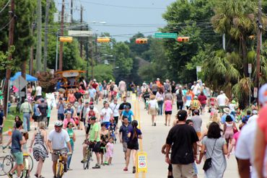
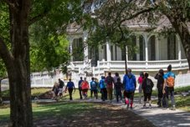
Go Healthy Houston Taskforce
Go Healthy Houston aims to improve the health of all Houstonians by increasing access to healthy foods, physical activity, and tobacco-free places.
Notes:
The Houston Health Department solicits guidance, assistance, and key input on selected strategies and implementation activities from the GHH Task Force and other partner organizations.

Slide 3
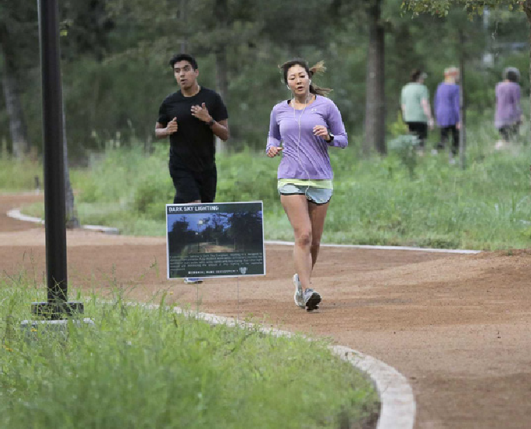
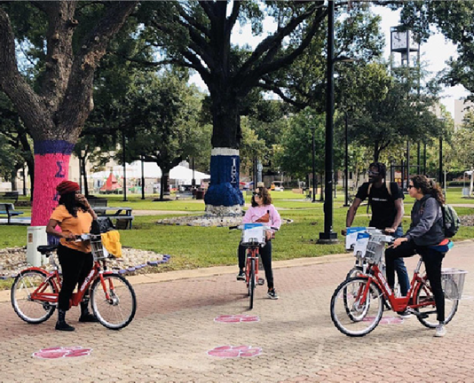
The Need for an Active Living Plan
Living an active lifestyle and being physically active have vital impacts on disease prevention, mental health, and overall quality of life of Houstonians.
  30.1% of adults did not engage in physical activity during free time
  32% of adults were obese
  31% of adults have high blood pressure
  12% of adults shave diabetes.

Slide 4
The Vision
Houston is a place where active living is easy. All residents live, work, play, and age in safe, attractive, and connected environments where physical activity is an integral part of their everyday life.

Slide 5
The Process
Planning 2016
Year long
Call for Action
Updating ALP
Virtual Meetings
32 organizations
Community Workshops
ALP 2017
Encourage adoption of Strategies
COVID-19 Pandemic
2021 ALP
Partnerships to promote active living
Indicators for success
12 sectors
Goals
Strategies
ALP Subcommittee
Presentation
Virtual Focus groups
Action Plan
Aligns with the National Physical Activity Plan
Living Document
Notes:
--
The process for updating the Active Living Plan involved virtual meetings (due to COVID) with the Active Living Plan Subcommittee, focus group participants, and community partners and stakeholders. The focus groups conducted included participants drawn from several sectors and asked participants to consider the role that active living plays in their personal lives and their communities, and how they could encourage and promote active living within their respective sectors. Based on the points discussed and suggested by the 29 focus group participants, the subcommittee team compiled and analyzed inputs to develop steps for implementation, potential partnerships to promote active living across the sectors, and indicators that can be measured to determine successful implementation of the Plan’s recommendations.
---
These updates expanded the Plan’s scope to incorporate six additional sectors, for a new total of 12. Each sector has unique goals and strategies that have been developed based on that sector’s particular strengths and needs.
These updates also better aligns the Houston Active Living Plan with the National Physical Activity Plan while maintaining its unique Houston perspective. The National Physical Activity Plan has served as a model for governments nation-wide, and by incorporating elements of it into the Active Living Plan, the update brings Houston more into line with other peer cities.
Same as with the original publication in 2017, the Houston Active Living Plan is meant to be a “living document” to be built upon as conditions change and other opportunities arise. Thus this update should be regarded as only the latest that the plan may undergo as one of many potential paths to further expanding the Active Living Plan.

Slide 6
Active Living Plan
The Active Living Plan is broken into 12 sectors, with each sector having unique goals and strategies based on a sector’s particular strengths and needs:
Original Sectors (Adopted 2018) | Sectors Added (2021)
Public Health Culture Transportation Built Environment Parks & Recreation Sports & Fitness | Faith-Based Military/Veterans Business/Industry Education Health Care Media

Slide 7
FAITH-BASED
GOAL:
Promote information- sharing and programming that encourage active living strategies for congregants across all faith-based institutions, socio-economic groups, abilities, and ages.

Slide 8
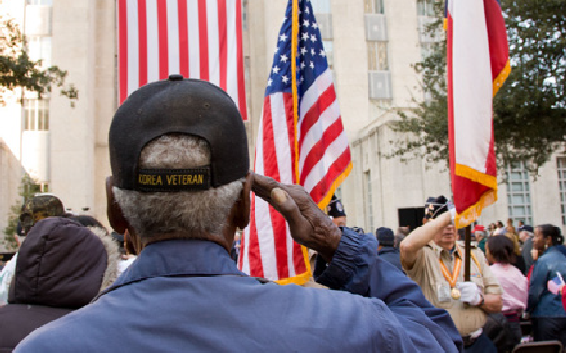
MILITARY & VETERANS
GOAL:
Improve overall awareness of active living opportunities and accessibility of facilities for the military/veteran population that will fulfill physical, mental, and social needs.

Slide 9

BUSINESS & INDUSTRY
GOAL:
Implement policies and programs
that enable and encourage employees to adopt active living lifestyles to address their physical and mental health.

Slide 10
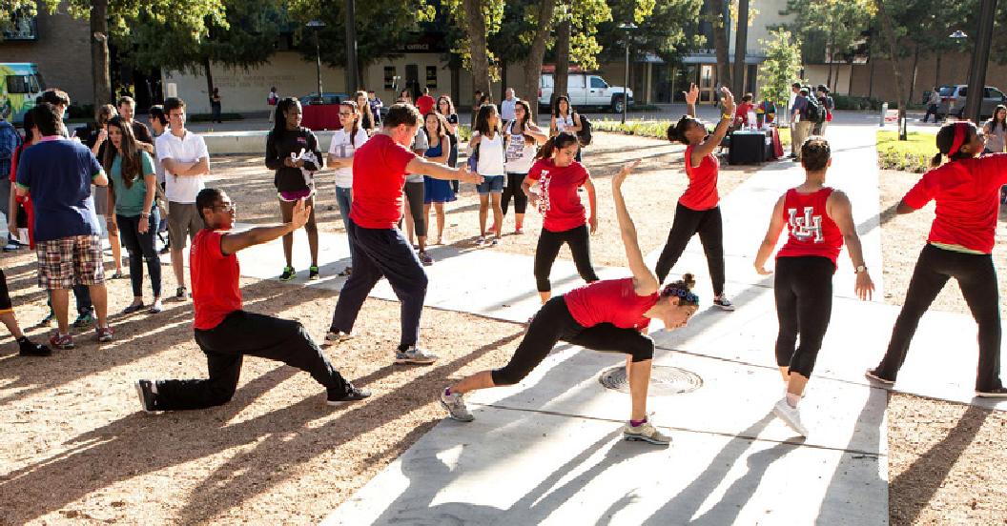
EDUCATION
GOAL:
Educational institutions should look for ways to promote and institutionalize physical activity among their students as well as their staff, including the importance of physical activity benefiting mental health stresses.

Slide 11
HEALTH CARE
GOAL:
Promote multi-sector partnerships with health care systems and professionals to increase physical activity of patients.

Slide 12
MEDIA
GOAL:
Promote awareness of active living behaviors and their importance and benefits among the broader public.
Notes:
There are six major television stations and one major citywide paper in Houston, as well as numerous smaller TV and radio stations and publications that serve the city’s large and diverse audiences. These media outlets provide information, keeping Houstonians informed and up-to-date on local news. They are trusted sources of information. Houstonians are also engaged with new, online media and digital tools, such as Facebook, Twitter, TikTok, and Instagram. They go to these platforms to learn about the latest trends, to follow influencers and creators. Media, both new and traditional, has an important role to play in active living for its ability to inform, instruct, and influence people.

Slide 13
CALL TO ACTION
Better health outcomes are the responsibility of everyone.
Everyone has a role.
Notes:
Each one of us, no matter our profession, background, or circumstances, has the power to contribute to the collective effort of achieving active living for all. Whether you are a healthcare professional, an educator, a community leader, or a concerned citizen, your actions and influence can inspire and empower others to make positive changes in their lives.
So, I challenge you to reflect on your own potential to drive change. How can you be an agent of transformation in your sphere of influence?
How can you support and encourage those around you to embrace active living as a way of life?

Slide 14
Thank you for your support.
Debra Maxwell, MPH
Debra.Maxwell@houstontx.gov
Latreka Staten, MPH, MBA
Latreka.Staten@houstontx.gov
Website: GoHealthyHouston.org
Facebook: Go Healthy Houston | Facebook

