Slide 1

HITS - 101
April 18, 2016
Tina Carkhuff, Interim Director/CIO
Houston IT Services

Slide 2
Agenda
How we are all connected
Data Centers
HITS Supported Applications
Redundancy versus Non-Redundancy
SAP Environment
Questions?
Notes:
Purpose
Update Council on our efforts and have a discussion on what makes sense.
Goal
There are certain area that make sense for development to occur. Neighborhoods generally understand that more intense development occurs along transit corridors, major thoroughfares and more densely developed areas, i.e. Uptown. There are certain areas where neighborhoods do not expect more intense development to occur such as local and collector streets – attempt to eliminate the surprise moment for neighborhoods

Slide 3
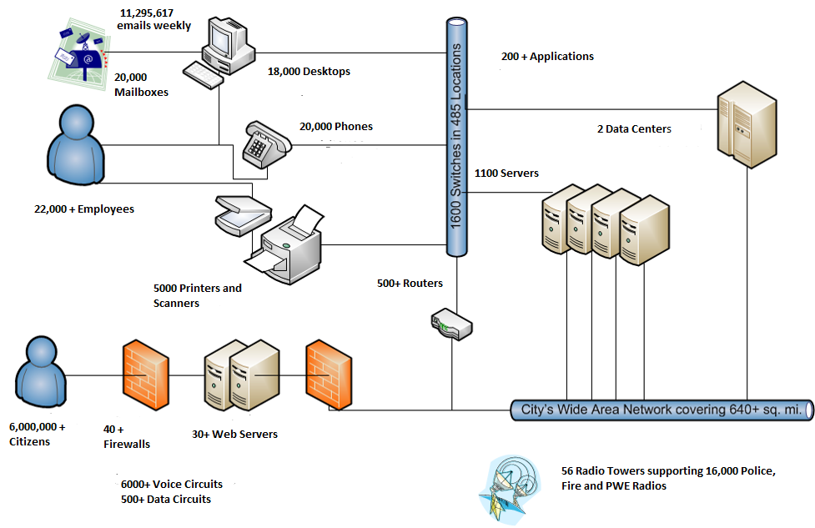
Basic Networking Diagram
How We Are All Connected

Slide 4
Data Centers
Tier Level | Requirements
1 | Single, non-redundant distribution path serving the IT equipment Non-redundant capacity components Basic site infrastructure with expected availability of 99.671%
2 | Meets or exceeds all Tier 1 requirements Redundant site infrastructure capacity components with expected availability of 99.741%
3 | Meets or exceed all Tier 2 requirements Multiple independent distribution paths serving the IT equipment All IT equipment must be dual-powered and fully compatible with the topology of a site’s architecture Concurrently maintainable site infrastructure with expected availability of 99.982%
4 | Meets or exceeds all Tier 3 requirements All cooling equipment is independently dual-powered, including chillers and heating, ventilating and air conditioning (HVAC) systems Fault tolerant site infrastructure with electrical power storage and distribution facilities with expected availability of 99.995%

Slide 5
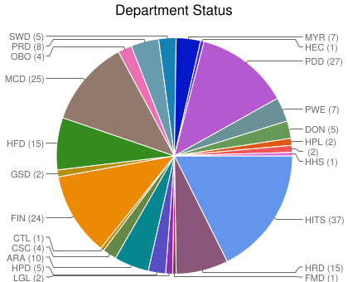
HITS Supported Applications, by Department

Slide 6
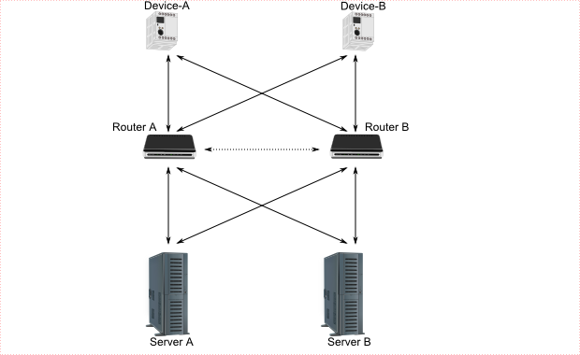
Redundancy versus Non-Redundancy
Duplication of critical components or functions of a system with the intention of increasing reliability of the system, usually in the form of backup or fail-safe.
  Hardware redundancy
  Database redundancy
  Application redundancy
  Site redundancy

Slide 7
SAP Ecosystem
Municipal /Classified Employees Pension System
Time reporting from Kronos
Payroll and Time Reporting
Financial
Human Capital Management
Employee Benefits
HFD Scheduling
Payroll file transfer to Financial Institutions
Hiring through NeoGov
Billing and Financial Information from other City Applications such as BARC, Burglar Alarm
Employee Training and HEAR Evaluation Score
Capital Plan and Budget
Accounts Receivables
Various Reporting Systems
Capital Assets
Org Structure to Various Systems
Accounts Payable
Vendor Information

Slide 8
Questions?

