Slide 1


Slide 2


Slide 3
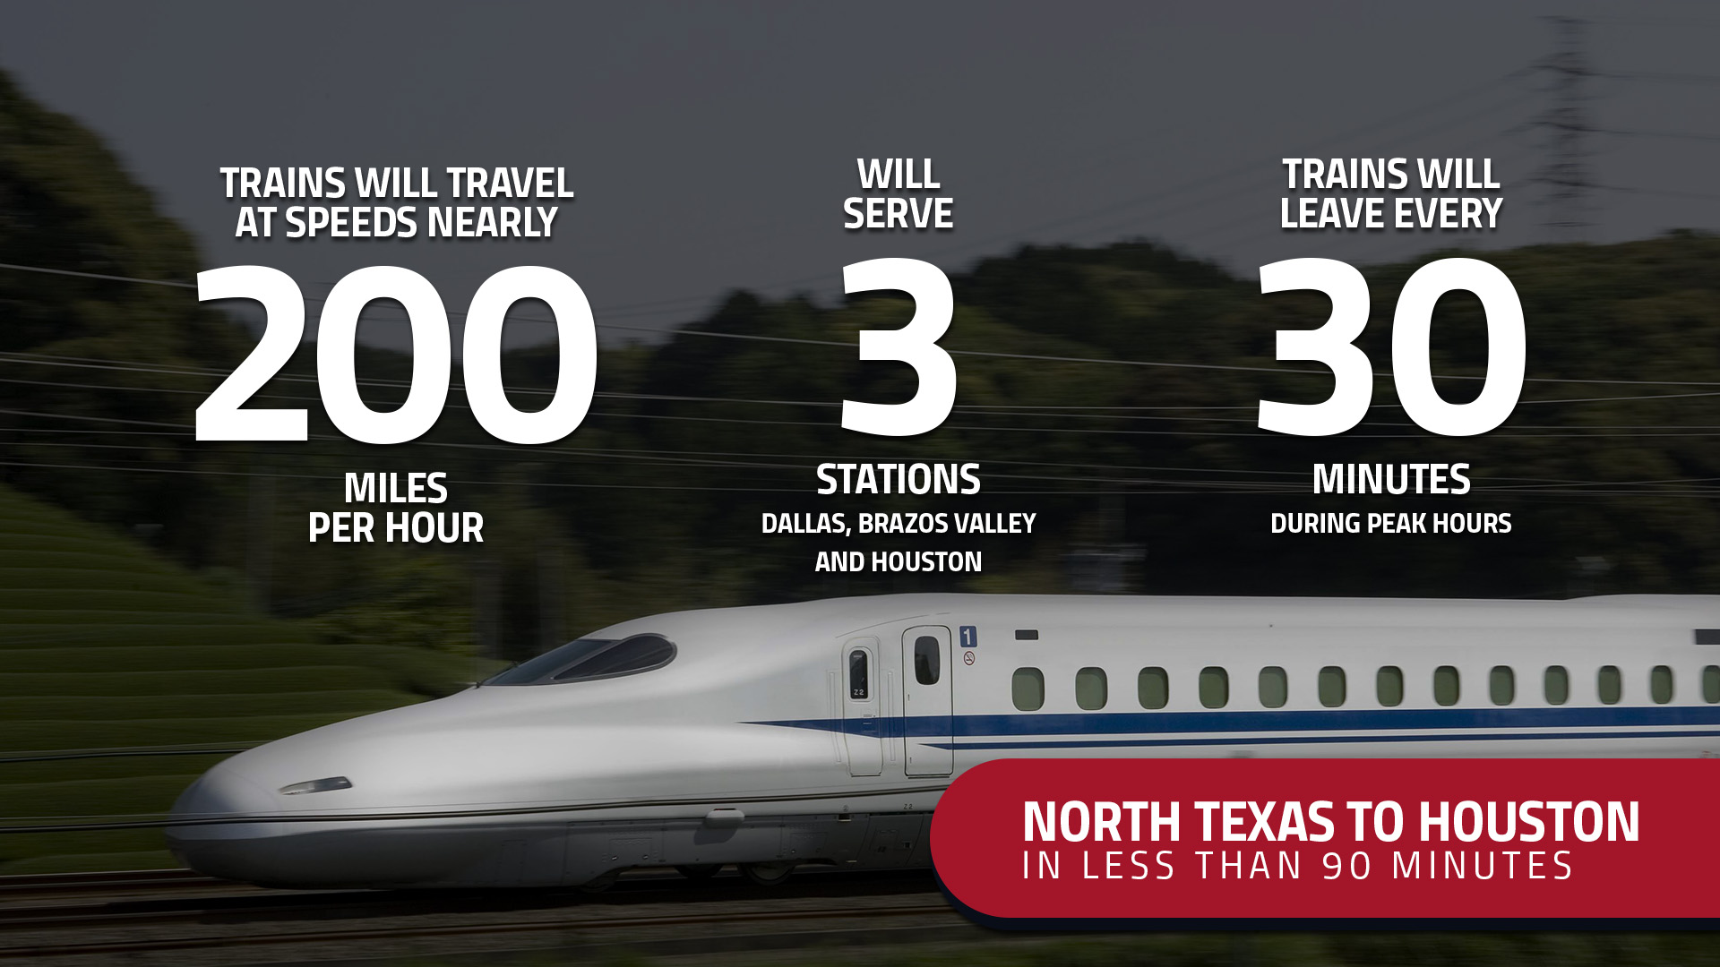

Slide 4



Slide 5
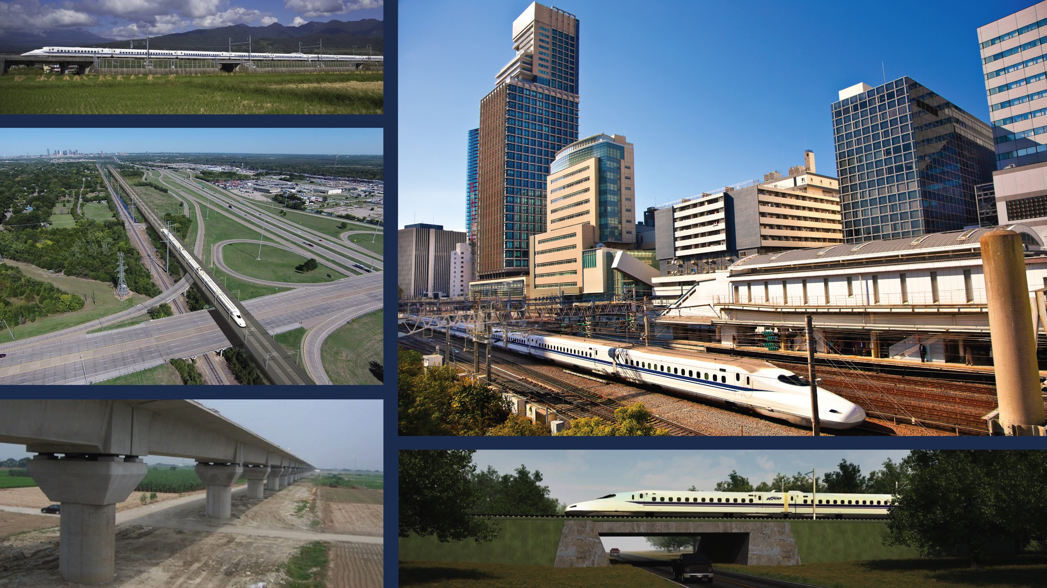

Slide 6


Slide 7


Slide 8


Slide 9


Slide 10
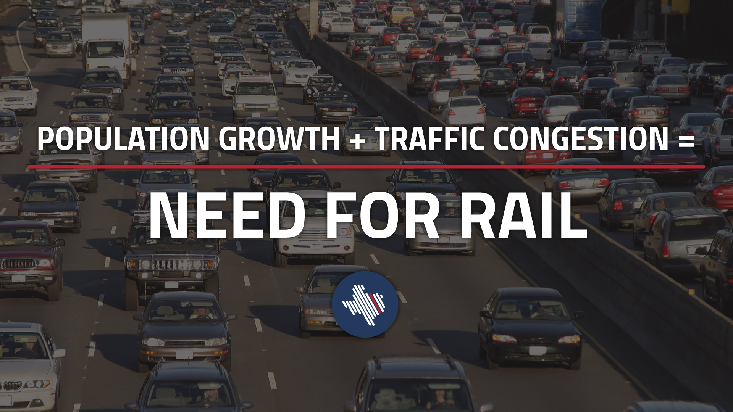

Slide 11


Slide 12


Slide 13





Slide 14


Slide 15


Slide 16
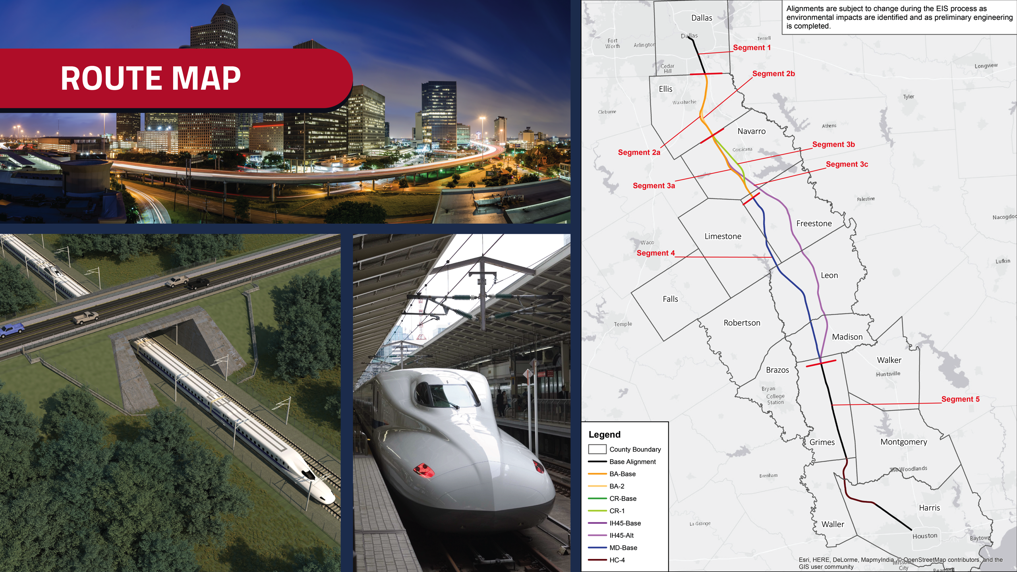

Slide 17


Slide 18


Slide 19


Slide 20
NEXT STEPS
Texas Central will continue conversations with the City of Houston, Harris County, METRO, Gulf Coast Rail District, Houston-Galveston Area Council, and other partners on topics including:
Right of way along Hempstead Road
Station and related economic development at Loop 610 and Highway 290
Connectivity throughout the Houston region

