Slide 1



Municipal Setting Designations
Mark A. Wooten Jr.
Program Coordinator

Slide 2
What is an MSD?
A voluntary deed restriction that prohibits the use of impaired groundwater as potable water
    A tool property owners can use to address environmental impairments to groundwater
    Allows reinvestment and redevelopment of impaired properties
A public health protection

Slide 3
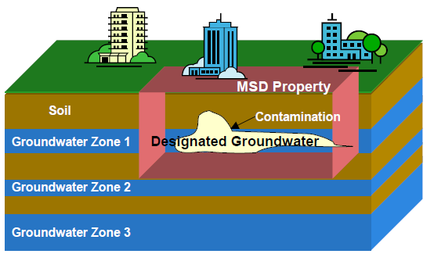
MSD Depiction

Slide 4
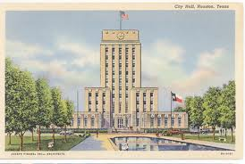
What is an MSD?
It is a State Program
    Administered by the Texas Commission on Environmental Quality (TCEQ)
    Requires Local Support
Article 13 of Chapter 47
    Public Hearing Required

Slide 5
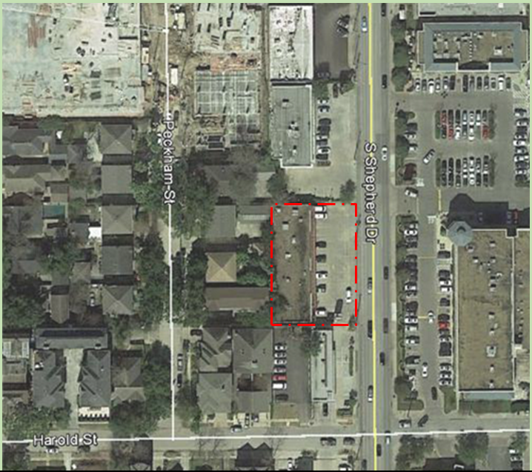
2620 South Shepherd Dr.

Slide 6
The Shops at Shepherd
Eco Cleaners operated an on-site tetrachloroethene (PCE) dry cleaner from 1991- 2000.
Eco Cleaners converted from PCE to Stoddard Solvent usage in Oct 2000.
The property was enrolled in the Texas Voluntary Cleanup Program in 2013.

Slide 7
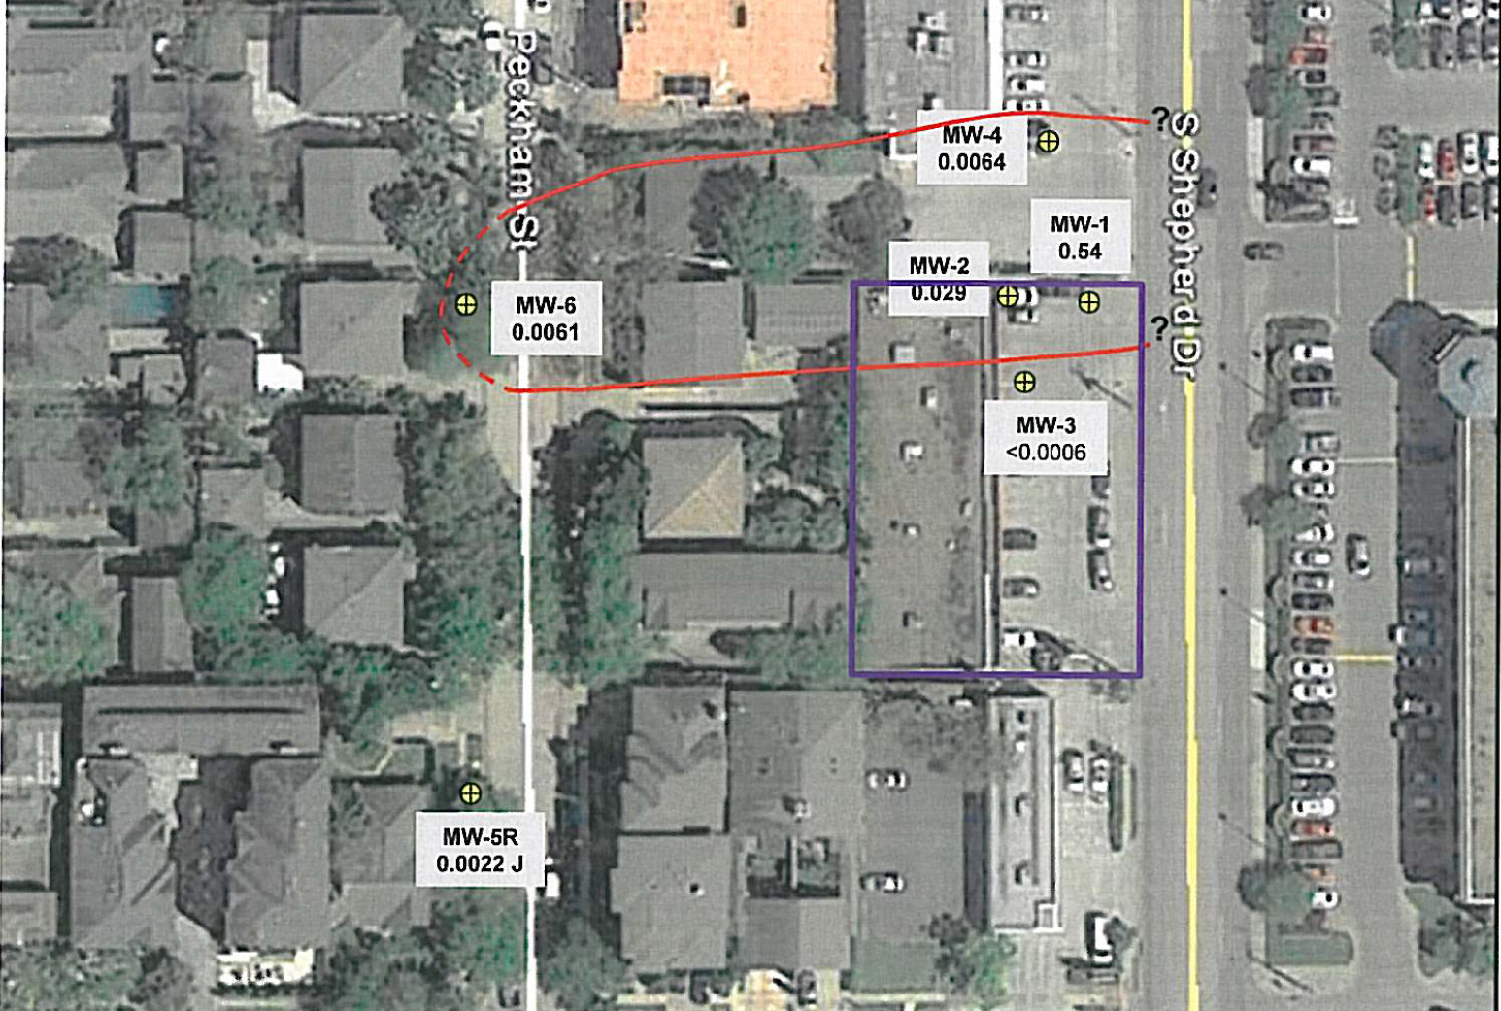
Groundwater Impacts

Slide 8
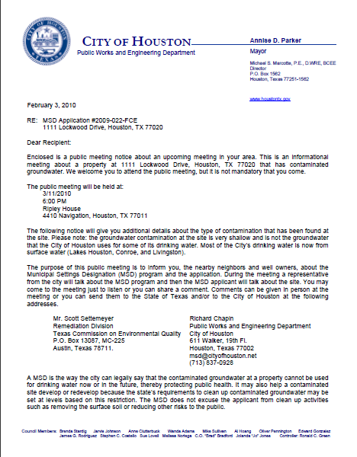
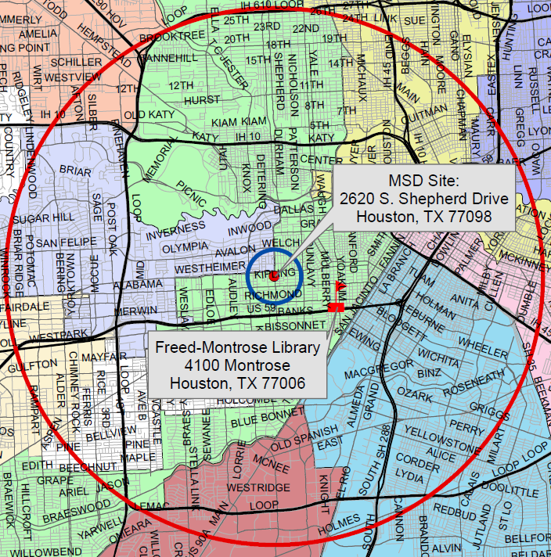
MSD Notice Letters
Property Owners
First-Class Mail
½-Mile Radius
City Requirement
Water Well Owners
Certified Mail
5-Mile Radius
State Requirement

Slide 9
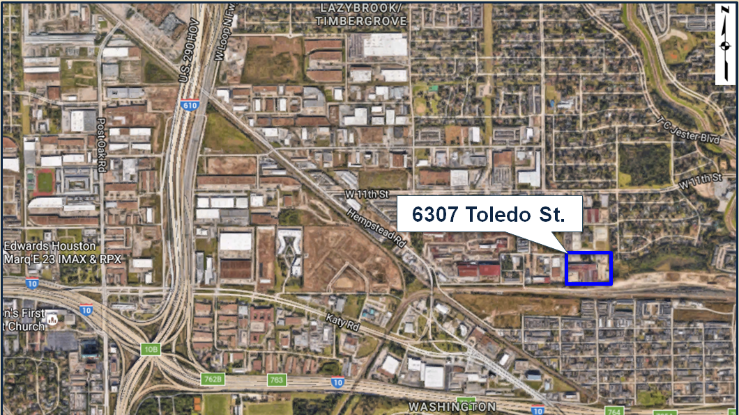
6307 Toledo

Slide 10
Northwest Pipe Company
The site served as a steel pipe mill that was in operation from the early 1950s to 2014.
In 1999, Northwest Pipe Company purchased the property.
Northwest Pipe ceased operations in 2014 removing all equipment.

Slide 11
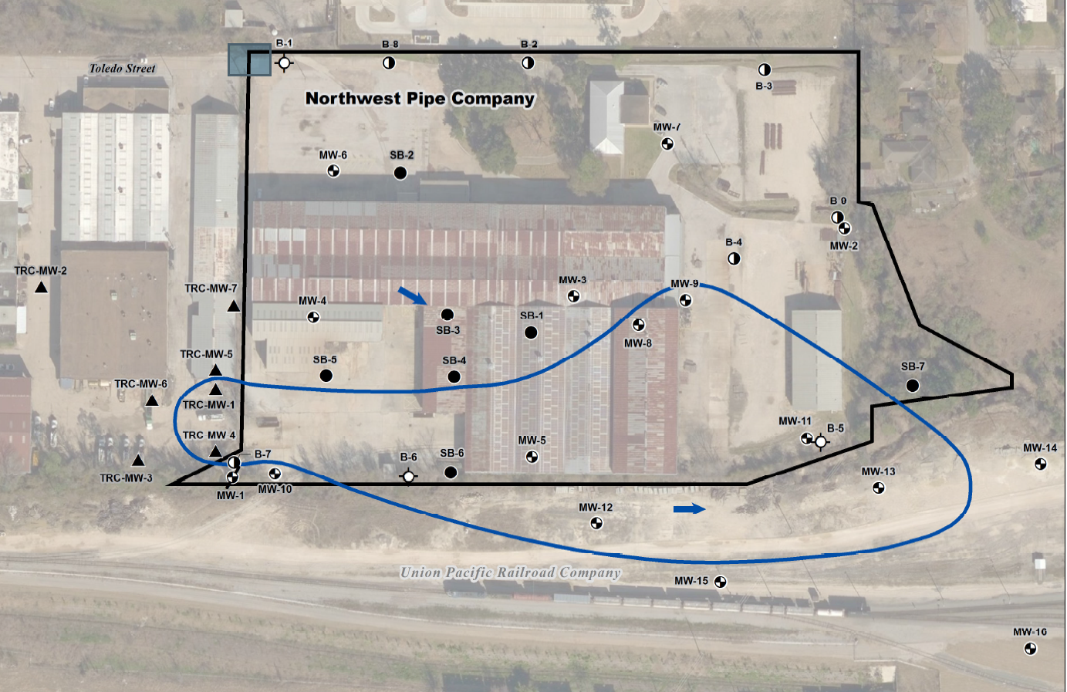
Groundwater Impacts

Slide 12
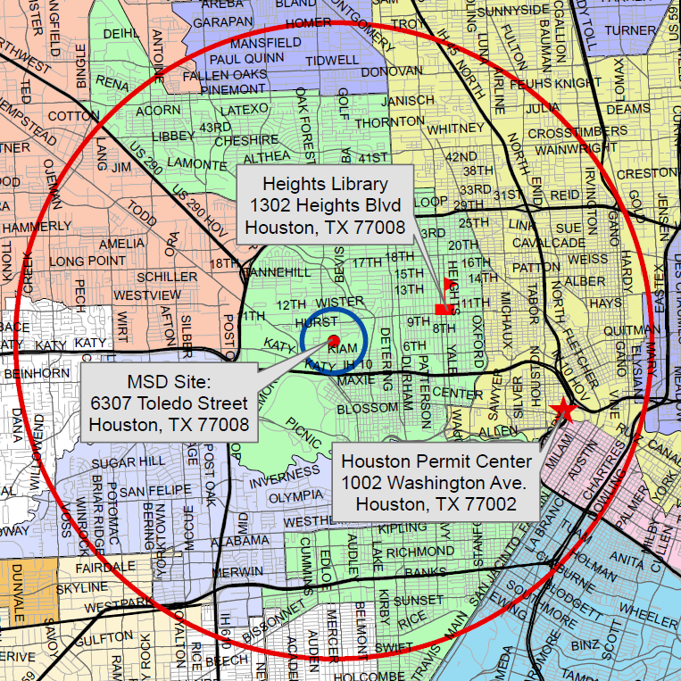
MSD Notice Letters
Property Owners
First-Class Mail
½-Mile Radius
City Requirement
Water Well Owners
Certified Mail
5-Mile Radius
State Requirement

Slide 13
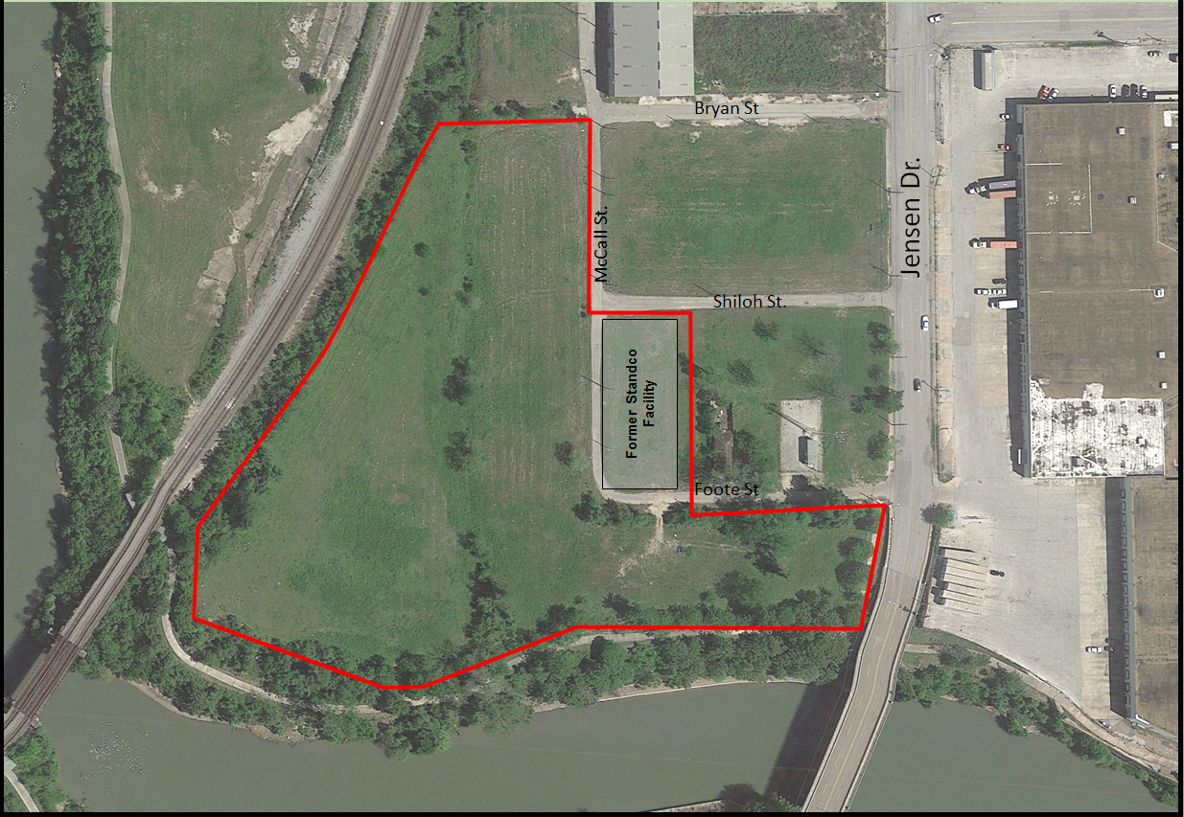
2701 Foote St.

Slide 14
Pinto East End, LLC
The Site is comprised of two vacant, undeveloped tracts of land totaling 9.022 acres of land located east of downtown Houston.
Standco operated at the site from 1969-1985. They manufactured a variety of oilfield products.
Process included parts degreasing that used trichloroethene (TCE) as a cleaning solvent.

Slide 15
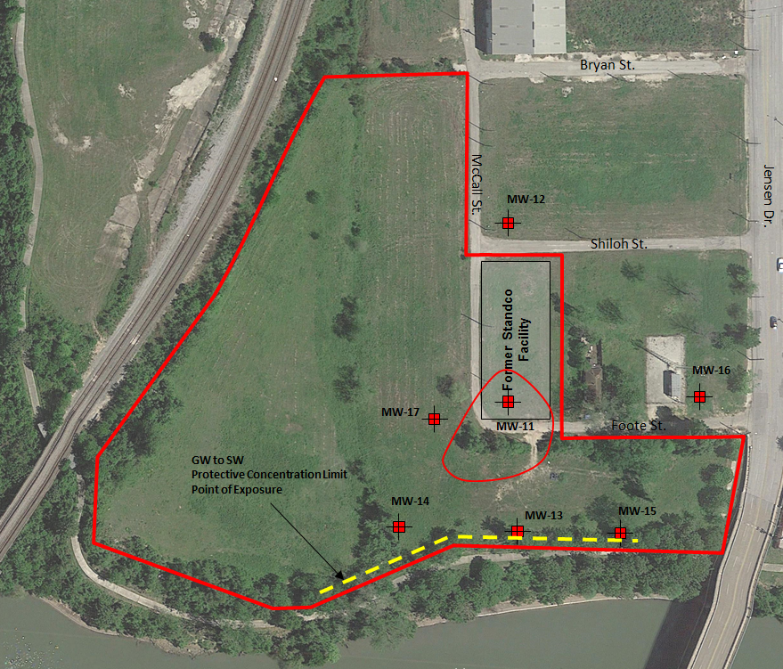
Groundwater Impacts

Slide 16
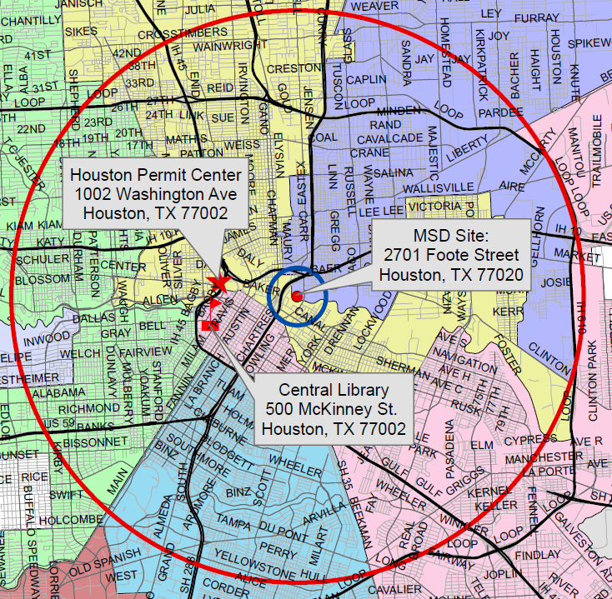
MSD Notice Letters
Property Owners
First-Class Mail
½-Mile Radius
City Requirement
Water Well Owners
Certified Mail
5-Mile Radius
State Requirement

Slide 17
Contact Information
Mark A. Wooten Jr.
Program Coordinator
Public Works & Engineering
City of Houston,
1002 Washington, 3rd Floor
Houston, Texas 77002
msd@houstontx.gov
(832) 394-9003

