Slide 1

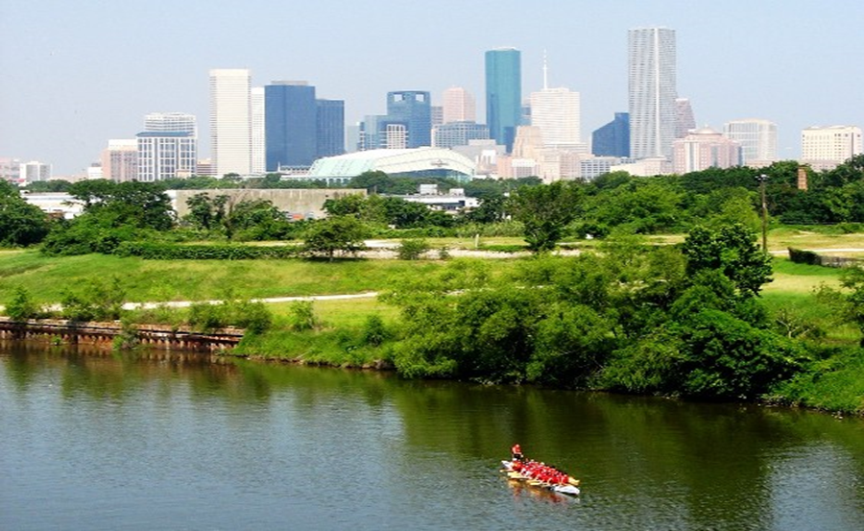

Municipal Setting Designations
Jennifer Clancey
Program Manager

Slide 2
What is an MSD?
A voluntary deed restriction that prohibits the use of impaired groundwater as potable water
    A tool property owners can use to address environmental impairments to groundwater
    Allows reinvestment and redevelopment of impaired properties
A public health protection

Slide 3
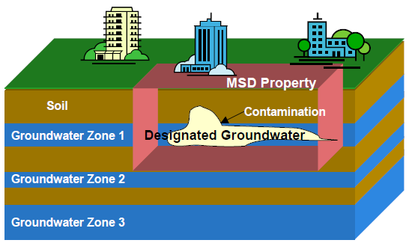
MSD Depiction

Slide 4
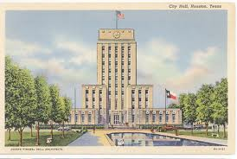
What is an MSD?
It is a State Program
    Administered by the Texas Commission on Environmental Quality (TCEQ)
    Requires Local Support
Article 13 of Chapter 47
    Public Hearing Required

Slide 5
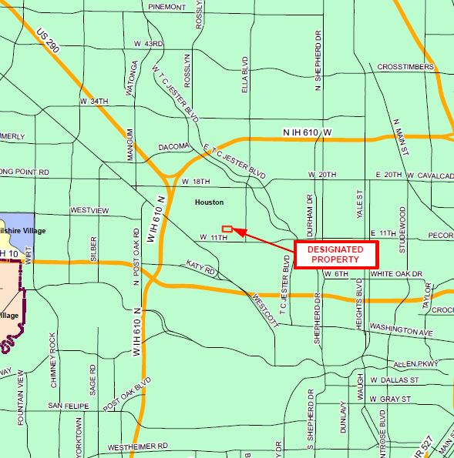
3480-3482-3484 West 12th St.

Slide 6
Texas InTownHomes, LLC
Approximately 8 acres
Track one
  Oil/gas reserve pit located on southern portion of tract in 1940s.
  Warehouse building was built in 1960s.
  Occupants: mechanical equipment sales/service companies, pump and oil well supply manufacturers, package shipping and a clothing warehouse.
  Two Underground Storage Tanks were installed in 1984 and removed in 1993 and 1999
  Building was demolished in 2013.
  Currently the property is unimproved vacant land under construction.
Tract 2
  Warehouse building was built in the 1960s.
  Occupants: lithograph/printing companies, an industrial supply company, mail distribution company, seafood wholesaler, wineries, and a clothing warehouse.
  Building was demolished in 2014.
  Currently the property is unimproved vacant land under construction.
Tract 3
  Warehouse building was built in the 1960s.
  Occupants: industrial equipment and insulation company, a paper wholesaler, and a clothing warehouse.
  Currently the property is occupied by a beverage wholesaler.

Slide 7
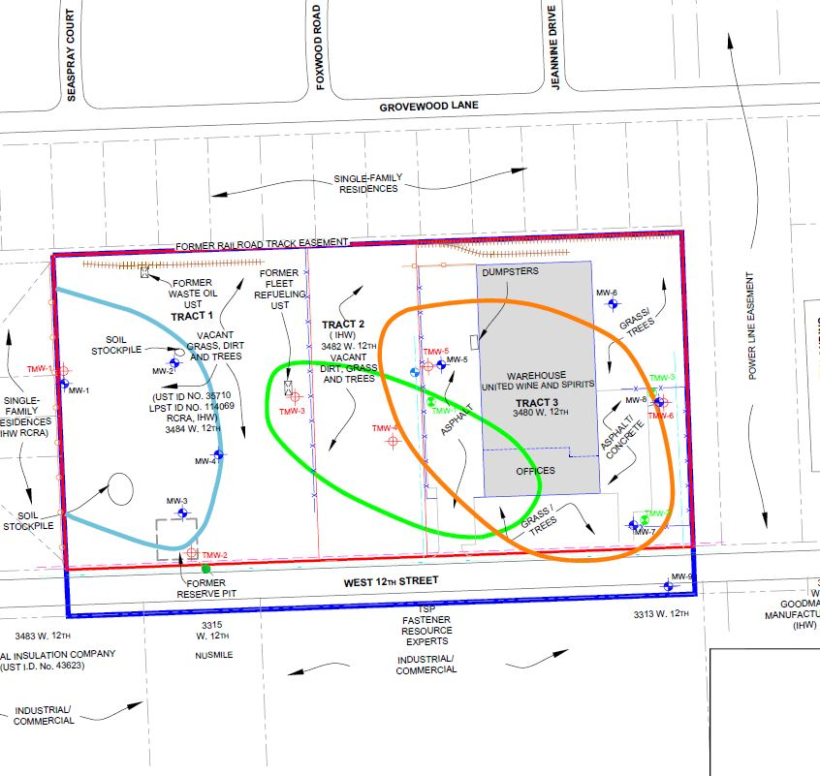
Groundwater Impacts

Slide 8
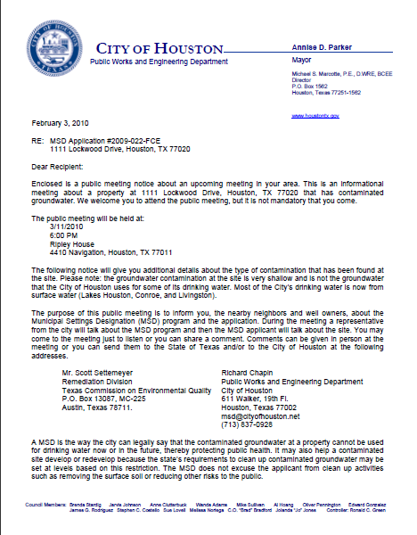
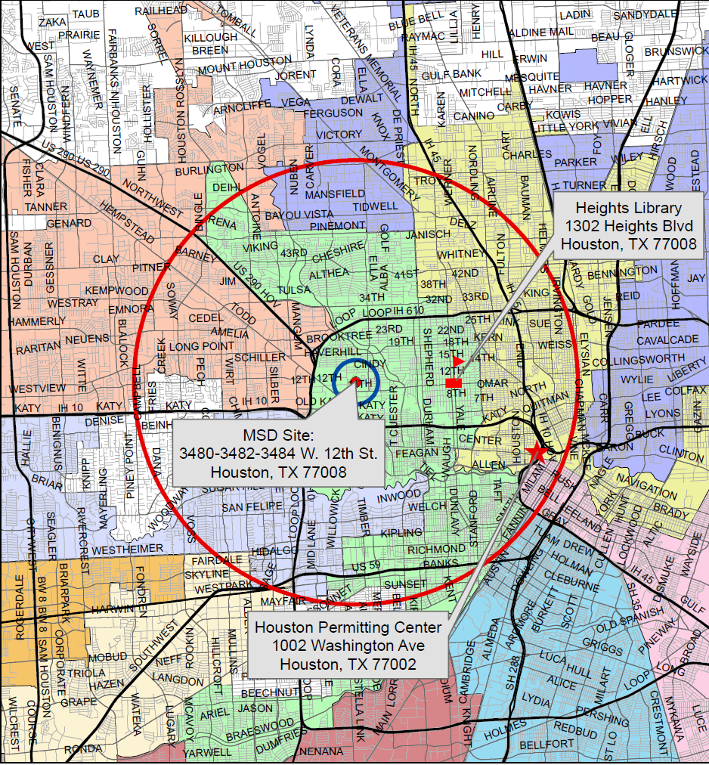
MSD Notice Letters
Property Owners
First-Class Mail
½-Mile Radius
City Requirement
Water Well Owners
Certified Mail
5-Mile Radius
State Requirement

Slide 9
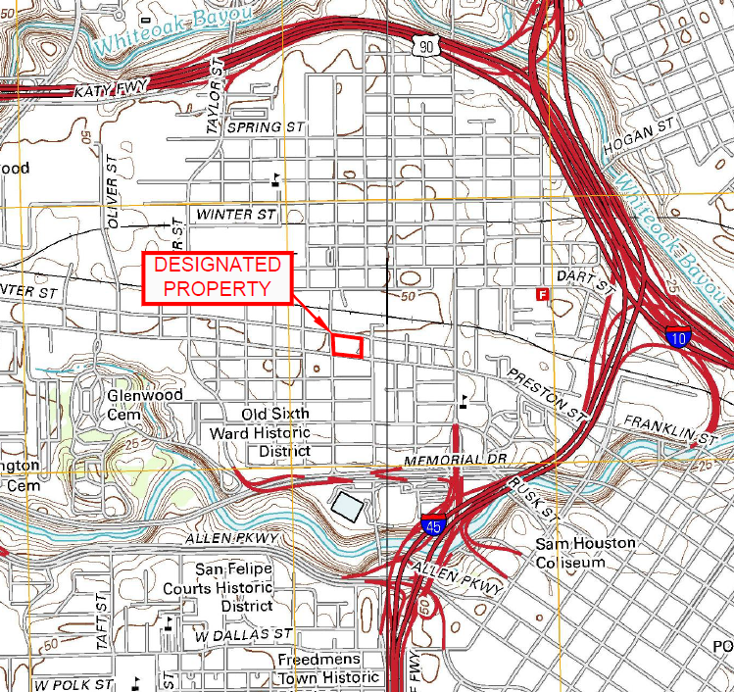
1807 Center Street

Slide 10
Sage Interest, InTownBuilder GP, Texas InTownHomes, Crosby 2100
Approximately 2.36 acres
1950s to 1960s: Central portion of property occupied by a dry cleaning facility.
1960s to 1994: Southwestern portion of property occupied by a filling station.
1974 to mid-2000s: Property owned/occupied by North Merfish Supply Company.

Slide 11
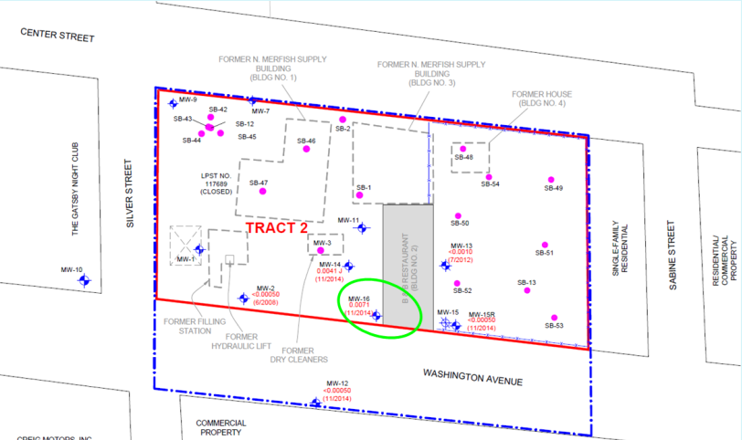
Groundwater Impacts

Slide 12
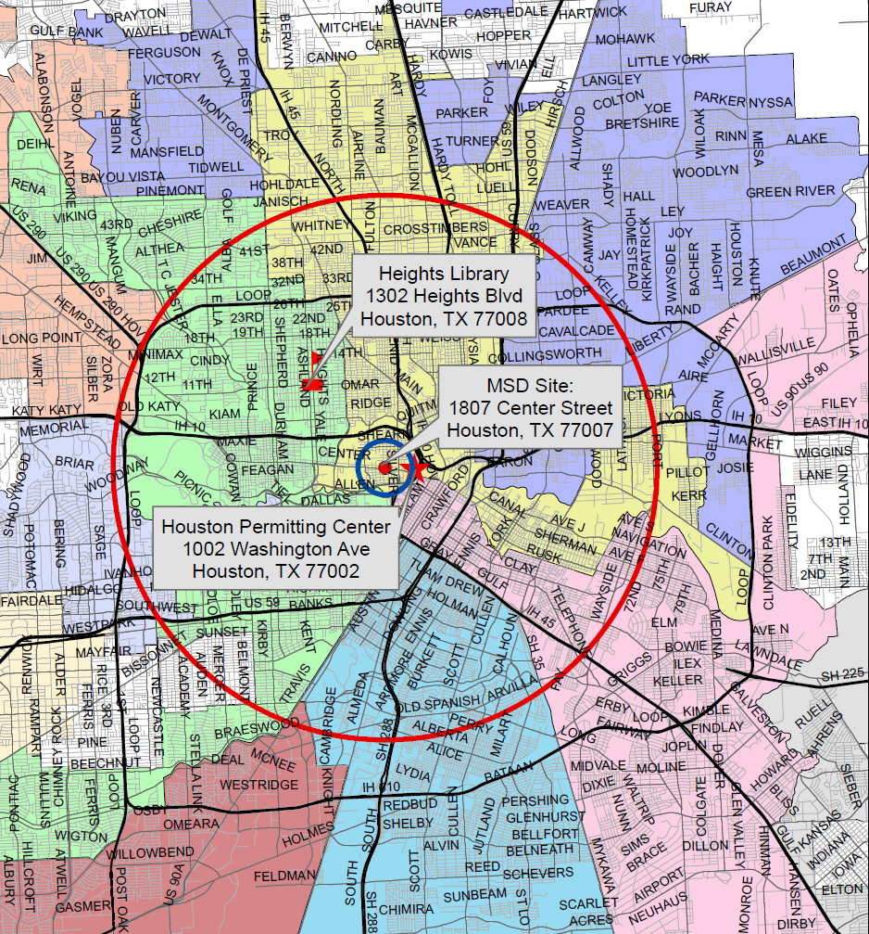
MSD Notice Letters
Property Owners
First-Class Mail
½-Mile Radius
City Requirement
Water Well Owners
Certified Mail
5-Mile Radius
State Requirement

Slide 13
Contact Information
Jennifer Clancey
Program Manager
Public Works & Engineering
City of Houston,
1002 Washington, 3rd Floor
Houston, Texas 77002
msd@houstontx.gov
(832) 394-9005

