Slide 1
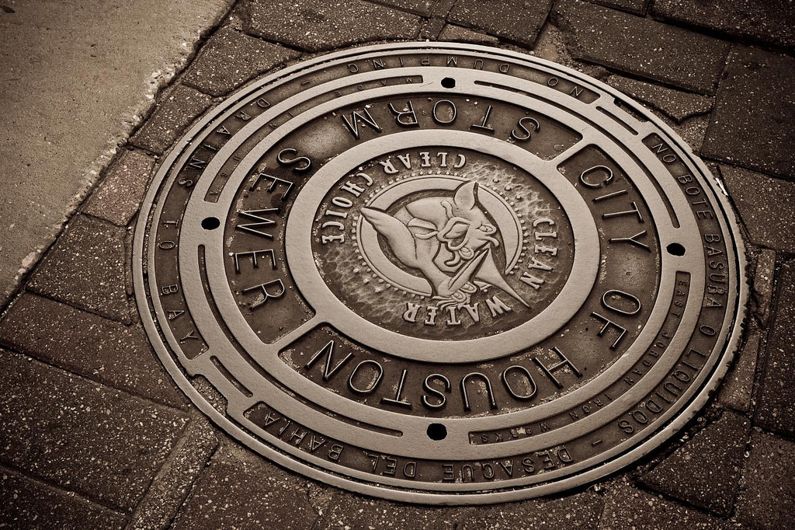
SWAT PROGRAM
TTI Presentation
Revised on 04/11/2017
Re

Slide 2
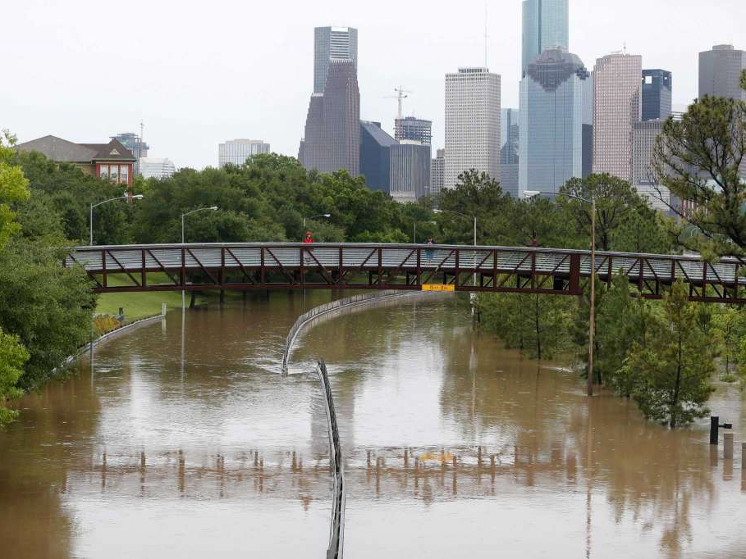
On 01-11-17 Mayor Turner rolled out a new initiative to proactively reduce drainage problems that are not directly attributed to overflow from the bayous.

Slide 3
SWAT - Storm Water Action Team
Improvements
Ditch Widening
Driveway Culvert Replacement
Inlet Replacement
Side Lot Swales
Sewer Line Replacements/Repairs (collapsed outfalls)
Detention Ponds
Funding
$10 million approved by City Council on January 11, 2017
Start with 22 projects/2 in each council district
Issues
Department Resources
Policy Changes
De minimus Storage
Roadside Ditch Driveways
Roadside Ditch/Off-Road Ditch Obstructions
Ditch Widening
Roadside Ditch Driveways
Roadside Ditch/Off-Road Ditch Obstructions

Slide 4
SWAT – Team Composition
Composition Duties
PWE Engineering Meet residents
PWE Maintenance Field visit flooding site
Engineering Consultant (if necessary) Evaluate flooding cause
Contractors Formulate potential solutions
Design solutions (In- house/Consultants)
Support Construct improvements (In-
Legal house/Contractors)
DON
Community Leadership
Notes:
Project locations will be determined by reviewing 311 calls, non-riverine structural flooding locations, and known areas with drainage concerns. Projects will be developed by investigating and inspecting the system and developing an assessment/work plan for addressing the area(s) of highest need.

Slide 5
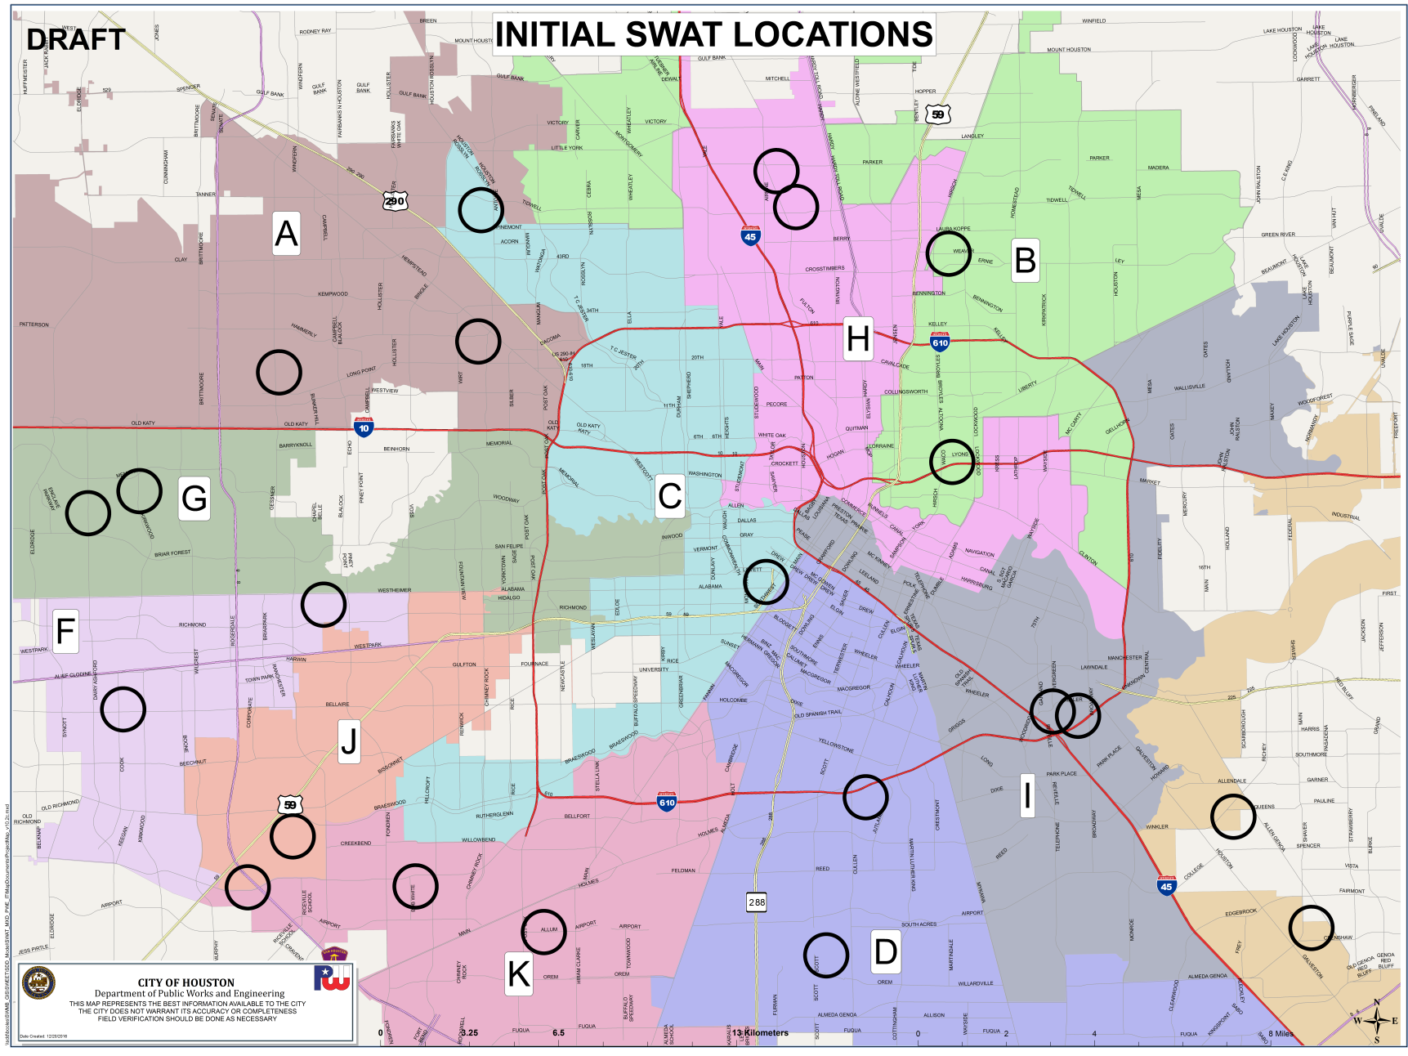
SWAT Project Map
Revised
Notes:
Initial SWAT Project Rollout

Slide 6
UPDATE

Slide 7
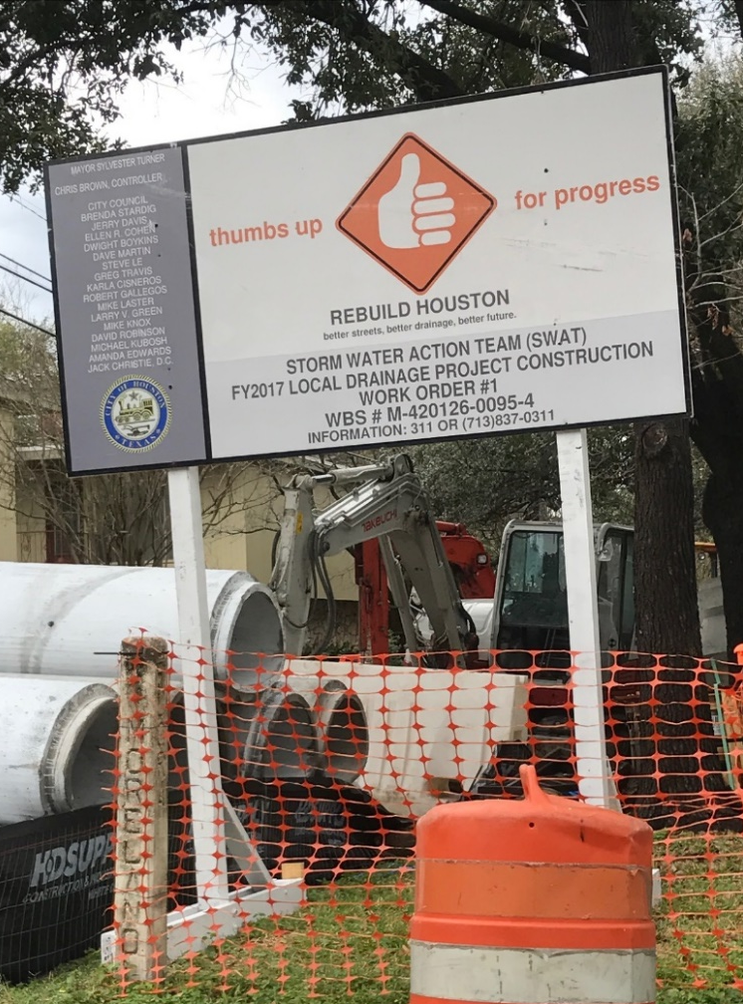
SWAT – Status of Projects
Initial Roll Out: 22 Projects
Forecast: ~25 Additional Projects
Backlog: 100’s Projects
Status (as of 04/11/17)
Completed: 3
In Construction: 6
In Design: 5
NTP Pending: 6
Reconfigured DR 2015: 2
Notes:
Status of Initial Roll Out projects as of 4/10/2017

Slide 8
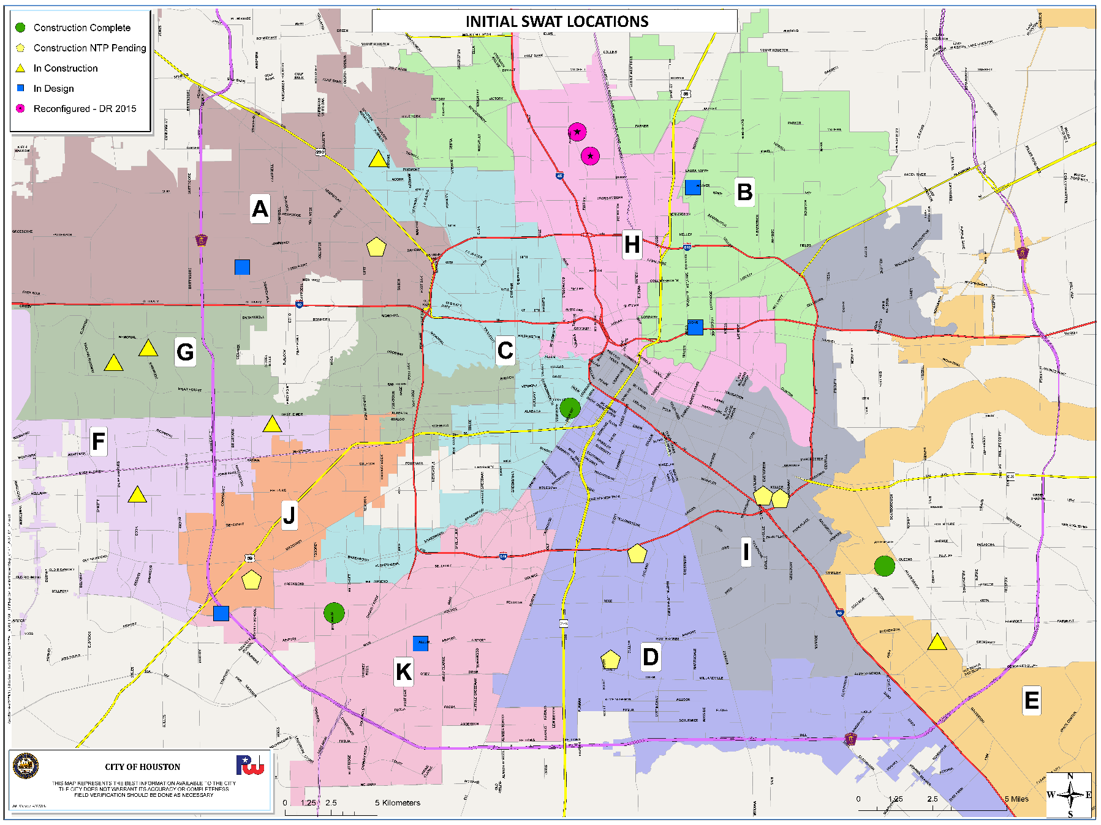
SWAT Project Map (As of 4/11/2017)
Notes:
Map showing status of projects by district as of 4/10/2017

Slide 9
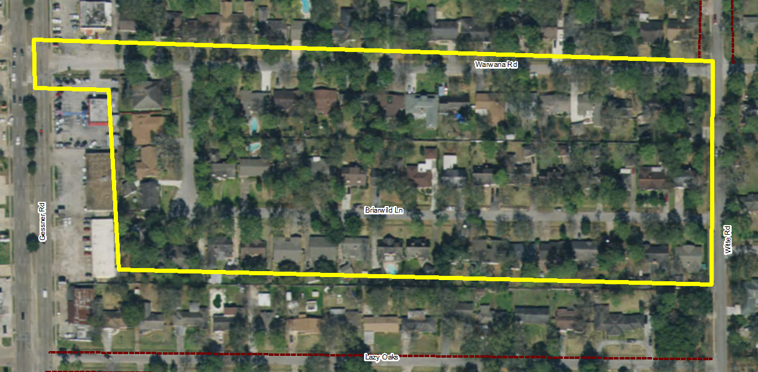
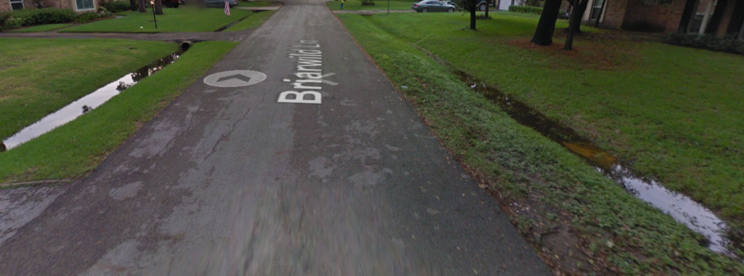
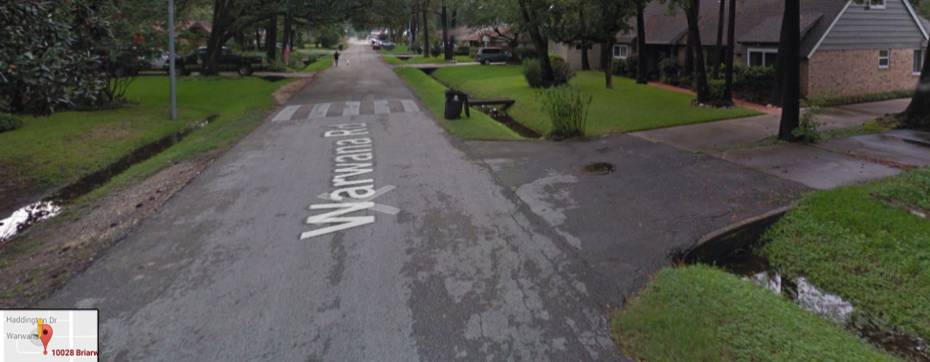
District A – Project 1
In Design
10058 Briarwild Ln.
(N - Warwana Rd.; S - Briarwild Ln.;
E - Gessner Rd.; W - Witte Rd.)
Drainage Issues:
Culverts undersized, collapsed or
not set to proper flow line
Silted ditch flow lines and culverts

Slide 10
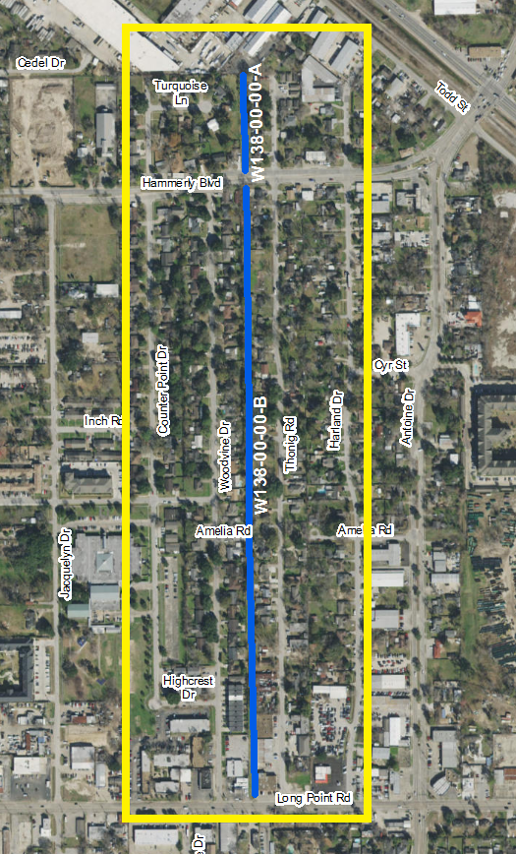
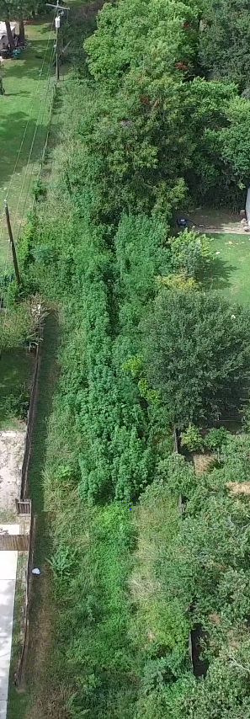
District A – Project 2
Construction
NTP Pending
2113 Woodvine Dr.
(from Long Point Rd.
to Turquoise Ln.)
Drainage Issues:
Needs Clear and Grubbing/
Re-establishment
Ditch ID: W138-00-00-A & B

Slide 11
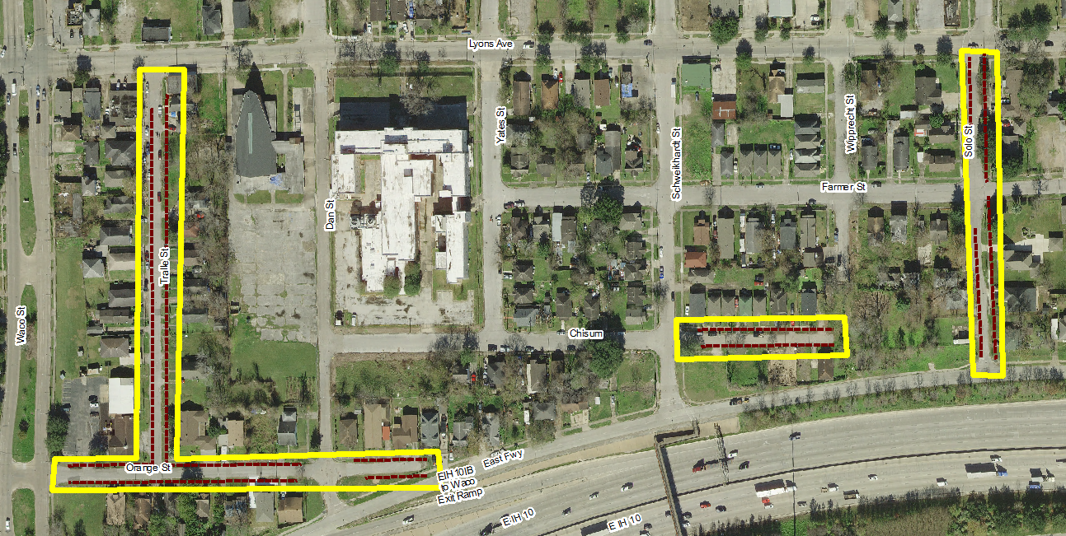
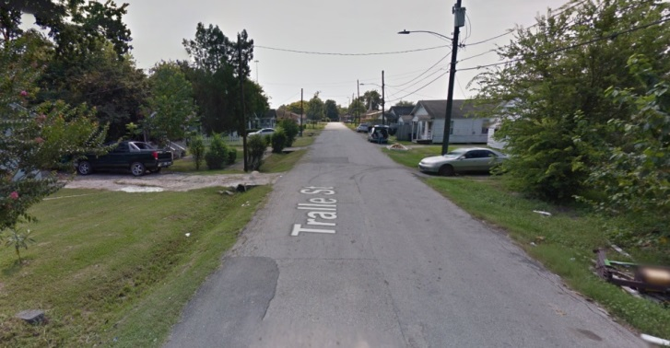
District B – Project 1
In Design
Greater Fifth Ward (N- Farmer St.; S- Chisum St.; E - Wipprecht St. & W - Yates St.)
Drainage Issues: Culverts undersized, collapsed or not set to proper flow line
Silted ditch flow lines and culverts

Slide 12
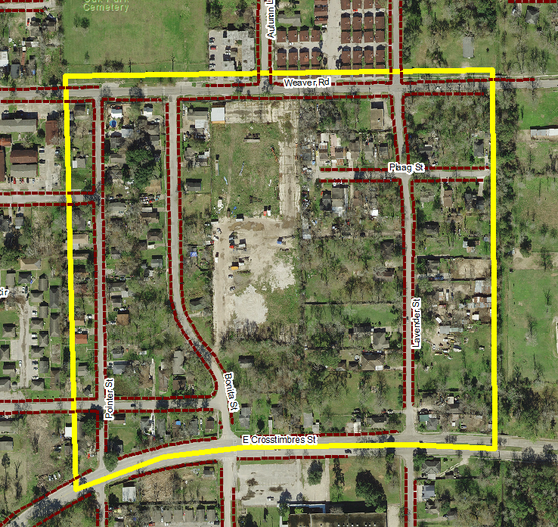
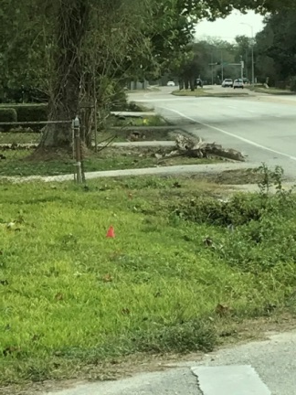
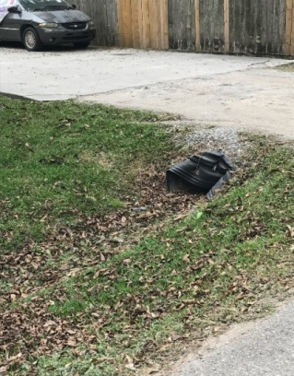
District B – Project 2
In Design
Trinity/Houston Gardens (N - Weaver Rd.; S - Crosstimbers St.; E - Lavender St.; W - Painter St.)
Drainage Issues: Culverts undersized, collapsed or not set to proper flow line
Silted ditch flow lines and culverts

Slide 13
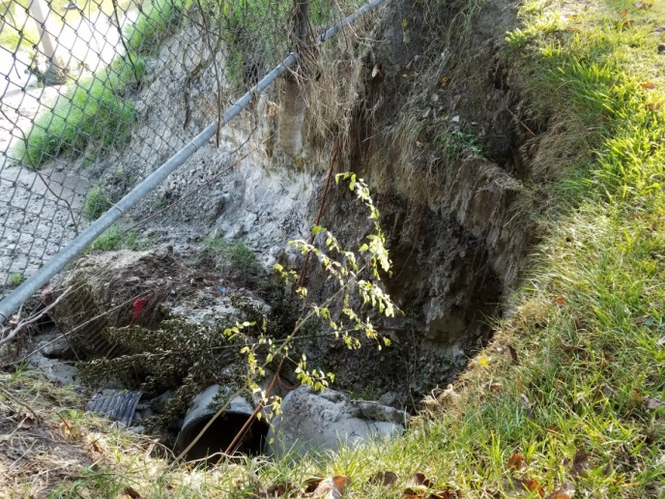
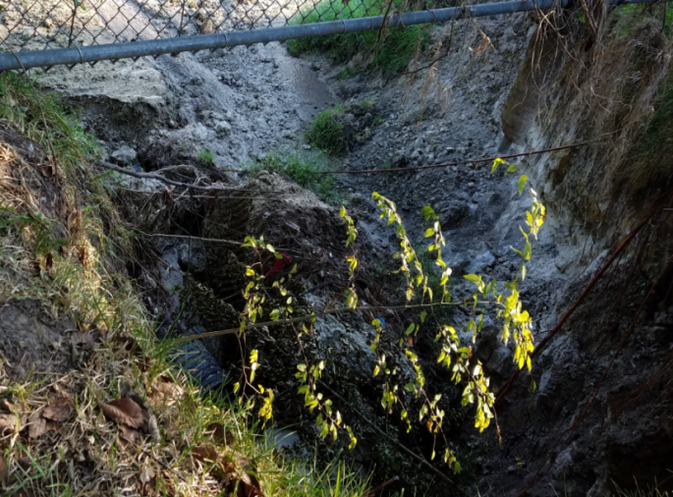
District C – Project 1
5942 Greenmont Dr.
Drainage Issues: 36-inch outfall has collapsed and caused cave-in

Slide 14
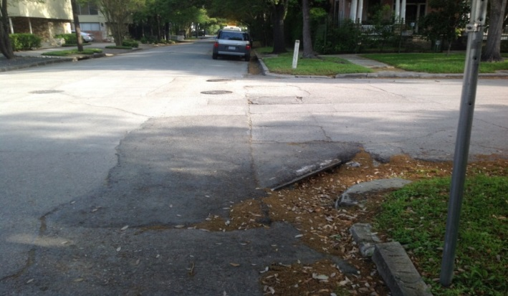
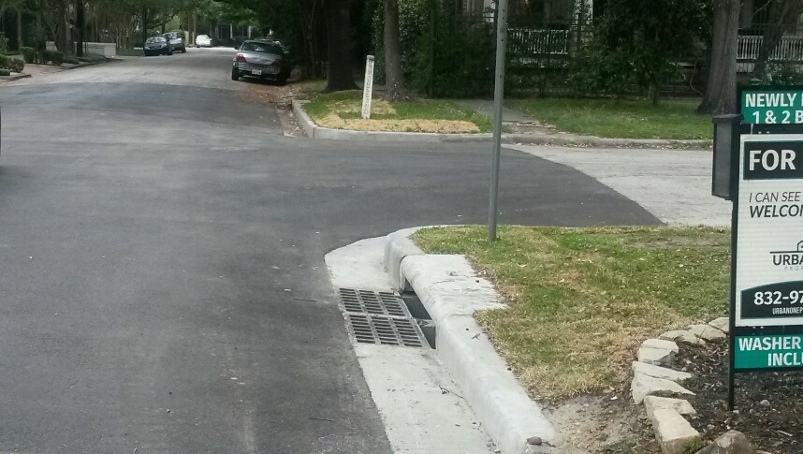
District C – Project 2
3600 Flora St.
Drainage Issues: Existing culvert/grate failure blocking proper drainage
BEFORE
AFTER

Slide 15
District C – Project 2
3600 Flora St.
Drainage Issues: Existing culvert/grate failure blocking proper drainage
Subject: SWAT Project Westmoreland
“Dear Council Member Cohen,
The Officers and Board of the Westmoreland Civic Association would like to express our sincere appreciation for the recent completion of a SWAT project in our neighborhood. The project was completed in a timely manor and with minimum disruption of traffic flow. Thank you for representing District C.”
David Krentz
President, Westmoreland Civic Association
Notes:
Thank you letter received from President of Westmoreland Civic Association.

Slide 16
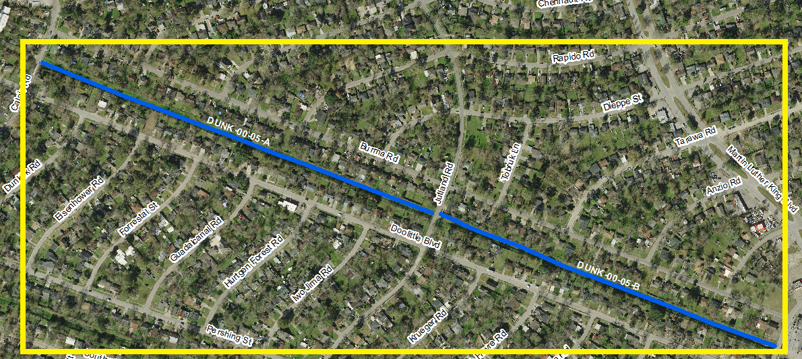
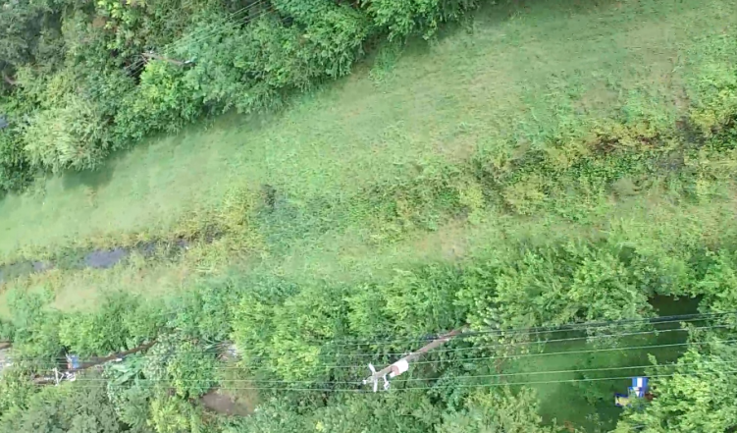
District D – Project 1
Construction
NTP Pending
7300 Calais Rd. (from Calais Rd. to St. Lo Rd.)
Drainage Issues: Needs Clear and Grubbing/ Re-establishment
Ditch ID: DUNK-00-05-A, B

Slide 17
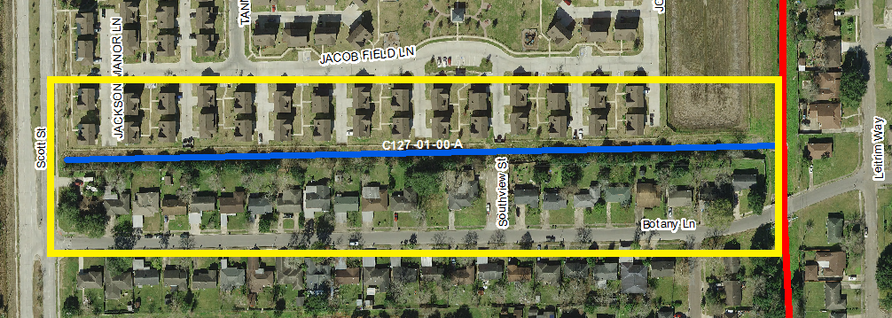
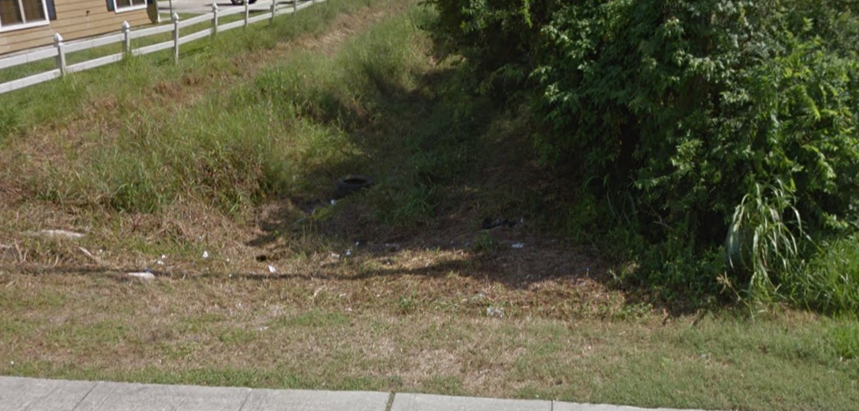
District D – Project 2
Construction
NTP Pending
4007 Botany Ln.
Drainage Issues: Needs Clear and Grubbing/ Re-establishment
Ditch ID: C127-01-00-A

Slide 18
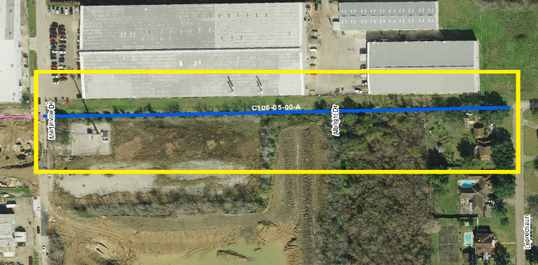
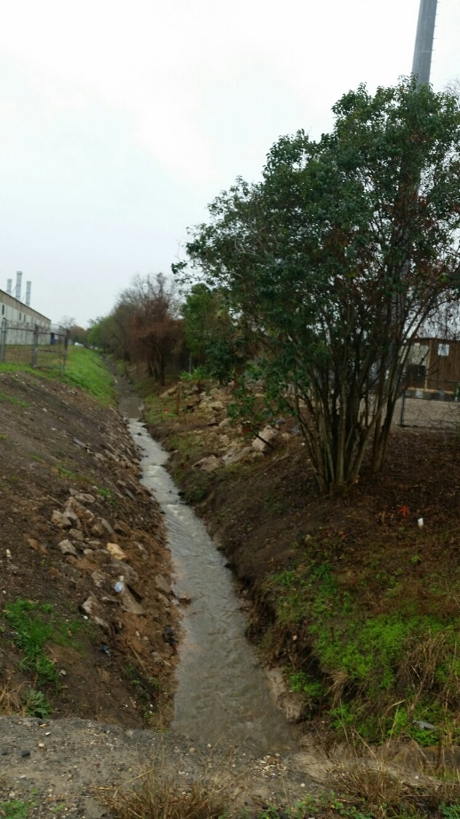
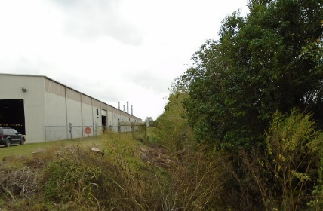
District E – Project 1
2440 Albright Dr. (from Leprechaun St. to Martinville Dr.)
Drainage Issues: Needs Clear and Grubbing/ Re-establishment
Ditch ID: C106-05-00-A
AFTER
BEFORE

Slide 19
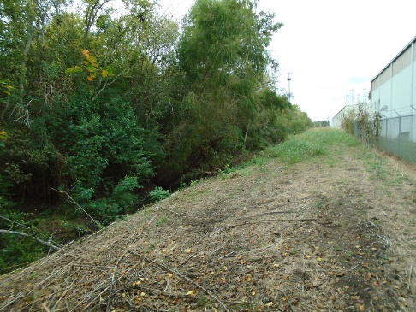
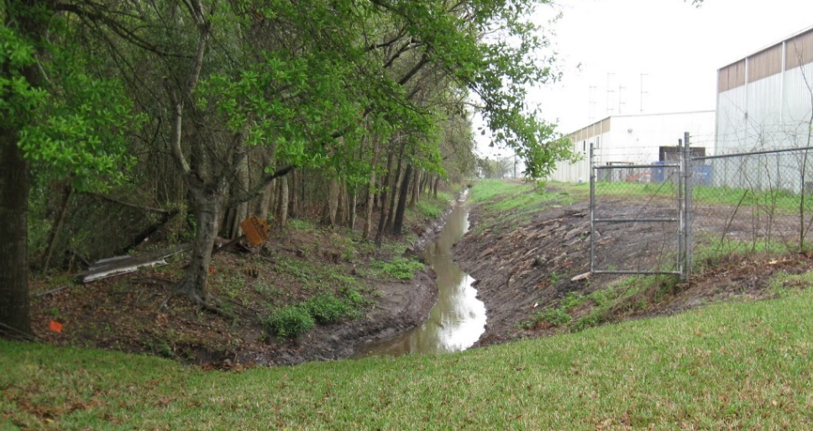
District E – Project 1
2440 Albright Dr. (from Leprechaun St. to Martinville Dr.)
Drainage Issues: Needs Clear and Grubbing/ Re-establishment
Ditch ID: C106-05-00-A
Subject: Drainage project
“Mr. Bryant,
I want to again thank you and your crew for the excellent work you did in clearing our storm drainage pipes. I feel secure in the knowledge that my street, Leprechaun Street, Houston, TX 77017 will drain without obstruction in the future. Getting rid of the 18-inches of sludge in the concrete pipe feeding into the new retention pond will give relief not only to my street but also to the 170+ homes in the adjacent subdivision, and will allow our storm water to freely flow away down the recently cleaned Ditch #C106-05. Your guys did a thorough and efficient job, and were courteous and personable to my wife and I, and we appreciate meeting you as the work continued. It is good to know that management takes an active interest in our area.
Have a wonderful week.”
Baxter Williams
BEFORE
AFTER
Notes:
Thank you letter received from resident.

Slide 20
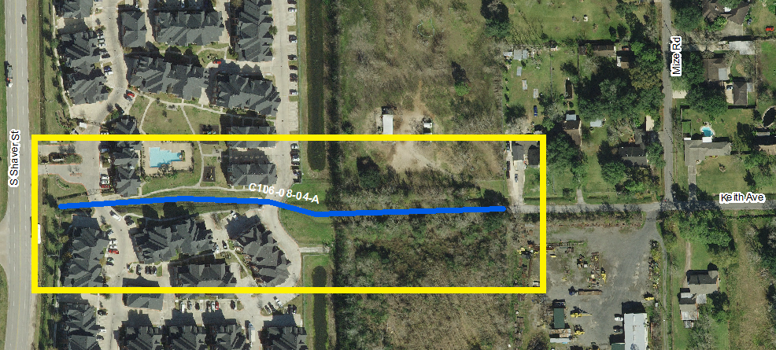
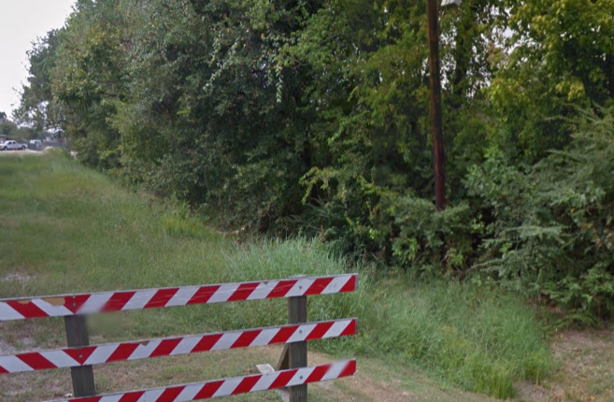
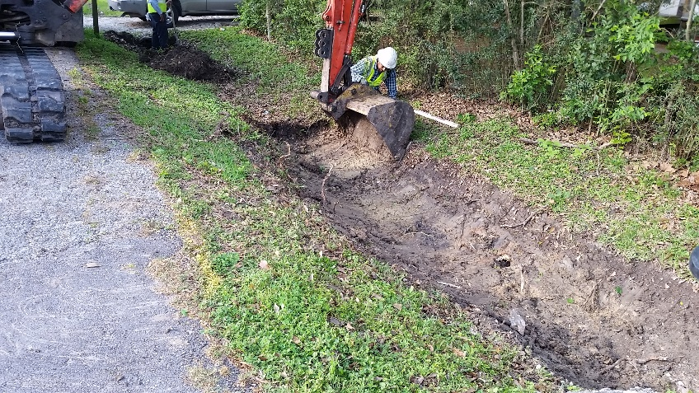
District E – Project 2
531 Keith Ave. (From S. Shaver St. to Mize Rd.)
Drainage Issues:
Needs Clear and Grubbing/ Re-establishment
Ditch ID: C106-08-04-A
BEFORE
Construction

Slide 21
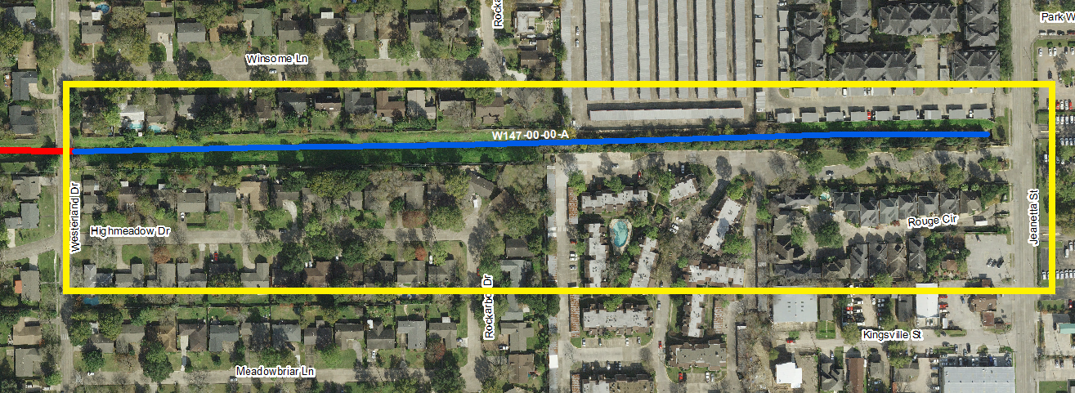
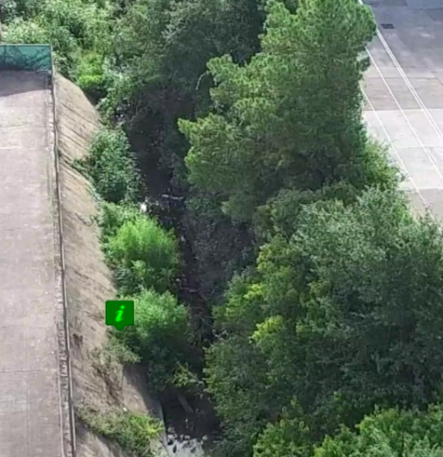
District F – Project 1
Tanglewilde - Westmont Area (from Jeanetta St. to Westerland Dr.)
Drainage Issues: Needs Clear and Grubbing/ Re-establishment
Ditch ID: W147-00-00-A
Notes:
Work Authorization issued for 4/10/17 Contractor has not given actual start date.

Slide 22
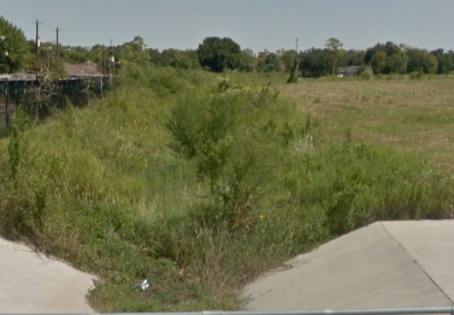
District F – Project 2
Bellaire West Detention Pond
Drainage Issues: Needs Clear and Grubbing/ Re-establishment
Notes:
WA issued for 4/10/17. Contractor has not given actual start date.

Slide 23
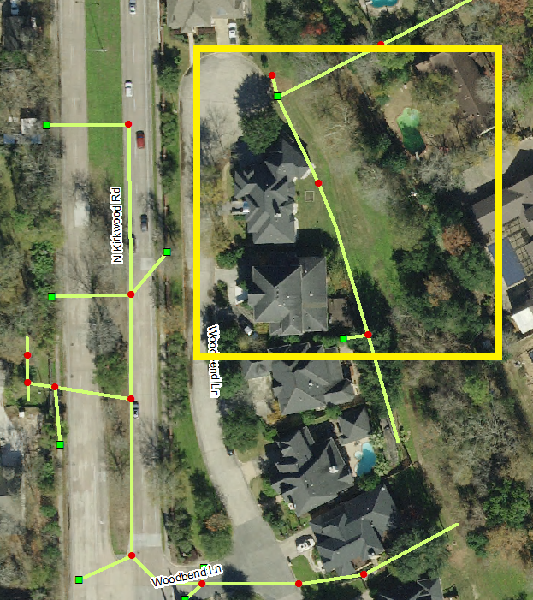
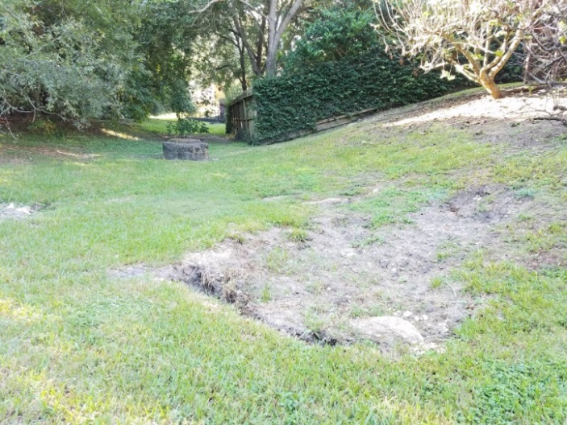
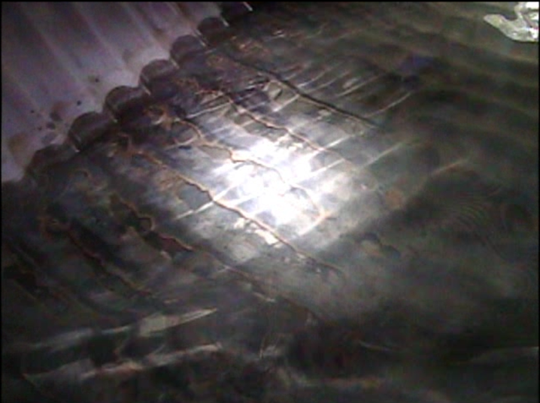
District G – Project 1
614 Woodbend Ln.
Drainage Issues: 120-inch storm sewer line has eroded at bottom
and caused multiple small cave-ins
Notes:
Working on Change Order for Spin Casting 120” pipe.

Slide 24
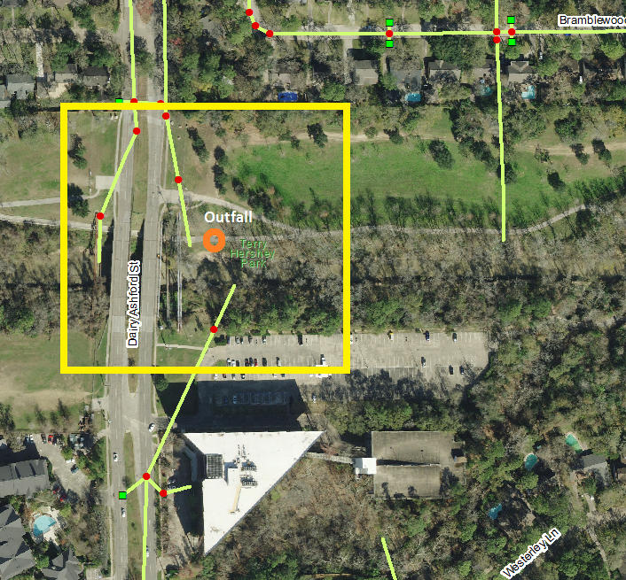
District G – Project 2
1209 S Dairy Ashford Rd.
Drainage Issues: 36-inch outfall has collapsed at Terry Hershey Park and caused a cave-in
BEFORE
Construction
Notes:
Waiting on spin cast of final section of 36” pipe.

Slide 25
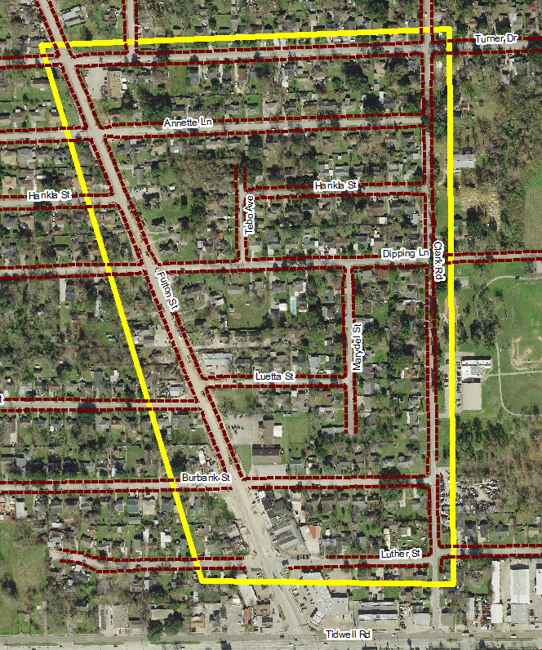
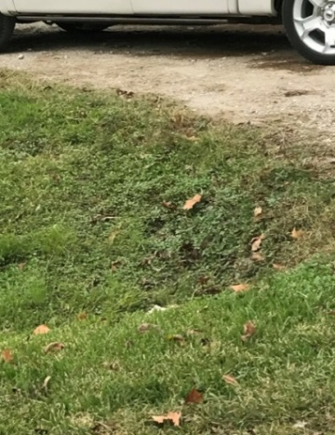
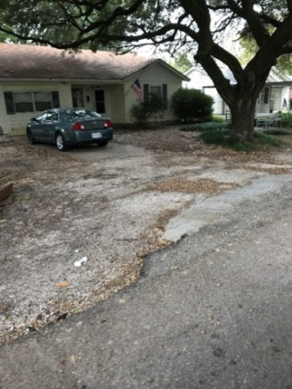
District H – Project 1
Reconfigured
DR 2015
Northside/ Northline Area Roadside Ditch Project 1
(N - Turner Dr.; S - Luther St.;
E - Clark Rd.; W - Fulton St.)
Drainage Issues:
Culverts undersized, collapsed or not set to proper flow line
Silted ditch flow lines and culverts

Slide 26
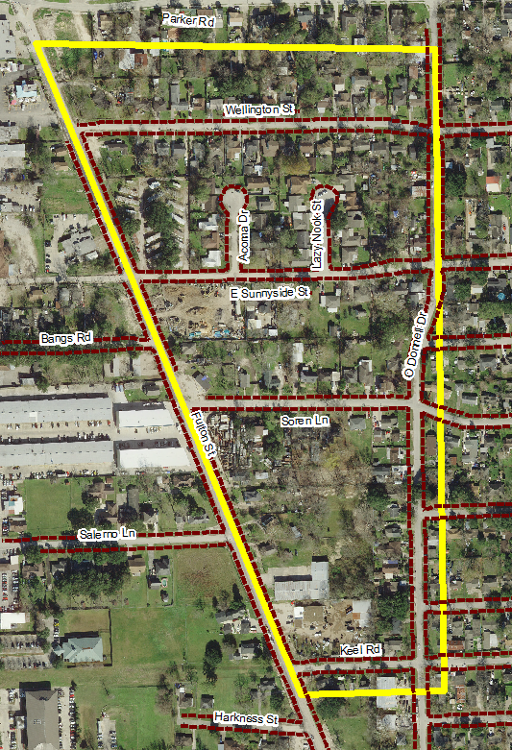
District H – Project 2
Reconfigured
DR 2015
Northside/ Northline Area Roadside Ditch Project 2
(N - Wellington St.; S - Keel Rd.; E - O'Donnell Dr.;
W - Fulton St.)
Drainage Issues:
Culverts undersized, collapsed or not set to proper flow line
Silted ditch flow lines and culverts

Slide 27
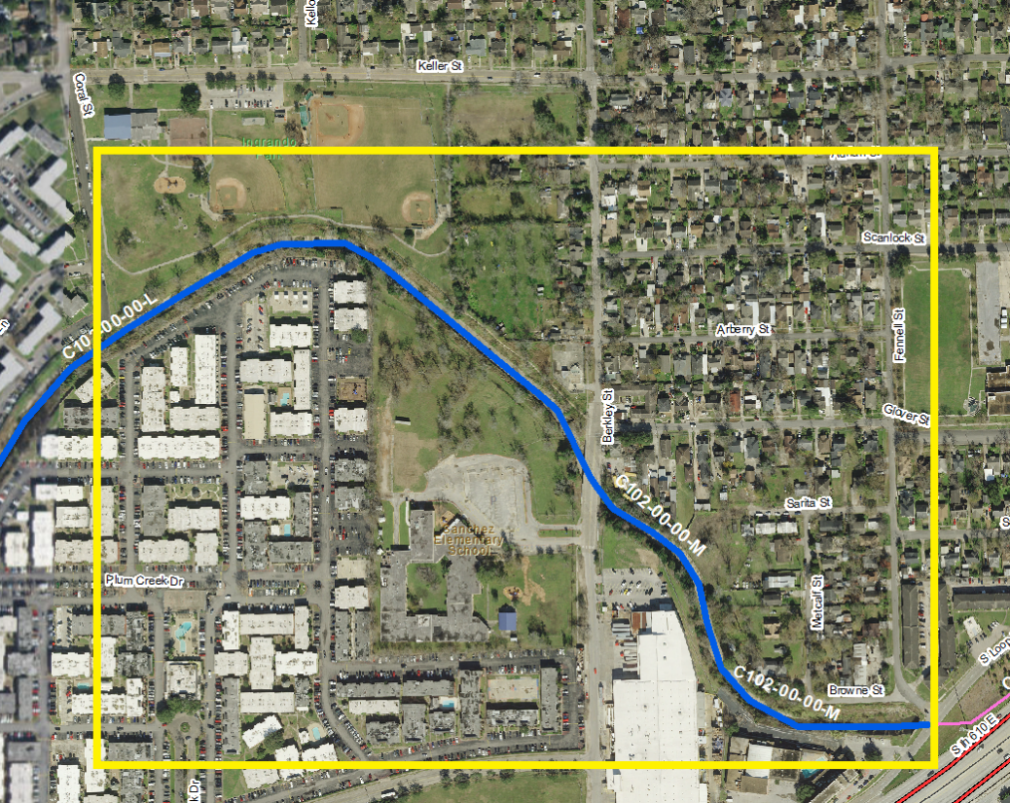
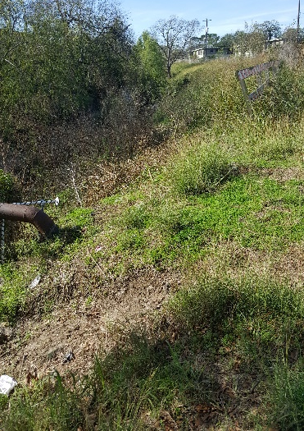
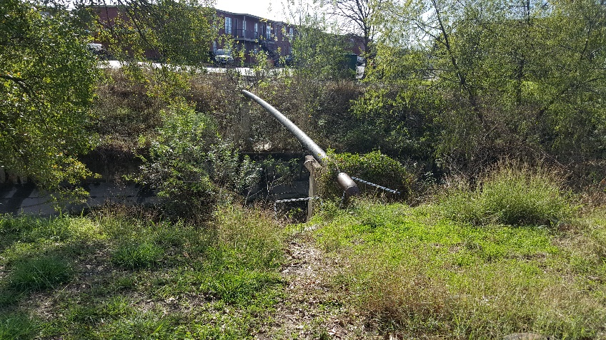
District I – Project 1
Construction
NTP Pending
Plum Creek Clean Up (Part A) (from I-610 E. to Coral St.)
Drainage Issues: Needs Clear and Grubbing/ Re-establishment
Ditch ID: C102-00-00-M

Slide 28
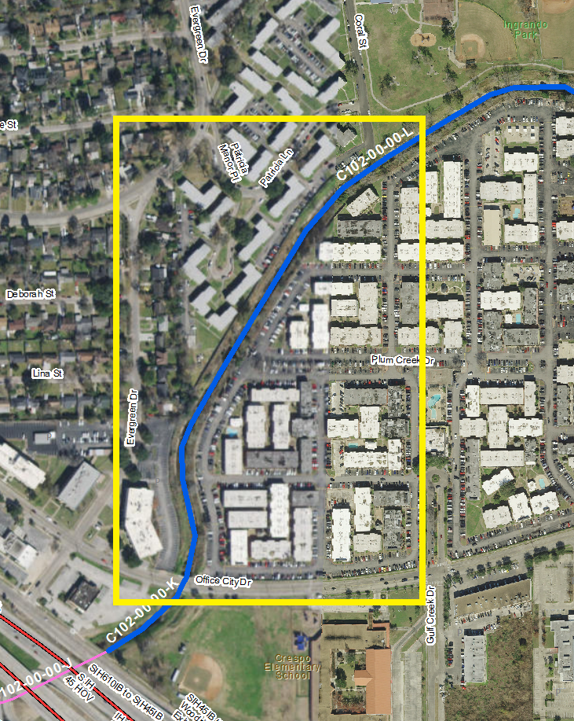
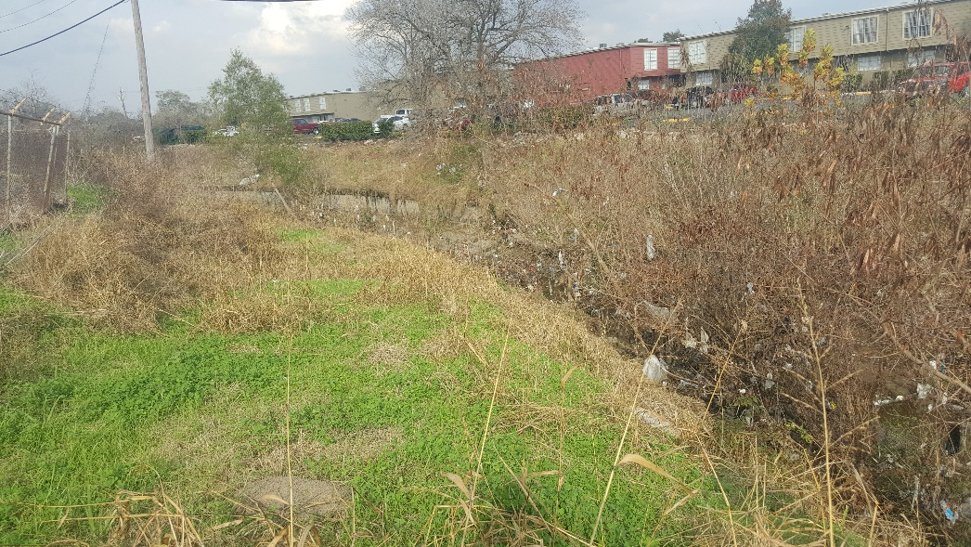
District I – Project 2
Construction
NTP Pending
Plum Creek Clean Up (Part B)
(Coral St. to Office City Dr.)
Drainage Issues:
Needs Clear and Grubbing/ Re-establishment
Ditch ID: C102-00-00-L

Slide 29
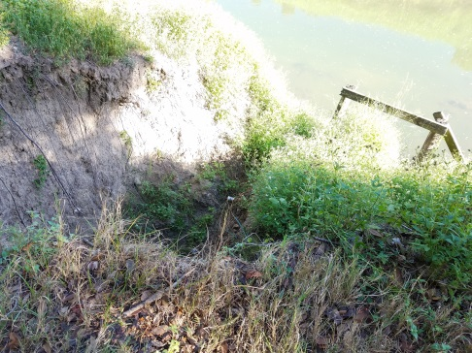
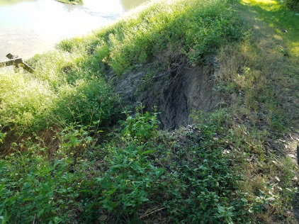
District J – Project 1
Construction
NTP Pending
9238 Tooley Dr.
Drainage Issues: 60-inch outfall has collapsed and caused a cave-in

Slide 30
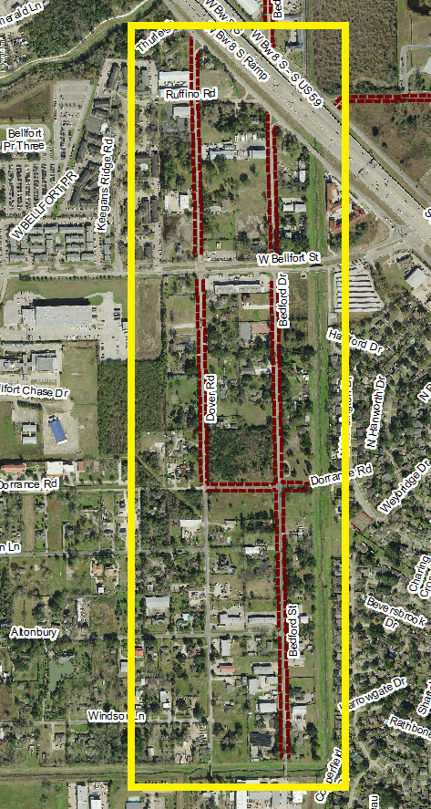
District J – Project 2
In Design
Bedford Project
(N - Beltway 8; S - Dorrance Rd.; E - Bedford Dr.; W - Dover St.)
Drainage Issues:
Culverts undersized, collapsed or not set to proper flow line
Silted ditch flow lines and culverts

Slide 31
District K – Project 1
11507 Bowlan Ln. (Westbury Pkg. 2)
Drainage Issues:
24-inch outfall collapse

Slide 32
District K – Project 1
BEFORE
11507 Bowlan Ln. (Westbury Pkg. 2)
Drainage Issues:
24-inch outfall collapse
In Construction
AFTER

Slide 33
District K – Project 2
In Design
Cambridge Village Park (N - Allum St.; S - Lotus St.; E - Nitida St.; W - S. Post Oak Rd.)
Drainage Issues: Culverts undersized, collapsed or not set to proper flow line
Silted ditch flow lines and culverts

Slide 34
All Projects Identified (as of 4/11/17)
Projects by Council District and Asset Count
Projects by Asset Type

Slide 35
SWAT Projects Cost Estimate (as of 4/11/17)

Slide 36
Ideas for potential SWAT projects in your district?
Contact:
Stephen Costello, 832-393-0811, stephen.costello@houstontx.gov
Sallie Alcorn, 832-393-1123, sallie.alcorn@houstontx.gov

